Slide 1
^{FERTILIZER USE}
^{Quebec}
^{CDN 2023}

Slide 2

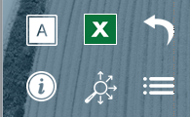
Navigation
Grain Corn
General Fertilizer Practices
Fertilizer Timing
Sources of Fertilizer Advice
Fertilizer Source
Frequency of Soil Testing Nitrogen
Fertilizer Placement
Reasons for Not Soil Testing for N Every Year
Nitrogen Rates
Frequency of Soil Testing P, K and S
Phosphorus Rates
Frequency of Soil Testing - Micronutrients
Potassium Rates
Frequency of Soil Testing - Electrical Conductivity
Sulphur Rates
Frequency of Soil Testing - Organic Matter
Fertilizer Program
Frequency of Soil Testing - pH
Use of Variable Rates by Fertilizer Type
Familiarity with 4R Concept
Consistency with 4R Practices
Growers Who Believe They Comply With 4R
Reasons for Not Meeting Consistency Criteria
Growers Who Work With A 4R Certified Retailer
Nitrogen Fixing Crop in Previous Year
Growers Who Work With A 4R Nutrient Management Specialty CCA
Rates Set By Field
Growers Who Have A 4R Plan In Place
Approaches Used To Decide Rate
Benefits Of Having A 4R Plan In Place
Main Person Who Determined Rate
Reasons Some Farmers Do Not Adopt 4R Practices
Rate Decisions on 4R Consistency Compliance
Fee to Prepare 4R Plan
Professional Designation
Sources of Fertilizer Information
Importance of Professional Designation
Programs Used to Measure Environmental Footprint
Deviation from Recommended Rate
Reasons for Increasing Rate
Demographics
Reasons for Decreasing Rate
Crop Hectare Categories
Use of Nitrogen Stabilizers
Demographics
Use of EEFs by Timing - % of N Volume
Study Methodology & Sample
Target Yield vs. Actual Yield
Use of Micro/Secondary Nutrients
Key Findings
Custom Application by Timing
Grain Corn Summary
Tillage Practices
4R Nutrient Stewardship
Use of Biostimulants
Use of Nitrogen Fixing Biostimulants
In SLIDESHOW VIEW, click on any title or button on the above slide to navigate to the section.
Use the icons in the side-bar of each slide for convenient navigation and quick access to more information:
DETAILED DATA
Escape from Slideshow View to NORMAL VIEW; then click to open a worksheet with detailed data.
ATTRIBUTES
Click to see the full attribute statement behind abbreviations used in charts.
BACK TO LIST
Click to return to the list of several similar charts.
INFORMATION
Click for a pop-up that explains the slide. Click again to hide.
SECTION NAVIGATION
Click to return to the navigation slide for the section you are in.
NAVIGATION
Click to return to this study navigation slide.

Slide 3
Grain Corn in Quebec - Summary
NITROGEN
Primary Nitrogen fertilizers were applied on 184% of grain corn hectares (multiple applications on many hectares). 
Urea represents 46% of total Nitrogen volume, UAN 32% represents 28% of the total Nitrogen volume in 2023. 
46% of Nitrogen volumes were applied after planting/in-crop; 35% of the Nitrogen volumes were applied in the spring at planting. 
25% of Nitrogen volume was side banded at planting and 22% was side-dressed after planting/in-crop. 
Average rate = 167 kg/ha.  Average rate after planting was 105 kg/ha; average rate at planting was 71 kg/ha. 
Primary Phosphorus fertilizers were applied on 102% of grain corn hectares (multiple applications on some hectares). 
DAP represents 46% of total Phosphorus volume; ammonium polyphosphate accounted for another 21% of the total P volume. 
90% of Phosphorus volumes were applied at planting; 8% of the volumes were applied in the spring before planting. 
43% of P₂O₅ volumes were side banded at planting, 21% broadcast with incorporation before planting. 
Average rate = 41 kg/ha, higher in 2023.  Average rate at planting was 36 kg/ha; average rate after planting was 47 kg/ha. 
Potassium fertilizers were applied on 79% of grain corn hectares. 
Dry potash represents 78% of total Potassium volume; Potassium nitrate represents 10% of the total Potassium volume. 
51% of K₂O volumes were applied at planting; 28% applied before planting; an increase compared to 2022. 
75% of K₂O volumes were side-banded at planting, 7% seed placed and 7% pre-banded before planting. 
Average rate = 33 kg/ha.  31% of grain corn hectares were not treated with any K₂O. 
Primary Sulphur fertilizers were applied on 37% of grain corn hectares. 
Ammonium sulphate represents 21% of total Sulphur volume; K Mag represents 12% of the total Sulphur volume. 
56% of Sulphur volumes were applied at planting (a decline in 2023), 23% before planting and 15% in the fall (both increased). 
42% of Sulphur volumes were side-banded at planting, 18% pre-banded before planting. 
Average rate = 7 kg/ha.  56% of grain corn hectares were not treated with any Sulphur. 
Source:
Timing:
Placement:
Rate:
PHOSPHORUS
Grain Corn Summary 
Source:
Timing:
Placement:
Rate:
POTASSIUM
Source:
Timing:
Placement:
Rate:
SULPHUR
Source:
Timing:
Placement:
Rate:

Slide 4
4R Nutrient Stewardship - Summary
NITROGEN
Adoption of 4R practices and the number of growers with a formal 4R plan in place both increased in 2023.
Just under half of Quebec growers said they were very familiar or somewhat familiar with 4R. 
4R concept familiarity is relatively uniform across age and farm size (slightly higher familiarity on large farms). 
61% of growers in Quebec believe that their fertilizer practices comply with 4R nutrient stewardship, an increase in 2023. 
Those who are familiar with 4R were more likely to say their fertilizer practices comply. 
17% of growers said they worked with a 4R Certified Retailer in 2023, slightly higher compared to 2022. 
20% of growers said they worked with a 4R Nutrient Management Specialty CCA in 2023. 
13% of growers had a formal 4R plan in place on their farm in 2023, significantly higher compared to 2022. 
A higher percentage of growers who are familiar with 4R have a 4R Plan in place. 
Those with a 4R Plan say there are multiple benefits led by improved soil quality and nutrient availability. 
Those who do not think they comply with 4R say that lack of time/manpower and lack of the right equipment are the main reasons. 
Crop Advisors and Ag Retailers are the main sources of information about 4R. 
4R NUTRIENT STEWARDSHIP
PHOSPHORUS
4R Summary 
POTASSIUM
SULPHUR

Slide 5
Grain Corn
Grain Corn
Fertilizer Timing
Fertilizer Source
Fertilizer Placement
Nitrogen Rates
Phosphorus Rates
Potassium Rates
Sulphur Rates
Fertilizer Program
Answering Key Questions:
What are the most common application timings for each nutrient and fertilizer type?
What nutrients and fertilizer types are being used?
What are the most common placements for each nutrient and fertilizer type?
What rates are being applied?
To what extent do farmers vary their fertilizer program from field to field?
To what extent are farmers incorporating nitrogen fixing crops into their rotation?
How do farmers decide what fertilizer rate to apply?
How extensively are nitrogen stabilized products being used?
How do actual yields compare to target yields?
How many growers are applying micro or secondary nutrients?
What tillage practices were used?
To what extent were biostimulants used?
Use of Variable Rates by Fertilizer Type
Consistency with 4R Practices
Reasons for Not Meeting Consistency Criteria
Nitrogen Fixing Crop in Previous Year
Rates Set By Field
Approaches Used To Decide Rate
Main Person Who Determined Rate
Rate Decisions on 4R Consistency Compliance
Professional Designation
Importance of Professional Designation
Deviation from Recommended Rate
Reasons for Increasing Rate
Reasons for Decreasing Rate
Use of Nitrogen Stabilizers
Use of EEFs by Timing
Target Yield vs. Actual Yield
Use of Micro/Secondary Nutrients
Custom Application by Timing
Tillage Practices
Use of Biostimulants
Use of Nitrogen Fixing Biostimulants
In SLIDESHOW VIEW, click on any title or button on the above slide to navigate to the section.
Use the icons in the side-bar of each slide for convenient navigation and quick access to more information:
DETAILED DATA
Escape from Slideshow View to NORMAL VIEW; then click to open a worksheet with detailed data.
ATTRIBUTES
Click to see the full attribute statement behind abbreviations used in charts.
BACK TO LIST
Click to return to the list of several similar charts.
INFORMATION
Click for a pop-up that explains the slide. Click again to hide.
SECTION NAVIGATION
Click to return to the navigation slide for the section you are in.
NAVIGATION
Click to return to this study navigation slide.

Slide 6

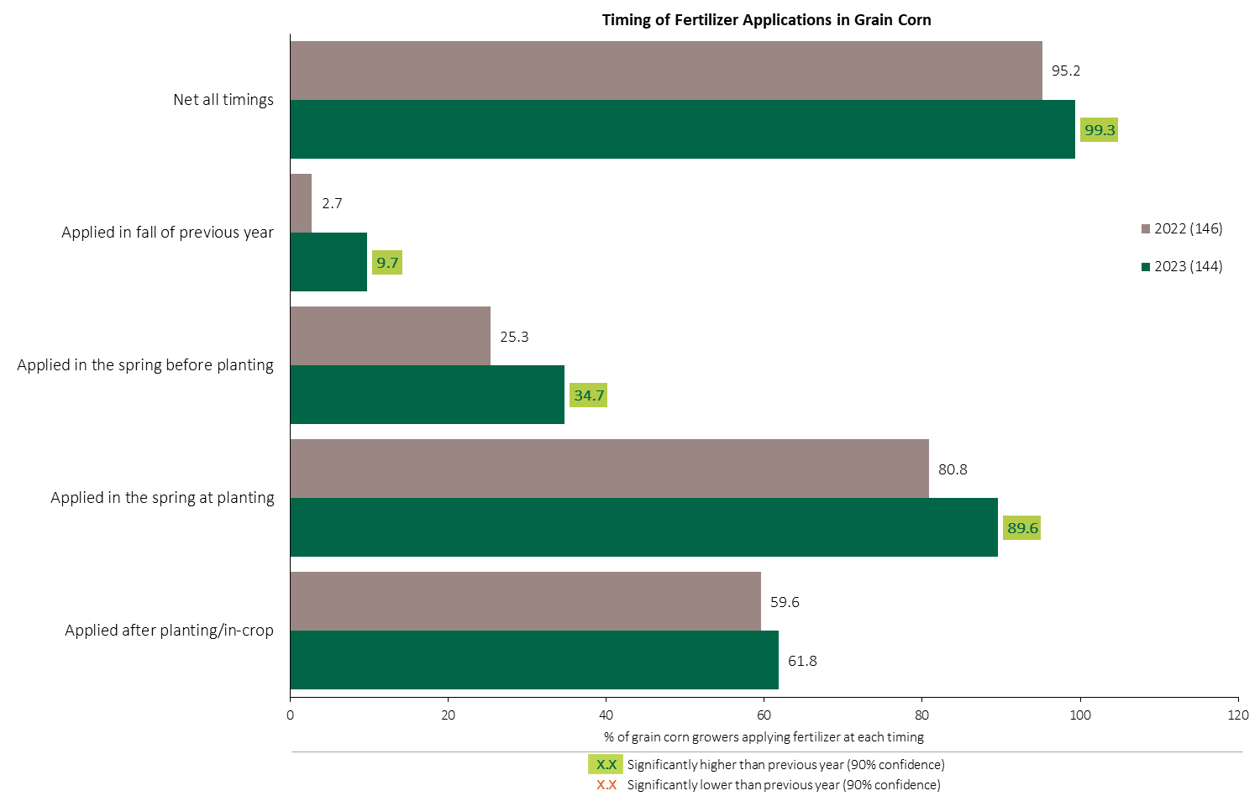

Fertilizer Applications in Grain Corn - % Growers
Grain Corn
Significantly more corn growers applied fertilizer in 2023.
Applications in the fall, in the spring before planting and in the spring at planting all increased.
Respondents were asked: “For your 2023 grain corn crop, did you apply fertilizer at each timing? – and given the options of a) Applied in fall of previous year, b) in the spring before planting, c) in the spring at planting and d) after planting/in-crop.
The chart illustrates the % of respondents who applied fertilizer at each timing in each year.

Slide 7
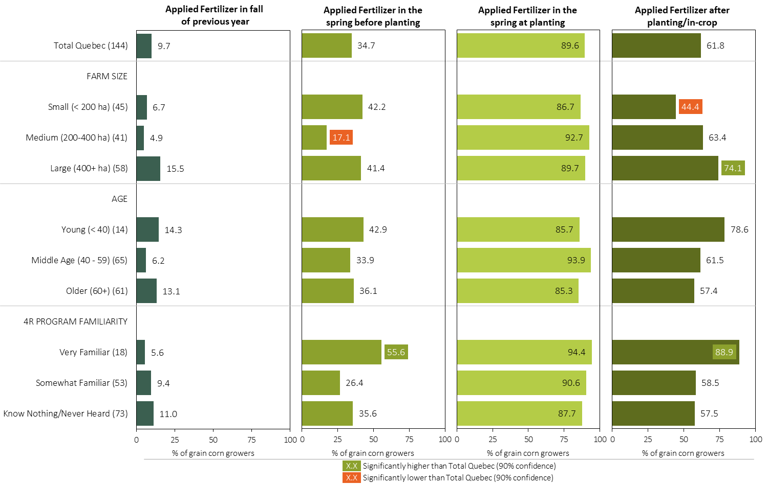
Fertilizer Applications in Grain Corn - % Growers by Timing in 2023
Grain Corn
Respondents were asked: “For your 2023 grain corn crop, did you apply fertilizer at each timing? – and given the options of a) Applied in fall of previous year, b) in the spring before planting, c) in the spring at planting and d) after planting/in-crop.
Separately by farm size, age and 4R program familiarity, the charts illustrate the % of grain corn growers who applied fertilizer at each timing.

Slide 8
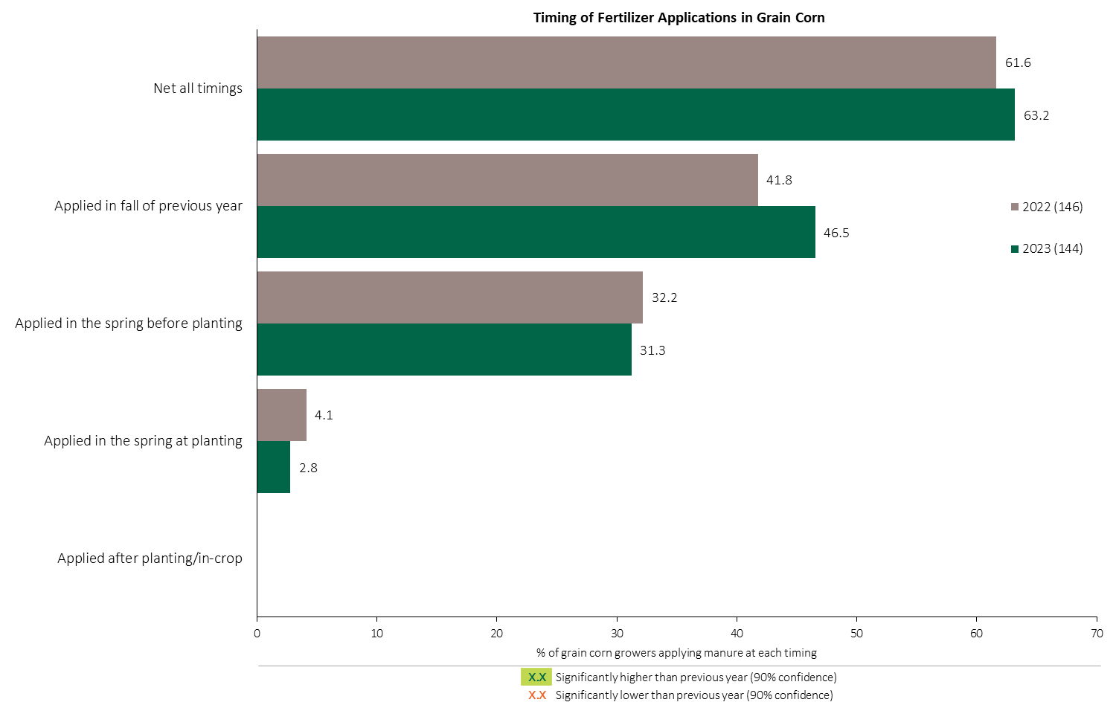
Manure Applications in Grain Corn - % Growers
Grain Corn
Respondents were asked: “For your 2023 grain corn crop, did you apply manure at each timing? – and given the options of a) Applied in fall of previous year, b) in the spring before planting, c) in the spring at planting and d) after planting/in-crop.
The chart illustrates the % of respondents who applied manure at each timing in each year.

Slide 9
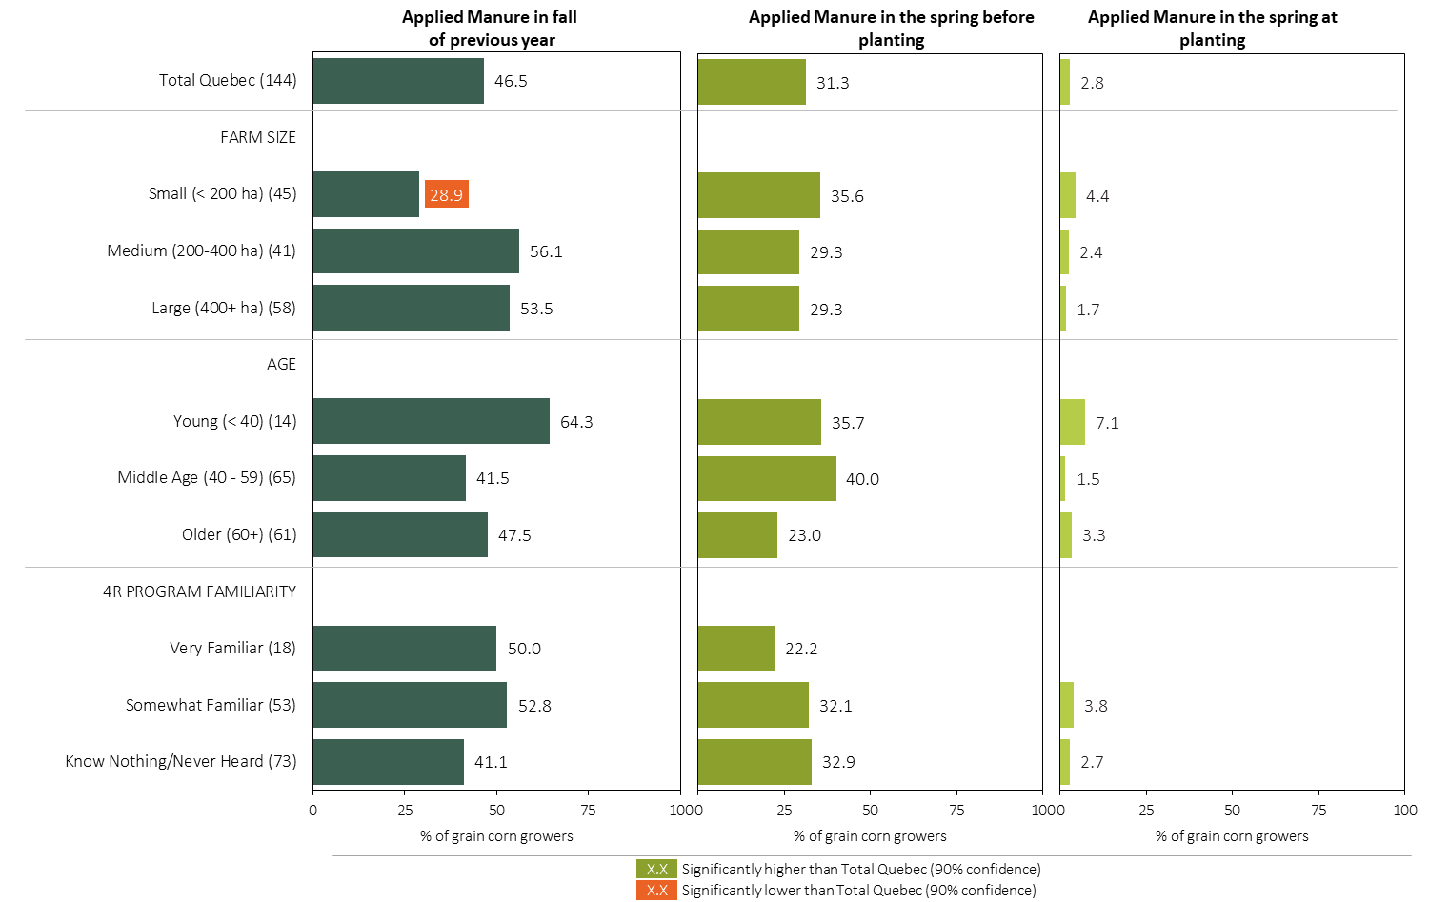
Manure Applications in Grain Corn - % Growers by Timing in 2023
Grain Corn
Respondents were asked: “For your 2023 grain corn crop, did you apply manure at each timing? – and given the options of a) Applied in fall of previous year, b) in the spring before planting, c) in the spring at planting and d) after planting/in-crop.
Separately by farm size, age and 4R program familiarity, the charts illustrate the % of grain corn growers who applied manure at each timing.

Slide 10
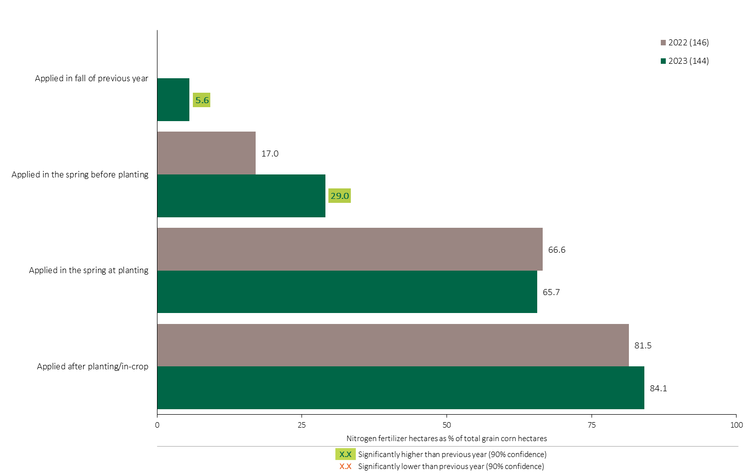

Nitrogen Timing in Grain Corn - % of Crop Area Treated
Grain Corn
A higher % of corn hectares were treated In the fall and in the spring before planting in 2023.
84% of grain corn hectares were treated with a Nitrogen fertilizer in-crop.
Note: Nitrogen only includes those fertilizer types where nitrogen is the primary component.
For each application timing, respondents were asked: “Of your [xxx] hectares of grain corn , how many hectares of each fertilizer type did you apply?”
The chart illustrates the % of total grain corn hectares that were treated with a primary Nitrogen fertilizer at each timing in each year. A list of Primary Nitrogen fertilizers can be accessed by clicking on the “A” button.

Slide 11
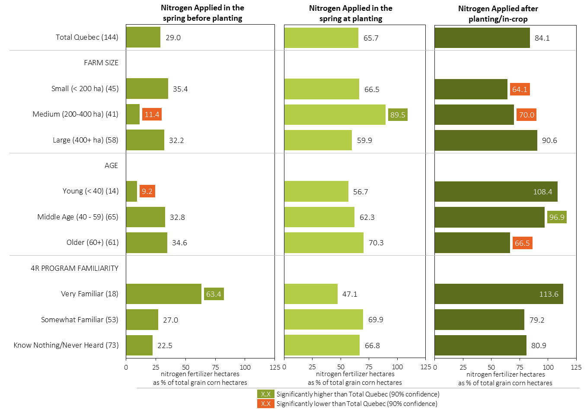
Nitrogen Timing in Grain Corn in 2023 (% of Crop Area Treated)
Grain Corn
Note: Nitrogen only includes those fertilizer types where nitrogen is the primary component.
For each application timing, respondents were asked: “Of your [xxx] hectares of grain corn, how many hectares of each fertilizer type did you apply?”
Separately for each timing, the charts illustrate the % of total grain corn hectares that were treated with a primary nitrogen fertilizer by farm size, age and 4R program familiarity.
Nitrogen only includes those fertilizer types where nitrogen is the primary component. A list can be accessed by clicking on the “A” button.

Slide 12
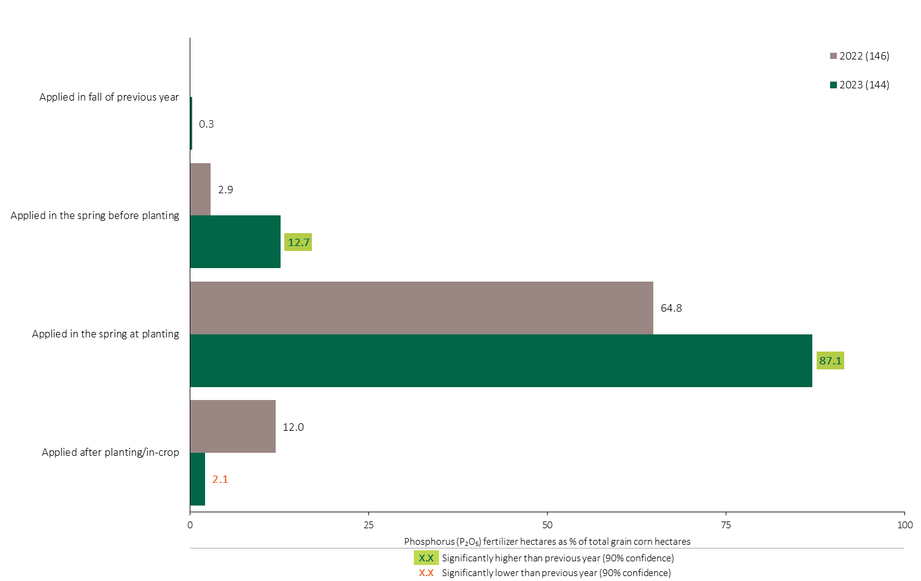
Phosphorus (P₂O₅) Timing in Grain Corn - % of Crop Area Treated
Grain Corn
More corn hectares were treated with a Phosphorous fertilizer before planting.
87% of grain corn hectares were treated with a Phosphorus fertilizer at planting, an increase in 2023.
Note: Phosphorus only includes those fertilizer types where phosphorus is the primary component.
For each application timing, respondents were asked: “Of your [xxx] hectares of grain corn , how many hectares of each fertilizer type did you apply?”
The chart illustrates the % of total grain corn hectares that were treated with a primary Phosphorus fertilizer at each timing in each year. A list of Primary Phosphorus fertilizers can be accessed by clicking on the “A” button.

Slide 13
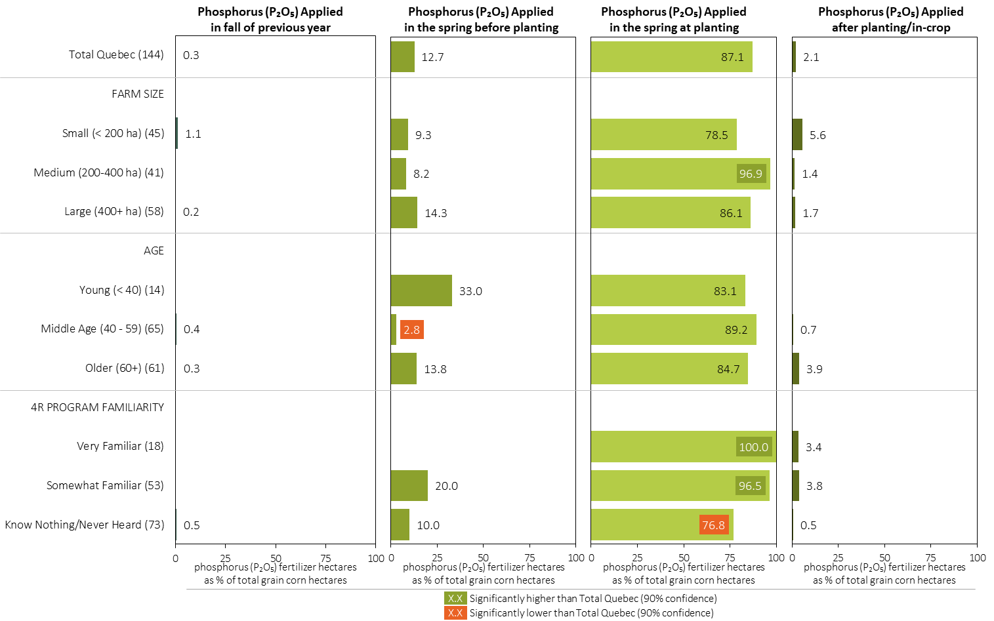
Phosphorus (P₂O₅) Timing in Grain Corn in 2023 (% of Crop Area Treated)
Grain Corn
Note: Phosphorus only includes those fertilizer types where phosphorus is the primary component.
For each application timing, respondents were asked: “Of your [xxx] hectares of grain corn , how many hectares of each fertilizer type did you apply?”
Separately for each timing, the charts illustrate the % of total grain corn hectares that was treated with a primary phosphorus fertilizer by farm size, age and 4R program familiarity.
Phosphorus only includes those fertilizer types where phosphorus is the primary component. A list can be accessed by clicking on the “A” button.

Slide 14
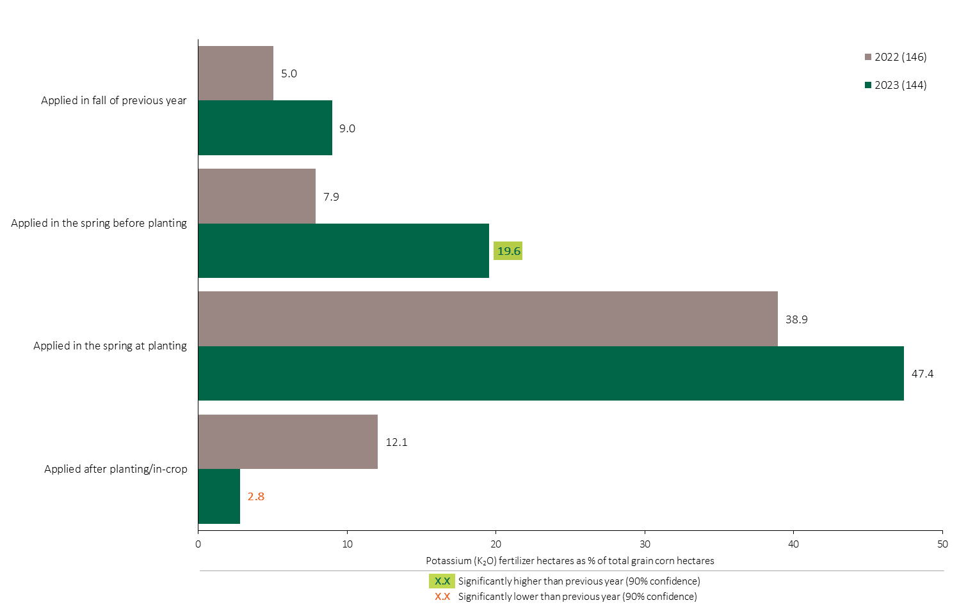
Potassium (K₂O) Timing in Grain Corn - % of Crop Area Treated
Grain Corn
More corn hectares were treated with a Potassium fertilizer before planting.
47% of total grain corn hectares were treated with Potassium at planting.
Note: Potassium only includes those fertilizer types where potassium is the primary component.
For each application timing, respondents were asked: “Of your [xxx] hectares of grain corn , how many hectares of each fertilizer type did you apply?”
The chart illustrates the % of total grain corn hectares that were treated with a primary Potassium fertilizer at each timing in each year. A list of Primary Potassium fertilizers can be accessed by clicking on the “A” button.

Slide 15
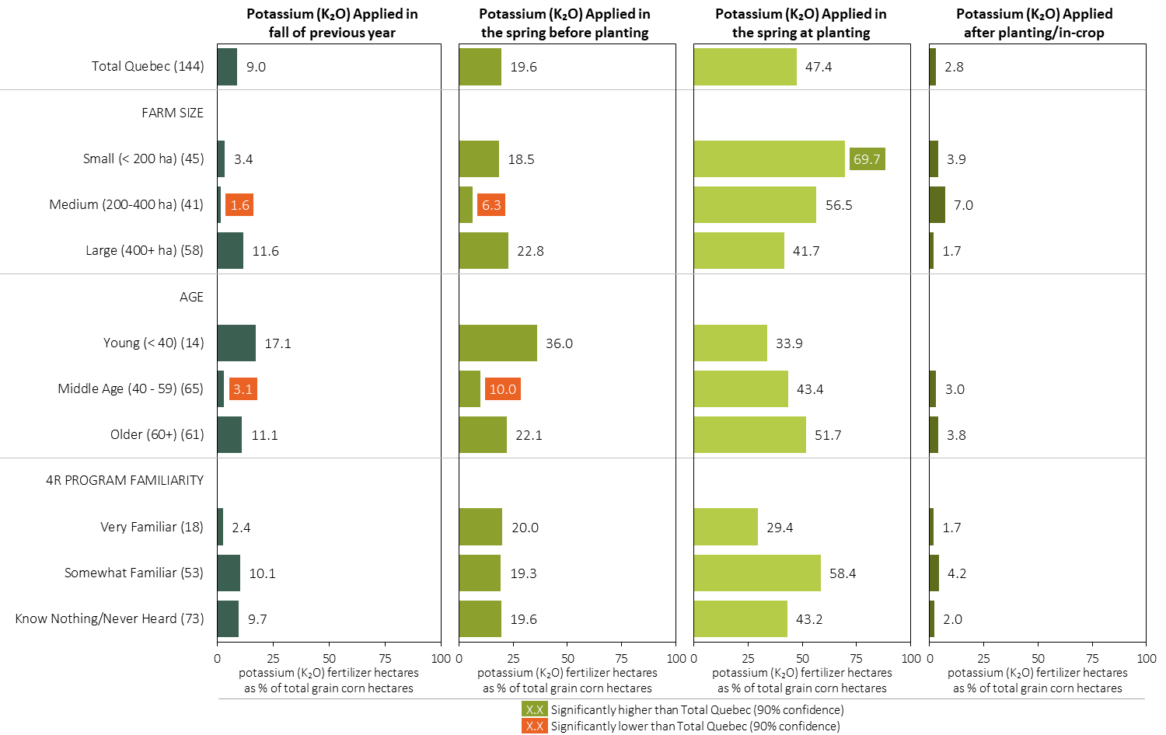
Potassium (K₂O) Timing in Grain Corn in 2023 (% of Crop Area Treated)
Grain Corn
Note: Potassium only includes those fertilizer types where potassium is the primary component.
For each application timing, respondents were asked: “Of your [xxx] hectares of grain corn , how many hectares of each fertilizer type did you apply?”
Separately for each timing, the charts illustrate the % of total grain corn hectares that was treated with a primary potassium fertilizer by farm size, age and 4R program familiarity.
Potassium only includes those fertilizer types where potassium is the primary component. A list can be accessed by clicking on the “A” button.

Slide 16
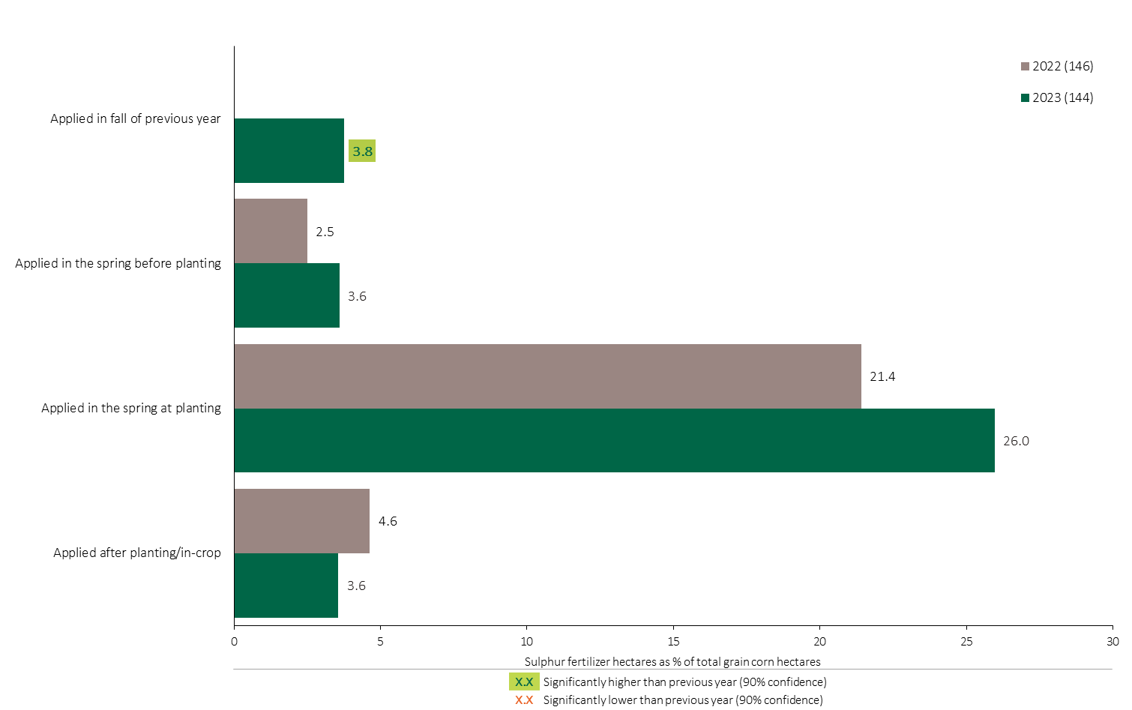
Sulphur Timing in Grain Corn - % of Crop Area Treated
Grain Corn
26% of grain corn hectares were treated with a Sulphur fertilizer at planting in 2023.
Note: Sulphur only includes those fertilizer types where sulphur is the primary component.
For each application timing, respondents were asked: “Of your [xxx] hectares of grain corn , how many hectares of each fertilizer type did you apply?”
The chart illustrates the % of total grain corn hectares that were treated with a primary Sulphur fertilizer at each timing in each year. A list of Primary Sulphur fertilizers can be accessed by clicking on the “A” button.

Slide 17
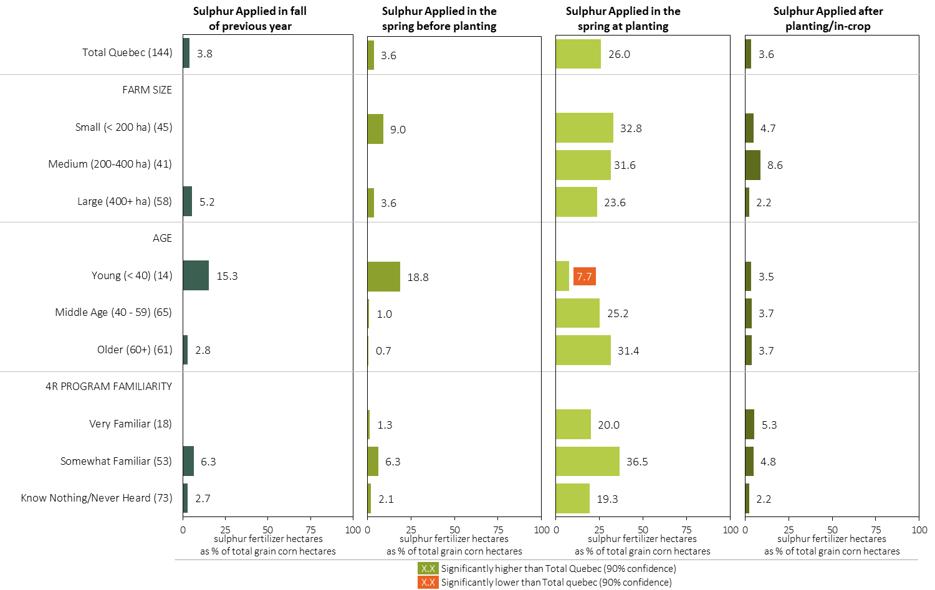
Sulphur Timing in Grain Corn in 2023 (% of Crop Area Treated)
Grain Corn
Note: Sulphur only includes those fertilizer types where sulphur is the primary component.
For each application timing, respondents were asked: “Of your [xxx] hectares of grain corn , how many hectares of each fertilizer type did you apply?”
Separately for each timing, the charts illustrate the % of total grain corn hectares that was treated with a primary sulphur fertilizer by farm size, age and 4R program familiarity.
Sulphur only includes those fertilizer types where sulphur is the primary component. A list can be accessed by clicking on the “A” button.

Slide 18
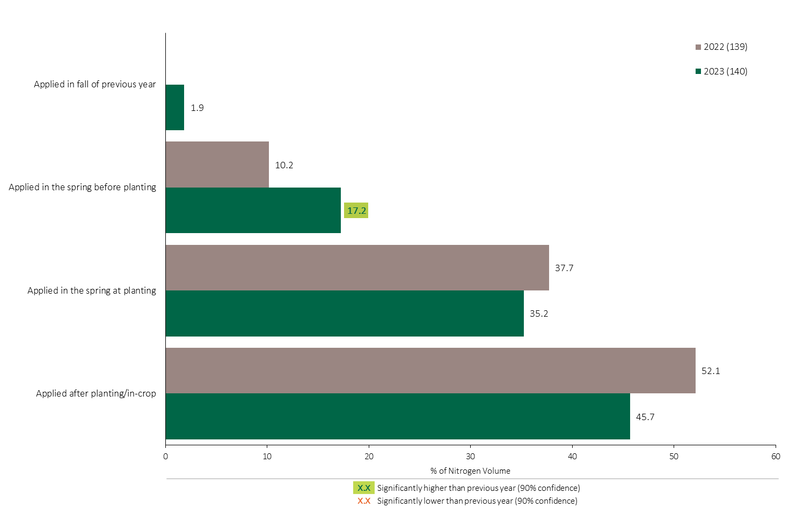
Nitrogen Timing in Grain Corn - % of Volume
Grain Corn
Grain Corn Summary 
Nitrogen volumes applied before planting increased in 2023.
45% of total Nitrogen applied in grain corn was applied in-crop.
Note: Nitrogen volume was calculated from all sources of nitrogen contained in all fertilizer types
For each fertilizer type used in either a custom blend or applied as an unblended product, respondents were asked: a) how many hectares they applied, and b) the application rate in kilograms of actual nutrient/ha. Volumes of each nutrient were calculated by multiplying hectares treated times the application rate.
The graph illustrates the % of total Nitrogen volume applied in grain corn that was applied at each timing in each year.
Total kilograms of actual Nitrogen applied was calculated based on all sources of Nitrogen from all fertilizer types.

Slide 19
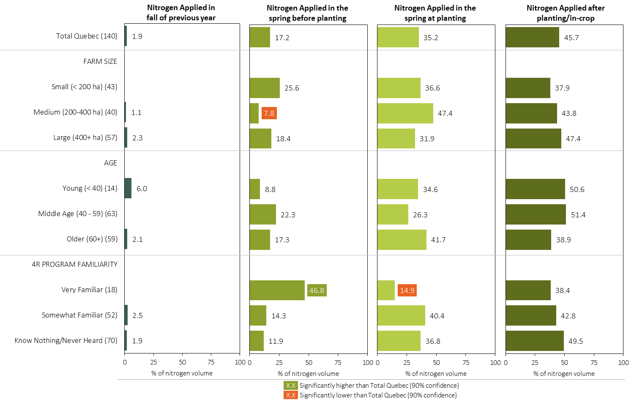
Nitrogen Timing in Grain Corn in 2023 (% of Volume)
Grain Corn
Note: Nitrogen volume was calculated from all sources of nitrogen contained in all fertilizer types
For each fertilizer type used in either a custom blend or applied as an unblended product, respondents were asked: a) how many hectares they applied, and b) the application rate in kilograms of actual nutrient/ha. Volumes of each nutrient were calculated by multiplying hectares treated times the application rate.
Separately for each timing, the charts illustrate the % of total nitrogen volume that was applied by farm size, age and 4R program familiarity.
Total kilograms of actual nitrogen applied was calculated based on all sources of nitrogen from all fertilizer types.

Slide 20
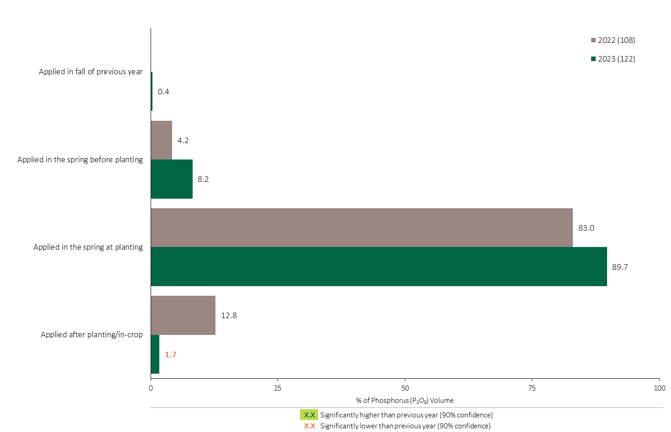
Phosphorus (P₂O₅) Timing in Grain Corn - % of Volume
Grain Corn
Grain Corn Summary 
90% of total Phosphorus (P₂O₅) applied in grain corn was applied at planting.
Note: Phosphorus (P₂O₅) volume was calculated from all sources of phosphorus contained in all fertilizer types
For each fertilizer type used in either a custom blend or applied as an unblended product, respondents were asked: a) how many hectares they applied, and b) the application rate in kilograms of actual nutrient/ha. Volumes of each nutrient were calculated by multiplying hectares treated times the application rate.
The graph illustrates the % of total Phosphorus (P₂O₅) volume applied in grain corn that was applied at each timing in each year.
Total kilograms of actual Phosphorus (P₂O₅) applied was calculated based on all sources of Phosphorus (P₂O₅) from all fertilizer types.

Slide 21
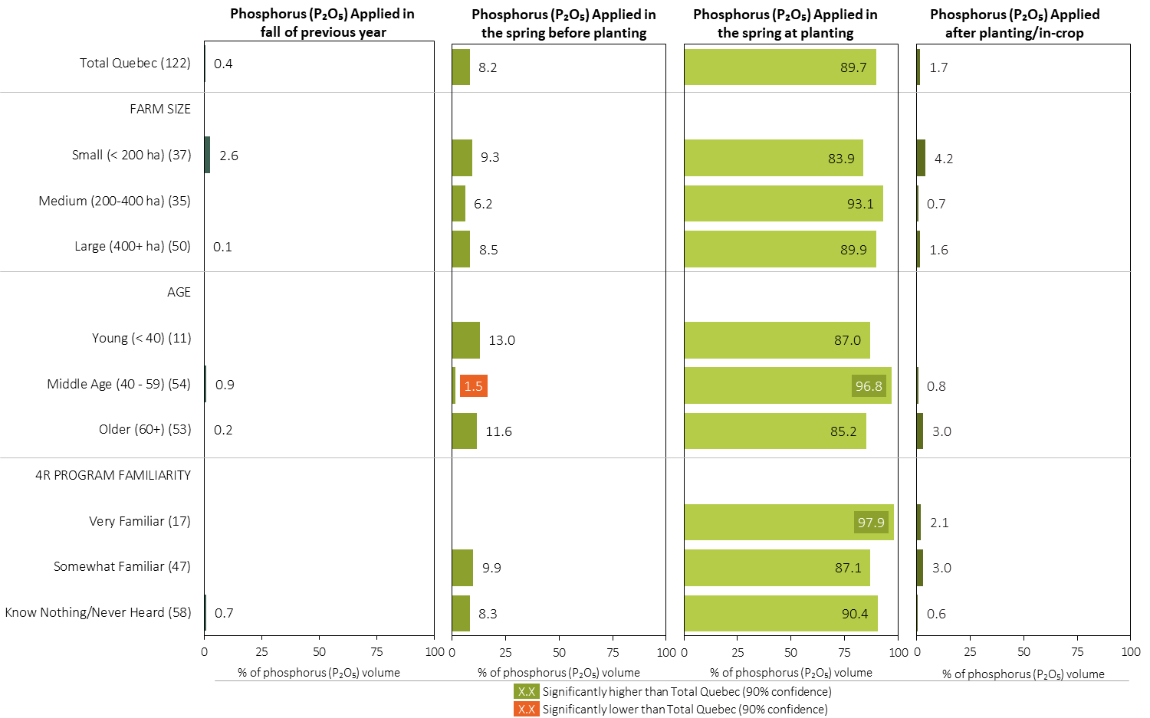
Phosphorus (P₂O₅) Timing in Grain Corn in 2023 (% of Volume)
Grain Corn
Note: Phosphorus (P₂O₅) volume was calculated from all sources of phosphorus contained in all fertilizer types
For each fertilizer type used in either a custom blend or applied as an unblended product, respondents were asked: a) how many hectares they applied, and b) the application rate in kilograms of actual nutrient/ha. Volumes of each nutrient were calculated by multiplying hectares treated times the application rate.
Separately for each timing, the charts illustrate the % of total Phosphorus (P₂O₅) volume that was applied by farm size, age and 4R program familiarity.
Total kilograms of actual Phosphorus (P₂O₅) applied was calculated based on all sources of Phosphorus (P₂O₅) from all fertilizer types.

Slide 22
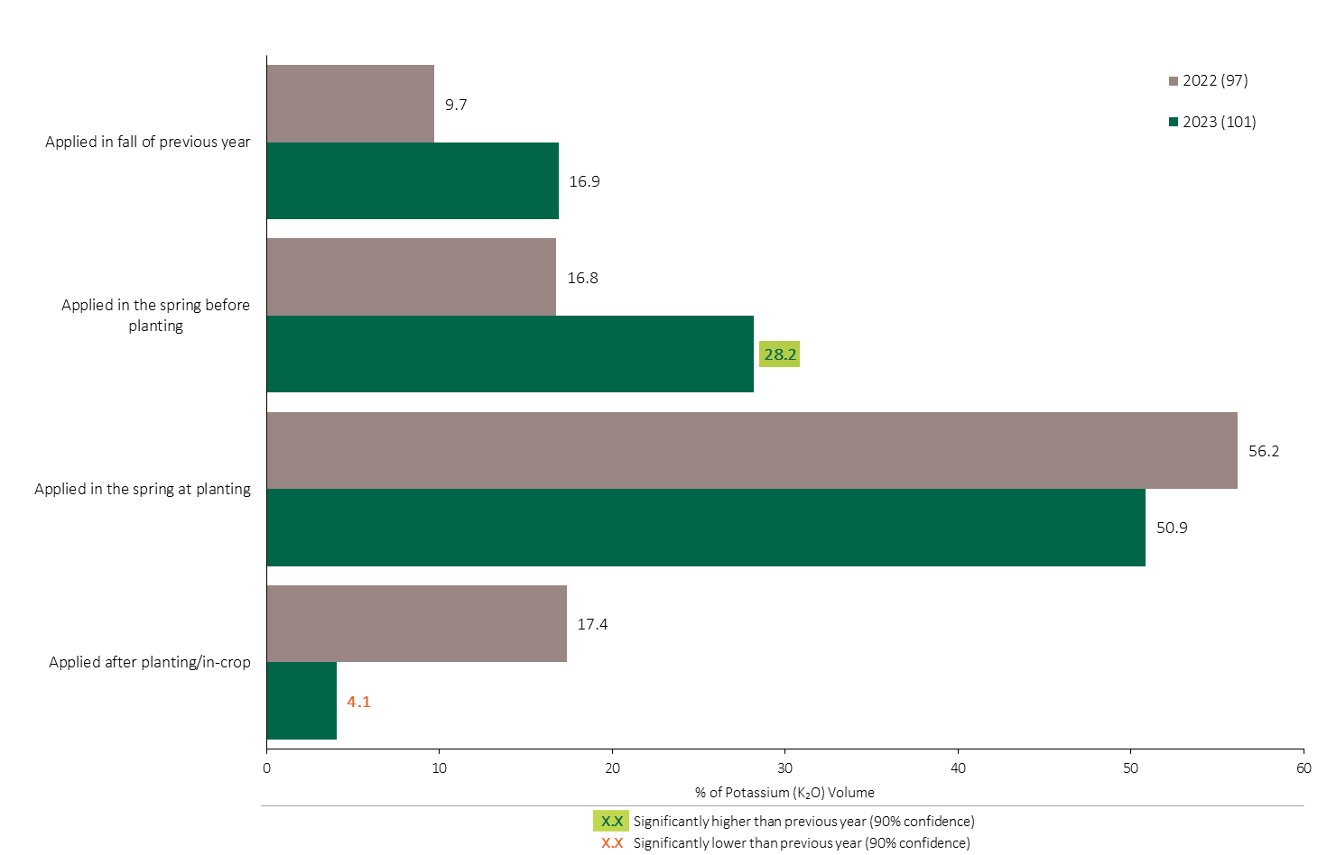
Potassium (K₂O) Timing in Grain Corn - % of Volume
Grain Corn
Grain Corn Summary 
Potassium volumes applied before planting increased in 2023.
51% of total Potassium applied in grain corn was applied at planting.
Note: Potassium (K₂O) volume was calculated from all sources of potassium contained in all fertilizer types
For each fertilizer type used in either a custom blend or applied as an unblended product, respondents were asked: a) how many hectares they applied, and b) the application rate in kilograms of actual nutrient/ha. Volumes of each nutrient were calculated by multiplying hectares treated times the application rate.
The graph illustrates the % of total Potassium (K₂O) volume applied in grain corn that was applied at each timing in each year.
Total kilograms of actual Potassium (K₂O) applied was calculated based on all sources of Potassium (K₂O) from all fertilizer types.

Slide 23
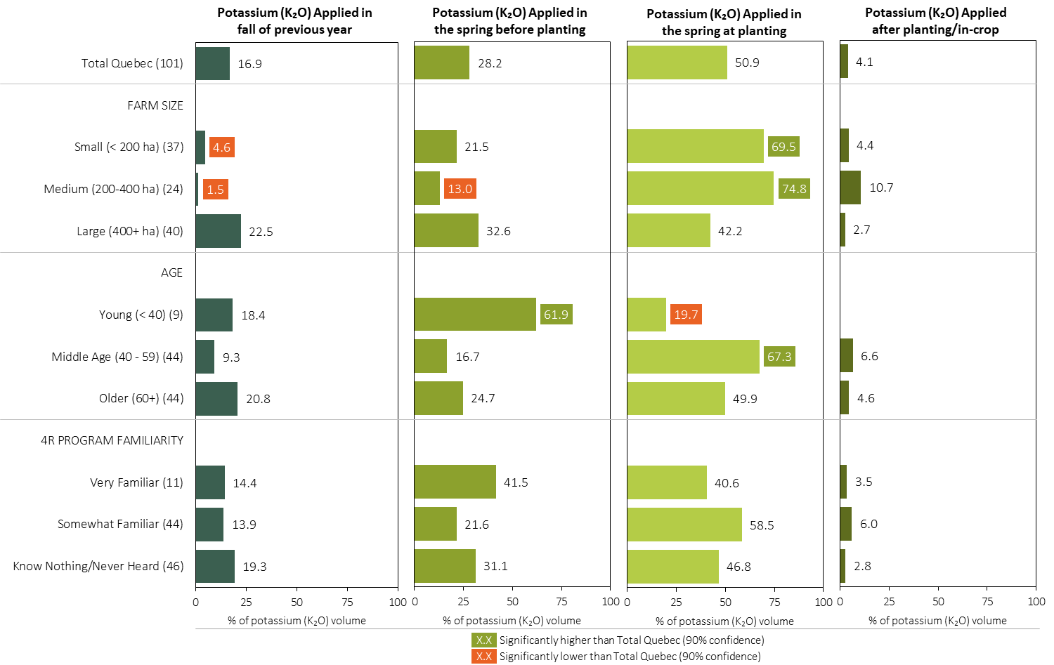
Potassium (K₂O) Timing in Grain Corn in 2023 (% of Volume)
Grain Corn
Note: Potassium (K₂O) volume was calculated from all sources of potassium contained in all fertilizer types
For each fertilizer type used in either a custom blend or applied as an unblended product, respondents were asked: a) how many hectares they applied, and b) the application rate in kilograms of actual nutrient/ha. Volumes of each nutrient were calculated by multiplying hectares treated times the application rate.
Separately for each timing, the charts illustrate the % of total Potassium (K₂O) volume that was applied by farm size, age and 4R program familiarity.
Total kilograms of actual potassium (K₂O) applied was calculated based on all sources of potassium (K₂O) from all fertilizer types.

Slide 24
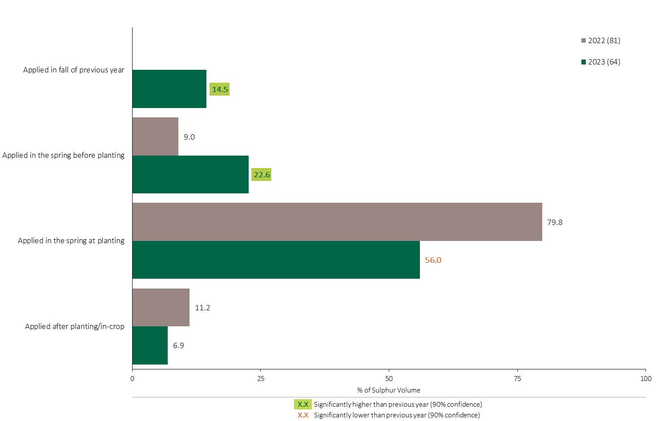
Sulphur Timing in Grain Corn - % of Volume
Grain Corn
Sulphur volumes applied in the fall and in the spring before planting both increased in 2023.
Grain Corn Summary 
56% of the Sulphur volume in grain corn was applied at planting in 2023, a decline in 2023.
Note: Sulphur volume was calculated from all sources of sulphur contained in all fertilizer types
For each fertilizer type used in either a custom blend or applied as an unblended product, respondents were asked: a) how many hectares they applied, and b) the application rate in kilograms of actual nutrient/ha. Volumes of each nutrient were calculated by multiplying hectares treated times the application rate.
The graph illustrates the % of total Sulphur volume applied in grain corn that was applied at each timing in each year.
Total kilograms of actual Sulphur applied was calculated based on all sources of Sulphur from all fertilizer types.

Slide 25
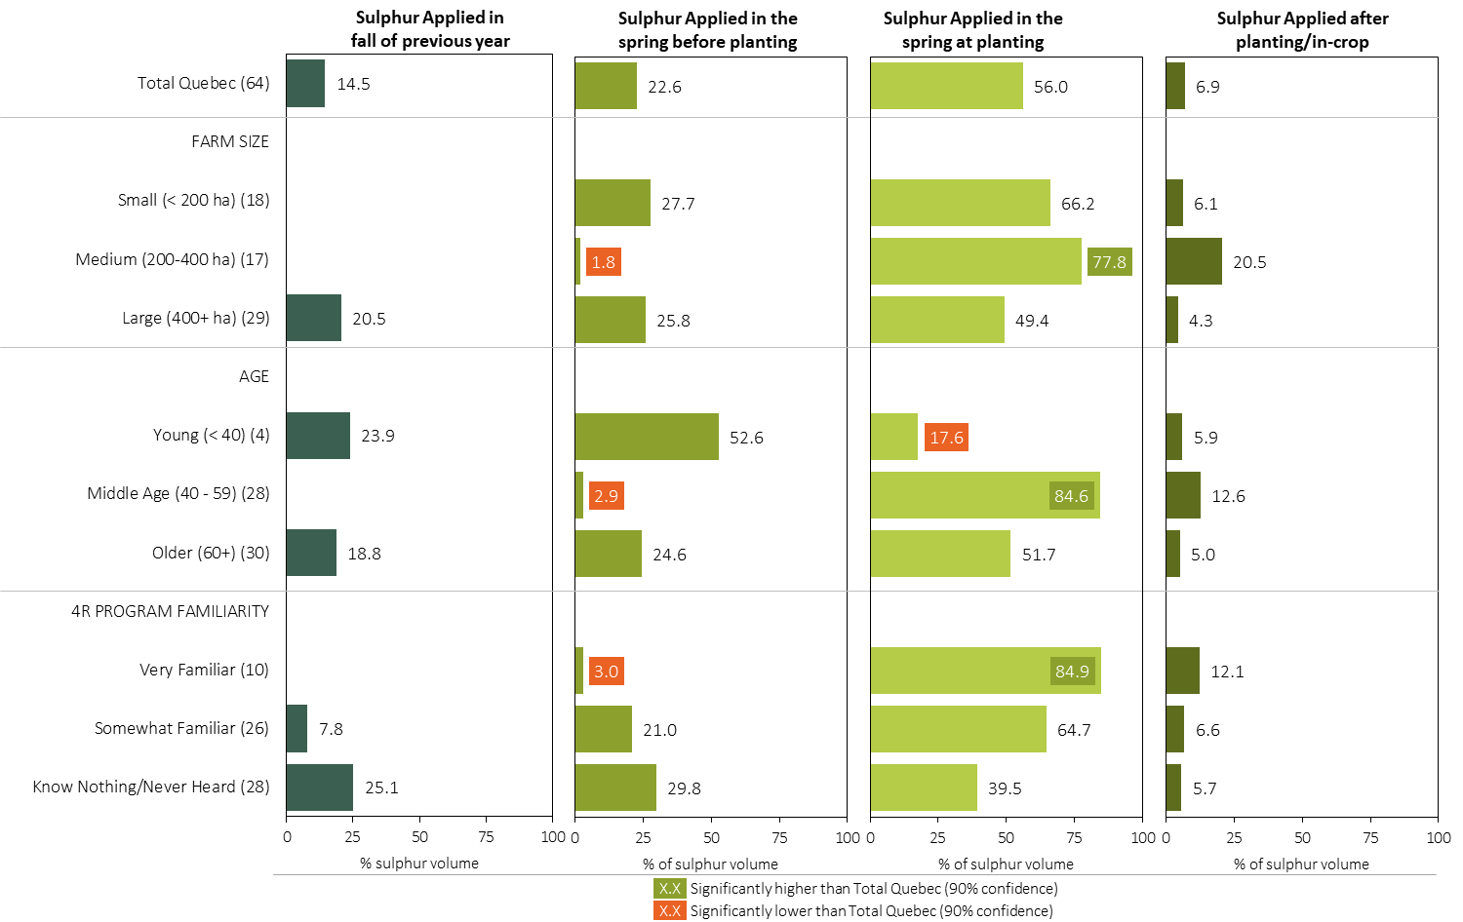
Sulphur Timing in Grain Corn in 2023 (% of Volume)
Grain Corn
Note: Sulphur volume was calculated from all sources of sulphur contained in all fertilizer types
For each fertilizer type used in either a custom blend or applied as an unblended product, respondents were asked: a) how many hectares they applied, and b) the application rate in kilograms of actual nutrient/ha. Volumes of each nutrient were calculated by multiplying hectares treated times the application rate.
Separately for each timing, the charts illustrate the % of total sulphur volume that was applied by, farm size, age and 4R program familiarity.
Total kilograms of actual sulphur applied was calculated based on all sources of sulphur from all fertilizer types.

Slide 26
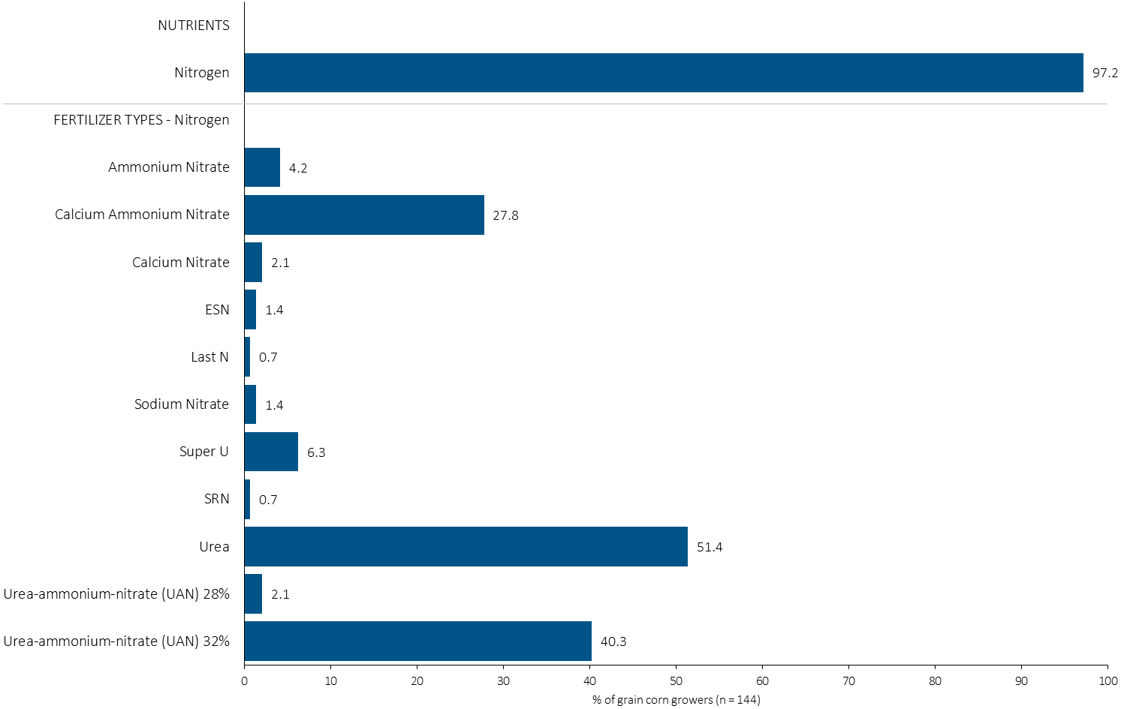
% of Grain Corn Growers Using Each Nitrogen Source in in 2023
Grain Corn
51% of grain corn growers used Urea in 2023.
Note: Nutrients were defined based on any fertilizer type that contains the nutrient.
Respondents were asked: “For your 2023 grain corn crop, did you apply fertilizer or manure at each timing? – and given the options of a) Applied in fall of previous year, b) in the spring before planting, c) in the spring at planting and d) after planting/in-crop. For your 2023 grain corn crop, which fertilizer types did you apply at each timing?
The chart illustrates the % of grain corn growers who indicated that they used this nutrient and each fertilizer type in grain corn in 2023.
Nutrients were defined based on any fertilizer type that contains the nutrient.

Slide 27
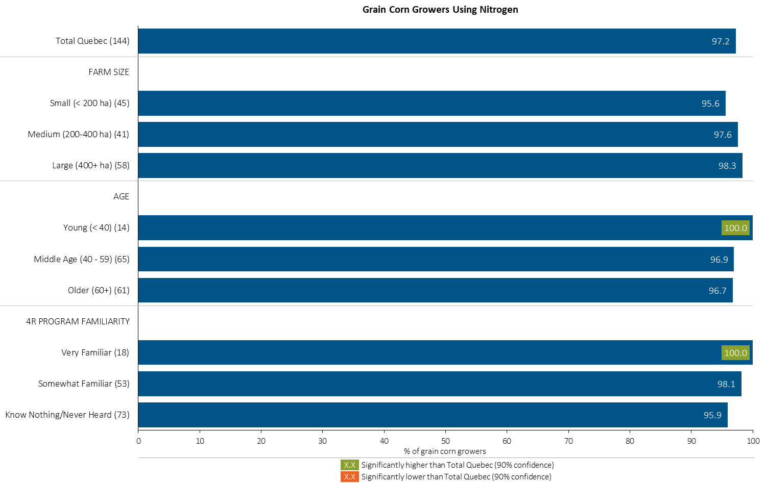
% of Grain Corn Growers Using Nitrogen in 2023
Grain Corn
Note: Nutrients were defined based on any fertilizer type that contains the nutrient.
Respondents were asked: “For your 2023 grain corn crop, did you apply fertilizer or manure at each timing? – and given the options of a) Applied in fall of previous year, b) in the spring before planting, c) in the spring at planting and d) after planting/in-crop. For your 2023 grain corn crop, which fertilizer types did you apply at each timing?
The chart illustrates the % of grain corn growers who indicated that they used this nutrient in grain corn in 2023 by farm size, age and 4R familiarity.
Nutrients were defined based on any fertilizer type that contains the nutrient.

Slide 28
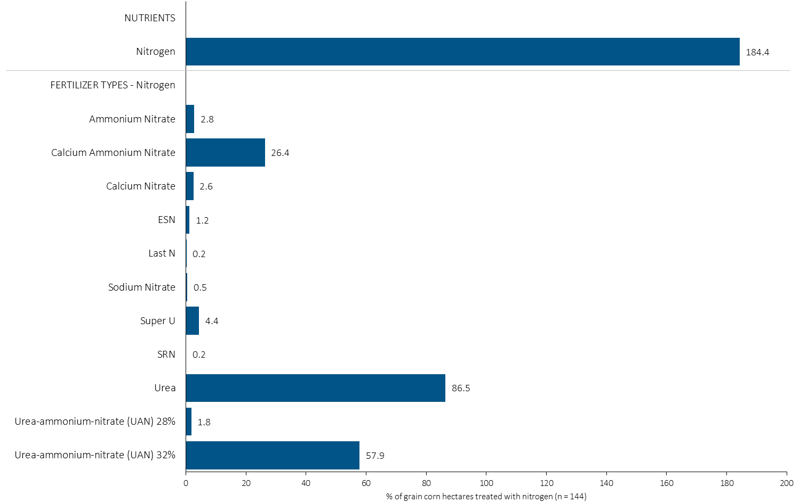
Hectares Treated With Each Nitrogen Source in Grain Corn in 2023
Grain Corn
Multiple Nitrogen fertilizers were often applied on the same fields.
Grain Corn Summary 
Note: Nutrients were defined based on the primary component of each fertilizer type
For each application timing, respondents were asked: “Of your [xxx] hectares of grain corn, how many hectares of each fertilizer type did you apply?”
The chart illustrates the % of total grain corn hectares that were treated with this nutrient and each fertilizer type in 2023.
Nutrients were defined based on the primary component (see adjacent fertilizer types by clicking on the “A” button).

Slide 29
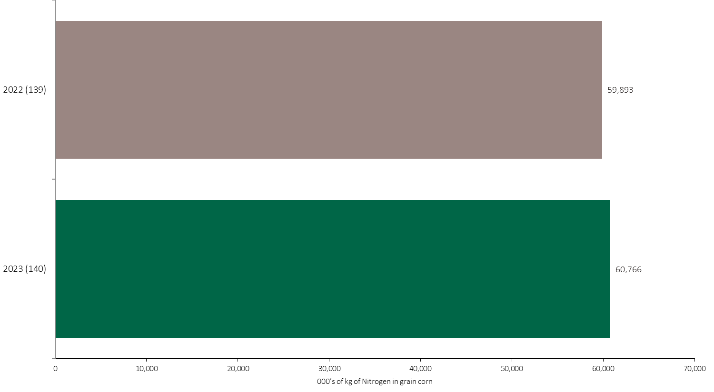
Nitrogen Volume in Grain Corn
Grain Corn
An estimated 61 million kilograms of N was used in grain corn in 2023.
Note: Nitrogen volume was calculated from all sources of nitrogen contained in all fertilizer types
For each fertilizer type used in either a custom blend or applied as an unblended product, respondents were asked: a) how many hectares they applied, and b) the application rate in kilograms of actual nutrient/ha. Volumes of each nutrient were calculated by multiplying hectares treated times the application rate.
The chart illustrates the total nitrogen volume (000’s of kilograms) that was used in each year. The nitrogen volume was calculated from all sources of nitrogen contained in all fertilizer types.

Slide 30
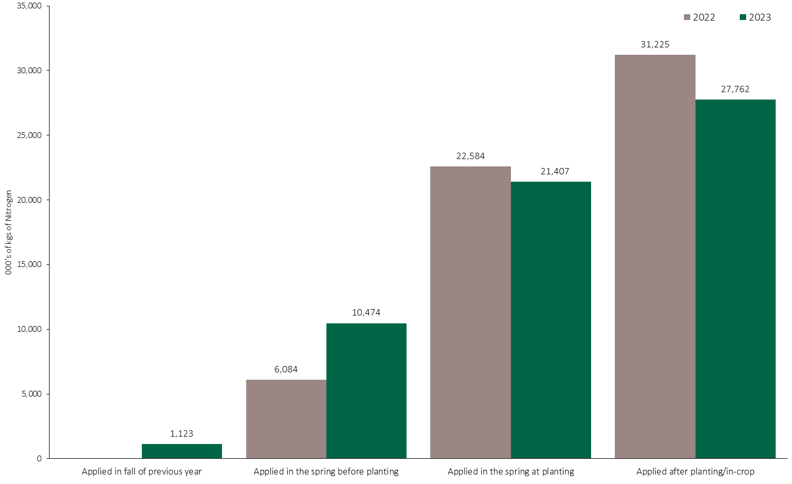
Nitrogen Volume in Grain Corn by Timing
Grain Corn
Note: Nitrogen volume was calculated from all sources of nitrogen contained in all fertilizer types
For each fertilizer type used in either a custom blend or applied as an unblended product, respondents were asked: a) how many hectares they applied, and b) the application rate in kilograms of actual nutrient/ha. Volumes of each nutrient were calculated by multiplying hectares treated times the application rate.
The chart illustrates the total nitrogen volume (000’s of kilograms) that was used in each year by application timing. The nitrogen volume was calculated from all sources of nitrogen contained in all fertilizer types.

Slide 31
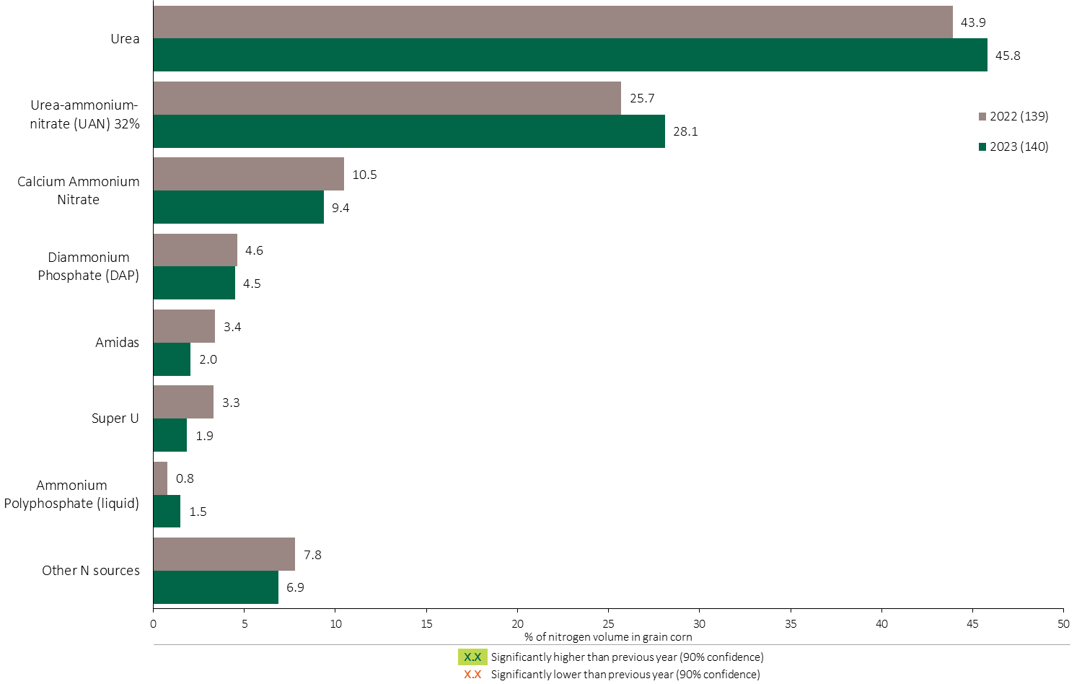
Nitrogen Fertilizer Source in Grain Corn - All Timings
46% of the nitrogen volume in grain corn was applied as Urea.
Grain Corn
28% of the N volume was applied as UAN 32%.
Grain Corn Summary 
Note: Nitrogen volume was calculated from all sources of nitrogen contained in all fertilizer types
For each fertilizer type used in either a custom blend or applied as an unblended product, respondents were asked: a) how many hectares they applied, and b) the application rate in kilograms of actual nutrient/ha. Volumes of each nutrient were calculated by multiplying hectares treated times the application rate.
The chart illustrates the % of total nitrogen volume applied at all timings that was provided by each fertilizer type. The nitrogen volume was calculated from all sources of nitrogen contained in all fertilizer types.

Slide 32
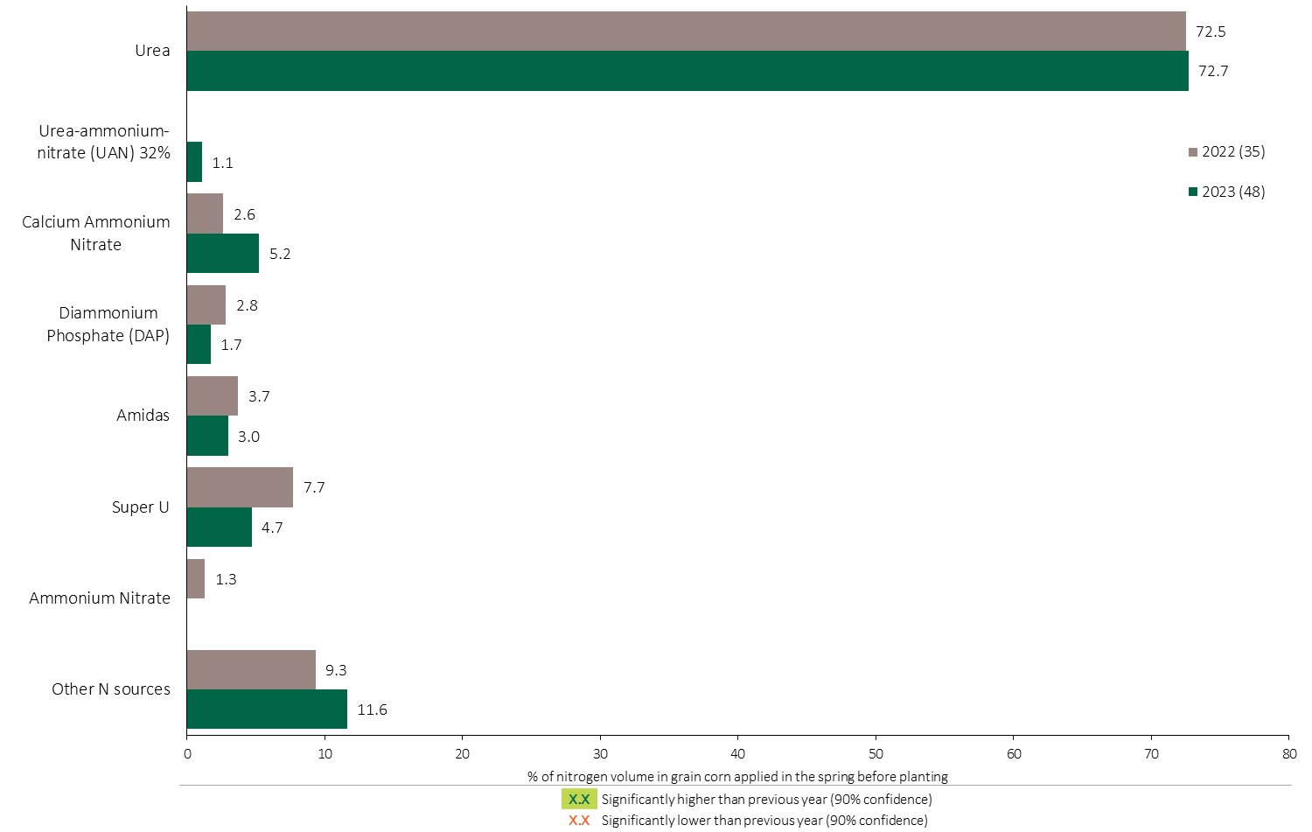
Nitrogen Fertilizer Source in Grain Corn - Spring Before Planting
Grain Corn
Note: Nitrogen volume was calculated from all sources of nitrogen contained in all fertilizer types
For each fertilizer type used in either a custom blend or applied as an unblended product, respondents were asked: a) how many hectares they applied, and b) the application rate in kilograms of actual nutrient/ha. Volumes of each nutrient were calculated by multiplying hectares treated times the application rate.
The chart illustrates the % of total nitrogen volume applied in the spring before planting that was provided by each fertilizer type. The nitrogen volume was calculated from all sources of nitrogen contained in all fertilizer types.

Slide 33
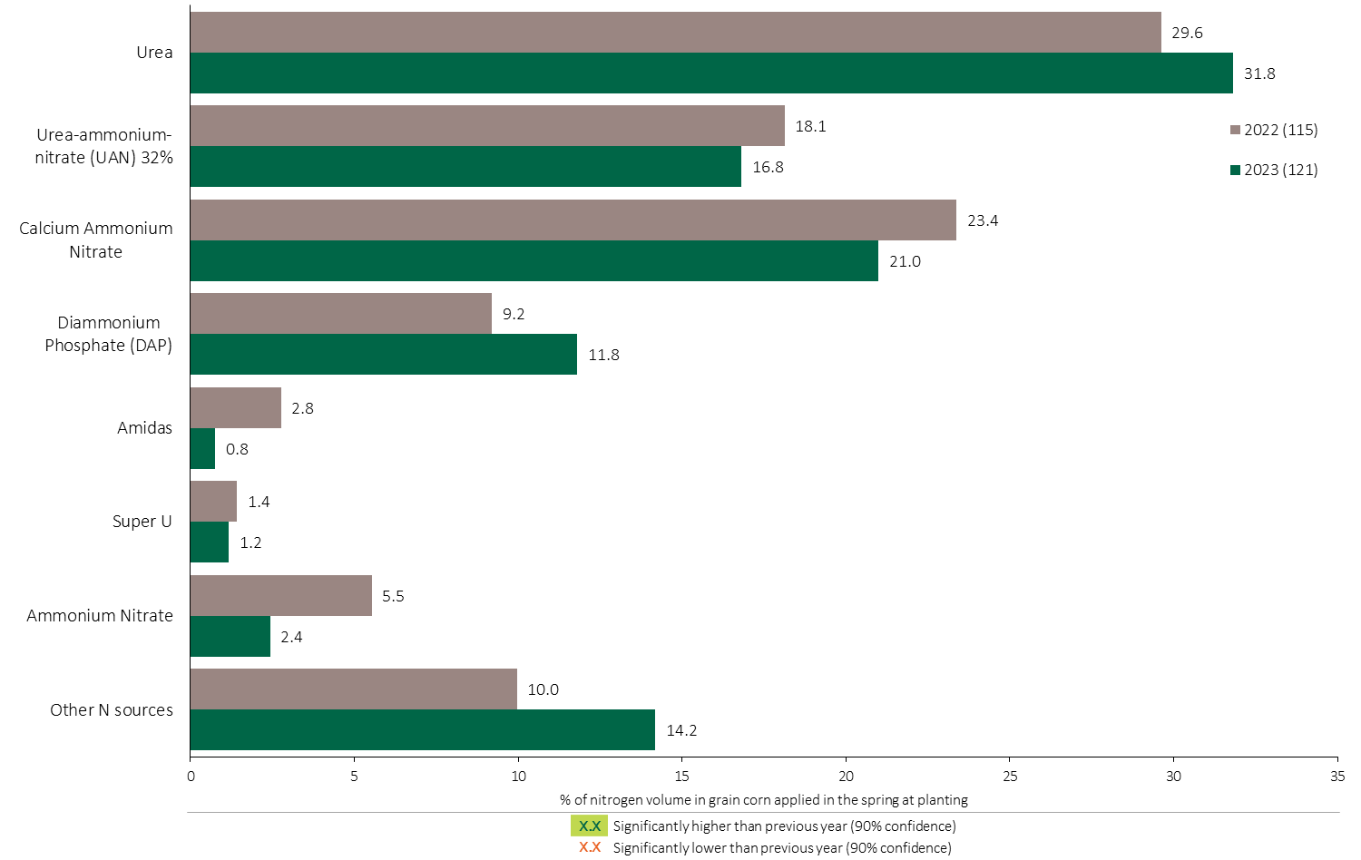
Nitrogen Fertilizer Source in Grain Corn – Spring At Planting
Grain Corn
Note: Nitrogen volume was calculated from all sources of nitrogen contained in all fertilizer types
For each fertilizer type used in either a custom blend or applied as an unblended product, respondents were asked: a) how many hectares they applied, and b) the application rate in kilograms of actual nutrient/ha. Volumes of each nutrient were calculated by multiplying hectares treated times the application rate.
The chart illustrates the % of total nitrogen volume applied in the spring at planting that was provided by each fertilizer type. The nitrogen volume was calculated from all sources of nitrogen contained in all fertilizer types.

Slide 34
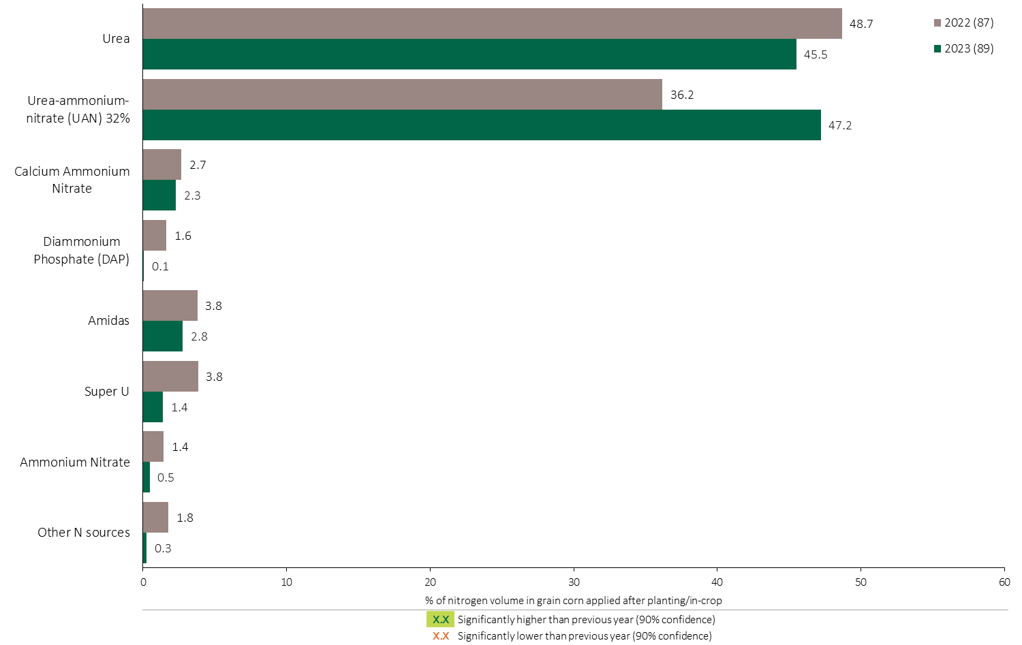
Nitrogen Fertilizer Source in Grain Corn - In-Crop
Grain Corn
Note: Nitrogen volume was calculated from all sources of nitrogen contained in all fertilizer types
For each fertilizer type used in either a custom blend or applied as an unblended product, respondents were asked: a) how many hectares they applied, and b) the application rate in kilograms of actual nutrient/ha. Volumes of each nutrient were calculated by multiplying hectares treated times the application rate.
The chart illustrates the % of total nitrogen volume applied after planting/in-crop that was provided by each fertilizer type. The nitrogen volume was calculated from all sources of nitrogen contained in all fertilizer types.

Slide 35
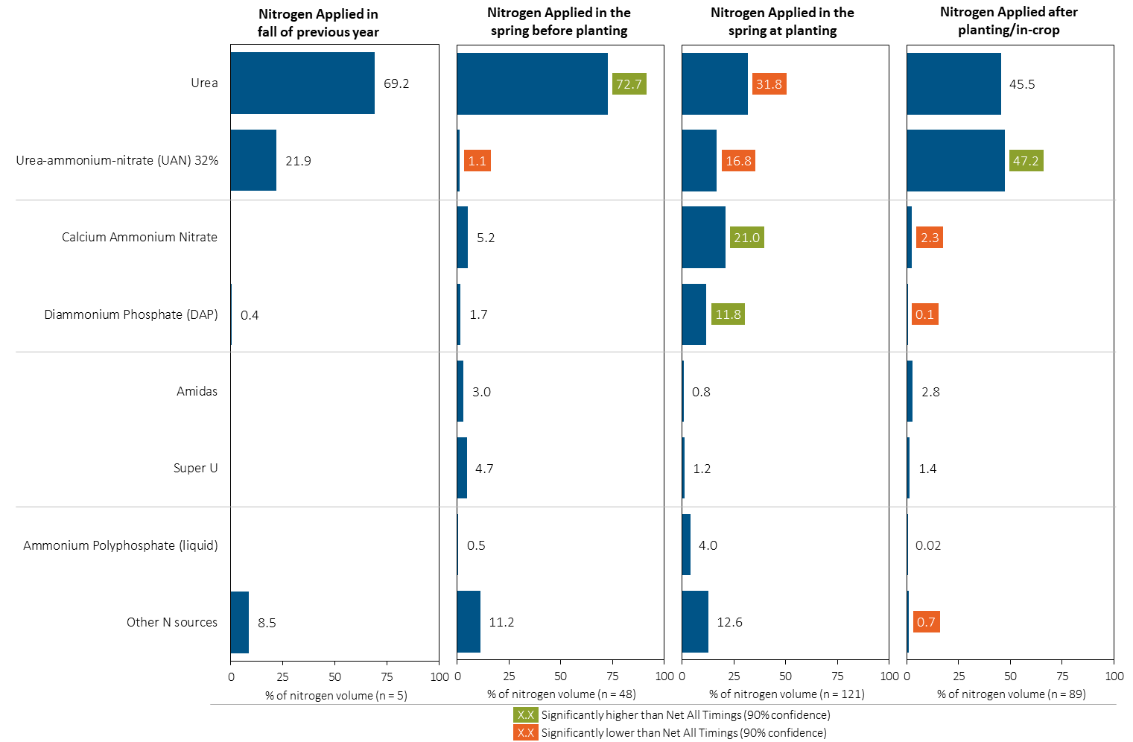
Nitrogen Fertilizer Source in Grain Corn by Timing
Grain Corn
Note: Nitrogen volume was calculated from all sources of nitrogen contained in all fertilizer types
For each fertilizer type used in either a custom blend or applied as an unblended product, respondents were asked: a) how many hectares they applied, and b) the application rate in kilograms of actual nutrient/ha. Volumes of each nutrient were calculated by multiplying hectares treated times the application rate.
Separately for each application timing, the graphs illustrate the % of total nitrogen volume applied in grain corn that came from each fertilizer source.
Total kilograms of actual nitrogen applied was calculated based on all sources of nitrogen from all fertilizer types.

Slide 36
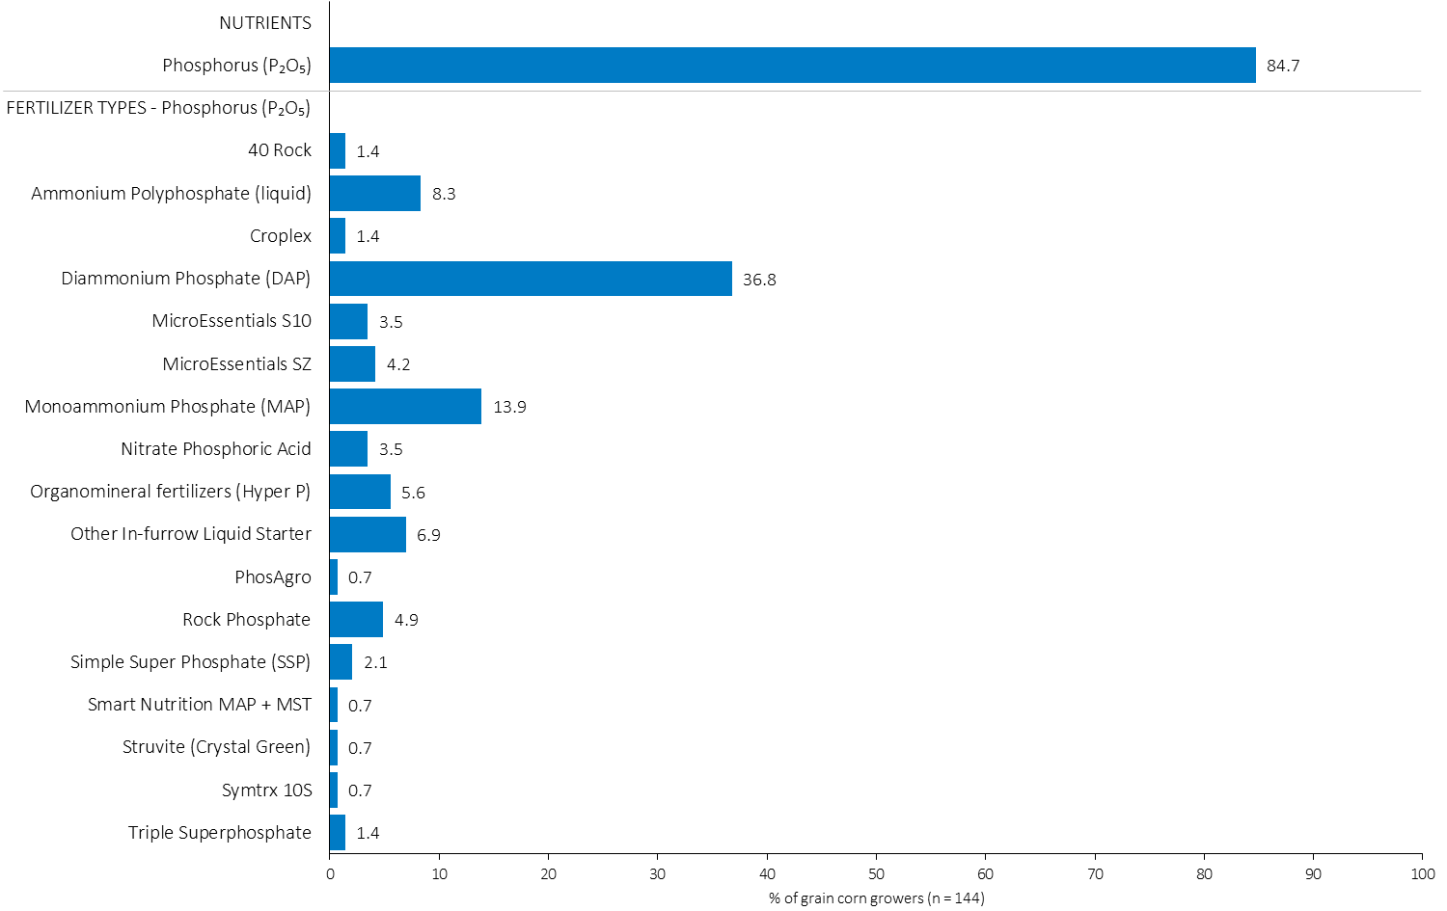
% of Grain Corn Growers Using Each Phosphorus (P₂O₅) Source in in 2023
Grain Corn
37% of grain corn growers used DAP in 2023.
Note: Nutrients were defined based on any fertilizer type that contains the nutrient.
Respondents were asked: “For your 2023 grain corn crop, did you apply fertilizer or manure at each timing? – and given the options of a) Applied in fall of previous year, b) in the spring before planting, c) in the spring at planting and d) after planting/in-crop. For your 2023 grain corn crop, which fertilizer types did you apply at each timing?
The chart illustrates the % of grain corn growers who indicated that they used this nutrient and each fertilizer type in grain corn in 2023.
Nutrients were defined based on any fertilizer type that contains the nutrient.

Slide 37
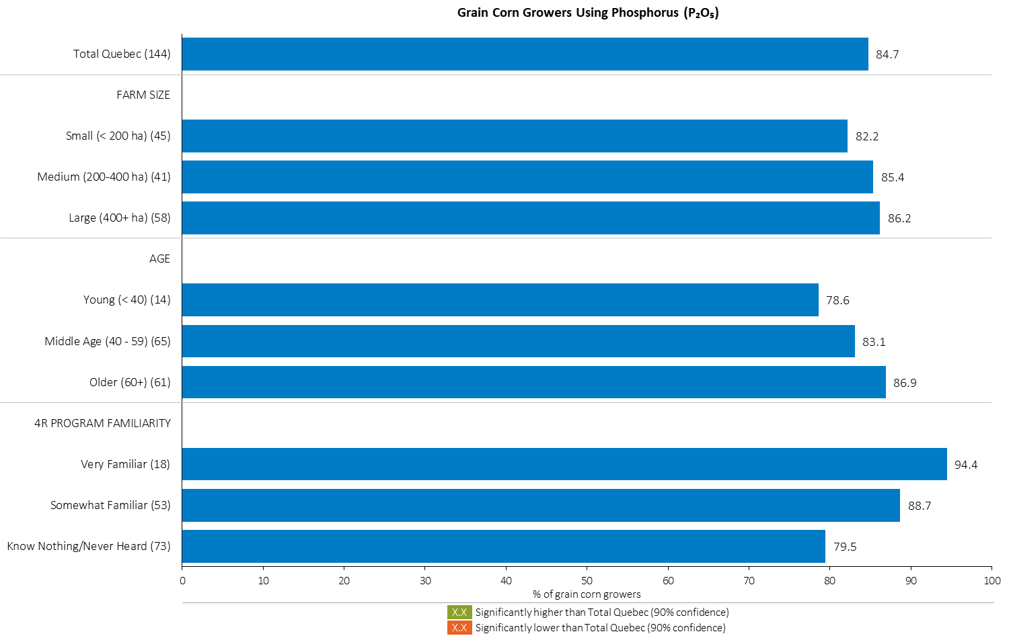
% of Grain Corn Growers Using Phosphorus (P₂O₅) in 2023
Grain Corn
Note: Nutrients were defined based on any fertilizer type that contains the nutrient.
Respondents were asked: “For your 2023 grain corn crop, did you apply fertilizer or manure at each timing? – and given the options of a) Applied in fall of previous year, b) in the spring before planting, c) in the spring at planting and d) after planting/in-crop. For your 2023 grain corn crop, which fertilizer types did you apply at each timing?
The chart illustrates the % of grain corn growers who indicated that they used this nutrient in grain corn in 2023 by farm size, age and 4R familiarity.
Nutrients were defined based on any fertilizer type that contains the nutrient.

Slide 38
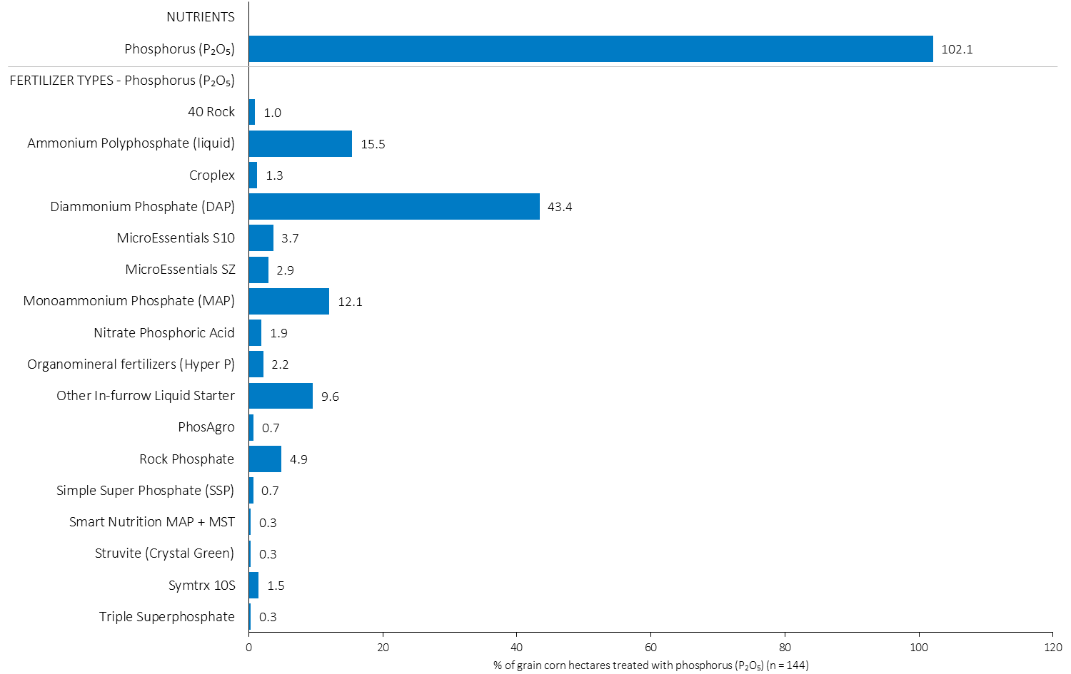
Hectares Treated With Each Phosphorus (P₂O₅) Source in Grain Corn in 2023
Multiple Phosphorous fertilizers were applied on some fields.
Grain Corn
Grain Corn Summary 
Note: Nutrients were defined based on the primary component of each fertilizer type
For each application timing, respondents were asked: “Of your [xxx] hectares of grain corn, how many hectares of each fertilizer type did you apply?”
The chart illustrates the % of total grain corn hectares that were treated with this nutrient and each fertilizer type in 2023.
Nutrients were defined based on the primary component (see adjacent fertilizer types by clicking on the “A” button).

Slide 39
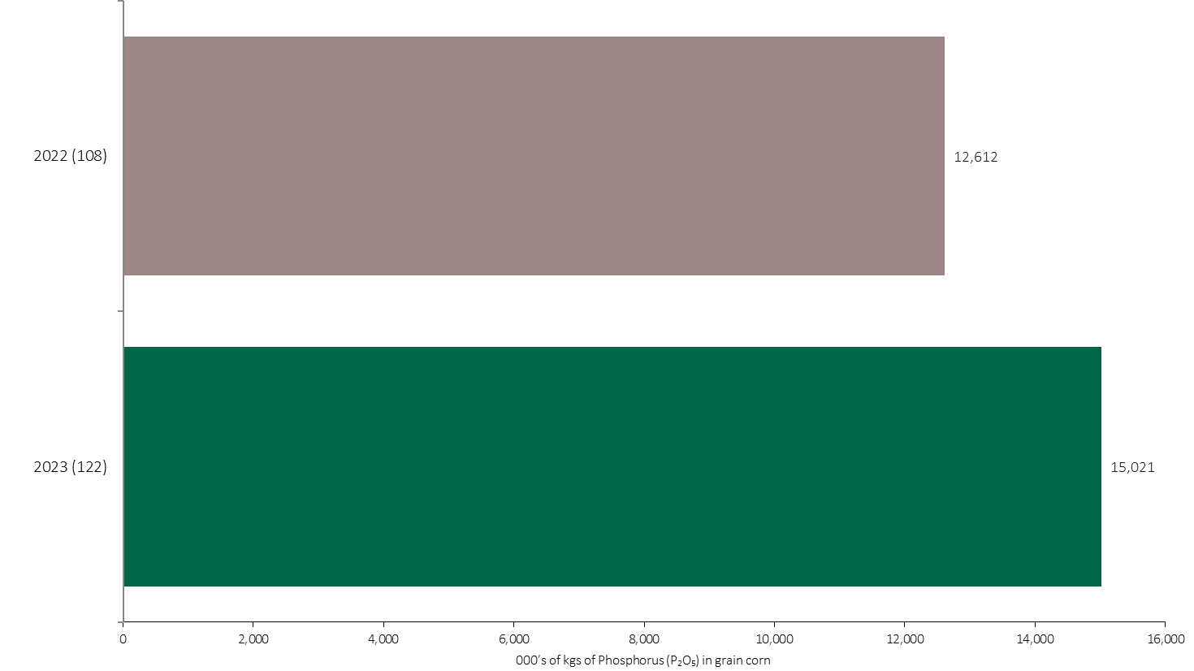
Phosphorus (P₂O₅) Volume in Grain Corn
Grain Corn
An estimated 15 million kilograms of P₂O₅ was used in grain corn in 2023.
Note: Phosphorus (P₂O₅) volume was calculated from all sources of phosphorus contained in all fertilizer types
For each fertilizer type used in either a custom blend or applied as an unblended product, respondents were asked: a) how many hectares they applied, and b) the application rate in kilograms of actual nutrient/ha. Volumes of each nutrient were calculated by multiplying hectares treated times the application rate.
The chart illustrates the total phosphorus (P₂O₅) volume (000’s of kilograms) that was used in each year. The phosphorus (P₂O₅) volume was calculated from all sources of phosphorus (P₂O₅) contained in all fertilizer types.

Slide 40
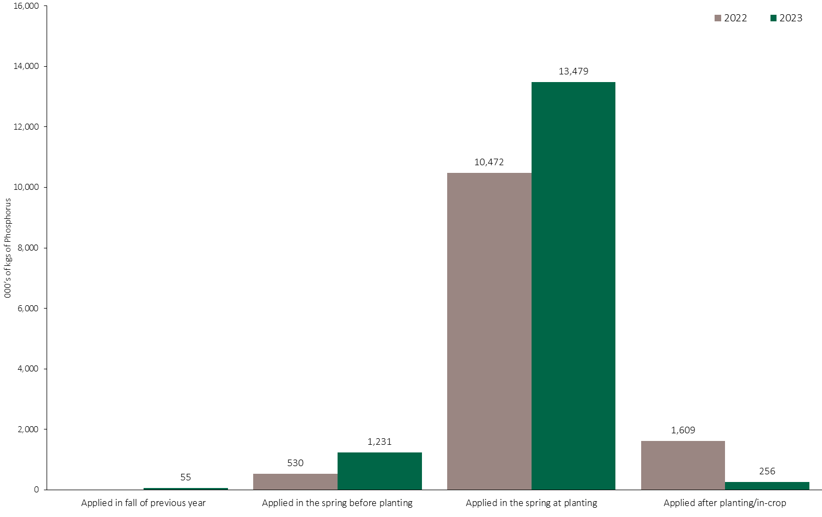
Phosphorus (P₂O₅) Volume in Grain Corn by Timing
Grain Corn
Note: Phosphorus (P₂O₅) volume was calculated from all sources of phosphorus contained in all fertilizer types
For each fertilizer type used in either a custom blend or applied as an unblended product, respondents were asked: a) how many hectares they applied, and b) the application rate in kilograms of actual nutrient/ha. Volumes of each nutrient were calculated by multiplying hectares treated times the application rate.
The chart illustrates the total phosphorus (P₂O₅) volume (000’s of kilograms) that was used in each year by application timing. The phosphorus (P₂O₅) volume was calculated from all sources of phosphorus (P₂O₅) contained in all fertilizer types.

Slide 41
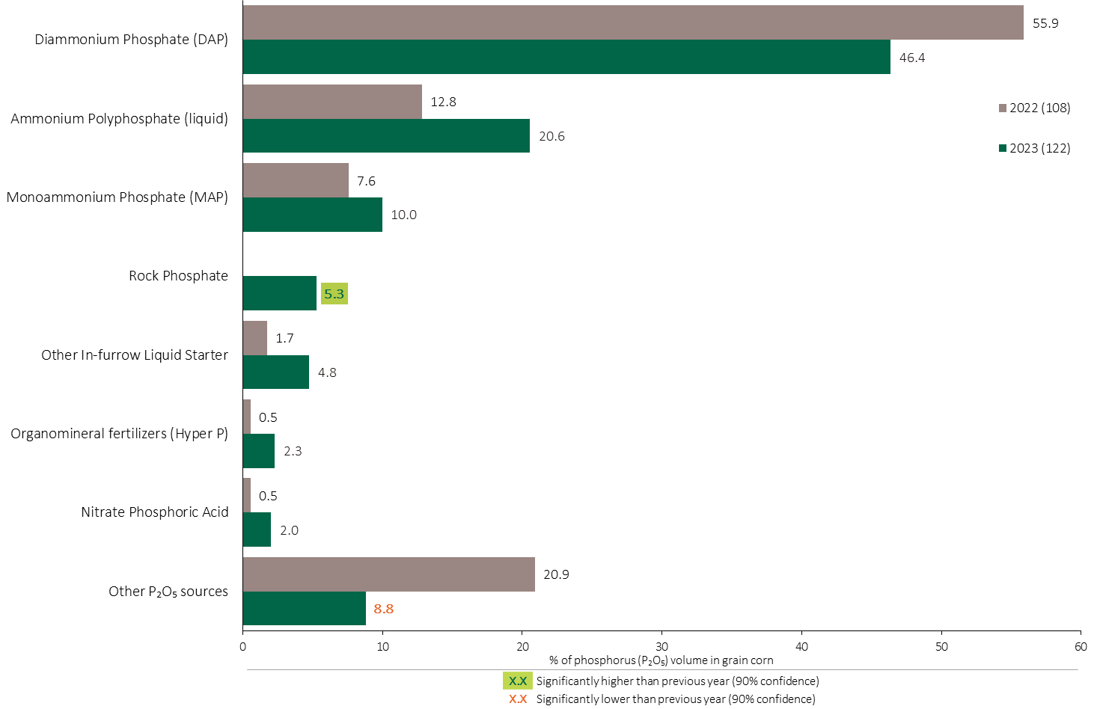
Phosphorus (P₂O₅) Fertilizer Source in Grain Corn - All Timings
Grain Corn
46% of total Phosphorus (P₂O₅) volume was applied as DAP in grain corn.
Grain Corn Summary 
Note: Phosphorus (P₂O₅) volume was calculated from all sources of phosphorus contained in all fertilizer types
For each fertilizer type used in either a custom blend or applied as an unblended product, respondents were asked: a) how many hectares they applied, and b) the application rate in kilograms of actual nutrient/ha. Volumes of each nutrient were calculated by multiplying hectares treated times the application rate.
The chart illustrates the % of total phosphorus (P₂O₅) volume applied at all timings that was provided by each fertilizer type. The phosphorus (P₂O₅) volume was calculated from all sources of phosphorus (P₂O₅) contained in all fertilizer types.

Slide 42
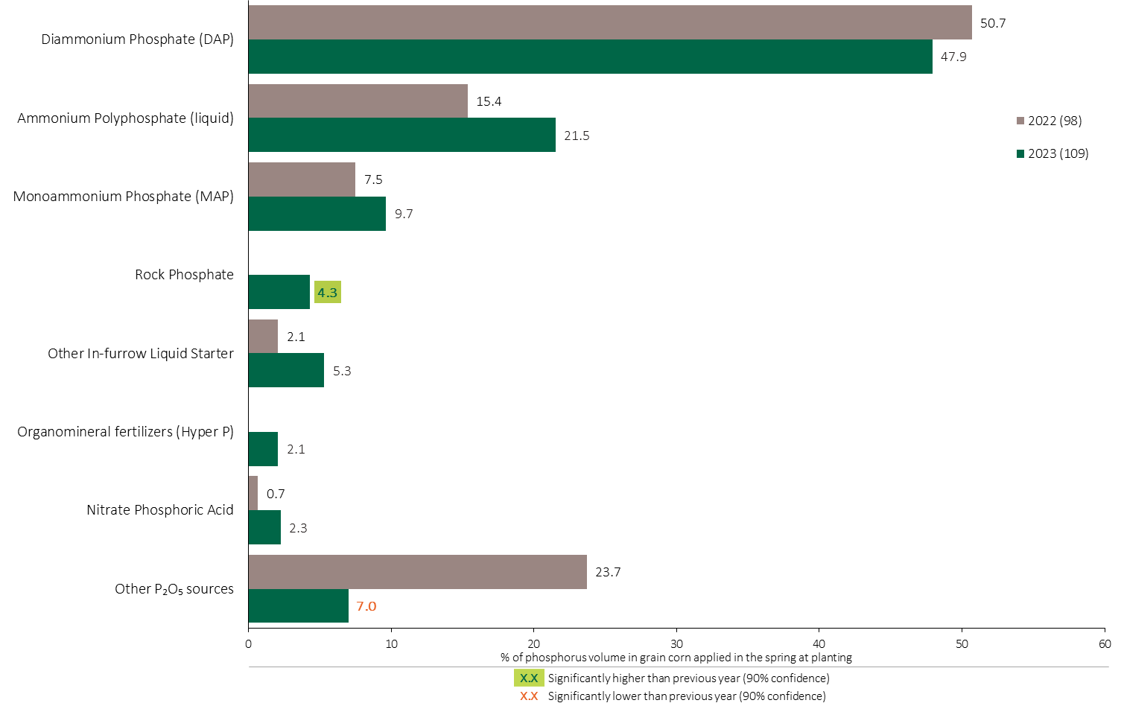
Phosphorus (P₂O₅) Fertilizer Source in Grain Corn - Spring at Planting
Grain Corn
Note: Phosphorus (P₂O₅) volume was calculated from all sources of phosphorus contained in all fertilizer types
For each fertilizer type used in either a custom blend or applied as an unblended product, respondents were asked: a) how many hectares they applied, and b) the application rate in kilograms of actual nutrient/ha. Volumes of each nutrient were calculated by multiplying hectares treated times the application rate.
The chart illustrates the % of total phosphorus (P₂O₅) volume applied in the spring at planting that was provided by each fertilizer type. The phosphorus (P₂O₅) volume was calculated from all sources of phosphorus (P₂O₅) contained in all fertilizer types.

Slide 43
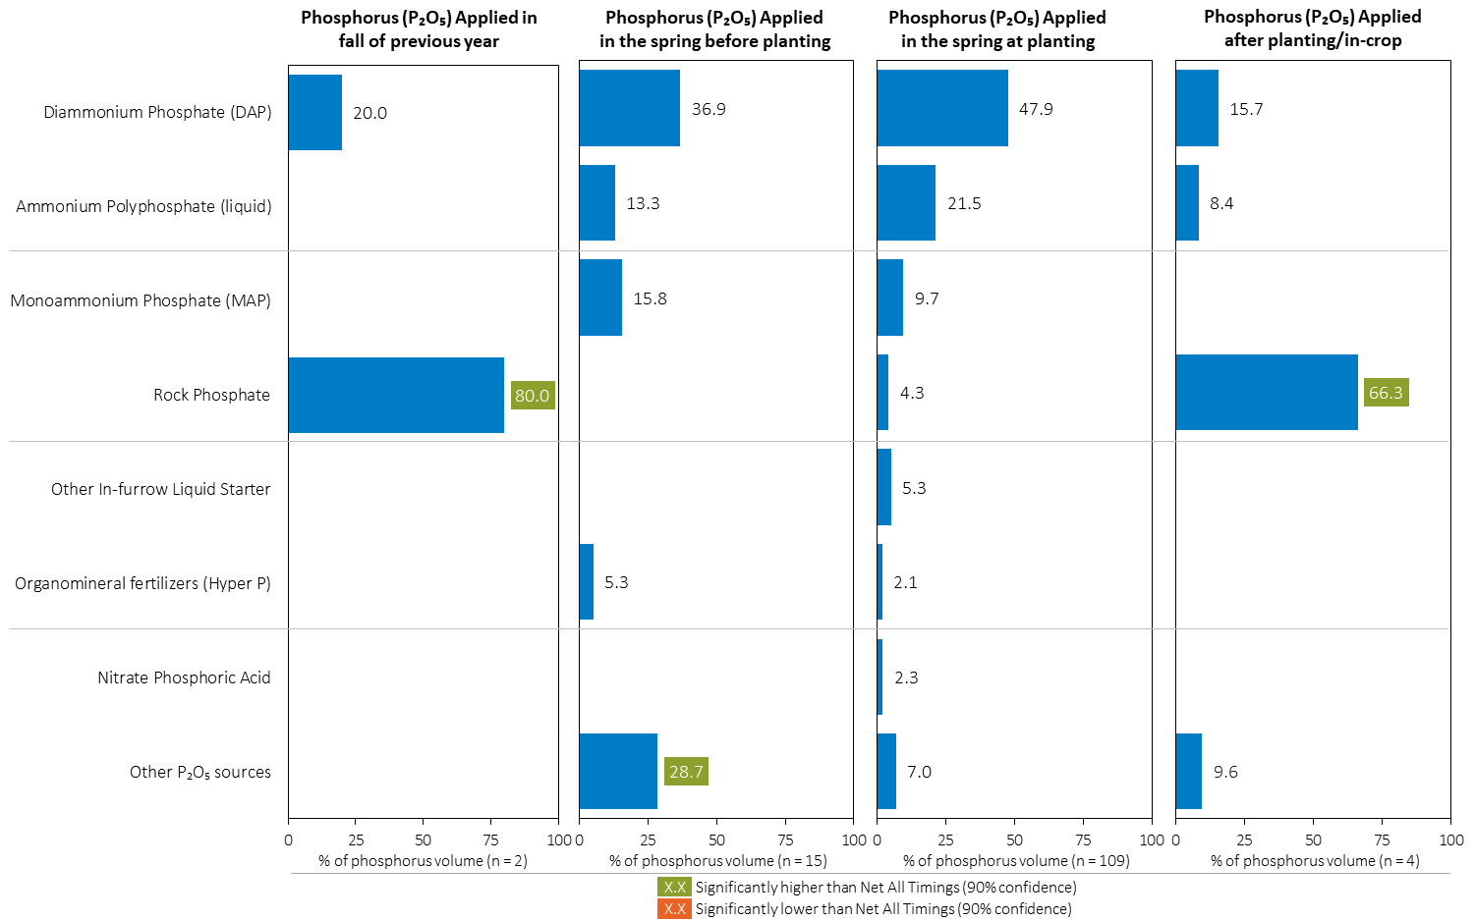
Phosphorus (P₂O₅) Fertilizer Source in Grain Corn by Timing
Grain Corn
Note: Phosphorus (P₂O₅) volume was calculated from all sources of phosphorus contained in all fertilizer types
For each fertilizer type used in either a custom blend or applied as an unblended product, respondents were asked: a) how many hectares they applied, and b) the application rate in kilograms of actual nutrient/ha. Volumes of each nutrient were calculated by multiplying hectares treated times the application rate.
Separately for each application timing, the graphs illustrate the % of total phosphorus (P₂O₅) volume applied in grain corn that came from each fertilizer source.
Total kilograms of actual phosphorus (P₂O₅) applied was calculated based on all sources of phosphorus (P₂O₅) from all fertilizer types.

Slide 44
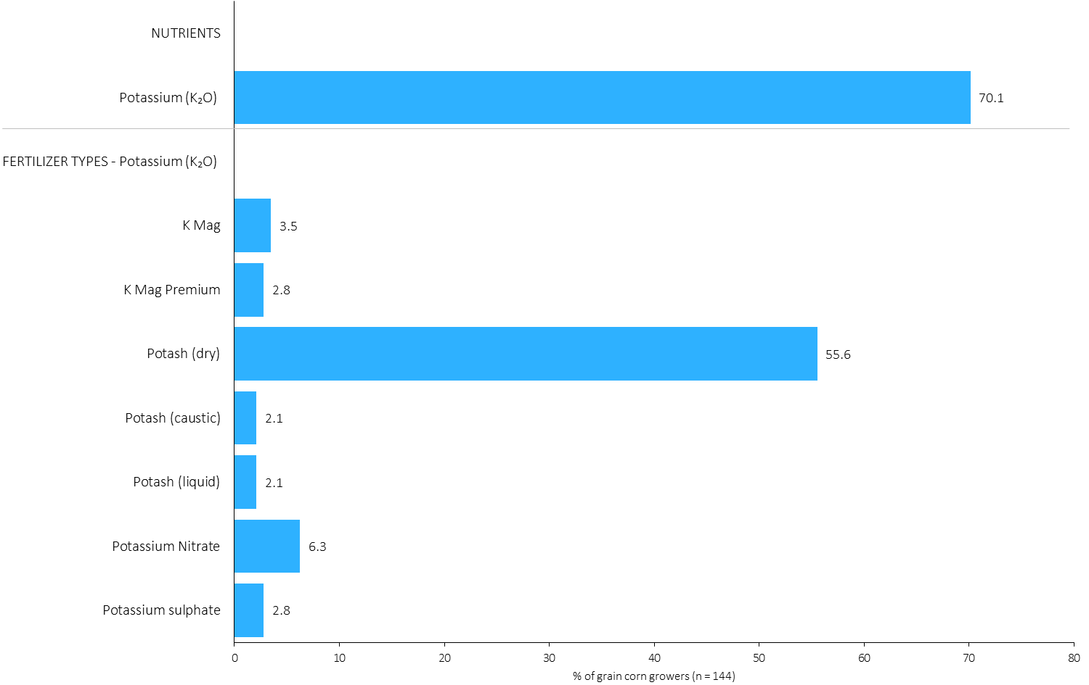
% of Grain Corn Growers Using Each Potassium (K₂O) Source in in 2023
Grain Corn
56% of grain corn growers used dry potash in 2023.
Note: Nutrients were defined based on any fertilizer type that contains the nutrient.
Respondents were asked: “For your 2023 grain corn crop, did you apply fertilizer or manure at each timing? – and given the options of a) Applied in fall of previous year, b) in the spring before planting, c) in the spring at planting and d) after planting/in-crop. For your 2023 grain corn crop, which fertilizer types did you apply at each timing?
The chart illustrates the % of grain corn growers who indicated that they used this nutrient and each fertilizer type in grain corn in 2023.
Nutrients were defined based on any fertilizer type that contains the nutrient.

Slide 45
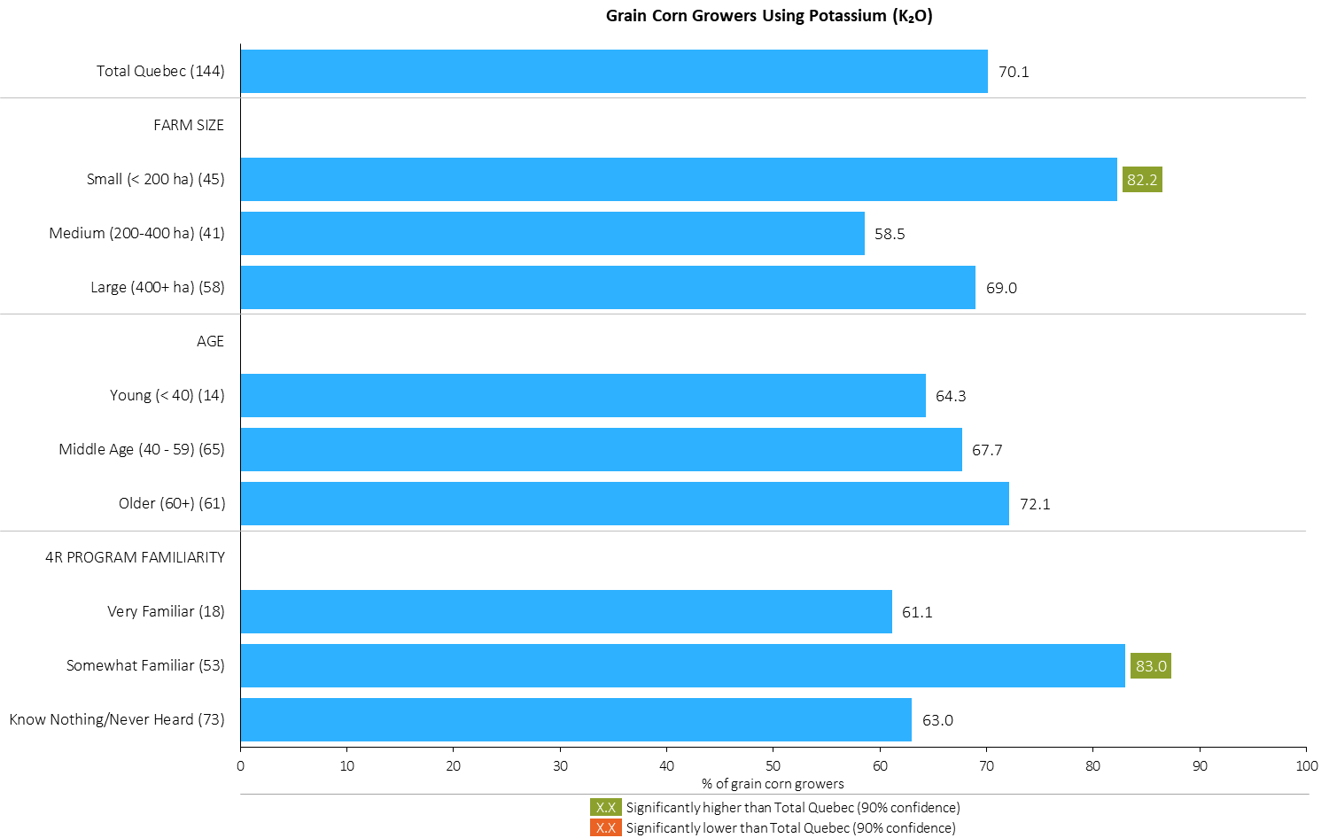
% of Grain Corn Growers Using Potassium (K₂O) in 2023
Grain Corn
Note: Nutrients were defined based on any fertilizer type that contains the nutrient.
Respondents were asked: “For your 2023 grain corn crop, did you apply fertilizer or manure at each timing? – and given the options of a) Applied in fall of previous year, b) in the spring before planting, c) in the spring at planting and d) after planting/in-crop. For your 2023 grain corn crop, which fertilizer types did you apply at each timing?
The chart illustrates the % of grain corn growers who indicated that they used this nutrient in grain corn in 2023 by farm size, age and 4R familiarity.
Nutrients were defined based on any fertilizer type that contains the nutrient.

Slide 46
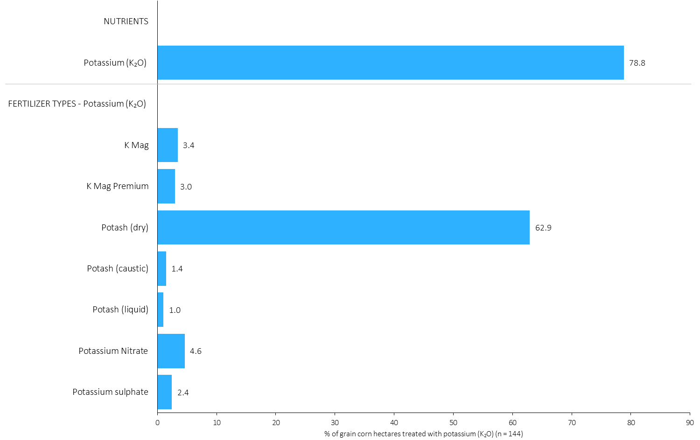
Hectares Treated With Each Potassium (K₂O) Source in Grain Corn in 2023
Grain Corn
79% of grain corn hectares received an application of potassium fertilizer.
Grain Corn Summary 
Note: Nutrients were defined based on the primary component of each fertilizer type
For each application timing, respondents were asked: “Of your [xxx] hectares of grain corn, how many hectares of each fertilizer type did you apply?”
The chart illustrates the % of total grain corn hectares that were treated with this nutrient and each fertilizer type in 2023.
Nutrients were defined based on the primary component (see adjacent fertilizer types by clicking on the “A” button).

Slide 47
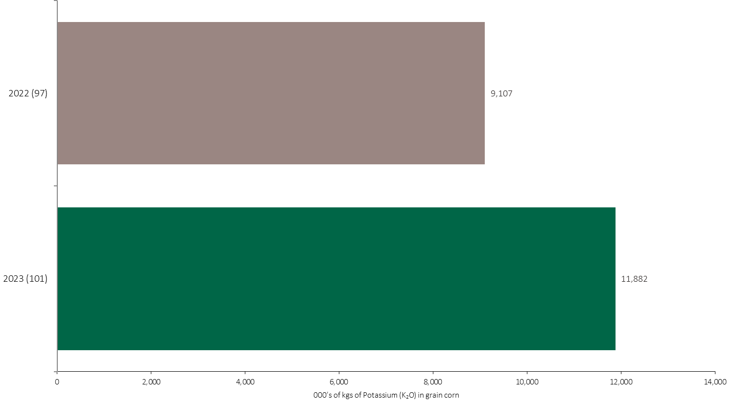
Potassium (K₂O) Volume in Grain Corn
Grain Corn
An estimated 12 million kilograms of K₂O was used in grain corn in 2023.
Note: Potassium (K₂O) volume was calculated from all sources of potassium contained in all fertilizer types
For each fertilizer type used in either a custom blend or applied as an unblended product, respondents were asked: a) how many hectares they applied, and b) the application rate in kilograms of actual nutrient/ha. Volumes of each nutrient were calculated by multiplying hectares treated times the application rate.
The chart illustrates the total potassium (K₂O) volume (000’s of kilograms) that was used in each year. The potassium (K₂O) volume was calculated from all sources of potassium (K₂O) contained in all fertilizer types.

Slide 48
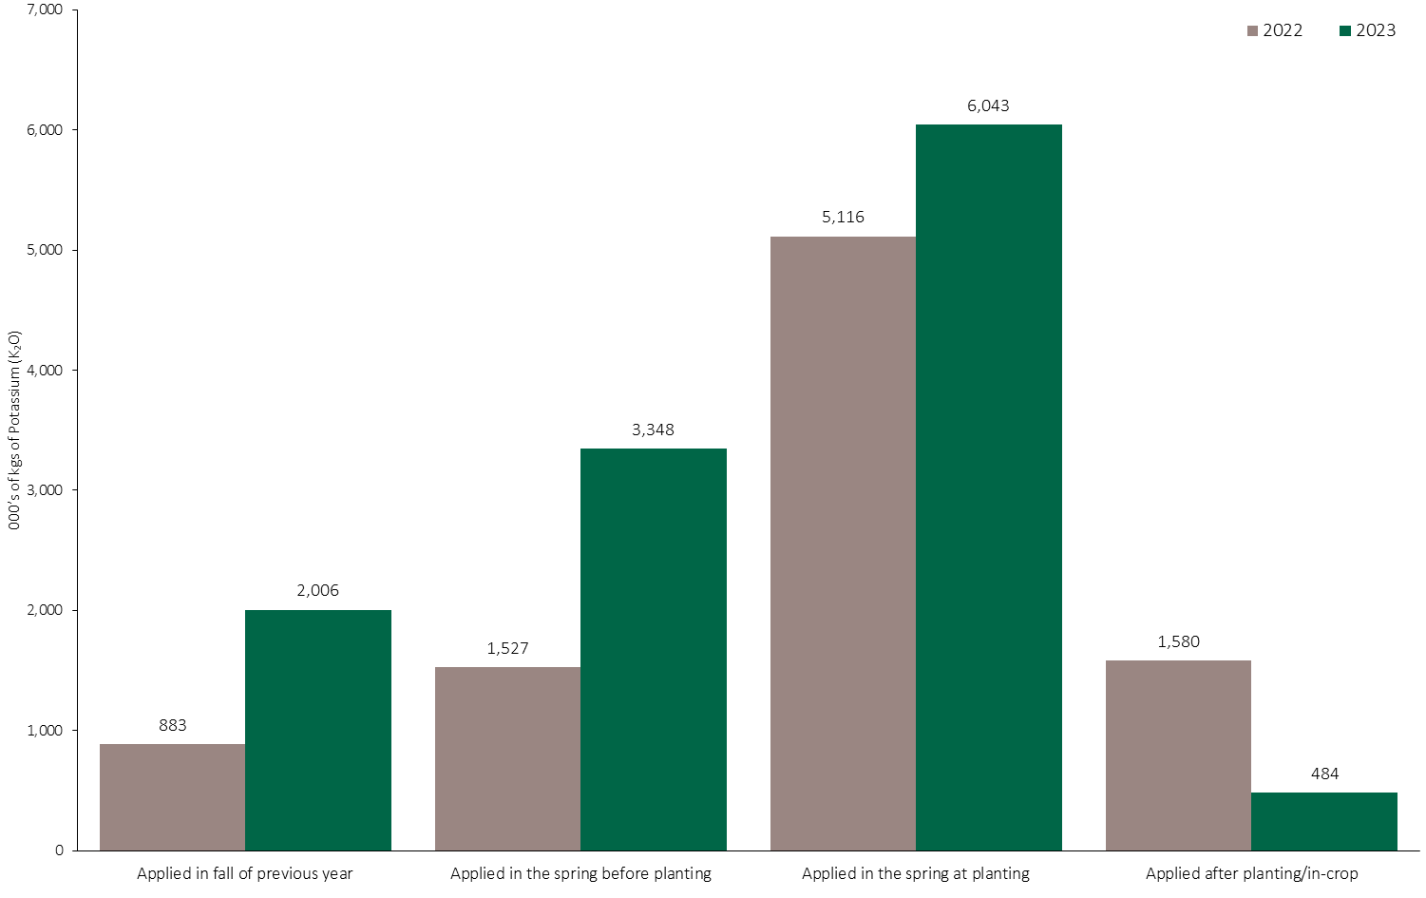
Potassium (K₂O) Volume in Grain Corn by Timing
Grain Corn
Note: Potassium (K₂O) volume was calculated from all sources of potassium contained in all fertilizer types
For each fertilizer type used in either a custom blend or applied as an unblended product, respondents were asked: a) how many hectares they applied, and b) the application rate in kilograms of actual nutrient/ha. Volumes of each nutrient were calculated by multiplying hectares treated times the application rate.
The chart illustrates the total potassium (K₂O) volume (000’s of kilograms) that was used in each year by application timing. The potassium (K₂O) volume was calculated from all sources of potassium (K₂O) contained in all fertilizer types.

Slide 49
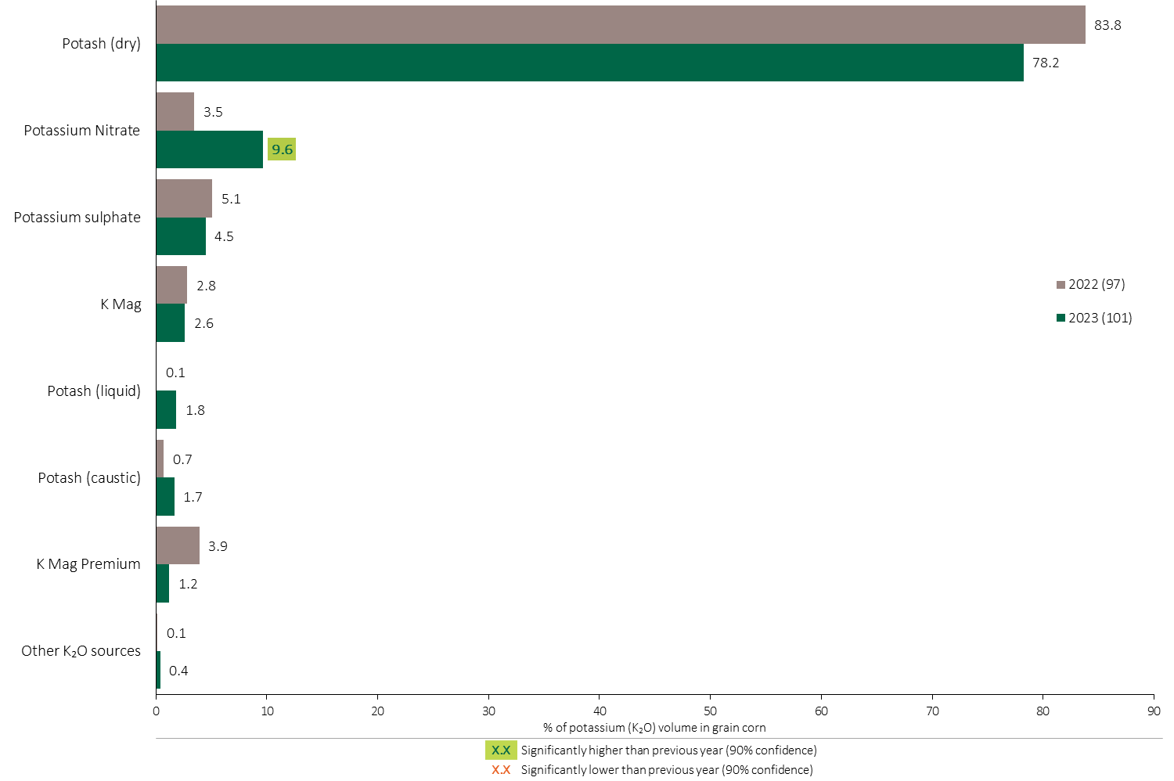
Potassium (K₂O) Fertilizer Source in Grain Corn - All Timings
78% of the total Potassium volume was applied as dry Potash.
Grain Corn
A higher volume of Potassium Nitrate was applied in grain corn in 2023.
Grain Corn Summary 
Note: Potassium (K₂O) volume was calculated from all sources of potassium contained in all fertilizer types
For each fertilizer type used in either a custom blend or applied as an unblended product, respondents were asked: a) how many hectares they applied, and b) the application rate in kilograms of actual nutrient/ha. Volumes of each nutrient were calculated by multiplying hectares treated times the application rate.
The chart illustrates the % of total potassium (K₂O) volume applied at all timings that was provided by each fertilizer type. The potassium (K₂O) volume was calculated from all sources of potassium (K₂O) contained in all fertilizer types.

Slide 50
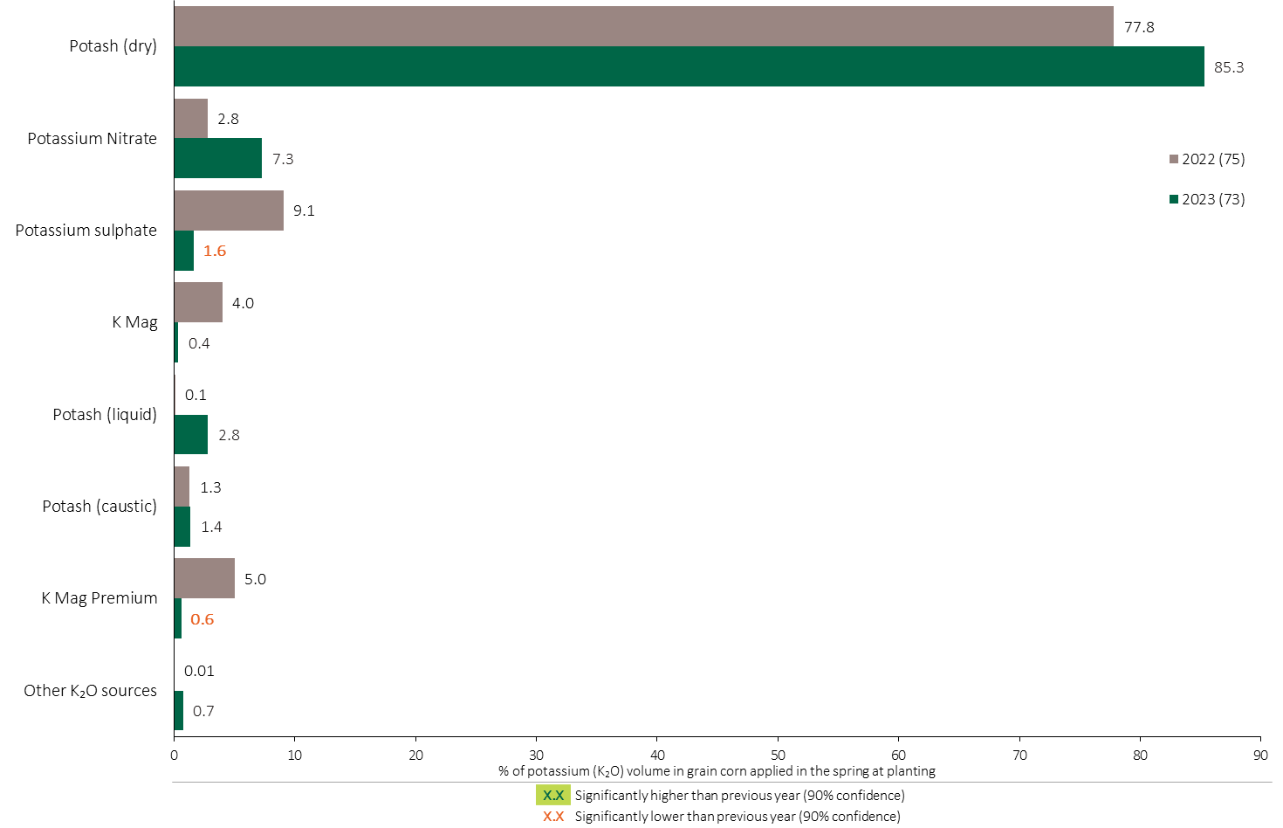
Potassium (K₂O) Fertilizer Source in Grain Corn - Spring at Planting
Grain Corn
Note: Potassium (K₂O) volume was calculated from all sources of potassium contained in all fertilizer types
For each fertilizer type used in either a custom blend or applied as an unblended product, respondents were asked: a) how many hectares they applied, and b) the application rate in kilograms of actual nutrient/ha. Volumes of each nutrient were calculated by multiplying hectares treated times the application rate.
The chart illustrates the % of total potassium (K₂O) volume applied in the spring at planting that was provided by each fertilizer type. The potassium (K₂O) volume was calculated from all sources of potassium (K₂O) contained in all fertilizer types.

Slide 51
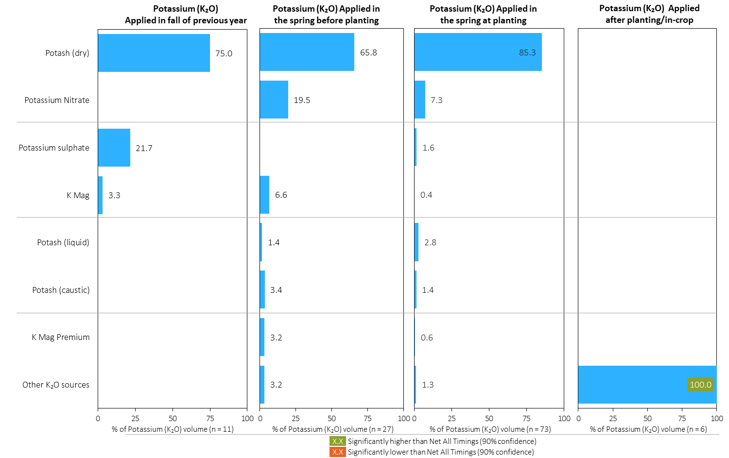
Potassium (K₂O) Fertilizer Source in Grain Corn by Timing
Grain Corn
Note: Potassium (K₂O) volume was calculated from all sources of potassium contained in all fertilizer types
For each fertilizer type used in either a custom blend or applied as an unblended product, respondents were asked: a) how many hectares they applied, and b) the application rate in kilograms of actual nutrient/ha. Volumes of each nutrient were calculated by multiplying hectares treated times the application rate.
Separately for each application timing, the graphs illustrate the % of total potassium (K₂O) volume applied in grain corn that came from each fertilizer source.
Total kilograms of actual potassium (K₂O) applied was calculated based on all sources of potassium (K₂O) from all fertilizer types.

Slide 52
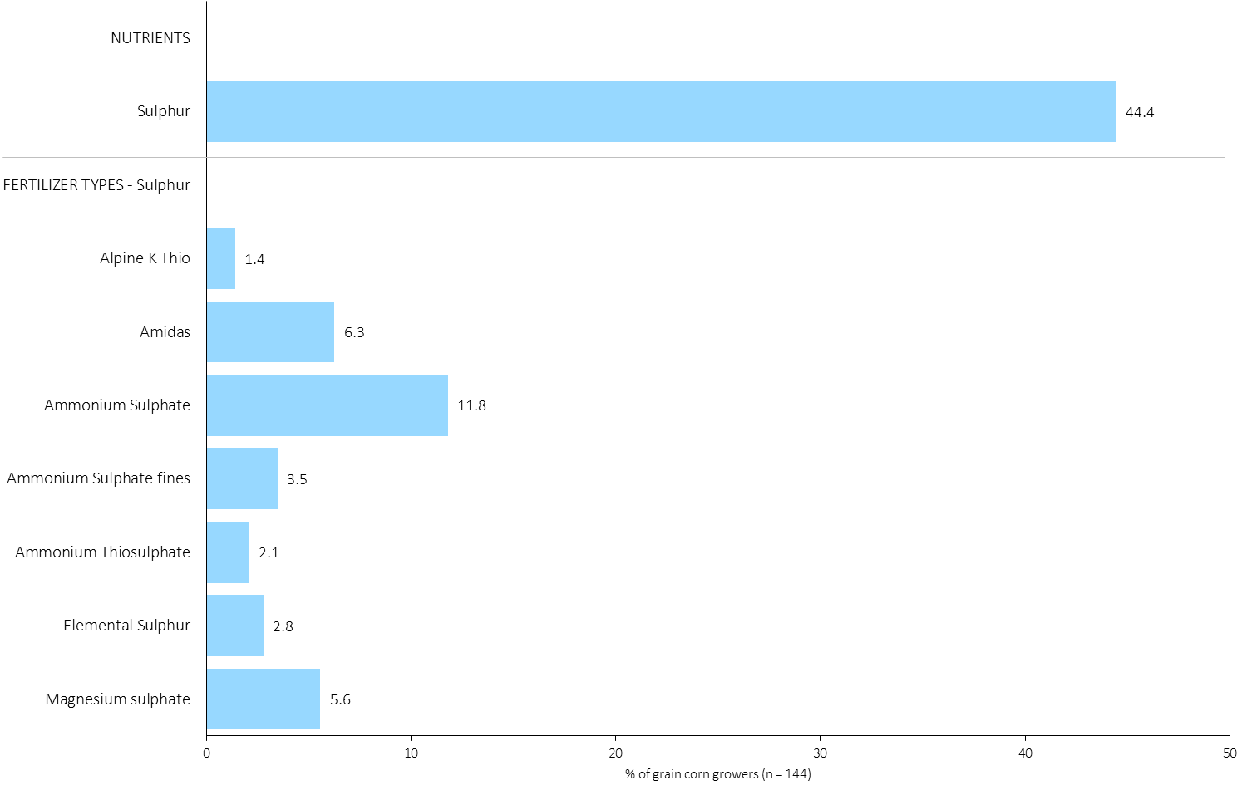
% of Grain Corn Growers Using Each Sulphur Source in in 2023
Grain Corn
44% of grain corn growers used a Sulphur fertilizer in 2023.
Note: Nutrients were defined based on any fertilizer type that contains the nutrient.
Respondents were asked: “For your 2023 grain corn crop, did you apply fertilizer or manure at each timing? – and given the options of a) Applied in fall of previous year, b) in the spring before planting, c) in the spring at planting and d) after planting/in-crop. For your 2023 grain corn crop, which fertilizer types did you apply at each timing?
The chart illustrates the % of grain corn growers who indicated that they used this nutrient and each fertilizer type in grain corn in 2023.
Nutrients were defined based on any fertilizer type that contains the nutrient.

Slide 53
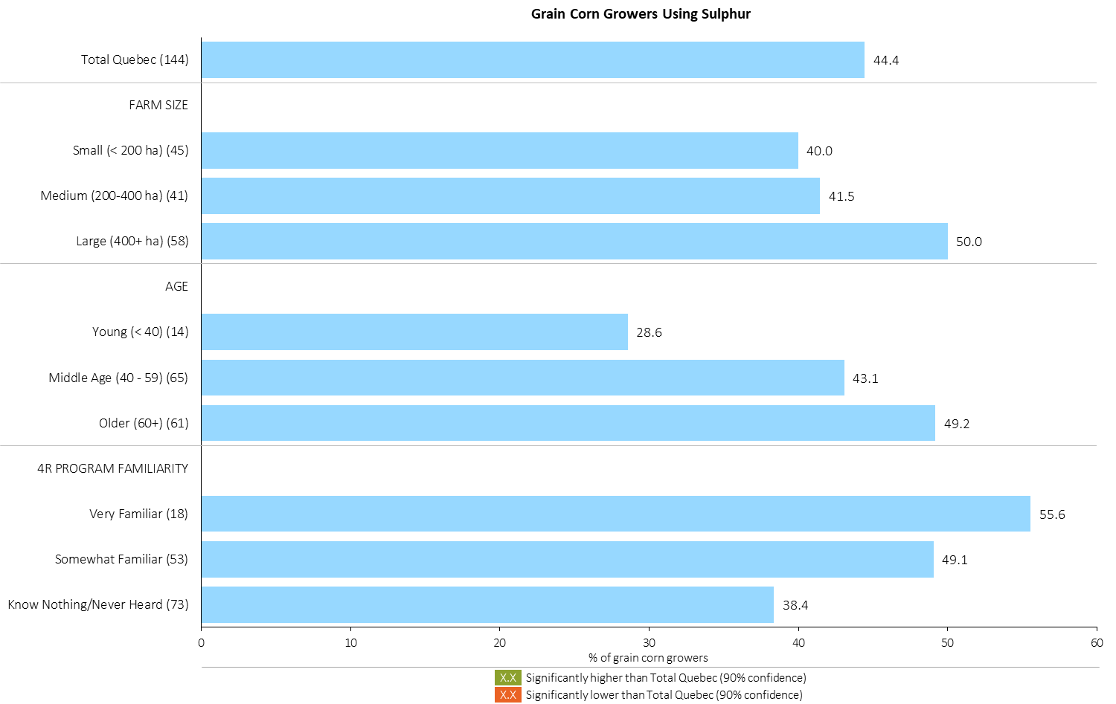
% of Grain Corn Growers Using Sulphur in 2023
Grain Corn
Note: Nutrients were defined based on any fertilizer type that contains the nutrient.
Respondents were asked: “For your 2023 grain corn crop, did you apply fertilizer or manure at each timing? – and given the options of a) Applied in fall of previous year, b) in the spring before planting, c) in the spring at planting and d) after planting/in-crop. For your 2023 grain corn crop, which fertilizer types did you apply at each timing?
The chart illustrates the % of grain corn growers who indicated that they used this nutrient in grain corn in 2023 by farm size, age and 4R familiarity.
Nutrients were defined based on any fertilizer type that contains the nutrient.

Slide 54
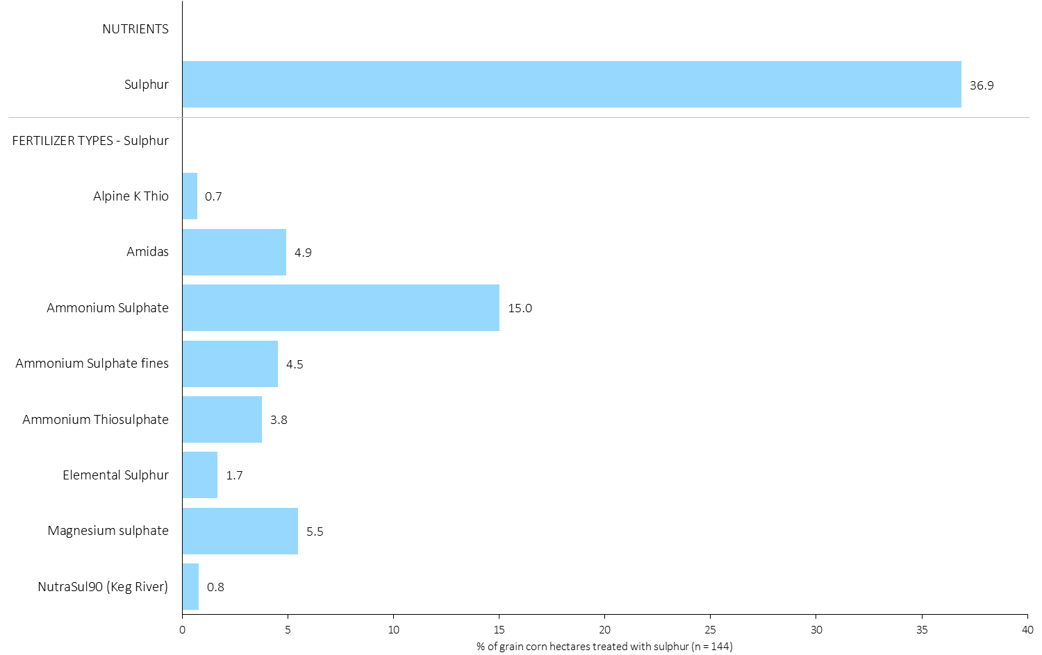
Hectares Treated With Each Sulphur Source in Grain Corn in 2023
Grain Corn
About 37% of grain corn hectares were treated with a Sulphur fertilizer in 2023.
Grain Corn Summary 
Note: Nutrients were defined based on the primary component of each fertilizer type
For each application timing, respondents were asked: “Of your [xxx] hectares of grain corn, how many hectares of each fertilizer type did you apply?”
The chart illustrates the % of total grain corn hectares that were treated with this nutrient and each fertilizer type in 2023.
Nutrients were defined based on the primary component (see adjacent fertilizer types by clicking on the “A” button).

Slide 55

Sulphur Volume in Grain Corn
Grain Corn
An estimated 2.6 million kilograms of Sulphur was used in grain corn in 2023.
Note: Sulphur volume was calculated from all sources of sulphur contained in all fertilizer types
For each fertilizer type used in either a custom blend or applied as an unblended product, respondents were asked: a) how many hectares they applied, and b) the application rate in kilograms of actual nutrient/ha. Volumes of each nutrient were calculated by multiplying hectares treated times the application rate.
The chart illustrates the total sulphur volume (000’s of kilograms) that was used in each year. The sulphur volume was calculated from all sources of sulphur contained in all fertilizer types.

Slide 56

Sulphur Volume in Grain Corn by Timing
Grain Corn
Note: Sulphur volume was calculated from all sources of sulphur contained in all fertilizer types
For each fertilizer type used in either a custom blend or applied as an unblended product, respondents were asked: a) how many hectares they applied, and b) the application rate in kilograms of actual nutrient/ha. Volumes of each nutrient were calculated by multiplying hectares treated times the application rate.
The chart illustrates the total sulphur volume (000’s of kilograms) that was used in each year by application timing. The sulphur volume was calculated from all sources of sulphur contained in all fertilizer types.

Slide 57

Sulphur Fertilizer Source in Grain Corn - All Timings
21% of total Sulphur volume was applied as Ammonium sulphate in grain corn.
Grain Corn
Grain Corn Summary 
Note: Sulphur volume was calculated from all sources of sulphur contained in all fertilizer types
For each fertilizer type used in either a custom blend or applied as an unblended product, respondents were asked: a) how many hectares they applied, and b) the application rate in kilograms of actual nutrient/ha. Volumes of each nutrient were calculated by multiplying hectares treated times the application rate.
The chart illustrates the % of total sulphur volume applied at all timings that was provided by each fertilizer type. The sulphur volume was calculated from all sources of sulphur contained in all fertilizer types.

Slide 58

Sulphur Fertilizer Source in Grain Corn - Spring at Planting
Grain Corn
Note: Sulphur volume was calculated from all sources of sulphur contained in all fertilizer types
For each fertilizer type used in either a custom blend or applied as an unblended product, respondents were asked: a) how many hectares they applied, and b) the application rate in kilograms of actual nutrient/ha. Volumes of each nutrient were calculated by multiplying hectares treated times the application rate.
The chart illustrates the % of total sulphur volume applied in the spring at planting that was provided by each fertilizer type. The sulphur volume was calculated from all sources of sulphur contained in all fertilizer types.

Slide 59

Sulphur Fertilizer Source in Grain Corn by Timing
Grain Corn
Note: Sulphur volume was calculated from all sources of sulphur contained in all fertilizer types
For each fertilizer type used in either a custom blend or applied as an unblended product, respondents were asked: a) how many hectares they applied, and b) the application rate in kilograms of actual nutrient/ha. Volumes of each nutrient were calculated by multiplying hectares treated times the application rate.
Separately for each application timing, the graphs illustrate the % of total sulphur volume applied in grain corn that came from each fertilizer source.
Total kilograms of actual sulphur applied was calculated based on all sources of sulphur from all fertilizer types.

Slide 60

Nitrogen Placement in Grain Corn - % of Crop Area
Grain Corn
Note: Nutrients were defined based on the primary component of each fertilizer type
For each application timing, respondents were asked: “Of your [xxx] hectares of grain corn, how many hectares of each fertilizer type did you apply?”
Separately for each nutrient, the chart illustrates the % of total grain corn hectares that was applied using each placement at each timing.
Nutrients were defined based on the primary component (see adjacent fertilizer types by clicking on the “A” button).

Slide 61

Nitrogen Placement in Grain Corn - % Nutrient Volume Applied at All Timings
Grain Corn
Grain Corn Summary 
Note: Nutrient volume was calculated from all sources of the nutrient contained in all fertilizer types
For each fertilizer type used in either a custom blend or applied as an unblended product, respondents were asked: a) how many hectares they applied, and b) the application rate in kilograms of actual nutrient/ha. Volumes of each nutrient were calculated by multiplying hectares treated times the application rate.
The graph illustrates the % of total nutrient volume applied in grain corn that was applied at each timing/placement (i.e. across all timings, the sum of percentages = 100%).
Total kilograms of actual nutrient applied was calculated based on all sources of the nutrient from all fertilizer types.

Slide 62

Phosphorus (P₂O₅) Placement in Grain Corn - % of Crop Area
Grain Corn
Note: Nutrients were defined based on the primary component of each fertilizer type
For each application timing, respondents were asked: “Of your [xxx] hectares of grain corn, how many hectares of each fertilizer type did you apply?”
Separately for each nutrient, the chart illustrates the % of total grain corn hectares that was applied using each placement at each timing.
Nutrients were defined based on the primary component (see adjacent fertilizer types by clicking on the “A” button).

Slide 63

Phosphorus (P₂O₅) Placement in Grain Corn - % Nutrient Volume Applied at All Timings
Grain Corn
Grain Corn Summary 
Note: Nutrient volume was calculated from all sources of the nutrient contained in all fertilizer types
For each fertilizer type used in either a custom blend or applied as an unblended product, respondents were asked: a) how many hectares they applied, and b) the application rate in kilograms of actual nutrient/ha. Volumes of each nutrient were calculated by multiplying hectares treated times the application rate.
The graph illustrates the % of total nutrient volume applied in grain corn that was applied at each timing/placement (i.e. across all timings, the sum of percentages = 100%).
Total kilograms of actual nutrient applied was calculated based on all sources of the nutrient from all fertilizer types.

Slide 64

Potassium (K₂O) Placement in Grain Corn - % of Crop Area
Grain Corn
Note: Nutrients were defined based on the primary component of each fertilizer type
For each application timing, respondents were asked: “Of your [xxx] hectares of grain corn, how many hectares of each fertilizer type did you apply?”
Separately for each nutrient, the chart illustrates the % of total grain corn hectares that was applied using each placement at each timing.
Nutrients were defined based on the primary component (see adjacent fertilizer types by clicking on the “A” button).

Slide 65

Potassium (K₂O) Placement in Grain Corn - % Nutrient Volume Applied at All Timings
Grain Corn
Grain Corn Summary 
Note: Nutrient volume was calculated from all sources of the nutrient contained in all fertilizer types
For each fertilizer type used in either a custom blend or applied as an unblended product, respondents were asked: a) how many hectares they applied, and b) the application rate in kilograms of actual nutrient/ha. Volumes of each nutrient were calculated by multiplying hectares treated times the application rate.
The graph illustrates the % of total nutrient volume applied in grain corn that was applied at each timing/placement (i.e. across all timings, the sum of percentages = 100%).
Total kilograms of actual nutrient applied was calculated based on all sources of the nutrient from all fertilizer types.

Slide 66

Sulphur Placement in Grain Corn - % of Crop Area
Grain Corn
Note: Nutrients were defined based on the primary component of each fertilizer type
For each application timing, respondents were asked: “Of your [xxx] hectares of grain corn, how many hectares of each fertilizer type did you apply?”
Separately for each nutrient, the chart illustrates the % of total grain corn hectares that was applied using each placement at each timing.
Nutrients were defined based on the primary component (see adjacent fertilizer types by clicking on the “A” button).

Slide 67

Sulphur Placement in Grain Corn - % Nutrient Volume Applied at All Timings
Grain Corn
Grain Corn Summary 
Note: Nutrient volume was calculated from all sources of the nutrient contained in all fertilizer types
For each fertilizer type used in either a custom blend or applied as an unblended product, respondents were asked: a) how many hectares they applied, and b) the application rate in kilograms of actual nutrient/ha. Volumes of each nutrient were calculated by multiplying hectares treated times the application rate.
The graph illustrates the % of total nutrient volume applied in grain corn that was applied at each timing/placement (i.e. across all timings, the sum of percentages = 100%).
Total kilograms of actual nutrient applied was calculated based on all sources of the nutrient from all fertilizer types.

Slide 68

Average Nitrogen Rates in Grain Corn
Nitrogen rates were similar in 2023 compared to 2022.
Grain Corn
Grain Corn Summary 
Note: Nitrogen volume was calculated from all sources of nitrogen contained in all fertilizer types
Note: Rates include growers who did not apply any nitrogen
For each fertilizer type used in either a custom blend or applied as an unblended product, respondents were asked: a) how many hectares they applied, and b) the application rate in kilograms of actual nutrient/ha. Volumes of each nutrient were calculated by multiplying hectares treated times the application rate.
The chart illustrates the average rate of nitrogen applied in each year expressed in kilograms of actual nitrogen per hectare.

Slide 69

Nitrogen Rates in Grain Corn - Average Rate in 2023
Grain Corn
Grain Corn Summary 
Note: Nitrogen volume was calculated from all sources of nitrogen contained in all fertilizer types
Note: Rates include growers who did not apply any nitrogen
For each fertilizer type used in either a custom blend or applied as an unblended product, respondents were asked: a) how many hectares they applied, and b) the application rate in kilograms of actual nutrient/ha. Volumes of each nutrient were calculated by multiplying hectares treated times the application rate.
Separately by farm size, age and 4R familiarity, the graph illustrates the average nitrogen application rate in kilograms of nitrogen per hectare (including untreated grain corn hectares).

Slide 70

Nitrogen Rates in Grain Corn - Rate Ranges in 2023
Grain Corn
Note: Nitrogen volume was calculated from all sources of nitrogen contained in all fertilizer types
For each fertilizer type used in either a custom blend or applied as an unblended product, respondents were asked: a) how many hectares they applied, and b) the application rate in kilograms of actual nutrient/ha. Volumes of each nutrient were calculated by multiplying hectares treated times the application rate.
The graph on the left illustrates the % of grain corn hectares that were treated with nitrogen at an application rate that fell within each rate range. The graph on the right illustrates the cumulative % of grain corn hectares that were treated with nitrogen at an application rate that fell within each rate range.

Slide 71

Nitrogen Rate Ranges in Grain Corn - % of Volume in 2023
Grain Corn
65% of the N volume was applied between 160 – 239.9 kg/ha
Note: Nitrogen volume was calculated from all sources of nitrogen contained in all fertilizer types
For each fertilizer type used in either a custom blend or applied as an unblended product, respondents were asked: a) how many hectares they applied, and b) the application rate in kilograms of actual nutrient/ha. Volumes of each nutrient were calculated by multiplying hectares treated times the application rate.
The chart illustrates the % of nitrogen volume that was applied in grain corn within each rate range.
Total kilograms of actual nitrogen applied was calculated based on all sources of nitrogen from all fertilizer types.

Slide 72

Average Nitrogen Rates in Grain Corn - By Timing
Grain Corn
Grain Corn Summary 
Nitrogen rates at planting were 71 kg/ha in 2023.
Note: Nitrogen volume was calculated from all sources of nitrogen contained in all fertilizer types
Note: Rates exclude growers who did not apply any nitrogen
For each fertilizer type used in either a custom blend or applied as an unblended product, respondents were asked: a) how many hectares they applied, and b) the application rate in kilograms of actual nutrient/ha. Volumes of each nutrient were calculated by multiplying hectares treated times the application rate.
The chart illustrates the average rate of Nitrogen applied at each application timing in each year expressed in kilograms of actual Nitrogen per hectare.
Note: Rates exclude non-users of Nitrogen.

Slide 73

Average Phosphorus (P₂O₅) Rates in Grain Corn
Phosphorous rates were slightly higher in 2023.
Grain Corn
Grain Corn Summary 
Note: Phosphorus (P₂O₅) volume was calculated from all sources of phosphorus contained in all fertilizer types
Note: Rates include growers who did not apply any phosphorus
For each fertilizer type used in either a custom blend or applied as an unblended product, respondents were asked: a) how many hectares they applied, and b) the application rate in kilograms of actual nutrient/ha. Volumes of each nutrient were calculated by multiplying hectares treated times the application rate.
The chart illustrates the average rate of Phosphorus (P₂O₅) applied in each year expressed in kilograms of actual Phosphorus (P₂O₅) per hectare.
Note: Rates include non-users of Phosphorus (P₂O₅).

Slide 74

Phosphorus (P₂O₅) Rates in Grain Corn - Average Rate in 2023
Grain Corn
Grain Corn Summary 
Younger farmers tend to use slightly higher P₂O₅ rates.
Note: Phosphorus (P₂O₅) volume was calculated from all sources of phosphorus contained in all fertilizer types
Note: Rates include growers who did not apply any phosphorus
For each fertilizer type used in either a custom blend or applied as an unblended product, respondents were asked: a) how many hectares they applied, and b) the application rate in kilograms of actual nutrient/ha. Volumes of each nutrient were calculated by multiplying hectares treated times the application rate.
Separately by farm size, age and 4R familiarity, the graph illustrates the average Phosphorus (P₂O₅) application rate in kilograms of Phosphorus (P₂O₅) per hectare (including untreated grain corn hectares).

Slide 75

Phosphorus (P₂O₅) Rates in Grain Corn - Rate Ranges in 2023
Grain Corn
Note: Phosphorus (P₂O₅) volume was calculated from all sources of phosphorus contained in all fertilizer types
For each fertilizer type used in either a custom blend or applied as an unblended product, respondents were asked: a) how many hectares they applied, and b) the application rate in kilograms of actual nutrient/ha. Volumes of each nutrient were calculated by multiplying hectares treated times the application rate.
The graph on the left illustrates the % of grain corn hectares that were treated with phosphorus (P₂O₅) at an application rate that fell within each rate range. The graph on the right illustrates the cumulative % of grain corn hectares that were treated with phosphorus (P₂O₅) at an application rate that fell within each rate range.

Slide 76

Phosphorus (P₂O₅) Rate Ranges in Grain Corn - % of Volume in 2023
Grain Corn
66% of the P₂O₅ volume was applied between 40 – 69.9 lbs./ac.
Note: Phosphorus (P₂O₅) volume was calculated from all sources of phosphorus contained in all fertilizer types
For each fertilizer type used in either a custom blend or applied as an unblended product, respondents were asked: a) how many hectares they applied, and b) the application rate in kilograms of actual nutrient/ha. Volumes of each nutrient were calculated by multiplying hectares treated times the application rate.
The chart illustrates the % of phosphorus (P₂O₅) volume that was applied in grain corn within each rate range.
Total kilograms of actual phosphorus (P₂O₅) applied was calculated based on all sources of phosphorus (P₂O₅) from all fertilizer types.

Slide 77

Average Phosphorus (P₂O₅) Rates in Grain Corn - By Timing
Grain Corn
Grain Corn Summary 
Note: Phosphorus (P₂O₅) volume was calculated from all sources of phosphorus contained in all fertilizer types
Note: Rates exclude growers who did not apply any phosphorus
For each fertilizer type used in either a custom blend or applied as an unblended product, respondents were asked: a) how many hectares they applied, and b) the application rate in kilograms of actual nutrient/ha. Volumes of each nutrient were calculated by multiplying hectares treated times the application rate.
The chart illustrates the average rate of Phosphorus (P₂O₅) applied at each application timing in each year expressed in kilograms of actual Phosphorus (P₂O₅) per hectare.
Note: Rates exclude non-users of Phosphorus (P₂O₅).

Slide 78

Average Potassium (K₂O) Rates in Grain Corn
Potassium rates were slightly higher in 2023.
Grain Corn
Grain Corn Summary 
Note: Potassium (K₂O) volume was calculated from all sources of potassium contained in all fertilizer types
Note: Rates include growers who did not apply any potassium
For each fertilizer type used in either a custom blend or applied as an unblended product, respondents were asked: a) how many hectares they applied, and b) the application rate in kilograms of actual nutrient/ha. Volumes of each nutrient were calculated by multiplying hectares treated times the application rate.
The chart illustrates the average rate of Potassium (K₂O) applied in each year expressed in kilograms of actual Potassium (K₂O) per hectare.
Note: Rates include non-users of Potassium (K₂O).

Slide 79

Potassium (K₂O) Rates in Grain Corn - Average Rate in 2023
Grain Corn
Small farms were more likely to apply higher rates of Potassium.
Grain Corn Summary 
Middle Aged growers were more likely to apply lower rates of Potassium.
Note: Potassium (K₂O) volume was calculated from all sources of potassium contained in all fertilizer types
Note: Rates include growers who did not apply any potassium
For each fertilizer type used in either a custom blend or applied as an unblended product, respondents were asked: a) how many hectares they applied, and b) the application rate in kilograms of actual nutrient/ha. Volumes of each nutrient were calculated by multiplying hectares treated times the application rate.
Separately by farm size, age and 4R familiarity, the graph illustrates the average Potassium (K₂O) application rate in kilograms of Potassium (K₂O) per hectare (including untreated grain corn hectares).

Slide 80

Potassium (K₂O) Rates in Grain Corn - Rate Ranges in 2023
Grain Corn
Grain Corn Summary 
Note: Potassium (K₂O) volume was calculated from all sources of potassium contained in all fertilizer types
For each fertilizer type used in either a custom blend or applied as an unblended product, respondents were asked: a) how many hectares they applied, and b) the application rate in kilograms of actual nutrient/ha. Volumes of each nutrient were calculated by multiplying hectares treated times the application rate.
The graph on the left illustrates the % of grain corn hectares that were treated with potassium (K₂O) at an application rate that fell within each rate range. The graph on the right illustrates the cumulative % of grain corn hectares that were treated with potassium (K₂O) at an application rate that fell within each rate range.

Slide 81

Potassium (K₂O) Rate Ranges in Grain Corn - % of Volume in 2023
Grain Corn
35% of the potassium volume was applied between 50 to 59.9 kg/ha.
Note: Potassium (K₂O) volume was calculated from all sources of potassium contained in all fertilizer types
For each fertilizer type used in either a custom blend or applied as an unblended product, respondents were asked: a) how many hectares they applied, and b) the application rate in kilograms of actual nutrient/ha. Volumes of each nutrient were calculated by multiplying hectares treated times the application rate.
The chart illustrates the % of potassium (K₂O) volume that was applied in grain corn within each rate range.
Total kilograms of actual potassium (K₂O) applied was calculated based on all sources of potassium (K₂O) from all fertilizer types.

Slide 82

Average Potassium (K₂O) Rates in Grain Corn - By Timing
Grain Corn
Note: Potassium (K₂O) volume was calculated from all sources of potassium contained in all fertilizer types
Note: Rates exclude growers who did not apply any potassium
For each fertilizer type used in either a custom blend or applied as an unblended product, respondents were asked: a) how many hectares they applied, and b) the application rate in kilograms of actual nutrient/ha. Volumes of each nutrient were calculated by multiplying hectares treated times the application rate.
The chart illustrates the average rate of Potassium (K₂O) applied at each application timing in each year expressed in kilograms of actual Potassium (K₂O) per hectare.
Note: Rates exclude non-users of Potassium (K₂O).

Slide 83

Average Sulphur Rates in Grain Corn
Sulphur rates were down very slightly in 2023.
Grain Corn
Grain Corn Summary 
Note: Sulphur volume was calculated from all sources of sulphur contained in all fertilizer types
For each fertilizer type used in either a custom blend or applied as an unblended product, respondents were asked: a) how many hectares they applied, and b) the application rate in kilograms of actual nutrient/ha. Volumes of each nutrient were calculated by multiplying hectares treated times the application rate.
The chart illustrates the average rate of Sulphur applied in each year expressed in kilograms of actual Sulphur per hectare.
Note: Rates include non-users of Sulphur.

Slide 84

Sulphur Rates in Grain Corn - Average Rate in 2023
Grain Corn
Grain Corn Summary 
Note: Sulphur volume was calculated from all sources of sulphur contained in all fertilizer types
For each fertilizer type used in either a custom blend or applied as an unblended product, respondents were asked: a) how many hectares they applied, and b) the application rate in kilograms of actual nutrient/ha. Volumes of each nutrient were calculated by multiplying hectares treated times the application rate.
Separately by farm size, age and 4R familiarity, the graph illustrates the average sulphur application rate in kilograms of sulphur per hectare (including untreated grain corn hectares).

Slide 85

Sulphur Rates in Grain Corn - Rate Ranges in 2023
Grain Corn
Grain Corn Summary 
Note: Sulphur volume was calculated from all sources of sulphur contained in all fertilizer types
For each fertilizer type used in either a custom blend or applied as an unblended product, respondents were asked: a) how many hectares they applied, and b) the application rate in kilograms of actual nutrient/ha. Volumes of each nutrient were calculated by multiplying hectares treated times the application rate.
The graph on the left illustrates the % of grain corn hectares that were treated with sulphur at an application rate that fell within each rate range. The graph on the right illustrates the cumulative % of grain corn hectares that were treated with sulphur at an application rate that fell within each rate range.

Slide 86

Sulphur Rate Ranges in Grain Corn - % of Volume in 2023
Grain Corn
34% of the S volume was applied between 20 – 29.9 lbs./ac.
Note: Sulphur volume was calculated from all sources of sulphur contained in all fertilizer types
For each fertilizer type used in either a custom blend or applied as an unblended product, respondents were asked: a) how many hectares they applied, and b) the application rate in kilograms of actual nutrient/ha. Volumes of each nutrient were calculated by multiplying hectares treated times the application rate.
The chart illustrates the % of sulphur volume that was applied in grain corn within each rate range.
Total kilograms of actual sulphur applied was calculated based on all sources of sulphur nutrient from all fertilizer types.

Slide 87

Average Sulphur Rates in Grain Corn - By Timing
Grain Corn
Note: Sulphur volume was calculated from all sources of sulphur contained in all fertilizer types
Note: Rates exclude growers who did not apply any sulphur
For each fertilizer type used in either a custom blend or applied as an unblended product, respondents were asked: a) how many hectares they applied, and b) the application rate in kilograms of actual nutrient/ha. Volumes of each nutrient were calculated by multiplying hectares treated times the application rate.
The chart illustrates the average rate of Sulphur applied at each application timing in each year expressed in kilograms of actual Sulphur per hectare.
Note: Rates exclude non-users of Sulphur.

Slide 88

Fertilizer Program in Grain Corn
Grain Corn
About 48% of grain corn growers say they tailor their fertilizer program field by field.
Respondents were asked: “For your fertilizer application on your 2023 grain corn crop, did you: a) use variable rate technology based on prescription maps on all of your grain corn hectares, b) use variable rate technology based on prescription maps on some of your grain corn hectares, c) tailor your fertilizer program on a field-by-field basis or d) use exactly the same fertilizer program for all grain corn fields on the farm?
The graph illustrates the % of grain corn growers who followed each fertilizer program in their 2023 grain corn crop.

Slide 89

Fertilizer Program in Grain Corn - Trends
Grain Corn
Slightly more corn growers said they tailored their fertilizer program field by field in 2023.
Respondents were asked: “For your fertilizer application on your 2023 grain corn crop, did you: a) use variable rate technology based on prescription maps on all of your grain corn hectares, b) use variable rate technology based on prescription maps on some of your grain corn hectares, c) tailor your fertilizer program on a field-by-field basis or d) use exactly the same fertilizer program for all grain corn fields on the farm?
The graph illustrates the % of grain corn growers who followed each fertilizer program in their grain corn crop in each year.

Slide 90

Fertilizer Program in Grain Corn - by Sub-Group
Grain Corn
Young growers were less likely to tailor program field by field.
Older growers were less likely to use variable rates.
Respondents were asked: “For your fertilizer application on your 2023 grain corn crop, did you: a) use variable rate technology based on prescription maps on all of your grain corn hectares, b) use variable rate technology based on prescription maps on some of your grain corn hectares, c) tailor your fertilizer program on a field-by-field basis or d) use exactly the same fertilizer program for all grain corn fields on the farm?
Separately by farm size, age and 4R familiarity, the graph on the left illustrates the % of grain corn growers who used variable rates on some or all of their grain corn fields. The graph in the middle illustrates the % of grain corn growers who tailored their fertilizer program on a field-by-field basis. The graph on the right illustrates the % of grain corn growers who used the same fertilizer program on all of their grain corn fields.

Slide 91

Use of Variable Rates by Fertilizer Type
Grain Corn
Users of each fertilizer type who used variable rates on some or all of their fields were asked: "For which of the following fertilizer types/blends did you use variable rates?"
The chart illustrates the % of users of each fertilizer type who used variable rates when they applied that fertilizer type.

Slide 92

Consistency Criteria for Grain Corn
LEVEL 1 – NITROGEN
RATE Must meet the following criteria for N rate determination:
- Do one or more of the following:
- Soil test for N every year
- Nutrient balance calculation
- CCA/Qualified agronomist recommendation
- Follow provincial recommendations
- Use variable rate prescription maps
- Use on farm research
TIMING Must not do any of the following:
- Apply UAN or Ammonium nitrate in the fall
- Apply NH3 or Urea in the fall before October 15
- Apply any N fertilizer in winter on snow covered or frozen ground
PLACEMENT Must not do any of the following:
- Apply Urea in the fall on the surface with no incorporation
- Apply NH3, Urea, UAN or AN preplant on the surface with no incorporation
- Apply NH3, Urea, UAN or AN at planting on the surface with no incorporation
LEVEL 1 – PHOSPHORUS
RATE Must meet the following criteria for P rate determination:
- Soil test at least every 4 years AND
- Do one or more of the following:
    - Soil test
- Nutrient balance calculation
- CCA/Qualified agronomist recommendation
- Follow provincial recommendations
- Use variable rate prescription maps
- Use on farm research
TIMING Must not do any of the following:
- Apply any P fertilizer in winter on snow covered or frozen ground
PLACEMENT Must not do any of the following:
- Apply any P fertilizer in the fall on the surface with no incorporation
- Apply any P fertilizer preplant on the surface with no incorporation
- Apply any P fertilizer at planting on the surface with no incorporation
Grain Corn
82% grain corn hectares were Level 1 compliant in 2023; similar to 2022.
CONSISTENCY CRITERIA
17% of grain corn hectares were Level 2 compliant, an increase compared to 2022.
Level 1 consistency means that the grower’s on-farm practices meet the requirements for 4R best management practices as defined by Fertilizer Canada.
Level 2 compliance means that, in addition to meeting the Level 1 criteria, the grower also works with a 4R Certified Retailer.
The upper charts illustrate Level 1 Consistency with 4R best management practices expressed as the % of grain corn hectares and grain corn hectares (000s). The lower charts illustrate Level 2 Consistency expressed as the % of grain corn hectares and grain corn hectares (000s).
LEVEL 2 Must work with a 4R Certified Retailer

Slide 93

Reasons for Not Meeting 4R Consistency Criteria
Grain Corn
More grain corn hectares did not meet 4R consistency criteria in 2023 because of Nitrogen Timing criteria.
Respondents were asked a series of questions about their fertilizer use practices. Those practices were matched against the 4R consistency criteria that were developed by Fertilizer Canada.
The chart illustrates the reasons for not meeting the 4R Consistency Criteria, expressed as a % of total planted hectares of this crop.

Slide 94

Do Not Meet 4R Consistency Criteria in 2023
Grain Corn
Respondents were asked a series of questions about their fertilizer use practices. Those practices were matched against the 4R consistency criteria that were developed by Fertilizer Canada.
The chart illustrates the % of total planted hectares of grain corn that did not meet the Level 1 4R consistency criteria across various demographic segments.

Slide 95

Use of Nitrogen Fixing Crop in Previous Year - Grain Corn
Grain Corn
44% of growers indicated they grew a N-fixing crop in some or all of their fields in 2022.
Respondents were asked: “Thinking of your 2023 grain corn crop, in the year prior (2022) did you grow a nitrogen fixing crop on: a) all of your 2023 grain corn fields, b) some of your 2023 grain corn fields, or c) none of your 2023 grain corn fields? (Nitrogen fixing crops include peas, beans, corn for grains, chickpeas, oats, and forage legumes)."
The graph on the left illustrates the % of grain corn growers who planted a nitrogen fixing crop in 2022 on all of their 2023 grain corn fields, some of their 2023 grain corn fields or none of their 2023 grain corn fields. Separately by farm size, age and 4R familiarity, the graph on the right illustrates the % of grain corn growers who planted a nitrogen fixing crop in 2022 on some or all of their 2023 grain corn fields.

Slide 96

Trend in Use of Nitrogen Fixing Crop in Previous Year - Grain Corn
Grain Corn
Respondents were asked: “Thinking of your 2023 grain corn crop, in the year prior (2022) did you grow a nitrogen fixing crop on: a) all of your 2023 grain corn fields, b) some of your 2023 grain corn fields, or c) none of your 2023 grain corn fields? (Nitrogen fixing crops include peas, beans, corn for grains, chickpeas, oats, and forage legumes)."
The chart illustrates the % of grain corn growers in each year who planted a nitrogen fixing crop in the prior year on all of their grain corn fields, some of their grain corn fields or none of their grain corn fields.

Slide 97

Rates Set By Field Based On Expected Crop Yield
Grain Corn
36% of grain corn growers set rates by field.
Young growers were less likely to set rates by field.
4R knowledge is linked to setting rates by field.
Respondents were asked: "Do you set specific rates for each grain corn field based on expected crop yield?"
The chart on the left illustrates the % of grain corn growers who set rates for each field based on expected crop yield in each year. Separately for various demographic segments, the chart on the right illustrates the % of grain corn growers who set rates based on expected yields.

Slide 98

Approaches Used to Decide Fertilizer Rate in Grain Corn
Grain Corn
Respondents who used a fertilizer type containing each nutrient were asked: “For each nutrient, which approaches did you use to decide the amount of fertilizer to apply to your grain corn in 2023? (Please check all that apply.)”
Separately by nutrient type, the graphs illustrate the % of nutrient users who used each approach to decide their application rate in grain corn in 2023.

Slide 99

Trend in Approaches Used to Decide Nitrogen Rate in Grain Corn
Grain Corn
Approaches used to determine Nitrogen rates have been consistent over the past 2 years.
Respondents who used a fertilizer type containing each nutrient were asked: “For each nutrient, which approaches did you use to decide the amount of fertilizer to apply to your grain corn in 2023? (Please check all that apply.)”
Separately by nutrient type, the graphs illustrate the % of Nitrogen users who used each approach to decide their application rate in grain corn in 2022 to 2023.

Slide 100

Trend in Approaches Used to Decide Phosphorus Rate in Grain Corn
Grain Corn
Respondents who used a fertilizer type containing each nutrient were asked: “For each nutrient, which approaches did you use to decide the amount of fertilizer to apply to your grain corn in 2023? (Please check all that apply.)”
Separately by nutrient type, the graphs illustrate the % of Phosphorus users who used each approach to decide their application rate in grain corn in 2022 to 2023.

Slide 101

Main Person Who Determined Fertilizer Rate
Grain Corn
Those very familiar with 4R were slightly less likely to rely on their retailer.
Respondents were asked: "Who was the main person who determined what fertilizer application rate you should use for your grain corn in 2023?"
The chart on the left illustrates the % of grain corn growers who indicated each person who determined their fertilizer application rate in 2023. Separately by farm size, age category and 4R familiarity, the chart on the right illustrates the % of grain corn growers who rely on their ag retailer for rate decisions.

Slide 102

Linkage of Who Makes Rate Decisions on 4R Consistency Compliance - Grain Corn
Grain Corn
Respondents were asked: "Who is the main person who determined what fertilizer application rate you should use for your grain corn?" The chart illustrates the % of crop acres that meet Level 1 and Level 2 4R consistency criteria based on who made the fertilizer rate decision.

Slide 103

Linkage of Who Makes Rate Decisions on
4R Consistency Compliance - Grain Corn - Trends
Grain Corn
Level 1 compliance was higher in 2023 among those who made fertilizer rate decisions on farm.
Level 2 compliance was higher in 2023 among those who relied on their ag retailer and among those who made rate decisions on farm.
Are independent crop consultants a barrier to Level 2 compliance in QC?
Respondents were asked: "Who is the main person who determined what fertilizer application rate you should use for your grain corn?" The chart illustrates the % of crop acres that meet Level 1 and Level 2 4R consistency criteria based on who made the fertilizer rate decision.

Slide 104

Linkage of Nitrogen Rates and Who Makes Rate Decisions - Grain Corn
No significant differences in Nitrogen application rates based on who made the rate decision.
Grain Corn
Ag retailer recommended rates are slightly lower than other people who make the decision.
Respondents were asked: "Who is the main person who determined what fertilizer application rate you should use for your grain corn?" The chart illustrates the average nitrogen rate applied, based on who made the fertilizer rate decision.

Slide 105

Professional Designation of Person Who Determined Fertilizer Rate
Grain Corn
Respondents were asked: "Did the person who determined your fertilizer application rate hold any of the following professional designations?"
Separately for each type of person who determined the fertilizer application rate, the charts illustrate the professional designation of those people.

Slide 106

Importance of Professional Designation
Grain Corn
A third of those growers who use an ICA to provide fertilizer rate recommendations indicated the professional designation is extremely important.
Respondents were asked: "How important is it to you that the person providing your fertilizer application rate recommendation has a professional designation (i.e. CCA, P.Ag.)"
Separately for each type of person who determined the fertilizer application rate, the chart illustrates the level of importance for having a professional designation.

Slide 107

Deviation from Recommended Application Rate
Grain Corn
Older growers were less likely to deviate from the recommended rate.
Respondents were asked: "Did you decide to increase or decrease your fertilizer application rate in grain corn above or below the recommended rate?"
The chart on the left illustrates the % of respondents who went above the recommended rate, below the recommended rate or applied the recommended rate. Separately by farm size, age category and 4R familiarity, the chart on the right illustrates the % of respondents who increased their fertilizer rate above the recommended rate.

Slide 108

Reasons for Increasing Above Recommended Application Rate
Grain Corn
Farmers who increased rates said that crop prices and weather conditions at planting were looking good.
Respondents who increased their fertilizer rate above the recommended rate were asked: "What were the reasons that you increased your fertilizer application rate in grain corn above the recommended rate?"
The chart illustrates the main reason and other reasons for applying more than the recommended rate in 2023.

Slide 109

Reasons for Decreasing Below Recommended Application Rate
Grain Corn
Farmers who decreased rates said that fertilizer prices were high and crop prices were not looking good.
Respondents who decreased their fertilizer rate below the recommended rate were asked: "What were the reasons that you decreased your fertilizer application rate in grain corn below the recommended rate?"
The chart illustrates the main reason and other reasons for applying less than the recommended rate in 2023.

Slide 110

Use of Individual Nitrogen Stabilizers in Corn – By Fertilizer Type
Grain Corn
Note: This analysis excludes ESN and SuperU
Separately for each timing, users of primary nitrogen fertilizers were asked: "Which of the following nitrogen stabilizers did you use?"
The chart illustrates the use of any nitrogen stabilizer on each nitrogen fertilizer type, expressed as the % of hectares treated with each primary nitrogen fertilizer type.

Slide 111

Use of Individual Nitrogen Stabilizers in Corn – By Application Timing
Grain Corn
Note: This analysis excludes ESN and SuperU
Separately for each timing, users of primary nitrogen fertilizers were asked: "Which of the following nitrogen stabilizers did you use?"
The chart illustrates the use of any nitrogen stabilizer on any nitrogen fertilizer type by timing, expressed as the % of hectares treated with any primary nitrogen fertilizer type that was treated with any nitrogen stabilizer.

Slide 112

Use of Nitrogen Stabilizers by Geographic/Demographic Segment
Nitrogen stabilizers were more widely used on small farms.
Grain Corn
Note: This analysis excludes ESN and SuperU
Separately for each timing, users of primary nitrogen fertilizers were asked: "Which of the following nitrogen stabilizers did you use? If none were used, check the box at the bottom of the table."
Separately for each demographic segment, the chart illustrates the use of any nitrogen stabilizer on any nitrogen fertilizer type, expressed as the % of hectares treated with any primary nitrogen fertilizer type that was treated with any nitrogen stabilizer.

Slide 113

Use of EEFs by Timing - % of Nitrogen Volume
14% of total N volume was applied in a protected form.
Grain Corn
All respondents were asked: "Which of the following fertilizer types did you apply (the list included ESN and SuperU)?"
Respondents who used any other primary Nitrogen fertilizer were asked: "Which of the following nitrogen stabilizers did you use?"
Separately for each application timing, the chart illustrates the % of primary Nitrogen volume that was treated with each type of EEF.

Slide 114

Use of EEFs by Timing - % of Nitrogen Volume - Net All Timings
Grain Corn
Respondents were asked: "Which of the following fertilizer types did you apply (the list included ESN and SuperU)"
Respondents who used any primary Nitrogen fertilizer (excluding ESN and SuperU) were asked: "Which of the following nitrogen stabilizers did you use?"
Separately for each EEF type, the chart illustrates the % of primary Nitrogen fertilizer volume that was applied with an EEF using each placement.

Slide 115

Target vs. Actual Yield in Grain Corn
Grain Corn
Actual yields were slightly lower than target yields in 2023.
Respondents were asked: “What was your target yield for your grain corn in 2023 (respondents had the option to report that they did not have a target yield)? What was the average yield for your grain corn in 2023?
The graph illustrates the average target yield and the average actual yield reported in each year.

Slide 116

Target vs. Actual Yield in Grain Corn in 2023
Grain Corn
Respondents were asked: “What was your target yield for your grain corn in 2023 (respondents had the option to report that they did not have a target yield)? What was the average yield for your grain corn in 2023?
Separately by farm size, age and 4R familiarity, the graph on the left illustrates the average target yield in 2023. The middle graph illustrates the average actual yield in 2023. The graph on the right illustrates the gap between the target yield and the actual yield.

Slide 117

Factors Considered When Setting Target Yield
Grain Corn
Respondents who set a target yield were asked: "Which of the following factors did you consider when you set your target yield for grain corn in 2023?"
The chart illustrates the main factor and other factors considered when setting the target yield in grain corn .

Slide 118

Use of Micro/Secondary Nutrients - % of Growers Using
Boron was the most widely used micronutrient in corn.
Grain Corn
Separately for each timing, respondents were asked: “Did you use any of the following micro/secondary nutrients for your 2023 grain corn crop – boron, calcium, copper, magnesium, manganese, molybdenum, zinc?”
The chart illustrates the % of grain corn growers who used each micronutrient in each year.

Slide 119

Application Method for Micro/Secondary Nutrients
Grain Corn
Respondents who used a micro or secondary nutrient were asked: "How were the micronutrients/secondary nutrients that you used in grain corn at [TIMING] applied? If you used more than one method, indicate the most common method that you used.
The chart illustrates the % of micro/secondary nutrient users who used each application method on a net basis for all application timings.

Slide 120

Formulation Type for Soil Applied Micro/Secondary Nutrients
Grain Corn
55% of soil applied Boron was granular.
Respondents who soil-applied a micro or secondary nutrient were asked: "For your soil applied micronutrients/secondary nutrients, what was the formulation?"
The chart illustrates the % of soil-applied micro/secondary nutrient users who indicated that they used each formulation type.

Slide 121

Method Used to Determine Need for Micro/Secondary Nutrients
Grain Corn
Respondents who used a micro or secondary nutrient were asked: "How did you determine that you needed to apply [MICRONUTRIENT] in 2023?"
The chart illustrates the % of micro/secondary nutrient users who indicated that they used each method to determine the need for the micro/secondary nutrient.

Slide 122

Custom Application by Fertilizer Source
Grain Corn
Respondents were asked: "For each fertilizer type that was applied [TIMING], who applied the majority of the product?"
Separately for each fertilizer type, the chart illustrates the % of fertilizer type users who self-applied versus custom-applied the fertilizer type.

Slide 123

Tillage Practices - % of planted hectares
44% of the crop area was minimum till.
grain corn
Respondents were asked: "For your tillage practices, what percent of your grain corn hectares in 2023 was zero till, min-till and conventional tillage?
Zero till means there were no dedicated tillage operations and a reasonably low disturbance one-pass seeding opener.
Min-till means there was one tillage operation in addition to the seeding operation or a higher disturbance opener on the seeding equipment.
Conventional tillage means there were multiple tillage operations to prepare the seedbed.
Separately for various demographic segments, the chart illustrates the % of grain corn hectares with each tillage practice.

Slide 124

Use of Biostimulants
Use of biostimulants increased in 2023 (see embedded Excel).
Grain Corn
Respondents were asked: "Biostimulants contain substances or microorganisms whose marketed function when applied to plants or in the root zone is to stimulate natural processes to enhance nutrient uptake, nutrient use efficiency, tolerance to environmental stress, and/or crop quality. Examples include seaweed extracts, humic/fulvic acid, plant hormones, beneficial bacteria, or fungi, but not Bio-Pesticide products. Did you use a biostimulant product on your grain corn in the 2023 season?
The chart illustrates the % of growers who used a biostimulant in 2023.

Slide 125

Use of Nitrogen Fixing Biostimulants
Grain Corn
Respondents who used a biostimulant were asked: "Was the biostimulant that you applied in grain grain corn in 2023 a nitrogen fixing product?
The chart illustrates the % of growers who used a nitrogen fixing biostimulant in 2023.

Slide 126
General Fertilizer Practices
Sources of Fertilizer Advice
Frequency of Soil Testing Nitrogen
Reasons for Not Soil Testing for N Every Year
Frequency of Soil Testing P, K and S
Answering Key Questions:
Where do farmers get advice about fertilizer management?
How often do they do soil testing?
Why do some farmers not do soil testing for nitrogen every year?
How familiar are farmers with the 4R nutrient stewardship program?
How many growers believe that they comply with 4R nutrient stewardship guidelines?
How many growers are working with a 4R Designated Agronomist or a 4R Nutrient Management Specialty CCA?
How many growers have a 4R Plan in place? What are the benefits?
Why do some farmers not have a 4R Plan for their farm?
Why do some farmers not adopt 4R practices?
What are the sources that farmers would use to get information about the 4R program?
Frequency of Soil Testing - Micronutrients
Frequency of Soil Testing - Electrical Conductivity
Frequency of Soil Testing - Organic Matter
Frequency of Soil Testing - pH
Familiarity with 4R Concept
Growers Who Believe They Comply With 4R
Growers Who Work With A 4R Certified Retailer
Growers Who Work With A 4R Nutrient Management Specialty CCA
Growers Who Have A 4R Plan In Place
Benefits Of Having A 4R Plan In Place
Reasons Some Farmers Do Not Adopt 4R Practices
Fee to Prepare 4R Plan
Sources of Fertilizer Information
Programs Used to Measure Environmental Footprint
In SLIDESHOW VIEW, click on any title or button on the above slide to navigate to the section.
Use the icons in the side-bar of each slide for convenient navigation and quick access to more information:
DETAILED DATA
Escape from Slideshow View to NORMAL VIEW; then click to open a worksheet with detailed data.
ATTRIBUTES
Click to see the full attribute statement behind abbreviations used in charts.
BACK TO LIST
Click to return to the list of several similar charts.
INFORMATION
Click for a pop-up that explains the slide. Click again to hide.
SECTION NAVIGATION
Click to return to the navigation slide for the section you are in.
NAVIGATION
Click to return to this study navigation slide.

Slide 127

Sources of Fertilizer Advice
The majority of grain corn growers say they relied on their Independent advisor for fertilizer advice.
General Fertilizer Practices
Respondents were asked: “Did you use any of the following for your decisions about fertilizer and nutrient management? (Please check all that apply)”
The chart illustrates the % of total respondents who indicated that they use each source when making decisions about their fertilizer program.

Slide 128

Sources of Fertilizer Advice
General Fertilizer Practices
Respondents were asked: “Did you use any of the following for your decisions about fertilizer and nutrient management? (Please check all that apply.)”
Separately by farm size, age category and 4R program familiarity, the graph illustrates the % of total respondents who get advice about fertilizer management from each source.

Slide 129

Frequency of Soil Testing - Nitrogen
General Fertilizer Practices
Young growers tend to test for Nitrogen slightly more frequently.
Many Quebec farmers say they
soil test for Nitrogen every 4 years.
Respondents were asked: “How often does each of your fields typically get soil tested for Nitrogen - a) every year, b) every 2nd year, c) every 3rd year, d) every 4 or 5 years, e) less often than every 4 or 5 years, or f) never?”
The chart illustrates the % of total respondents who reported each frequency of soil testing for nitrogen in each year.

Slide 130

Frequency of Soil Testing - Nitrogen
General Fertilizer Practices
Respondents were asked: “How often does each of your fields typically get soil tested for Nitrogen - a) every year, b) every 2nd year, c) every 3rd year, d) every 4 or 5 years, e) less often than every 4 or 5 years, or f) never?”
The graph on the left illustrates the % of total respondents who do soil testing for nitrogen at each frequency level. Separately by farm size, age category and 4R familiarity, the graph on the right illustrates the % of total respondents who soil test for nitrogen every year.

Slide 131

Reasons for Not Soil Testing for Nitrogen Every Year
Not being recommended by an advisor is the main reason for not testing for N every year.
General Fertilizer Practices
Respondents who do not soil test for nitrogen every year were asked: “Please tell us what keeps you from soil testing for nitrogen every year. (Check all that apply.) “
The graph illustrates the % of those respondents who do not soil test for nitrogen every year who reported each reason for not soil testing every year.

Slide 132

Frequency of Soil Testing - Phosphorus
General Fertilizer Practices
The most common frequency of soil testing for Phosphorous is every 4 years.
Respondents were asked: “How often does each of your fields typically get soil tested for Phosphorus - a) every year, b) every 2nd year, c) every 3rd year, d) every 4 or 5 years, e) less often than every 4 or 5 years, or f) never?”
The chart illustrates the % of total respondents who reported each frequency of soil testing for Phosphorus in each year.

Slide 133

Frequency of Soil Testing - Phosphorus
General Fertilizer Practices
Respondents were asked: “How often does each of your fields typically get soil tested for Phosphorus - a) every year, b) every 2nd year, c) every 3rd year, d) every 4 or 5 years, e) less often than every 4 or 5 years, or f) never?”
The graph on the left illustrates the % of total respondents who do soil testing for phosphorus at each frequency level. Separately by farm size, age category and 4R familiarity, the graph on the right illustrates the % of total respondents who soil test for phosphorus at least every 3 years.

Slide 134

Frequency of Soil Testing - Potassium
General Fertilizer Practices
49% of growers say they test for Potassium every 4 years.
Respondents were asked: “How often does each of your fields typically get soil tested for Potassium - a) every year, b) every 2nd year, c) every 3rd year, d) every 4 or 5 years, e) less often than every 4 or 5 years, or f) never?”
The chart illustrates the % of total respondents who reported each frequency of soil testing for Potassium in each year.

Slide 135

Frequency of Soil Testing - Potassium
General Fertilizer Practices
Respondents were asked: “How often does each of your fields typically get soil tested for Potassium - a) every year, b) every 2nd year, c) every 3rd year, d) every 4 or 5 years, e) less often than every 4 or 5 years, or f) never?”
The graph on the left illustrates the % of total respondents who do soil testing for potassium at each frequency level. Separately by farm size, age category and 4R familiarity, the graph on the right illustrates the % of total respondents who soil test for potassium at least every 3 years.

Slide 136

Frequency of Soil Testing - Sulphur
General Fertilizer Practices
47% of growers say they test for Sulphur every 4 years.
Respondents were asked: “How often does each of your fields typically get soil tested for Sulphur - a) every year, b) every 2nd year, c) every 3rd year, d) every 4 or 5 years, e) less often than every 4 or 5 years, or f) never?”
The chart illustrates the % of total respondents who reported each frequency of soil testing for Sulphur in each year.

Slide 137

Frequency of Soil Testing - Sulphur
General Fertilizer Practices
Respondents were asked: “How often does each of your fields typically get soil tested for Sulphur - a) every year, b) every 2nd year, c) every 3rd year, d) every 4 or 5 years, e) less often than every 4 or 5 years, or f) never?”
The graph on the left illustrates the % of total respondents who do soil testing for sulphur at each frequency level. Separately by farm size, age category and 4R familiarity, the graph on the right illustrates the % of total respondents who soil test for sulphur every year.

Slide 138

Frequency of Soil Testing - Micronutrients
General Fertilizer Practices
42% of growers say they test for micronutrients every 4 years.
Respondents were asked: “How often does each of your fields typically get soil tested for micronutrients - a) every year, b) every 2nd year, c) every 3rd year, d) every 4 or 5 years, e) less often than every 4 or 5 years, or f) never?”
The chart illustrates the % of total respondents who reported each frequency of soil testing for micronutrients in each year.

Slide 139

Frequency of Soil Testing - Micronutrients
General Fertilizer Practices
Respondents were asked: "How often does each of your fields typically get soil tested for micronutrients?
The chart on the left illustrates the % of total respondents who reported each frequency of soil testing for micronutrients. The chart on the right illustrates the % of total respondents in each demographic segment who soil test for micronutrients every year.

Slide 140

Frequency of Soil Testing - Electrical Conductivity
General Fertilizer Practices
Young growers were less likely to test for EC.
31% of growers say they test for EC every 4 years.
Respondents were asked: “How often does each of your fields typically get soil tested for electrical conductivity - a) every year, b) every 2nd year, c) every 3rd year, d) every 4 or 5 years, e) less often than every 4 or 5 years, or f) never?”
The chart illustrates the % of total respondents who reported each frequency of soil testing for electrical conductivity in each year.

Slide 141

Frequency of Soil Testing - Electrical Conductivity
General Fertilizer Practices
Respondents were asked: "How often does each of your fields typically get soil tested for electrical conductivity?“
The chart on the left illustrates the % of total respondents who reported each frequency of soil testing for electrical conductivity. The chart on the right illustrates the % of total respondents in each demographic segment who soil test for electrical conductivity every year.

Slide 142

Frequency of Soil Testing - Organic Matter
General Fertilizer Practices
49% of growers say they test for organic matter every 4 years.
Respondents were asked: “How often does each of your fields typically get soil tested for organic matter - a) every year, b) every 2nd year, c) every 3rd year, d) every 4 or 5 years, e) less often than every 4 or 5 years, or f) never?”
The chart illustrates the % of total respondents who reported each frequency of soil testing for organic matter in each year.

Slide 143

Frequency of Soil Testing - Organic Matter
General Fertilizer Practices
Respondents were asked: "How often does each of your fields typically get soil tested for organic matter?
The chart on the left illustrates the % of total respondents who reported each frequency of soil testing for organic matter. The chart on the right illustrates the % of total respondents in each demographic segment who soil test for organic matter every year.

Slide 144

Frequency of Soil Testing - pH
General Fertilizer Practices
49% of growers say they test for pH every 4 years.
Respondents were asked: “How often does each of your fields typically get soil tested for pH - a) every year, b) every 2nd year, c) every 3rd year, d) every 4 or 5 years, e) less often than every 4 or 5 years, or f) never?”
The chart illustrates the % of total respondents who reported each frequency of soil testing for pH in each year.

Slide 145

Frequency of Soil Testing - pH
General Fertilizer Practices
Respondents were asked: "How often does each of your fields typically get soil tested for pH?
The chart on the left illustrates the % of total respondents who reported each frequency of soil testing for pH. The chart on the right illustrates the % of total respondents in each demographic segment who soil test for pH every year.

Slide 146

Familiarity With 4R Concept
General Fertilizer Practices
13% of corn growers said they were very familiar with 4R.
4R Summary 
Respondents were asked: “Which of the following best describes how familiar you are with the concept of 4R nutrient stewardship, meaning right source, right rate, right time, right place?”
The chart illustrates the % of total respondents who expressed each level of familiarity with the concept of 4R nutrient stewardship.

Slide 147

Familiarity With 4R Concept
General Fertilizer Practices
4R Summary 
Fewer growers said they had never heard of 4R in 2023.
Respondents were asked: “Which of the following best describes how familiar you are with the concept of 4R nutrient stewardship, meaning right source, right rate, right time, right place?”
The graph on the left illustrates the % of total respondents who are a) very familiar with the 4R nutrient stewardship program, b) somewhat familiar, c) heard about it but don’t know anything about it or d) never heard of it.
Separately by farm size and age category, the graph on the right illustrates the % of total respondents who are very familiar with the 4R nutrient stewardship program.

Slide 148

Growers Who Believe Their Fertilizer Practices Comply With 4R Nutrient Stewardship
General Fertilizer Practices
More growers believe their practices comply with 4R nutrient stewardship in 2023.
4R Summary 
Respondents who do not have a formal 4R Plan in place were asked: "Do you think that your fertilizer practices comply with the guidelines of 4R nutrient stewardship?“ Those respondents with a 4R Plan were assigned a “yes” response.
The chart illustrates the % of respondents who believe that their fertilizer program complies with the 4R nutrient stewardship guidelines in each year.

Slide 149

Growers Who Believe Their Fertilizer Practices Comply With 4R Nutrient Stewardship
General Fertilizer Practices
4R Summary 
Those familiar with 4R were more likely to say their practices were compliant.
Respondents who do not have a formal 4R Plan in place were asked: "Do you think that your fertilizer practices comply with the guidelines of 4R nutrient stewardship?"
The chart illustrates the % of respondents in each demographic segment who believe that their fertilizer program complies with the 4R nutrient stewardship guidelines.

Slide 150

Growers Who Work With A 4R Certified Retailer
General Fertilizer Practices
17% of growers said they work with a 4R Certified Retailer; edging slightly higher in 2023.
4R Summary 
Respondents in Quebec were asked: "Do you work with a 4R Certified retailer (that is, the fertilizer retailer you work with has undergone a 4R Certification Audit to be certified as competent to advise farmers about 4R Nutrient Stewardship)?"
The chart illustrates the % of respondents who work with a 4R Certified Retailer in each year.

Slide 151

Growers Who Work With A 4R Certified Retailer
General Fertilizer Practices
4R Summary 
Those familiar with 4R were more likely to have worked with a 4R Certified Retailer in 2023.
Respondents in Quebec were asked: "Do you work with a 4R Certified retailer (that is, the fertilizer retailer you work with has undergone a 4R Certification Audit to be certified as competent to advise farmers about 4R Nutrient Stewardship)?"
The chart illustrates the % of respondents in each demographic segment who work with a 4R Certified Retailer.

Slide 152

Growers Who Work With A 4R Nutrient Management Specialty CCA
General Fertilizer Practices
20% of grain corn growers worked with a 4R Nutrient Management Specialty CCA in 2023.
4R Summary 
Respondents in Quebec were asked: "Do you work with a 4R Nutrient Management Specialty CCA (Certified Crop Advisor) – that is a CCA who focuses their work in the area of nutrient management planning?"
The chart illustrates the % of respondents who work with a 4R Nutrient Management Specialty CCA in each year.

Slide 153

Growers Who Work With A 4R Nutrient Management Specialty CCA
General Fertilizer Practices
4R Summary 
Those familiar with 4R were more likely to work with a 4R specialty CCA.
Respondents were asked: "Do you work with a 4R Nutrient Management Specialty CCA (Certified Crop Advisor) – that is a CCA who focuses their work in the area of nutrient management planning?"
Separately for various demographic segments, the chart illustrates the % of respondents who work with a 4R Nutrient Management Specialty CCA.

Slide 154

Growers Who Have A 4R Plan In Place
General Fertilizer Practices
Significantly more growers had a formal 4R plan in place on their farm in 2023.
4R Summary 
Respondents in Quebec were asked: "Do you have a 4R Plan in place for your farm (that is, a formal plan that has been approved by your 4R Designated Agronomist?)"
The chart illustrates the % of respondents who have/do not have a formal 4R Plan in place in each year.

Slide 155

Growers Who Have A 4R Plan In Place
General Fertilizer Practices
4R Summary 
Respondents in Quebec were asked: "Do you have a 4R Plan in place for your farm (that is, a formal plan that has been approved by your 4R Designated Agronomist?)"
The chart illustrates the % of respondents in each demographic segment who have a formal 4R Plan in place.

Slide 156

Benefits Of Having A 4R Plan In Place
Improving soil quality and nutrient availability was the leading benefit of a 4R Plan.
General Fertilizer Practices
4R Summary 
Respondents with a formal 4R Plan in place were asked: "In your experience, what are the benefits of having a 4R Plan in place? Check all that apply."
On a total province basis, the chart illustrates the % of those respondents with a 4R Plan in place who indicated each benefit.

Slide 157

Reasons for Not Adopting 4R Practices
General Fertilizer Practices
4R Summary 
Respondents who do not think their practices comply with the guidelines of 4R nutrient stewardship were asked: “What is the main reason that has prevented you from adopting 4R nutrient stewardship practices? And what are the other reasons that have prevented you from adopting 4R nutrient stewardship practices?”
The graph illustrates the reasons for not adopting 4R nutrient stewardship practices expressed as a % of respondents who do not think that they comply with 4R nutrient stewardship guidelines.

Slide 158

Paid Fee to Prepare 4R Plan
General Fertilizer Practices
61% of those with a 4R Plan paid a fee for the preparation of the Plan.
Respondents who have a 4R Plan in place were asked: "Did you pay someone a fee to prepare the 4R Plan?"
The chart illustrates the % of those with a 4R Plan who paid a fee to get the 4R Plan prepared in each year.

Slide 159

Sources of Information About 4R Nutrient Stewardship Program
Ag retailers and CCA’s are the primary sources of information about 4R Nutrient Stewardship.
General Fertilizer Practices
4R Summary 
Respondents were asked: “From what sources would you be most likely to obtain information about 4R nutrient stewardship? (Please check your main sources - you can select up to three.)”
The graph illustrates the % of total respondents who mentioned each information source.

Slide 160

Programs Used to Measure Environmental Footprint
General Fertilizer Practices
Respondents were asked: "Agricultural practices can have adverse impacts on the environment. Fertilizer loss from the field can result in reduced air and water quality and contribute to greenhouse gas emissions. There are programs growers can use to determine the impact of their on-farm practices on the environment or their “environmental footprint.”
Have you ever used any of the following programs below to determine your environmental footprint? Select all that apply."
The chart illustrates the percent of total respondents who indicated they use each of the programs to determine their environmental footprint.

Slide 161
Demographics
Crop Hectare Categories
Demographics
Study Methodology & Sample
In SLIDESHOW VIEW, click on any title or button on the above slide to navigate to the section.
Use the icons in the side-bar of each slide for convenient navigation and quick access to more information:
DETAILED DATA
Escape from Slideshow View to NORMAL VIEW; then click to open a worksheet with detailed data.
ATTRIBUTES
Click to see the full attribute statement behind abbreviations used in charts.
BACK TO LIST
Click to return to the list of several similar charts.
INFORMATION
Click for a pop-up that explains the slide. Click again to hide.
SECTION NAVIGATION
Click to return to the navigation slide for the section you are in.
NAVIGATION
Click to return to this study navigation slide.

Slide 162

Crop Hectare Categories
Demographics
Respondents were asked:
“In total, how many hectares of crops did you grow in 2023?“

Slide 163

Personal and Farm Demographics of Study Sample
Demographics
Respondents were asked:
In what year were you born?
When it comes to implementing new ideas about crop production on your farm, do you find that you are often one of the first in your area to try the new ideas or you like to wait and see the results proven by others?
Which of the following statements best describes your farm operation in five years: increase the size of your farm, stay about the same size as it is today, decrease the size of your farm or exit farming?
Do you pay an independent crop advisor to provide crop consulting services? By independent crop advisor, we mean an advisor who is not employed by an Ag Retailer.
Which of the following categories best describes your farming operation?
Which types of livestock do you produce?

Slide 164
Study Methodology & Sample
Data Collection
Online survey:
  Data collected during period of December 1st, 2023 – March 11th, 2024.
  Average length was 28 minutes.
  Farmers paid $25 to $50 as an incentive for participation.
Questionnaire design:
  Input provided by project technical committee.
  2023 questionnaire modified by Stratus with input from Fertilizer Canada.
  Programmed and tested by Stratus.
Sampling:
  Stratus has large, unbiased database of Canadian farmers (14,000 with valid email address; 4,500 active survey participants).
  Survey invitations distributed by email to random sample. Repeated weekly.
  Screened for:
    Main decision maker for fertilizer use decisions.
    Minimum of 12 hectares of grain corn.
  Quotas set by Census Ag Region in proportion to crop hectares.
Demographics

Slide 165
Study Methodology & Sample
Data Cleaning
Each individual record was reviewed for accuracy:
  Eliminate any obvious duplication in fertilizer types reported as both blended and unblended products.
  Verify that fertilizer blends contained either all dry or all liquid components.
  Calculate rates for minor nutrient components (e.g. N rate in MAP).
  Calculate total kilograms of each nutrient for each respondent; clean outliers.
  Check for missing rates for each nutrient; if missing fill with average rate.
Demographics

Slide 166
^{FERTILIZER USE}
^{Quebec}
^{CDN 2023}

