Slide 1
^{FERTILIZER USE}
^{PEI}
^{CDN 2023}

Slide 2

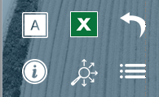
Navigation
Potatoes
General Fertilizer Practices
Fertilizer Timing
Sources of Fertilizer Advice
Fertilizer Applications at Each Growth Stage
Frequency of Soil Testing Nitrogen
Fertilizer Source
Reasons for Not Soil Testing for N Every Year
Fertilizer Placement
Frequency of Soil Testing P, K and S
Nitrogen Rates
Frequency of Soil Testing - Micronutrients
Phosphorus Rates
Frequency of Soil Testing - Electrical Conductivity
Potassium Rates
Frequency of Soil Testing - Organic Matter
Sulphur Rates
Frequency of Soil Testing - pH
Fertilizer Program
Familiarity with 4R Concept
Use of Variable Rates by Fertilizer Type
Growers Who Believe They Comply With 4R
Consistency with 4R Practices
Growers Who Work With A 4R Designated Agronomist
Reasons for Not Meeting Consistency Criteria
Growers Who Have A 4R Plan In Place
Nitrogen Fixing Crop in Previous Year
Benefits Of Having A 4R Plan In Place
Rates Set By Field
Reasons For Not Putting A 4R Plan In Place
Approaches Used To Decide Rate
Fee to Prepare 4R Plan
Main Person Who Determined Rate
Sources of Fertilizer Information
Rate Decisions on 4R Consistency Compliance
Programs Used to Measure Environmental Footprint
Professional Designation
Importance of Professional Designation
Demographics
Deviation from Recommended Rate
Farm Size & Crop Acre Categories
Use of Nitrogen Stabilizers
Demographics
Use of EEFs by Timing
Distribution of Potato Acres
Target Yield vs. Actual Yield
Study Methodology & Sample
Nitrogen Use Efficiency
Factors Considered When Setting Target Yield
Key Findings
Use of Micro/Secondary Nutrients
Potatoes Summary
Custom Application by Timing
4R Nutrient Stewardship
Use of Biostimulants
In SLIDESHOW VIEW, click on any title or button on the above slide to navigate to the section.
Use the icons in the side-bar of each slide for convenient navigation and quick access to more information:
DETAILED DATA
Escape from Slideshow View to NORMAL VIEW; then click to open a worksheet with detailed data.
ATTRIBUTES
Click to see the full attribute statement behind abbreviations used in charts.
BACK TO LIST
Click to return to the list of several similar charts.
INFORMATION
Click for a pop-up that explains the slide. Click again to hide.
SECTION NAVIGATION
Click to return to the navigation slide for the section you are in.
NAVIGATION
Click to return to this study navigation slide.

Slide 3
Potatoes in PEI - Summary
NITROGEN
Primary Nitrogen fertilizers were applied on 182% of potato acres (multiple applications on many acres). 
Calcium ammonium nitrate represents 20% of total Nitrogen volume, Urea represents 16%. 
75% of Nitrogen volumes were applied at planting; applications before planting accounted for 20% of the volume. 
58% of Nitrogen volume was applied in furrow and 17% was broadcast without incorporation at planting. 
Average rate = 145 lbs./ac.  Average rates applied in the spring at planting were 116 lbs./ac. 
Primary Phosphorus fertilizers were applied on 105% of potato acres (multiple applications on some acres). 
DAP represents 29% of total Phosphorus volume; MAP accounted for 43%. 
92% of Phosphorus volumes were applied at planting. 
83% of P₂O₅ volumes were applied in furrow at planting and 10% broadcast without incorporation before planting. 
Average rate = 94 lbs./ac.  About 20% of potato acres were not treated with P₂O₅. 
Potassium fertilizers were applied on 152% of potato acres (multiple applications were common). 
Dry potash represents 75% of total potassium volume, down from 90% last year. 
58% of K₂O volumes were applied at planting; 30% before planting and 12% in the fall of the previous year. 
52% of K₂O volumes were applied in furrow at planting, 17% broadcast with incorporation before planting. 
Average rate = 133 lbs./ac.  Only 12% of potato acres were not treated with any K₂O. 
Primary Sulphur fertilizers were applied on 29% of potato acres. 
K-Mag represents 49% of total Sulphur volume; Ammonium sulphate represents 12%. 
78% of Sulphur volumes were applied at planting, 19% before planting. 
75% of Sulphur volumes were applied in furrow. 
Average rate = 24 lbs./ac.  29% of potato acres were not treated with any Sulphur. 
Source:
Timing:
Placement:
Rate:
PHOSPHORUS
Potatoes Summary 
Source:
Timing:
Placement:
Rate:
POTASSIUM
Source:
Timing:
Placement:
Rate:
SULPHUR
Source:
Timing:
Placement:
Rate:

Slide 4
4R Nutrient Stewardship - Summary
NITROGEN
Most growers are familiar with 4R, but many do not know if their practices comply, and few have a formal 4R plan in place.
75% of potato growers said they were very familiar or somewhat familiar with the 4R concept. 
4R familiarity is higher among younger growers and those on large farms. 
55% of growers said their practices meet 4R requirements in 2023; but 38% don’t know if their practices comply. 
35% of growers said they worked with a Designated Agronomist in 2023 (about the same as last year). 
Those who are very familiar with 4R were more likely to work with a 4R Designated Agronomist. 
20% of growers said they had a 4R Plan in place in 2023 (a nice increase over 2022). 
Those with a 4R Plan say improved soil quality and best environmental practices are the leading benefits. 
Those without a 4R Plan say there are many reasons; Lack of proven benefits and complexity are the top 2 factors. 
Certified Crop Advisors and Professional Agrologists are the main sources of information about 4R. 
4R NUTRIENT STEWARDSHIP
PHOSPHORUS
4R Summary 
POTASSIUM
SULPHUR

Slide 5
Potatoes
Potatoes
Fertilizer Timing
Fertilizer Applications at Each Growth Stage
Fertilizer Source
Fertilizer Placement
Nitrogen Rates
Phosphorus Rates
Potassium Rates
Sulphur Rates
Answering Key Questions:
What are the most common application timings for each nutrient and fertilizer type?
What nutrients and fertilizer types are being used?
What are the most common placements for each nutrient and fertilizer type?
What rates are being applied?
To what extent do farmers vary their fertilizer program from field to field?
To what extent are farmers incorporating nitrogen fixing crops into their rotation?
How do farmers decide what fertilizer rate to apply?
To what extent are farmers deviating from the recommended rate? Why?
How extensively are nitrogen stabilized products being used?
How do actual yields compare to target yields?
How many growers are applying micro or secondary nutrients?
To what extent were biostimulants used?
Fertilizer Program
Use of Variable Rates by Fertilizer Type
Consistency with 4R Practices
Reasons for Not Meeting Consistency Criteria
Nitrogen Fixing Crop in Previous Year
Rates Set By Field
Approaches Used To Decide Rate
Main Person Who Determined Rate
Rate Decisions on 4R Consistency Compliance
Professional Designation
Importance of Professional Designation
Deviation from Recommended Rate
Use of Nitrogen Stabilizers
Use of EEFs by Timing
Target Yield vs. Actual Yield
Nitrogen Use Efficiency
Factors Considered When Setting Target Yield
Use of Micro/Secondary Nutrients
Custom Application by Timing
Use of Biostimulants
In SLIDESHOW VIEW, click on any title or button on the above slide to navigate to the section.
Use the icons in the side-bar of each slide for convenient navigation and quick access to more information:
DETAILED DATA
Escape from Slideshow View to NORMAL VIEW; then click to open a worksheet with detailed data.
ATTRIBUTES
Click to see the full attribute statement behind abbreviations used in charts.
BACK TO LIST
Click to return to the list of several similar charts.
INFORMATION
Click for a pop-up that explains the slide. Click again to hide.
SECTION NAVIGATION
Click to return to the navigation slide for the section you are in.
NAVIGATION
Click to return to this study navigation slide.

Slide 6

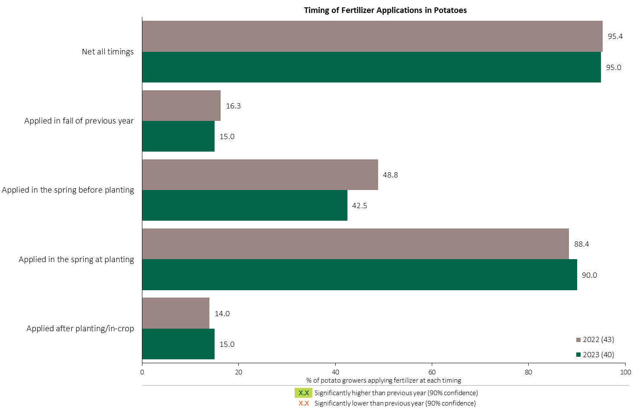

Fertilizer Applications in Potatoes - % Growers
Potatoes
42% of potato growers applied fertilizer before planting.
90% of potato growers applied fertilizer at planting.
Respondents were asked: “For your 2023 potato crop, did you apply fertilizer at each timing? - and given the options of a) Applied in fall of previous year, b) in the spring before planting, c) in the spring at planting and d) after planting/in-crop.
The chart illustrates the % of respondents who applied fertilizer at each timing in each year.

Slide 7
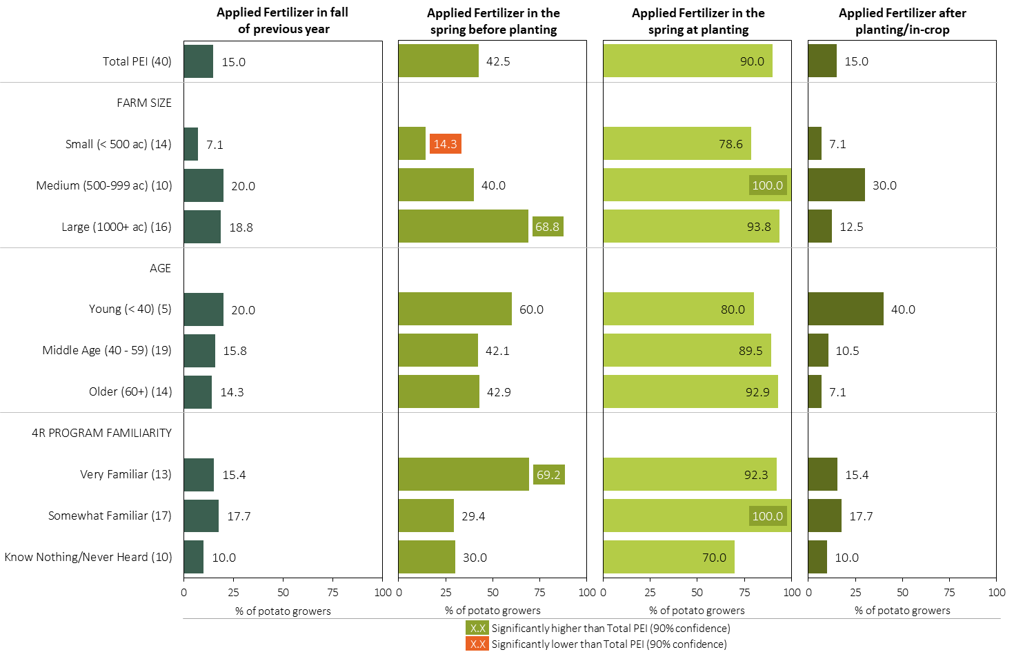
Fertilizer Applications in Potatoes - % Growers by Timing in 2023
Potatoes
Respondents were asked: “For your 2023 potato crop, did you apply fertilizer at each timing? - and given the options of a) Applied in fall of previous year, b) in the spring before planting, c) in the spring at planting and d) after planting/in-crop.
Separately by farm size, age and 4R program familiarity, the charts illustrate the % of potato growers who applied fertilizer at each timing.

Slide 8
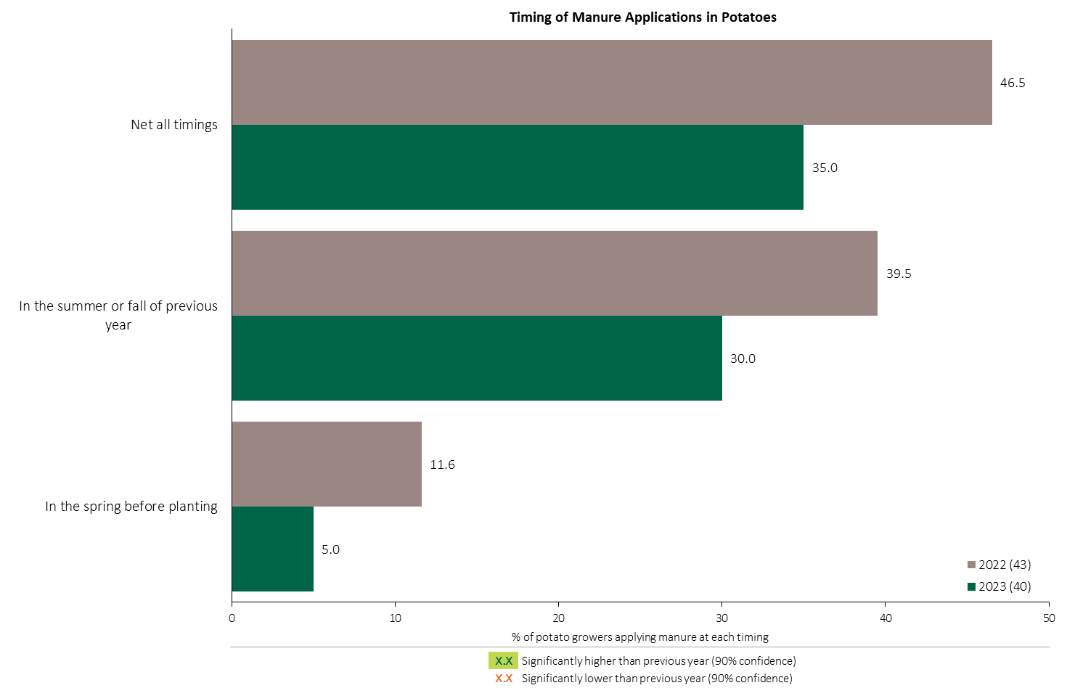
Manure Applications in Potatoes - % Growers
Potatoes
Respondents were asked: “For your 2023 potato crop, did you apply manure at each timing? - and given the options of a) Applied in fall of previous year, b) in the spring before planting, c) in the spring at planting and d) after planting/in-crop.
The chart illustrates the % of respondents who applied manure at each timing in each year.

Slide 9
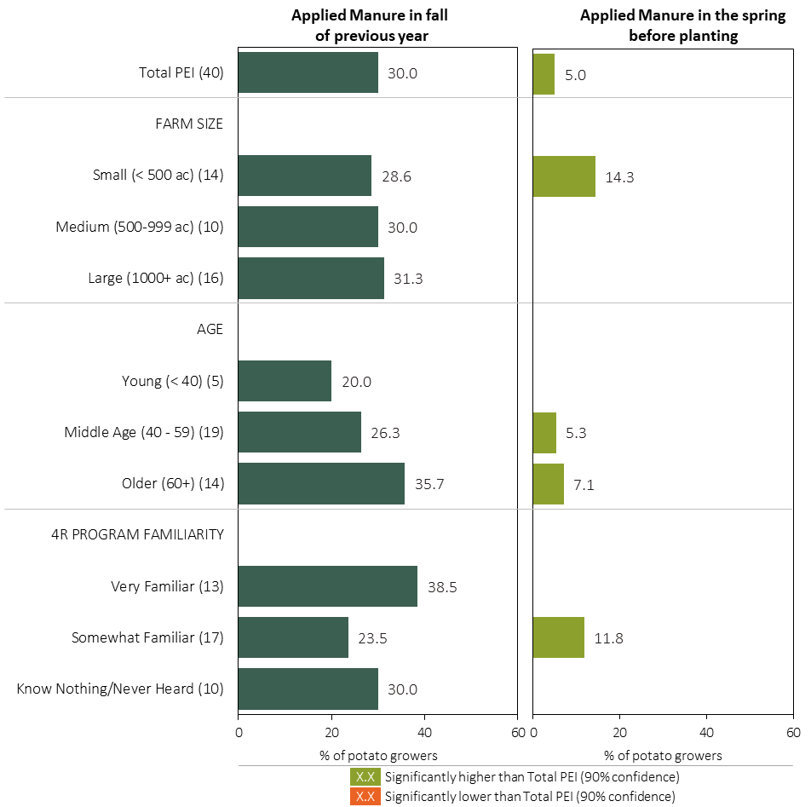
Manure Applications in Potatoes - % Growers by Timing in 2023
Potatoes
Respondents were asked: “For your 2023 potato crop, did you apply manure at each timing? - and given the options of a) Applied in fall of previous year, b) in the spring before planting, c) in the spring at planting and d) after planting/in-crop.
Separately by farm size, age and 4R program familiarity, the charts illustrate the % of potato growers who applied manure at each timing.

Slide 10
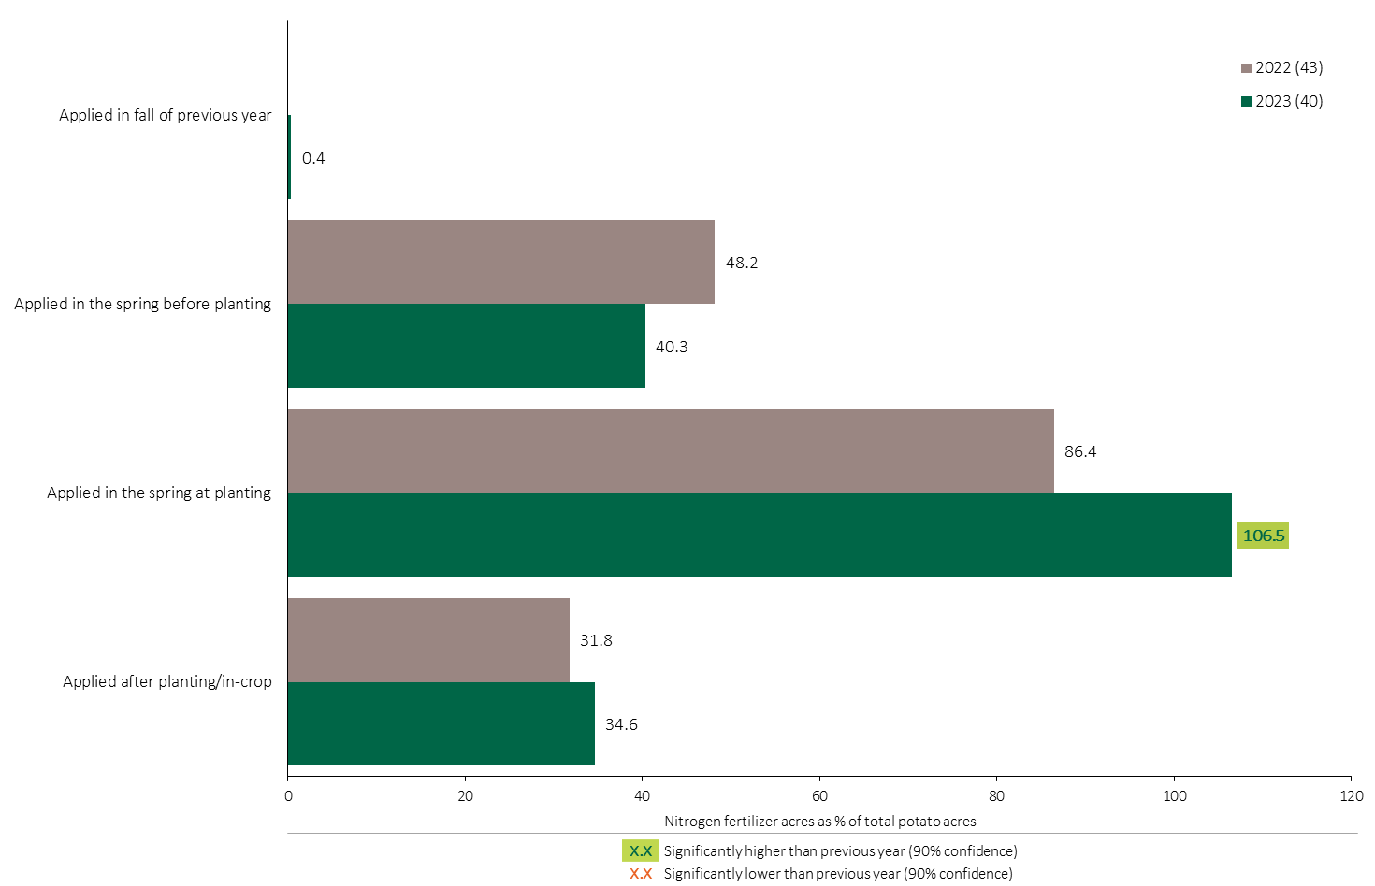

Nitrogen Timing in Potatoes - % Crop Acres
Potatoes
40% of potato acres were treated with a Nitrogen fertilizer before planting.
Multiple Nitrogen fertilizers were applied on a few acres at planting in 2023.
Note: Nitrogen only includes those fertilizer types where nitrogen is the primary component.
For each application timing, respondents were asked: “Of your [xxx] acres of potatoes, how many acres of each fertilizer type did you apply?”
The chart illustrates the % of total potato acres that were treated with a primary Nitrogen fertilizer at each timing in each year. A list of Primary Nitrogen fertilizers can be accessed by clicking on the “A” button.

Slide 11
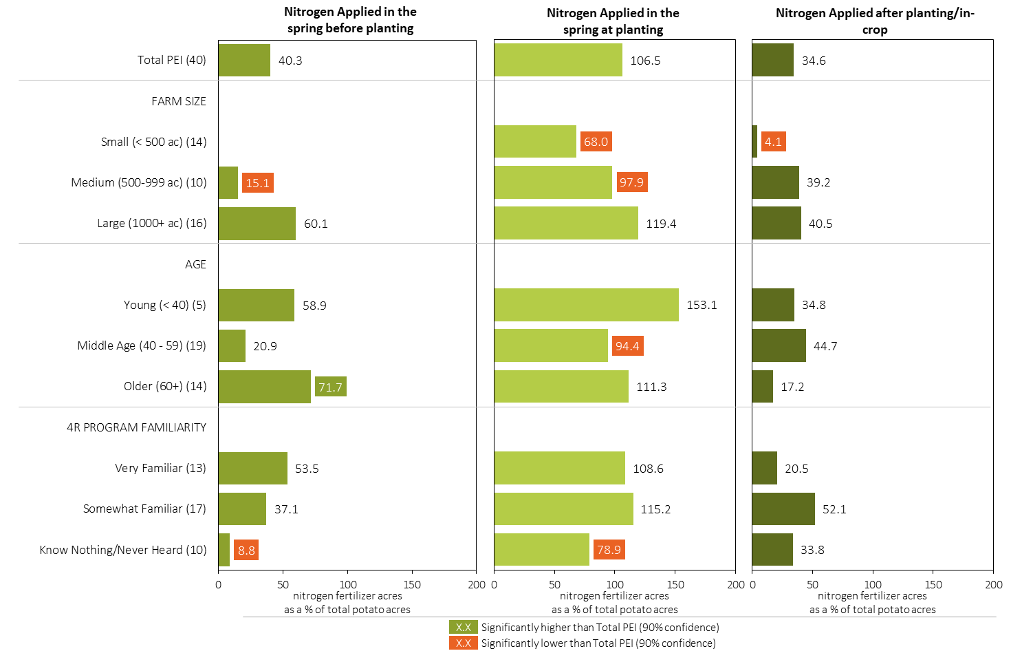
Nitrogen Timing in Potatoes in 2023 (% of Crop Acres)
Potatoes
Note: Nitrogen only includes those fertilizer types where nitrogen is the primary component.
For each application timing, respondents were asked: “Of your [xxx] acres of potatoes, how many acres of each fertilizer type did you apply?”
Separately for each timing, the charts illustrate the % of total potato acres that was treated with a primary nitrogen fertilizer by farm size, age and 4R program familiarity.
Nitrogen only includes those fertilizer types where nitrogen is the primary component. A list can be accessed by clicking on the “A” button.

Slide 12
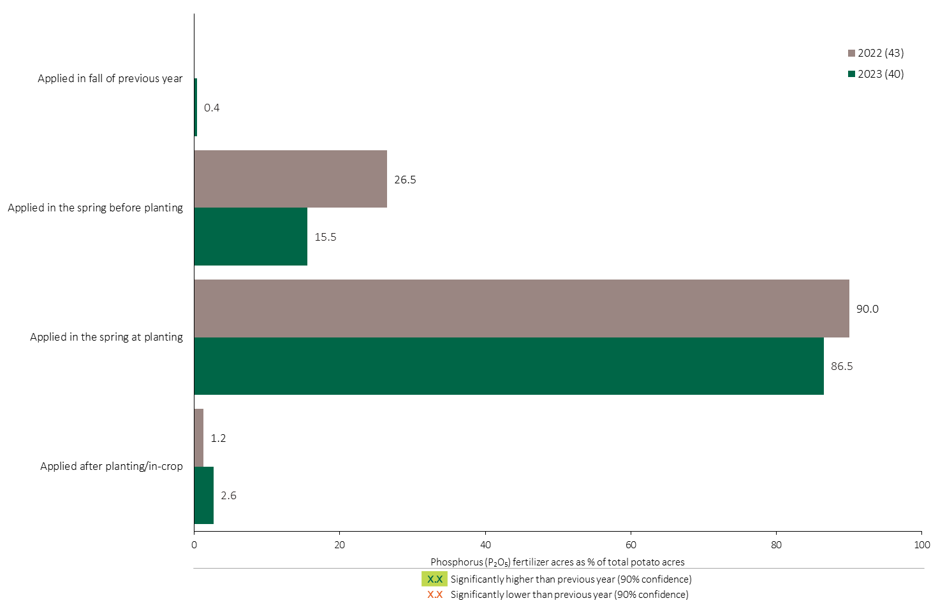
Phosphorus (P₂O₅) Timing in Potatoes - % Crop Acres
Potatoes
87% of potato acres were treated with a Phosphorus fertilizer at planting in 2023.
Note: Phosphorus only includes those fertilizer types where phosphorus is the primary component.
For each application timing, respondents were asked: “Of your [xxx] acres of potatoes, how many acres of each fertilizer type did you apply?”
The chart illustrates the % of total potato acres that were treated with a primary Phosphorus fertilizer at each timing in each year. A list of Primary Phosphorus fertilizers can be accessed by clicking on the “A” button.

Slide 13
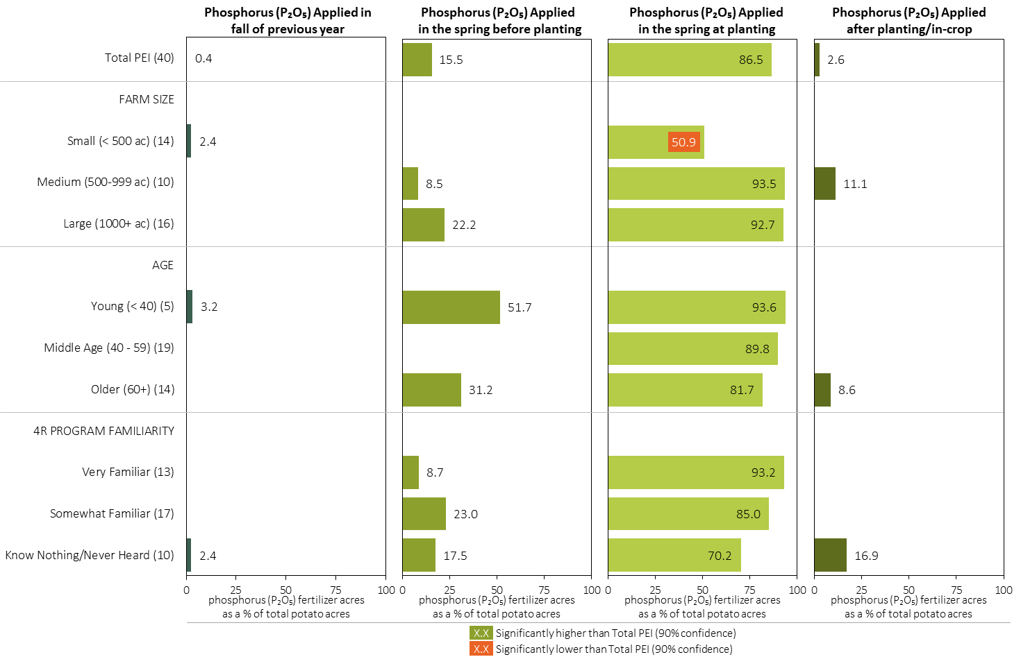
Phosphorus (P₂O₅) Timing in Potatoes in 2023 (% of Crop Acres)
Potatoes
Note: Phosphorus only includes those fertilizer types where phosphorus is the primary component.
For each application timing, respondents were asked: “Of your [xxx] acres of potatoes, how many acres of each fertilizer type did you apply?”
Separately for each timing, the charts illustrate the % of total potato acres that was treated with a primary phosphorus fertilizer by farm size, age and 4R program familiarity.
Phosphorus only includes those fertilizer types where phosphorus is the primary component. A list can be accessed by clicking on the “A” button.

Slide 14
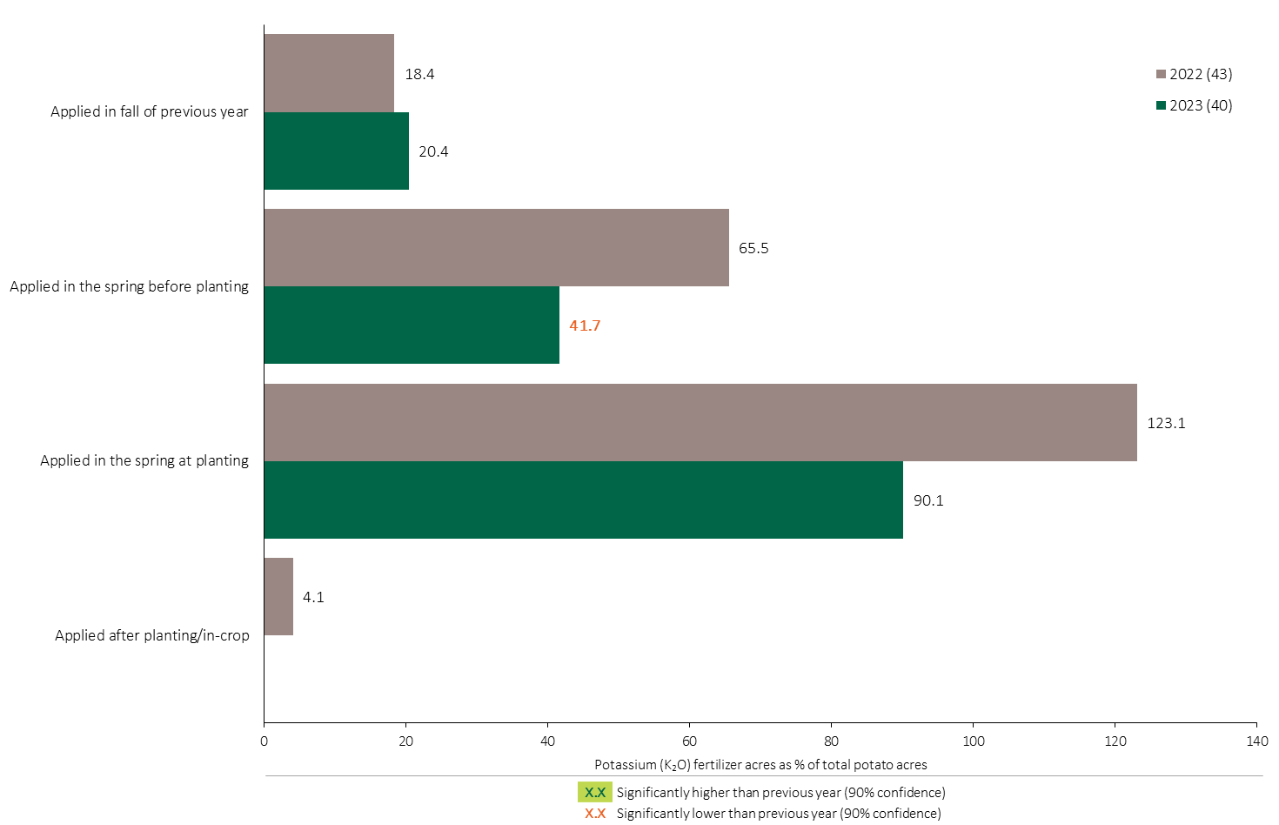
Potassium (K₂O) Timing in Potatoes - % Crop Acres
Potatoes
Fewer potato acres were treated with Potassium before planting in 2023.
90% of total potato acres were treated with Potassium at planting.
Note: Potassium only includes those fertilizer types where potassium is the primary component.
For each application timing, respondents were asked: “Of your [xxx] acres of potatoes, how many acres of each fertilizer type did you apply?”
The chart illustrates the % of total potato acres that were treated with a primary Potassium fertilizer at each timing in each year. A list of Primary Potassium fertilizers can be accessed by clicking on the “A” button.

Slide 15
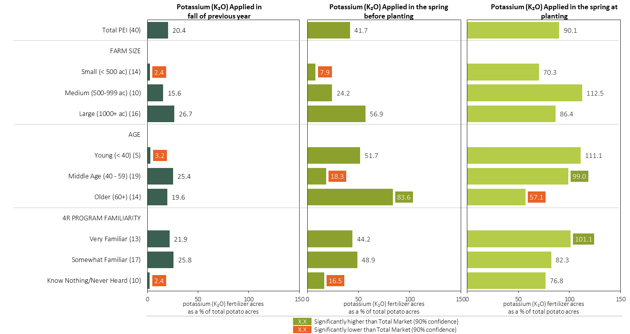
Potassium (K₂O) Timing in Potatoes in 2023 (% of Crop Acres)
Potatoes
Note: Potassium only includes those fertilizer types where potassium is the primary component.
For each application timing, respondents were asked: “Of your [xxx] acres of potatoes, how many acres of each fertilizer type did you apply?”
Separately for each timing, the charts illustrate the % of total potato acres that was treated with a primary potassium fertilizer by size, age and 4R program familiarity.
Potassium only includes those fertilizer types where potassium is the primary component. A list can be accessed by clicking on the “A” button.

Slide 16
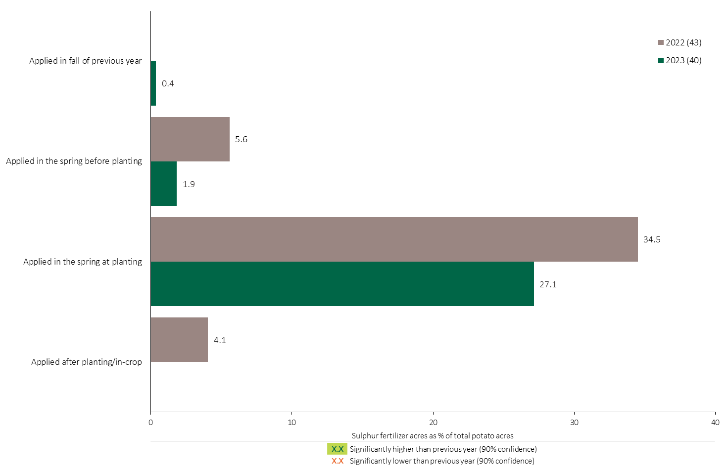
Sulphur Timing in Potatoes - % Crop Acres
Potatoes
27% of potato acres were treated with a Sulphur fertilizer at planting.
Note: Sulphur only includes those fertilizer types where sulphur is the primary component.
For each application timing, respondents were asked: “Of your [xxx] acres of potatoes, how many acres of each fertilizer type did you apply?”
The chart illustrates the % of total potato acres that were treated with a primary Sulphur fertilizer at each timing in each year. A list of Primary Sulphur fertilizers can be accessed by clicking on the “A” button.

Slide 17
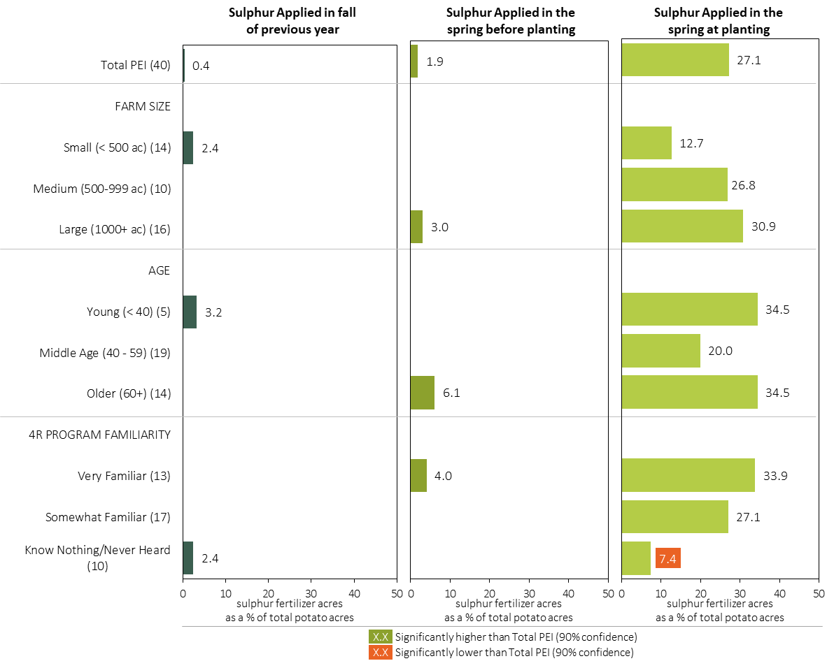
Sulphur Timing in Potatoes in 2023 (% of Crop Acres)
Potatoes
Note: Sulphur only includes those fertilizer types where sulphur is the primary component.
For each application timing, respondents were asked: “Of your [xxx] acres of potatoes, how many acres of each fertilizer type did you apply?”
Separately for each timing, the charts illustrate the % of total potato acres that was treated with a primary sulphur fertilizer by, farm size, age and 4R program familiarity.
Sulphur only includes those fertilizer types where sulphur is the primary component. A list can be accessed by clicking on the “A” button.

Slide 18
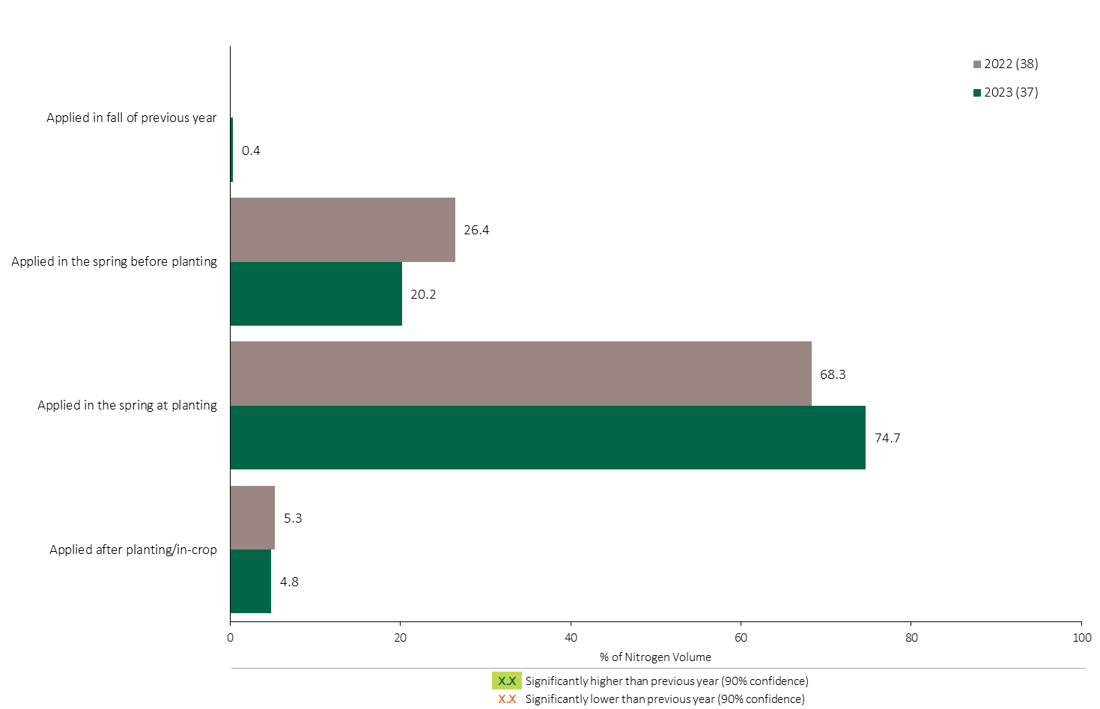
Nitrogen Timing in Potatoes - % of Volume
Potatoes
Potatoes Summary 
About 75% of total Nitrogen applied in potatoes was applied at planting.
Note: Nitrogen volume was calculated from all sources of nitrogen contained in all fertilizer types
For each fertilizer type used in either a custom blend or applied as an unblended product, respondents were asked: a) how many acres they applied, and b) the application rate in pounds of actual nutrient/ac. Volumes of each nutrient were calculated by multiplying acres treated times the application rate.
The graph illustrates the % of total Nitrogen volume applied in potatoes that was applied at each timing in each year.
Total pounds of actual Nitrogen applied was calculated based on all sources of Nitrogen from all fertilizer types.

Slide 19
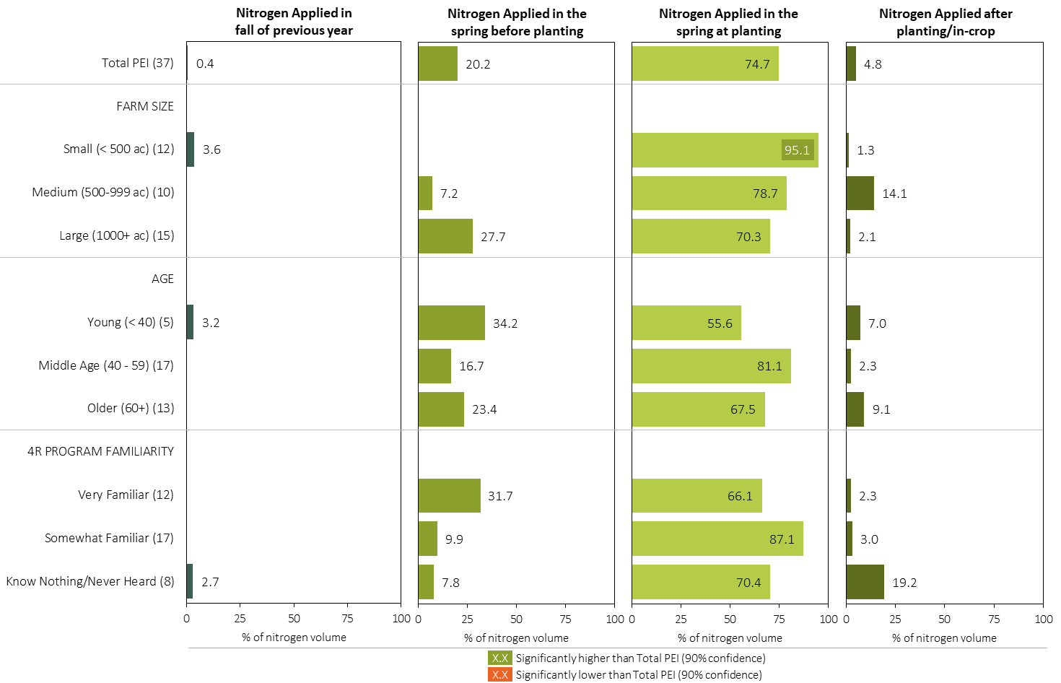
Nitrogen Timing in Potatoes in 2023 (% of Volume)
Potatoes
Note: Nitrogen volume was calculated from all sources of nitrogen contained in all fertilizer types
For each fertilizer type used in either a custom blend or applied as an unblended product, respondents were asked: a) how many acres they applied, and b) the application rate in pounds of actual nutrient/ac. Volumes of each nutrient were calculated by multiplying acres treated times the application rate.
Separately for each timing, the charts illustrate the % of total nitrogen volume that was applied by farm size, age and 4R program familiarity.
Total pounds of actual nitrogen applied was calculated based on all sources of nitrogen from all fertilizer types.

Slide 20
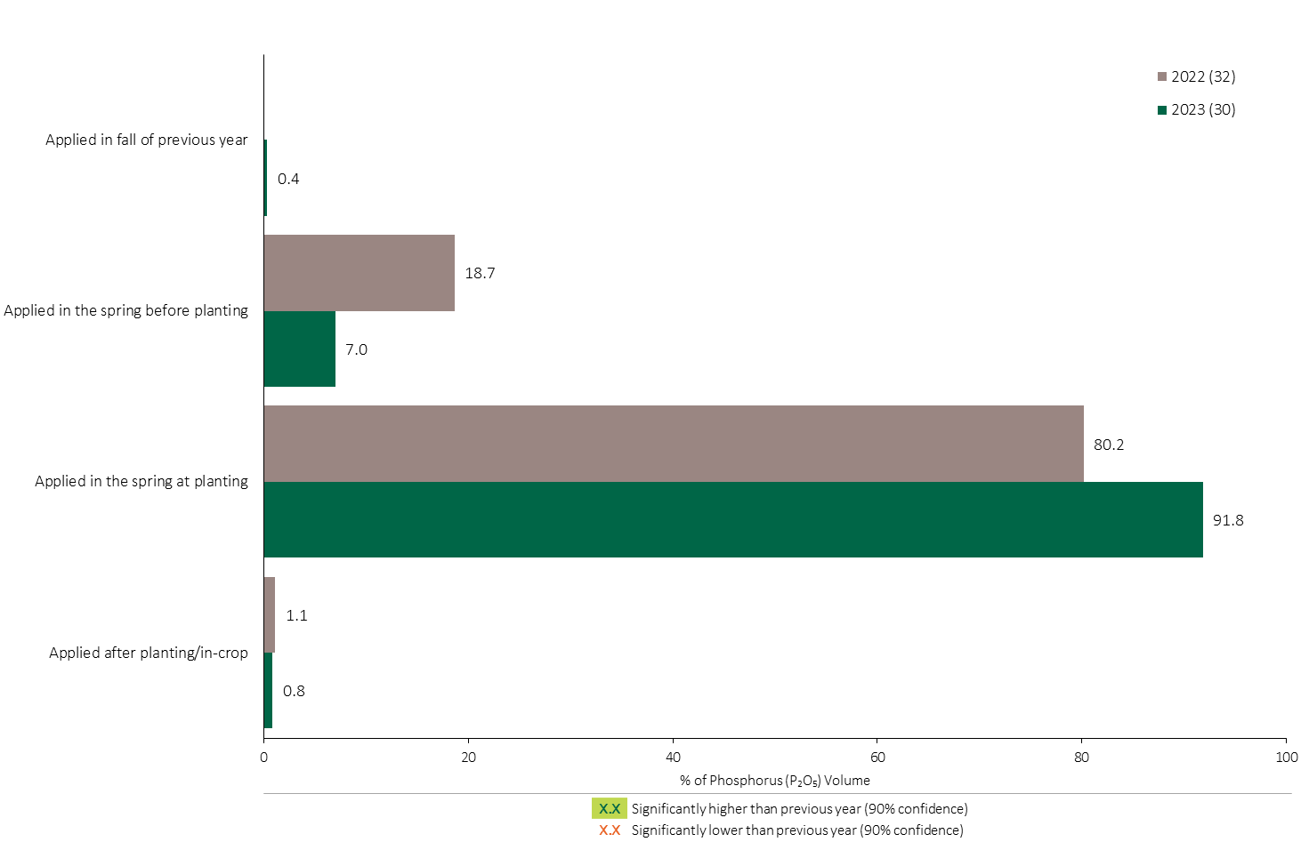
Phosphorus (P₂O₅) Timing in Potatoes - % of Volume
Potatoes
Potatoes Summary 
92% of total Phosphorus (P₂O₅) applied in potatoes was applied at planting.
Note: Phosphorus (P₂O₅) volume was calculated from all sources of phosphorus contained in all fertilizer types
For each fertilizer type used in either a custom blend or applied as an unblended product, respondents were asked: a) how many acres they applied, and b) the application rate in pounds of actual nutrient/ac. Volumes of each nutrient were calculated by multiplying acres treated times the application rate.
The graph illustrates the % of total Phosphorus (P₂O₅) volume applied in potatoes that was applied at each timing in each year.
Total pounds of actual Phosphorus (P₂O₅) applied was calculated based on all sources of Phosphorus (P₂O₅) from all fertilizer types.

Slide 21
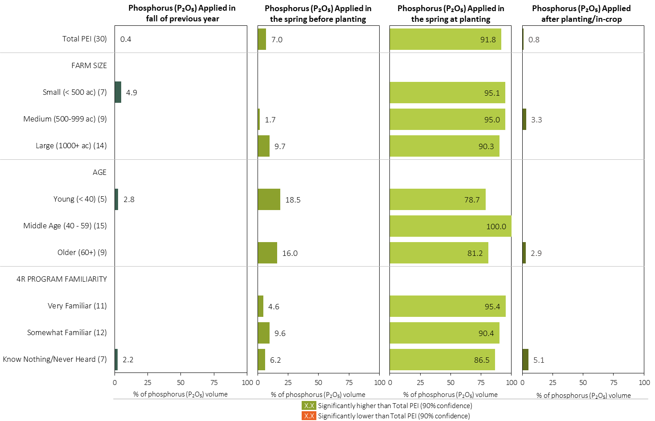
Phosphorus (P₂O₅) Timing in Potatoes in 2023 (% of Volume)
Potatoes
Note: Phosphorus (P₂O₅) volume was calculated from all sources of phosphorus contained in all fertilizer types
For each fertilizer type used in either a custom blend or applied as an unblended product, respondents were asked: a) how many acres they applied, and b) the application rate in pounds of actual nutrient/ac. Volumes of each nutrient were calculated by multiplying acres treated times the application rate.
Separately for each timing, the charts illustrate the % of total Phosphorus (P₂O₅) volume that was applied by farm size, age and 4R program familiarity.
Total pounds of actual Phosphorus (P₂O₅) applied was calculated based on all sources of Phosphorus (P₂O₅) from all fertilizer types.

Slide 22
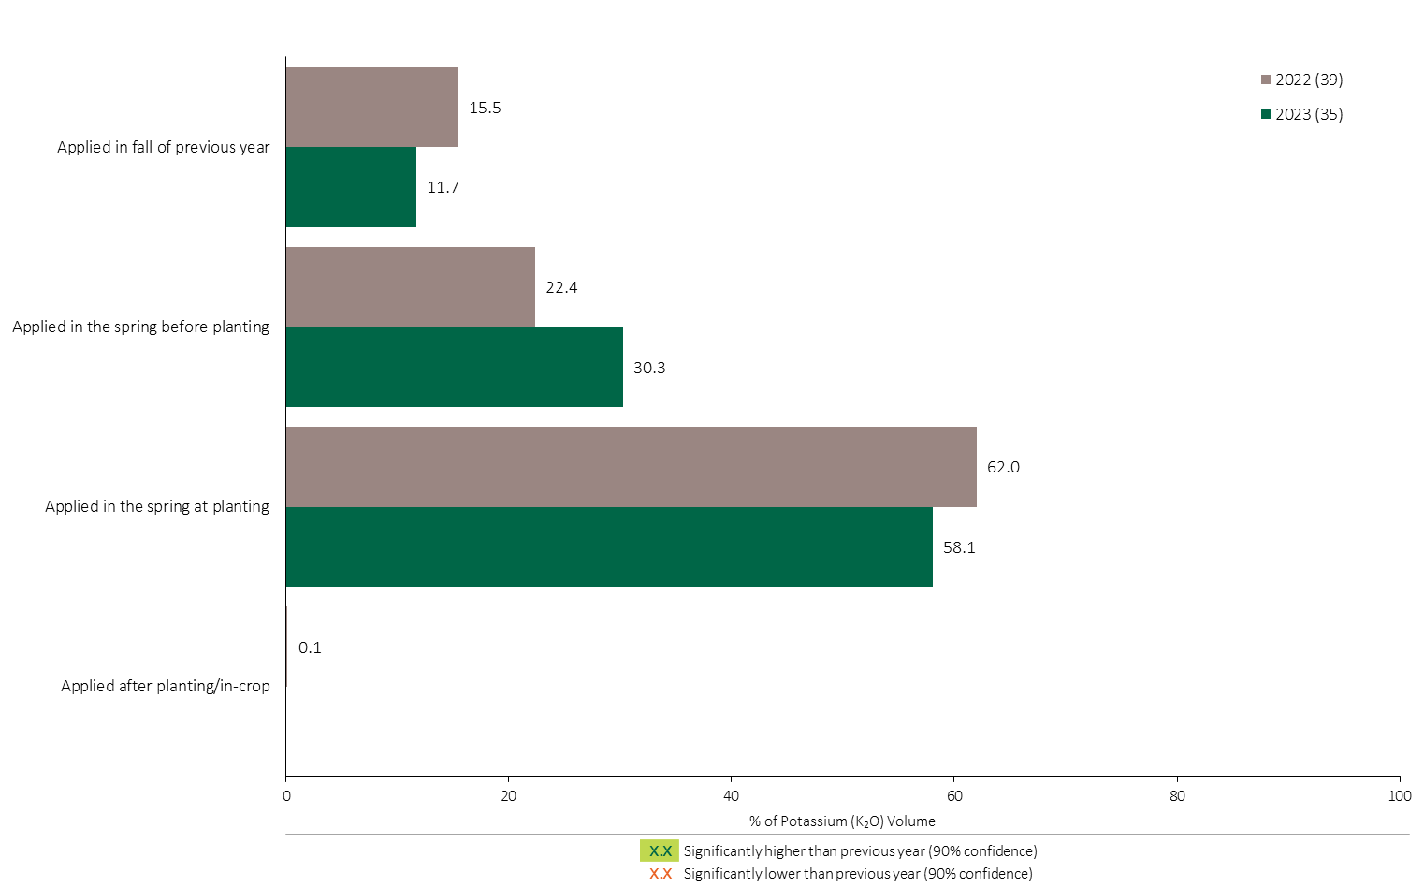
Potassium (K₂O) Timing in Potatoes - % of Volume
Potatoes
Potatoes Summary 
58% of total Potassium applied in potatoes was applied at planting.
Note: Potassium (K₂O) volume was calculated from all sources of potassium contained in all fertilizer types
For each fertilizer type used in either a custom blend or applied as an unblended product, respondents were asked: a) how many acres they applied, and b) the application rate in pounds of actual nutrient/ac. Volumes of each nutrient were calculated by multiplying acres treated times the application rate.
The graph illustrates the % of total Potassium (K₂O) volume applied in potatoes that was applied at each timing in each year.
Total pounds of actual Potassium (K₂O) applied was calculated based on all sources of Potassium (K₂O) from all fertilizer types.

Slide 23
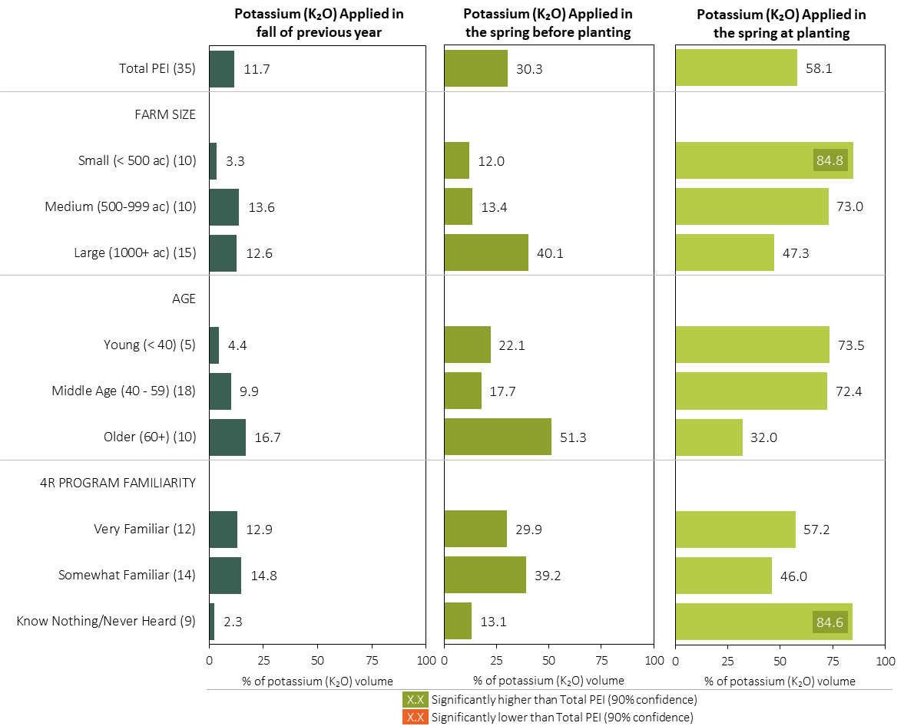
Potassium (K₂O) Timing in Potatoes in 2023 (% of Volume)
Potatoes
Note: Potassium (K₂O) volume was calculated from all sources of potassium contained in all fertilizer types
For each fertilizer type used in either a custom blend or applied as an unblended product, respondents were asked: a) how many acres they applied, and b) the application rate in pounds of actual nutrient/ac. Volumes of each nutrient were calculated by multiplying acres treated times the application rate.
Separately for each timing, the charts illustrate the % of total Potassium (K₂O) volume that was applied by farm size, age and 4R program familiarity.
Total pounds of actual potassium (K₂O) applied was calculated based on all sources of potassium (K₂O) from all fertilizer types.

Slide 24
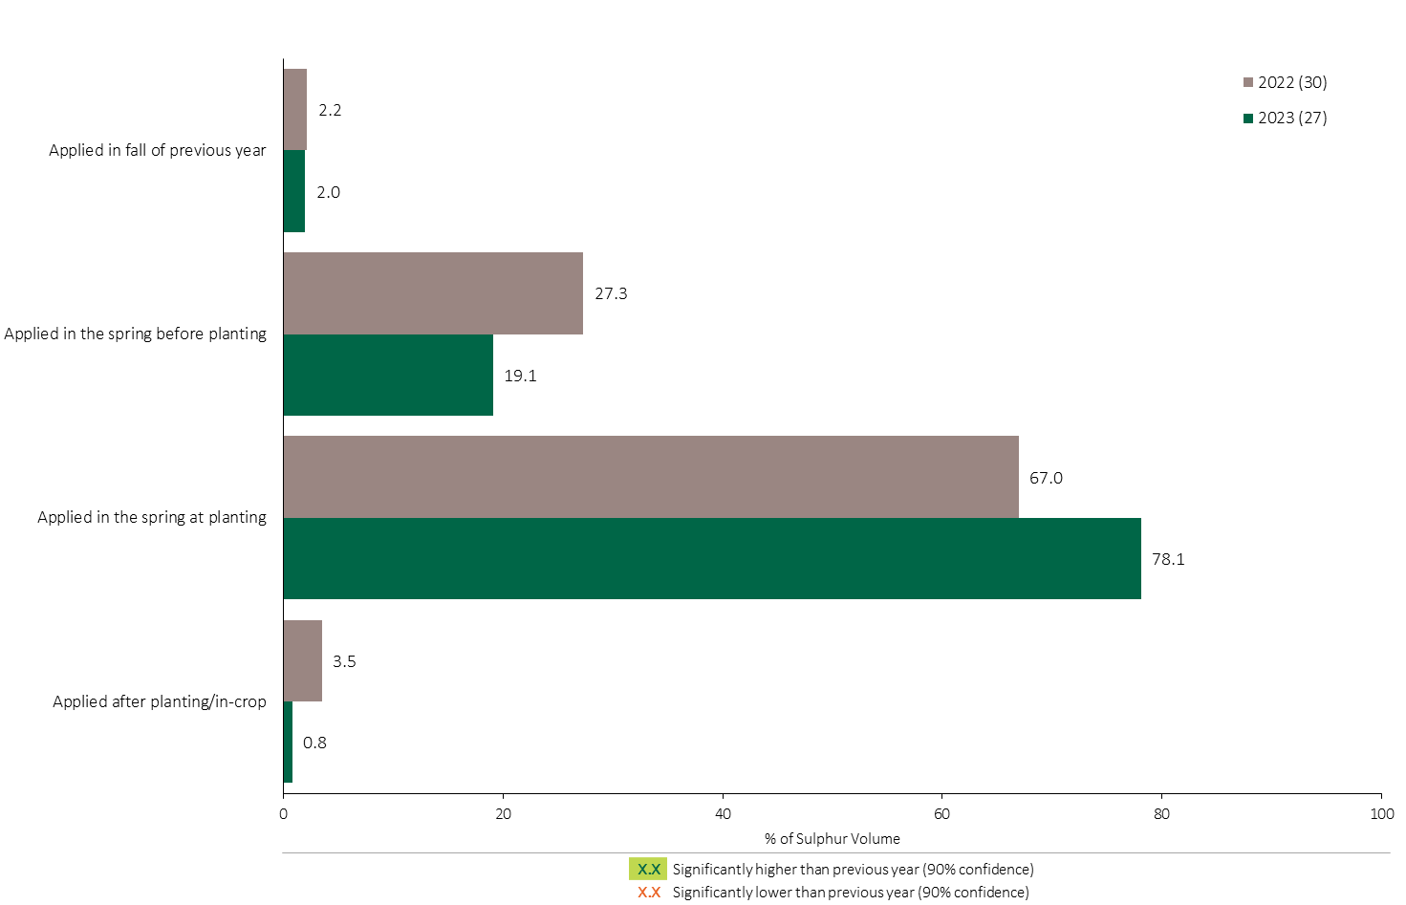
Sulphur Timing in Potatoes - % of Volume
Potatoes
Potatoes Summary 
78% of the Sulphur volume in potatoes was applied at planting in 2023.
Note: Sulphur volume was calculated from all sources of sulphur contained in all fertilizer types
For each fertilizer type used in either a custom blend or applied as an unblended product, respondents were asked: a) how many acres they applied, and b) the application rate in pounds of actual nutrient/ac. Volumes of each nutrient were calculated by multiplying acres treated times the application rate.
The graph illustrates the % of total Sulphur volume applied in potatoes that was applied at each timing in each year.
Total pounds of actual Sulphur applied was calculated based on all sources of Sulphur from all fertilizer types.

Slide 25
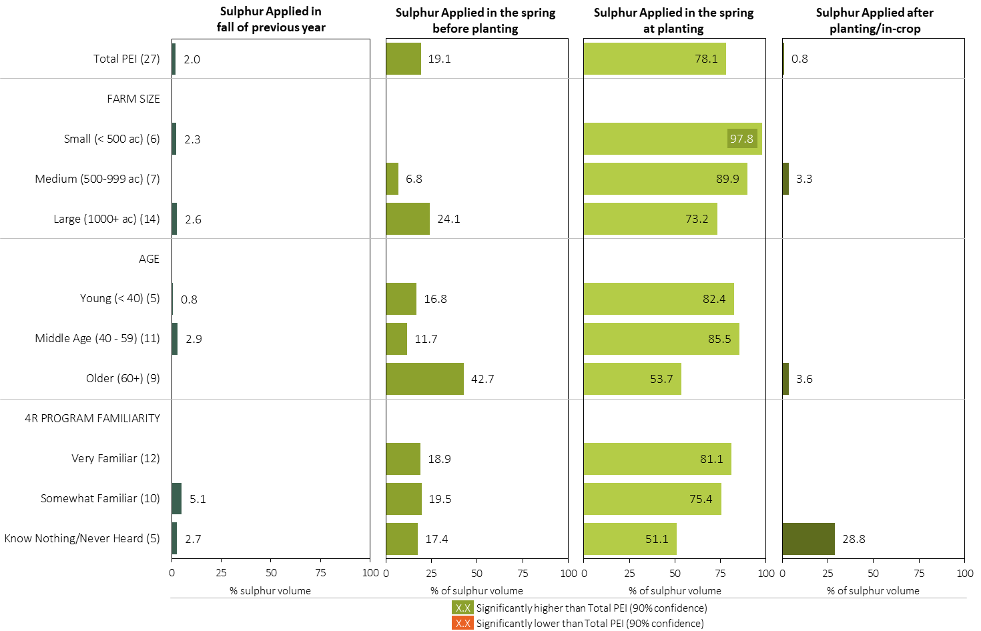
Sulphur Timing in Potatoes in 2023 (% of Volume)
Potatoes
Note: Sulphur volume was calculated from all sources of sulphur contained in all fertilizer types
For each fertilizer type used in either a custom blend or applied as an unblended product, respondents were asked: a) how many acres they applied, and b) the application rate in pounds of actual nutrient/ac. Volumes of each nutrient were calculated by multiplying acres treated times the application rate.
Separately for each timing, the charts illustrate the % of total sulphur volume that was applied by farm size, age and 4R program familiarity.
Total pounds of actual sulphur applied was calculated based on all sources of sulphur from all fertilizer types.

Slide 26
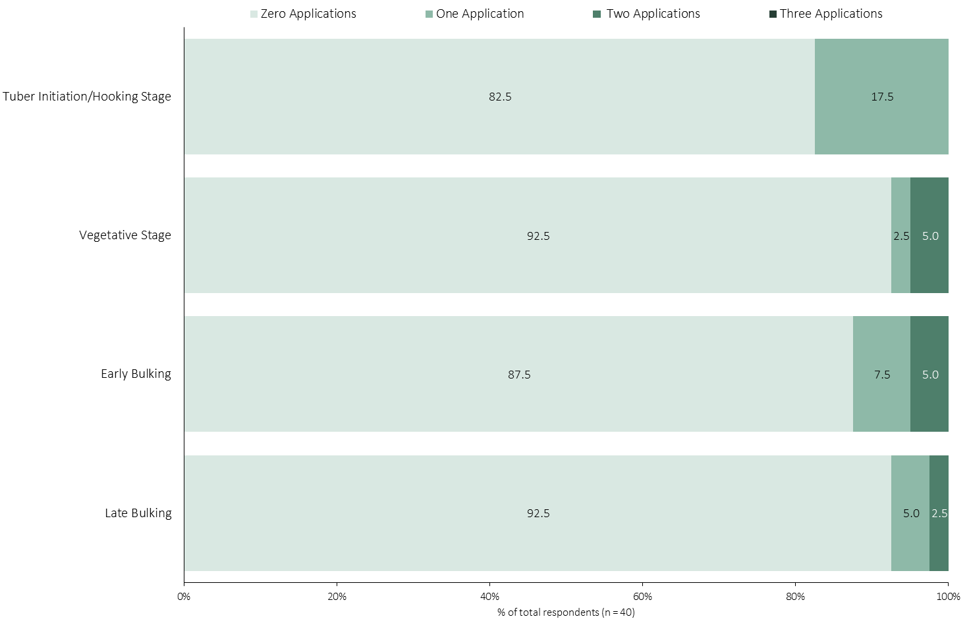
Number of Fertilizer Applications at Each Growth Stage After Planting/In-Crop
Potatoes
Potato growers who applied fertilizer after planting/in crop were asked: "How many times did you apply fertilizer at each growth stage in 2023?"
The chart illustrates the % of respondents who applied each number of fertilizer applications at each growth stage in potatoes.

Slide 27
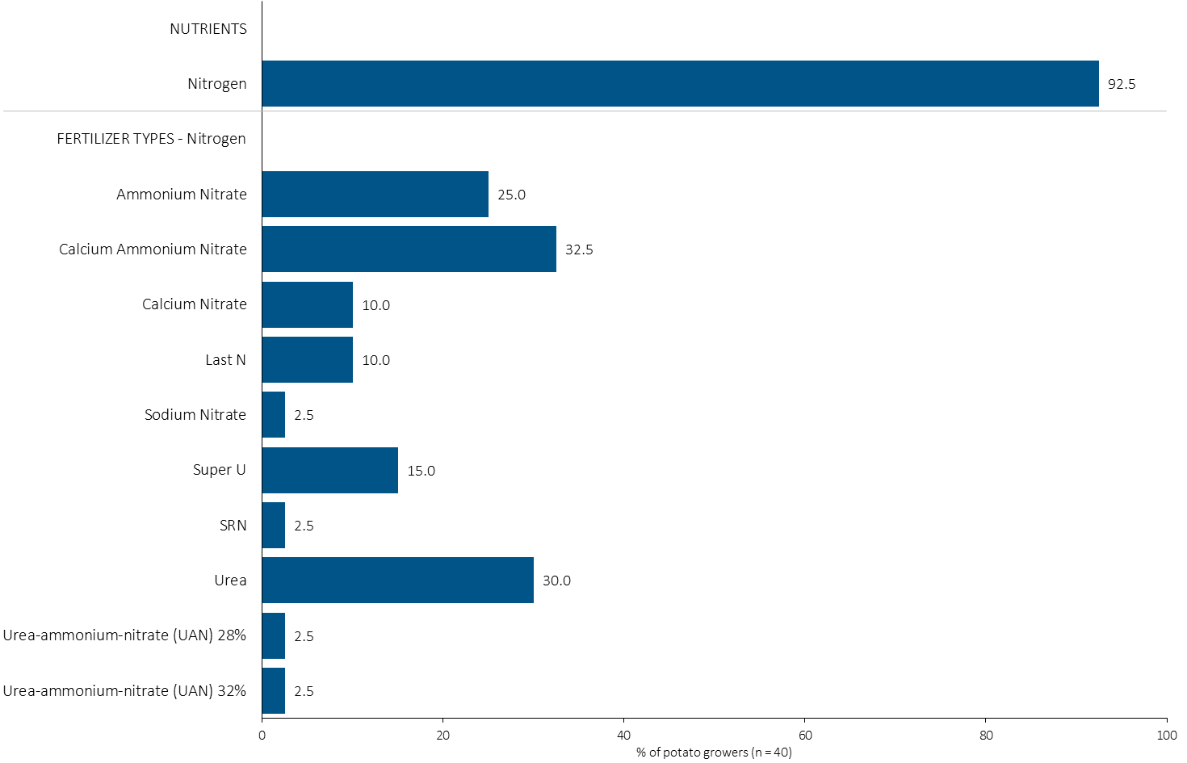
% of Potato Growers Using Each Nitrogen Source in in 2023
Potatoes
93% of potato growers applied nitrogen in 2023.
Note: Nutrients were defined based on any fertilizer type that contains the nutrient.
Respondents were asked: “For your 2023 potato crop, did you apply fertilizer or manure at each timing? - and given the options of a) Applied in fall of previous year, b) in the spring before planting, c) in the spring at planting and d) after planting/in-crop. For your 2023 potato crop, which fertilizer types did you apply at each timing?
The chart illustrates the % of potato growers who indicated that they used this nutrient and each fertilizer type in potatoes in 2023.
Nutrients were defined based on any fertilizer type that contains the nutrient.

Slide 28
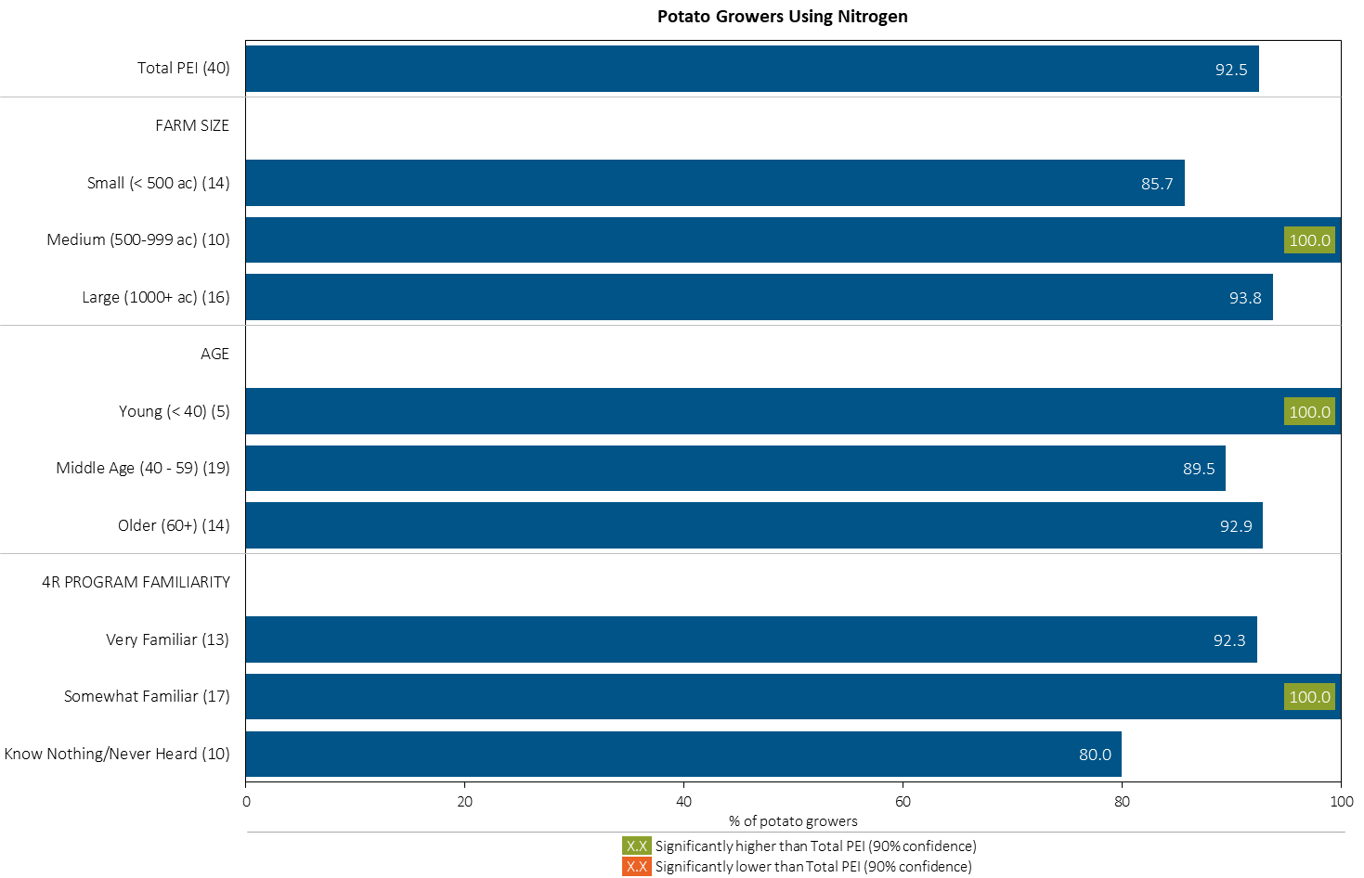
% of Potato Growers Using Nitrogen in 2023
Potatoes
Note: Nutrients were defined based on any fertilizer type that contains the nutrient.
Respondents were asked: “For your 2023 potato crop, did you apply fertilizer or manure at each timing? - and given the options of a) Applied in fall of previous year, b) in the spring before planting, c) in the spring at planting and d) after planting/in-crop. For your 2023 potato crop, which fertilizer types did you apply at each timing?
The chart illustrates the % of potato growers who indicated that they used this nutrient in potatoes in 2023 by farm size, age and 4R familiarity.
Nutrients were defined based on any fertilizer type that contains the nutrient.

Slide 29
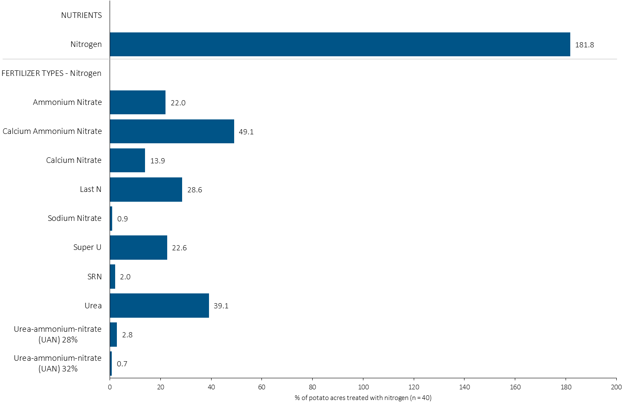
Acres Treated With Each Nitrogen Source in Potatoes in 2023
Potatoes
Multiple Nitrogen fertilizers were applied on most potato acres.
Potatoes Summary 
Note: Nutrients were defined based on the primary component of each fertilizer type
For each application timing, respondents were asked: “Of your [xxx] acres of potato, how many acres of each fertilizer type did you apply?”
The chart illustrates the % of total potato acres that were treated with this nutrient and each fertilizer type in 2023.
Nutrients were defined based on the primary component (see adjacent fertilizer types by clicking on the “A” button.

Slide 30
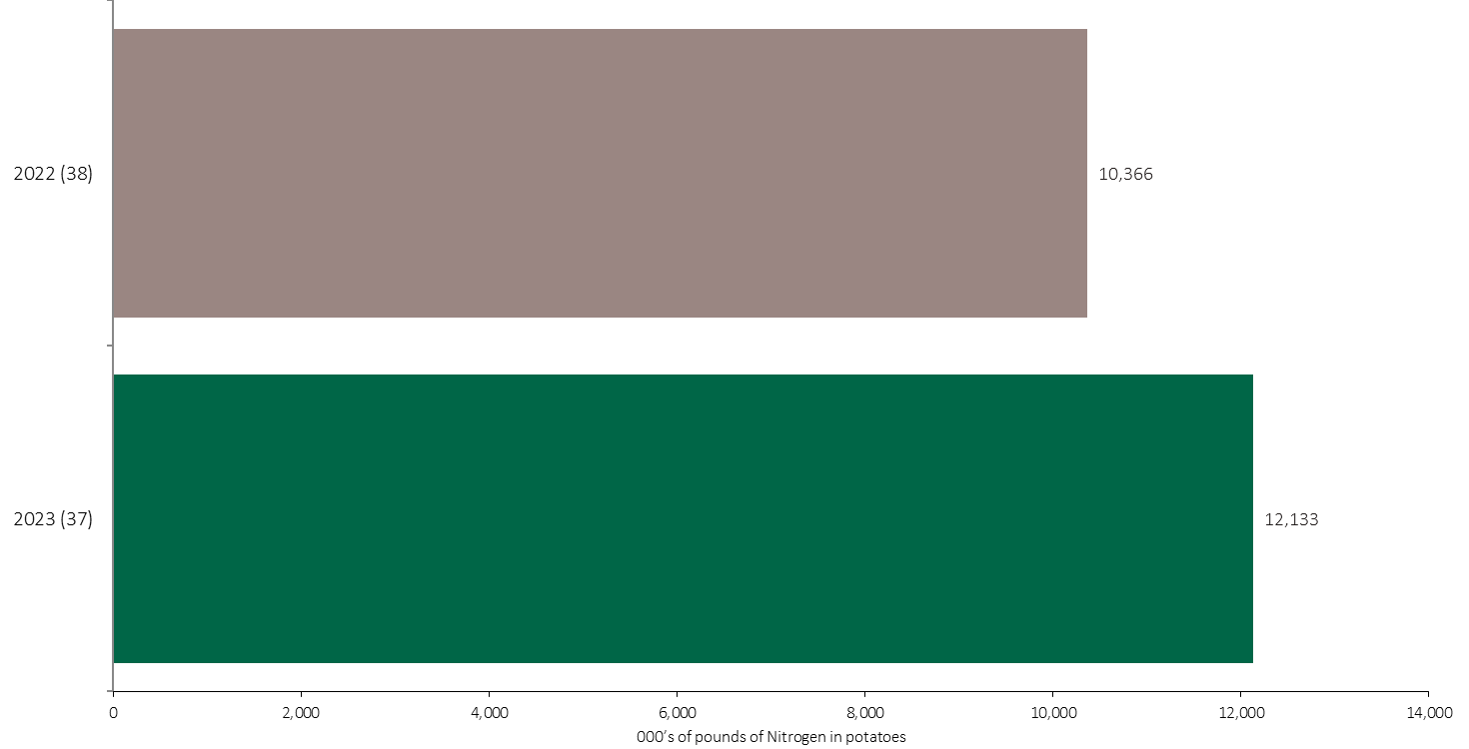
Nitrogen Volume in Potatoes
Potatoes
An estimated 12 million pounds of N was used in potatoes in 2023.
Note: Nitrogen volume was calculated from all sources of nitrogen contained in all fertilizer types
For each fertilizer type used in either a custom blend or applied as an unblended product, respondents were asked: a) how many acres they applied, and b) the application rate in pounds of actual nutrient/ac. Volumes of each nutrient were calculated by multiplying acres treated times the application rate.
The chart illustrates the total nitrogen volume (000’s of pounds) that was used in each year. The nitrogen volume was calculated from all sources of nitrogen contained in all fertilizer types.

Slide 31
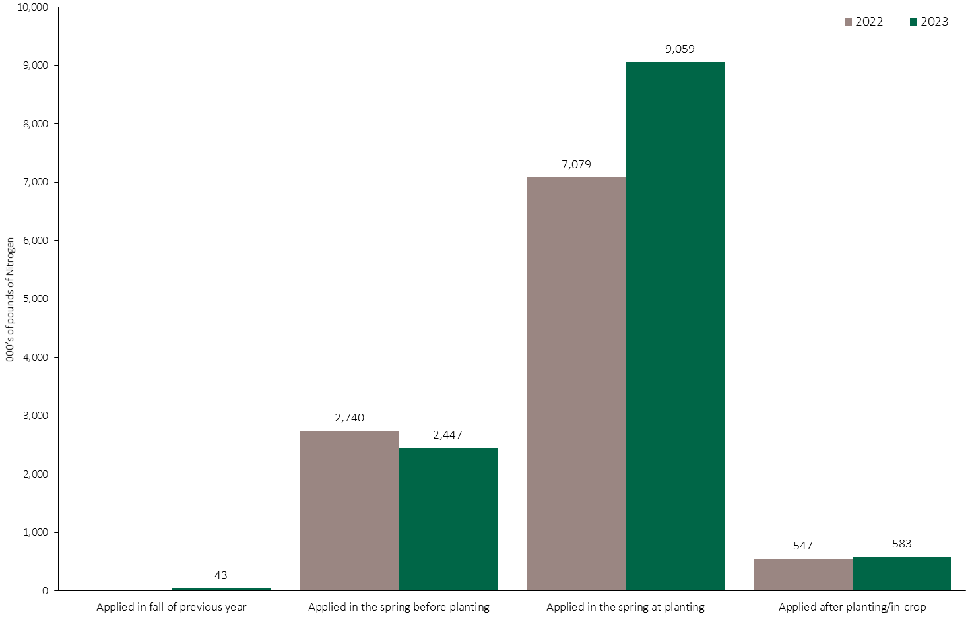
Nitrogen Volume in Potatoes by Timing
Potatoes
Note: Nitrogen volume was calculated from all sources of nitrogen contained in all fertilizer types
For each fertilizer type used in either a custom blend or applied as an unblended product, respondents were asked: a) how many acres they applied, and b) the application rate in pounds of actual nutrient/ac. Volumes of each nutrient were calculated by multiplying acres treated times the application rate.
The chart illustrates the total nitrogen volume (000’s of pounds) that was used in each year by application timing. The nitrogen volume was calculated from all sources of nitrogen contained in all fertilizer types.

Slide 32
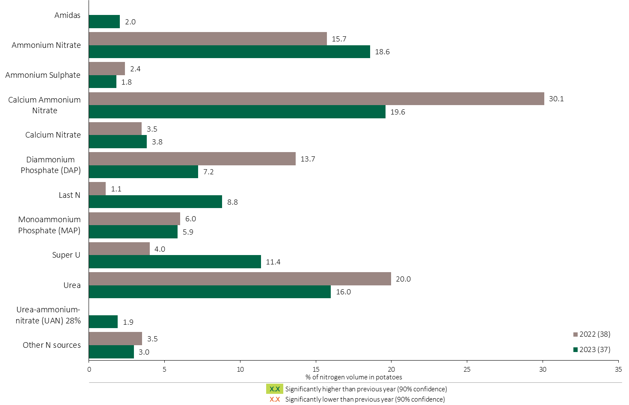
Nitrogen Fertilizer Source in Potatoes - All Timings
Potatoes
Potatoes Summary 
16% of the total nitrogen volume was applied as urea.
Note: Nitrogen volume was calculated from all sources of nitrogen contained in all fertilizer types
For each fertilizer type used in either a custom blend or applied as an unblended product, respondents were asked: a) how many acres they applied, and b) the application rate in pounds of actual nutrient/ac. Volumes of each nutrient were calculated by multiplying acres treated times the application rate.
The chart illustrates the % of total nitrogen volume applied at all timings that was provided by each fertilizer type. The nitrogen volume was calculated from all sources of nitrogen contained in all fertilizer types.

Slide 33
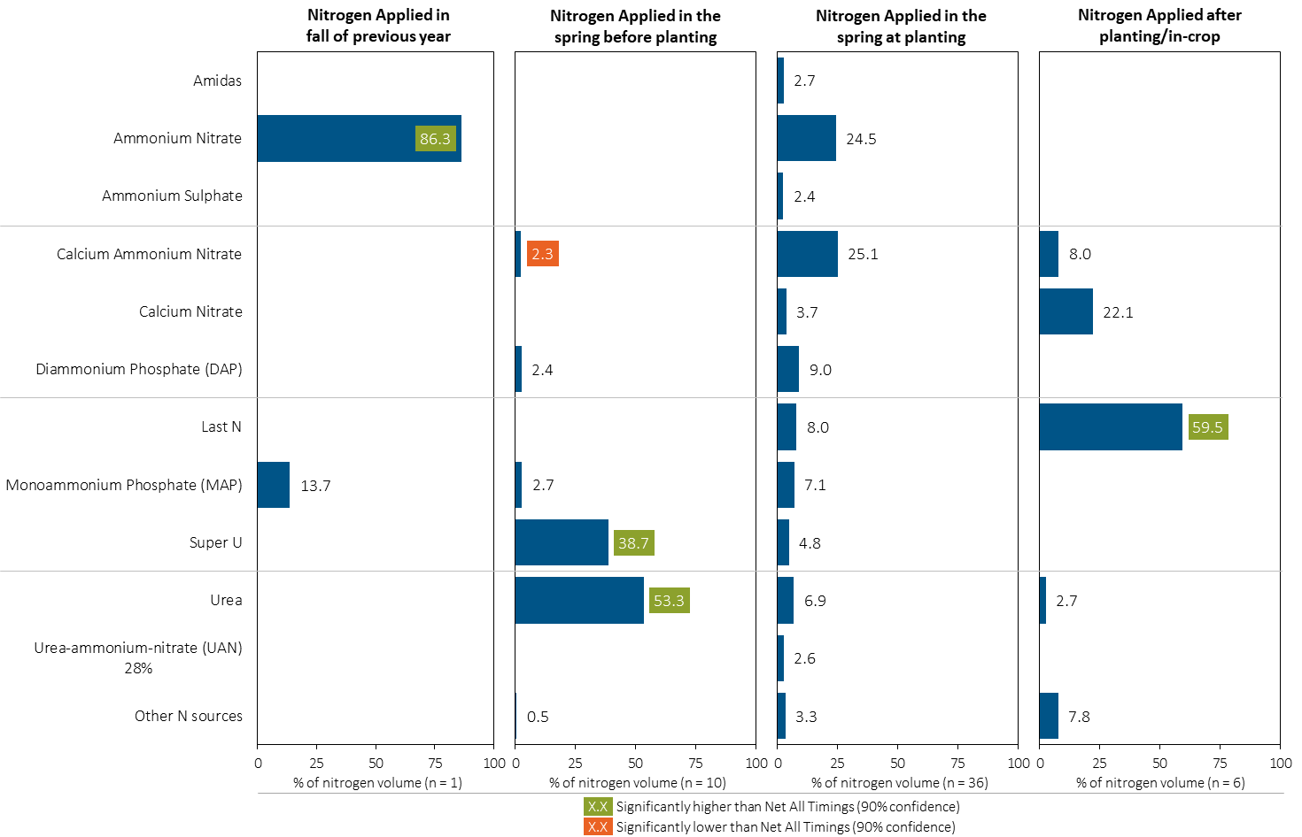
Nitrogen Fertilizer Source in Potatoes by Timing
Potatoes
Note: Nitrogen volume was calculated from all sources of nitrogen contained in all fertilizer types
For each fertilizer type used in either a custom blend or applied as an unblended product, respondents were asked: a) how many acres they applied, and b) the application rate in pounds of actual nutrient/ac. Volumes of each nutrient were calculated by multiplying acres treated times the application rate.
Separately for each application timing, the graphs illustrate the % of total nitrogen volume applied in potatoes that came from each fertilizer source.
Total pounds of actual nitrogen applied was calculated based on all sources of nitrogen from all fertilizer types.

Slide 34
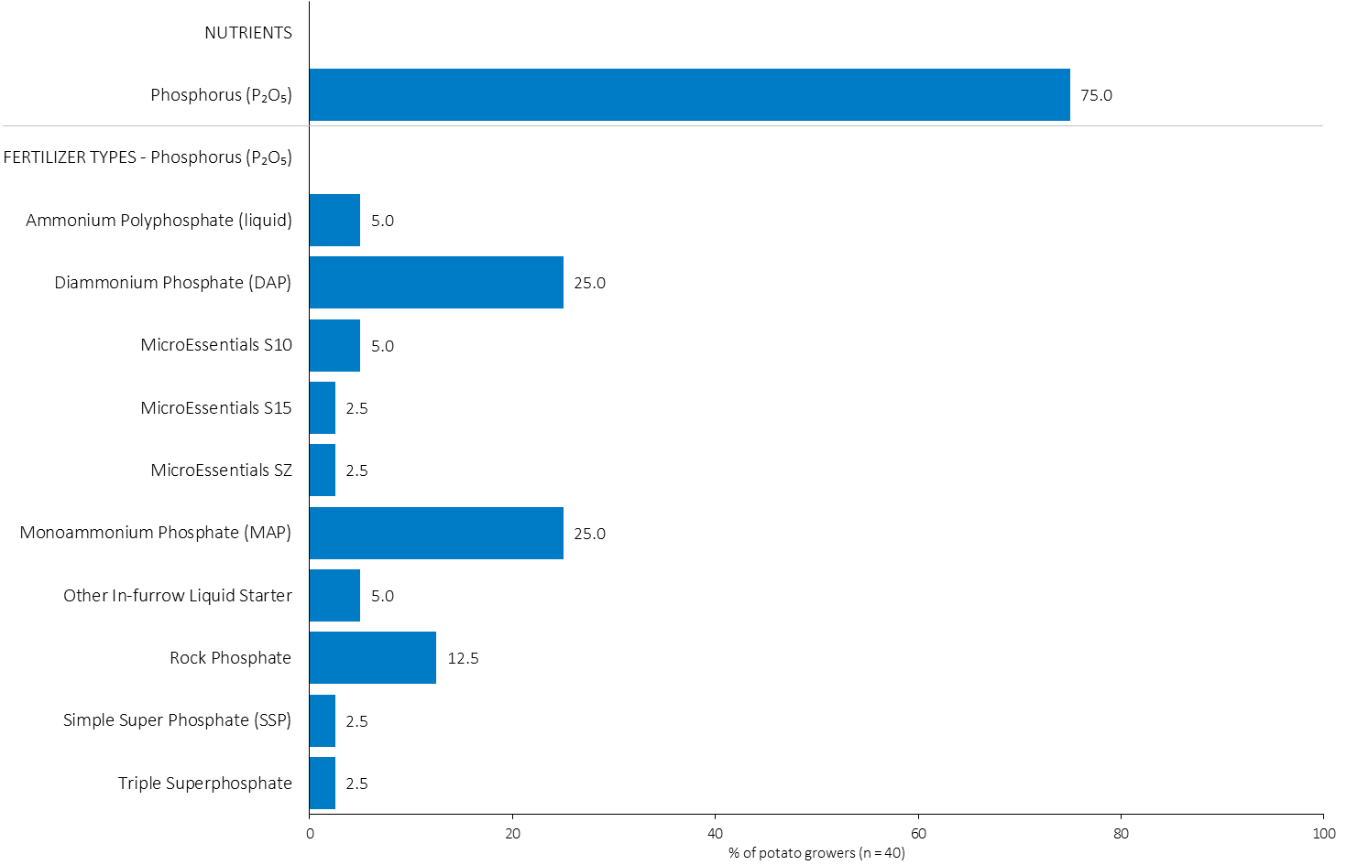
% of Potato Growers Using Each Phosphorus (P₂O₅) Source in in 2023
Potatoes
25% of potato growers used DAP in 2023.
Note: Nutrients were defined based on any fertilizer type that contains the nutrient.
Respondents were asked: “For your 2023 potato crop, did you apply fertilizer or manure at each timing? - and given the options of a) Applied in fall of previous year, b) in the spring before planting, c) in the spring at planting and d) after planting/in-crop. For your 2023 potato crop, which fertilizer types did you apply at each timing?
The chart illustrates the % of potato growers who indicated that they used this nutrient and each fertilizer type in potatoes in 2023.
Nutrients were defined based on any fertilizer type that contains the nutrient.

Slide 35
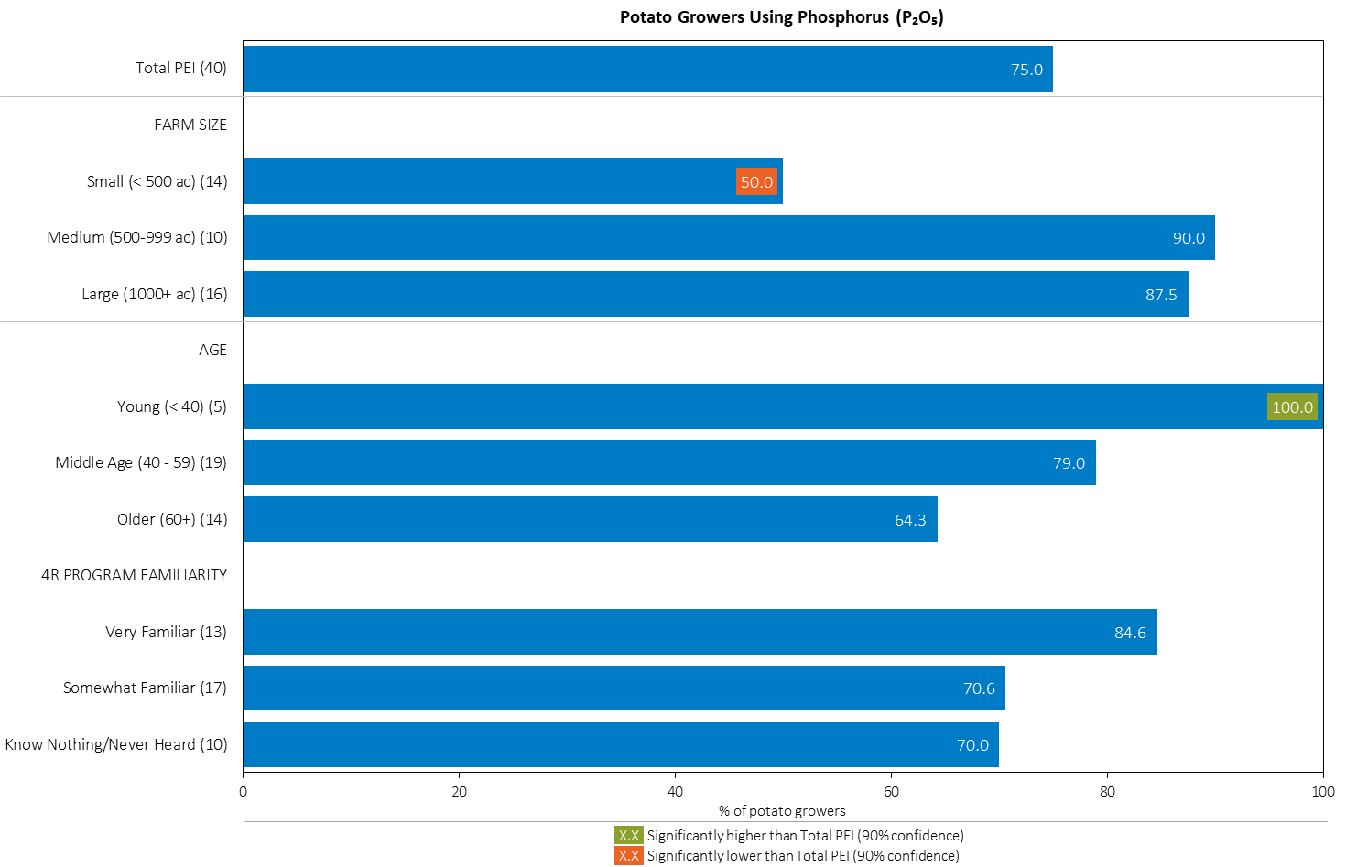
% of Potato Growers Using Phosphorus (P₂O₅) in 2023
Potatoes
Small growers were less likely to apply Phosphorus.
Note: Nutrients were defined based on any fertilizer type that contains the nutrient.
Respondents were asked: “For your 2023 potato crop, did you apply fertilizer or manure at each timing? - and given the options of a) Applied in fall of previous year, b) in the spring before planting, c) in the spring at planting and d) after planting/in-crop. For your 2023 potato crop, which fertilizer types did you apply at each timing?
The chart illustrates the % of potato growers who indicated that they used this nutrient in potatoes in 2023 by farm size, age and 4R familiarity.
Nutrients were defined based on any fertilizer type that contains the nutrient.

Slide 36
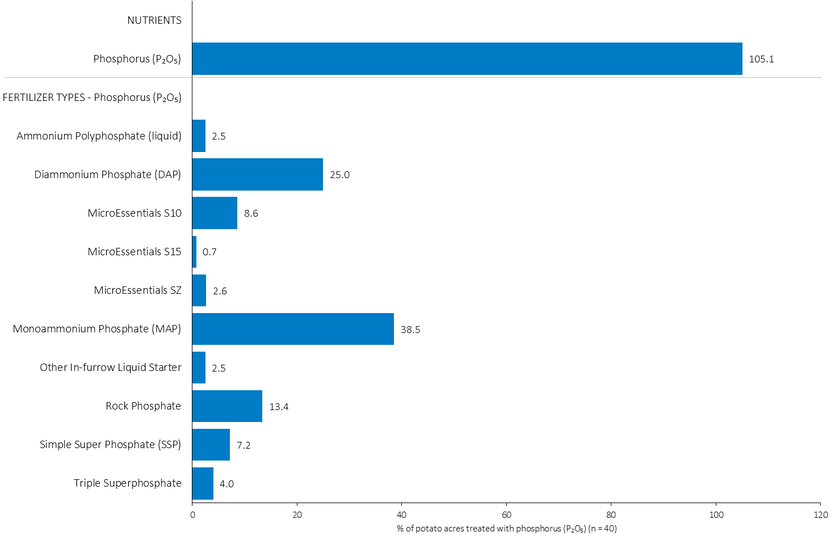
Acres Treated With Each Phosphorus (P₂O₅) Source in Potatoes in 2023
Potatoes
Multiple Phosphorus fertilizers were applied on some potato acres.
Potatoes Summary 
Note: Nutrients were defined based on the primary component of each fertilizer type
For each application timing, respondents were asked: “Of your [xxx] acres of potato, how many acres of each fertilizer type did you apply?”
The chart illustrates the % of total potato acres that were treated with this nutrient and each fertilizer type in 2023.
Nutrients were defined based on the primary component (see adjacent fertilizer types by clicking on the “A” button.

Slide 37
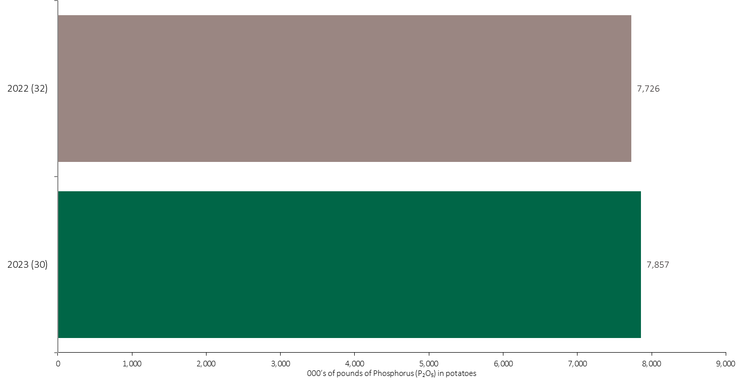
Phosphorus (P₂O₅) Volume in Potatoes
Potatoes
An estimated 8 million pounds of P₂O₅ was used in potatoes in 2023.
Note: Phosphorus (P₂O₅) volume was calculated from all sources of phosphorus contained in all fertilizer types
For each fertilizer type used in either a custom blend or applied as an unblended product, respondents were asked: a) how many acres they applied, and b) the application rate in pounds of actual nutrient/ac. Volumes of each nutrient were calculated by multiplying acres treated times the application rate.
The chart illustrates the total phosphorus (P₂O₅) volume (000’s of pounds) that was used in each year. The phosphorus (P₂O₅) volume was calculated from all sources of phosphorus (P₂O₅) contained in all fertilizer types.

Slide 38
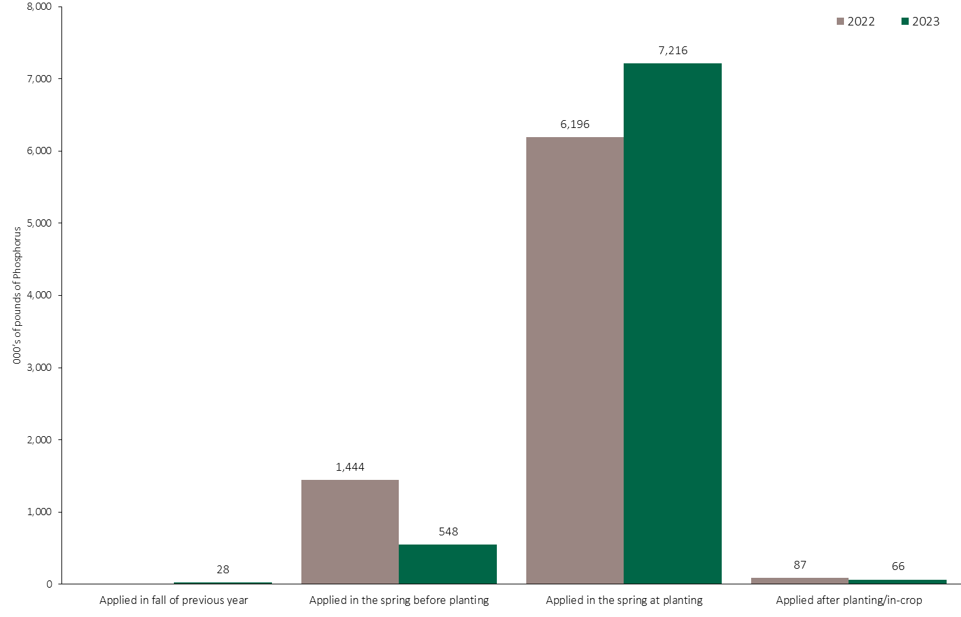
Phosphorus (P₂O₅) Volume in Potatoes by Timing
Potatoes
Note: Phosphorus (P₂O₅) volume was calculated from all sources of phosphorus contained in all fertilizer types
For each fertilizer type used in either a custom blend or applied as an unblended product, respondents were asked: a) how many acres they applied, and b) the application rate in pounds of actual nutrient/ac. Volumes of each nutrient were calculated by multiplying acres treated times the application rate.
The chart illustrates the total phosphorus (P₂O₅) volume (000’s of pounds) that was used in each year by application timing. The phosphorus (P₂O₅) volume was calculated from all sources of phosphorus (P₂O₅) contained in all fertilizer types.

Slide 39
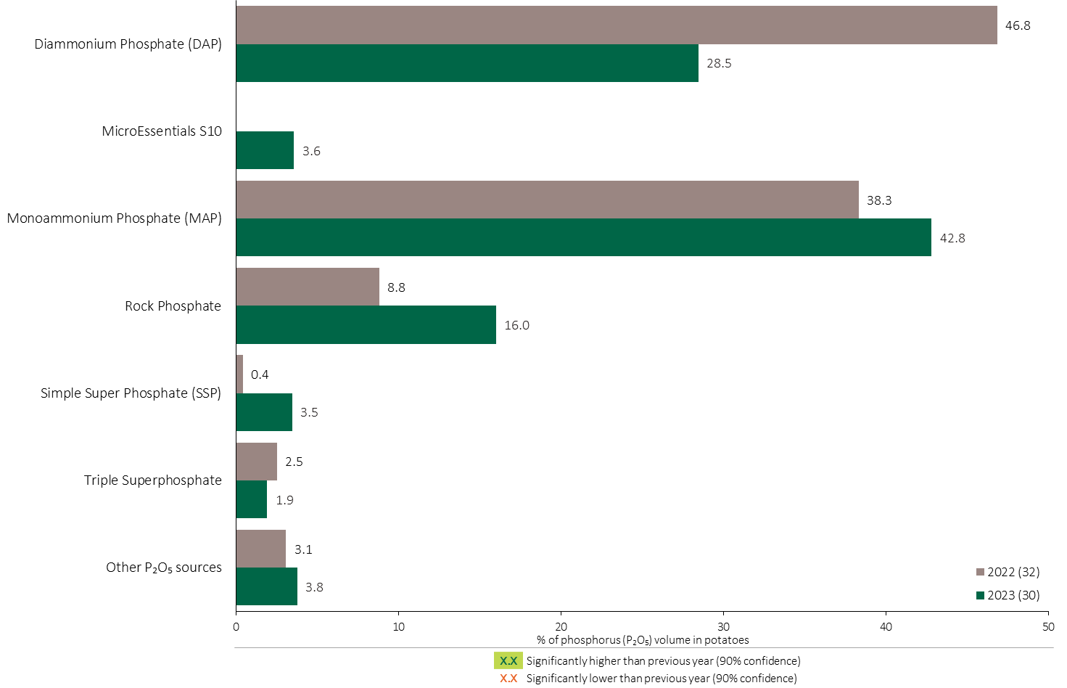
Phosphorus (P₂O₅) Fertilizer Source in Potatoes - All Timings
Potatoes
29% of total Phosphorus (P₂O₅) volume was applied as DAP in 2023.
Potatoes Summary 
Note: Phosphorus (P₂O₅) volume was calculated from all sources of phosphorus contained in all fertilizer types
For each fertilizer type used in either a custom blend or applied as an unblended product, respondents were asked: a) how many acres they applied, and b) the application rate in pounds of actual nutrient/ac. Volumes of each nutrient were calculated by multiplying acres treated times the application rate.
The chart illustrates the % of total phosphorus (P₂O₅) volume applied at all timings that was provided by each fertilizer type. The phosphorus (P₂O₅) volume was calculated from all sources of phosphorus (P₂O₅) contained in all fertilizer types.

Slide 40
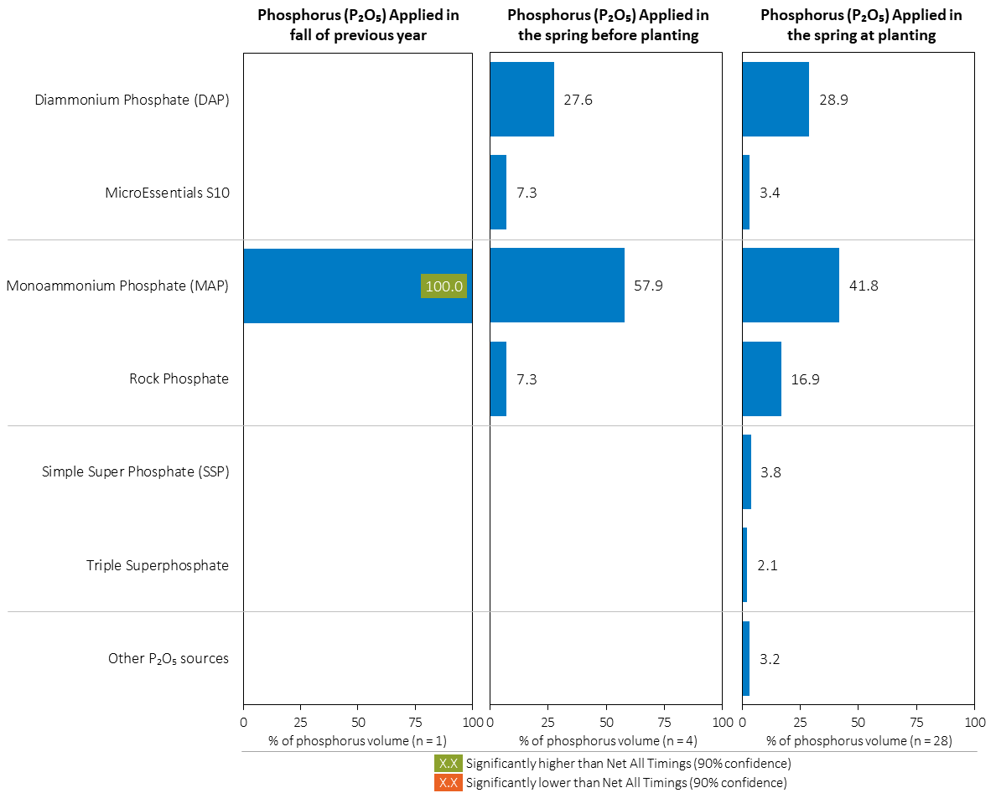
Phosphorus (P₂O₅ Fertilizer Source in Potatoes by Timing
Potatoes
Note: Phosphorus (P₂O₅) volume was calculated from all sources of phosphorus contained in all fertilizer types
For each fertilizer type used in either a custom blend or applied as an unblended product, respondents were asked: a) how many acres they applied, and b) the application rate in pounds of actual nutrient/ac. Volumes of each nutrient were calculated by multiplying acres treated times the application rate.
Separately for each application timing, the graphs illustrate the % of total phosphorus (P₂O₅) volume applied in potatoes that came from each fertilizer source.
Total pounds of actual phosphorus (P₂O₅) applied was calculated based on all sources of phosphorus (P₂O₅) from all fertilizer types.

Slide 41
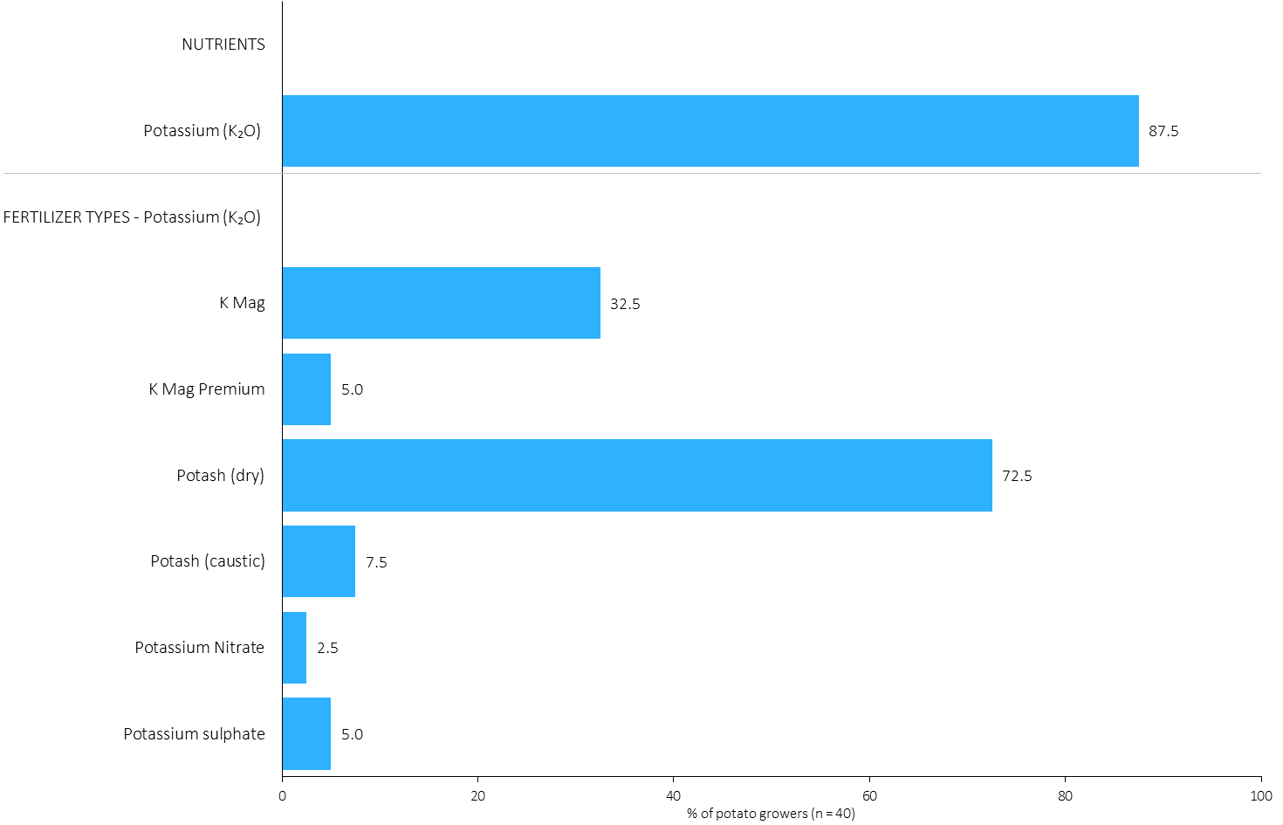
% of Potato Growers Using Each Potassium (K₂O) Source in in 2023
Potatoes
73% of potato growers used dry potash in 2023.
Note: Nutrients were defined based on any fertilizer type that contains the nutrient.
Respondents were asked: “For your 2023 potato crop, did you apply fertilizer or manure at each timing? - and given the options of a) Applied in fall of previous year, b) in the spring before planting, c) in the spring at planting and d) after planting/in-crop. For your 2023 potato crop, which fertilizer types did you apply at each timing?
The chart illustrates the % of potato growers who indicated that they used this nutrient and each fertilizer type in potatoes in 2023.
Nutrients were defined based on any fertilizer type that contains the nutrient.

Slide 42
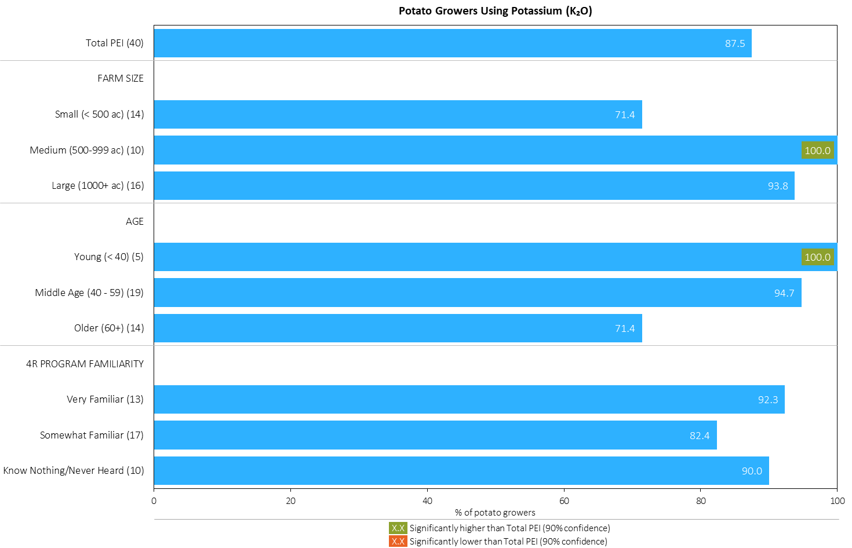
% of Potato Growers Using Potassium (K₂O) in 2023
Potatoes
Note: Nutrients were defined based on any fertilizer type that contains the nutrient.
Respondents were asked: “For your 2023 potato crop, did you apply fertilizer or manure at each timing? - and given the options of a) Applied in fall of previous year, b) in the spring before planting, c) in the spring at planting and d) after planting/in-crop. For your 2023 potato crop, which fertilizer types did you apply at each timing?
The chart illustrates the % of potato growers who indicated that they used this nutrient in potatoes in 2023 by farm size, age and 4R familiarity.
Nutrients were defined based on any fertilizer type that contains the nutrient.

Slide 43
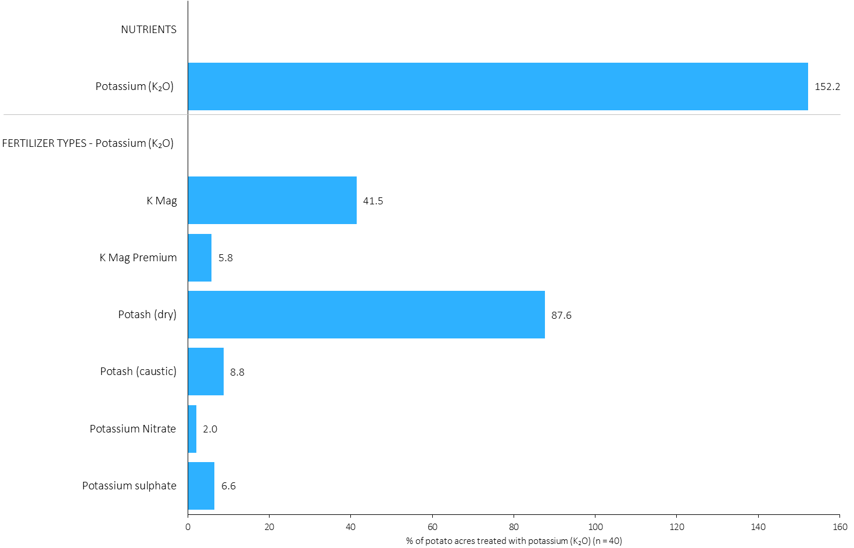
Acres Treated With Each Potassium (K₂O) Source in Potatoes in 2023
Potatoes
Multiple Potassium fertilizers were applied on some potato acres.
Potatoes Summary 
Note: Nutrients were defined based on the primary component of each fertilizer type
For each application timing, respondents were asked: “Of your [xxx] acres of potato, how many acres of each fertilizer type did you apply?”
The chart illustrates the % of total potato acres that were treated with this nutrient and each fertilizer type in 2023.
Nutrients were defined based on the primary component (see adjacent fertilizer types by clicking on the “A” button).

Slide 44
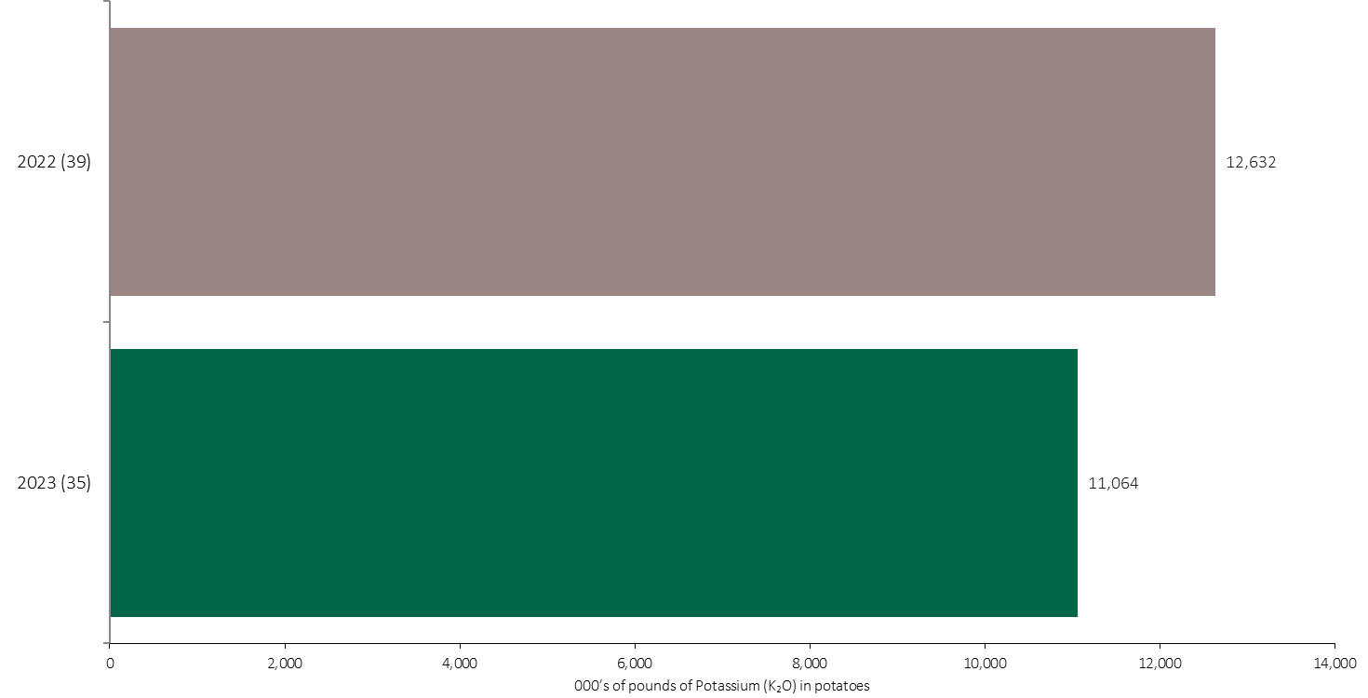
Potassium (K₂O) Volume in Potatoes
Potatoes
An estimated 11 million pounds of K₂O was used in potatoes in 2023.
Note: Potassium (K₂O) volume was calculated from all sources of potassium contained in all fertilizer types
For each fertilizer type used in either a custom blend or applied as an unblended product, respondents were asked: a) how many acres they applied, and b) the application rate in pounds of actual nutrient/ac. Volumes of each nutrient were calculated by multiplying acres treated times the application rate.
The chart illustrates the total potassium (K₂O) volume (000’s of pounds) that was used in each year. The potassium (K₂O) volume was calculated from all sources of potassium (K₂O) contained in all fertilizer types.

Slide 45
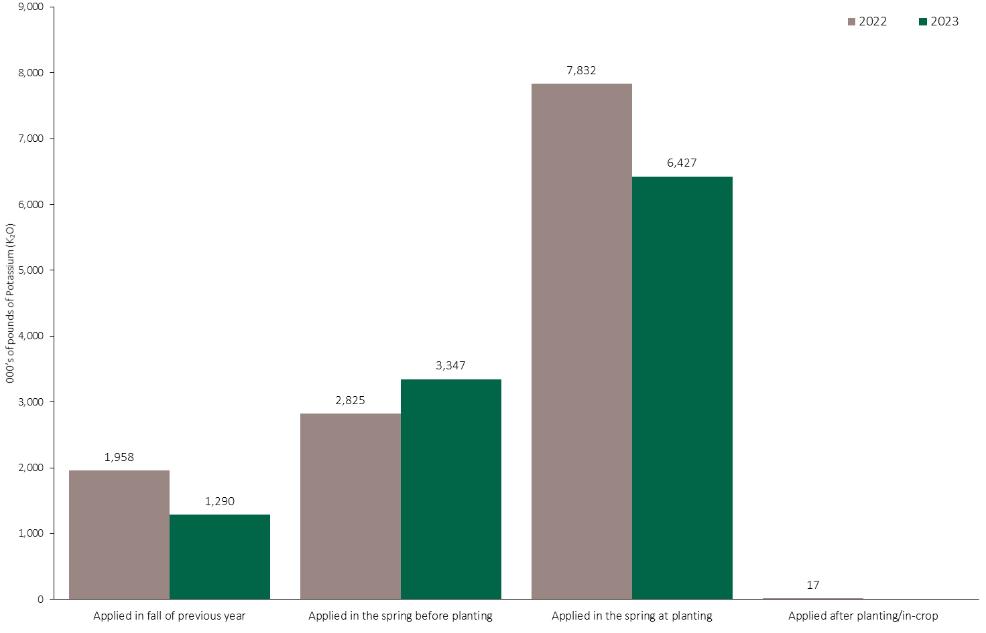
Potassium (K₂O) Volume in Potatoes by Timing
Potatoes
Note: Potassium (K₂O) volume was calculated from all sources of potassium contained in all fertilizer types
For each fertilizer type used in either a custom blend or applied as an unblended product, respondents were asked: a) how many acres they applied, and b) the application rate in pounds of actual nutrient/ac. Volumes of each nutrient were calculated by multiplying acres treated times the application rate.
The chart illustrates the total potassium (K₂O) volume (000’s of pounds) that was used in each year by application timing. The potassium (K₂O) volume was calculated from all sources of potassium (K₂O) contained in all fertilizer types.

Slide 46
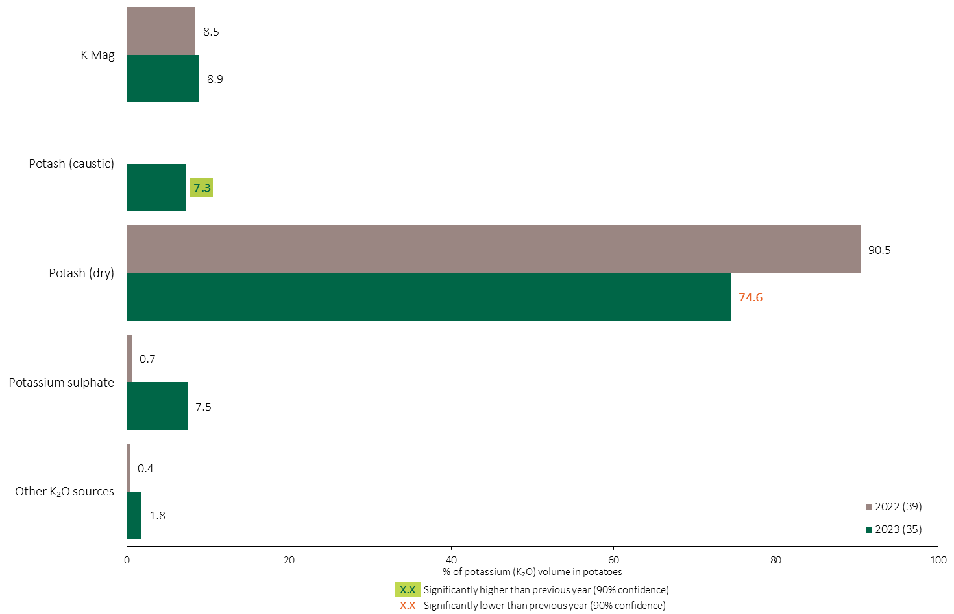
Potassium (K₂O) Fertilizer Source in Potatoes - All Timings
Potatoes
Potatoes Summary 
75% of the total Potassium volume was applied as dry potash in in 2023.
Note: Potassium (K₂O) volume was calculated from all sources of potassium contained in all fertilizer types
For each fertilizer type used in either a custom blend or applied as an unblended product, respondents were asked: a) how many acres they applied, and b) the application rate in pounds of actual nutrient/ac. Volumes of each nutrient were calculated by multiplying acres treated times the application rate.
The chart illustrates the % of total potassium (K₂O) volume applied at all timings that was provided by each fertilizer type. The potassium (K₂O) volume was calculated from all sources of potassium (K₂O) contained in all fertilizer types.

Slide 47
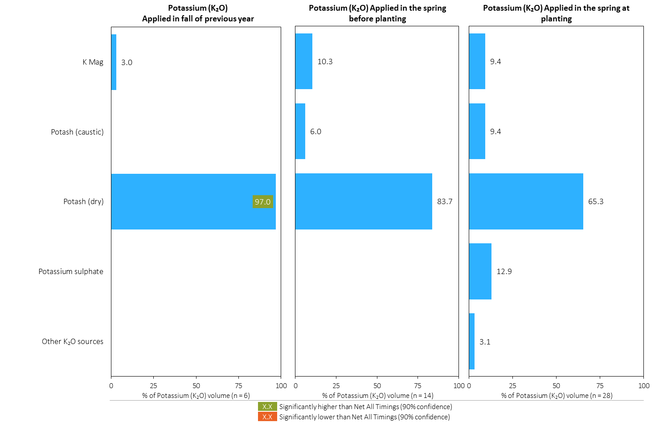
Potassium (K₂O) Fertilizer Source in Potatoes by Timing
Potatoes
Note: Potassium (K₂O) volume was calculated from all sources of potassium contained in all fertilizer types
For each fertilizer type used in either a custom blend or applied as an unblended product, respondents were asked: a) how many acres they applied, and b) the application rate in pounds of actual nutrient/ac. Volumes of each nutrient were calculated by multiplying acres treated times the application rate.
Separately for each application timing, the graphs illustrate the % of total potassium (K₂O) volume applied in potatoes that came from each fertilizer source.
Total pounds of actual potassium (K₂O) applied was calculated based on all sources of potassium (K₂O) from all fertilizer types.

Slide 48
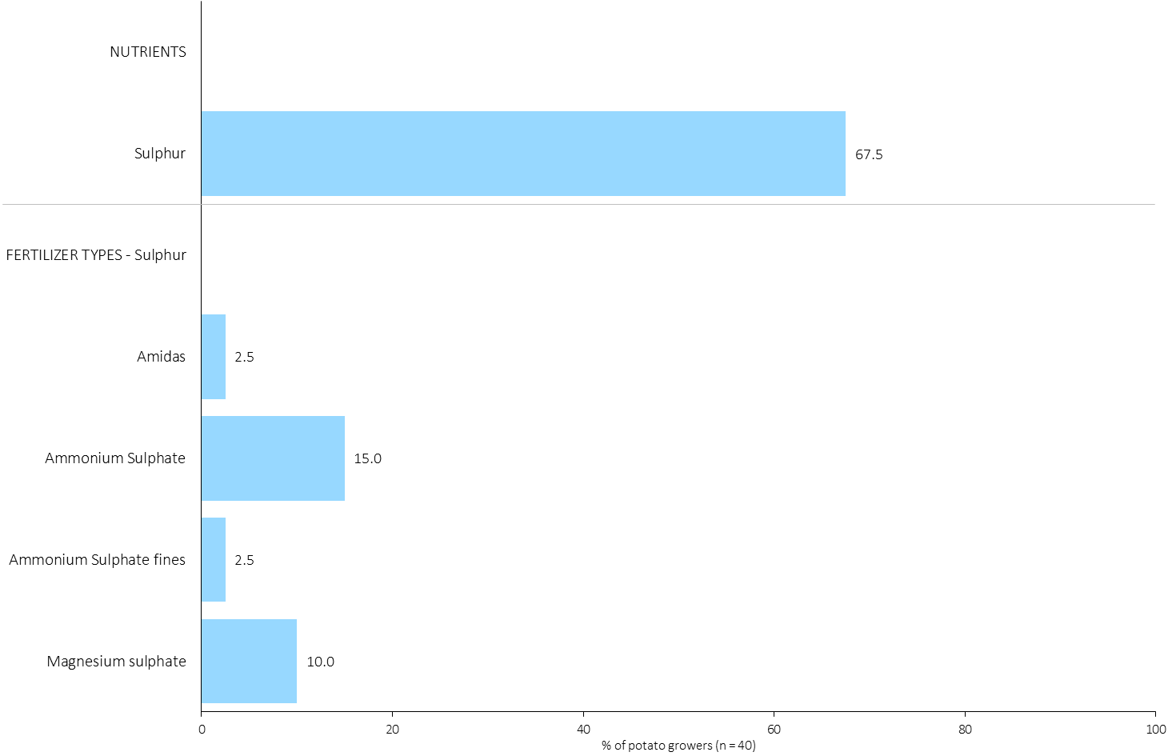
% of Potato Growers Using Each Sulphur Source in in 2023
Potatoes
68% of potato growers applied Sulphur in 2023.
Note: Nutrients were defined based on any fertilizer type that contains the nutrient.
Respondents were asked: “For your 2023 potato crop, did you apply fertilizer or manure at each timing? - and given the options of a) Applied in fall of previous year, b) in the spring before planting, c) in the spring at planting and d) after planting/in-crop. For your 2023 potato crop, which fertilizer types did you apply at each timing?
The chart illustrates the % of potato growers who indicated that they used this nutrient and each fertilizer type in potatoes in 2023.
Nutrients were defined based on any fertilizer type that contains the nutrient.

Slide 49
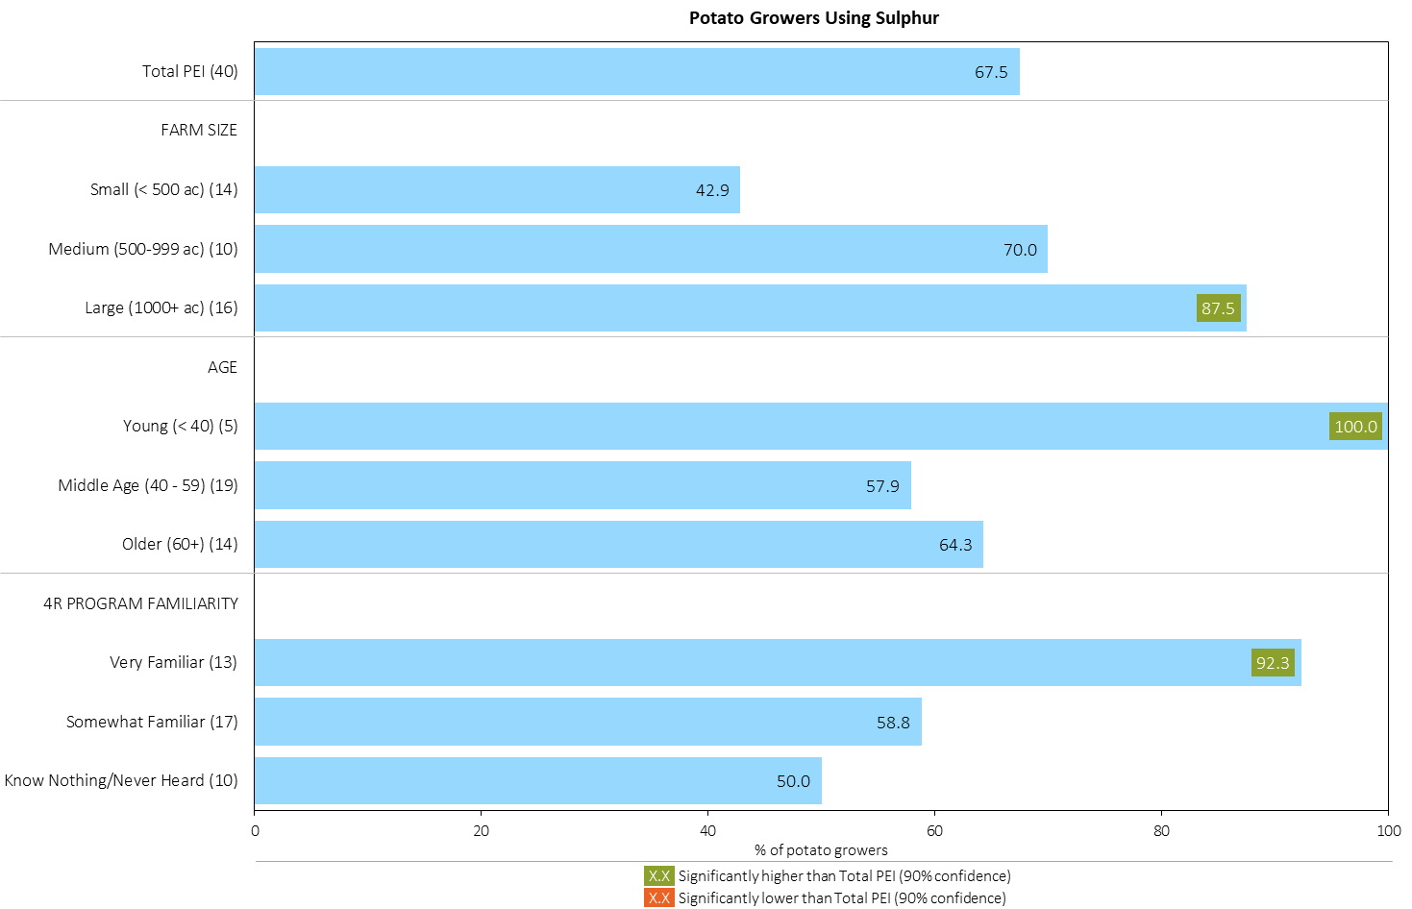
% of Potato Growers Using Sulphur in 2023
Potatoes
Large farms, young growers and those familiar with 4R were more likely to apply Sulphur.
Note: Nutrients were defined based on any fertilizer type that contains the nutrient.
Respondents were asked: “For your 2023 potato crop, did you apply fertilizer or manure at each timing? - and given the options of a) Applied in fall of previous year, b) in the spring before planting, c) in the spring at planting and d) after planting/in-crop. For your 2023 potato crop, which fertilizer types did you apply at each timing?
The chart illustrates the % of potato growers who indicated that they used this nutrient in potatoes in 2023 by farm size, age and 4R familiarity.
Nutrients were defined based on any fertilizer type that contains the nutrient.

Slide 50
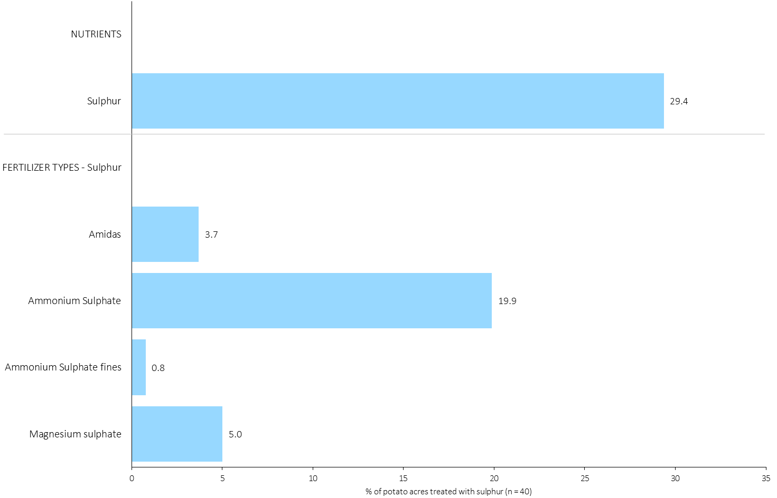
Acres Treated With Each Sulphur Source in Potatoes in 2023
Potatoes
Potatoes Summary 
29% of potato acres were treated with Sulphur in 2023.
Note: Nutrients were defined based on the primary component of each fertilizer type
For each application timing, respondents were asked: “Of your [xxx] acres of potatoes, how many acres of each fertilizer type did you apply?”
The chart illustrates the % of total potato acres that were treated with this nutrient and each fertilizer type in 2023.
Nutrients were defined based on the primary component (see adjacent fertilizer types by clicking on the “A” button).

Slide 51
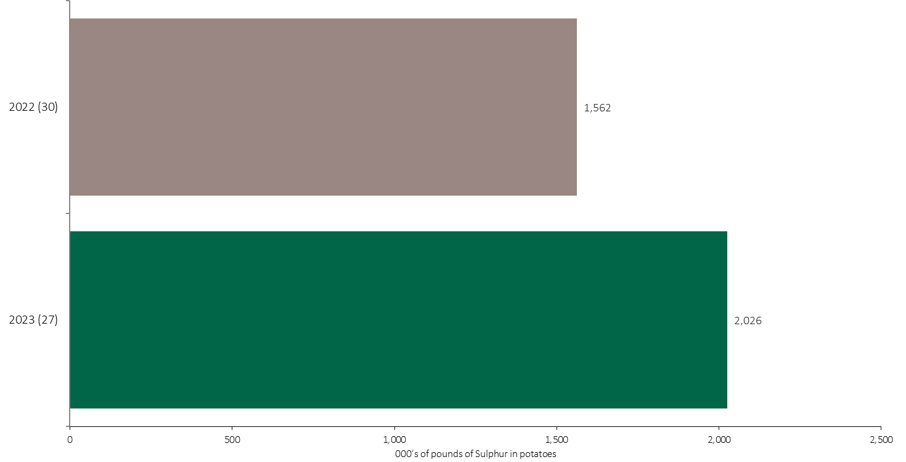
Sulphur Volume in Potatoes
Potatoes
An estimated 2 million pounds of Sulphur was used in potatoes in 2023.
Note: Sulphur volume was calculated from all sources of sulphur contained in all fertilizer types
For each fertilizer type used in either a custom blend or applied as an unblended product, respondents were asked: a) how many acres they applied, and b) the application rate in pounds of actual nutrient/ac. Volumes of each nutrient were calculated by multiplying acres treated times the application rate.
The chart illustrates the total sulphur volume (000’s of pounds) that was used in each year. The sulphur volume was calculated from all sources of sulphur contained in all fertilizer types.

Slide 52
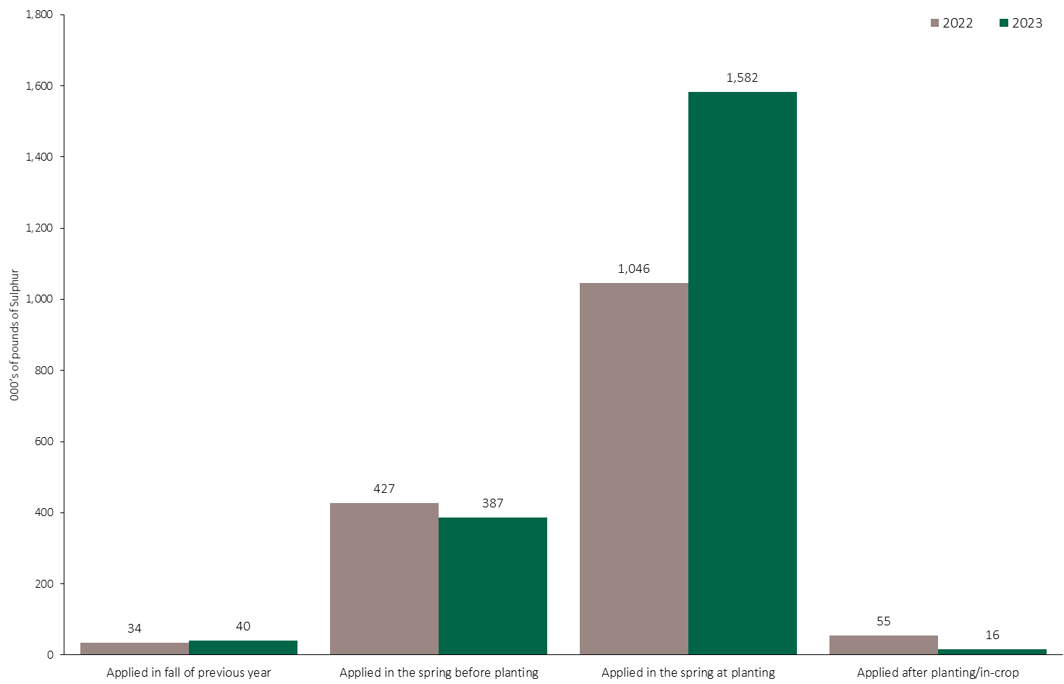
Sulphur Volume in Potatoes by Timing
Potatoes
Note: Sulphur volume was calculated from all sources of sulphur contained in all fertilizer types
For each fertilizer type used in either a custom blend or applied as an unblended product, respondents were asked: a) how many acres they applied, and b) the application rate in pounds of actual nutrient/ac. Volumes of each nutrient were calculated by multiplying acres treated times the application rate.
The chart illustrates the total sulphur volume (000’s of pounds) that was used in each year by application timing. The sulphur volume was calculated from all sources of sulphur contained in all fertilizer types.

Slide 53
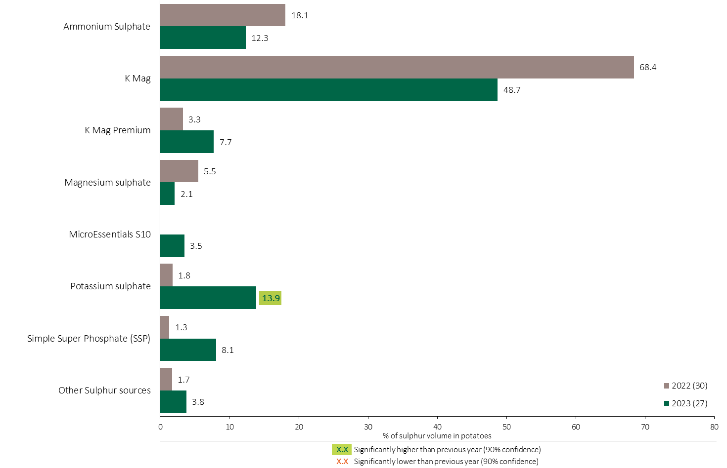
Sulphur Fertilizer Source in Potatoes - All Timings
Potatoes
49% of the total sulphur volume was applied as K-Mag in 2023.
Potatoes Summary 
Note: Sulphur volume was calculated from all sources of sulphur contained in all fertilizer types
For each fertilizer type used in either a custom blend or applied as an unblended product, respondents were asked: a) how many acres they applied, and b) the application rate in pounds of actual nutrient/ac. Volumes of each nutrient were calculated by multiplying acres treated times the application rate.
The chart illustrates the % of total sulphur volume applied at all timings that was provided by each fertilizer type. The sulphur volume was calculated from all sources of sulphur contained in all fertilizer types.

Slide 54
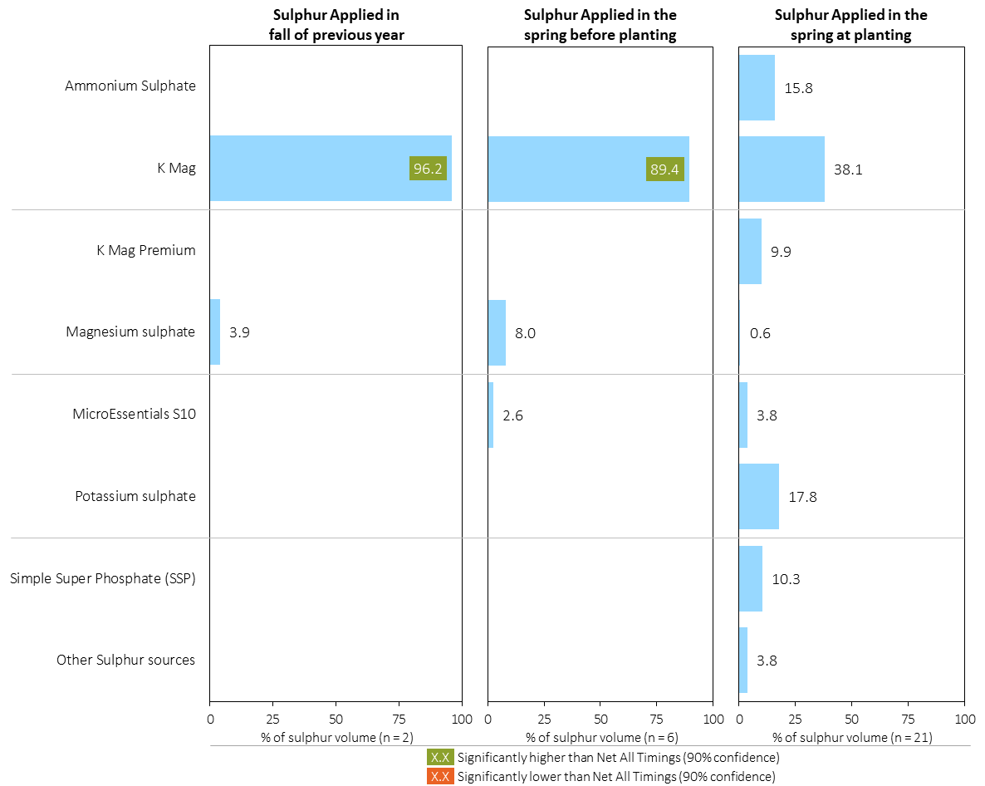
Sulphur Fertilizer Source in Potatoes by Timing
Potatoes
Note: Sulphur volume was calculated from all sources of sulphur contained in all fertilizer types
For each fertilizer type used in either a custom blend or applied as an unblended product, respondents were asked: a) how many acres they applied, and b) the application rate in pounds of actual nutrient/ac. Volumes of each nutrient were calculated by multiplying acres treated times the application rate.
Separately for each application timing, the graphs illustrate the % of total sulphur volume applied in potatoes that came from each fertilizer source.
Total pounds of actual sulphur applied was calculated based on all sources of sulphur from all fertilizer types.

Slide 55

Nitrogen Placement in Potatoes - % Crop Acres
Potatoes
Note: Nutrients were defined based on the primary component of each fertilizer type
For each application timing, respondents were asked: “Of your [xxx] acres of potatoes, how many acres of each fertilizer type did you apply?”
Separately for each nutrient, the chart illustrates the % of total potato acres that was applied using each placement at each timing.
Nitrogen was defined based on it being the primary component (see adjacent fertilizer types by clicking on the “A” button.

Slide 56

Nitrogen Placement in Potatoes - % Nutrient Volume Applied at All Timings
Potatoes
Potatoes Summary 
Note: Nutrient volume was calculated from all sources of the nutrient contained in all fertilizer types
For each fertilizer type used in either a custom blend or applied as an unblended product, respondents were asked: a) how many acres they applied, and b) the application rate in pounds of actual nutrient/ac. Volumes of each nutrient were calculated by multiplying acres treated times the application rate.
The graph illustrates the % of total nutrient volume applied in potatoes that was applied at each timing/placement (i.e. across all timings, the sum of percentages = 100%).
Total pounds of actual nutrient applied was calculated based on all sources of the nutrient from all fertilizer types.

Slide 57

Phosphorus (P₂O₅) Placement in Potatoes - % Crop Acres
Potatoes
Potatoes Summary 
Note: Nutrients were defined based on the primary component of each fertilizer type
For each application timing, respondents were asked: “Of your [xxx] acres of potatoes, how many acres of each fertilizer type did you apply?”
Separately for each nutrient, the chart illustrates the % of total potato acres that was applied using each placement at each timing.
Phosphorus was defined based on it being the primary component (see adjacent fertilizer types by clicking on the “A” button).

Slide 58

Phosphorus (P₂O₅) Placement in Potatoes - % Nutrient Volume Applied at All Timings
Potatoes
Potatoes Summary 
Note: Nutrient volume was calculated from all sources of the nutrient contained in all fertilizer types
For each fertilizer type used in either a custom blend or applied as an unblended product, respondents were asked: a) how many acres they applied, and b) the application rate in pounds of actual nutrient/ac. Volumes of each nutrient were calculated by multiplying acres treated times the application rate.
The graph illustrates the % of total nutrient volume applied in potatoes that was applied at each timing/placement (i.e. across all timings, the sum of percentages = 100%).
Total pounds of actual nutrient applied was calculated based on all sources of the nutrient from all fertilizer types.

Slide 59

Potassium (K₂O) Placement in Potatoes - % Crop Acres
Potatoes
Potatoes Summary 
Note: Nutrients were defined based on the primary component of each fertilizer type
For each application timing, respondents were asked: “Of your [xxx] acres of potato, how many acres of each fertilizer type did you apply?”
Separately for each nutrient, the chart illustrates the % of total potato acres that was applied using each placement at each timing.
Potassium was defined based on it being the primary component (see adjacent fertilizer types by clicking on the “A” button.

Slide 60

Potassium (K₂O) Placement in Potatoes - % Nutrient Volume Applied at All Timings
Potatoes
Potatoes Summary 
Note: Nutrient volume was calculated from all sources of the nutrient contained in all fertilizer types
For each fertilizer type used in either a custom blend or applied as an unblended product, respondents were asked: a) how many acres they applied, and b) the application rate in pounds of actual nutrient/ac. Volumes of each nutrient were calculated by multiplying acres treated times the application rate.
The graph illustrates the % of total nutrient volume applied in potatoes that was applied at each timing/placement (i.e. across all timings, the sum of percentages = 100%).
Total pounds of actual nutrient applied was calculated based on all sources of the nutrient from all fertilizer types.

Slide 61

Sulphur Placement in Potatoes - % Crop Acres
Potatoes
Potatoes Summary 
Note: Nutrients were defined based on the primary component of each fertilizer type
For each application timing, respondents were asked: “Of your [xxx] acres of potato, how many acres of each fertilizer type did you apply?”
Separately for each nutrient, the chart illustrates the % of total potato acres that was applied using each placement at each timing.
Sulphur was defined based on it being the primary component (see adjacent fertilizer types by clicking on the “A” button.

Slide 62

Sulphur Placement in Potatoes - % Nutrient Volume Applied at All Timings
Potatoes
Potatoes Summary 
Note: Nutrient volume was calculated from all sources of the nutrient contained in all fertilizer types
For each fertilizer type used in either a custom blend or applied as an unblended product, respondents were asked: a) how many acres they applied, and b) the application rate in pounds of actual nutrient/ac. Volumes of each nutrient were calculated by multiplying acres treated times the application rate.
The graph illustrates the % of total nutrient volume applied in potatoes that was applied at each timing/placement (i.e. across all timings, the sum of percentages = 100%).
Total pounds of actual nutrient applied was calculated based on all sources of the nutrient from all fertilizer types.

Slide 63

Average Nitrogen Rates in Potatoes
Potatoes
The average N rate was 145 lbs./ac in 2023, up from 2022.
Potatoes Summary 
Note: Nitrogen volume was calculated from all sources of nitrogen contained in all fertilizer types
Note: Rates include growers who did not apply any nitrogen
For each fertilizer type used in either a custom blend or applied as an unblended product, respondents were asked: a) how many acres they applied, and b) the application rate in pounds of actual nutrient/ac. Volumes of each nutrient were calculated by multiplying acres treated times the application rate.
The chart illustrates the average rate of nitrogen applied in each year expressed in pounds of actual nitrogen per acre.

Slide 64

Nitrogen Rates in Potatoes - Average Rate in 2023
Potatoes
Small farms used lower N rates.
Potatoes Summary 
Note: Nitrogen volume was calculated from all sources of nitrogen contained in all fertilizer types
Note: Rates include growers who did not apply any nitrogen
For each fertilizer type used in either a custom blend or applied as an unblended product, respondents were asked: a) how many acres they applied, and b) the application rate in pounds of actual nutrient/ac. Volumes of each nutrient were calculated by multiplying acres treated times the application rate.
Separately by farm size, age and 4R familiarity, the graph illustrates the average nitrogen application rate in pounds of nitrogen per acre (including untreated potato acres).

Slide 65

Nitrogen Rates in Potatoes - Rate Ranges in 2023
Potatoes
Note: Nitrogen volume was calculated from all sources of nitrogen contained in all fertilizer types
For each fertilizer type used in either a custom blend or applied as an unblended product, respondents were asked: a) how many acres they applied, and b) the application rate in pounds of actual nutrient/ac. Volumes of each nutrient were calculated by multiplying acres treated times the application rate.
The graph on the left illustrates the % of potato acres that were treated with nitrogen at an application rate that fell within each rate range. The graph on the right illustrates the cumulative % of potato acres that were treated with nitrogen at an application rate that fell within each rate range.

Slide 66

Nitrogen Rate Ranges in Potatoes - % of Volume in 2023
Potatoes
55% of the N volume was applied at 170+ lbs./ac.
Note: Nitrogen volume was calculated from all sources of nitrogen contained in all fertilizer types
For each fertilizer type used in either a custom blend or applied as an unblended product, respondents were asked: a) how many acres they applied, and b) the application rate in pounds of actual nutrient/ac. Volumes of each nutrient were calculated by multiplying acres treated times the application rate.
The chart illustrates the % of nitrogen volume that was applied in potatoes within each rate range.
Total pounds of actual nitrogen applied was calculated based on all sources of nitrogen from all fertilizer types.

Slide 67

Average Nitrogen Rates in Potatoes - By Timing
Potatoes
Potatoes Summary 
Average N rates at planting were 116 lbs./ac in 2023.
Note: Nitrogen volume was calculated from all sources of nitrogen contained in all fertilizer types
Note: Rates exclude growers who did not apply any nitrogen
For each fertilizer type used in either a custom blend or applied as an unblended product, respondents were asked: a) how many acres they applied, and b) the application rate in pounds of actual nutrient/ac. Volumes of each nutrient were calculated by multiplying acres treated times the application rate.
The chart illustrates the average rate of Nitrogen applied at each application timing in each year expressed in pounds of actual Nitrogen per acre.
Note: Rates exclude non-users of Nitrogen.

Slide 68

Average Phosphorus (P₂O₅) Rates in Potatoes
Potatoes
Average P₂O₅ rates were unchanged in 2023 at 94 lbs./ac.
Potatoes Summary 
Note: Phosphorus (P₂O₅) volume was calculated from all sources of phosphorus contained in all fertilizer types
Note: Rates include growers who did not apply any phosphorus
For each fertilizer type used in either a custom blend or applied as an unblended product, respondents were asked: a) how many acres they applied, and b) the application rate in pounds of actual nutrient/ac. Volumes of each nutrient were calculated by multiplying acres treated times the application rate.
The chart illustrates the average rate of Phosphorus (P₂O₅) applied in each year expressed in pounds of actual Phosphorus (P₂O₅) per acre.
Note: Rates include non-users of Phosphorus (P₂O₅).

Slide 69

Phosphorus (P₂O₅) Rates in Potatoes - Average Rate in 2023
Potatoes
Potatoes Summary 
Note: Phosphorus (P₂O₅) volume was calculated from all sources of phosphorus contained in all fertilizer types
Note: Rates include growers who did not apply any phosphorus
For each fertilizer type used in either a custom blend or applied as an unblended product, respondents were asked: a) how many acres they applied, and b) the application rate in pounds of actual nutrient/ac. Volumes of each nutrient were calculated by multiplying acres treated times the application rate.
Separately by farm size, age and 4R familiarity, the graph illustrates the average Phosphorus (P₂O₅) application rate in pounds of Phosphorus (P₂O₅) per acre (including untreated potato acres).

Slide 70

Phosphorus (P₂O₅) Rates in Potatoes - Rate Ranges in 2023
Potatoes
20% of potato acres did not receive an application of Phosphorus.
Potatoes Summary 
Note: Phosphorus (P₂O₅) volume was calculated from all sources of phosphorus contained in all fertilizer types
For each fertilizer type used in either a custom blend or applied as an unblended product, respondents were asked: a) how many acres they applied, and b) the application rate in pounds of actual nutrient/ac. Volumes of each nutrient were calculated by multiplying acres treated times the application rate.
The graph on the left illustrates the % of potato acres that were treated with phosphorus (P₂O₅) at an application rate that fell within each rate range. The graph on the right illustrates the cumulative % of potato acres that were treated with phosphorus (P₂O₅) at an application rate that fell within each rate range.

Slide 71

Phosphorus (P₂O₅) Rate Ranges in Potatoes - % of Volume in 2023
Potatoes
Almost 40% of the P volume was applied at 140 to 179.9 lbs./ac.
Note: Phosphorus (P₂O₅) volume was calculated from all sources of phosphorus contained in all fertilizer types
For each fertilizer type used in either a custom blend or applied as an unblended product, respondents were asked: a) how many acres they applied, and b) the application rate in pounds of actual nutrient/ac. Volumes of each nutrient were calculated by multiplying acres treated times the application rate.
The chart illustrates the % of phosphorus (P₂O₅) volume that was applied in potatoes within each rate range.
Total pounds of actual phosphorus (P₂O₅) applied was calculated based on all sources of phosphorus (P₂O₅) from all fertilizer types.

Slide 72

Average Phosphorus (P₂O₅) Rates in Potatoes - By Timing
Potatoes
P₂O₅ application rates at planting were unchanged in 2023.
Note: Phosphorus (P₂O₅) volume was calculated from all sources of phosphorus contained in all fertilizer types
Note: Rates exclude growers who did not apply any phosphorus
For each fertilizer type used in either a custom blend or applied as an unblended product, respondents were asked: a) how many acres they applied, and b) the application rate in pounds of actual nutrient/ac. Volumes of each nutrient were calculated by multiplying acres treated times the application rate.
The chart illustrates the average rate of Phosphorus (P₂O₅) applied at each application timing in each year expressed in pounds of actual Phosphorus (P₂O₅) per acre.
Note: Rates exclude non-users of Phosphorus (P₂O₅).

Slide 73

Average Potassium (K₂O) Rates in Potatoes
Potatoes
Potatoes Summary 
Average K₂O rates were lower in 2023 at 133lbs./ac.
Note: Potassium (K₂O) volume was calculated from all sources of potassium contained in all fertilizer types
Note: Rates include growers who did not apply any potassium
For each fertilizer type used in either a custom blend or applied as an unblended product, respondents were asked: a) how many acres they applied, and b) the application rate in pounds of actual nutrient/ac. Volumes of each nutrient were calculated by multiplying acres treated times the application rate.
The chart illustrates the average rate of Potassium (K₂O) applied in each year expressed in pounds of actual Potassium (K₂O) per acre.
Note: Rates include non-users of Potassium (K₂O).

Slide 74

Potassium (K₂O) Rates in Potatoes - Average Rate in 2023
Potatoes
Potatoes Summary 
Note: Potassium (K₂O) volume was calculated from all sources of potassium contained in all fertilizer types
Note: Rates include growers who did not apply any potassium
For each fertilizer type used in either a custom blend or applied as an unblended product, respondents were asked: a) how many acres they applied, and b) the application rate in pounds of actual nutrient/ac. Volumes of each nutrient were calculated by multiplying acres treated times the application rate.
Separately by farm size, age and 4R familiarity, the graph illustrates the average potassium (K₂O) application rate in pounds of potassium (K₂O) per acre (including untreated potato acres).

Slide 75

Potassium (K₂O) Rates in Potatoes - Rate Ranges in 2023
Potatoes
10% of potato acres received a K₂O application at 70 – 79.9 lbs./ac.
Potatoes Summary 
Note: Potassium (K₂O) volume was calculated from all sources of potassium contained in all fertilizer types
For each fertilizer type used in either a custom blend or applied as an unblended product, respondents were asked: a) how many acres they applied, and b) the application rate in pounds of actual nutrient/ac. Volumes of each nutrient were calculated by multiplying acres treated times the application rate.
The graph on the left illustrates the % of potato acres that were treated with potassium (K₂O) at an application rate that fell within each rate range. The graph on the right illustrates the cumulative % of potato acres that were treated with potassium (K₂O) at an application rate that fell within each rate range.

Slide 76

Potassium (K₂O) Rate Ranges in Potatoes - % of Volume in 2023
Potatoes
Potassium volumes were scattered across a wide range of application rates.
Note: Potassium (K₂O) volume was calculated from all sources of potassium contained in all fertilizer types
For each fertilizer type used in either a custom blend or applied as an unblended product, respondents were asked: a) how many acres they applied, and b) the application rate in pounds of actual nutrient/ac. Volumes of each nutrient were calculated by multiplying acres treated times the application rate.
The chart illustrates the % of potassium (K₂O) volume that was applied in potatoes within each rate range.
Total pounds of actual potassium (K₂O) applied was calculated based on all sources of potassium (K₂O) from all fertilizer types.

Slide 77

Average Potassium (K₂O) Rates in Potatoes - By Timing
Potatoes
K₂O rates at planting were just over 100 lbs./ac again in 2023.
Note: Potassium (K₂O) volume was calculated from all sources of potassium contained in all fertilizer types
Note: Rates exclude growers who did not apply any potassium
For each fertilizer type used in either a custom blend or applied as an unblended product, respondents were asked: a) how many acres they applied, and b) the application rate in pounds of actual nutrient/ac. Volumes of each nutrient were calculated by multiplying acres treated times the application rate.
The chart illustrates the average rate of Potassium (K₂O) applied at each application timing in each year expressed in pounds of actual Potassium (K₂O) per acre.
Note: Rates exclude non-users of Potassium (K₂O).

Slide 78

Average Sulphur Rates in Potatoes
Potatoes
Average Sulphur rates were higher in 2023 at 24 lbs./ac.
Potatoes Summary 
Note: Sulphur volume was calculated from all sources of sulphur contained in all fertilizer types
For each fertilizer type used in either a custom blend or applied as an unblended product, respondents were asked: a) how many acres they applied, and b) the application rate in pounds of actual nutrient/ac. Volumes of each nutrient were calculated by multiplying acres treated times the application rate.
The chart illustrates the average rate of Sulphur applied in each year expressed in pounds of actual Sulphur per acre.
Note: Rates include non-users of Sulphur.

Slide 79

Sulphur Rates in Potatoes - Average Rate in 2023
Potatoes
Potatoes Summary 
Note: Sulphur volume was calculated from all sources of sulphur contained in all fertilizer types
For each fertilizer type used in either a custom blend or applied as an unblended product, respondents were asked: a) how many acres they applied, and b) the application rate in pounds of actual nutrient/ac. Volumes of each nutrient were calculated by multiplying acres treated times the application rate.
Separately by farm size, age and 4R familiarity, the graph illustrates the average sulphur application rate in pounds of sulphur per acre (including untreated potato acres).

Slide 80

Sulphur Rates in Potatoes - Rate Ranges in 2023
Potatoes
29% of potato acres did not receive an application of Sulphur in 2023.
Potatoes Summary 
Note: Sulphur volume was calculated from all sources of sulphur contained in all fertilizer types
For each fertilizer type used in either a custom blend or applied as an unblended product, respondents were asked: a) how many acres they applied, and b) the application rate in pounds of actual nutrient/ac. Volumes of each nutrient were calculated by multiplying acres treated times the application rate.
The graph on the left illustrates the % of potato acres that were treated with sulphur at an application rate that fell within each rate range. The graph on the right illustrates the cumulative % of potato acres that were treated with sulphur at an application rate that fell within each rate range.

Slide 81

Sulphur Rate Ranges in Potatoes - % of Volume in 2023
Potatoes
32% of the S volume was applied between 30 - 39.9 lbs./ac.
Note: Sulphur volume was calculated from all sources of sulphur contained in all fertilizer types
For each fertilizer type used in either a custom blend or applied as an unblended product, respondents were asked: a) how many acres they applied, and b) the application rate in pounds of actual nutrient/ac. Volumes of each nutrient were calculated by multiplying acres treated times the application rate.
The chart illustrates the % of sulphur volume that was applied in potatoes within each rate range.
Total pounds of actual sulphur applied was calculated based on all sources of sulphur nutrient from all fertilizer types.

Slide 82

Average Sulphur Rates in Potatoes - By Timing
Potatoes
Sulphur rates at planting were a little higher in 2023 at 31 lbs./ac.
Note: Sulphur volume was calculated from all sources of sulphur contained in all fertilizer types
Note: Rates exclude growers who did not apply any sulphur
For each fertilizer type used in either a custom blend or applied as an unblended product, respondents were asked: a) how many acres they applied, and b) the application rate in pounds of actual nutrient/ac. Volumes of each nutrient were calculated by multiplying acres treated times the application rate.
The chart illustrates the average rate of Sulphur applied at each application timing in each year expressed in pounds of actual Sulphur per acre.
Note: Rates exclude non-users of Sulphur.

Slide 83

Fertilizer Program in Potatoes
Potatoes
45% of potato growers say they tailor their fertilizer program field by field.
Respondents were asked: “For your fertilizer application on your 2023 potato crop, did you: a) use variable rate technology based on prescription maps on all of your potato acres, b) use variable rate technology based on prescription maps on some of your potato acres, c) tailor your fertilizer program on a field-by-field basis or d) use exactly the same fertilizer program for all potatoes fields on the farm?
The graph illustrates the % of potato growers who followed each fertilizer program in their 2023 potato crop.

Slide 84

Trend in Fertilizer Program in Potatoes
Potatoes
Fewer growers reported using variable rates in 2023.
Respondents were asked: “For your fertilizer application on your 2023 potato crop, did you: a) use variable rate technology based on prescription maps on all of your potato acres, b) use variable rate technology based on prescription maps on some of your potato acres, c) tailor your fertilizer program on a field-by-field basis or d) use exactly the same fertilizer program for all potatoes fields on the farm?
The graph illustrates the % of potato growers who followed each fertilizer program in their potato crop in each year.

Slide 85

Fertilizer Program in Potatoes - by Sub-Group
Potatoes
Respondents were asked: “For your fertilizer application on your 2023 potato crop, did you: a) use variable rate technology based on prescription maps on all of your potato acres, b) use variable rate technology based on prescription maps on some of your potato acres, c) tailor your fertilizer program on a field-by-field basis or d) use exactly the same fertilizer program for all potatoes fields on the farm?
Separately by farm size, age and 4R familiarity, the graph on the left illustrates the % of potato growers who used variable rates on some or all of their potatoes fields. The graph in the middle illustrates the % of potato growers who tailored their fertilizer program on a field-by-field basis. The graph on the right illustrates the % of potato growers who used the same fertilizer program on all of their potatoes fields.

Slide 86

Use of Variable Rates by Fertilizer Type
Potatoes
Users of each fertilizer type who used variable rates on some or all of their fields were asked: "For which of the following fertilizer types/blends did you use variable rates?"
The chart illustrates the % of users of each fertilizer type who used variable rates when they applied that fertilizer type.

Slide 87

Consistency Criteria for Potatoes
LEVEL 1 - NITROGEN
RATE Must meet the following criteria for N rate determination:
- Do one or more of the following:
- Soil test for N every year
- Nutrient balance calculation
- CCA/Qualified agronomist recommendation
- Follow provincial recommendations
- Use variable rate prescription maps
- Use on farm research
TIMING Must not do any of the following:
- Apply UAN or Ammonium nitrate in the fall
- Apply NH3 or Urea in the fall before October 15
- Apply any N fertilizer in winter on snow covered or frozen ground
PLACEMENT Must not do any of the following:
- Apply Urea in the fall on the surface with no incorporation
- Apply NH3, Urea, UAN or AN preplant on the surface with no incorporation
- Apply NH3, Urea, UAN or AN at planting on the surface with no incorporation
LEVEL 1 - PHOSPHORUS
RATE Must meet the following criteria for P rate determination:
- Soil test at least every 4 years AND
- Do one or more of the following:
    - Soil test
- Nutrient balance calculation
- CCA/Qualified agronomist recommendation
- Follow provincial recommendations
- Use variable rate prescription maps
- Use on farm research
TIMING Must not do any of the following:
- Apply any P fertilizer in winter on snow covered or frozen ground
PLACEMENT Must not do any of the following:
- Apply any P fertilizer in the fall on the surface with no incorporation
- Apply any P fertilizer preplant on the surface with no incorporation
- Apply any P fertilizer at planting on the surface with no incorporation
Potatoes
88% of potato acres were Level 1 compliant in 2023.
CONSISTENCY CRITERIA
44% of potato acres were Level 2 compliant in 2023.
Level 1 consistency means that the grower’s on-farm practices meet the requirements for 4R best management practices as defined by Fertilizer Canada.
Level 2 compliance means that, in addition to meeting the Level 1 criteria, the grower also works with a 4R designated agronomist.
The upper charts illustrate Level 1 Consistency with 4R best management practices expressed as the % of potato acres and potato acres (000s). The lower charts illustrate Level 2 Consistency expressed as the % of potato acres and potato acres (000s).
LEVEL 2 Must work with a 4R Designated Agronomist

Slide 88

Reasons for Not Meeting 4R Consistency Criteria
Potatoes
8% of potato acres did not comply with nitrogen placement criteria.
Respondents were asked a series of questions about their fertilizer use practices. Those practices were matched against the 4R consistency criteria that were developed by Fertilizer Canada.
The chart illustrates the reasons for not meeting the 4R Consistency Criteria, expressed as a % of total planted acres of potatoes.

Slide 89

Do Not Meet 4R Consistency Criteria in 2023
Potatoes
Older farmers are less compliant with 4R consistency criteria.
Respondents were asked a series of questions about their fertilizer use practices. Those practices were matched against the 4R consistency criteria that were developed by Fertilizer Canada.
The chart illustrates the % of total planted acres of potatoes that did not meet the Level 1 consistency criteria across various demographic segments.

Slide 90

Use of Nitrogen Fixing Crop in Previous Year - Potatoes
Potatoes
N-fixing crops in the prior year were common.
Respondents were asked: “Thinking of your 2023 potato crop, in the year prior (2022) did you grow a nitrogen fixing crop on: a) all of your 2023 potato fields, b) some of your 2023 potato fields, or c) none of your 2023 potato fields? (Nitrogen fixing crops include pulse crops, soybeans, alfalfa, clover etc.)”.
The graph on the left illustrates the % of potato growers who planted a nitrogen fixing crop in 2022 on all of their 2023 potato fields, some of their 2023 potato fields or none of their 2023 potato fields. Separately by farm size, age and 4R familiarity, the graph on the right illustrates the % of potato growers who planted a nitrogen fixing crop in 2022 on some or all of their 2023 potato fields.

Slide 91

Trend in Use of Nitrogen Fixing Crop in Previous Year - Potatoes
Potatoes
More growers reported a N-fixing crop on all potato acres in 2023.
Respondents were asked: “Thinking of your 2023 potato crop, in the year prior (2022) did you grow a nitrogen fixing crop on: a) all of your 2023 potato fields, b) some of your 2023 potato fields, or c) none of your 2023 potato fields? (Nitrogen fixing crops include pulse crops, soybeans, alfalfa, clover etc.)”.
The chart illustrates the % of corn growers who planted a nitrogen fixing crop in the prior year on all of their potato fields, some of their potato fields or none of their potato fields in each year.

Slide 92

Rates Set By Field Based On Expected Crop Yield
Potatoes
Small farms less often set rates by field.
56% of potato growers set rates by field.
4R knowledge is linked to setting rates by field.
Respondents were asked: "Do you set specific rates for each potato field based on expected crop yield?"
The chart on the left illustrates the % of potato growers who set rates for each field based on expected crop yield in each year. Separately for various demographic segments, the chart on the right illustrates the % of potato growers who set rates based on expected yields.

Slide 93

Approaches Used to Decide Fertilizer Rate in Potatoes
Potatoes
Respondents who used a fertilizer type containing each nutrient were asked: “For each nutrient, which approaches did you use to decide the amount of fertilizer to apply to your potatoes in 2023? (Please check all that apply.)”
Separately by nutrient type, the graphs illustrate the % of nutrient users who used each approach to decide their application rate in potatoes in 2023.

Slide 94

Trend in Approaches Used to Decide Nitrogen Rate in Potatoes
Potatoes
Approaches used to determine Nitrogen rates have been consistent year-over-year.
Respondents who used a fertilizer type containing each nutrient were asked: “For each nutrient, which approaches did you use to decide the amount of fertilizer to apply to your potatoes in 2023? (Please check all that apply.)”
The graph illustrates the % of Nitrogen users who used each approach to decide their application rate in potatoes in each year.

Slide 95

Trend in Approaches Used to Decide Phosphorus Rate in Potatoes
Potatoes
No meaningful changes in the approaches used to set Phosphorus rates compared to last year.
Respondents who used a fertilizer type containing each nutrient were asked: “For each nutrient, which approaches did you use to decide the amount of fertilizer to apply to your potatoes in 2023? (Please check all that apply.)”
The graph illustrates the % of Phosphorus users who used each approach to decide their application rate in potatoes in each year.

Slide 96

Main Person Who Determined Fertilizer Rate
Potatoes
Use of an independent crop consultant is linked to knowledge of 4R.
Respondents were asked: "Who was the main person who determined what fertilizer application rate you should use for your potatoes in 2023?"
The chart on the left illustrates the % of potato growers who indicated each person who determined their fertilizer application rate in 2023. Separately by farm size, age and 4R familiarity, the chart on the right illustrates the % of potato growers for whom their fertilizer rate was determined by their independent advisor.

Slide 97

Linkage of Who Makes Rate Decisions on 4R Consistency Compliance - Potatoes
Potatoes
Level 2 compliance is higher when fertilizer rate decisions are made by an independent advisor.
Respondents were asked: "Who is the main person who determined what fertilizer application rate you should use for your Potatoes?”
The chart illustrates the % of crop acres that meet Level 1 and Level 2 4R consistency criteria based on who made the fertilizer rate decision in each year.

Slide 98

Professional Designation of Person Who Determined Fertilizer Rate
Potatoes
Respondents were asked: "Did the person who determined your fertilizer application rate hold any of the following professional designations?"
Separately for each type of person who determined the fertilizer application rate, the charts illustrate the professional designation of those people.

Slide 99

Importance of Professional Designation
Potatoes
55% of those growers who use an ICA to provide fertilizer rate recommendations indicated the professional designation is extremely important.
Respondents were asked: "How important is it to you that the person providing your fertilizer application rate recommendation has a professional designation (i.e. CCA, P.Ag.)"
Separately for each type of person who determined the fertilizer application rate, the chart illustrates the level of importance for having a professional designation.

Slide 100

Deviation from Recommended Application Rate
Potatoes
Respondents were asked: "Did you decide to increase or decrease your fertilizer application rate in potatoes above or below the recommended rate?"
The chart illustrates the % of respondents who went above the recommended rate, below the recommended rate or applied the recommended rate.

Slide 101

Use of Nitrogen Stabilizers by Geographic/Demographic Segment
Potatoes
Note: This analysis excludes ESN and SuperU
Separately for each timing, users of primary nitrogen fertilizers were asked: "Which of the following nitrogen stabilizers did you use? If none were used, check the box at the bottom of the table."
Separately for each demographic segment, the chart illustrates the use of any nitrogen stabilizer on any nitrogen fertilizer type, expressed as the % of acres treated with any primary nitrogen fertilizer type that was treated with any nitrogen stabilizer.

Slide 102

Use of EEFs by Timing - % of Nitrogen Volume
Potatoes
27% of total N volume was applied in a protected form.
All respondents were asked: "Which of the following fertilizer types did you apply (the list included ESN and SuperU)?"
Respondents who used any other primary Nitrogen fertilizer were asked: "Which of the following nitrogen stabilizers did you use?"
Separately for each application timing, the chart illustrates the % of primary Nitrogen fertilizer users who used each type of EEF.

Slide 103

Target vs. Actual Yield in Potatoes
Potatoes
Actual yields were a little below target yields in 2023.
Respondents were asked: “What was your target yield for your potatoes in 2023 (respondents had the option to report that they did not have a target yield)? What was the average yield for your potatoes in 2023?
The graph illustrates the average target yield and the average actual yield reported in each year.

Slide 104

Target vs. Actual Yield in Potatoes in 2023
Potatoes
Respondents were asked: “What was your target yield for your potatoes in 2023 (respondents had the option to report that they did not have a target yield)? What was the average yield for your potatoes in 2023?
Separately by farm size, age and 4R familiarity, the graph on the left illustrates the average target yield in 2023. The middle graph illustrates the average actual yield in 2023. The graph on the right illustrates the gap between the target yield and the actual yield.

Slide 105

Nitrogen Use Efficiency
Potatoes
The chart illustrates nitrogen use efficiency based on average actual yields and target yields. The NUE was calculated by dividing the total volume of nitrogen applied across all timings by the average actual yield and target yield.

Slide 106

Factors Considered When Setting Target Yield
Potatoes
Respondents who set a target yield were asked: "Which of the following factors did you consider when you set your target yield for potatoes in 2023?"
The chart illustrates the main factor and other factors considered when setting the target yield in potatoes.

Slide 107

Use of Micro/Secondary Nutrients - % of Growers Using
Boron was the most widely used micronutrient in potatoes.
Potatoes
Separately for each timing, respondents were asked: “Did you use any of the following micro/secondary nutrients for your 2023 potato crop - boron, calcium, copper, magnesium, manganese, molybdenum, zinc?”
The chart illustrates the % of potato growers who used each micronutrient in each year.

Slide 108

Application Method for Micro/Secondary Nutrients
Potatoes
Respondents who used a micro or secondary nutrient were asked: "How were the micronutrients/secondary nutrients that you used in potatoes at [TIMING] applied? If you used more than one method, indicate the most common method that you used.
The chart illustrates the % of micro/secondary nutrient users who used each application method on a net basis for all application timings.

Slide 109

Formulation Type for Soil Applied Micro/Secondary Nutrients
Potatoes
53% of Boron was applied as a coating on granular fertilizer.
Respondents who soil-applied a micro or secondary nutrient were asked: "For your soil applied micronutrients/secondary nutrients, what was the formulation?"
The chart illustrates the % of soil-applied micro/secondary nutrient users who indicated that they used each formulation type.

Slide 110

Method Used to Determine Need for Micro/Secondary Nutrients
Potatoes
Respondents who used a micro or secondary nutrient were asked: "How did you determine that you needed to apply [MICRONUTRIENT] in 2023?"
The chart illustrates the % of micro/secondary nutrient users who indicated that they used each method to determine the need for the micro/secondary nutrient.

Slide 111

Custom Application by Fertilizer Source
Potatoes
Respondents were asked: "For each fertilizer type that was applied [TIMING], who applied the majority of the product?"
Separately for each fertilizer type, the chart illustrates the % of fertilizer type users who self-applied versus custom-applied the fertilizer type.

Slide 112

Use of Biostimulants
Potatoes
Young growers were more likely to have used a biostimulant.
4R knowledge appears to be linked to biostimulant use.
Respondents were asked: "Biostimulants contain substances or microorganisms whose marketed function when applied to plants or in the root zone is to stimulate natural processes to enhance nutrient uptake, nutrient use efficiency, tolerance to environmental stress, and/or crop quality. Examples include seaweed extracts, humic/fulvic acid, plant hormones, beneficial bacteria, or fungi, but not Bio-Pesticide products. Did you use a biostimulant product on your potatoes in the 2023 season?
The chart illustrates the % of growers who used a biostimulant in 2023.

Slide 113
General Fertilizer Practices
Sources of Fertilizer Advice
Frequency of Soil Testing Nitrogen
Reasons for Not Soil Testing for N Every Year
Frequency of Soil Testing P, K and S
Answering Key Questions:
Where do farmers get advice about fertilizer management?
How often do they do soil testing?
Why do some farmers not do soil testing for nitrogen every year?
How familiar are farmers with the 4R nutrient stewardship program?
How many growers believe that they comply with 4R nutrient stewardship guidelines?
How many growers are working with a 4R Designated Agronomist or a 4R Nutrient Management Specialty CCA?
How many growers have a 4R Plan in place? What are the benefits?
Why do some farmers not have a 4R Plan for their farm?
Why do some farmers not adopt 4R practices?
What are the sources that farmers would use to get information about the 4R program?
Frequency of Soil Testing - Micronutrients
Frequency of Soil Testing - Electrical Conductivity
Frequency of Soil Testing - Organic Matter
Frequency of Soil Testing - pH
Familiarity with 4R Concept
Growers Who Believe They Comply With 4R
Growers Who Work With A 4R Designated Agronomist
Growers Who Have A 4R Plan In Place
Benefits Of Having A 4R Plan In Place
Reasons For Not Putting A 4R Plan In Place
Fee to Prepare 4R Plan
Sources of Fertilizer Information
Programs Used to Measure Environmental Footprint
In SLIDESHOW VIEW, click on any title or button on the above slide to navigate to the section.
Use the icons in the side-bar of each slide for convenient navigation and quick access to more information:
DETAILED DATA
Escape from Slideshow View to NORMAL VIEW; then click to open a worksheet with detailed data.
ATTRIBUTES
Click to see the full attribute statement behind abbreviations used in charts.
BACK TO LIST
Click to return to the list of several similar charts.
INFORMATION
Click for a pop-up that explains the slide. Click again to hide.
SECTION NAVIGATION
Click to return to the navigation slide for the section you are in.
NAVIGATION
Click to return to this study navigation slide.

Slide 114

Sources of Fertilizer Advice
Fewer potato farmers indicated that they used an ag retailer, dealer or sales rep for advice.
General Fertilizer Practices
Respondents were asked: “Did you use any of the following for your decisions about fertilizer and nutrient management? (Please check all that apply)”
The chart illustrates the % of total respondents who indicated that they use each source when making decisions about their fertilizer program.

Slide 115

Sources of Fertilizer Advice
General Fertilizer Practices
Respondents were asked: “Did you use any of the following for your decisions about fertilizer and nutrient management? (Please check all that apply.)”
Separately by farm size, age category and 4R program familiarity, the graph illustrates the % of total respondents who get advice about fertilizer management from each source.

Slide 116

Frequency of Soil Testing - Nitrogen
General Fertilizer Practices
53% of growers said they test for nitrogen every 3 years.
Respondents were asked: “How often does each of your fields typically get soil tested for Nitrogen - a) every year, b) every 2nd year, c) every 3rd year, d) every 4 or 5 years, e) less often than every 4 or 5 years, or f) never?”
The chart illustrates the % of total respondents who reported each frequency of soil testing for nitrogen in each year.

Slide 117

Frequency of Soil Testing - Nitrogen
General Fertilizer Practices
53% of growers said they test for nitrogen every 3 years.
Respondents were asked: “How often does each of your fields typically get soil tested for Nitrogen - a) every year, b) every 2nd year, c) every 3rd year, d) every 4 or 5 years, e) less often than every 4 or 5 years, or f) never?”
The graph on the left illustrates the % of total respondents who do soil testing for nitrogen at each frequency level. Separately by farm size, age category and 4R familiarity, the graph on the right illustrates the % of total respondents who soil test for nitrogen at least every 3 years.

Slide 118

Reasons for Not Soil Testing for Nitrogen Every Year
33% of potato growers say they don’t have time to soil test for N every year.
General Fertilizer Practices
Respondents who do not soil test for nitrogen every year were asked: “Please tell us what keeps you from soil testing for nitrogen every year. (Check all that apply.) “
The graph illustrates the % of those respondents who do not soil test for nitrogen every year who reported each reason for not soil testing every year.

Slide 119

Frequency of Soil Testing - Phosphorus
General Fertilizer Practices
63% of growers say they test for Phosphorous every 3 years.
Respondents were asked: “How often does each of your fields typically get soil tested for Phosphorus - a) every year, b) every 2nd year, c) every 3rd year, d) every 4 or 5 years, e) less often than every 4 or 5 years, or f) never?”
The chart illustrates the % of total respondents who reported each frequency of soil testing for Phosphorus in each year.

Slide 120

Frequency of Soil Testing - Phosphorus
General Fertilizer Practices
63% of growers say they test for Phosphorous every 3 years.
Respondents were asked: “How often does each of your fields typically get soil tested for Phosphorus - a) every year, b) every 2nd year, c) every 3rd year, d) every 4 or 5 years, e) less often than every 4 or 5 years, or f) never?”
The graph on the left illustrates the % of total respondents who do soil testing for phosphorus at each frequency level. Separately by farm size, age category and 4R familiarity, the graph on the right illustrates the % of total respondents who soil test for phosphorus at least every 3 years.

Slide 121

Frequency of Soil Testing - Potassium
General Fertilizer Practices
63% of growers soil test for K every 3 years.
Respondents were asked: “How often does each of your fields typically get soil tested for Potassium - a) every year, b) every 2nd year, c) every 3rd year, d) every 4 or 5 years, e) less often than every 4 or 5 years, or f) never?”
The chart illustrates the % of total respondents who reported each frequency of soil testing for Potassium in each year.

Slide 122

Frequency of Soil Testing - Potassium
General Fertilizer Practices
63% of growers soil test for K every 3 years.
Respondents were asked: “How often does each of your fields typically get soil tested for Potassium - a) every year, b) every 2nd year, c) every 3rd year, d) every 4 or 5 years, e) less often than every 4 or 5 years, or f) never?”
The graph on the left illustrates the % of total respondents who do soil testing for potassium at each frequency level. Separately by farm size, age category and 4R familiarity, the graph on the right illustrates the % of total respondents who soil test for potassium at least every 3 years.

Slide 123

Frequency of Soil Testing - Sulphur
General Fertilizer Practices
63% of growers test for S every 3 years.
Respondents were asked: “How often does each of your fields typically get soil tested for Sulphur - a) every year, b) every 2nd year, c) every 3rd year, d) every 4 or 5 years, e) less often than every 4 or 5 years, or f) never?”
The chart illustrates the % of total respondents who reported each frequency of soil testing for Sulphur in each year.

Slide 124

Frequency of Soil Testing - Sulphur
General Fertilizer Practices
63% of growers test for S every 3 years.
Respondents were asked: “How often does each of your fields typically get soil tested for Sulphur - a) every year, b) every 2nd year, c) every 3rd year, d) every 4 or 5 years, e) less often than every 4 or 5 years, or f) never?”
The graph on the left illustrates the % of total respondents who do soil testing for sulphur at each frequency level. Separately by farm size, age category and 4R familiarity, the graph on the right illustrates the % of total respondents who soil test for sulphur at least every 3 years.

Slide 125

Frequency of Soil Testing - Micronutrients
General Fertilizer Practices
63% of growers test for micronutrients every 3 years.
Respondents were asked: “How often does each of your fields typically get soil tested for micronutrients - a) every year, b) every 2nd year, c) every 3rd year, d) every 4 or 5 years, e) less often than every 4 or 5 years, or f) never?”
The chart illustrates the % of total respondents who reported each frequency of soil testing for micronutrients in each year.

Slide 126

Frequency of Soil Testing - Micronutrients
General Fertilizer Practices
63% of growers test for micronutrients every 3 years.
Respondents were asked: "How often does each of your fields typically get soil tested for micronutrients?
The chart on the left illustrates the % of total respondents who reported each frequency of soil testing for micronutrients. The chart on the right illustrates the % of total respondents in each demographic segment who soil test for micronutrients at least every 3 years.

Slide 127

Frequency of Soil Testing - Electrical Conductivity
General Fertilizer Practices
35% of growers test for EC every 3 years.
Respondents were asked: “How often does each of your fields typically get soil tested for electrical conductivity - a) every year, b) every 2nd year, c) every 3rd year, d) every 4 or 5 years, e) less often than every 4 or 5 years, or f) never?”
The chart illustrates the % of total respondents who reported each frequency of soil testing for electrical conductivity in each year.

Slide 128

Frequency of Soil Testing - Electrical Conductivity
General Fertilizer Practices
Respondents were asked: "How often does each of your fields typically get soil tested for electrical conductivity?“
The chart on the left illustrates the % of total respondents who reported each frequency of soil testing for electrical conductivity. The chart on the right illustrates the % of total respondents in each demographic segment who soil test for electrical conductivity at least every 3 years.

Slide 129

Frequency of Soil Testing - Organic Matter
General Fertilizer Practices
65% of growers test for soil organic matter every 3 years.
Respondents were asked: “How often does each of your fields typically get soil tested for organic matter - a) every year, b) every 2nd year, c) every 3rd year, d) every 4 or 5 years, e) less often than every 4 or 5 years, or f) never?”
The chart illustrates the % of total respondents who reported each frequency of soil testing for organic matter in each year.

Slide 130

Frequency of Soil Testing - Organic Matter
General Fertilizer Practices
Respondents were asked: "How often does each of your fields typically get soil tested for organic matter?
The chart on the left illustrates the % of total respondents who reported each frequency of soil testing for organic matter. The chart on the right illustrates the % of total respondents in each demographic segment who soil test for organic matter at least every 3 years.

Slide 131

Frequency of Soil Testing - pH
General Fertilizer Practices
65% of growers test soil pH every 3 years.
Respondents were asked: “How often does each of your fields typically get soil tested for pH - a) every year, b) every 2nd year, c) every 3rd year, d) every 4 or 5 years, e) less often than every 4 or 5 years, or f) never?”
The chart illustrates the % of total respondents who reported each frequency of soil testing for pH in each year.

Slide 132

Frequency of Soil Testing - pH
General Fertilizer Practices
Respondents were asked: "How often does each of your fields typically get soil tested for pH?
The chart on the left illustrates the % of total respondents who reported each frequency of soil testing for pH. The chart on the right illustrates the % of total respondents in each demographic segment who soil test for pH at least every 3 years.

Slide 133

Familiarity With 4R Concept - Trends
General Fertilizer Practices
One-third of potato growers said they were very familiar with 4R.
4R Summary 
Respondents were asked: “Which of the following best describes how familiar you are with the concept of 4R nutrient stewardship, meaning right source, right rate, right time, right place?”
The chart illustrates the % of total respondents who expressed each level of familiarity with the concept of 4R nutrient stewardship in each year.

Slide 134

Familiarity With 4R Concept
General Fertilizer Practices
4R Summary 
Large farms are more familiar with 4R.
Respondents were asked: “Which of the following best describes how familiar you are with the concept of 4R nutrient stewardship, meaning right source, right rate, right time, right place?”
The graph on the left illustrates the % of total respondents who are a) very familiar with the 4R nutrient stewardship program, b) somewhat familiar, c) heard about it but don’t know anything about it or d) never heard of it.
Separately by farm size and age category, the graph on the right illustrates the % of total respondents who are very familiar with the 4R nutrient stewardship program.

Slide 135

Growers Who Believe Their Fertilizer Practices Comply With 4R Nutrient Stewardship
General Fertilizer Practices
55% of growers believe their practices comply with 4R requirements.
4R Summary 
Respondents who do not have a formal 4R Plan in place were asked: "Do you think that your fertilizer practices comply with the guidelines of 4R nutrient stewardship?“ Those respondents with a 4R Plan were assigned a “yes” response.
The chart illustrates the % of respondents who believe that their fertilizer program complies with the 4R nutrient stewardship guidelines in each year.

Slide 136

Growers Who Believe Their Fertilizer Practices Comply With 4R Nutrient Stewardship
General Fertilizer Practices
Small farms were less likely to believe their practices comply with 4R.
4R Summary 
Respondents who do not have a formal 4R Plan in place were asked: "Do you think that your fertilizer practices comply with the guidelines of 4R nutrient stewardship?"
The chart illustrates the % of respondents in each demographic segment who believe that their fertilizer program complies with the 4R nutrient stewardship guidelines.

Slide 137

Growers Who Work With A 4R Designated Agronomist
General Fertilizer Practices
4R Summary 
Respondents in PEI were asked: "Do you work with a 4R Designated Agronomist (that is, the agronomist and fertilizer retailer you work with has undergone training to be designated as competent to advise farmers about 4R Nutrient Stewardship)?"
The chart illustrates the % of respondents who work with a 4R Designated Agronomist in each year.

Slide 138

Growers Who Work With A 4R Designated Agronomist
General Fertilizer Practices
4R Summary 
Respondents in PEI were asked: "Do you work with a 4R Designated Agronomist (that is, the agronomist and fertilizer retailer you work with has undergone training to be designated as competent to advise farmers about 4R Nutrient Stewardship)?"
The chart illustrates the % of respondents in each demographic segment who work with a 4R Designated Agronomist.

Slide 139

Growers Who Have A 4R Plan In Place
General Fertilizer Practices
4R Summary 
20% of farmers have a 4R Plan in place.
Respondents in PEI were asked: "Do you have a 4R Plan in place for your farm (that is, a formal plan that has been approved by your 4R Designated Agronomist?)"
The chart illustrates the % of respondents who have/do not have a formal 4R Plan in place in each year.

Slide 140

Growers Who Have A 4R Plan In Place
General Fertilizer Practices
4R Summary 
Respondents in PEI were asked: "Do you have a 4R Plan in place for your farm (that is, a formal plan that has been approved by your 4R Designated Agronomist?)"
The chart illustrates the % of respondents in each demographic segment who have a formal 4R Plan in place.

Slide 141

Benefits Of Having A 4R Plan In Place
Improving soil quality and nutrient availability was the leading benefit of a 4R Plan.
General Fertilizer Practices
4R Summary 
Respondents with a formal 4R Plan in place were asked: "In your experience, what are the benefits of having a 4R Plan in place? Check all that apply."
The chart illustrates the % of those respondents with a 4R Plan in place who indicated each benefit.

Slide 142

Reasons For Not Putting A 4R Plan In Place
General Fertilizer Practices
4R Summary 
Respondents in PEI who have heard of 4R but do not have a 4R Plan in place were asked: "What is the main reason that has prevented you from working with a 4R Designated Agronomist to put a 4R Plan in place for your farm? And what are the other reasons that have prevented you from putting a 4R Plan in place?"
The chart illustrates the % of respondents who have heard of 4R but do not have a 4R Plan in place who indicated each reason for not having a 4R Plan.

Slide 143

Fee to Prepare 4R Plan
General Fertilizer Practices
Respondents who have a 4R Plan in place were asked: "Did you pay someone a fee to prepare the 4R Plan?"
The chart illustrates the % of those with a 4R Plan who paid a fee to get the 4R Plan prepared in each year.

Slide 144

Sources of Information About 4R Nutrient Stewardship Program
General Fertilizer Practices
4R Summary 
Respondents were asked: “From what sources would you be most likely to obtain information about 4R nutrient stewardship? (Please check your main sources - you can select up to three.)”
The graph illustrates the % of total respondents who mentioned each information source.

Slide 145

Programs Used to Measure Environmental Footprint
General Fertilizer Practices
Respondents were asked: "Agricultural practices can have adverse impacts on the environment. Fertilizer loss from the field can result in reduced air and water quality and contribute to greenhouse gas emissions. There are programs growers can use to determine the impact of their on-farm practices on the environment or their “environmental footprint.”
Have you ever used any of the following programs below to determine your environmental footprint? Select all that apply."
The chart illustrates the percent of respondents who indicated they use each of the programs to determine their environmental footprint.

Slide 146
Demographics
Farm Size & Crop Acre Categories
Demographics
Distribution of Potato Acres
Study Methodology & Sample
In SLIDESHOW VIEW, click on any title or button on the above slide to navigate to the section.
Use the icons in the side-bar of each slide for convenient navigation and quick access to more information:
DETAILED DATA
Escape from Slideshow View to NORMAL VIEW; then click to open a worksheet with detailed data.
ATTRIBUTES
Click to see the full attribute statement behind abbreviations used in charts.
BACK TO LIST
Click to return to the list of several similar charts.
INFORMATION
Click for a pop-up that explains the slide. Click again to hide.
SECTION NAVIGATION
Click to return to the navigation slide for the section you are in.
NAVIGATION
Click to return to this study navigation slide.

Slide 147

Farm Size and Crop Acre Categories
Demographics
Respondents were asked:
“In total, how many acres of crops did you grow in 2023? “

Slide 148

Personal and Farm Demographics of Study Sample
Demographics
Respondents were asked:
In what year were you born?
When it comes to implementing new ideas about crop production on your farm, do you find that you are often one of the first in your area to try the new ideas or you like to wait and see the results proven by others?
Which of the following statements best describes your farm operation in five years: increase the size of your farm, stay about the same size as it is today, decrease the size of your farm or exit farming?
Do you pay an independent crop advisor to provide crop consulting services? By independent crop advisor, we mean an advisor who is not employed by an Ag Retailer.
Which of the following categories best describes your farming operation?
Which types of livestock do you produce?

Slide 149

Distribution of Potato Acres
Demographics

Slide 150
Study Methodology & Sample
Data Collection
Online survey:
  Data collected during period of December 1st - March 11th, 2024.
  Average length was 25 minutes.
  Farmers paid $40 as an incentive for participation.
Questionnaire design:
  Input provided by project technical committee.
  2023 questionnaire modified by Stratus with input from Fertilizer Canada.
  Programmed and tested by Stratus.
Sampling:
  Stratus has large, unbiased database of Canadian farmers (14,000 with valid email address; 4,500 active survey participants).
  The PEI Potato board sent out weekly emails to their database with the link to the survey.
  Survey invitations distributed by email to random sample. Repeated weekly.
  Screened for:
    Main decision maker for fertilizer use decisions.
    Minimum of 20 acres of potatoes.
Demographics

Slide 151
Study Methodology & Sample
Data Cleaning
Each individual record was reviewed for accuracy:
  Eliminate any obvious duplication in fertilizer types reported as both blended and unblended products.
  Verify that fertilizer blends contained either all dry or all liquid components.
  Calculate rates for minor nutrient components (e.g. N rate in MAP).
  Calculate total pounds of each nutrient for each respondent; clean outliers.
  Check for missing rates for each nutrient; if missing fill with average rate.
Demographics

Slide 152
^{FERTILIZER USE}
^{PEI}
^{CDN 2023}

