Slide 1
^{FERTILIZER USE}
^{Ontario}
^{CDN 2023}

Slide 2

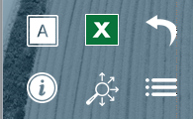
Navigation
Fertilizer Use in Grain Corn
Fertilizer Use in Soybean
General Fertilizer Practices
Fertilizer Timing
Fertilizer Timing
Sources of Fertilizer Advice
Fertilizer Source
Fertilizer Source
Frequency of Soil Testing Nitrogen
Fertilizer Placement
Fertilizer Placement
Reasons for Not Soil Testing for N Every Year
Nitrogen Rates
Nitrogen Rates
Frequency of Soil Testing P, K and S
Phosphorus Rates
Phosphorus Rates
Frequency of Soil Testing - Micronutrients
Potassium Rates
Potassium Rates
Frequency of Soil Testing - Electrical Conductivity
Sulphur Rates
Sulphur Rates
Frequency of Soil Testing - Organic Matter
Fertilizer Program
Fertilizer Program
Frequency of Soil Testing - pH
Use of Variable Rates by Fertilizer Type
Use of Variable Rates by Fertilizer Type
Familiarity with 4R Concept
Consistency with 4R Practices
Consistency with 4R Practices
Growers Who Believe They Comply With 4R
Reasons for Not Meeting Consistency Criteria
Reasons for Not Meeting Consistency Criteria
Growers Who Work With A 4R Certified Retailer
Nitrogen Fixing Crop in Previous Year
Nitrogen Fixing Crop in Previous Year
Growers Who Have A 4R Plan In Place
Rates Set By Field Based On Expected Crop Yield
Rates Set By Field Based On Expected Crop Yield
Benefits Of Having A 4R Plan In Place
Approaches Used To Decide Fertilizer Rate
Approaches Used To Decide Fertilizer Rate
Reasons For Not Putting A 4R Plan In Place
Main Person Who Determined Fertilizer Rate
Main Person Who Determined Fertilizer Rate
Reasons Some Farmers Do Not Adopt 4R Practices
Rate Decisions on 4R Consistency Compliance
Rate Decisions on 4R Consistency Compliance
Fee to Prepare 4R Plan
Professional Designation
Professional Designation
Costs to Implement 4R Plan
Importance of Professional Designation
Importance of Professional Designation
Sources of Fertilizer Information
Deviation from Recommended Application Rate
Deviation from Recommended Application Rate
Programs Used to Measure Environmental Footprint
Reasons for Increasing Rate
Reasons for Increasing Rate
Reasons for Decreasing Rate
Reasons for Decreasing Rate
Demographics
Use of Nitrogen Stabilizers
Use of EEFs by Timing
Geographic Distribution
Use of EEFs by Timing
Target Yield vs. Actual Yield
Farm Size and Crop Acre Categories
Target Yield vs. Actual Yield
Nitrogen Use Efficiency
Demographics
Nitrogen Use Efficiency
Factors Considered When Setting Target Yield
Study Methodology & Sample
Factors Considered When Setting Target Yield
Use of Micro/Secondary Nutrients
Use of Micro/Secondary Nutrients
Custom Application by Timing
Key Findings
Custom Application by Timing
Tillage Practices
Grain Corn
Tillage Practices
Use of Biostimulants
Soybean
Application To Fertilize Next Year's Crop
Use of Nitrogen Fixing Biostimulants
4R Nutrient Stewardship
Use of Biostimulants
Use of Nitrogen Fixing Biostimulants
In SLIDESHOW VIEW, click on any title or button on the above slide to navigate to the section.
Use the icons in the side-bar of each slide for convenient navigation and quick access to more information:
DETAILED DATA
Escape from Slideshow View to NORMAL VIEW; then click to open a worksheet with detailed data.
ATTRIBUTES
Click to see the full attribute statement behind abbreviations used in charts.
BACK TO LIST
Click to return to the list of several similar charts.
INFORMATION
Click for a pop-up that explains the slide. Click again to hide.
SECTION NAVIGATION
Click to return to the navigation slide for the section you are in.
NAVIGATION
Click to return to this study navigation slide.

Slide 3
Grain Corn in Ontario - Summary
NITROGEN
Nitrogen fertilizers were applied on 164% of corn acres (multiple applications were common). 
The primary Nitrogen source in 2023 was Urea, use of UAN continued to expand in 2023. 
35% of the total Nitrogen volume was applied after planting/in-crop; another 37% was applied in the spring before planting. 
29% of N volume was surface applied with incorporation before planting; 18% was side-dressed in-crop. 
Average rate = 164 lbs./ac.  Rates were a little higher when applied before planting, edging lower at planting. 
Source:
Timing:
Placement:
Rate:
PHOSPHORUS
Phosphorus fertilizers were applied on 107% of corn acres (multiple applications on some acres). 
MAP has consistently been the primary Phosphorus (P₂O₅) source in corn (about 77% of the total volume). 
46% of total Phosphorus (P₂O₅) was applied at planting; fall applications decreased while applications before planting increased. 
35% of P₂O₅ volumes were side banded at planting; 17% were broadcast with incorporation in the fall. 
Average rate = 55 lbs./ac; down slightly from 2022.  About 18% of corn acres were not treated with P₂O₅. 
Source:
Timing:
Placement:
Rate:
POTASSIUM
Potassium fertilizers were applied on 106% of corn acres (multiple applications on a few acres). 
Dry potash represents about 85% of total volume in 2023. 
Spring pre-plant applications of Potassium before planting increased while applications at planting decreased for 2023. 
30% of K₂O volumes were surface applied with incorporation in the spring before planting. 
Average rate = 73 lbs./ac, down slightly in 2023.  Rates applied at planting were lower in 2023. 
Source:
Timing:
Placement:
Rate:
SULPHUR
Sulphur fertilizers were applied on 53% of corn acres. 
Ammonium sulphate represents 22% of the total Sulphur applied in corn. K Mag accounts for 25%, an increase from 2022. 
50% of Sulphur volumes were applied at planting, down from last year. 
37% of Sulphur volumes were side banded at planting, 27% were surface applied with incorporation before planting. 
Average rate = 15 lbs./ac; consistent over time.  34% of corn acres were not treated with any Sulphur. 
Source:
Timing:
Placement:
Rate:

Slide 4
Soybean in Ontario - Summary
NITROGEN
Nitrogen fertilizers were applied on 12% of soybean acres. 
49% of Nitrogen volume came from MAP. Urea accounts for 25%, a small increase in 2023. 
58% of N volume was applied in the spring before planting. Another 19% was applied at planting. 
49% of Nitrogen volumes were surface applied before planting with incorporation. 
Average rate = 7.4 lbs./ac, down slightly from 2022.  The average rate in the spring before planting was 15 lbs./ac. 
Source:
Timing:
Placement:
Rate:
PHOSPHORUS
Phosphorus fertilizers were applied on 50% of soybean acres. 
MAP represents 85% of total Phosphorus volume, up slightly from 2022. 
49% of P₂O₅ volume was applied in the spring before planting. 32% was applied in the fall of the previous year. 
40% of P₂O₅ volumes were broadcast with incorporation before planting. Another 22% was broadcast with incorporation in the fall. 
Average rate = 20 lbs./ac; unchanged from 2022.  52% of soybean acres were not treated with P₂O₅. 
Source:
Timing:
Placement:
Rate:
POTASSIUM
Potassium fertilizers were applied on 63% of soybean acres. 
Dry potash represents over 90% of total volume, use appears to be trending a little lower. 
Farmers shifted some Potassium applications to the fall of 2022, cutting back on spring preplant applications. 
35% of K₂O volumes were broadcast with incorporation before planting. Another 28% was broadcast with incorporation in the fall. 
Average rate = 43 lbs./ac; unchanged from 2022.  42% of soybean acres were not treated with any K₂O. 
Source:
Timing:
Placement:
Rate:
SULPHUR
Sulphur fertilizers were applied on 9% of soybean acres. 
K Mag represents 26% of total Sulphur volume; a decline from 2022. Ammonium sulphate represents another 19%. 
48% of Sulphur volumes were applied in the spring before planting; another 24% were applied at planting. 
32% of Sulphur volumes were broadcast with incorporation before planting, 16% were broadcast without incorporation. 
Average rate = 2.5 lbs./ac, down from 2022.  Where Sulphur was applied, average rates were 14 lbs./ac in 2023. 
Source:
Timing:
Placement:
Rate:

Slide 5
4R Nutrient Stewardship - Summary
NITROGEN
Adoption of 4R practices in Ontario appears to have plateaued.
Self-assessed knowledge of 4R edged a little higher in 2023. 
4R concept familiarity is much higher among large farms and younger farmers. 
Most Ontario farmers believe their fertilizer practices comply with 4R nutrient stewardship. 
% of farmers who work with a 4R Certified Retailer was stable in 2023. 
Those growers very familiar with 4R more often work with a 4R certified retailer. 
The number of Ontario farmers with a 4R Plan was unchanged in 2023. 
A higher percentage of growers who are very familiar with 4R have a 4R Plan in place. 
Those with a 4R Plan say there are multiple benefits led by environmental stewardship. 
Reasons for not having a 4R Plan are scattered; lack of incentive and lack of information/knowledge are the top 2 factors. 
Those who do not think they comply with 4R say that lack of the right equipment is the main reason. 
Ag retailers and Certified Crop Advisors are the main sources of information about 4R. 
4R NUTRIENT STEWARDSHIP
PHOSPHORUS
POTASSIUM
SULPHUR

Slide 6
Grain Corn
Fertilizer Timing
Fertilizer Source
Fertilizer Placement
Nitrogen Rates
Phosphorus Rates
Potassium Rates
Sulphur Rates
Fertilizer Program
Answering Key Questions:
What are the most common application timings for each nutrient and fertilizer type?
What nutrients and fertilizer types are being used?
What are the most common placements for each nutrient and fertilizer type?
What rates are being applied?
To what extent do farmers vary their fertilizer program from field to field?
To what extent are farmers incorporating nitrogen fixing crops into their rotation?
How do farmers decide what fertilizer rate to apply?
How extensively are nitrogen stabilized products being used?
How do actual yields compare to target yields?
How many growers are applying micro or secondary nutrients?
What tillage practices were used?
To what extent were biostimulants used?
Use of Variable Rates by Fertilizer Type
Consistency with 4R Practices
Reasons for Not Meeting Consistency Criteria
Nitrogen Fixing Crop in Previous Year
Rates Set By Field Based On Expected Crop Yield
Approaches Used To Decide Fertilizer Rate
Main Person Who Determined Fertilizer Rate
Rate Decisions on 4R Consistency Compliance
Professional Designation
Importance of Professional Designation
Deviation from Recommended Application Rate
Reasons for Increasing Rate
Reasons for Decreasing Rate
Use of Nitrogen Stabilizers
Use of EEFs by Timing
Target Yield vs. Actual Yield
Nitrogen Use Efficiency
Factors Considered When Setting Target Yield
Use of Micro/Secondary Nutrients
Custom Application by Timing
Tillage Practices
Application To Fertilize Next Year's Crop
Use of Biostimulants
Use of Nitrogen Fixing Biostimulants
In SLIDESHOW VIEW, click on any title or button on the above slide to navigate to the section.
Use the icons in the side-bar of each slide for convenient navigation and quick access to more information:
DETAILED DATA
Escape from Slideshow View to NORMAL VIEW; then click to open a worksheet with detailed data.
ATTRIBUTES
Click to see the full attribute statement behind abbreviations used in charts.
BACK TO LIST
Click to return to the list of several similar charts.
INFORMATION
Click for a pop-up that explains the slide. Click again to hide.
SECTION NAVIGATION
Click to return to the navigation slide for the section you are in.
NAVIGATION
Click to return to this study navigation slide.

Slide 7

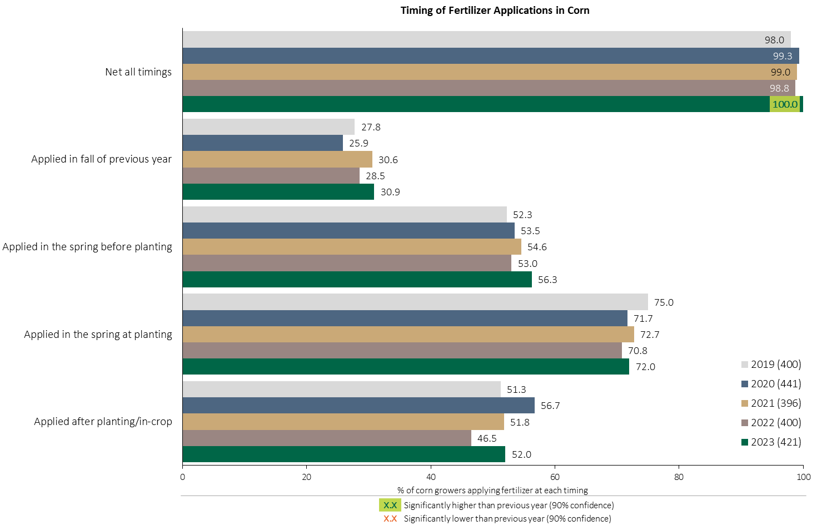

Fertilizer Applications in Corn - % Growers
Grain Corn
The timing of fertilizer applications in grain corn has been very consistent over the past 5 years.
Respondents were asked: “For your 2023 corn crop, did you apply fertilizer at each timing? – and given the options of a) Applied in fall of previous year, b) in the spring before planting, c) in the spring at planting and d) after planting/in-crop.”
The chart illustrates the % of respondents who applied fertilizer at each timing in each year.

Slide 8
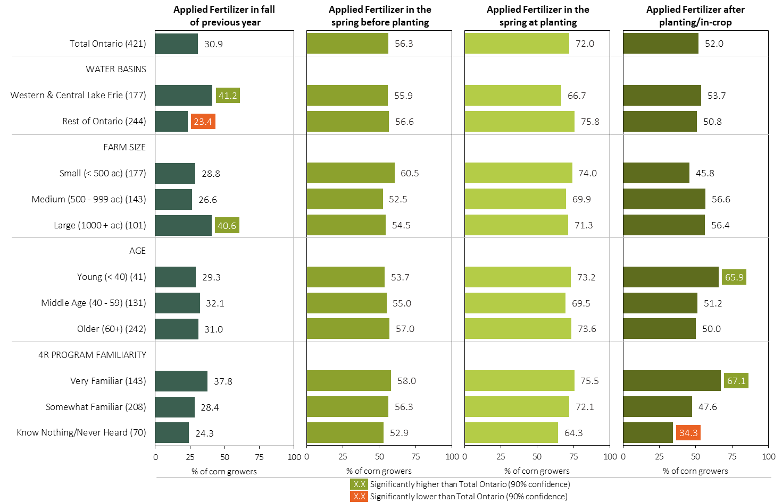
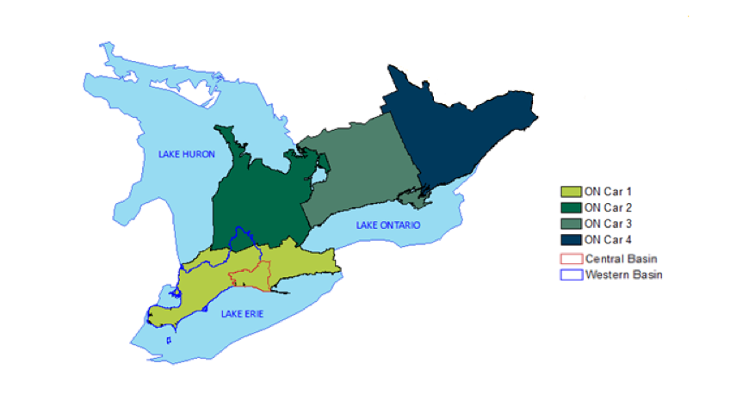
Fertilizer Applications in Corn - % Growers by Timing in 2023
Grain Corn
MAP
Respondents were asked: “For your 2023 corn crop, did you apply fertilizer at each timing? – and given the options of a) Applied in fall of previous year, b) in the spring before planting, c) in the spring at planting and d) after planting/in-crop.”
Separately by geography, farm size, age and 4R program familiarity, the charts illustrate the % of corn growers who applied fertilizer at each timing.

Slide 9
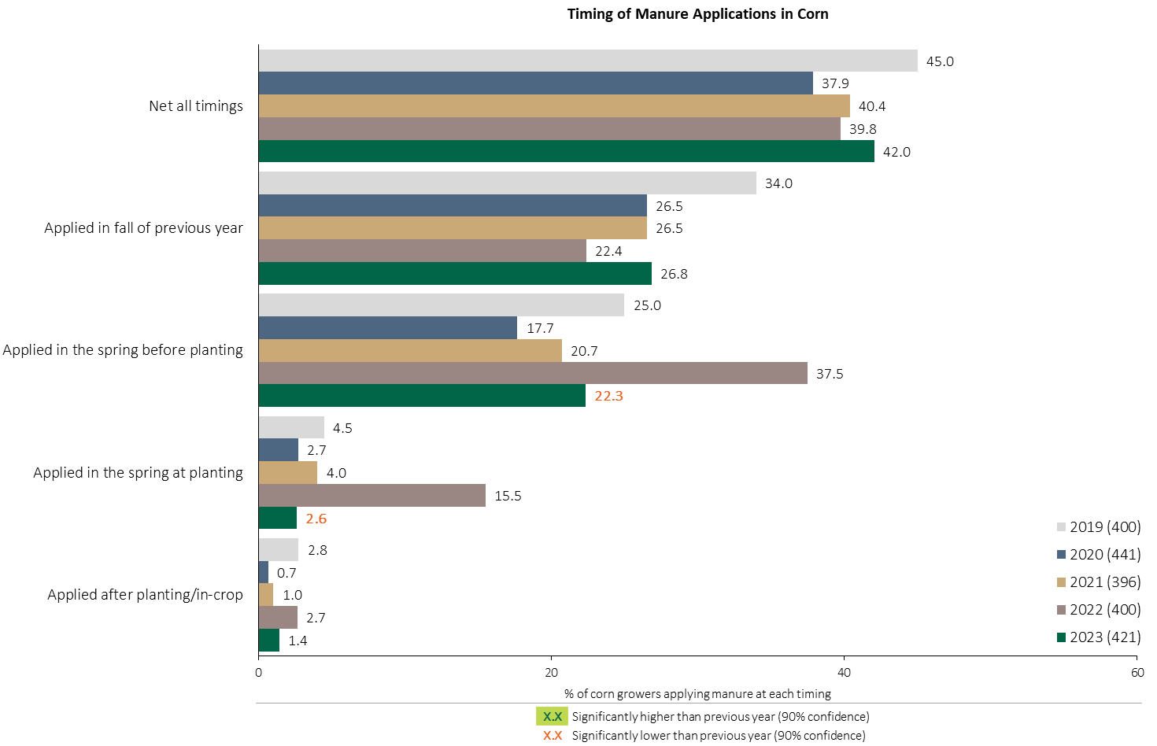
Manure Applications in Corn - % Growers
Grain Corn
Consistently about 40% of corn growers are applying manure.
Manure applications in the spring before planting and at planting returned to more normal levels in 2023.
Respondents were asked: “For your 2023 corn crop, did you apply manure at each timing? – and given the options of a) Applied in fall of previous year, b) in the spring before planting, c) in the spring at planting and d) after planting/in-crop.”
The chart illustrates the % of respondents who applied manure at each timing in each year.

Slide 10
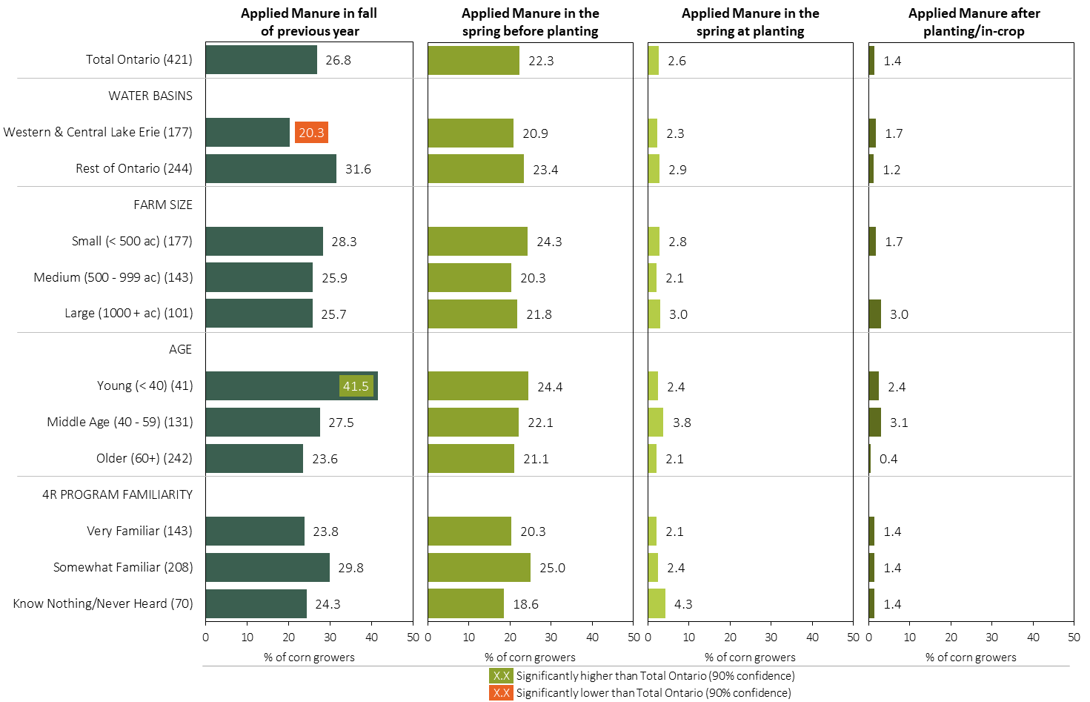
Manure Applications in Corn - % Growers by Timing in 2023
Grain Corn
MAP
Respondents were asked: “For your 2023 corn crop, did you apply manure at each timing? – and given the options of a) Applied in fall of previous year, b) in the spring before planting, c) in the spring at planting and d) after planting/in-crop.”
Separately by geography, farm size, age and 4R program familiarity, the charts illustrate the % of corn growers who applied manure at each timing.

Slide 11
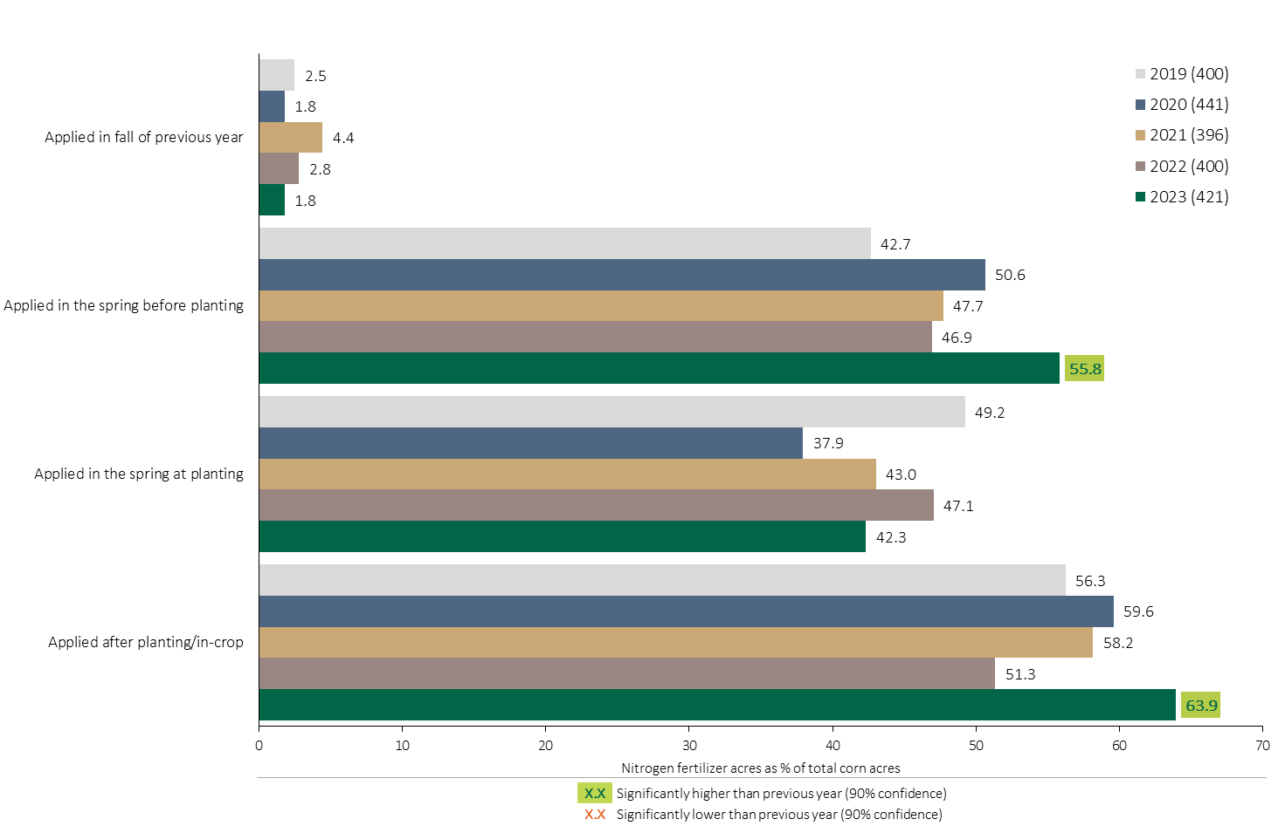

Nitrogen Timing in Corn - % Crop Acres
Grain Corn
A higher % of corn acres were treated with a Nitrogen fertilizer after planting/in-crop in 2023.
Note: Nitrogen only includes those fertilizer types where nitrogen is the primary component.
For each application timing, respondents were asked: “Of your [xxx] acres of corn, how many acres of each fertilizer type did you apply?”
The chart illustrates the % of total corn acres that were treated with a primary Nitrogen fertilizer at each timing in each year. A list of Primary Nitrogen fertilizers can be accessed by clicking on the “A” button. Significant changes from 2022 to 2023 are highlighted.

Slide 12
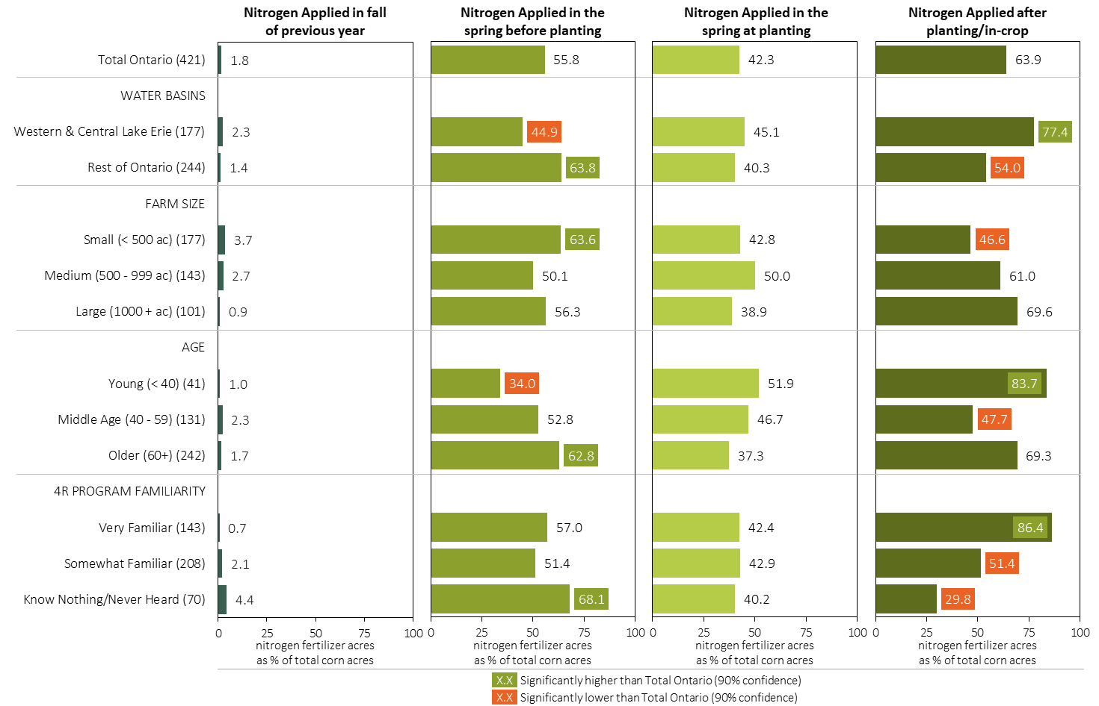
Nitrogen Timing in Corn in 2023 (% of Crop Acres)
Grain Corn
MAP
Note: Nitrogen only includes those fertilizer types where nitrogen is the primary component.
For each application timing, respondents were asked: “Of your [xxx] acres of corn, how many acres of each fertilizer type did you apply?”
Separately for each timing, the charts illustrate the % of total corn acres that was treated with a primary nitrogen fertilizer by geography, farm size, age and 4R program familiarity.
Nitrogen only includes those fertilizer types where nitrogen is the primary component. A list can be accessed by clicking on the “A” button.

Slide 13
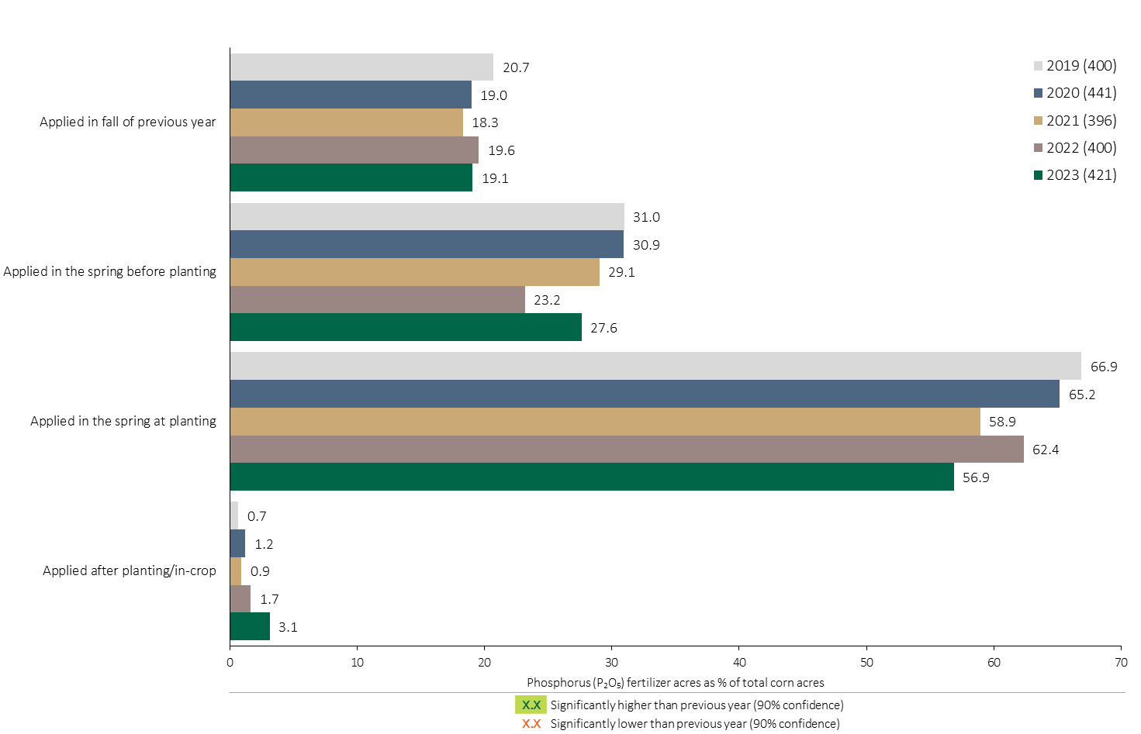
Phosphorus (P₂O₅) Timing in Corn - % Crop Acres
Grain Corn
Appears to be a slow decline in % of corn acres treated with P₂O₅ at planting.
Note: Phosphorus only includes those fertilizer types where phosphorus is the primary component.
For each application timing, respondents were asked: “Of your [xxx] acres of corn, how many acres of each fertilizer type did you apply?”
The chart illustrates the % of total corn acres that was treated with a primary Phosphorus fertilizer at each timing in each year. A list of Primary Phosphorus fertilizers can be accessed by clicking on the “A” button. Significant changes from 2022 to 2023 are highlighted.

Slide 14
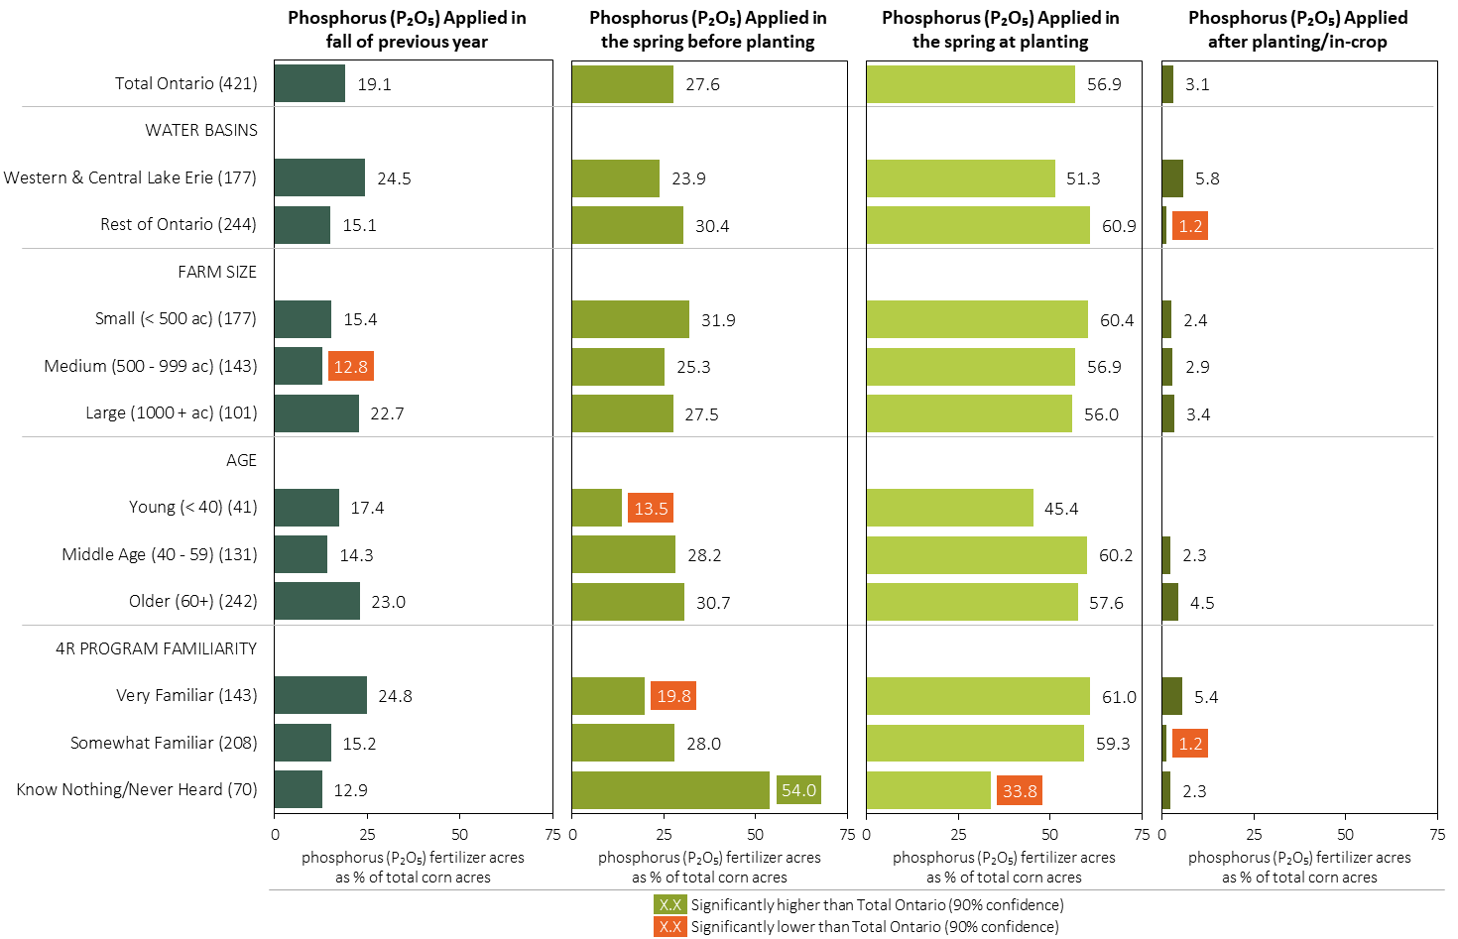
Phosphorus (P₂O₅) Timing in Corn in 2023 (% of Crop Acres)
Grain Corn
MAP
Note: Phosphorus only includes those fertilizer types where phosphorus is the primary component.
For each application timing, respondents were asked: “Of your [xxx] acres of corn, how many acres of each fertilizer type did you apply?”
Separately for each timing, the charts illustrate the % of total corn acres that was treated with a primary phosphorus fertilizer by geography, farm size, age and 4R program familiarity.
Phosphorus only includes those fertilizer types where phosphorus is the primary component. A list can be accessed by clicking on the “A” button.

Slide 15
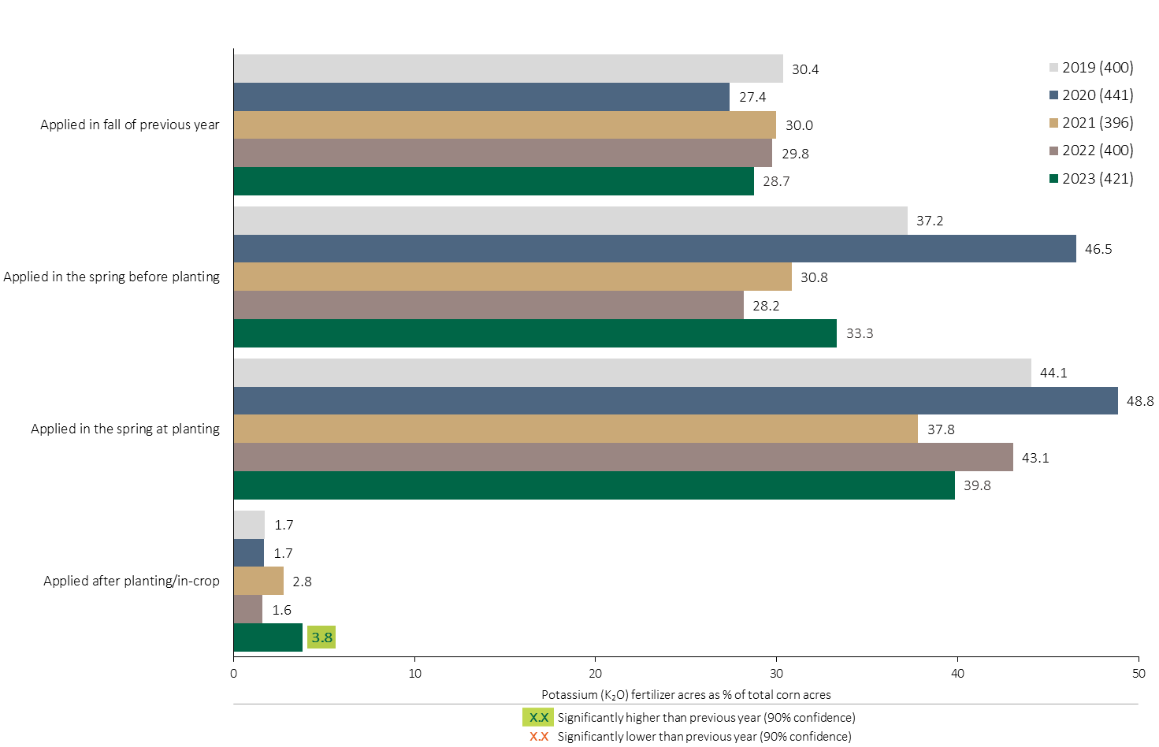
Potassium (K₂O) Timing in Corn - % Crop Acres
Grain Corn
The % of corn acres treated with a K₂O fertilizer in the spring before planting recovered in 2023.
Note: Potassium only includes those fertilizer types where potassium is the primary component.
For each application timing, respondents were asked: “Of your [xxx] acres of corn, how many acres of each fertilizer type did you apply?”
The chart illustrates the % of total corn acres that were treated with a primary Potassium fertilizer at each timing in each year. A list of Primary Potassium fertilizers can be accessed by clicking on the “A” button. Significant changes from 2022 to 2023 are highlighted.

Slide 16
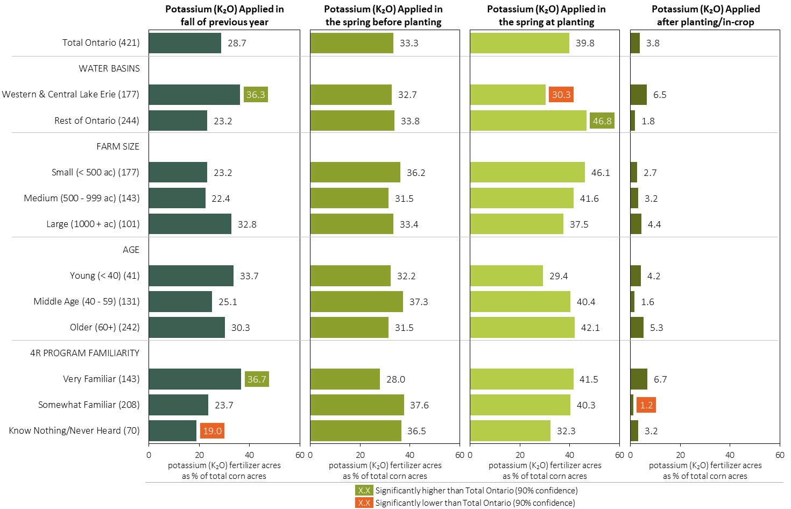
Potassium (K₂O) Timing in Corn in 2023 (% of Crop Acres)
Grain Corn
MAP
Note: Potassium only includes those fertilizer types where potassium is the primary component.
For each application timing, respondents were asked: “Of your [xxx] acres of corn, how many acres of each fertilizer type did you apply?”
Separately for each timing, the charts illustrate the % of total corn acres that was treated with a primary potassium fertilizer by geography, farm size, age and 4R program familiarity.
Potassium only includes those fertilizer types where potassium is the primary component. A list can be accessed by clicking on the “A” button.

Slide 17
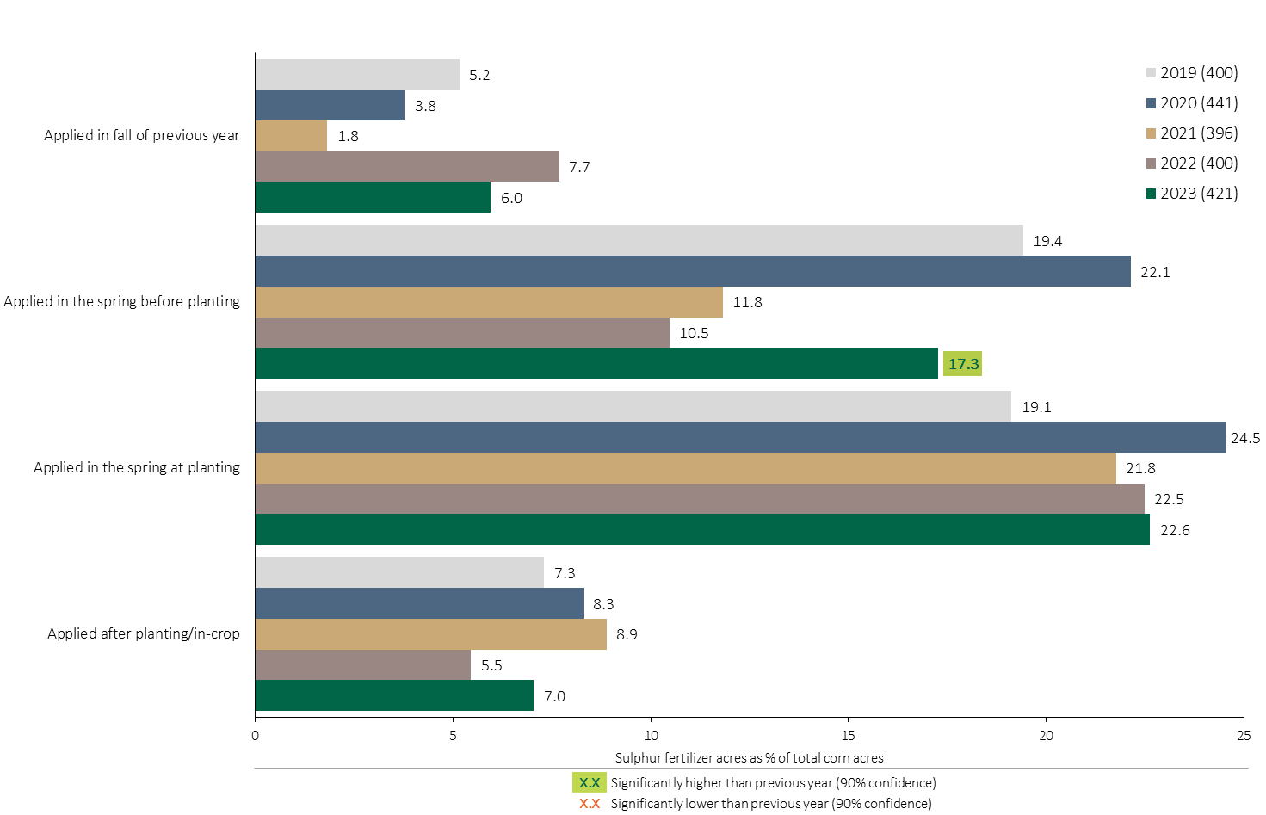
Sulphur Timing in Corn - % Crop Acres
Grain Corn
More corn acres were treated with a Sulphur fertilizer before planting.
Note: Sulphur only includes those fertilizer types where sulphur is the primary component.
For each application timing, respondents were asked: “Of your [xxx] acres of corn, how many acres of each fertilizer type did you apply?”
The chart illustrates the % of total corn acres that were treated with a primary Sulphur fertilizer at each timing in each year. A list of Primary Sulphur fertilizers can be accessed by clicking on the “A” button. Significant changes from 2022 to 2023 are highlighted.

Slide 18
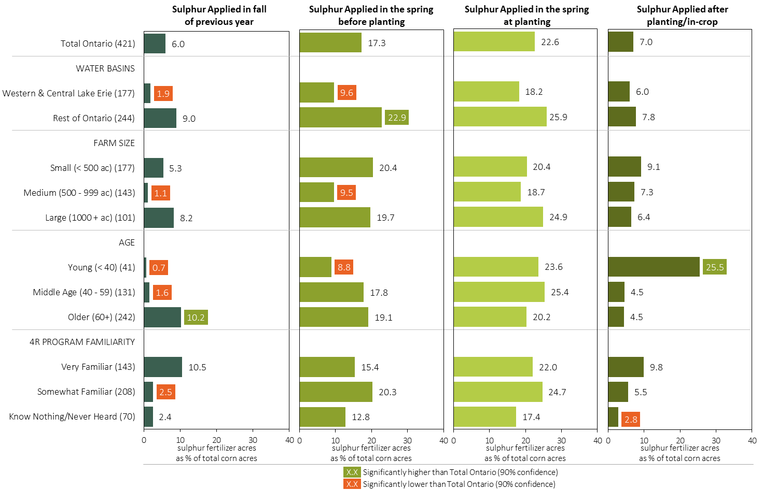
Sulphur Timing in Corn in 2023 (% of Crop Acres)
Grain Corn
MAP
Note: Sulphur only includes those fertilizer types where sulphur is the primary component.
For each application timing, respondents were asked: “Of your [xxx] acres of corn, how many acres of each fertilizer type did you apply?”
Separately for each timing, the charts illustrate the % of total corn acres that was treated with a primary sulphur fertilizer by geography, farm size, age and 4R program familiarity.
Sulphur only includes those fertilizer types where sulphur is the primary component. A list can be accessed by clicking on the “A” button.

Slide 19
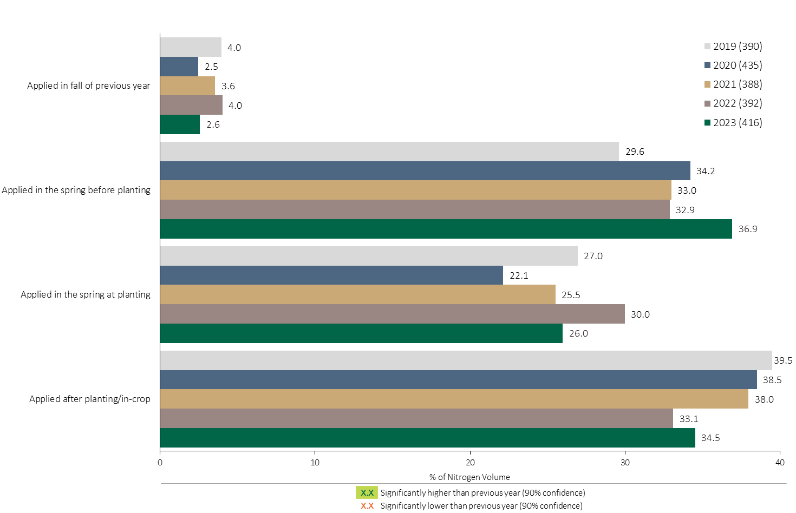
Nitrogen Timing in Corn - % of Volume
Grain Corn
Limited use of N containing fertilizers in the previous fall.
Grain Corn Summary 
About a third of total Nitrogen applied in grain corn was applied after planting/in-crop.
Note: Nitrogen volume was calculated from all sources of nitrogen contained in all fertilizer types
For each fertilizer type used in either a custom blend or applied as an unblended product, respondents were asked: a) how many acres they applied, and b) the application rate in pounds of actual nutrient/ac. Volumes of each nutrient were calculated by multiplying acres treated times the application rate.
The graph illustrates the % of total Nitrogen volume applied in corn that was applied at each timing in each year.
Total pounds of actual Nitrogen applied was calculated based on all sources of Nitrogen from all fertilizer types.

Slide 20
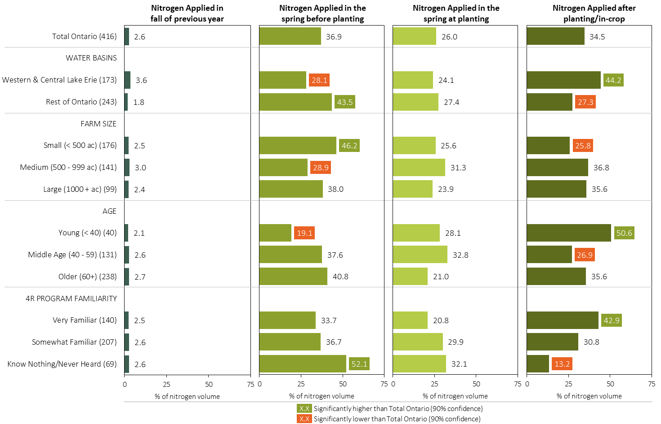
Nitrogen Timing in Corn in 2023 (% of Volume)
Grain Corn
MAP
Note: Nitrogen volume was calculated from all sources of nitrogen contained in all fertilizer types
For each fertilizer type used in either a custom blend or applied as an unblended product, respondents were asked: a) how many acres they applied, and b) the application rate in pounds of actual nutrient/ac. Volumes of each nutrient were calculated by multiplying acres treated times the application rate.
Separately for each timing, the charts illustrate the % of total nitrogen volume that was applied by geography, farm size, age and 4R program familiarity.
Total pounds of actual nitrogen applied was calculated based on all sources of nitrogen from all fertilizer types.

Slide 21
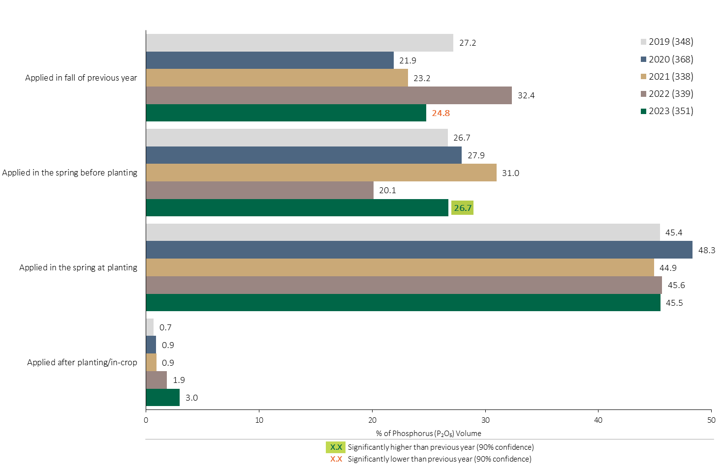
Phosphorus (P₂O₅) Timing in Corn - % of Volume
Grain Corn
Grain Corn Summary 
P₂O₅ volumes applied before planting returned to more normal levels shifting from fall to spring.
Consistently, about 45% of P₂O₅ volumes are applied at planting.
Note: Phosphorus (P₂O₅) volume was calculated from all sources of phosphorus contained in all fertilizer types
For each fertilizer type used in either a custom blend or applied as an unblended product, respondents were asked: a) how many acres they applied, and b) the application rate in pounds of actual nutrient/ac. Volumes of each nutrient were calculated by multiplying acres treated times the application rate.
The graph illustrates the % of total Phosphorus (P₂O₅) volume applied in corn that was applied at each timing in each year.
Total pounds of actual Phosphorus (P₂O₅) applied was calculated based on all sources of Phosphorus (P₂O₅) from all fertilizer types.

Slide 22
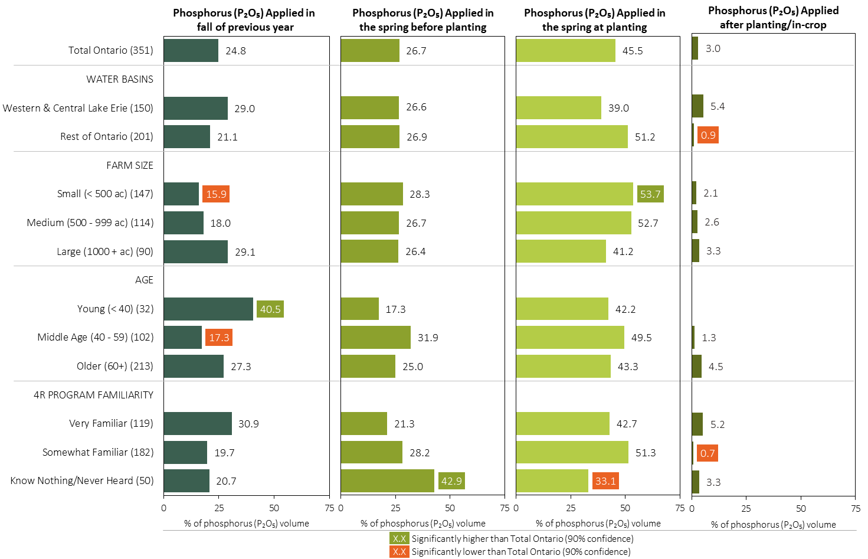
Phosphorus (P₂O₅) Timing in Corn in 2023 (% of Volume)
Grain Corn
MAP
Note: Phosphorus (P₂O₅) volume was calculated from all sources of phosphorus contained in all fertilizer types
For each fertilizer type used in either a custom blend or applied as an unblended product, respondents were asked: a) how many acres they applied, and b) the application rate in pounds of actual nutrient/ac. Volumes of each nutrient were calculated by multiplying acres treated times the application rate.
Separately for each timing, the charts illustrate the % of total Phosphorus (P₂O₅) volume that was applied by geography, farm size, age and 4R program familiarity.
Total pounds of actual Phosphorus (P₂O₅) applied was calculated based on all sources of Phosphorus (P₂O₅) from all fertilizer types.

Slide 23
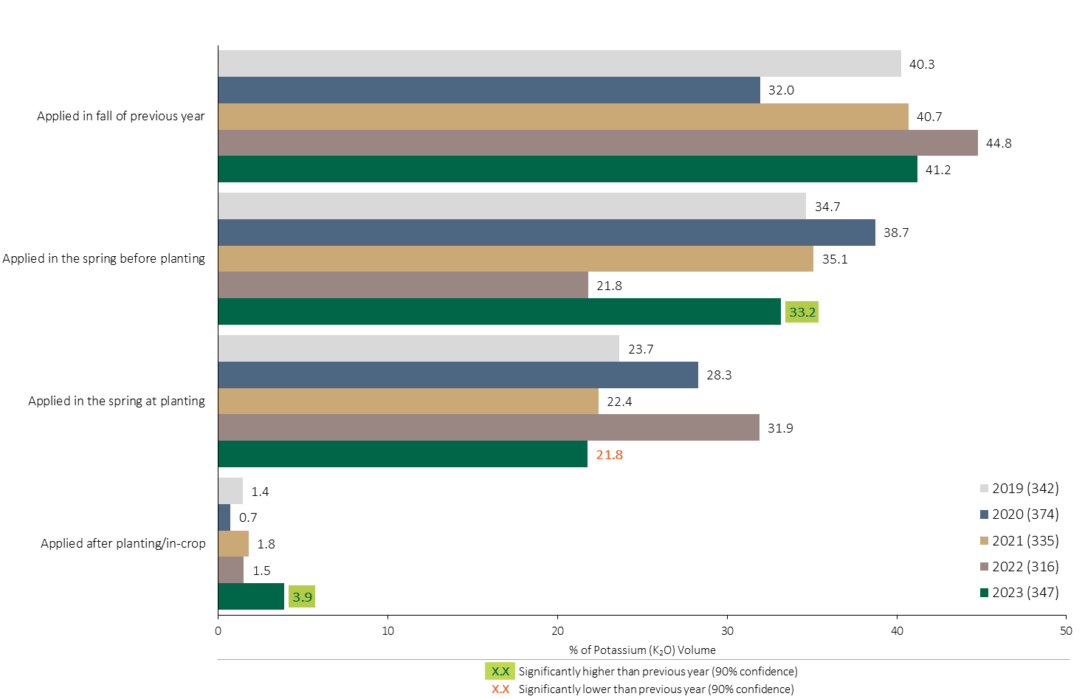
Potassium (K₂O) Timing in Corn - % of Volume
Grain Corn
Grain Corn Summary 
A higher % of Potassium (K₂O) volume was applied in the spring before planting in 2023, returning to more typical levels.
Note: Potassium (K₂O) volume was calculated from all sources of potassium contained in all fertilizer types
For each fertilizer type used in either a custom blend or applied as an unblended product, respondents were asked: a) how many acres they applied, and b) the application rate in pounds of actual nutrient/ac. Volumes of each nutrient were calculated by multiplying acres treated times the application rate.
The graph illustrates the % of total Potassium (K₂O) volume applied in corn that was applied at each timing in each year.
Total pounds of actual Potassium (K₂O) applied was calculated based on all sources of Potassium (K₂O) from all fertilizer types.

Slide 24
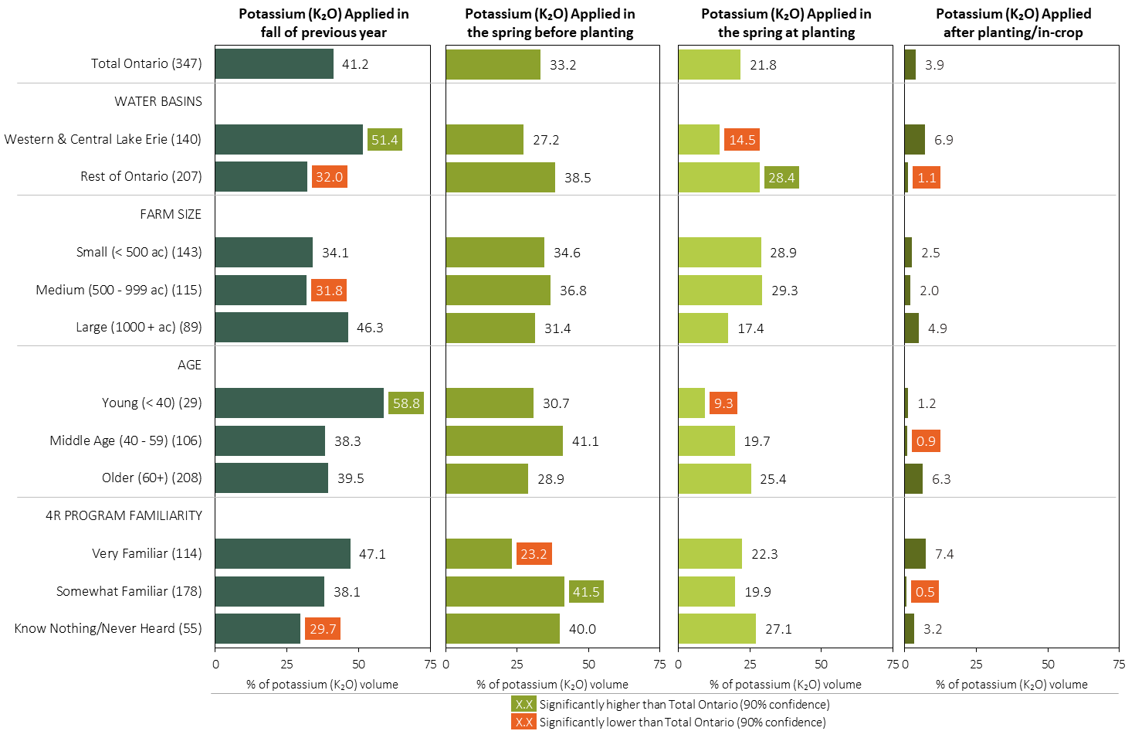
Potassium (K₂O) Timing in Corn in 2023 (% of Volume)
Grain Corn
MAP
Note: Potassium (K₂O) volume was calculated from all sources of potassium contained in all fertilizer types
For each fertilizer type used in either a custom blend or applied as an unblended product, respondents were asked: a) how many acres they applied, and b) the application rate in pounds of actual nutrient/ac. Volumes of each nutrient were calculated by multiplying acres treated times the application rate.
Separately for each timing, the charts illustrate the % of total Potassium (K₂O) volume that was applied by geography, farm size, age and 4R program familiarity.
Total pounds of actual potassium (K₂O) applied was calculated based on all sources of potassium (K₂O) from all fertilizer types.

Slide 25
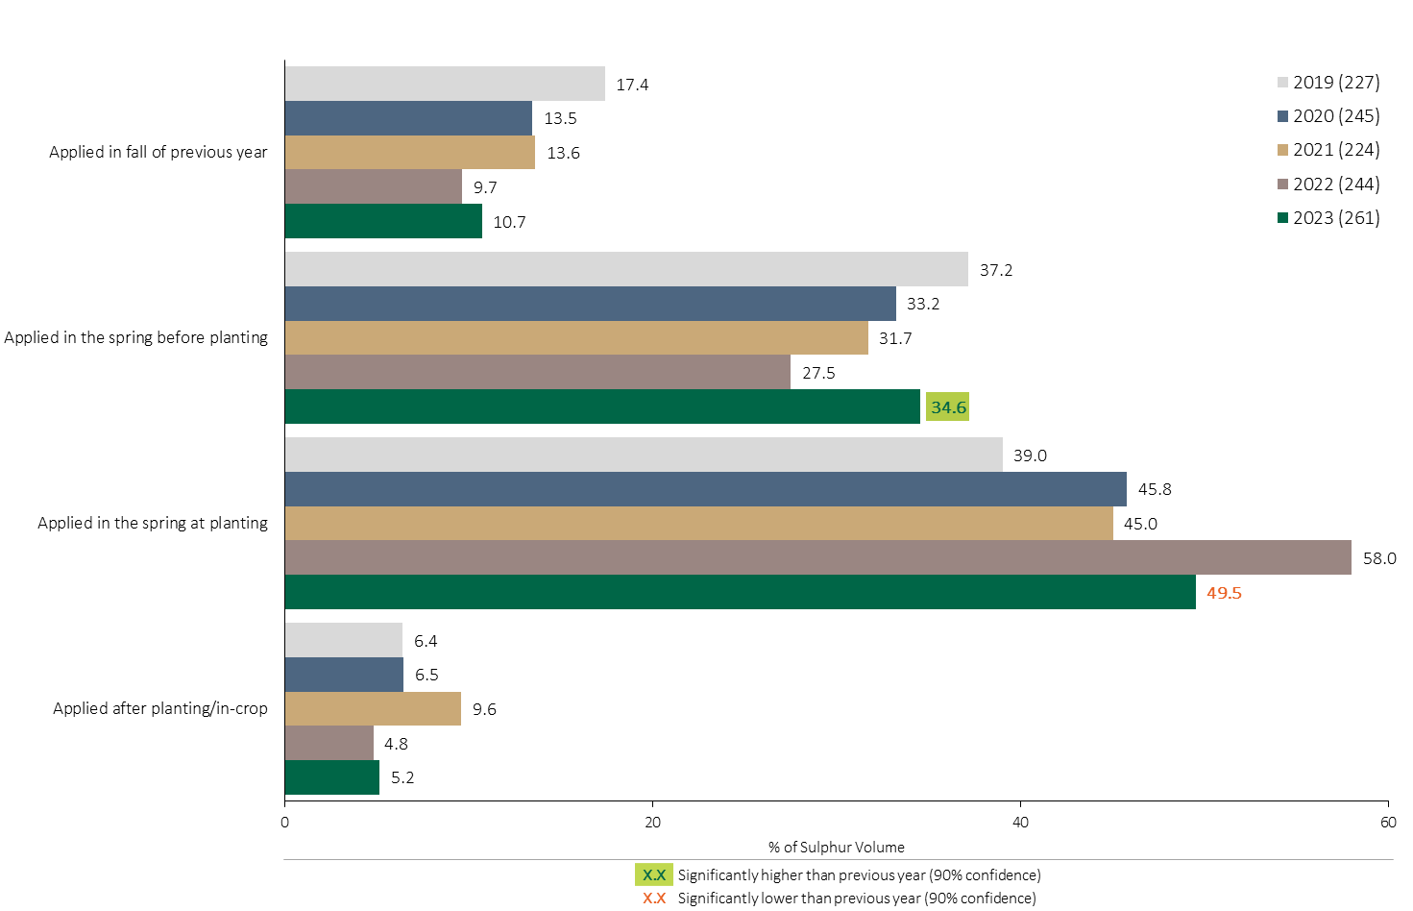
Sulphur Timing in Corn - % of Volume
Grain Corn
Grain Corn Summary 
Half of the total Sulphur volume in corn was applied at planting in 2023.
Note: Sulphur volume was calculated from all sources of sulphur contained in all fertilizer types
For each fertilizer type used in either a custom blend or applied as an unblended product, respondents were asked: a) how many acres they applied, and b) the application rate in pounds of actual nutrient/ac. Volumes of each nutrient were calculated by multiplying acres treated times the application rate.
The graph illustrates the % of total Sulphur volume applied in corn that was applied at each timing in each year.
Total pounds of actual Sulphur applied was calculated based on all sources of Sulphur from all fertilizer types.

Slide 26
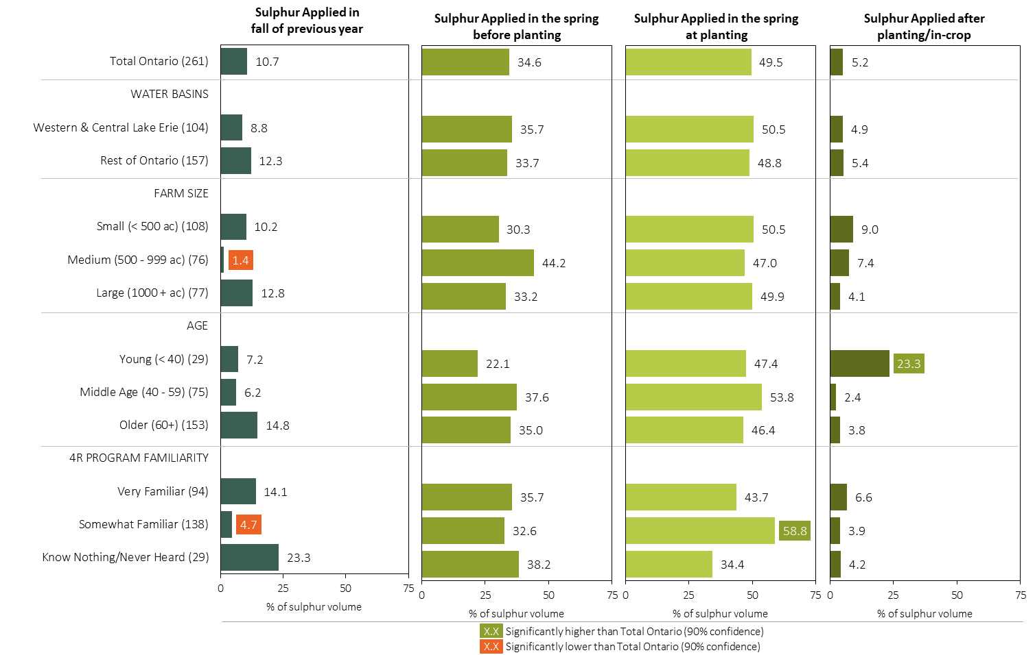
Sulphur Timing in Corn in 2023 (% of Volume)
Grain Corn
MAP
Note: Sulphur volume was calculated from all sources of sulphur contained in all fertilizer types
For each fertilizer type used in either a custom blend or applied as an unblended product, respondents were asked: a) how many acres they applied, and b) the application rate in pounds of actual nutrient/ac. Volumes of each nutrient were calculated by multiplying acres treated times the application rate.
Separately for each timing, the charts illustrate the % of total sulphur volume that was applied by geography, farm size, age and 4R program familiarity.
Total pounds of actual sulphur applied was calculated based on all sources of sulphur from all fertilizer types.

Slide 27
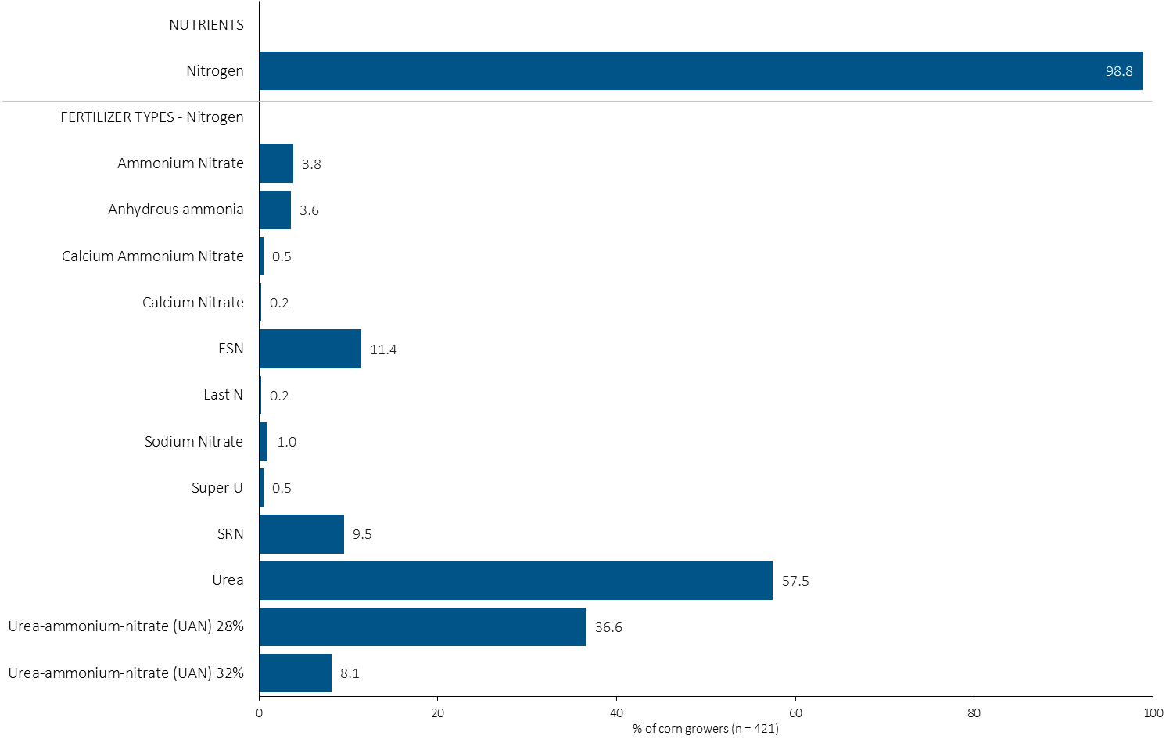
% of Corn Growers Using Each Nitrogen Source in 2023
Grain Corn
58% of corn growers used urea in 2023.
Note: Nutrients were defined based on any fertilizer type that contains the nutrient.
Respondents were asked: “For your 2023 corn crop, did you apply fertilizer or manure at each timing? – and given the options of a) Applied in fall of previous year, b) in the spring before planting, c) in the spring at planting and d) after planting/in-crop. For your 2023 corn crop, which fertilizer types did you apply at each timing?
The chart illustrates the % of corn growers who indicated that they used this nutrient and each fertilizer type in corn in 2023.
Nutrients were defined based on any fertilizer type that contains the nutrient.

Slide 28
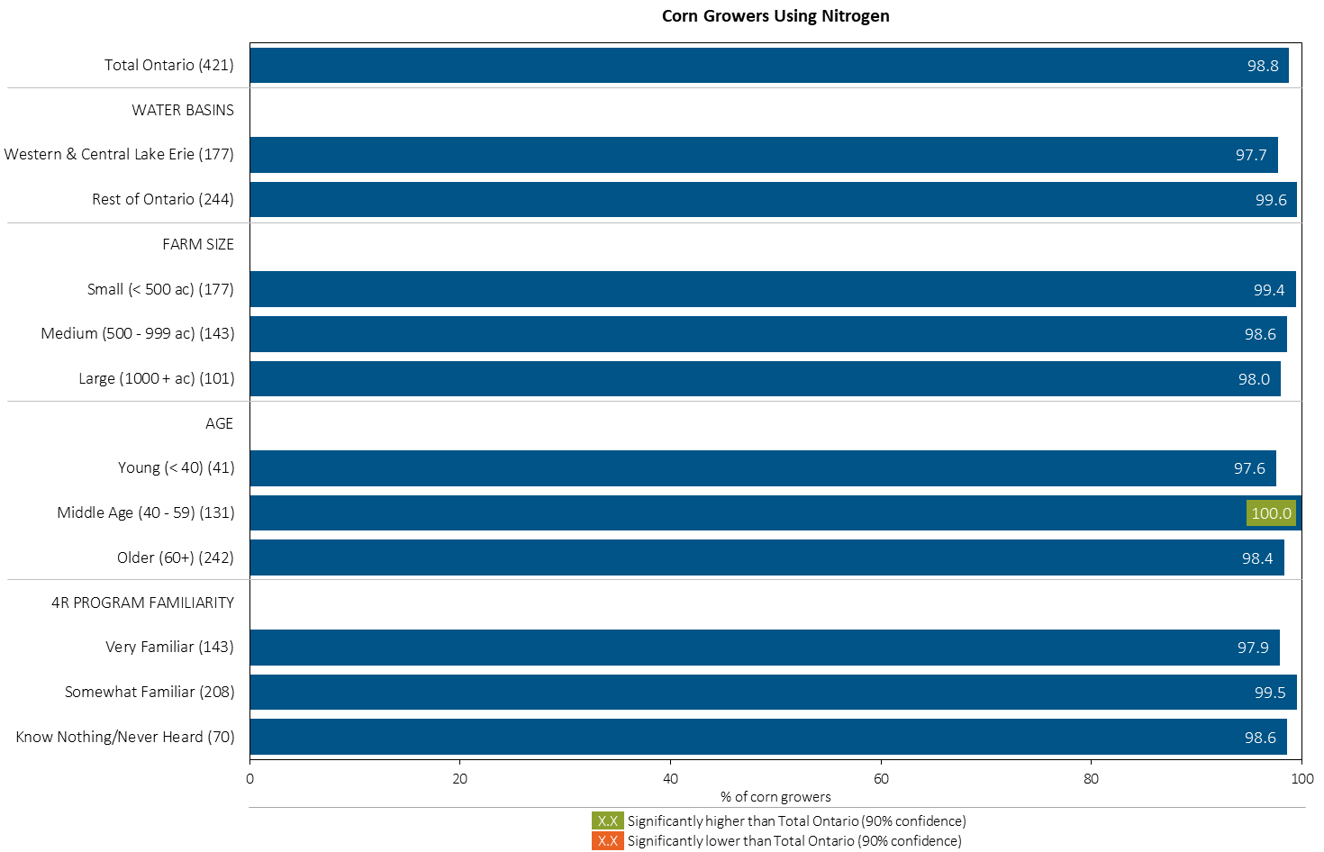
% of Corn Growers Using Nitrogen in 2023
Grain Corn
MAP
Note: Nutrients were defined based on any fertilizer type that contains the nutrient.
Respondents were asked: “For your 2023 corn crop, did you apply fertilizer or manure at each timing? – and given the options of a) Applied in fall of previous year, b) in the spring before planting, c) in the spring at planting and d) after planting/in-crop. For your 2023 corn crop, which fertilizer types did you apply at each timing?
The chart illustrates the % of corn growers who indicated that they used this nutrient in corn in 2023 by geography, farm size, age and 4R program familiarity.
Nutrients were defined based on any fertilizer type that contains the nutrient.

Slide 29
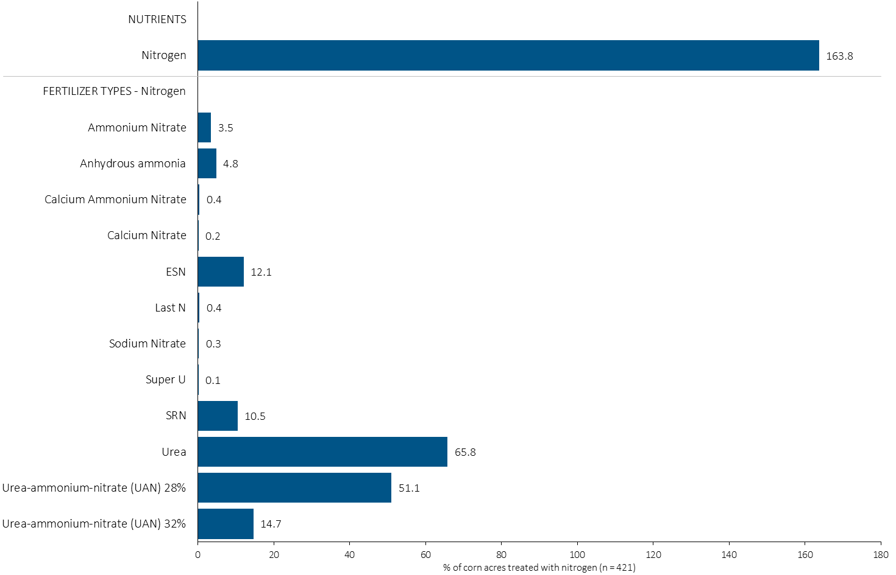
Acres Treated With Each Nitrogen Source in Corn in 2023
Grain Corn
Multiple N-fertilizer applications were common.
Grain Corn Summary 
Note: Nutrients were defined based on the primary component of each fertilizer type
For each application timing, respondents were asked: “Of your [xxx] acres of corn, how many acres of each fertilizer type did you apply?”
The chart illustrates the % of total corn acres that were treated with this nutrient and each fertilizer type in 2023.
Nutrients were defined based on the primary component (see adjacent fertilizer types by clicking on the “A” button).

Slide 30
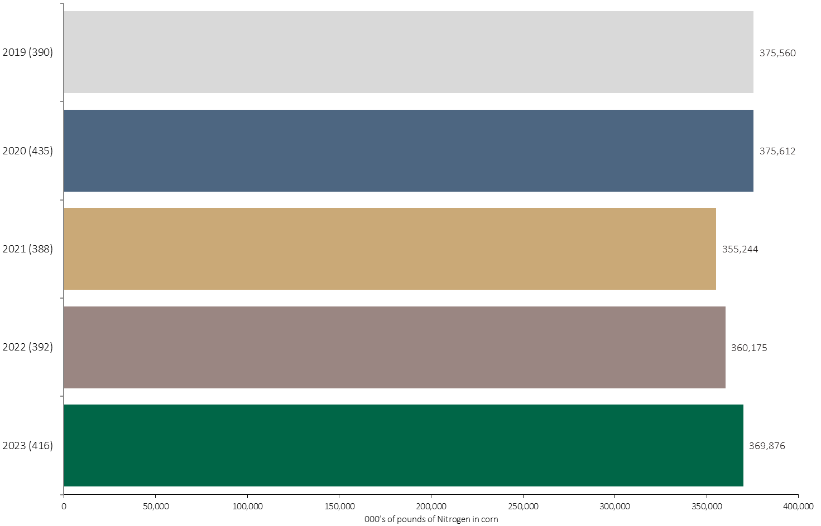
Nitrogen Volume in Corn
Grain Corn
370 million pounds of Nitrogen was applied in corn in 2023.
Note: Nitrogen volume was calculated from all sources of nitrogen contained in all fertilizer types
For each fertilizer type used in either a custom blend or applied as an unblended product, respondents were asked: a) how many acres they applied, and b) the application rate in pounds of actual nutrient/ac. Volumes of each nutrient were calculated by multiplying acres treated times the application rate.
The chart illustrates the total nitrogen volume (000’s of pounds) that was used in each year. The nitrogen volume was calculated from all sources of nitrogen contained in all fertilizer types.

Slide 31
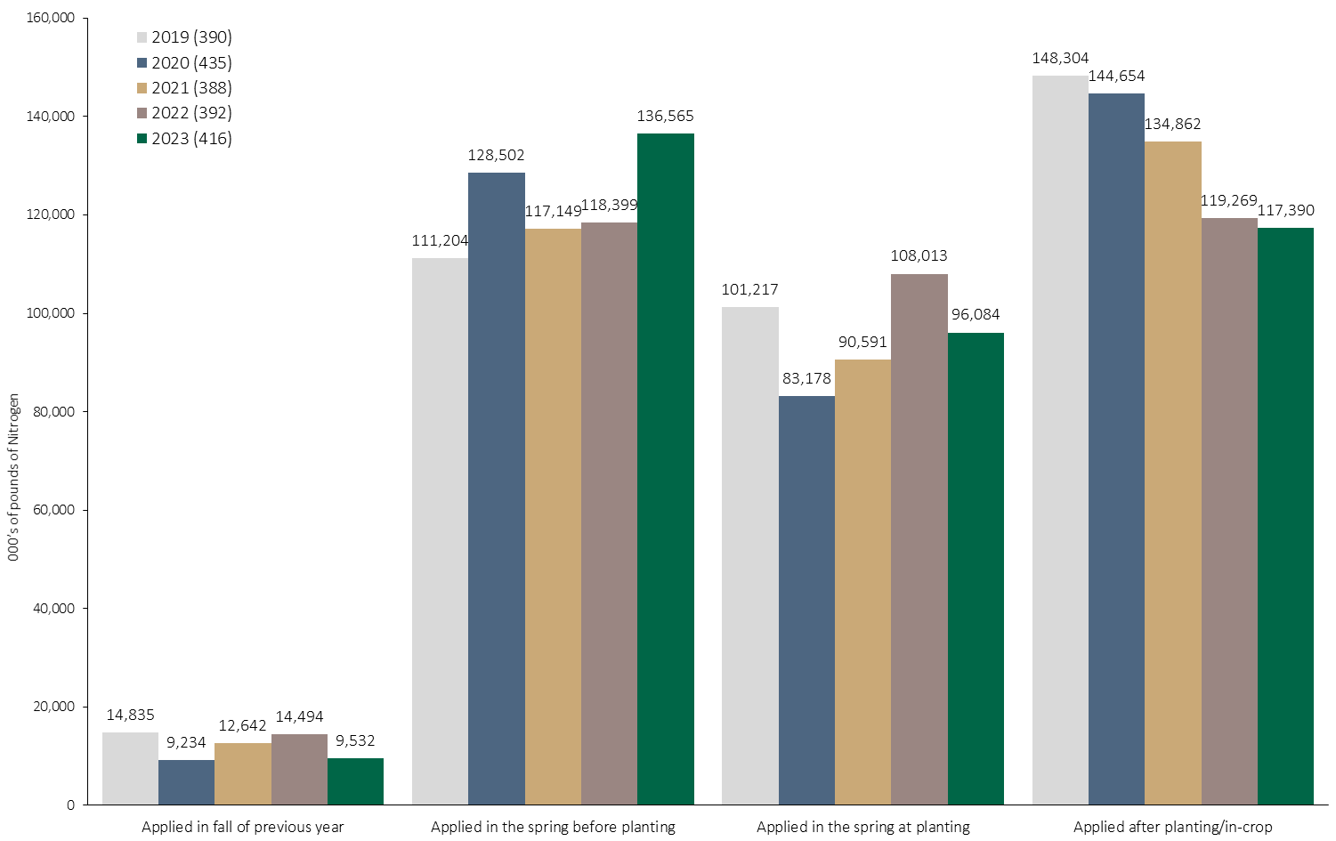
Nitrogen Volume in Corn by Timing
Grain Corn
Note: Nitrogen volume was calculated from all sources of nitrogen contained in all fertilizer types
For each fertilizer type used in either a custom blend or applied as an unblended product, respondents were asked: a) how many acres they applied, and b) the application rate in pounds of actual nutrient/ac. Volumes of each nutrient were calculated by multiplying acres treated times the application rate.
The chart illustrates the total nitrogen volume (000’s of pounds) that was used in each year by application timing. The nitrogen volume was calculated from all sources of nitrogen contained in all fertilizer types.

Slide 32
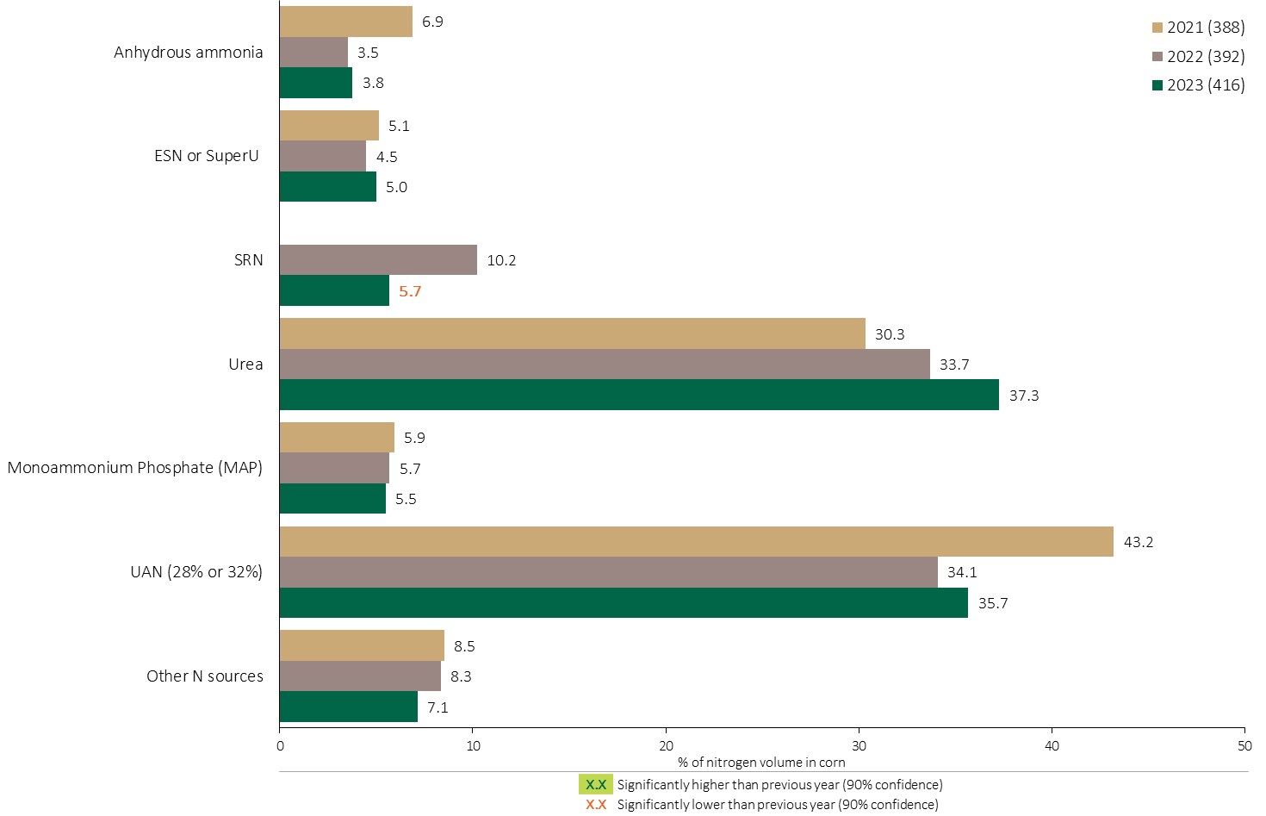
Nitrogen Fertilizer Source in Corn - All Timings
Grain Corn
Grain Corn Summary 
Use of urea continued to expand as a % of total N applied.
Note: Nitrogen volume was calculated from all sources of nitrogen contained in all fertilizer types
For each fertilizer type used in either a custom blend or applied as an unblended product, respondents were asked: a) how many acres they applied, and b) the application rate in pounds of actual nutrient/ac. Volumes of each nutrient were calculated by multiplying acres treated times the application rate.
The chart illustrates the % of total nitrogen volume applied at all timings that was provided by each fertilizer type. The nitrogen volume was calculated from all sources of nitrogen contained in all fertilizer types.

Slide 33
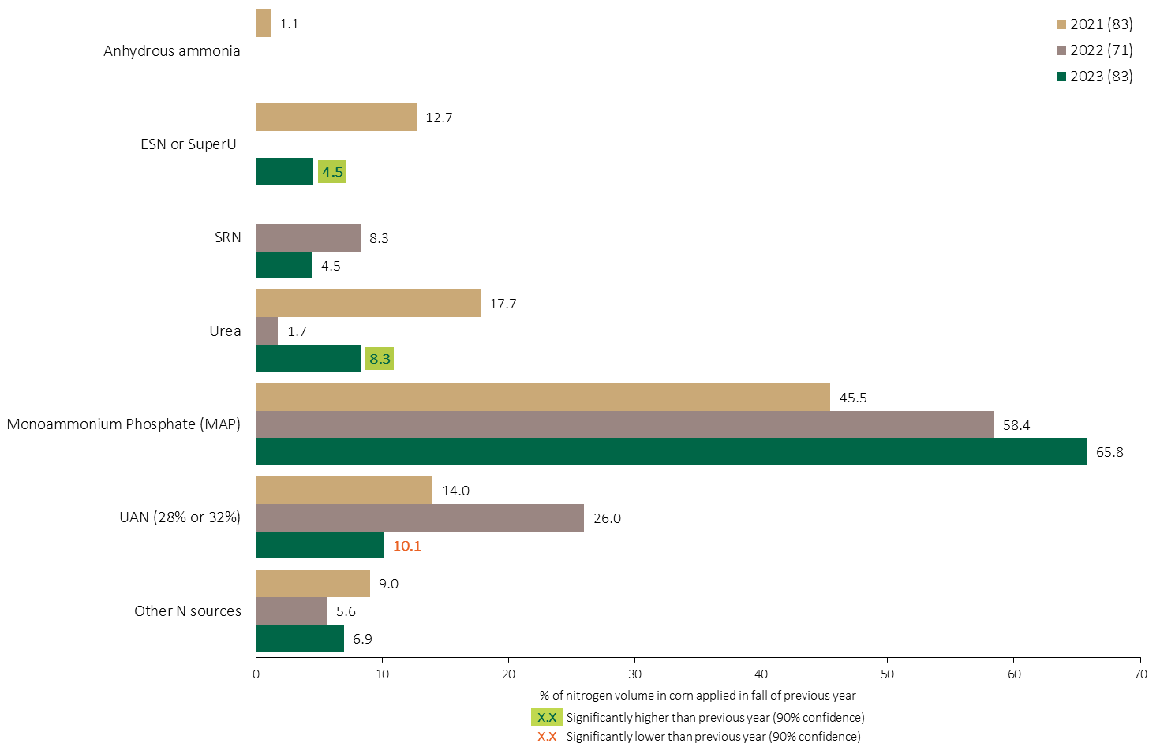
Nitrogen Fertilizer Source in Corn - Fall Timing
Grain Corn
Use of urea in the fall partially recovered in 2023.
MAP continues to be the primary N source applied in the fall.
Use of UAN in the previous fall decreased in 2023.
Note: Nitrogen volume was calculated from all sources of nitrogen contained in all fertilizer types
For each fertilizer type used in either a custom blend or applied as an unblended product, respondents were asked: a) how many acres they applied, and b) the application rate in pounds of actual nutrient/ac. Volumes of each nutrient were calculated by multiplying acres treated times the application rate.
The chart illustrates the % of total nitrogen volume applied in the fall of the previous year that was provided by each fertilizer type in each year. The nitrogen volume was calculated from all sources of nitrogen contained in all fertilizer types.

Slide 34
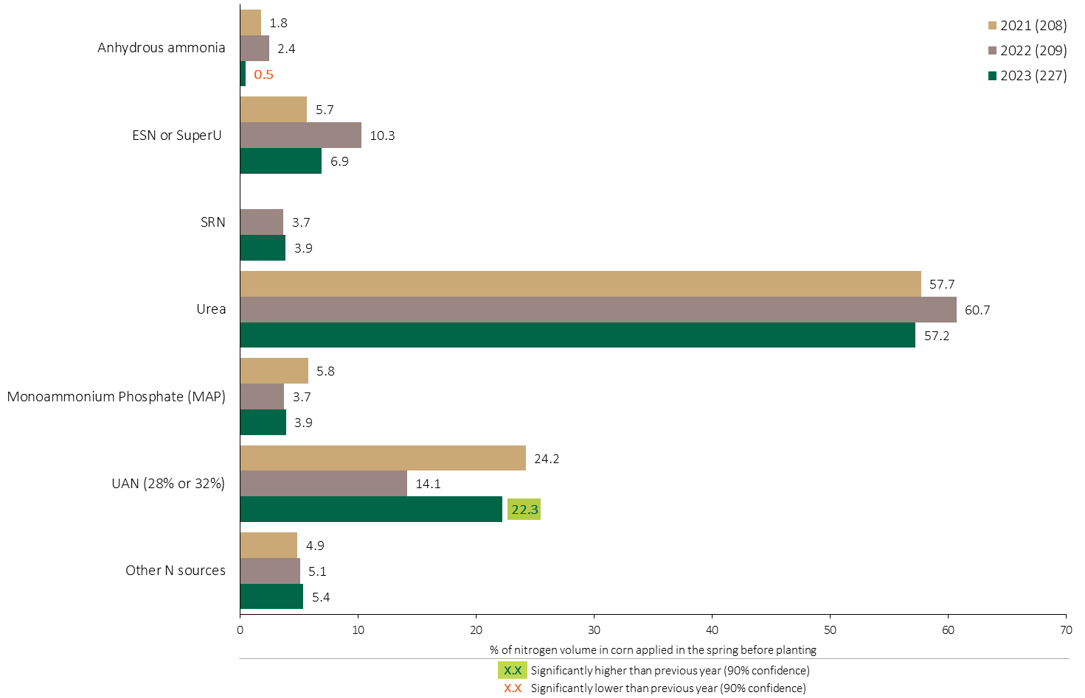
Nitrogen Fertilizer Source in Corn - Spring Before Planting
Use of anhydrous before planting was negligible.
Grain Corn
Consistently, Urea has been the primary N source applied in the spring before planting.
Use of UAN before planting rebounded in 2023.
Note: Nitrogen volume was calculated from all sources of nitrogen contained in all fertilizer types
For each fertilizer type used in either a custom blend or applied as an unblended product, respondents were asked: a) how many acres they applied, and b) the application rate in pounds of actual nutrient/ac. Volumes of each nutrient were calculated by multiplying acres treated times the application rate.
The chart illustrates the % of total nitrogen volume applied in the spring before planting that was provided by each fertilizer type in each year. The nitrogen volume was calculated from all sources of nitrogen contained in all fertilizer types.

Slide 35
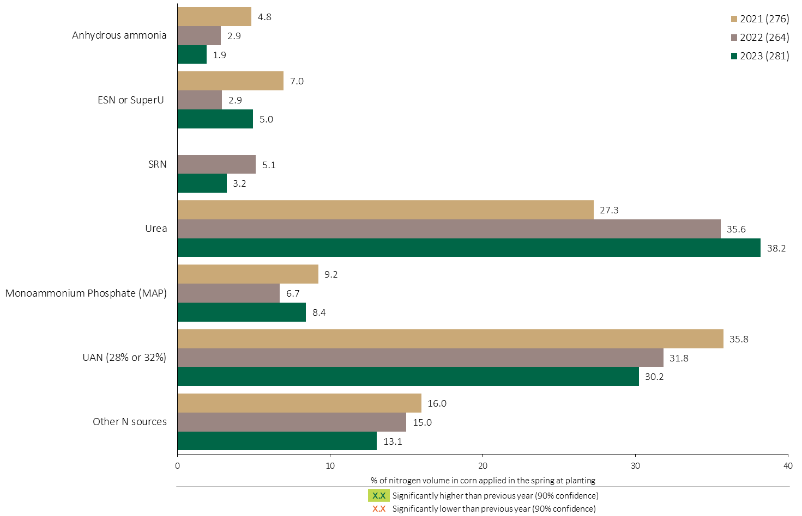
Nitrogen Fertilizer Source in Corn - At Planting
Grain Corn
Urea applied at planting continued to trend upward.
Note: Nitrogen volume was calculated from all sources of nitrogen contained in all fertilizer types
For each fertilizer type used in either a custom blend or applied as an unblended product, respondents were asked: a) how many acres they applied, and b) the application rate in pounds of actual nutrient/ac. Volumes of each nutrient were calculated by multiplying acres treated times the application rate.
The chart illustrates the % of total nitrogen volume applied in the spring at planting that was provided by each fertilizer type in each year. The nitrogen volume was calculated from all sources of nitrogen contained in all fertilizer types.

Slide 36
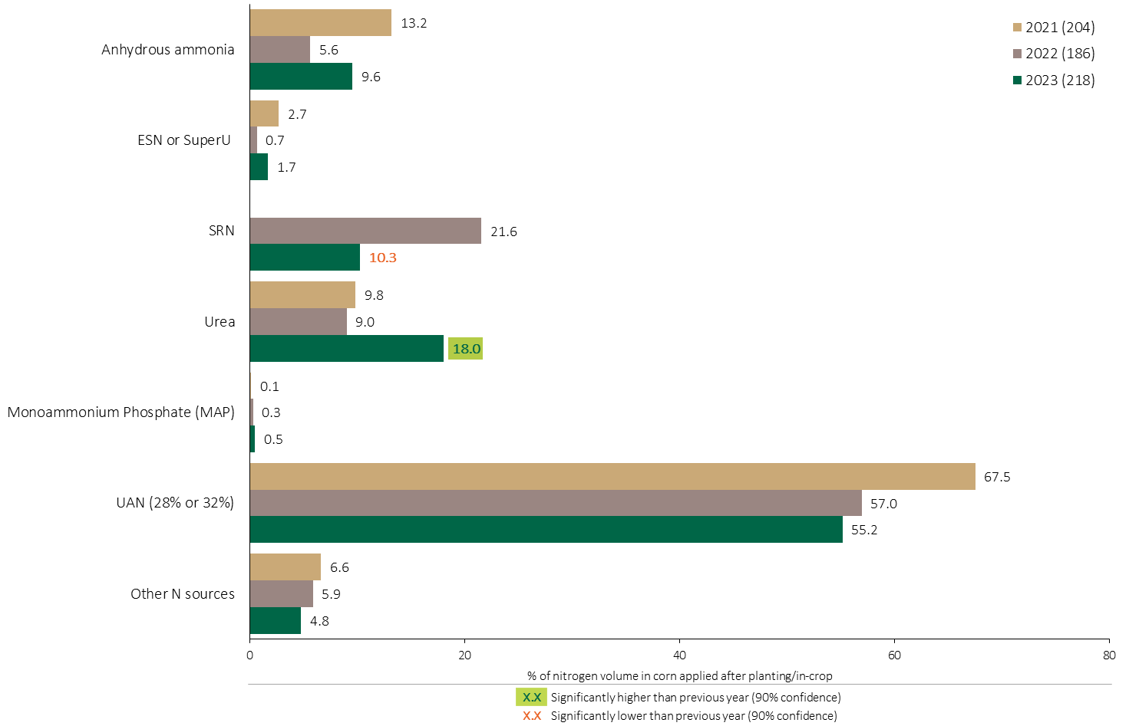
Nitrogen Fertilizer Source in Corn - In-Crop
Grain Corn
18% of the N volume applied after planting/in-crop was applied as urea.
UAN represents over half of the N applied after planting/in-crop.
Note: Nitrogen volume was calculated from all sources of nitrogen contained in all fertilizer types
For each fertilizer type used in either a custom blend or applied as an unblended product, respondents were asked: a) how many acres they applied, and b) the application rate in pounds of actual nutrient/ac. Volumes of each nutrient were calculated by multiplying acres treated times the application rate.
The chart illustrates the % of total nitrogen volume applied after planting/in-crop that was provided by each fertilizer type in each year. The nitrogen volume was calculated from all sources of nitrogen contained in all fertilizer types.

Slide 37
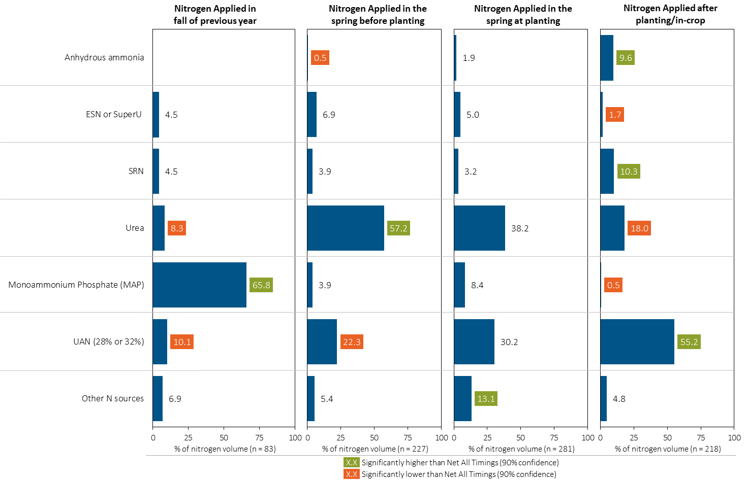
Nitrogen Fertilizer Source in Corn by Timing
Grain Corn
Note: Nitrogen volume was calculated from all sources of nitrogen contained in all fertilizer types
For each fertilizer type used in either a custom blend or applied as an unblended product, respondents were asked: a) how many acres they applied, and b) the application rate in pounds of actual nutrient/ac. Volumes of each nutrient were calculated by multiplying acres treated times the application rate.
Separately for each application timing, the graphs illustrate the % of total nitrogen volume applied in corn that came from each fertilizer source.
Total pounds of actual nitrogen applied was calculated based on all sources of nitrogen from all fertilizer types.

Slide 38
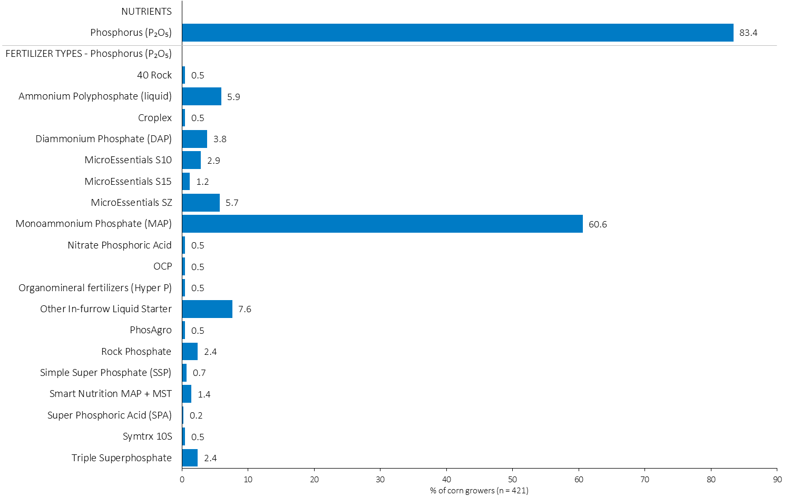
% of Corn Growers Using Each Phosphorus (P₂O₅) Source in 2023
Grain Corn
61% of corn growers used MAP in 2023.
Note: Nutrients were defined based on any fertilizer type that contains the nutrient.
Respondents were asked: “For your 2023 corn crop, did you apply fertilizer or manure at each timing? – and given the options of a) Applied in fall of previous year, b) in the spring before planting, c) in the spring at planting and d) after planting/in-crop. For your 2023 corn crop, which fertilizer types did you apply at each timing?
The chart illustrates the % of corn growers who indicated that they used this nutrient and each fertilizer type in corn in 2023.
Nutrients were defined based on any fertilizer type that contains the nutrient.

Slide 39
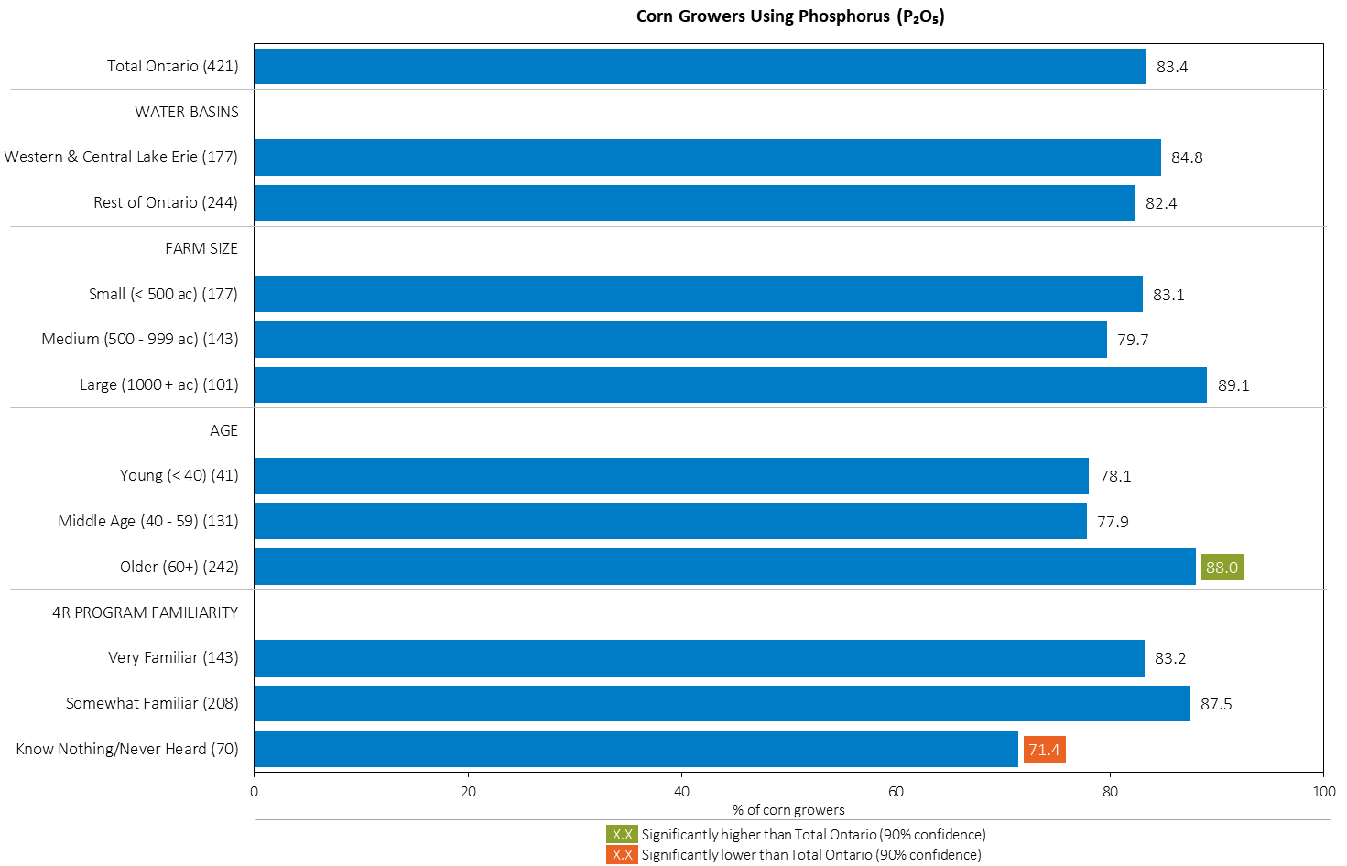
% of Corn Growers Using Phosphorus (P₂O₅) in 2023
Grain Corn
Older growers were more likely to apply P₂O₅ in corn.
MAP
Those unfamiliar with 4R were less likely to apply P₂O₅ in corn.
Note: Nutrients were defined based on any fertilizer type that contains the nutrient.
Respondents were asked: “For your 2023 corn crop, did you apply fertilizer or manure at each timing? – and given the options of a) Applied in fall of previous year, b) in the spring before planting, c) in the spring at planting and d) after planting/in-crop. For your 2023 corn crop, which fertilizer types did you apply at each timing?
The chart illustrates the % of corn growers who indicated that they used this nutrient in corn in 2023 by geography, farm size, age and 4R familiarity.
Nutrients were defined based on any fertilizer type that contains the nutrient.

Slide 40
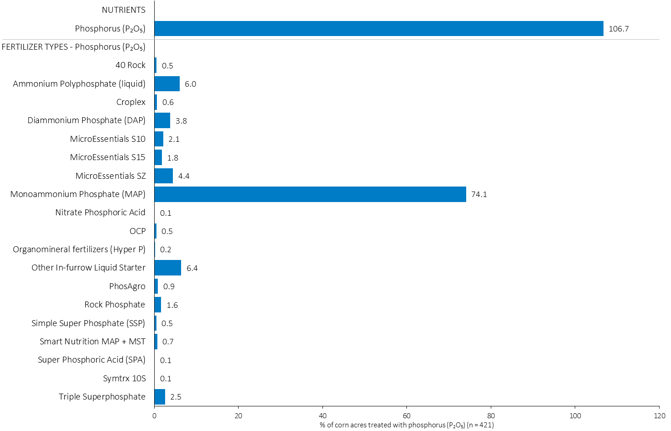
Acres Treated With Each Phosphorus (P₂O₅) Source in Corn in 2023
Grain Corn
Multiple P₂O₅ fertilizer applications were made on some fields.
Grain Corn Summary 
MAP was applied on 74% of corn acres in 2023.
Note: Nutrients were defined based on the primary component of each fertilizer type
For each application timing, respondents were asked: “Of your [xxx] acres of corn, how many acres of each fertilizer type did you apply?”
The chart illustrates the % of total corn acres that were treated with this nutrient and each fertilizer type in 2023.
Nutrients were defined based on the primary component (see adjacent fertilizer types by clicking on the “A” button).

Slide 41
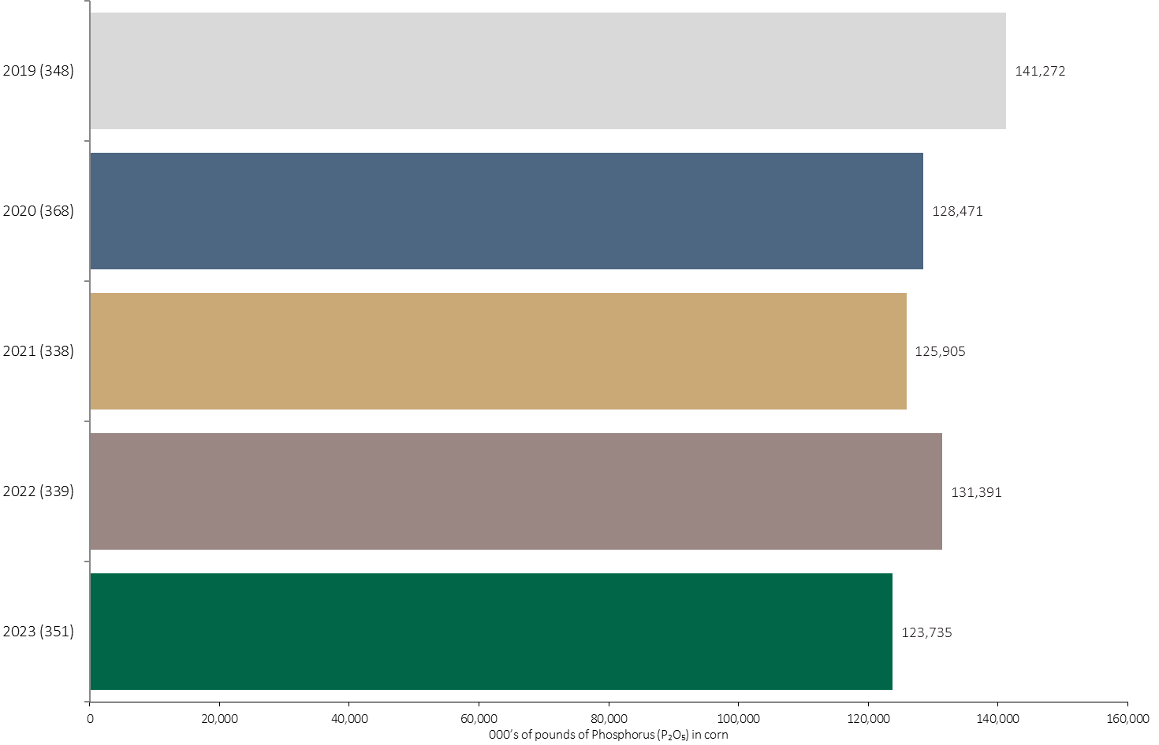
Phosphorus (P₂O₅) Volume in Corn
Grain Corn
124 million pounds of Phosphorus (P₂O₅) was applied in corn in 2023.
Note: Phosphorus (P₂O₅) volume was calculated from all sources of phosphorus contained in all fertilizer types
For each fertilizer type used in either a custom blend or applied as an unblended product, respondents were asked: a) how many acres they applied, and b) the application rate in pounds of actual nutrient/ac. Volumes of each nutrient were calculated by multiplying acres treated times the application rate.
The chart illustrates the total phosphorus (P₂O₅) volume (000’s of pounds) that was used in each year. The phosphorus (P₂O₅) volume was calculated from all sources of phosphorus (P₂O₅) contained in all fertilizer types.

Slide 42
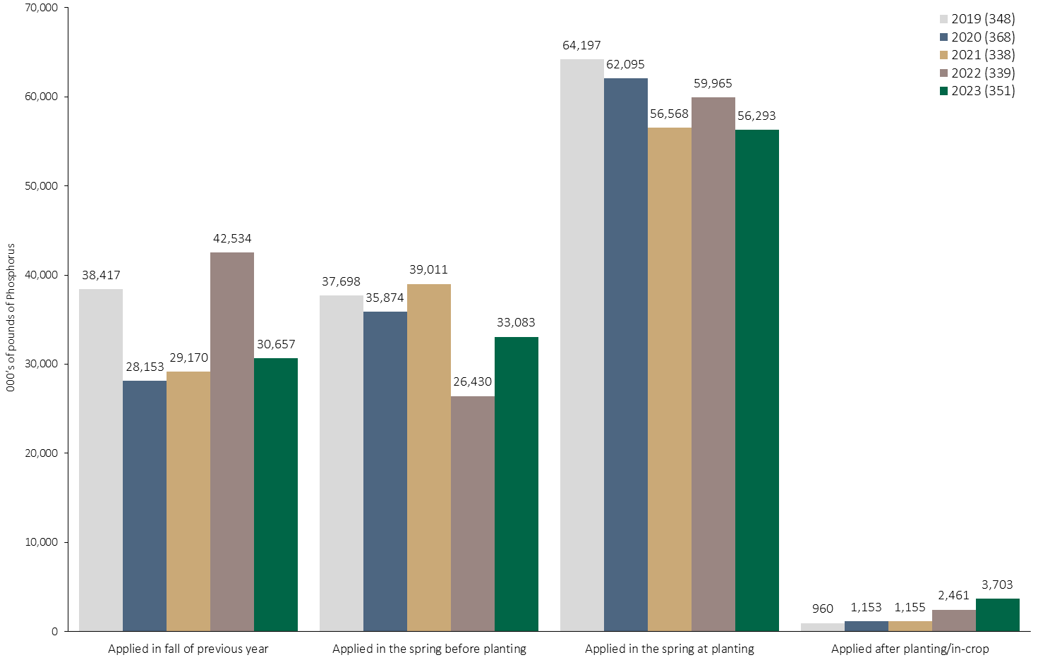
Phosphorus (P₂O₅) Volume in Corn by Timing
Grain Corn
Note: Phosphorus (P₂O₅) volume was calculated from all sources of phosphorus contained in all fertilizer types
For each fertilizer type used in either a custom blend or applied as an unblended product, respondents were asked: a) how many acres they applied, and b) the application rate in pounds of actual nutrient/ac. Volumes of each nutrient were calculated by multiplying acres treated times the application rate.
The chart illustrates the total phosphorus (P₂O₅) volume (000’s of pounds) that was used in each year by application timing. The phosphorus (P₂O₅) volume was calculated from all sources of phosphorus (P₂O₅) contained in all fertilizer types.

Slide 43
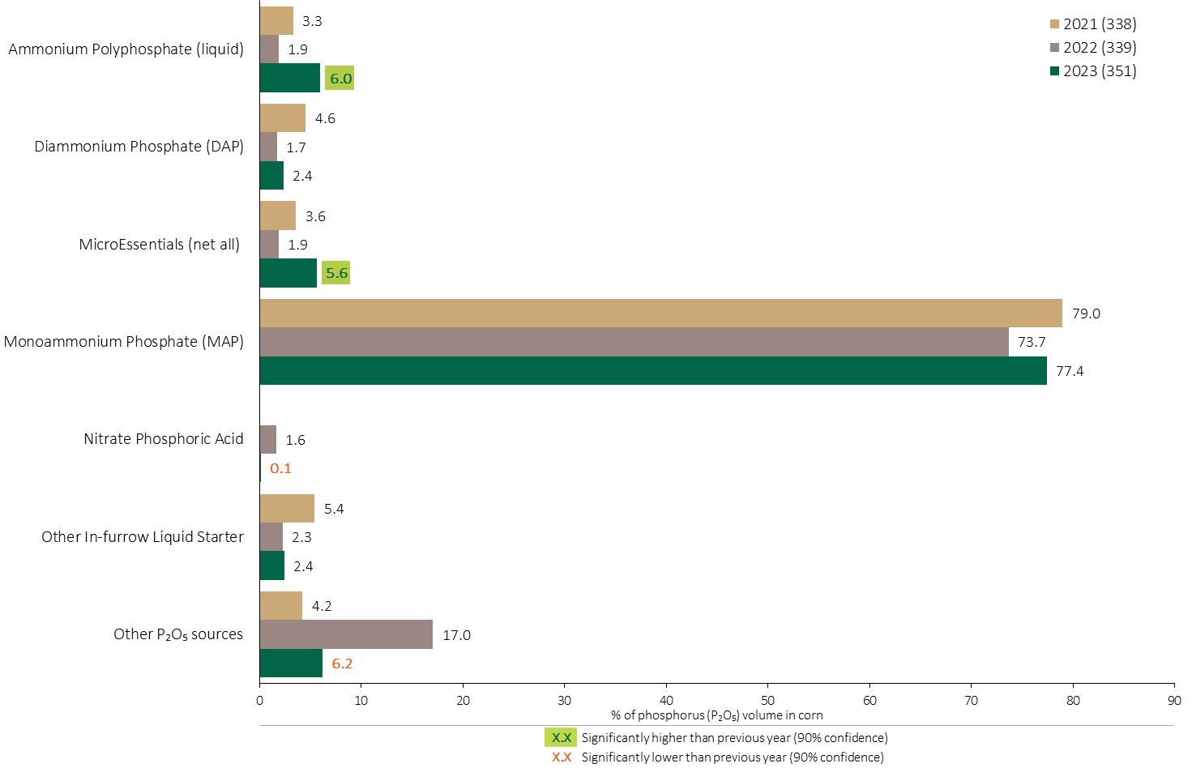
Phosphorus (P₂O₅) Fertilizer Source in Corn - All Timings
Grain Corn
Grain Corn Summary 
Use of MicroEssentials increased in 2023.
MAP has consistently been the primary Phosphorus (P₂O₅) source in corn.
Use of other P₂O₅ sources declined in 2023.
Note: Phosphorus (P₂O₅) volume was calculated from all sources of phosphorus contained in all fertilizer types
For each fertilizer type used in either a custom blend or applied as an unblended product, respondents were asked: a) how many acres they applied, and b) the application rate in pounds of actual nutrient/ac. Volumes of each nutrient were calculated by multiplying acres treated times the application rate.
The chart illustrates the % of total phosphorus (P₂O₅) volume applied at all timings that was provided by each fertilizer type. The phosphorus (P₂O₅) volume was calculated from all sources of phosphorus (P₂O₅) contained in all fertilizer types.

Slide 44
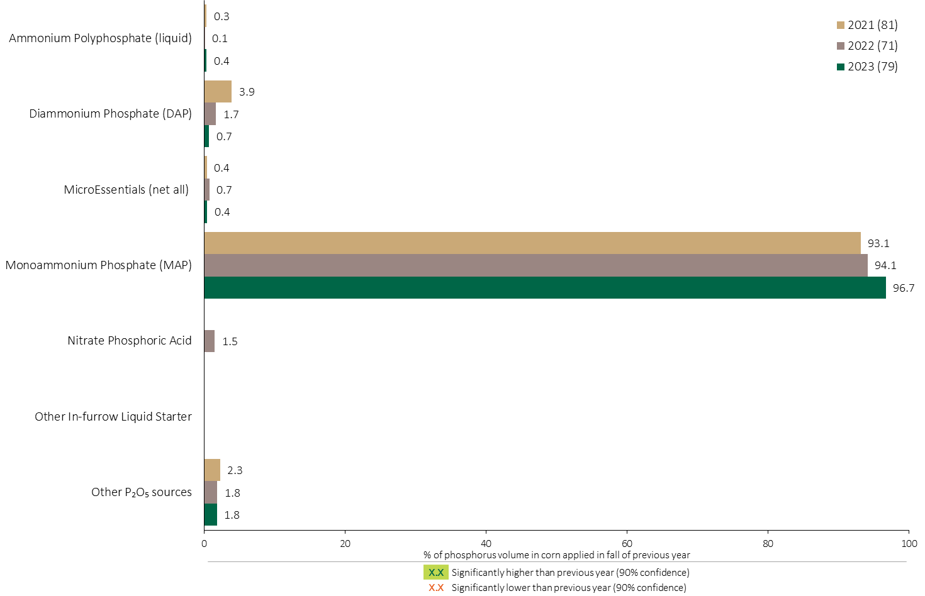
Phosphorus (P₂O₅) Fertilizer Source in Corn - Fall Timing
Grain Corn
Note: Phosphorus (P₂O₅) volume was calculated from all sources of phosphorus contained in all fertilizer types
For each fertilizer type used in either a custom blend or applied as an unblended product, respondents were asked: a) how many acres they applied, and b) the application rate in pounds of actual nutrient/ac. Volumes of each nutrient were calculated by multiplying acres treated times the application rate.
The chart illustrates the % of total phosphorus (P₂O₅) volume applied at the fall timing that was provided by each fertilizer type. The phosphorus (P₂O₅) volume was calculated from all sources of phosphorus (P₂O₅) contained in all fertilizer types.

Slide 45
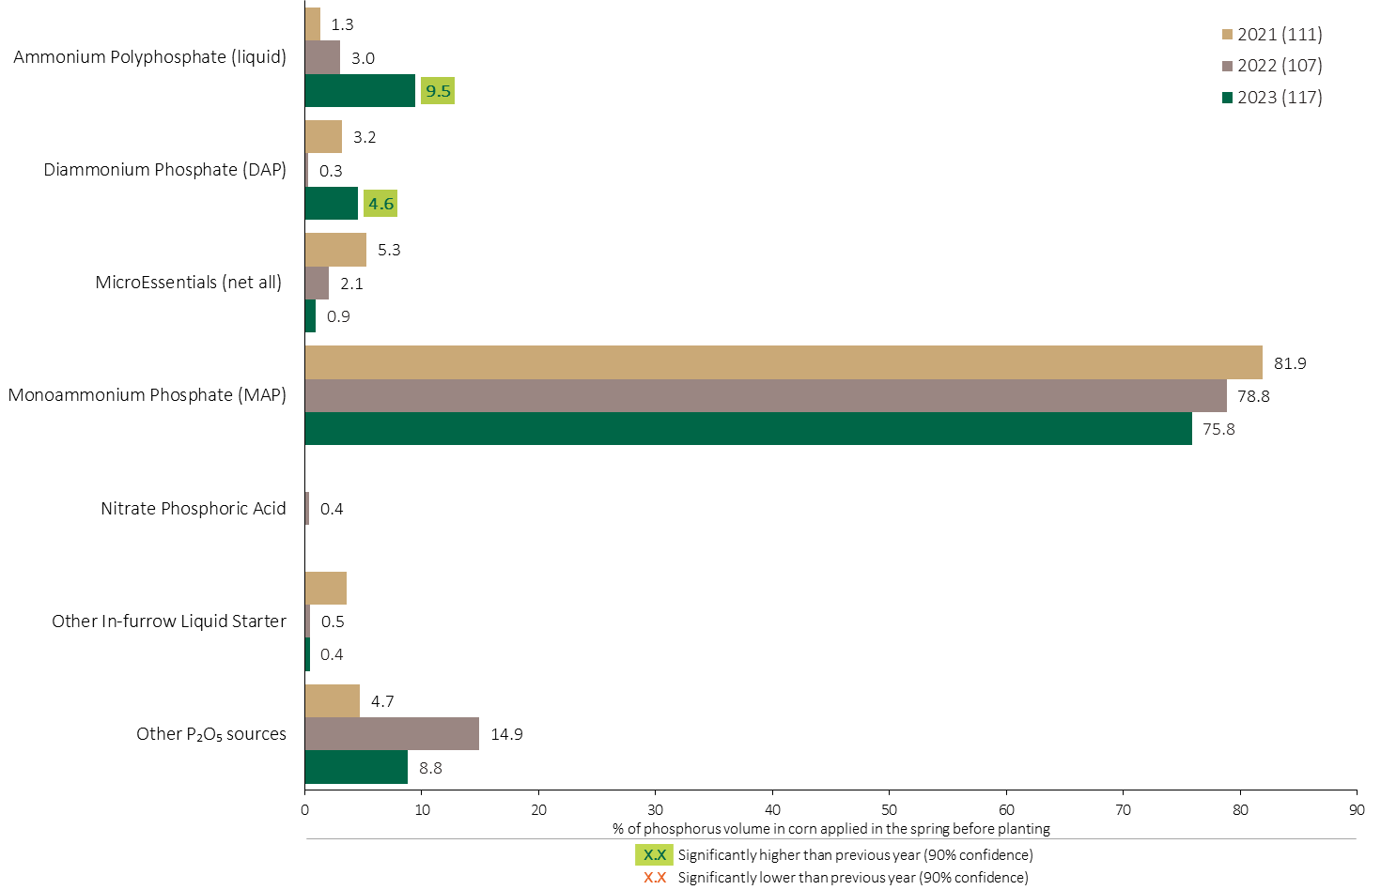
Phosphorus (P₂O₅) Fertilizer Source in Corn - Spring Before Planting
Grain Corn
Note: Phosphorus (P₂O₅) volume was calculated from all sources of phosphorus contained in all fertilizer types
For each fertilizer type used in either a custom blend or applied as an unblended product, respondents were asked: a) how many acres they applied, and b) the application rate in pounds of actual nutrient/ac. Volumes of each nutrient were calculated by multiplying acres treated times the application rate.
The chart illustrates the % of total phosphorus (P₂O₅) volume applied in the spring before planting that was provided by each fertilizer type in each year. The phosphorus (P₂O₅) volume was calculated from all sources of phosphorus (P₂O₅) contained in all fertilizer types.

Slide 46
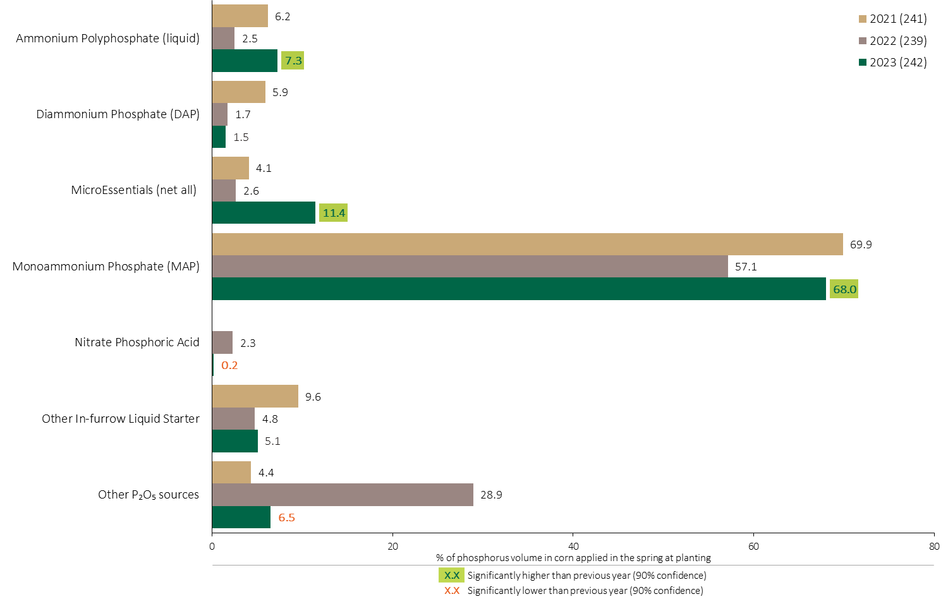
Phosphorus (P₂O₅) Fertilizer Source in Corn - At Planting
Grain Corn
Use of MicroEssentials at planting increased in 2023.
Use of MAP applied at planting recovered in 2023.
Note: Phosphorus (P₂O₅) volume was calculated from all sources of phosphorus contained in all fertilizer types
For each fertilizer type used in either a custom blend or applied as an unblended product, respondents were asked: a) how many acres they applied, and b) the application rate in pounds of actual nutrient/ac. Volumes of each nutrient were calculated by multiplying acres treated times the application rate.
The chart illustrates the % of total phosphorus (P₂O₅) volume applied in the spring at planting that was provided by each fertilizer type. The phosphorus (P₂O₅) volume was calculated from all sources of phosphorus (P₂O₅) contained in all fertilizer types.

Slide 47
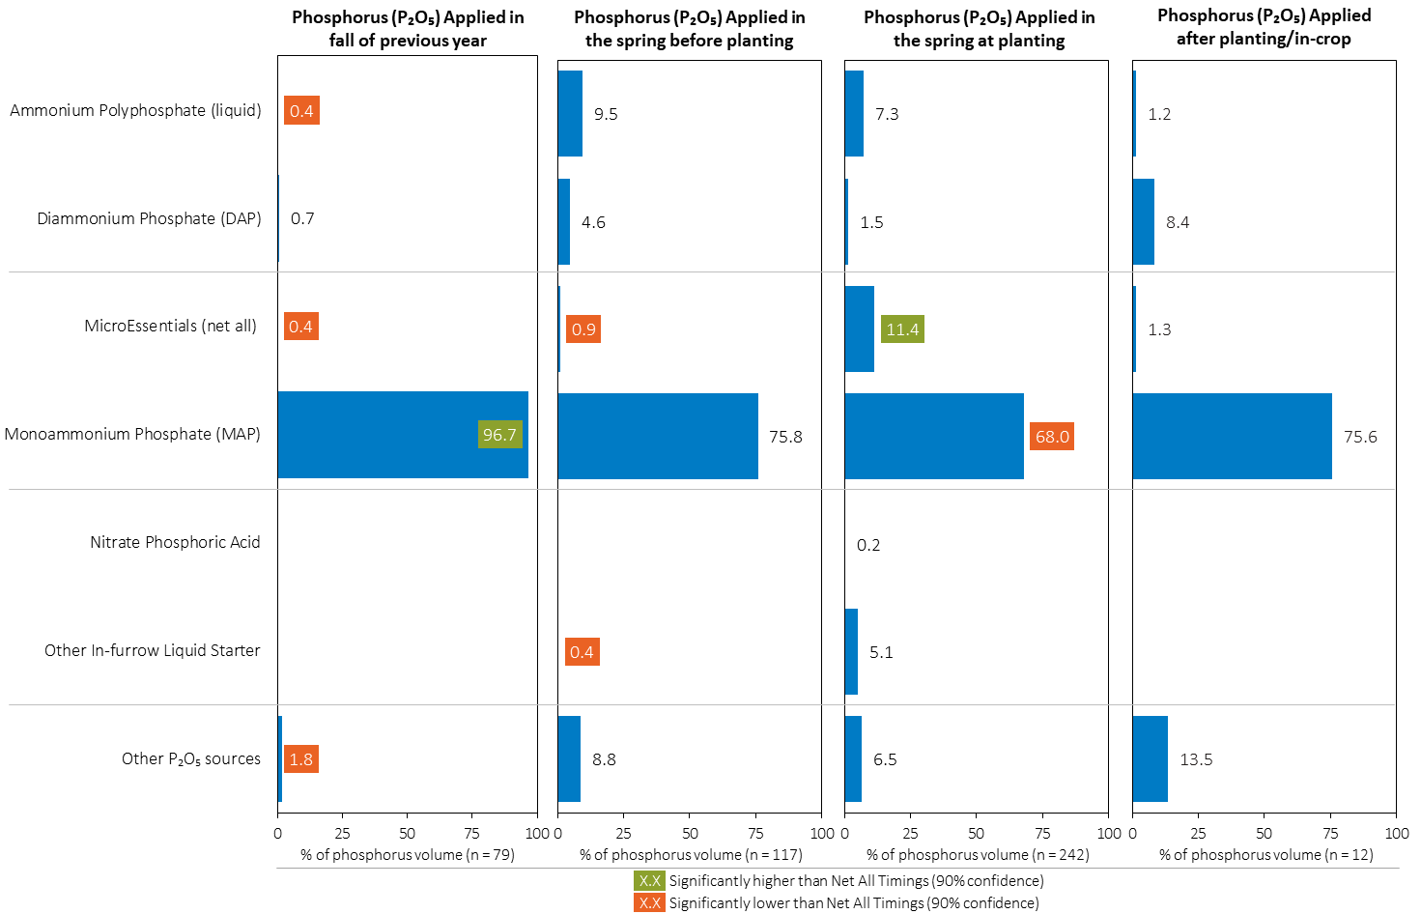
Phosphorus (P₂O₅) Fertilizer Source in Corn by Timing
Grain Corn
Note: Phosphorus (P₂O₅) volume was calculated from all sources of phosphorus contained in all fertilizer types
For each fertilizer type used in either a custom blend or applied as an unblended product, respondents were asked: a) how many acres they applied, and b) the application rate in pounds of actual nutrient/ac. Volumes of each nutrient were calculated by multiplying acres treated times the application rate.
Separately for each application timing, the graphs illustrate the % of total phosphorus (P₂O₅) volume applied in corn that came from each fertilizer source.
Total pounds of actual phosphorus (P₂O₅) applied was calculated based on all sources of phosphorus (P₂O₅) from all fertilizer types.

Slide 48
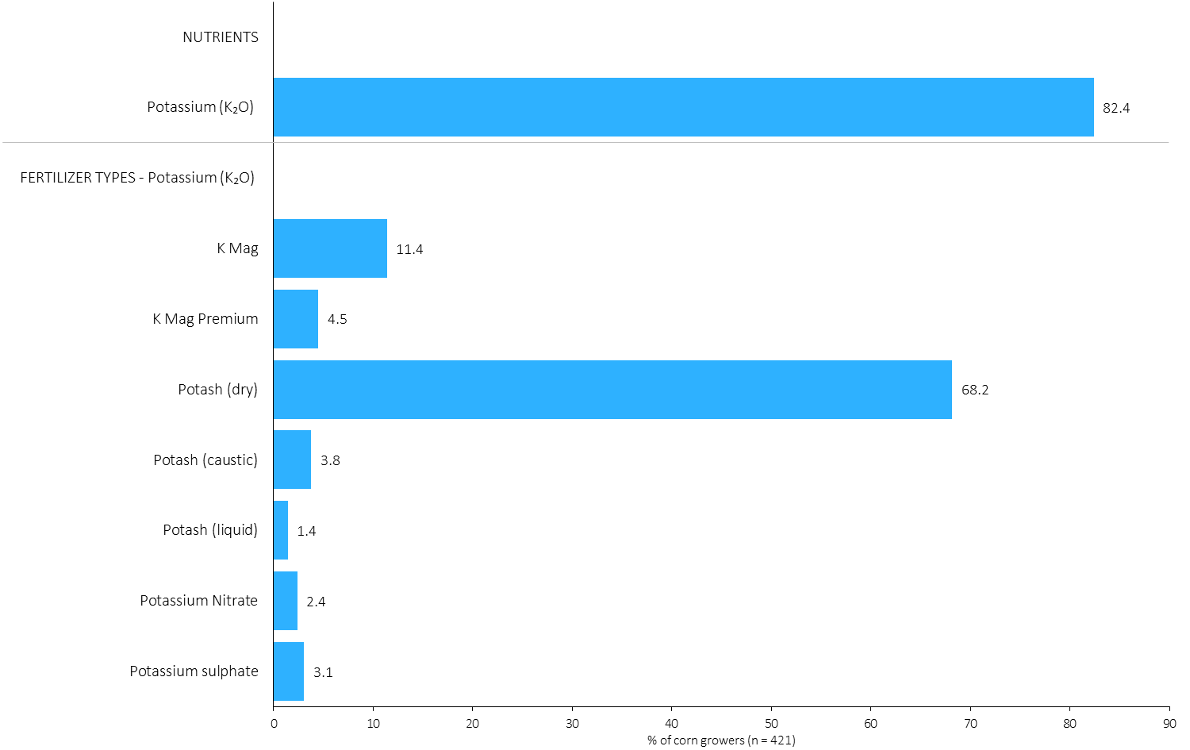
% of Corn Growers Using Each Potassium (K₂O) Source in 2023
Grain Corn
68% of corn growers used dry potash in 2023.
Note: Nutrients were defined based on any fertilizer type that contains the nutrient.
Respondents were asked: “For your 2023 corn crop, did you apply fertilizer or manure at each timing? – and given the options of a) Applied in fall of previous year, b) in the spring before planting, c) in the spring at planting and d) after planting/in-crop. For your 2023 corn crop, which fertilizer types did you apply at each timing?
The chart illustrates the % of corn growers who indicated that they used this nutrient and each fertilizer type in corn in 2023.
Nutrients were defined based on any fertilizer type that contains the nutrient.

Slide 49
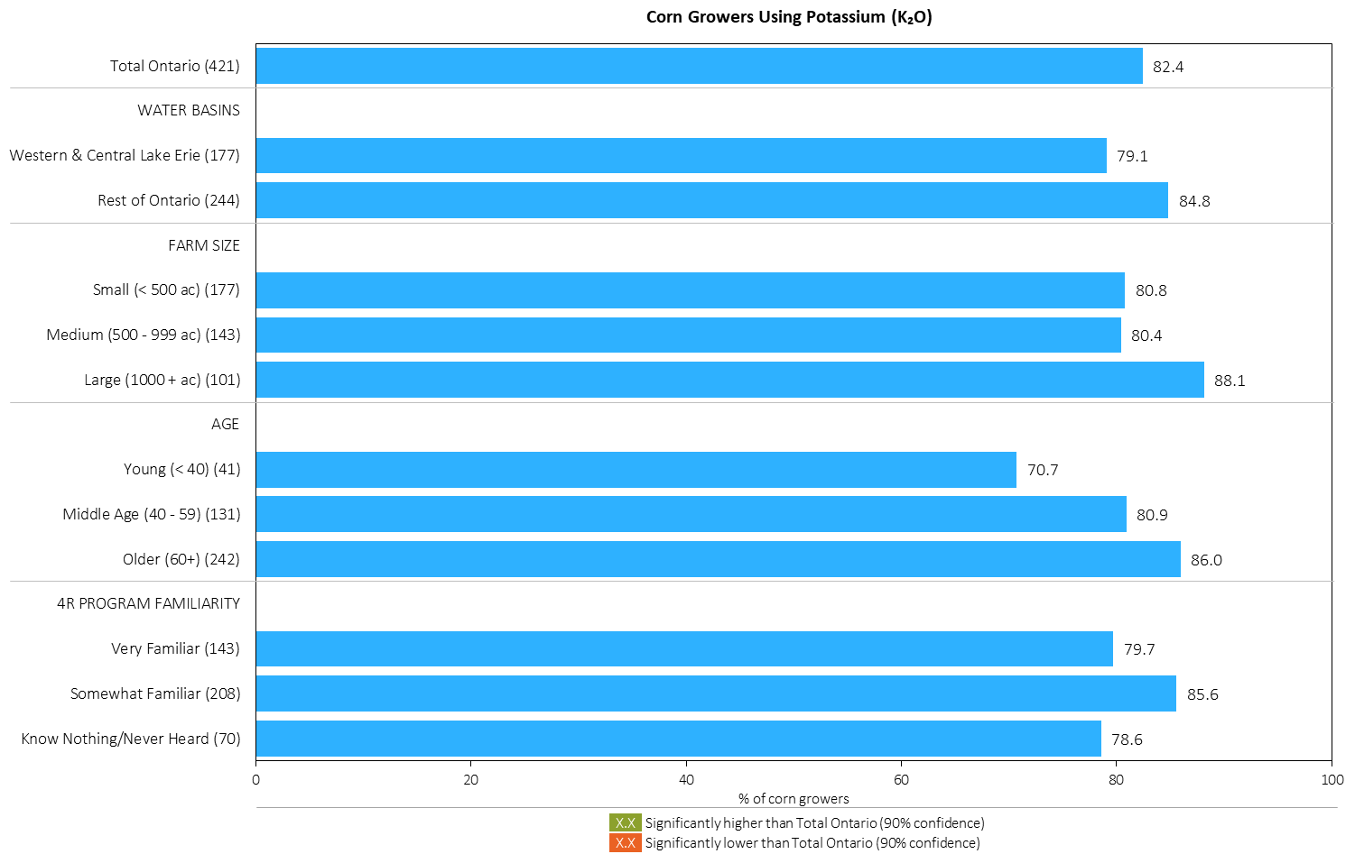
% of Corn Growers Using Potassium (K₂O) in 2023
Grain Corn
Young growers were a little less likely to apply K₂O in corn.
MAP
Note: Nutrients were defined based on any fertilizer type that contains the nutrient.
Respondents were asked: “For your 2023 corn crop, did you apply fertilizer or manure at each timing? – and given the options of a) Applied in fall of previous year, b) in the spring before planting, c) in the spring at planting and d) after planting/in-crop. For your 2023 corn crop, which fertilizer types did you apply at each timing?
The chart illustrates the % of corn growers who indicated that they used this nutrient in corn in 2023 by geography, farm size, age and 4R familiarity.
Nutrients were defined based on any fertilizer type that contains the nutrient.

Slide 50
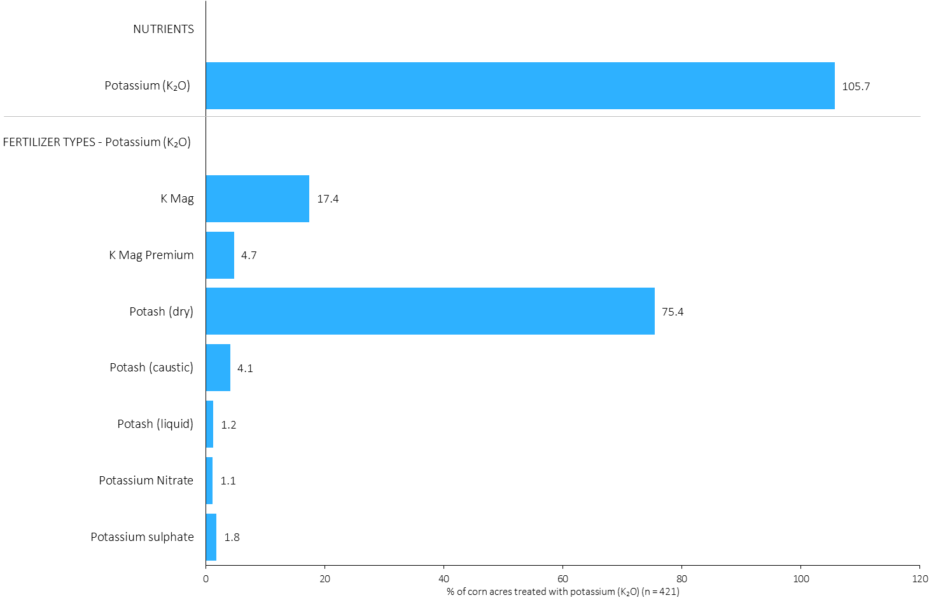
Acres Treated With Each Potassium (K₂O) Source in Corn in 2023
Grain Corn
Multiple potassium fertilizer applications were made on some fields.
Grain Corn Summary 
75% of corn acres received an application of dry potash in 2023.
Note: Nutrients were defined based on the primary component of each fertilizer type
For each application timing, respondents were asked: “Of your [xxx] acres of corn, how many acres of each fertilizer type did you apply?”
The chart illustrates the % of total corn acres that were treated with this nutrient and each fertilizer type in 2023.
Nutrients were defined based on the primary component (see adjacent fertilizer types by clicking on the “A” button).

Slide 51
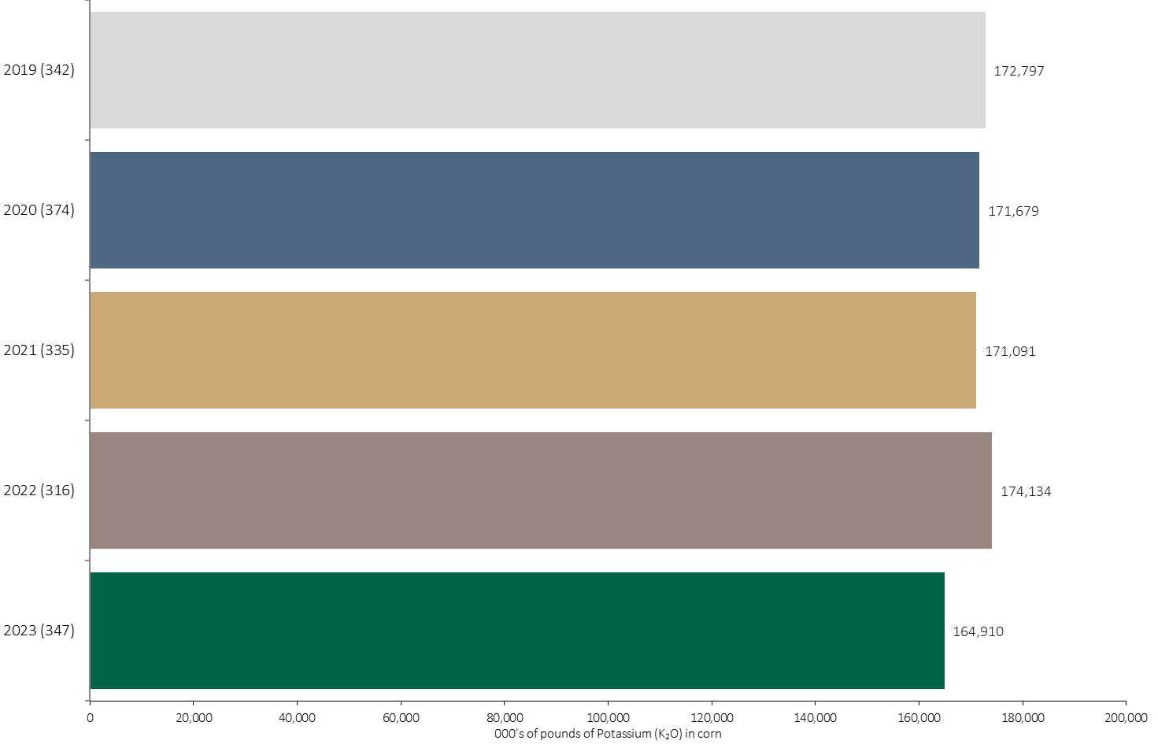
Potassium (K₂O) Volume in Corn
Grain Corn
165 million pounds of Potassium (K₂O) was applied in corn in 2023.
Note: Potassium (K₂O) volume was calculated from all sources of potassium contained in all fertilizer types
For each fertilizer type used in either a custom blend or applied as an unblended product, respondents were asked: a) how many acres they applied, and b) the application rate in pounds of actual nutrient/ac. Volumes of each nutrient were calculated by multiplying acres treated times the application rate.
The chart illustrates the total potassium (K₂O) volume (000’s of pounds) that was used in each year. The potassium (K₂O) volume was calculated from all sources of potassium (K₂O) contained in all fertilizer types.

Slide 52
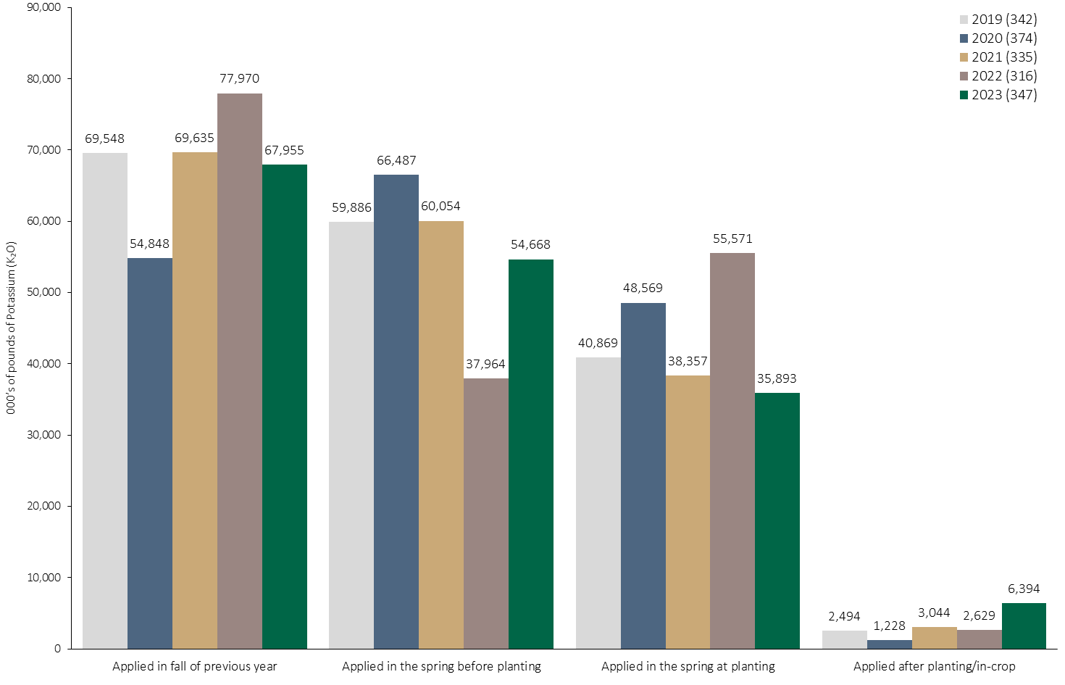
Potassium (K₂O) Volume in Corn by Timing
Grain Corn
Note: Potassium (K₂O) volume was calculated from all sources of potassium contained in all fertilizer types
For each fertilizer type used in either a custom blend or applied as an unblended product, respondents were asked: a) how many acres they applied, and b) the application rate in pounds of actual nutrient/ac. Volumes of each nutrient were calculated by multiplying acres treated times the application rate.
The chart illustrates the total potassium (K₂O) volume (000’s of pounds) that was used in each year by application timing. The potassium (K₂O) volume was calculated from all sources of potassium (K₂O) contained in all fertilizer types.

Slide 53
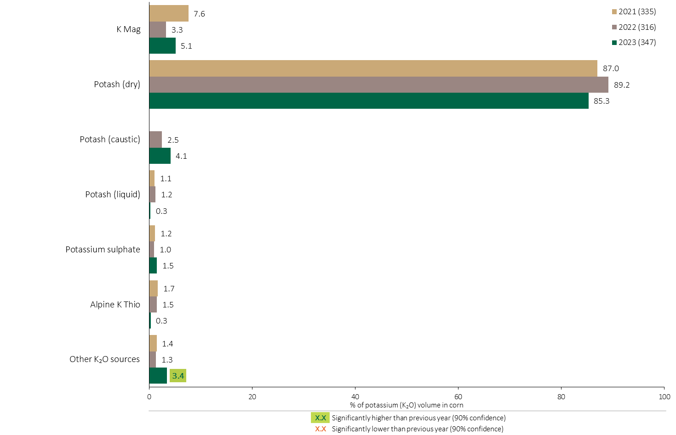
Potassium (K₂O) Fertilizer Source in Corn - All Timings
Grain Corn
Grain Corn Summary 
Dry potash is by far the leading source of K₂O.
Note: Potassium (K₂O) volume was calculated from all sources of potassium contained in all fertilizer types
For each fertilizer type used in either a custom blend or applied as an unblended product, respondents were asked: a) how many acres they applied, and b) the application rate in pounds of actual nutrient/ac. Volumes of each nutrient were calculated by multiplying acres treated times the application rate.
The chart illustrates the % of total potassium (K₂O) volume applied at all timings that was provided by each fertilizer type in each year. The potassium (K₂O) volume was calculated from all sources of potassium (K₂O) contained in all fertilizer types.

Slide 54
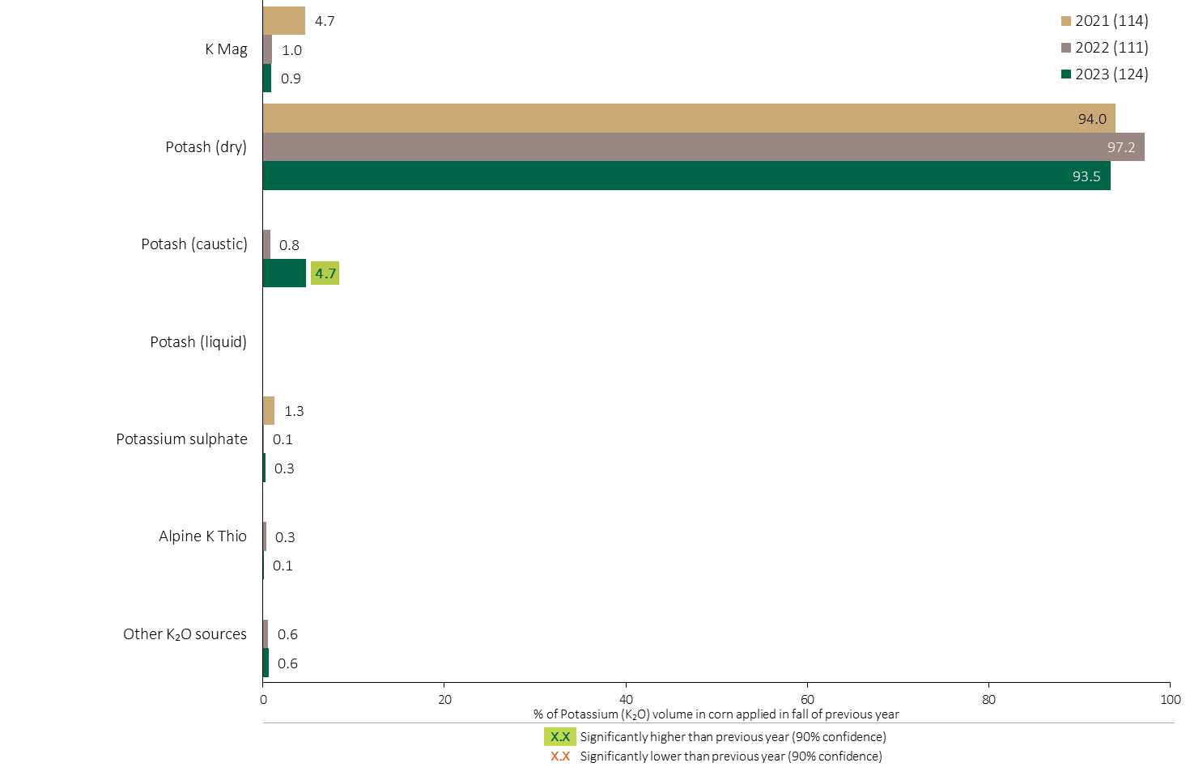
Potassium (K₂O) Fertilizer Source in Corn - Fall Timing
Grain Corn
Note: Potassium (K₂O) volume was calculated from all sources of potassium contained in all fertilizer types
For each fertilizer type used in either a custom blend or applied as an unblended product, respondents were asked: a) how many acres they applied, and b) the application rate in pounds of actual nutrient/ac. Volumes of each nutrient were calculated by multiplying acres treated times the application rate.
The chart illustrates the % of total potassium (K₂O) volume applied at the fall timing that was provided by each fertilizer type in each year. The potassium (K₂O) volume was calculated from all sources of potassium (K₂O) contained in all fertilizer types.

Slide 55

Potassium (K₂O) Fertilizer Source in Corn - Spring Before Planting
Grain Corn
Note: Potassium (K₂O) volume was calculated from all sources of potassium contained in all fertilizer types
For each fertilizer type used in either a custom blend or applied as an unblended product, respondents were asked: a) how many acres they applied, and b) the application rate in pounds of actual nutrient/ac. Volumes of each nutrient were calculated by multiplying acres treated times the application rate.
The chart illustrates the % of total potassium (K₂O) volume applied in the spring before planting that was provided by each fertilizer type in each year. The potassium (K₂O) volume was calculated from all sources of potassium (K₂O) contained in all fertilizer types.

Slide 56

Potassium (K₂O) Fertilizer Source in Corn - At Planting
Use of KMag at planting rebounded in 2023.
Grain Corn
Use of dry Potash at planting decreased in 2023.
Note: Potassium (K₂O) volume was calculated from all sources of potassium contained in all fertilizer types
For each fertilizer type used in either a custom blend or applied as an unblended product, respondents were asked: a) how many acres they applied, and b) the application rate in pounds of actual nutrient/ac. Volumes of each nutrient were calculated by multiplying acres treated times the application rate.
The chart illustrates the % of total potassium (K₂O) volume applied in the spring at planting that was provided by each fertilizer type in each year. The potassium (K₂O) volume was calculated from all sources of potassium (K₂O) contained in all fertilizer types.

Slide 57

Potassium (K₂O) Fertilizer Source in Corn by Timing
Grain Corn
Note: Potassium (K₂O) volume was calculated from all sources of potassium contained in all fertilizer types
For each fertilizer type used in either a custom blend or applied as an unblended product, respondents were asked: a) how many acres they applied, and b) the application rate in pounds of actual nutrient/ac. Volumes of each nutrient were calculated by multiplying acres treated times the application rate.
Separately for each application timing, the graphs illustrate the % of total potassium (K₂O) volume applied in corn that came from each fertilizer source.
Total pounds of actual potassium (K₂O) applied was calculated based on all sources of potassium (K₂O) from all fertilizer types.

Slide 58

% of Corn Growers Using Each Sulphur Source in 2023
Grain Corn
17% of corn growers used ammonium sulphate in 2023.
Note: Nutrients were defined based on any fertilizer type that contains the nutrient.
Respondents were asked: “For your 2023 corn crop, did you apply fertilizer or manure at each timing? – and given the options of a) Applied in fall of previous year, b) in the spring before planting, c) in the spring at planting and d) after planting/in-crop. For your 2023 corn crop, which fertilizer types did you apply at each timing?
The chart illustrates the % of corn growers who indicated that they used this nutrient and each fertilizer type in corn in 2023.
Nutrients were defined based on any fertilizer type that contains the nutrient.

Slide 59

% of Corn Growers Using Sulphur in 2023
Grain Corn
MAP
Note: Nutrients were defined based on any fertilizer type that contains the nutrient.
Respondents were asked: “For your 2023 corn crop, did you apply fertilizer or manure at each timing? – and given the options of a) Applied in fall of previous year, b) in the spring before planting, c) in the spring at planting and d) after planting/in-crop. For your 2023 corn crop, which fertilizer types did you apply at each timing?
The chart illustrates the % of corn growers who indicated that they used this nutrient in corn in 2023 by geography, farm size, age and 4R familiarity.
Nutrients were defined based on any fertilizer type that contains the nutrient.

Slide 60

Acres Treated With Each Sulphur Source in Corn in 2023
Grain Corn
Grain Corn Summary 
20% of corn acres were treated with ammonium sulphate in 2023.
Note: Nutrients were defined based on the primary component of each fertilizer type
For each application timing, respondents were asked: “Of your [xxx] acres of corn, how many acres of each fertilizer type did you apply?”
The chart illustrates the % of total corn acres that were treated with this nutrient and each fertilizer type in 2023.
Nutrients were defined based on the primary component (see adjacent fertilizer types by clicking on the “A” button).

Slide 61

Sulphur Volume in Corn
Grain Corn
34 million pounds of Sulphur was applied in corn in 2023.
Note: Sulphur volume was calculated from all sources of sulphur contained in all fertilizer types
For each fertilizer type used in either a custom blend or applied as an unblended product, respondents were asked: a) how many acres they applied, and b) the application rate in pounds of actual nutrient/ac. Volumes of each nutrient were calculated by multiplying acres treated times the application rate.
The chart illustrates the total sulphur volume (000’s of pounds) that was used in each year. The sulphur volume was calculated from all sources of sulphur contained in all fertilizer types.

Slide 62

Sulphur Volume in Corn by Timing
Grain Corn
Note: Sulphur volume was calculated from all sources of sulphur contained in all fertilizer types
For each fertilizer type used in either a custom blend or applied as an unblended product, respondents were asked: a) how many acres they applied, and b) the application rate in pounds of actual nutrient/ac. Volumes of each nutrient were calculated by multiplying acres treated times the application rate.
The chart illustrates the total sulphur volume (000’s of pounds) that was used in each year by application timing. The sulphur volume was calculated from all sources of sulphur contained in all fertilizer types.

Slide 63

Sulphur Fertilizer Source in Corn - All Timings
Use of K Mag partially recovered in 2023.
Grain Corn
Grain Corn Summary 
Use of Elemental Sulphur increased in 2023.
Note: Sulphur volume was calculated from all sources of sulphur contained in all fertilizer types
For each fertilizer type used in either a custom blend or applied as an unblended product, respondents were asked: a) how many acres they applied, and b) the application rate in pounds of actual nutrient/ac. Volumes of each nutrient were calculated by multiplying acres treated times the application rate.
The chart illustrates the % of total sulphur volume applied at all timings that was provided by each fertilizer type in each year. The sulphur volume was calculated from all sources of sulphur contained in all fertilizer types.

Slide 64

Sulphur Fertilizer Source in Corn - Fall Timing
Grain Corn
Note: Sulphur volume was calculated from all sources of sulphur contained in all fertilizer types
For each fertilizer type used in either a custom blend or applied as an unblended product, respondents were asked: a) how many acres they applied, and b) the application rate in pounds of actual nutrient/ac. Volumes of each nutrient were calculated by multiplying acres treated times the application rate.
The chart illustrates the % of total sulphur volume applied at the fall timing that was provided by each fertilizer type in each year. The sulphur volume was calculated from all sources of sulphur contained in all fertilizer types.

Slide 65

Sulphur Fertilizer Source in Corn - Spring Before Planting
Grain Corn
% of Sulphur applied before planting as K Mag Premium increased in 2023.
Note: Sulphur volume was calculated from all sources of sulphur contained in all fertilizer types
For each fertilizer type used in either a custom blend or applied as an unblended product, respondents were asked: a) how many acres they applied, and b) the application rate in pounds of actual nutrient/ac. Volumes of each nutrient were calculated by multiplying acres treated times the application rate.
The chart illustrates the % of total sulphur volume applied in the spring before planting that was provided by each fertilizer type in each year. The sulphur volume was calculated from all sources of sulphur contained in all fertilizer types.

Slide 66

Sulphur Fertilizer Source in Corn - At Planting
Use of K Mag applied at planting recovered in 2023.
Grain Corn
Note: Sulphur volume was calculated from all sources of sulphur contained in all fertilizer types
For each fertilizer type used in either a custom blend or applied as an unblended product, respondents were asked: a) how many acres they applied, and b) the application rate in pounds of actual nutrient/ac. Volumes of each nutrient were calculated by multiplying acres treated times the application rate.
The chart illustrates the % of total sulphur volume applied in the spring at planting that was provided by each fertilizer type in each year. The sulphur volume was calculated from all sources of sulphur contained in all fertilizer types.

Slide 67

Sulphur Fertilizer Source in Corn - In-Crop
Grain Corn
Note: Sulphur volume was calculated from all sources of sulphur contained in all fertilizer types
For each fertilizer type used in either a custom blend or applied as an unblended product, respondents were asked: a) how many acres they applied, and b) the application rate in pounds of actual nutrient/ac. Volumes of each nutrient were calculated by multiplying acres treated times the application rate.
The chart illustrates the % of total sulphur volume applied after planting/in-crop that was provided by each fertilizer type in each year. The sulphur volume was calculated from all sources of sulphur contained in all fertilizer types.

Slide 68

Sulphur Fertilizer Source in Corn by Timing
Grain Corn
Note: Sulphur volume was calculated from all sources of sulphur contained in all fertilizer types
For each fertilizer type used in either a custom blend or applied as an unblended product, respondents were asked: a) how many acres they applied, and b) the application rate in pounds of actual nutrient/ac. Volumes of each nutrient were calculated by multiplying acres treated times the application rate.
Separately for each application timing, the graphs illustrate the % of total sulphur volume applied in corn that came from each fertilizer source.
Total pounds of actual sulphur applied was calculated based on all sources of sulphur from all fertilizer types.

Slide 69

Nitrogen Placement in Corn - % Crop Acres
Grain Corn
Note: Nutrients were defined based on the primary component of each fertilizer type
For each application timing, respondents were asked: “For each fertilizer type that you applied [TIMING], how many acres did you apply using each placement?”
For Nitrogen, the chart illustrates the % of total corn acres that was applied using each placement at each timing.
Nitrogen was defined based on it being the primary component (see adjacent fertilizer types by clicking on the “A” button).

Slide 70

Nitrogen Placement in Corn - % Nutrient Volume Applied at All Timings
Grain Corn
Grain Corn Summary 
Note: Nutrient volume was calculated from all sources of the nutrient contained in all fertilizer types
For each fertilizer type used in either a custom blend or applied as an unblended product, respondents were asked: a) how many acres they applied, and b) the application rate in pounds of actual nutrient/ac. Volumes of each nutrient were calculated by multiplying acres treated times the application rate.
For Nitrogen, the graph illustrates the % of total nutrient volume applied in corn that was applied at each timing/placement (i.e. across all timings, the sum of percentages = 100%).
Total pounds of actual nutrient applied was calculated based on all sources of the nutrient from all fertilizer types.

Slide 71

Phosphorus (P₂O₅) Placement in Corn - % Crop Acres
Grain Corn
Note: Nutrients were defined based on the primary component of each fertilizer type
For each application timing, respondents were asked: “For each fertilizer type that you applied [TIMING], how many acres did you apply using each placement?”
For Phosphorus, the chart illustrates the % of total corn acres that was applied using each placement at each timing.
Phosphorus was defined based on it being the primary component (see adjacent fertilizer types by clicking on the “A” button).

Slide 72

Phosphorus (P₂O₅) Placement in Corn - % Nutrient Volume Applied at All Timings
Grain Corn
Grain Corn Summary 
Note: Nutrient volume was calculated from all sources of the nutrient contained in all fertilizer types
For each fertilizer type used in either a custom blend or applied as an unblended product, respondents were asked: a) how many acres they applied, and b) the application rate in pounds of actual nutrient/ac. Volumes of each nutrient were calculated by multiplying acres treated times the application rate.
For Phosphorus, the graph illustrates the % of total nutrient volume applied in corn that was applied at each timing/placement (i.e. across all timings, the sum of percentages = 100%).
Total pounds of actual nutrient applied was calculated based on all sources of the nutrient from all fertilizer types.

Slide 73

Potassium (K₂O) Placement in Corn - % Crop Acres
Grain Corn
Note: Nutrients were defined based on the primary component of each fertilizer type
For each application timing, respondents were asked: “For each fertilizer type that you applied [TIMING], how many acres did you apply using each placement?”
For Potassium, the chart illustrates the % of total corn acres that was applied using each placement at each timing.
Potassium was defined based on it being the primary component (see adjacent fertilizer types by clicking on the “A” button).

Slide 74

Potassium (K₂O) Placement in Corn - % Nutrient Volume Applied at All Timings
Grain Corn
Grain Corn Summary 
Note: Nutrient volume was calculated from all sources of the nutrient contained in all fertilizer types
For each fertilizer type used in either a custom blend or applied as an unblended product, respondents were asked: a) how many acres they applied, and b) the application rate in pounds of actual nutrient/ac. Volumes of each nutrient were calculated by multiplying acres treated times the application rate.
For Potassium, the graph illustrates the % of total nutrient volume applied in corn that was applied at each timing/placement (i.e. across all timings, the sum of percentages = 100%).
Total pounds of actual nutrient applied was calculated based on all sources of the nutrient from all fertilizer types.

Slide 75

Sulphur Placement in Corn - % Crop Acres
Grain Corn
Note: Nutrients were defined based on the primary component of each fertilizer type
For each application timing, respondents were asked: “For each fertilizer type that you applied [TIMING], how many acres did you apply using each placement?”
For Sulphur, the chart illustrates the % of total corn acres that was applied using each placement at each timing.
Sulphur was defined based on it being the primary component (see adjacent fertilizer types by clicking on the “A” button).

Slide 76

Sulphur Placement in Corn - % Nutrient Volume Applied at All Timings
Grain Corn
Grain Corn Summary 
Note: Nutrient volume was calculated from all sources of the nutrient contained in all fertilizer types
For each fertilizer type used in either a custom blend or applied as an unblended product, respondents were asked: a) how many acres they applied, and b) the application rate in pounds of actual nutrient/ac. Volumes of each nutrient were calculated by multiplying acres treated times the application rate.
For Sulphur, the graph illustrates the % of total nutrient volume applied in corn that was applied at each timing/placement (i.e. across all timings, the sum of percentages = 100%).
Total pounds of actual nutrient applied was calculated based on all sources of the nutrient from all fertilizer types.

Slide 77

Average Nitrogen Rates in Corn
Nitrogen rates edged higher in 2023.
Grain Corn
Grain Corn Summary 
For each fertilizer type used in either a custom blend or applied as an unblended product, respondents were asked: a) how many acres they applied, and b) the application rate in pounds of actual nutrient/ac. Volumes of each nutrient were calculated by multiplying acres treated times the application rate.
The chart illustrates the average rate of Nitrogen applied in each year expressed in pounds of actual Nitrogen per acre.
Note: Rates include non-users of Nitrogen.

Slide 78

Nitrogen Rates in Corn - Average Rate in 2023
Grain Corn
MAP
Farmers who are unfamiliar with 4R use lower N rates.
Note: Nitrogen volume was calculated from all sources of nitrogen contained in all fertilizer types
Note: Rates include growers who did not apply any nitrogen
For each fertilizer type used in either a custom blend or applied as an unblended product, respondents were asked: a) how many acres they applied, and b) the application rate in pounds of actual nutrient/ac. Volumes of each nutrient were calculated by multiplying acres treated times the application rate.
Separately by geography, farm size, age and 4R familiarity, the graph illustrates the average nitrogen application rate in pounds of nitrogen per acre (including untreated corn acres).

Slide 79

Nitrogen Rates in Corn - Rate Ranges in 2023
Grain Corn
The most common rate was 190 – 199.9 pounds of N/ac.
Note: Nitrogen volume was calculated from all sources of nitrogen contained in all fertilizer types
For each fertilizer type used in either a custom blend or applied as an unblended product, respondents were asked: a) how many acres they applied, and b) the application rate in pounds of actual nutrient/ac. Volumes of each nutrient were calculated by multiplying acres treated times the application rate.
The graph on the left illustrates the % of corn acres that was treated with nitrogen at an application rate that fell within each rate range. The graph on the right illustrates the cumulative % of corn acres that was treated with nitrogen at an application rate that fell within each rate range.

Slide 80

Nitrogen Rate Ranges in Corn - % of Volume in 2023
Grain Corn
55% of the N volume was applied between 180 – 229.9 lbs./ac.
Note: Nitrogen volume was calculated from all sources of nitrogen contained in all fertilizer types
For each fertilizer type used in either a custom blend or applied as an unblended product, respondents were asked: a) how many acres they applied, and b) the application rate in pounds of actual nutrient/ac. Volumes of each nutrient were calculated by multiplying acres treated times the application rate.
The chart illustrates the % of nitrogen volume that was applied in corn within each rate range.
Total pounds of actual nitrogen applied was calculated based on all sources of nitrogen from all fertilizer types.

Slide 81

Average Nitrogen Rates in Corn - By Timing
Grain Corn
Grain Corn Summary 
Nitrogen rates were 108 lbs./ac when applied before planting in 2023.
Note: Nitrogen volume was calculated from all sources of nitrogen contained in all fertilizer types
Note: Rates exclude growers who did not apply any nitrogen
For each fertilizer type used in either a custom blend or applied as an unblended product, respondents were asked: a) how many acres they applied, and b) the application rate in pounds of actual nutrient/ac. Volumes of each nutrient were calculated by multiplying acres treated times the application rate.
The chart illustrates the average rate of Nitrogen applied at each application timing in each year expressed in pounds of actual Nitrogen per acre.
Note: Rates exclude non-users of Nitrogen.

Slide 82

Average Phosphorus (P₂O₅) Rates in Corn
Phosphorus (P₂O₅) rates slipped a little in 2023.
Grain Corn
Grain Corn Summary 
Note: Phosphorus (P₂O₅) volume was calculated from all sources of phosphorus contained in all fertilizer types
Note: Rates include growers who did not apply any phosphorus
For each fertilizer type used in either a custom blend or applied as an unblended product, respondents were asked: a) how many acres they applied, and b) the application rate in pounds of actual nutrient/ac. Volumes of each nutrient were calculated by multiplying acres treated times the application rate.
The chart illustrates the average rate of Phosphorus (P₂O₅) applied in each year expressed in pounds of actual Phosphorus (P₂O₅) per acre.
Note: Rates include non-users of Phosphorus (P₂O₅).

Slide 83

Phosphorus (P₂O₅) Rates in Corn - Average Rate in 2023
Grain Corn
MAP
Note: Phosphorus (P₂O₅) volume was calculated from all sources of phosphorus contained in all fertilizer types
Note: Rates include growers who did not apply any phosphorus
For each fertilizer type used in either a custom blend or applied as an unblended product, respondents were asked: a) how many acres they applied, and b) the application rate in pounds of actual nutrient/ac. Volumes of each nutrient were calculated by multiplying acres treated times the application rate.
Separately by geography, farm size, age and 4R familiarity, the graph illustrates the average Phosphorus (P₂O₅) application rate in pounds of Phosphorus (P₂O₅) per acre (including untreated corn acres).

Slide 84

Phosphorus (P₂O₅) Rates in Corn - Rate Ranges in 2023
Grain Corn
18% of corn acres were not treated with Phosphorus.
Grain Corn Summary 
The most common Phosphorus (P₂O₅) rate was between 50 to 54.9 pounds/acre.
Note: Phosphorus (P₂O₅) volume was calculated from all sources of phosphorus contained in all fertilizer types
For each fertilizer type used in either a custom blend or applied as an unblended product, respondents were asked: a) how many acres they applied, and b) the application rate in pounds of actual nutrient/ac. Volumes of each nutrient were calculated by multiplying acres treated times the application rate.
The graph on the left illustrates the % of corn acres that was treated with phosphorus (P₂O₅) at an application rate that fell within each rate range. The graph on the right illustrates the cumulative % of corn acres that was treated with phosphorus (P₂O₅) at an application rate that fell within each rate range.

Slide 85

Phosphorus (P₂O₅) Rate Ranges in Corn - % of Volume in 2023
Grain Corn
57% of the P₂O₅ volume was applied at 40 to 79.9 lbs./ac.
Note: Phosphorus (P₂O₅) volume was calculated from all sources of phosphorus contained in all fertilizer types
For each fertilizer type used in either a custom blend or applied as an unblended product, respondents were asked: a) how many acres they applied, and b) the application rate in pounds of actual nutrient/ac. Volumes of each nutrient were calculated by multiplying acres treated times the application rate.
The chart illustrates the % of phosphorus (P₂O₅) volume that was applied in corn within each rate range.
Total pounds of actual phosphorus (P₂O₅) applied was calculated based on all sources of phosphorus (P₂O₅) from all fertilizer types.

Slide 86

Average Phosphorus (P₂O₅) Rates in Corn - By Timing
Grain Corn
Phosphorus (P₂O₅) rates averaged 45 lbs./ac when applied at planting.
Note: Phosphorus (P₂O₅) volume was calculated from all sources of phosphorus contained in all fertilizer types
Note: Rates exclude growers who did not apply any phosphorus
For each fertilizer type used in either a custom blend or applied as an unblended product, respondents were asked: a) how many acres they applied, and b) the application rate in pounds of actual nutrient/ac. Volumes of each nutrient were calculated by multiplying acres treated times the application rate.
The chart illustrates the average rate of Phosphorus (P₂O₅) applied at each application timing in each year expressed in pounds of actual Phosphorus (P₂O₅) per acre.
Note: Rates exclude non-users of Phosphorus (P₂O₅).

Slide 87

Average Potassium (K₂O) Rates in Corn
Potassium (K₂O) rates were slightly lower in 2023.
Grain Corn
Grain Corn Summary 
Note: Potassium (K₂O) volume was calculated from all sources of potassium contained in all fertilizer types
Note: Rates include growers who did not apply any potassium
For each fertilizer type used in either a custom blend or applied as an unblended product, respondents were asked: a) how many acres they applied, and b) the application rate in pounds of actual nutrient/ac. Volumes of each nutrient were calculated by multiplying acres treated times the application rate.
The chart illustrates the average rate of Potassium (K₂O) applied in each year expressed in pounds of actual Potassium (K₂O) per acre.
Note: Rates include non-users of Potassium (K₂O).

Slide 88

Potassium (K₂O) Rates in Corn - Average Rate in 2023
Grain Corn
Potassium (K₂O) rates were lower on small farms.
MAP
Note: Potassium (K₂O) volume was calculated from all sources of potassium contained in all fertilizer types
Note: Rates include growers who did not apply any potassium
For each fertilizer type used in either a custom blend or applied as an unblended product, respondents were asked: a) how many acres they applied, and b) the application rate in pounds of actual nutrient/ac. Volumes of each nutrient were calculated by multiplying acres treated times the application rate.
Separately by geography, farm size, age and 4R familiarity, the graph illustrates the average potassium (K₂O) application rate in pounds of potassium (K₂O) per acre (including untreated corn acres).

Slide 89

Potassium (K₂O) Rates in Corn - Rate Ranges in 2023
18% of corn acres did not receive any Potassium in 2023.
Grain Corn
Note: Potassium (K₂O) volume was calculated from all sources of potassium contained in all fertilizer types
For each fertilizer type used in either a custom blend or applied as an unblended product, respondents were asked: a) how many acres they applied, and b) the application rate in pounds of actual nutrient/ac. Volumes of each nutrient were calculated by multiplying acres treated times the application rate.
The graph on the left illustrates the % of corn acres that was treated with potassium (K₂O) at an application rate that fell within each rate range. The graph on the right illustrates the cumulative % of corn acres that was treated with potassium (K₂O) at an application rate that fell within each rate range.

Slide 90

Potassium (K₂O) Rate Ranges in Corn - % of Volume in 2023
Potassium (K₂O) rates were scattered across a wide range.
Grain Corn
56% of the K₂O volume was applied at 70 to 124.9 lbs./ac.
Note: Potassium (K₂O) volume was calculated from all sources of potassium contained in all fertilizer types
For each fertilizer type used in either a custom blend or applied as an unblended product, respondents were asked: a) how many acres they applied, and b) the application rate in pounds of actual nutrient/ac. Volumes of each nutrient were calculated by multiplying acres treated times the application rate.
The chart illustrates the % of potassium (K₂O) volume that was applied in corn within each rate range.
Total pounds of actual potassium (K₂O) applied was calculated based on all sources of potassium (K₂O) from all fertilizer types.

Slide 91

Average Potassium (K₂O) Rates in Corn - By Timing
Grain Corn
Grain Corn Summary 
Average K₂O rates applied at planting were 40 lbs./ac in 2023.
Note: Potassium (K₂O) volume was calculated from all sources of potassium contained in all fertilizer types
Note: Rates exclude growers who did not apply any potassium
For each fertilizer type used in either a custom blend or applied as an unblended product, respondents were asked: a) how many acres they applied, and b) the application rate in pounds of actual nutrient/ac. Volumes of each nutrient were calculated by multiplying acres treated times the application rate.
The chart illustrates the average rate of Potassium (K₂O) applied at each application timing in each year expressed in pounds of actual Potassium (K₂O) per acre.
Note: Rates exclude non-users of Potassium (K₂O).

Slide 92

Average Sulphur Rates in Corn
Sulphur rates have been fairly consistent since 2020.
Grain Corn
Grain Corn Summary 
Note: Sulphur volume was calculated from all sources of sulphur contained in all fertilizer types
Note: Rates include growers who did not apply any sulphur
For each fertilizer type used in either a custom blend or applied as an unblended product, respondents were asked: a) how many acres they applied, and b) the application rate in pounds of actual nutrient/ac. Volumes of each nutrient were calculated by multiplying acres treated times the application rate.
The chart illustrates the average rate of Sulphur applied in each year expressed in pounds of actual Sulphur per acre.
Note: Rates include non-users of Sulphur.

Slide 93

Sulphur Rates in Corn - Average Rate in 2023
Grain Corn
Large farms tend to use higher Sulphur rates (not statistically higher).
MAP
Note: Sulphur volume was calculated from all sources of sulphur contained in all fertilizer types
For each fertilizer type used in either a custom blend or applied as an unblended product, respondents were asked: a) how many acres they applied, and b) the application rate in pounds of actual nutrient/ac. Volumes of each nutrient were calculated by multiplying acres treated times the application rate.
Separately by geography, farm size, age and 4R familiarity, the graph illustrates the average sulphur application rate in pounds of sulphur per acre (including untreated corn acres).

Slide 94

Sulphur Rates in Corn - Rate Ranges in 2023
Grain Corn
34% of corn acres were not treated with any Sulphur.
Grain Corn Summary 
Note: Sulphur volume was calculated from all sources of sulphur contained in all fertilizer types
For each fertilizer type used in either a custom blend or applied as an unblended product, respondents were asked: a) how many acres they applied, and b) the application rate in pounds of actual nutrient/ac. Volumes of each nutrient were calculated by multiplying acres treated times the application rate.
The graph on the left illustrates the % of corn acres that was treated with sulphur at an application rate that fell within each rate range. The graph on the right illustrates the cumulative % of corn acres that was treated with sulphur at an application rate that fell within each rate range.

Slide 95

Sulphur Rate Ranges in Corn - % of Volume in 2023
Grain Corn
29% of the S volume in 2023 was applied at 20 – 24.9 lbs./ac.
Note: Sulphur volume was calculated from all sources of sulphur contained in all fertilizer types
For each fertilizer type used in either a custom blend or applied as an unblended product, respondents were asked: a) how many acres they applied, and b) the application rate in pounds of actual nutrient/ac. Volumes of each nutrient were calculated by multiplying acres treated times the application rate.
The chart illustrates the % of sulphur volume that was applied in corn within each rate range.
Total pounds of actual sulphur applied was calculated based on all sources of sulphur nutrient from all fertilizer types.

Slide 96

Average Sulphur Rates in Corn - By Timing
Grain Corn
Note: Sulphur volume was calculated from all sources of sulphur contained in all fertilizer types
Note: Rates exclude growers who did not apply any sulphur
For each fertilizer type used in either a custom blend or applied as an unblended product, respondents were asked: a) how many acres they applied, and b) the application rate in pounds of actual nutrient/ac. Volumes of each nutrient were calculated by multiplying acres treated times the application rate.
The chart illustrates the average rate of Sulphur applied at each application timing in each year expressed in pounds of actual Sulphur per acre.
Note: Rates exclude non-users of Sulphur.

Slide 97

Fertilizer Program in Corn
Grain Corn
58% of corn growers say they use the same fertilizer program on all of their corn fields.
Respondents were asked: “For your fertilizer application on your 2023 corn crop, did you: a) use variable rate technology based on prescription maps on all of your corn acres, b) use variable rate technology based on prescription maps on some of your corn acres, c) tailor your fertilizer program on a field-by-field basis or d) use exactly the same fertilizer program for all corn fields on the farm?”
The graph illustrates the % of corn growers who followed each fertilizer program in their 2023 corn crop.

Slide 98

Trend in Fertilizer Program in Corn
Grain Corn
Use of variable rates does not appear to be expanding and may be slowly declining.
Respondents were asked: “For your fertilizer application on your 2023 corn crop, did you: a) use variable rate technology based on prescription maps on all of your corn acres, b) use variable rate technology based on prescription maps on some of your corn acres, c) tailor your fertilizer program on a field-by-field basis or d) use exactly the same fertilizer program for all corn fields on the farm?”
The graph illustrates the % of corn growers who followed each fertilizer program in their corn crop in each year.

Slide 99

Fertilizer Program in Corn - by Sub-Group
Grain Corn
Larger farms were more likely to tailor programs field by field.
Those very familiar with 4R were less likely to use the same program for all fields.
MAP
Respondents were asked: “For your fertilizer application on your 2023 corn crop, did you: a) use variable rate technology based on prescription maps on all of your corn acres, b) use variable rate technology based on prescription maps on some of your corn acres, c) tailor your fertilizer program on a field-by-field basis or d) use exactly the same fertilizer program for all corn fields on the farm?”
Separately by geography, farm size, age and 4R familiarity, the graph on the left illustrates the % of corn growers who used variable rates on some or all of their corn fields. The graph in the middle illustrates the % of corn growers who tailored their fertilizer program on a field-by-field basis. The graph on the right illustrates the % of corn growers who used the same fertilizer program on all of their corn fields.

Slide 100

Use of Variable Rates by Fertilizer Type
Grain Corn
Users of each fertilizer type who used variable rates on some or all of their fields were asked: "For which of the following fertilizer types/blends did you use variable rates?"
The chart illustrates the % of users of each fertilizer type who used variable rates when they applied that fertilizer type.

Slide 101

Consistency Criteria for Corn
LEVEL 1 – NITROGEN
RATE Must meet the following criteria for N rate determination:
- Do one or more of the following:
- Soil test for N every year
- Nutrient balance calculation
- CCA/Qualified agronomist recommendation
- Follow provincial recommendations
- Use variable rate prescription maps
- Use on farm research
TIMING Must not do any of the following:
- Apply UAN or Ammonium nitrate in the fall
- Apply NH3 or Urea in the fall before October 15
- Apply any N fertilizer in winter on snow covered or frozen ground
PLACEMENT Must not do any of the following:
- Apply Urea in the fall on the surface with no incorporation
- Apply NH3, Urea, UAN or AN preplant on the surface with no incorporation
- Apply NH3, Urea, UAN or AN at planting on the surface with no incorporation
LEVEL 1 – PHOSPHORUS
RATE Must meet the following criteria for P rate determination:
- Soil test at least every 4 years AND
- Do one or more of the following:
    - Soil test
- Nutrient balance calculation
- CCA/Qualified agronomist recommendation
- Follow provincial recommendations
- Use variable rate prescription maps
- Use on farm research
TIMING Must not do any of the following:
- Apply any P fertilizer in winter on snow covered or frozen ground
PLACEMENT Must not do any of the following:
- Apply any P fertilizer in the fall on the surface with no incorporation
- Apply any P fertilizer preplant on the surface with no incorporation
- Apply any P fertilizer at planting on the surface with no incorporation
Grain Corn
The % of corn acres meeting Level 1 criteria has been consistent over past 4 years.
CONSISTENCY CRITERIA
The % of corn acres meeting Level 2 criteria continued to trend lower in 2023.
Level 1 consistency means that the grower’s on-farm practices meet the requirements for 4R best management practices as defined by Fertilizer Canada.
Level 2 compliance means that, in addition to meeting the Level 1 criteria, the grower also works with a 4R designated retailer.
The upper charts illustrate Level 1 Consistency with 4R best management practices expressed as the % of corn acres and corn acres (000s). The lower charts illustrate Level 2 Consistency expressed as the % of corn acres and corn acres (000s).
LEVEL 2 Must work with a 4R Designated Retailer

Slide 102

Reasons for Not Meeting 4R Consistency Criteria
Grain Corn
More grain corn acres did not meet 4R consistency criteria in 2023 because of Nitrogen placement.
Fewer grain corn acres did not meet 4R consistency criteria in 2023 because of P₂O₅ placement.
Respondents were asked a series of questions about their fertilizer use practices. Those practices were matched against the 4R consistency criteria that were developed by Fertilizer Canada.
The chart illustrates the reasons for not meeting the 4R Consistency Criteria, expressed as a % of total planted acres of this crop.

Slide 103

Do Not Meet 4R Consistency Criteria in 2023
A lower % of grain corn acres did not meet 4R consistency criteria in the Western & Central Lake Erie basin.
Grain Corn
Respondents were asked a series of questions about their fertilizer use practices. Those practices were matched against the 4R consistency criteria that were developed by Fertilizer Canada.
The chart illustrates the % of total planted acres of this crop that did not meet the 4R consistency criteria across various geographic and demographic segments.

Slide 104

Use of Nitrogen Fixing Crop in Previous Year - Corn
Grain Corn
MAP
Respondents were asked: “Thinking of your 2023 corn crop, in the year prior (2022) did you grow a nitrogen fixing crop on: a) all of your 2023 corn fields, b) some of your 2023 corn fields, or c) none of your 2023 corn fields? Nitrogen fixing crops include peas, beans, lentils, chickpeas, soybeans, and forage legumes)."
The graph on the left illustrates the % of corn growers who planted a nitrogen fixing crop in 2022 on all of their 2023 corn fields, some of their 2023 corn fields or none of their 2023 corn fields. Separately by geography, farm size, age and 4R familiarity, the graph on the right illustrates the % of corn growers who planted a nitrogen fixing crop in 2022 on some or all of their 2023 corn fields.

Slide 105

Trend in Use of Nitrogen Fixing Crop in Previous Year - Corn
Grain Corn
No meaningful changes in previous year use of N-fixing crops.
Respondents were asked: “Thinking of your 2023 corn crop, in the year prior (2022) did you grow a nitrogen fixing crop on: a) all of your 2023 corn fields, b) some of your 2023 corn fields, or c) none of your 2023 corn fields? (Nitrogen fixing crops include peas, beans, corn for grains, chickpeas, oats, and forage legumes).“
The chart illustrates the % of corn growers who planted a nitrogen fixing crop in the prior year on all of their corn fields, some of their corn fields or none of their corn fields in each year.

Slide 106

Rates Set By Field Based On Expected Crop Yield
Grain Corn
52% of corn growers say they set rates for each field based on expected crop yield.
4R knowledge is linked to setting rates by field.
Respondents were asked: "Do you set specific rates for each corn field based on expected crop yield?"
The pie chart illustrates the % of corn growers who provided each response. Separately for various geographic and demographic segments, the chart on the right illustrates the % of corn growers who set rates based on expected yields.

Slide 107

Approaches Used to Decide Fertilizer Rate in Corn
Grain Corn
Respondents who used a fertilizer type containing each nutrient were asked: “For each nutrient, which approaches did you use to decide the amount of fertilizer to apply to your corn in 2023? (Please check all that apply.)”
Separately by nutrient type, the graphs illustrate the % of nutrient users who used each approach to decide their application rate in corn in 2023.

Slide 108

Trend in Approaches Used to Decide Nitrogen Rate in Grain Corn
Grain Corn
Approaches used to determine Nitrogen rates have been consistent over the past 3 years.
Respondents who used a fertilizer type containing each nutrient were asked: “For each nutrient, which approaches did you use to decide the amount of fertilizer to apply to your grain corn in 2023? (Please check all that apply.)”
Separately by nutrient type, the graphs illustrate the % of Nitrogen users who used each approach to decide their application rate in grain corn in 2021 to 2023.

Slide 109

Trend in Approaches Used to Decide Phosphorus Rate in Grain Corn
Grain Corn
No meaningful changes in the approaches used to set Phosphorus rates over the past 3 years.
Respondents who used a fertilizer type containing each nutrient were asked: “For each nutrient, which approaches did you use to decide the amount of fertilizer to apply to your grain corn in 2023? (Please check all that apply.)”
Separately by nutrient type, the graphs illustrate the % of Phosphorus users who used each approach to decide their application rate in grain corn in 2021 to 2023.

Slide 110

Main Person Who Determined Fertilizer Rate
Grain Corn
Older farmers tend to rely on ag retailer more often.
Respondents were asked: "Who was the main person who determined what fertilizer application rate you should use for your grain corn in 2023?"
The chart illustrates the % of grain corn growers who indicated each person who determined their fertilizer application rate in 2023.

Slide 111

Linkage of Who Makes Rate Decision on Compliance with 4R Consistency Criteria - Corn
Grain Corn
When fertilizer rate decisions are made by ag retailers, Level 2 4R Consistency is higher.
Respondents were asked: "Who is the main person who determined what fertilizer application rate you should use for your grain corn?" The chart illustrates the % of crop acres that meet Level 1 and Level 2 4R consistency criteria based on who made the fertilizer rate decision.

Slide 112

Linkage of Who Makes Rate Decision on Compliance with 4R Consistency Criteria - Corn - Trends
Grain Corn
Level 1 compliance declined in 2023 among those who used an independent consultant to make rate decisions.
Respondents were asked: "Who is the main person who determined what fertilizer application rate you should use for your grain corn?" The chart illustrates the % of crop acres that meet Level 1 and Level 2 4R consistency criteria based on who made the fertilizer rate decision.

Slide 113

Linkage of Nitrogen Rates and Who Makes Rate Decisions - Corn
Grain Corn
No significant differences in Nitrogen application rates based on who made the rate decision.
If anything, ag retailer recommended rates are slightly lower than other people who make the decision.
Respondents were asked: "Who is the main person who determined what fertilizer application rate you should use for your grain corn?" The chart illustrates the average nitrogen rate applied, based on who made the fertilizer rate decision.

Slide 114

Professional Designation of Person Who Determined Fertilizer Rate
Grain Corn
Respondents were asked: "Did the person who determined your fertilizer application rate hold any of the following professional designations?"
Separately for each type of person who determined the fertilizer application rate, the charts illustrate the professional designation of those people.

Slide 115

Importance of Professional Designation
Grain Corn
22% of those growers who use an ICA to provide fertilizer rate recommendations indicated the professional designation is extremely important.
Respondents were asked: "How important is it to you that the person providing your fertilizer application rate recommendation has a professional designation (i.e. CCA, P.Ag.)"
Separately for each type of person who determined the fertilizer application rate, the chart illustrates the level of importance for having a professional designation.

Slide 116

Deviation from Recommended Application Rate
Grain Corn
Large farms more often went above the recommended rate.
Respondents were asked: "Did you decide to increase or decrease your fertilizer application rate in grain corn above or below the recommended rate?"
The pie chart illustrates the % of respondents who went above the recommended rate, below the recommended rate or applied the recommended rate. Separately for various geographic and demographic segments, the chart on the right illustrates the % of respondents who decreased their application rate below the recommended rate.

Slide 117

Reasons for Increasing Above Recommended Application Rate
Grain Corn
Respondents who increased their fertilizer rate above the recommended rate were asked: "What were the reasons that you increased your fertilizer application rate in grain corn above the recommended rate?"
The chart illustrates the main reason and other reasons for applying more than the recommended rate in 2023.

Slide 118

Reasons for Decreasing Below Recommended Application Rate
Grain Corn
Respondents who decreased their fertilizer rate below the recommended rate were asked: "What were the reasons that you decreased your fertilizer application rate in grain corn below the recommended rate?"
The chart illustrates the main reason and other reasons for applying less than the recommended rate in 2023.

Slide 119

Use of Nitrogen Stabilizers in Corn - By Fertilizer Type
Grain Corn
35% of corn acres treated with urea had a nitrogen stabilizer added to the urea.
Note: This analysis excludes ESN and SuperU
Separately for each timing, users of primary nitrogen fertilizers were asked: "Which of the following nitrogen stabilizers did you use?"
The chart illustrates the use of any nitrogen stabilizer on each nitrogen fertilizer type, expressed as the % of acres treated with each primary nitrogen fertilizer type.

Slide 120

Use of Nitrogen Stabilizers in Corn - By Application Timing
Grain Corn
Farmers reported an increase in N fertilizer applied with a stabilizer.
Note: This analysis excludes ESN and SuperU
Separately for each timing, users of primary nitrogen fertilizers were asked: "Which of the following nitrogen stabilizers did you use? If none were used, check the box at the bottom of the table."
The chart illustrates the use of any nitrogen stabilizer on any nitrogen fertilizer type by timing, expressed as the % of acres treated with any primary nitrogen fertilizer type that was treated with any nitrogen stabilizer.

Slide 121

Use of Individual Nitrogen Stabilizers in Corn
Grain Corn
Excelis Maxx was the most commonly used stabilizer; applied on about 6% of total Nitrogen fertilizer acres.
Note: This analysis excludes ESN and SuperU
Separately for each timing, users of primary nitrogen fertilizers were asked: "Which of the following nitrogen stabilizers did you use? If none were used, check the box at the bottom of the table."
The chart illustrates the use of each nitrogen stabilizer product on any nitrogen fertilizer type at any timing, expressed as the % of acres treated with any primary nitrogen fertilizer type that was treated with each nitrogen stabilizer product.

Slide 122

Use of Nitrogen Stabilizers by Geographic/Demographic Segment
Grain Corn
Farmers located in the Western & Central Lake Erie basin were less likely to use a N stabilizer.
MAP
Note: This analysis excludes ESN and SuperU
Separately for each timing, users of primary nitrogen fertilizers were asked: "Which of the following nitrogen stabilizers did you use? If none were used, check the box at the bottom of the table."
Separately for each geographic and demographic segment, the chart illustrates the use of any nitrogen stabilizer on any nitrogen fertilizer type, expressed as the % of acres treated with any primary nitrogen fertilizer type that was treated with any nitrogen stabilizer.

Slide 123

Use of EEFs by Timing - % of Nitrogen Volume
Grain Corn
32% of the total N volume applied in corn was applied in a protected form.
All respondents were asked: "Which of the following fertilizer types did you apply (the list included ESN and SuperU)?"
Respondents who used any other primary Nitrogen fertilizer were asked: "Which of the following nitrogen stabilizers did you use?"
Separately for each application timing, the chart illustrates the % of primary Nitrogen fertilizer users who used each type of EEF.

Slide 124

Use of EEFs by Timing - % of Nitrogen Volume - Net All Timings
Grain Corn
Respondents were asked: "Which of the following fertilizer types did you apply (the list included ESN and SuperU)"
Respondents who used any primary Nitrogen fertilizer (excluding ESN and SuperU) were asked: "Which of the following nitrogen stabilizers did you use?"
Separately for each EEF type, the chart illustrates the % of primary Nitrogen fertilizer volume that was applied with an EEF using each placement.

Slide 125

Target vs. Actual Yield in Corn
Grain Corn
Actual yields were about 4 bu/ac above targeted yields in 2023.
Respondents were asked: “What was your target yield for your corn in 2023 (respondents had the option to report that they did not have a target yield)? What was the average yield for your corn in 2023? “
The graph illustrates the average target yield and the average actual yield reported in each year.

Slide 126

Target vs. Actual Yield in Corn in 2023
Grain Corn
MAP
Respondents were asked: “What was your target yield for your corn in 2023 (respondents had the option to report that they did not have a target yield)? What was the average yield for your corn in 2023? “
Separately by geography, farm size, age and 4R familiarity, the graph on the left illustrates the average target yield in 2023. The middle graph illustrates the average actual yield in 2023. The graph on the right illustrates the gap between the target yield and the actual yield.

Slide 127

Nitrogen Use Efficiency
Grain Corn
The chart illustrates grain corn nitrogen use efficiency based on average actual yields and target yields. The NUE was calculated by dividing the total volume of nitrogen applied across all timings in grain corn by the average actual yield and target yield.

Slide 128

Factors Considered When Setting Target Yield
Grain Corn
Respondents who set a target yield were asked: "Which of the following factors did you consider when you set your target yield for grain corn in 2023?"
The chart illustrates the main factor and other factors considered when setting the target yield in grain corn.

Slide 129

Use of Micro/Secondary Nutrients - % of Growers Using
Grain Corn
Use of zinc appears to be trending lower.
Separately for each timing, respondents were asked: “Did you use any of the following micro/secondary nutrients for your 2023 corn crop – boron, calcium, copper, magnesium, manganese, molybdenum, zinc?”
The chart illustrates the % of corn growers who used each micronutrient in each year.

Slide 130

Application Method for Micro/Secondary Nutrients
Grain Corn
Respondents who used a micro or secondary nutrient were asked: "How were the micronutrients/secondary nutrients that you used in corn at [TIMING] applied? If you used more than one method, indicate the most common method that you used.”
The chart illustrates the % of micro/secondary nutrient users who used each application method on a net basis for all application timings.

Slide 131

Formulation Type for Soil Applied Micro/Secondary Nutrients
Grain Corn
68% of soil-applied Zinc was granular.
Respondents who soil-applied a micro or secondary nutrient were asked: "For your soil applied micronutrients/secondary nutrients, what was the formulation?"
The chart illustrates the % of soil-applied micro/secondary nutrient users who indicated that they used each formulation type.

Slide 132

Method Used to Determine Need for Micro/Secondary Nutrients
Grain Corn
Respondents who used a micro or secondary nutrient were asked: "How did you determine that you needed to apply [MICRONUTRIENT] in 2023?"
The chart illustrates the % of micro/secondary nutrient users who indicated that they used each method to determine the need for the micro/secondary nutrient.

Slide 133

Custom Application by Fertilizer Source
Grain Corn
Respondents were asked: "For each fertilizer type that was applied [TIMING], who applied the majority of the product?"
Separately for each fertilizer type, the chart illustrates the % of fertilizer type users who self-applied versus custom-applied the fertilizer type.

Slide 134

Tillage Practices - % of planted acres
Grain Corn
MAP
Respondents were asked: "For your tillage practices, what percent of your corn acres in 2023 was zero till, min-till and conventional tillage?”
Zero till means there were no dedicated tillage operations and a reasonably low disturbance one-pass seeding opener.
Min-till means there was one tillage operation in addition to the seeding operation or a higher disturbance opener on the seeding equipment.
Conventional tillage means there were multiple tillage operations to prepare the seedbed.
Separately for various geographic and demographic segments, the chart illustrates the % of corn acres with each tillage practice.

Slide 135

Application Made This Year To Fertilize Next Year's Crop
Grain Corn
MAP
Respondents were asked: "In fields where you applied fertilizer for your 2023 grain corn crop, are you applying that fertilizer at a rate that will fertilize the crop that you will plant on those fields in 2023?"
Separately for various geographic and demographic segments, the chart illustrates the % of total corn growers who applied fertilizer in their 2023 grain corn crop at a rate that will fertilize the crop planted on those fields in 2023.

Slide 136

Use of Biostimulants
Grain Corn
Large farms were a little more likely to use biostimulants.
Respondents were asked: "Biostimulants contain substances or microorganisms whose marketed function when applied to plants or in the root zone is to stimulate natural processes to enhance nutrient uptake, nutrient use efficiency, tolerance to environmental stress, and/or crop quality. Examples include seaweed extracts, humic/fulvic acid, plant hormones, beneficial bacteria, or fungi, but not Bio-Pesticide products. Did you use a biostimulant product on your grain corn in the 2023 season?
The chart illustrates the % of total corn growers who used a biostimulant in 2023.

Slide 137

Use of Nitrogen Fixing Biostimulants
Grain Corn
Respondents who used a biostimulant were asked: "Was the biostimulant that you applied in grain corn in 2023 a nitrogen fixing product?
The chart illustrates the % of total corn growers who used a nitrogen fixing biostimulant in 2023.

Slide 138
Soybean
Fertilizer Timing
Fertilizer Source
Fertilizer Placement
Nitrogen Rates
Phosphorus Rates
Potassium Rates
Sulphur Rates
Fertilizer Program
Answering Key Questions:
What are the most common application timings for each nutrient and fertilizer type?
What nutrients and fertilizer types are being used?
What are the most common placements for each nutrient and fertilizer type?
What rates are being applied?
To what extent do farmers vary their fertilizer program from field to field?
To what extent are farmers incorporating nitrogen fixing crops into their rotation?
How do farmers decide what fertilizer rate to apply?
How extensively are nitrogen stabilized products being used?
How do actual yields compare to target yields?
How many growers are applying micro or secondary nutrients?
What tillage practices were used?
To what extent were biostimulants used?
Use of Variable Rates by Fertilizer Type
Consistency with 4R Practices
Reasons for Not Meeting Consistency Criteria
Nitrogen Fixing Crop in Previous Year
Rates Set By Field Based On Expected Crop Yield
Approaches Used To Decide Fertilizer Rate
Main Person Who Determined Fertilizer Rate
Rate Decisions on 4R Consistency Compliance
Professional Designation
Importance of Professional Designation
Deviation from Recommended Application Rate
Reasons for Increasing Rate
Reasons for Decreasing Rate
Use of EEFs by Timing
Target Yield vs. Actual Yield
Nitrogen Use Efficiency
Factors Considered When Setting Target Yield
Use of Micro/Secondary Nutrients
Custom Application by Timing
Tillage Practices
Use of Biostimulants
Use of Nitrogen Fixing Biostimulants
In SLIDESHOW VIEW, click on any title or button on the above slide to navigate to the section.
Use the icons in the side-bar of each slide for convenient navigation and quick access to more information:
DETAILED DATA
Escape from Slideshow View to NORMAL VIEW; then click to open a worksheet with detailed data.
ATTRIBUTES
Click to see the full attribute statement behind abbreviations used in charts.
BACK TO LIST
Click to return to the list of several similar charts.
INFORMATION
Click for a pop-up that explains the slide. Click again to hide.
SECTION NAVIGATION
Click to return to the navigation slide for the section you are in.
NAVIGATION
Click to return to this study navigation slide.

Slide 139

Fertilizer Applications in Soybeans - % Growers
Soybean
Higher % of growers applied fertilizer in their soybeans in 2023.
More soybean growers applied fertilizer at planting.
Respondents were asked: “For your 2023 soybean crop, did you apply fertilizer at each timing? – and given the options of a) Applied in fall of previous year, b) in the spring before planting, c) in the spring at planting and d) after planting/in-crop.”
The chart illustrates the % of respondents who applied fertilizer at each timing.

Slide 140

Fertilizer Applications in Soybean - % Growers by Timing in 2023
Soybean
Respondents were asked: “For your 2023 soybean crop, did you apply fertilizer at each timing? – and given the options of a) Applied pre-plant in the summer/fall of previous year, b) at planting in the summer/fall of previous year, c) after planting in the fall of previous year and d) in the spring.”
Separately by geography, farm size, age and 4R program familiarity, the charts illustrate the % of soybean growers who applied fertilizer at each timing.

Slide 141

Manure Applications in Soybeans - % Growers
Soybean
Respondents were asked: “For your 2023 soybean crop, did you apply manure at each timing? – and given the options of a) Applied in fall of previous year, b) in the spring before planting, c) in the spring at planting and d) after planting/in-crop.”
The chart illustrates the % of respondents who applied manure at each timing.

Slide 142

Manure Applications in Soybean - % Growers by Timing in 2023
Soybean
Respondents were asked: “For your 2023 soybean crop, did you apply manure at each timing? – and given the options of a) Applied in fall of previous year, b) in the spring before planting, c) in the spring at planting and d) after planting/in-crop.”
Separately by geography, farm size, age and 4R program familiarity, the charts illustrate the % of soybean growers who applied manure at each timing.

Slide 143

Nitrogen Timing in Soybean - % Crop Acres
Soybean
Note: Nitrogen only includes those fertilizer types where nitrogen is the primary component.
For each application timing, respondents were asked: “Of your [xxx] acres of soybean, how many acres of each fertilizer type did you apply?”
The chart illustrates the % of total soybean acres that was treated with a primary Nitrogen fertilizer at each timing in each year. A list of Primary Nitrogen fertilizers can be accessed by clicking on the “A” button. Significant changes from 2022 to 2023 are highlighted.

Slide 144

Nitrogen Timing in Soybean in 2023 (% of Crop Acres)
Soybean
MAP
Note: Nitrogen only includes those fertilizer types where nitrogen is the primary component.
For each application timing, respondents were asked: “Of your [xxx] acres of soybean, how many acres of each fertilizer type did you apply?”
Separately by geography, farm size, age and 4R program familiarity, the charts illustrate the % of soybean growers who applied nitrogen fertilizer at each timing.
Nitrogen only includes those fertilizer types where nitrogen is the primary component. A list can be accessed by clicking on the “A” button.

Slide 145

Phosphorus (P₂O₅) Timing in Soybean - % Crop Acres
Soybean
Phosphorous (P₂O₅) application timing has been fairly consistent in soybeans over the years.
Note: Phosphorus only includes those fertilizer types where phosphorus is the primary component.
For each application timing, respondents were asked: “Of your [xxx] acres of soybean, how many acres of each fertilizer type did you apply?”
The chart illustrates the % of total soybean acres that was treated with a primary Phosphorus fertilizer at each timing in each year. A list of Primary Phosphorus fertilizers can be accessed by clicking on the “A” button. Significant changes from 2022 to 2023 are highlighted.

Slide 146

Phosphorus (P₂O₅) Timing in Soybean in 2023 (% of Crop Acres)
Soybean
MAP
Note: Phosphorus only includes those fertilizer types where phosphorus is the primary component.
For each application timing, respondents were asked: “Of your [xxx] acres of soybean, how many acres of each fertilizer type did you apply?”
Separately for each timing, the charts illustrate the % of total soybean acres that was treated with a primary Phosphorus fertilizer by geography, farm size, age and 4R program familiarity.
Phosphorus only includes those fertilizer types where phosphorus is the primary component. A list can be accessed by clicking on the “A” button.

Slide 147

Potassium (K₂O) Timing in Soybean - % Crop Acres
Soybean
Note: Potassium only includes those fertilizer types where potassium is the primary component.
For each application timing, respondents were asked: “Of your [xxx] acres of soybean, how many acres of each fertilizer type did you apply?”
The chart illustrates the % of total soybean acres that was treated with a primary Potassium fertilizer at each timing in each year. A list of Primary Potassium fertilizers can be accessed by clicking on the “A” button. Significant changes from 2022 to 2023 are highlighted.

Slide 148

Potassium (K₂O) Timing in Soybean in 2023 (% of Crop Acres)
Soybean
MAP
Note: Potassium only includes those fertilizer types where potassium is the primary component.
For each application timing, respondents were asked: “Of your [xxx] acres of soybean, how many acres of each fertilizer type did you apply?”
Separately for each timing, the charts illustrate the % of total soybean acres that was treated with a primary potassium fertilizer by geography, farm size, age and 4R program familiarity.
Potassium only includes those fertilizer types where potassium is the primary component. A list can be accessed by clicking on the “A” button.

Slide 149

Sulphur Timing in Soybean - % Crop Acres
Soybean
Note: Sulphur only includes those fertilizer types where sulphur is the primary component.
For each application timing, respondents were asked: “Of your [xxx] acres of soybean, how many acres of each fertilizer type did you apply?”
The chart illustrates the % of total soybean acres that was treated with a primary Sulphur fertilizer at each timing in each year. A list of Primary Sulphur fertilizers can be accessed by clicking on the “A” button. Significant changes from 2022 to 2023 are highlighted.

Slide 150

Sulphur Timing in Soybean in 2023 (% of Crop Acres)
Soybean
MAP
Note: Sulphur only includes those fertilizer types where sulphur is the primary component.
For each application timing, respondents were asked: “Of your [xxx] acres of soybean, how many acres of each fertilizer type did you apply?”
Separately for each timing, the charts illustrate the % of total soybean acres that was treated with a primary sulphur fertilizer by geography, farm size, age and 4R program familiarity.
Sulphur only includes those fertilizer types where sulphur is the primary component. A list can be accessed by clicking on the “A” button.

Slide 151

Nitrogen Timing in Soybean - % of Volume
Soybean
Soybean Summary 
Nitrogen volumes in the spring before planting edged higher again in 2023.
Minor volumes of Nitrogen were applied after planting in 2023.
Note: Nitrogen volume was calculated from all sources of nitrogen contained in all fertilizer types
For each fertilizer type used in either a custom blend or applied as an unblended product, respondents were asked: a) how many acres they applied, and b) the application rate in pounds of actual nutrient/ac. Volumes of each nutrient were calculated by multiplying acres treated times the application rate.
The graph illustrates the % of total Nitrogen volume applied in soybean that was applied at each timing in each year.
Total pounds of actual Nitrogen applied was calculated based on all sources of Nitrogen from all fertilizer types.

Slide 152

Nitrogen Timing in Soybean in 2023 (% of Volume)
Soybean
MAP
Note: Nitrogen volume was calculated from all sources of nitrogen contained in all fertilizer types
For each fertilizer type used in either a custom blend or applied as an unblended product, respondents were asked: a) how many acres they applied, and b) the application rate in pounds of actual nutrient/ac. Volumes of each nutrient were calculated by multiplying acres treated times the application rate.
Separately for each timing, the charts illustrate the % of total nitrogen volume that was applied by geography, farm size, age and 4R program familiarity.
Total pounds of actual nitrogen applied was calculated based on all sources of nitrogen from all fertilizer types.

Slide 153

Phosphorus (P₂O₅) Timing in Soybean - % of Volume
Soybean
Soybean Summary 
No significant changes in application timing for Phosphorus in 2023.
Note: Phosphorus (P₂O₅) volume was calculated from all sources of phosphorus contained in all fertilizer types
For each fertilizer type used in either a custom blend or applied as an unblended product, respondents were asked: a) how many acres they applied, and b) the application rate in pounds of actual nutrient/ac. Volumes of each nutrient were calculated by multiplying acres treated times the application rate.
The graph illustrates the % of total Phosphorus (P₂O₅) volume applied in soybean that was applied at each timing in each year.
Total pounds of actual Phosphorus (P₂O₅) applied was calculated based on all sources of Phosphorus (P₂O₅) from all fertilizer types.

Slide 154

Phosphorus (P₂O₅) Timing in Soybean in 2023 (% of Volume)
Soybean
MAP
Note: Phosphorus (P₂O₅) volume was calculated from all sources of phosphorus contained in all fertilizer types
For each fertilizer type used in either a custom blend or applied as an unblended product, respondents were asked: a) how many acres they applied, and b) the application rate in pounds of actual nutrient/ac. Volumes of each nutrient were calculated by multiplying acres treated times the application rate.
Separately for each timing, the charts illustrate the % of total Phosphorus (P₂O₅) volume that was applied by geography, farm size, age and 4R program familiarity.
Total pounds of actual Phosphorus (P₂O₅) applied was calculated based on all sources of Phosphorus (P₂O₅) from all fertilizer types.

Slide 155

Potassium (K₂O) Timing in Soybean - % of Volume
Soybean
Soybean Summary 
Farmers shifted some Potassium applications to the fall of 2022, cutting back on spring preplant applications.
Note: Potassium (K₂O) volume was calculated from all sources of potassium contained in all fertilizer types
For each fertilizer type used in either a custom blend or applied as an unblended product, respondents were asked: a) how many acres they applied, and b) the application rate in pounds of actual nutrient/ac. Volumes of each nutrient were calculated by multiplying acres treated times the application rate.
The graph illustrates the % of total Potassium (K₂O) volume applied in soybean that was applied at each timing in each year.
Total pounds of actual Potassium (K₂O) applied was calculated based on all sources of Potassium (K₂O) from all fertilizer types.

Slide 156

Potassium (K₂O) Timing in Soybean in 2023 (% of Volume)
Soybean
MAP
Note: Potassium (K₂O) volume was calculated from all sources of potassium contained in all fertilizer types
For each fertilizer type used in either a custom blend or applied as an unblended product, respondents were asked: a) how many acres they applied, and b) the application rate in pounds of actual nutrient/ac. Volumes of each nutrient were calculated by multiplying acres treated times the application rate.
Separately for each timing, the charts illustrate the % of total Potassium (K₂O) volume that was applied by geography, farm size, age and 4R program familiarity.
Total pounds of actual potassium (K₂O) applied was calculated based on all sources of potassium (K₂O) from all fertilizer types.

Slide 157

Sulphur Timing in Soybean - % of Volume
Soybean
More Sulphur was applied in the fall of 2022 compared to the past couple of years.
Soybean Summary 
Note: Sulphur volume was calculated from all sources of sulphur contained in all fertilizer types
For each fertilizer type used in either a custom blend or applied as an unblended product, respondents were asked: a) how many acres they applied, and b) the application rate in pounds of actual nutrient/ac. Volumes of each nutrient were calculated by multiplying acres treated times the application rate.
The graph illustrates the % of total Sulphur volume applied in soybean that was applied at each timing in each year.
Total pounds of actual Sulphur applied was calculated based on all sources of Sulphur from all fertilizer types.

Slide 158

Sulphur Timing in Soybean in 2023 (% of Volume)
Soybean
MAP
Note: Sulphur volume was calculated from all sources of sulphur contained in all fertilizer types
For each fertilizer type used in either a custom blend or applied as an unblended product, respondents were asked: a) how many acres they applied, and b) the application rate in pounds of actual nutrient/ac. Volumes of each nutrient were calculated by multiplying acres treated times the application rate.
Separately for each timing, the charts illustrate the % of total sulphur volume that was applied by geography, farm size, age and 4R program familiarity.
Total pounds of actual sulphur applied was calculated based on all sources of sulphur from all fertilizer types.

Slide 159

% of Soybean Growers Using Each Nitrogen Source in 2023
Soybean
58% of soybean growers applied a fertilizer containing nitrogen in 2023.
Note: Nutrients were defined based on any fertilizer type that contains the nutrient.
Respondents were asked: “For your 2023 soybean crop, did you apply fertilizer or manure at each timing? – and given the options of a) Applied in fall of previous year, b) in the spring before planting, c) in the spring at planting and d) after planting/in-crop. For your 2023 soybean crop, which fertilizer types did you apply at each timing?
The chart illustrates the % of soybean growers who indicated that they used this nutrient and each fertilizer type in soybean in 2023.
Nutrients were defined based on any fertilizer type that contains the nutrient.

Slide 160

% of Soybean Growers Using Nitrogen in 2023
Soybean
MAP
Note: Nutrients were defined based on any fertilizer type that contains the nutrient.
Respondents were asked: “For your 2023 soybean crop, did you apply fertilizer or manure at each timing? – and given the options of a) Applied in fall of previous year, b) in the spring before planting, c) in the spring at planting and d) after planting/in-crop. For your 2023 soybean crop, which fertilizer types did you apply at each timing?
The chart illustrates the % of soybean growers who indicated that they used this nutrient in soybean in 2023 by geography, farm size, age and 4R familiarity.
Nutrients were defined based on any fertilizer type that contains the nutrient.

Slide 161

Acres Treated With Each Nitrogen Source in Soybean in 2023
Soybean
12% of soybean acres received an application of nitrogen fertilizer.
Soybean Summary 
Note: Nutrients were defined based on the primary component of each fertilizer type
For each application timing, respondents were asked: “Of your [xxx] acres of soybean, how many acres of each fertilizer type did you apply?”
The chart illustrates the % of total soybean acres that were treated with this nutrient and each fertilizer type in 2023.
Nutrients were defined based on the primary component (see adjacent fertilizer types by clicking on the “A” button).

Slide 162

Nitrogen Volume in Soybean
Soybean
An estimated 22 million pounds of N was used in soybeans in 2023.
Note: Nitrogen volume was calculated from all sources of nitrogen contained in all fertilizer types
For each fertilizer type used in either a custom blend or applied as an unblended product, respondents were asked: a) how many acres they applied, and b) the application rate in pounds of actual nutrient/ac. Volumes of each nutrient were calculated by multiplying acres treated times the application rate.
The chart illustrates the total nitrogen volume (000’s of pounds) that was used in each year. The nitrogen volume was calculated from all sources of nitrogen contained in all fertilizer types.

Slide 163

Nitrogen Volume in Soybean by Timing
Soybean
Note: Nitrogen volume was calculated from all sources of nitrogen contained in all fertilizer types
For each fertilizer type used in either a custom blend or applied as an unblended product, respondents were asked: a) how many acres they applied, and b) the application rate in pounds of actual nutrient/ac. Volumes of each nutrient were calculated by multiplying acres treated times the application rate.
The chart illustrates the total nitrogen volume (000’s of pounds) that was used in each year by application timing. The nitrogen volume was calculated from all sources of nitrogen contained in all fertilizer types.

Slide 164

Nitrogen Fertilizer Source in Soybean - All Timings
Soybean
Soybean Summary 
MAP continues to be the main source of N in soybeans.
Note: Nitrogen volume was calculated from all sources of nitrogen contained in all fertilizer types
For each fertilizer type used in either a custom blend or applied as an unblended product, respondents were asked: a) how many acres they applied, and b) the application rate in pounds of actual nutrient/ac. Volumes of each nutrient were calculated by multiplying acres treated times the application rate.
The chart illustrates the % of total nitrogen volume applied at all timings that was provided by each fertilizer type in each year. The nitrogen volume was calculated from all sources of nitrogen contained in all fertilizer types.

Slide 165

Nitrogen Fertilizer Source in Soybean - Fall Timing
Soybean
Consistently, most of the fall applied Nitrogen volume was MAP.
Note: Nitrogen volume was calculated from all sources of nitrogen contained in all fertilizer types
For each fertilizer type used in either a custom blend or applied as an unblended product, respondents were asked: a) how many acres they applied, and b) the application rate in pounds of actual nutrient/ac. Volumes of each nutrient were calculated by multiplying acres treated times the application rate.
The chart illustrates the % of total nitrogen volume applied in the fall of the previous year that was provided by each fertilizer type in each year. The nitrogen volume was calculated from all sources of nitrogen contained in all fertilizer types.

Slide 166

Nitrogen Fertilizer Source in Soybean - Spring Before Planting
Soybean
Use of Urea in the spring before planting increased again in 2023.
Note: Nitrogen volume was calculated from all sources of nitrogen contained in all fertilizer types
For each fertilizer type used in either a custom blend or applied as an unblended product, respondents were asked: a) how many acres they applied, and b) the application rate in pounds of actual nutrient/ac. Volumes of each nutrient were calculated by multiplying acres treated times the application rate.
The chart illustrates the % of total nitrogen volume applied in the spring before planting that was provided by each fertilizer type in each year. The nitrogen volume was calculated from all sources of nitrogen contained in all fertilizer types.

Slide 167

Nitrogen Fertilizer Source in Soybean - Spring At Planting
Soybean
Use of Urea in the spring at planting decreased in 2023.
Use of MAP and Ammonium sulphate both increased in 2023.
Note: Nitrogen volume was calculated from all sources of nitrogen contained in all fertilizer types
For each fertilizer type used in either a custom blend or applied as an unblended product, respondents were asked: a) how many acres they applied, and b) the application rate in pounds of actual nutrient/ac. Volumes of each nutrient were calculated by multiplying acres treated times the application rate.
The chart illustrates the % of total nitrogen volume applied in the spring at planting that was provided by each fertilizer type in each year. The nitrogen volume was calculated from all sources of nitrogen contained in all fertilizer types.

Slide 168

Nitrogen Fertilizer Source in Soybean by Timing
Soybean
Note: Nitrogen volume was calculated from all sources of nitrogen contained in all fertilizer types
For each fertilizer type used in either a custom blend or applied as an unblended product, respondents were asked: a) how many acres they applied, and b) the application rate in pounds of actual nutrient/ac. Volumes of each nutrient were calculated by multiplying acres treated times the application rate.
Separately for each application timing, the graphs illustrate the % of total nitrogen volume applied in soybean that came from each fertilizer source.
Total pounds of actual nitrogen applied was calculated based on all sources of nitrogen from all fertilizer types.

Slide 169

% of Soybean Growers Using Each Phosphorus (P₂O₅) Source in 2023
Soybean
43% of soybean growers used MAP in 2023.
Note: Nutrients were defined based on any fertilizer type that contains the nutrient.
Respondents were asked: “For your 2023 soybean crop, did you apply fertilizer or manure at each timing? – and given the options of a) Applied in fall of previous year, b) in the spring before planting, c) in the spring at planting and d) after planting/in-crop. For your 2023 soybean crop, which fertilizer types did you apply at each timing?
The chart illustrates the % of soybean growers who indicated that they used this nutrient and each fertilizer type in soybean in 2023.
Nutrients were defined based on any fertilizer type that contains the nutrient.

Slide 170

% of Soybean Growers Using Phosphorus (P₂O₅) in 2023
Soybean
Fewer young farmers used Phosphorus in their soybeans.
MAP
Note: Nutrients were defined based on any fertilizer type that contains the nutrient.
Respondents were asked: “For your 2023 soybean crop, did you apply fertilizer or manure at each timing? – and given the options of a) Applied in fall of previous year, b) in the spring before planting, c) in the spring at planting and d) after planting/in-crop. For your 2023 soybean crop, which fertilizer types did you apply at each timing?
The chart illustrates the % of soybean growers who indicated that they used this nutrient in soybean in 2023 by geography, farm size, age and 4R familiarity.
Nutrients were defined based on any fertilizer type that contains the nutrient.

Slide 171

Acres Treated With Each Phosphorus (P₂O₅) Source in Soybean in 2023
Soybean
50% of soybean acres received an application of Phosphorus fertilizer.
Soybean Summary 
Note: Nutrients were defined based on the primary component of each fertilizer type
For each application timing, respondents were asked: “Of your [xxx] acres of soybean, how many acres of each fertilizer type did you apply?”
The chart illustrates the % of total soybean acres that were treated with this nutrient and each fertilizer type in 2023.
Nutrients were defined based on the primary component (see adjacent fertilizer types by clicking on the “A” button).

Slide 172

Phosphorus (P₂O₅) Volume in Soybean
Soybean
An estimated 59 million pounds of P₂O₅ was used in soybeans in 2023.
Note: Phosphorus (P₂O₅) volume was calculated from all sources of phosphorus contained in all fertilizer types
For each fertilizer type used in either a custom blend or applied as an unblended product, respondents were asked: a) how many acres they applied, and b) the application rate in pounds of actual nutrient/ac. Volumes of each nutrient were calculated by multiplying acres treated times the application rate.
The chart illustrates the total phosphorus (P₂O₅) volume (000’s of pounds) that was used in each year. The phosphorus (P₂O₅) volume was calculated from all sources of phosphorus (P₂O₅) contained in all fertilizer types.

Slide 173

Phosphorus (P₂O₅) Volume in Soybean by Timing
Soybean
Note: Phosphorus (P₂O₅) volume was calculated from all sources of phosphorus contained in all fertilizer types
For each fertilizer type used in either a custom blend or applied as an unblended product, respondents were asked: a) how many acres they applied, and b) the application rate in pounds of actual nutrient/ac. Volumes of each nutrient were calculated by multiplying acres treated times the application rate.
The chart illustrates the total phosphorus (P₂O₅) volume (000’s of pounds) that was used at each application timing in each year. The phosphorus (P₂O₅) volume was calculated from all sources of phosphorus (P₂O₅) contained in all fertilizer types.

Slide 174

Phosphorus (P₂O₅) Fertilizer Source in Soybean - All Timings
Soybean
Soybean Summary 
MAP continues to be the main source of Phosphorous (P₂O₅) in soybeans.
Note: Phosphorus (P₂O₅) volume was calculated from all sources of phosphorus contained in all fertilizer types
For each fertilizer type used in either a custom blend or applied as an unblended product, respondents were asked: a) how many acres they applied, and b) the application rate in pounds of actual nutrient/ac. Volumes of each nutrient were calculated by multiplying acres treated times the application rate.
The chart illustrates the % of total phosphorus (P₂O₅) volume applied at all timings that was provided by each fertilizer type in each year. The phosphorus (P₂O₅) volume was calculated from all sources of phosphorus (P₂O₅) contained in all fertilizer types.

Slide 175

Phosphorus (P₂O₅) Fertilizer Source in Soybean - Fall Timing
Soybean
Note: Phosphorus (P₂O₅) volume was calculated from all sources of phosphorus contained in all fertilizer types
For each fertilizer type used in either a custom blend or applied as an unblended product, respondents were asked: a) how many acres they applied, and b) the application rate in pounds of actual nutrient/ac. Volumes of each nutrient were calculated by multiplying acres treated times the application rate.
The chart illustrates the % of total phosphorus (P₂O₅) volume applied in the fall of the previous year that was provided by each fertilizer type in each year. The phosphorus (P₂O₅) volume was calculated from all sources of phosphorus (P₂O₅) contained in all fertilizer types.

Slide 176

Phosphorus (P₂O₅) Fertilizer Source in Soybean - Spring Before Planting
Soybean
Note: Phosphorus (P₂O₅) volume was calculated from all sources of phosphorus contained in all fertilizer types
For each fertilizer type used in either a custom blend or applied as an unblended product, respondents were asked: a) how many acres they applied, and b) the application rate in pounds of actual nutrient/ac. Volumes of each nutrient were calculated by multiplying acres treated times the application rate.
The chart illustrates the % of total phosphorus (P₂O₅) volume applied in the spring before planting that was provided by each fertilizer type in each year. The phosphorus (P₂O₅) volume was calculated from all sources of phosphorus (P₂O₅) contained in all fertilizer types.

Slide 177

Phosphorus (P₂O₅) Fertilizer Source in Soybean - At Planting
Soybean
Note: Phosphorus (P₂O₅) volume was calculated from all sources of phosphorus contained in all fertilizer types
For each fertilizer type used in either a custom blend or applied as an unblended product, respondents were asked: a) how many acres they applied, and b) the application rate in pounds of actual nutrient/ac. Volumes of each nutrient were calculated by multiplying acres treated times the application rate.
The chart illustrates the % of total phosphorus (P₂O₅) volume applied in the spring at planting that was provided by each fertilizer type in each year. The phosphorus (P₂O₅) volume was calculated from all sources of phosphorus (P₂O₅) contained in all fertilizer types.

Slide 178

Phosphorus (P₂O₅) Fertilizer Source in Soybean by Timing
Soybean
Note: Phosphorus (P₂O₅) volume was calculated from all sources of phosphorus contained in all fertilizer types
For each fertilizer type used in either a custom blend or applied as an unblended product, respondents were asked: a) how many acres they applied, and b) the application rate in pounds of actual nutrient/ac. Volumes of each nutrient were calculated by multiplying acres treated times the application rate.
Separately for each application timing, the graphs illustrate the % of total phosphorus (P₂O₅) volume applied in soybean that came from each fertilizer source.
Total pounds of actual phosphorus (P₂O₅) applied was calculated based on all sources of phosphorus (P₂O₅) from all fertilizer types.

Slide 179

% of Soybean Growers Using Each Potassium (K₂O) Source in 2023
Soybean
58% of soybean growers used dry potash in 2023.
Note: Nutrients were defined based on any fertilizer type that contains the nutrient.
Respondents were asked: “For your 2023 soybean crop, did you apply fertilizer or manure at each timing? – and given the options of a) Applied in fall of previous year, b) in the spring before planting, c) in the spring at planting and d) after planting/in-crop. For your 2023 soybean crop, which fertilizer types did you apply at each timing?
The chart illustrates the % of soybean growers who indicated that they used this nutrient and each fertilizer type in soybean in 2023.
Nutrients were defined based on any fertilizer type that contains the nutrient.

Slide 180

% of Soybean Growers Using Potassium (K₂O) in 2023
Soybean
MAP
Note: Nutrients were defined based on any fertilizer type that contains the nutrient.
Respondents were asked: “For your 2023 soybean crop, did you apply fertilizer or manure at each timing? – and given the options of a) Applied in fall of previous year, b) in the spring before planting, c) in the spring at planting and d) after planting/in-crop. For your 2023 soybean crop, which fertilizer types did you apply at each timing?
The chart illustrates the % of soybean growers who indicated that they used this nutrient in soybean in 2023 by geography, farm size, age and 4R familiarity.
Nutrients were defined based on any fertilizer type that contains the nutrient.

Slide 181

Acres Treated With Each Potassium (K₂O) Source in Soybean in 2023
Soybean
63% of soybean acres received an application of Potassium fertilizer.
Soybean Summary 
Note: Nutrients were defined based on the primary component of each fertilizer type
For each application timing, respondents were asked: “Of your [xxx] acres of soybean, how many acres of each fertilizer type did you apply?”
The chart illustrates the % of total soybean acres that were treated with this nutrient and each fertilizer type in 2023.
Nutrients were defined based on the primary component (see adjacent fertilizer types by clicking on the “A” button).

Slide 182

Potassium (K₂O) Volume in Soybean
Soybean
An estimated 126 million pounds of K₂O was used in soybeans in 2023.
Note: Potassium (K₂O) volume was calculated from all sources of potassium contained in all fertilizer types
For each fertilizer type used in either a custom blend or applied as an unblended product, respondents were asked: a) how many acres they applied, and b) the application rate in pounds of actual nutrient/ac. Volumes of each nutrient were calculated by multiplying acres treated times the application rate.
The chart illustrates the total potassium (K₂O) volume (000’s of pounds) that was used in each year. The potassium (K₂O) volume was calculated from all sources of potassium (K₂O) contained in all fertilizer types.

Slide 183

Potassium (K₂O) Volume in Soybean by Timing
Soybean
Note: Potassium (K₂O) volume was calculated from all sources of potassium contained in all fertilizer types
For each fertilizer type used in either a custom blend or applied as an unblended product, respondents were asked: a) how many acres they applied, and b) the application rate in pounds of actual nutrient/ac. Volumes of each nutrient were calculated by multiplying acres treated times the application rate.
The chart illustrates the total potassium (K₂O) volume (000’s of pounds) that was used at each application timing in each year. The potassium (K₂O) volume was calculated from all sources of potassium (K₂O) contained in all fertilizer types.

Slide 184

Potassium (K₂O) Fertilizer Source in Soybean - All Timings
Soybean
Soybean Summary 
Dry Potash remains the dominant source of K₂O in soybeans.
Note: Potassium (K₂O) volume was calculated from all sources of potassium contained in all fertilizer types
For each fertilizer type used in either a custom blend or applied as an unblended product, respondents were asked: a) how many acres they applied, and b) the application rate in pounds of actual nutrient/ac. Volumes of each nutrient were calculated by multiplying acres treated times the application rate.
The chart illustrates the % of total potassium (K₂O) volume applied at all timings that was provided by each fertilizer type in each year. The potassium (K₂O) volume was calculated from all sources of potassium (K₂O) contained in all fertilizer types.

Slide 185

Potassium (K₂O) Fertilizer Source in Soybean - Fall Timing
Soybean
Note: Potassium (K₂O) volume was calculated from all sources of potassium contained in all fertilizer types
For each fertilizer type used in either a custom blend or applied as an unblended product, respondents were asked: a) how many acres they applied, and b) the application rate in pounds of actual nutrient/ac. Volumes of each nutrient were calculated by multiplying acres treated times the application rate.
The chart illustrates the % of total potassium (K₂O) volume applied in the fall of the previous year that was provided by each fertilizer type in each year. The potassium (K₂O) volume was calculated from all sources of potassium (K₂O) contained in all fertilizer types.

Slide 186

Potassium (K₂O) Fertilizer Source in Soybean - Spring Before Planting
Soybean
Increased use of caustic potash in 2023.
Note: Potassium (K₂O) volume was calculated from all sources of potassium contained in all fertilizer types
For each fertilizer type used in either a custom blend or applied as an unblended product, respondents were asked: a) how many acres they applied, and b) the application rate in pounds of actual nutrient/ac. Volumes of each nutrient were calculated by multiplying acres treated times the application rate.
The chart illustrates the % of total potassium (K₂O) volume applied at planting in the spring before planting that was provided by each fertilizer type in each year. The potassium (K₂O) volume was calculated from all sources of potassium (K₂O) contained in all fertilizer types.

Slide 187

Potassium (K₂O) Fertilizer Source in Soybean - Spring At Planting
Declining use of K Mag at planting.
Soybean
Note: Potassium (K₂O) volume was calculated from all sources of potassium contained in all fertilizer types
For each fertilizer type used in either a custom blend or applied as an unblended product, respondents were asked: a) how many acres they applied, and b) the application rate in pounds of actual nutrient/ac. Volumes of each nutrient were calculated by multiplying acres treated times the application rate.
The chart illustrates the % of total potassium (K₂O) volume applied after planting in the spring at planting that was provided by each fertilizer type. The potassium (K₂O) volume was calculated from all sources of potassium (K₂O) contained in all fertilizer types.

Slide 188

Potassium (K₂O) Fertilizer Source in Soybean by Timing
Soybean
Note: Potassium (K₂O) volume was calculated from all sources of potassium contained in all fertilizer types
For each fertilizer type used in either a custom blend or applied as an unblended product, respondents were asked: a) how many acres they applied, and b) the application rate in pounds of actual nutrient/ac. Volumes of each nutrient were calculated by multiplying acres treated times the application rate.
Separately for each application timing, the graphs illustrate the % of total potassium (K₂O) volume applied in soybean that came from each fertilizer source.
Total pounds of actual potassium (K₂O) applied was calculated based on all sources of potassium (K₂O) from all fertilizer types.

Slide 189

% of Soybean Growers Using Each Sulphur Source in 2023
Soybean
Just under a quarter of soybean growers applied Sulphur in 2023.
Note: Nutrients were defined based on any fertilizer type that contains the nutrient.
Respondents were asked: “For your 2023 soybean crop, did you apply fertilizer or manure at each timing? – and given the options of a) Applied in fall of previous year, b) in the spring before planting, c) in the spring at planting and d) after planting/in-crop. For your 2023 soybean crop, which fertilizer types did you apply at each timing?
The chart illustrates the % of soybean growers who indicated that they used this nutrient and each fertilizer type in soybean in 2023.
Nutrients were defined based on any fertilizer type that contains the nutrient.

Slide 190

% of Soybean Growers Using Sulphur in 2023
Soybean
MAP
Note: Nutrients were defined based on any fertilizer type that contains the nutrient.
Respondents were asked: “For your 2023 soybean crop, did you apply fertilizer or manure at each timing? – and given the options of a) Applied in fall of previous year, b) in the spring before planting, c) in the spring at planting and d) after planting/in-crop. For your 2023 soybean crop, which fertilizer types did you apply at each timing?
The chart illustrates the % of soybean growers who indicated that they used this nutrient in soybean in 2023 by geography, farm size, age and 4R familiarity.
Nutrients were defined based on any fertilizer type that contains the nutrient.

Slide 191

Acres Treated With Each Sulphur Source in Soybean in 2023
Soybean
9% of soybean acres received an application of Sulphur fertilizer.
Soybean Summary 
Note: Nutrients were defined based on the primary component of each fertilizer type
For each application timing, respondents were asked: “Of your [xxx] acres of soybean, how many acres of each fertilizer type did you apply?”
The chart illustrates the % of total soybean acres that were treated with this nutrient and each fertilizer type in 2023.
Nutrients were defined based on the primary component (see adjacent fertilizer types by clicking on the “A” button).

Slide 192

Sulphur Volume in Soybean
Soybean
An estimated 7 million pounds of Sulphur was used in soybeans in 2023.
Note: Sulphur volume was calculated from all sources of sulphur contained in all fertilizer types
For each fertilizer type used in either a custom blend or applied as an unblended product, respondents were asked: a) how many acres they applied, and b) the application rate in pounds of actual nutrient/ac. Volumes of each nutrient were calculated by multiplying acres treated times the application rate.
The chart illustrates the total sulphur volume (000’s of pounds) that was used in each year. The sulphur volume was calculated from all sources of sulphur contained in all fertilizer types.

Slide 193

Sulphur Volume in Soybean by Timing
Soybean
Note: Sulphur volume was calculated from all sources of sulphur contained in all fertilizer types
For each fertilizer type used in either a custom blend or applied as an unblended product, respondents were asked: a) how many acres they applied, and b) the application rate in pounds of actual nutrient/ac. Volumes of each nutrient were calculated by multiplying acres treated times the application rate.
The chart illustrates the total sulphur volume (000’s of pounds) that was used at each application timing in each year. The sulphur volume was calculated from all sources of sulphur contained in all fertilizer types.

Slide 194

Sulphur Fertilizer Source in Soybean - All Timings
Soybean
Farmers appear to be shifting from K Mag to K Mag Premium.
Soybean Summary 
Note: Sulphur volume was calculated from all sources of sulphur contained in all fertilizer types
For each fertilizer type used in either a custom blend or applied as an unblended product, respondents were asked: a) how many acres they applied, and b) the application rate in pounds of actual nutrient/ac. Volumes of each nutrient were calculated by multiplying acres treated times the application rate.
The chart illustrates the % of total sulphur volume applied at all timings that was provided by each fertilizer type in each year. The sulphur volume was calculated from all sources of sulphur contained in all fertilizer types.

Slide 195

Sulphur Fertilizer Source in Soybean - Fall Timing
Soybean
Elemental Sulphur was the leading source of Sulphur at the fall timing.
Note: Sulphur volume was calculated from all sources of sulphur contained in all fertilizer types
For each fertilizer type used in either a custom blend or applied as an unblended product, respondents were asked: a) how many acres they applied, and b) the application rate in pounds of actual nutrient/ac. Volumes of each nutrient were calculated by multiplying acres treated times the application rate.
The chart illustrates the % of total sulphur volume applied pre-plant in the fall of the previous year that was provided by each fertilizer type in each year. The sulphur volume was calculated from all sources of sulphur contained in all fertilizer types.

Slide 196

Sulphur Fertilizer Source in Soybean - Spring Before Planting
Soybean
Huge increase in use of K Mag Premium in the spring before planting.
Note: Sulphur volume was calculated from all sources of sulphur contained in all fertilizer types
For each fertilizer type used in either a custom blend or applied as an unblended product, respondents were asked: a) how many acres they applied, and b) the application rate in pounds of actual nutrient/ac. Volumes of each nutrient were calculated by multiplying acres treated times the application rate.
The chart illustrates the % of total sulphur volume applied at planting in the spring before planting that was provided by each fertilizer type in each year. The sulphur volume was calculated from all sources of sulphur contained in all fertilizer types.

Slide 197

Sulphur Fertilizer Source in Soybean - Spring At Planting
Soybean
Expanded use of Ammonium Sulphate in the spring at planting.
Note: Sulphur volume was calculated from all sources of sulphur contained in all fertilizer types
For each fertilizer type used in either a custom blend or applied as an unblended product, respondents were asked: a) how many acres they applied, and b) the application rate in pounds of actual nutrient/ac. Volumes of each nutrient were calculated by multiplying acres treated times the application rate.
The chart illustrates the % of total sulphur volume applied in the spring at planting that was provided by each fertilizer type in each year. The sulphur volume was calculated from all sources of sulphur contained in all fertilizer types.

Slide 198

Sulphur Fertilizer Source in Soybean by Timing
Soybean
Note: Sulphur volume was calculated from all sources of sulphur contained in all fertilizer types
For each fertilizer type used in either a custom blend or applied as an unblended product, respondents were asked: a) how many acres they applied, and b) the application rate in pounds of actual nutrient/ac. Volumes of each nutrient were calculated by multiplying acres treated times the application rate.
Separately for each application timing, the graphs illustrate the % of total sulphur volume applied in soybean that came from each fertilizer source.
Total pounds of actual sulphur applied was calculated based on all sources of sulphur from all fertilizer types.

Slide 199

Nitrogen Placement in Soybean - % Crop Acres
Soybean
Note: Nutrients were defined based on the primary component of each fertilizer type
For each application timing, respondents were asked: “For each fertilizer type that you applied [TIMING], how many acres did you apply using each placement?”
For Nitrogen, the chart illustrates the % of total soybean acres that was applied using each placement at each timing.
Nitrogen was defined based on it being the primary component (see adjacent fertilizer types by clicking on the “A” button).

Slide 200

Nitrogen Placement in Soybean - % Nutrient Volume Applied at All Timings
Soybean
Soybean Summary 
Note: Nutrient volume was calculated from all sources of the nutrient contained in all fertilizer types
For each fertilizer type used in either a custom blend or applied as an unblended product, respondents were asked: a) how many acres they applied, and b) the application rate in pounds of actual nutrient/ac. Volumes of each nutrient were calculated by multiplying acres treated times the application rate.
For Nitrogen, the graph illustrates the % of total nutrient volume applied in soybeans that was applied at each timing/placement (i.e. across all timings, the sum of percentages = 100%).
Total pounds of actual nutrient applied was calculated based on all sources of the nutrient from all fertilizer types.

Slide 201

Phosphorus (P₂O₅) Placement in Soybean - % Crop Acres
Soybean
Note: Nutrients were defined based on the primary component of each fertilizer type
For each application timing, respondents were asked: “For each fertilizer type that you applied [TIMING], how many acres did you apply using each placement?”
For Phosphorus, the chart illustrates the % of total soybean acres that was applied using each placement at each timing.
Phosphorus was defined based on it being the primary component (see adjacent fertilizer types by clicking on the “A” button).

Slide 202

Phosphorus (P₂O₅) Placement in Soybean - % Nutrient Volume Applied at All Timings
Soybean
Soybean Summary 
Note: Nutrient volume was calculated from all sources of the nutrient contained in all fertilizer types
For each fertilizer type used in either a custom blend or applied as an unblended product, respondents were asked: a) how many acres they applied, and b) the application rate in pounds of actual nutrient/ac. Volumes of each nutrient were calculated by multiplying acres treated times the application rate.
For Phosphorus, the graph illustrates the % of total nutrient volume applied in soybeans that was applied at each timing/placement (i.e. across all timings, the sum of percentages = 100%).
Total pounds of actual nutrient applied was calculated based on all sources of the nutrient from all fertilizer types.

Slide 203

Potassium (K₂O) Placement in Soybean - % Crop Acres
Soybean
Note: Nutrients were defined based on the primary component of each fertilizer type
For each application timing, respondents were asked: “For each fertilizer type that you applied [TIMING], how many acres did you apply using each placement?”
For Potassium, the chart illustrates the % of total soybean acres that was applied using each placement at each timing.
Potassium was defined based on it being the primary component (see adjacent fertilizer types by clicking on the “A” button).

Slide 204

Potassium (K₂O) Placement in Soybean - % Nutrient Volume Applied at All Timings
Soybean
Soybean Summary 
Note: Nutrient volume was calculated from all sources of the nutrient contained in all fertilizer types
For each fertilizer type used in either a custom blend or applied as an unblended product, respondents were asked: a) how many acres they applied, and b) the application rate in pounds of actual nutrient/ac. Volumes of each nutrient were calculated by multiplying acres treated times the application rate.
For Potassium, the graph illustrates the % of total nutrient volume applied in soybeans that was applied at each timing/placement (i.e. across all timings, the sum of percentages = 100%).
Total pounds of actual nutrient applied was calculated based on all sources of the nutrient from all fertilizer types.

Slide 205

Sulphur Placement in Soybean - % Crop Acres
Soybean
Note: Nutrients were defined based on the primary component of each fertilizer type
For each application timing, respondents were asked: “For each fertilizer type that you applied [TIMING], how many acres did you apply using each placement?”
For Sulphur, the chart illustrates the % of total soybean acres that was applied using each placement at each timing.
Sulphur was defined based on it being the primary component (see adjacent fertilizer types by clicking on the “A” button).

Slide 206

Sulphur Placement in Soybean - % Nutrient Volume Applied at All Timings
Soybean
Soybean Summary 
Note: Nutrient volume was calculated from all sources of the nutrient contained in all fertilizer types
For each fertilizer type used in either a custom blend or applied as an unblended product, respondents were asked: a) how many acres they applied, and b) the application rate in pounds of actual nutrient/ac. Volumes of each nutrient were calculated by multiplying acres treated times the application rate.
For Sulphur, the graph illustrates the % of total nutrient volume applied in soybeans that was applied at each timing/placement (i.e. across all timings, the sum of percentages = 100%).
Total pounds of actual nutrient applied was calculated based on all sources of the nutrient from all fertilizer types.

Slide 207

Average Nitrogen Rates in Soybean
Soybean
Average Nitrogen rates were slightly lower in 2023 vs. 2022.
Soybean Summary 
Note: Nitrogen volume was calculated from all sources of nitrogen contained in all fertilizer types
Note: Rates include growers who did not apply any nitrogen
For each fertilizer type used in either a custom blend or applied as an unblended product, respondents were asked: a) how many acres they applied, and b) the application rate in pounds of actual nutrient/ac. Volumes of each nutrient were calculated by multiplying acres treated times the application rate.
The chart illustrates the average rate of nitrogen applied in each year expressed in pounds of actual nitrogen per acre.
Note:
Rates include non-users of nitrogen.
Prior to 2022, respondents had the option of reporting rates in pounds of product or pounds of actual nutrient. Starting in 2022, respondents reported rates in pounds of actual nutrient only.

Slide 208

Nitrogen Rates in Soybean - Average Rate in 2023
Soybean
MAP
Note: Nitrogen volume was calculated from all sources of nitrogen contained in all fertilizer types
Note: Rates include growers who did not apply any nitrogen
For each fertilizer type used in either a custom blend or applied as an unblended product, respondents were asked: a) how many acres they applied, and b) the application rate in pounds of actual nutrient/ac. Volumes of each nutrient were calculated by multiplying acres treated times the application rate.
Separately by geography, farm size, age and 4R familiarity, the graph illustrates the average nitrogen application rate in pounds of nitrogen per acre (including untreated soybean acres).

Slide 209

Nitrogen Rates in Soybean - Rate Ranges in 2023
Soybean
51% of soybean acres were not treated with a N containing fertilizer.
Note: Nitrogen volume was calculated from all sources of nitrogen contained in all fertilizer types
For each fertilizer type used in either a custom blend or applied as an unblended product, respondents were asked: a) how many acres they applied, and b) the application rate in pounds of actual nutrient/ac. Volumes of each nutrient were calculated by multiplying acres treated times the application rate.
The graph on the left illustrates the % of soybean acres that was treated with nitrogen at an application rate that fell within each rate range. The graph on the right illustrates the cumulative % of soybean acres that was treated with nitrogen at an application rate that fell within each rate range.

Slide 210

Nitrogen Rate Ranges in Soybean - % of Volume in 2023
Soybean
25% of the N volume was applied at 10 to 14.9 lbs./ac.
Note: Nitrogen volume was calculated from all sources of nitrogen contained in all fertilizer types
For each fertilizer type used in either a custom blend or applied as an unblended product, respondents were asked: a) how many acres they applied, and b) the application rate in pounds of actual nutrient/ac. Volumes of each nutrient were calculated by multiplying acres treated times the application rate.
The chart illustrates the % of nitrogen volume that was applied in soybean within each rate range.
Total pounds of actual nitrogen applied was calculated based on all sources of nitrogen from all fertilizer types.

Slide 211

Average Nitrogen Rates in Soybean - By Timing
Soybean
Soybean Summary 
Note: Nitrogen volume was calculated from all sources of nitrogen contained in all fertilizer types
Note: Rates exclude growers who did not apply any nitrogen
For each fertilizer type used in either a custom blend or applied as an unblended product, respondents were asked: a) how many acres they applied, and b) the application rate in pounds of actual nutrient/ac. Volumes of each nutrient were calculated by multiplying acres treated times the application rate.
The chart illustrates the average rate of Nitrogen applied at each application timing in each year expressed in pounds of actual Nitrogen per acre.
Note: Rates exclude non-users of Nitrogen.

Slide 212

Average Phosphorus (P₂O₅) Rates in Soybean
Soybean
Soybean Summary 
Phosphorus (P₂O₅) rates were unchanged in 2023 compared to 2022.
Note: Phosphorus (P₂O₅) volume was calculated from all sources of phosphorus contained in all fertilizer types
Note: Rates include growers who did not apply any phosphorus
For each fertilizer type used in either a custom blend or applied as an unblended product, respondents were asked: a) how many acres they applied, and b) the application rate in pounds of actual nutrient/ac. Volumes of each nutrient were calculated by multiplying acres treated times the application rate.
The chart illustrates the average rate of Phosphorus (P₂O₅) applied in each year expressed in pounds of actual Phosphorus (P₂O₅) per acre.
Note: Rates include non-users of Phosphorus (P₂O₅).

Slide 213

Phosphorus (P₂O₅) Rates in Soybean - Average Rate in 2023
Soybean
Younger farmers use slightly lower P₂O₅ rates.
MAP
Note: Phosphorus (P₂O₅) volume was calculated from all sources of phosphorus contained in all fertilizer types
Note: Rates include growers who did not apply any phosphorus
For each fertilizer type used in either a custom blend or applied as an unblended product, respondents were asked: a) how many acres they applied, and b) the application rate in pounds of actual nutrient/ac. Volumes of each nutrient were calculated by multiplying acres treated times the application rate.
Separately by geography, farm size, age and 4R familiarity, the graph illustrates the average Phosphorus (P₂O₅) application rate in pounds of Phosphorus (P₂O₅) per acre (including untreated soybean acres).

Slide 214

Phosphorus (P₂O₅) Rates in Soybean - Rate Ranges in 2023
Soybean
52% of soybean acres were not treated with Phosphorus.
Soybean Summary 
Note: Phosphorus (P₂O₅) volume was calculated from all sources of phosphorus contained in all fertilizer types
For each fertilizer type used in either a custom blend or applied as an unblended product, respondents were asked: a) how many acres they applied, and b) the application rate in pounds of actual nutrient/ac. Volumes of each nutrient were calculated by multiplying acres treated times the application rate.
The graph on the left illustrates the % of soybean acres that was treated with phosphorus (P₂O₅) at an application rate that fell within each rate range. The graph on the right illustrates the cumulative % of soybean acres that was treated with phosphorus (P₂O₅) at an application rate that fell within each rate range.

Slide 215

Phosphorus (P₂O₅) Rate Ranges in Soybean - % of Volume in 2023
Soybean
30% of the P₂O₅ volume was applied between 50 to 54.9 lbs./ac.
Note: Phosphorus (P₂O₅) volume was calculated from all sources of phosphorus contained in all fertilizer types
For each fertilizer type used in either a custom blend or applied as an unblended product, respondents were asked: a) how many acres they applied, and b) the application rate in pounds of actual nutrient/ac. Volumes of each nutrient were calculated by multiplying acres treated times the application rate.
The chart illustrates the % of phosphorus (P₂O₅) volume that was applied in soybean within each rate range.
Total pounds of actual phosphorus (P₂O₅) applied was calculated based on all sources of phosphorus (P₂O₅) from all fertilizer types.

Slide 216

Average Phosphorus (P₂O₅) Rates in Soybean - By Timing
Soybean
Where Phosphorus was applied, average rates were 38 lbs./ac in 2023.
Note: Phosphorus (P₂O₅) volume was calculated from all sources of phosphorus contained in all fertilizer types
Note: Rates exclude growers who did not apply any phosphorus
For each fertilizer type used in either a custom blend or applied as an unblended product, respondents were asked: a) how many acres they applied, and b) the application rate in pounds of actual nutrient/ac. Volumes of each nutrient were calculated by multiplying acres treated times the application rate.
The chart illustrates the average rate of Phosphorus (P₂O₅) applied at each application timing in each year expressed in pounds of actual Phosphorus (P₂O₅) per acre.
Note: Rates exclude non-users of Phosphorus (P₂O₅).

Slide 217

Average Potassium (K₂O) Rates in Soybean
Soybean
Average Potassium (K₂O) rates were unchanged in 2023.
Soybean Summary 
Note: Potassium (K₂O) volume was calculated from all sources of potassium contained in all fertilizer types
Note: Rates include growers who did not apply any potassium
For each fertilizer type used in either a custom blend or applied as an unblended product, respondents were asked: a) how many acres they applied, and b) the application rate in pounds of actual nutrient/ac. Volumes of each nutrient were calculated by multiplying acres treated times the application rate.
The chart illustrates the average rate of Potassium (K₂O) applied in each year expressed in pounds of actual Potassium (K₂O) per acre.
Note: Rates include non-users of Potassium (K₂O).

Slide 218

Potassium (K₂O) Rates in Soybean - Average Rate in 2023
Soybean
MAP
Note: Potassium (K₂O) volume was calculated from all sources of potassium contained in all fertilizer types
Note: Rates include growers who did not apply any potassium
For each fertilizer type used in either a custom blend or applied as an unblended product, respondents were asked: a) how many acres they applied, and b) the application rate in pounds of actual nutrient/ac. Volumes of each nutrient were calculated by multiplying acres treated times the application rate.
Separately by geography, farm size, age and 4R familiarity, the graph illustrates the average potassium (K₂O) application rate in pounds of potassium (K₂O) per acre (including untreated soybean acres).

Slide 219

Potassium (K₂O) Rates in Soybean - Rate Ranges in 2023
42% of soybean acres did not receive any Potassium in 2023.
Soybean
Soybean Summary 
Note: Potassium (K₂O) volume was calculated from all sources of potassium contained in all fertilizer types
For each fertilizer type used in either a custom blend or applied as an unblended product, respondents were asked: a) how many acres they applied, and b) the application rate in pounds of actual nutrient/ac. Volumes of each nutrient were calculated by multiplying acres treated times the application rate.
The graph on the left illustrates the % of soybean acres that was treated with potassium (K₂O) at an application rate that fell within each rate range. The graph on the right illustrates the cumulative % of soybean acres that was treated with potassium (K₂O) at an application rate that fell within each rate range.

Slide 220

Potassium (K₂O) Rate Ranges in Soybean - % of Volume in 2023
Soybean
32% of the K₂O volume was applied between 100 – 129.9 lbs./ac.
Note: Potassium (K₂O) volume was calculated from all sources of potassium contained in all fertilizer types
For each fertilizer type used in either a custom blend or applied as an unblended product, respondents were asked: a) how many acres they applied, and b) the application rate in pounds of actual nutrient/ac. Volumes of each nutrient were calculated by multiplying acres treated times the application rate.
The chart illustrates the % of potassium (K₂O) volume that was applied in soybean within each rate range.
Total pounds of actual potassium (K₂O) applied was calculated based on all sources of potassium (K₂O) from all fertilizer types.

Slide 221

Average Potassium (K₂O) Rates in Soybean - By Timing
Soybean
Note: Potassium (K₂O) volume was calculated from all sources of potassium contained in all fertilizer types
Note: Rates exclude growers who did not apply any potassium
For each fertilizer type used in either a custom blend or applied as an unblended product, respondents were asked: a) how many acres they applied, and b) the application rate in pounds of actual nutrient/ac. Volumes of each nutrient were calculated by multiplying acres treated times the application rate.
The chart illustrates the average rate of Potassium (K₂O) applied at each application timing in each year expressed in pounds of actual Potassium (K₂O) per acre.
Note: Rates exclude non-users of Potassium (K₂O).

Slide 222

Average Sulphur Rates in Soybean
Soybean
Soybean Summary 
Sulphur rates were slightly lower in 2023 than in 2022.
Note: Sulphur volume was calculated from all sources of sulphur contained in all fertilizer types
Note: Rates include growers who did not apply any sulphur
For each fertilizer type used in either a custom blend or applied as an unblended product, respondents were asked: a) how many acres they applied, and b) the application rate in pounds of actual nutrient/ac. Volumes of each nutrient were calculated by multiplying acres treated times the application rate.
The chart illustrates the average rate of Sulphur applied in each year expressed in pounds of actual Sulphur per acre.
Note: Rates include non-users of Sulphur.

Slide 223

Sulphur Rates in Soybean - Average Rate in 2023
Soybean
MAP
Note: Sulphur volume was calculated from all sources of sulphur contained in all fertilizer types
For each fertilizer type used in either a custom blend or applied as an unblended product, respondents were asked: a) how many acres they applied, and b) the application rate in pounds of actual nutrient/ac. Volumes of each nutrient were calculated by multiplying acres treated times the application rate.
Separately by geography, farm size, age and 4R familiarity, the graph illustrates the average sulphur application rate in pounds of sulphur per acre (including untreated soybean acres).

Slide 224

Sulphur Rates in Soybean - Rate Ranges in 2023
Soybean
84% of soybean acres were not treated with Sulphur fertilizer.
Note: Sulphur volume was calculated from all sources of sulphur contained in all fertilizer types
For each fertilizer type used in either a custom blend or applied as an unblended product, respondents were asked: a) how many acres they applied, and b) the application rate in pounds of actual nutrient/ac. Volumes of each nutrient were calculated by multiplying acres treated times the application rate.
The graph on the left illustrates the % of soybean acres that was treated with sulphur at an application rate that fell within each rate range. The graph on the right illustrates the cumulative % of soybean acres that was treated with sulphur at an application rate that fell within each rate range.

Slide 225

Sulphur Rate Ranges in Soybean - % of Volume in 2023
Soybean
38% of the S volume was applied at 25+ lbs./ac.
Note: Sulphur volume was calculated from all sources of sulphur contained in all fertilizer types
For each fertilizer type used in either a custom blend or applied as an unblended product, respondents were asked: a) how many acres they applied, and b) the application rate in pounds of actual nutrient/ac. Volumes of each nutrient were calculated by multiplying acres treated times the application rate.
The chart illustrates the % of sulphur volume that was applied in soybean within each rate range.
Total pounds of actual sulphur applied was calculated based on all sources of sulphur nutrient from all fertilizer types.

Slide 226

Average Sulphur Rates in Soybean - By Timing
Soybean
Where Sulphur was applied, average rates were 14 lbs./ac in 2023.
Soybean Summary 
Note: Sulphur volume was calculated from all sources of sulphur contained in all fertilizer types
Note: Rates exclude growers who did not apply any sulphur
For each fertilizer type used in either a custom blend or applied as an unblended product, respondents were asked: a) how many acres they applied, and b) the application rate in pounds of actual nutrient/ac. Volumes of each nutrient were calculated by multiplying acres treated times the application rate.
The chart illustrates the average rate of Sulphur applied at each application timing in each year expressed in pounds of actual Sulphur per acre.
Note: Rates exclude non-users of Sulphur.

Slide 227

Fertilizer Program in Soybean
Soybean
Two-thirds of soybean growers say they use the same fertilizer program on all of their soybean fields.
Respondents were asked: “For your fertilizer application on your 2023 soybean crop, did you: a) use variable rate technology based on prescription maps on all of your soybean acres, b) use variable rate technology based on prescription maps on some of your soybean acres, c) tailor your fertilizer program on a field-by-field basis or d) use exactly the same fertilizer program for all soybean fields on the farm?”
The graph illustrates the % of soybean growers who followed each fertilizer program in their 2023 soybean crop.

Slide 228

Trend in Fertilizer Program in Soybean
Soybean
More soybean growers tailored their fertilizer program field by field.
Respondents were asked: “For your fertilizer application on your 2023 soybean crop, did you: a) use variable rate technology based on prescription maps on all of your soybean acres, b) use variable rate technology based on prescription maps on some of your soybean acres, c) tailor your fertilizer program on a field-by-field basis or d) use exactly the same fertilizer program for all soybean fields on the farm?”
The graph illustrates the % of soybean growers who followed each fertilizer program in their soybean crop in each year.

Slide 229

Fertilizer Program in Soybean - by Sub-Group
Soybean
MAP
Respondents were asked: “For your fertilizer application on your 2023 soybean crop, did you: a) use variable rate technology based on prescription maps on all of your soybean acres, b) use variable rate technology based on prescription maps on some of your soybean acres, c) tailor your fertilizer program on a field-by-field basis or d) use exactly the same fertilizer program for all soybean fields on the farm?”
Separately by geography, farm size, age and 4R familiarity, the graph on the left illustrates the % of soybean growers who used variable rates on some or all of their soybean fields. The graph in the middle illustrates the % of soybean growers who tailored their fertilizer program on a field-by-field basis. The graph on the right illustrates the % of soybean growers who used the same fertilizer program on all of their soybean fields.

Slide 230

Use of Variable Rates by Fertilizer Type
Soybean
Users of each fertilizer type who used variable rates on some or all of their fields were asked: "For which of the following fertilizer types/blends did you use variable rates?"
The chart illustrates the % of users of each fertilizer type who used variable rates when they applied that fertilizer type.

Slide 231

Consistency Criteria for Soybean
LEVEL 1 – NITROGEN
RATE Must meet the following criteria for N rate determination:
- Do one or more of the following:
- Soil test for N every year
- Nutrient balance calculation
- CCA/Qualified agronomist recommendation
- Follow provincial recommendations
- Use variable rate prescription maps
- Use on farm research
TIMING Must not do any of the following:
- Apply UAN or Ammonium nitrate in the fall
- Apply NH3 or Urea in the fall before October 15
- Apply any N fertilizer in winter on snow covered or frozen ground
PLACEMENT Must not do any of the following:
- Apply Urea in the fall on the surface with no incorporation
- Apply NH3, Urea, UAN or AN preplant on the surface with no incorporation
- Apply NH3, Urea, UAN or AN at planting on the surface with no incorporation
LEVEL 1 – PHOSPHORUS
RATE Must meet the following criteria for P rate determination:
- Soil test at least every 4 years AND
- Do one or more of the following:
    - Soil test
- Nutrient balance calculation
- CCA/Qualified agronomist recommendation
- Follow provincial recommendations
- Use variable rate prescription maps
- Use on farm research
TIMING Must not do any of the following:
- Apply any P fertilizer in winter on snow covered or frozen ground
PLACEMENT Must not do any of the following:
- Apply any P fertilizer in the fall on the surface with no incorporation
- Apply any P fertilizer preplant on the surface with no incorporation
- Apply any P fertilizer at planting on the surface with no incorporation
Soybean
Level 1 Compliance was unchanged in 2023.
CONSISTENCY CRITERIA
Level 2 Compliance declined in 2023.
Level 1 consistency means that the grower’s on-farm practices meet the requirements for 4R best management practices as defined by Fertilizer Canada.
Level 2 compliance means that, in addition to meeting the Level 1 criteria, the grower also works with a 4R designated retailer.
The upper charts illustrate Level 1 Consistency with 4R best management practices expressed as the % of soybean acres and soybean acres (000s). The lower charts illustrate Level 2 Consistency expressed as the % of soybean acres and soybean acres (000s).
LEVEL 2 Must work with a 4R Designated Retailer

Slide 232

Reasons for Not Meeting 4R Consistency Criteria
Soybean
The main reason for not meeting 4R consistency criteria was Phosphorus placement.
Respondents were asked a series of questions about their fertilizer use practices. Those practices were matched against the 4R consistency criteria that were developed by Fertilizer Canada.
The chart illustrates the reasons for not meeting the 4R Consistency Criteria, expressed as a % of total planted acres of this crop.

Slide 233

Do Not Meet 4R Consistency Criteria in 2023
Soybean
Small and mid-sized farms were more likely to not meet consistency criteria.
Respondents were asked a series of questions about their fertilizer use practices. Those practices were matched against the 4R consistency criteria that were developed by Fertilizer Canada.
The chart illustrates the % of total planted acres of this crop that did not meet the 4R consistency criteria across various geographic and demographic segments.

Slide 234

Use of Nitrogen Fixing Crop in Previous Year - Soybean
Soybean
MAP
Respondents were asked: “Thinking of your 2023 soybean crop, in the year prior (2022) did you grow a nitrogen fixing crop on: a) all of your 2023 soybean fields, b) some of your 2023 soybean fields, or c) none of your 2023 soybean fields? (Nitrogen fixing crops include peas, beans, soybean for grains, chickpeas, oats, and forage legumes)."
The graph on the left illustrates the % of soybean growers who planted a nitrogen fixing crop in 2022 on all of their 2023 soybean fields, some of their 2023 soybean fields or none of their 2023 soybean fields. Separately by geography, farm size, age and 4R familiarity, the graph on the right illustrates the % of soybean growers who planted a nitrogen fixing crop in 2022 on some or all of their 2023 soybean fields.

Slide 235

Trend in Use of Nitrogen Fixing Crop in Previous Year - Soybean
Soybean
Respondents were asked: “Thinking of your 2023 soybean crop, in the year prior (2022) did you grow a nitrogen fixing crop on: a) all of your 2023 soybean fields, b) some of your 2023 soybean fields, or c) none of your 2023 soybean fields? (Nitrogen fixing crops include peas, beans, soybean for grains, chickpeas, oats, and forage legumes).“
The chart illustrates the % of soybean growers in each year who planted a nitrogen fixing crop in the prior year on all of their soybean fields, some of their soybean fields or none of their soybean fields.

Slide 236

Rates Set By Field Based On Expected Crop Yield
Soybean
Small farms are less likely to set rates based on yield.
Respondents were asked: "Do you set specific rates for each soybean field based on expected crop yield?"
The pie chart illustrates the % of soybean growers who provided each response. Separately for various geographic and demographic segments, the chart on the right illustrates the % of soybean growers who set rates based on expected yields.

Slide 237

Approaches Used to Decide Fertilizer Rate in Soybean
Soybean
Respondents who used a fertilizer type containing each nutrient were asked: “For each nutrient, which approaches did you use to decide the amount of fertilizer to apply to your soybean in 2023? (Please check all that apply.)”
Separately by nutrient type, the graphs illustrate the % of nutrient users who used each approach to decide their application rate in soybean in 2023.

Slide 238

Trend in Approaches Used to Decide Nitrogen Rate in Soybean
Soybean
Respondents who used a fertilizer type containing each nutrient were asked: “For each nutrient, which approaches did you use to decide the amount of fertilizer to apply to your soybeans in 2023? (Please check all that apply.)”
Separately by nutrient type, the graphs illustrate the % of Nitrogen users who used each approach to decide their application rate in soybean in 2021 to 2023.

Slide 239

Trend in Approaches Used to Decide Phosphorus Rate in Soybean
Soybean
Over the past 3 years, soybean growers have used the same approaches to set Phosphorus rates.
Respondents who used a fertilizer type containing each nutrient were asked: “For each nutrient, which approaches did you use to decide the amount of fertilizer to apply to your soybeans in 2023? (Please check all that apply.)”
Separately by nutrient type, the graphs illustrate the % of Phosphorus users who used each approach to decide their application rate in soybean in 2021 to 2023.

Slide 240

Main Person Who Determined Fertilizer Rate
Soybean
Respondents were asked: "Who was the main person who determined what fertilizer application rate you should use for your soybean in 2023?"
The chart illustrates the % of soybean growers who indicated each person who determined their fertilizer application rate in 2023.

Slide 241

Linkage of Who Makes Rate Decision on Compliance with 4R Consistency Criteria - Soybean
Soybean
If rate decision is made by the ag retailer, Level 1 consistency is below average.
Respondents were asked: "Who is the main person who determined what fertilizer application rate you should use for your soybean?" The chart illustrates the % of crop acres that meet Level 1 and Level 2 4R consistency criteria based on who made the fertilizer rate decision.

Slide 242

Linkage of Who Makes Rate Decision on Compliance with 4R Consistency Criteria – Soybean - Trends
Soybean
Respondents were asked: "Who is the main person who determined what fertilizer application rate you should use for your soybean?" The chart illustrates the % of crop acres that meet Level 1 and Level 2 4R consistency criteria based on who made the fertilizer rate decision.

Slide 243

Linkage of Nitrogen Rates and Who Makes Rate Decisions - Soybean
No significant differences in N rates based on who made the rate decision.
Soybean
Respondents were asked: "Who is the main person who determined what fertilizer application rate you should use for your soybean?" The chart illustrates the average nitrogen rate applied, based on who made the fertilizer rate decision.

Slide 244

Professional Designation of Person Who Determined Fertilizer Rate
Soybean
Respondents were asked: "Did the person who determined your fertilizer application rate hold any of the following professional designations?"
Separately for each type of person who determined the fertilizer application rate, the charts illustrate the professional designation of those people.

Slide 245

Importance of Professional Designation
Soybean
20% of those growers who use an ICA to provide fertilizer rate recommendations indicated the professional designation is extremely important.
Respondents were asked: "How important is it to you that the person providing your fertilizer application rate recommendation has a professional designation (i.e. CCA, P.Ag.)"
Separately for each type of person who determined the fertilizer application rate, the chart illustrates the level of importance for having a professional designation.

Slide 246

Deviation from Recommended Application Rate
Soybean
Respondents were asked: "Did you decide to increase or decrease your fertilizer application rate in soybean above or below the recommended rate?"
The pie chart illustrates the % of respondents who went above the recommended rate, below the recommended rate or applied the recommended rate. Separately for various geographic and demographic segments, the chart on the right illustrates the % of respondents who decreased their application rate below the recommended rate.

Slide 247

Reasons for Increasing Above Recommended Application Rate
Soybean
Respondents who increased their fertilizer rate above the recommended rate were asked: "What were the reasons that you increased your fertilizer application rate in soybean above the recommended rate?"
The chart illustrates the main reason and other reasons for applying more than the recommended rate in 2023.

Slide 248

Reasons for Decreasing Below Recommended Application Rate
Soybean
Respondents who decreased their fertilizer rate below the recommended rate were asked: "What were the reasons that you decreased your fertilizer application rate in soybean below the recommended rate?"
The chart illustrates the main reason and other reasons for applying less than the recommended rate in 2023.

Slide 249

Use of EEFs by Timing - % of Nitrogen Volume
Soybean
8% of total N volume was applied in a protected form.
All respondents were asked: "Which of the following fertilizer types did you apply (the list included ESN and SuperU)?"
Respondents who used any other primary Nitrogen fertilizer were asked: "Which of the following nitrogen stabilizers did you use?"
Separately for each application timing, the chart illustrates the % of primary Nitrogen fertilizer users who used each type of EEF.

Slide 250

Target vs. Actual Yield in Soybean
Soybean
Actual yields were equal to targeted yields.
Respondents were asked: “What was your target yield for your soybean in 2023 (respondents had the option to report that they did not have a target yield)? What was the average yield for your soybean in 2023?”
The graph illustrates the average target yield and the average actual yield reported in each year.

Slide 251

Target vs. Actual Yield in Soybean in 2023
Soybean
MAP
Respondents were asked: “What was your target yield for your soybean in 2023 (respondents had the option to report that they did not have a target yield)? What was the average yield for your soybean in 2023?”
Separately by geography, farm size, age and 4R familiarity, the graph on the left illustrates the average target yield in 2023. The middle graph illustrates the average actual yield in 2023. The graph on the right illustrates the gap between the target yield and the actual yield.

Slide 252

Nitrogen Use Efficiency
Grain Corn
The chart illustrates grain corn nitrogen use efficiency based on average actual yields and target yields. The NUE was calculated by dividing the total volume of nitrogen applied across all timings in grain corn by the average actual yield and target yield.

Slide 253

Factors Considered When Setting Target Yield
Soybean
Respondents who set a target yield were asked: "Which of the following factors did you consider when you set your target yield for soybean in 2023?"
The chart illustrates the main factor and other factors considered when setting the target yield in soybean.

Slide 254

Use of Micro/Secondary Nutrients - % of Growers Using
Use of Boron rebounded in 2023 compared to 2022.
Soybean
Separately for each timing, respondents were asked: “Did you use any of the following micro/secondary nutrients for your 2023 soybean crop – boron, calcium, copper, magnesium, manganese, molybdenum, zinc?”
The chart illustrates the % of soybean growers who used each micronutrient in each year.

Slide 255

Application Method for Micro/Secondary Nutrients
Soybean
Respondents who used a micro or secondary nutrient were asked: "How were the micronutrients/secondary nutrients that you used in soybean at [TIMING] applied? If you used more than one method, indicate the most common method that you used.”
The chart illustrates the % of micro/secondary nutrient users who used each application method on a net basis for all application timings.

Slide 256

Formulation Type for Soil Applied Micro/Secondary Nutrients
Soybean
88% of soil-applied Manganese was granular.
Respondents who soil-applied a micro or secondary nutrient were asked: "For your soil applied micronutrients/secondary nutrients, what was the formulation?"
The chart illustrates the % of soil-applied micro/secondary nutrient users who indicated that they used each formulation type.

Slide 257

Method Used to Determine Need for Micro/Secondary Nutrients
Soybean
Respondents who used a micro or secondary nutrient were asked: "How did you determine that you needed to apply [MICRONUTRIENT] in 2023?"
The chart illustrates the % of micro/secondary nutrient users who indicated that they used each method to determine the need for the micro/secondary nutrient.

Slide 258

Custom Application by Timing
Soybean
Respondents were asked: "For each fertilizer type that was applied [TIMING], who applied the majority of the product?"
Separately for each fertilizer type, the chart illustrates the % of fertilizer type users who self-applied versus custom-applied the fertilizer type.

Slide 259

Tillage Practices - % of planted acres
Soybean
MAP
Respondents were asked: "For your tillage practices, what percent of your soybean acres in 2023 was zero till, min-till and conventional tillage?
Zero till means there were no dedicated tillage operations and a reasonably low disturbance one-pass seeding opener.
Min-till means there was one tillage operation in addition to the seeding operation or a higher disturbance opener on the seeding equipment.
Conventional tillage means there were multiple tillage operations to prepare the seedbed.
Separately for various geographic and demographic segments, the chart illustrates the % of soybean acres with each tillage practice.

Slide 260

Use of Biostimulants
Soybean
Respondents were asked: "Biostimulants contain substances or microorganisms whose marketed function when applied to plants or in the root zone is to stimulate natural processes to enhance nutrient uptake, nutrient use efficiency, tolerance to environmental stress, and/or crop quality. Examples include seaweed extracts, humic/fulvic acid, plant hormones, beneficial bacteria, or fungi, but not Bio-Pesticide products. Did you use a biostimulant product on your soybean in the 2023 season?
The chart illustrates the % of growers who used a biostimulant in 2023.

Slide 261

Use of Nitrogen Fixing Biostimulants
Soybean
Respondents who used a biostimulant were asked: "Was the biostimulant that you applied in soybean in 2023 a nitrogen fixing product?
The chart illustrates the % of growers who used a nitrogen fixing biostimulant in 2023.

Slide 262
General Fertilizer Practices
Sources of Fertilizer Advice
Frequency of Soil Testing Nitrogen
Reasons for Not Soil Testing for N Every Year
Frequency of Soil Testing P, K and S
Answering Key Questions:
Where do farmers get advice about fertilizer management?
How often do they do soil testing?
Why do some farmers not soil test for nitrogen every year?
How familiar are farmers with the 4R nutrient stewardship program?
How many growers believe that they comply with 4R nutrient stewardship guidelines?
How many growers are working with a 4R Certified Retailer or a 4R Nutrient Management Specialty CCA?
How many growers have a 4R Plan in place? What are the benefits?
Why do some farmers not have a 4R Plan for their farm?
Why do some farmers not adopt 4R practices?
What are the sources that farmers would use to get information about the 4R program?
Frequency of Soil Testing - Micronutrients
Frequency of Soil Testing - Electrical Conductivity
Frequency of Soil Testing - Organic Matter
Frequency of Soil Testing - pH
Familiarity with 4R Concept
Growers Who Believe They Comply With 4R
Growers Who Work With A 4R Certified Retailer
Growers Who Have A 4R Plan In Place
Benefits Of Having A 4R Plan In Place
Reasons For Not Putting A 4R Plan In Place
Reasons Some Farmers Do Not Adopt 4R Practices
Fee to Prepare 4R Plan
Costs to Implement 4R Plan
Sources of Fertilizer Information
Programs Used to Measure Environmental Footprint
In SLIDESHOW VIEW, click on any title or button on the above slide to navigate to the section.
Use the icons in the side-bar of each slide for convenient navigation and quick access to more information:
DETAILED DATA
Escape from Slideshow View to NORMAL VIEW; then click to open a worksheet with detailed data.
ATTRIBUTES
Click to see the full attribute statement behind abbreviations used in charts.
BACK TO LIST
Click to return to the list of several similar charts.
INFORMATION
Click for a pop-up that explains the slide. Click again to hide.
SECTION NAVIGATION
Click to return to the navigation slide for the section you are in.
NAVIGATION
Click to return to this study navigation slide.

Slide 263

Sources of Fertilizer Advice
40% of growers indicated they rely on a professional advisor associated with their retailer.
General Fertilizer Practices
Sources of fertilizer advice have been stable over time.
Respondents were asked: “Did you use any of the following for your decisions about fertilizer and nutrient management? (Please check all that apply)”
The chart illustrates the % of total respondents who indicated that they use each source when making decisions about their fertilizer program in each year.

Slide 264

Sources of Fertilizer Advice
General Fertilizer Practices
MAP
Respondents were asked: “Did you use any of the following for your decisions about fertilizer and nutrient management? (Please check all that apply.)”
Separately by geography, farm size, age category and 4R program familiarity, the graph illustrates the % of total respondents who get advice about fertilizer management from each source.

Slide 265

Frequency of Soil Testing - Nitrogen
General Fertilizer Practices
Over a third of growers in 2023 said they test nitrogen every 3 years.
Respondents were asked: “How often does each of your fields typically get soil tested for Nitrogen - a) every year, b) every 2nd year, c) every 3rd year, d) every 4 years, e) less often than every 4 years, or f) never?”
The chart illustrates the % of total respondents who reported each frequency of soil testing for nitrogen in each year.

Slide 266

Frequency of Soil Testing - Nitrogen
General Fertilizer Practices
Many Ontario farmers never soil test for Nitrogen.
MAP
Respondents were asked: “How often does each of your fields typically get soil tested for Nitrogen - a) every year, b) every 2nd year, c) every 3rd year, d) every 4 years, e) less often than every 4 years, or f) never?”
The graph on the left illustrates the % of total respondents who do soil testing for nitrogen at each frequency level. Separately by geography, farm size, age category and 4R familiarity, the graph on the right illustrates the % of total respondents who soil test for nitrogen every year.

Slide 267

Reasons for Not Soil Testing for Nitrogen Every Year
Soil tests not changing is the leading reason for not testing nitrogen every year.
General Fertilizer Practices
Respondents who do not soil test for nitrogen every year were asked: “Please tell us what keeps you from soil testing for nitrogen every year. (Check all that apply.) “
The graph illustrates the % of those respondents who do not soil test for nitrogen every year who reported each reason for not soil testing every year.

Slide 268

Frequency of Soil Testing - Phosphorus
General Fertilizer Practices
Over half of growers said they test phosphorous every 3 years.
Respondents were asked: “How often does each of your fields typically get soil tested for Phosphorus - a) every year, b) every 2nd year, c) every 3rd year, d) every 4 years, e) less often than every 4 years, or f) never?”
The chart illustrates the % of total respondents who reported each frequency of soil testing for Phosphorus in each year.

Slide 269

Frequency of Soil Testing - Phosphorus
General Fertilizer Practices
The most common frequency of soil testing for Phosphorus is every 3 years.
4R familiarity is linked to frequency of soil testing.
MAP
Respondents were asked: “How often does each of your fields typically get soil tested for Phosphorus - a) every year, b) every 2nd year, c) every 3rd year, d) every 4 years, e) less often than every 4 years, or f) never?”
The graph on the left illustrates the % of total respondents who do soil testing for phosphorus at each frequency level. Separately by geography, farm size, age category and 4R familiarity, the graph on the right illustrates the % of total respondents who soil test for phosphorus at least every 3 years.

Slide 270

Frequency of Soil Testing - Potassium
General Fertilizer Practices
Most growers said they test for potassium every 3 years.
Few growers said they never test for potassium.
Respondents were asked: “How often does each of your fields typically get soil tested for Potassium - a) every year, b) every 2nd year, c) every 3rd year, d) every 4 years, e) less often than every 4 years, or f) never?”
The chart illustrates the % of total respondents who reported each frequency of soil testing for Potassium in each year.

Slide 271

Frequency of Soil Testing - Potassium
General Fertilizer Practices
The most common frequency of soil testing for Potassium is every 3 years.
MAP
Respondents were asked: “How often does each of your fields typically get soil tested for Potassium - a) every year, b) every 2nd year, c) every 3rd year, d) every 4 years, e) less often than every 4 years, or f) never?”
The graph on the left illustrates the % of total respondents who do soil testing for potassium at each frequency level. Separately by geography, farm size, age category and 4R familiarity, the graph on the right illustrates the % of total respondents who soil test for potassium at least every 3 years.

Slide 272

Frequency of Soil Testing - Sulphur
Soil testing practices for Sulphur have been consistent over time.
General Fertilizer Practices
Respondents were asked: “How often does each of your fields typically get soil tested for Sulphur - a) every year, b) every 2nd year, c) every 3rd year, d) every 4 years, e) less often than every 4 years, or f) never?”
The chart illustrates the % of total respondents who reported each frequency of soil testing for Sulphur in each year.

Slide 273

Frequency of Soil Testing - Sulphur
General Fertilizer Practices
The most common frequency of soil testing for Sulphur is every 3 years.
MAP
Respondents were asked: “How often does each of your fields typically get soil tested for Sulphur - a) every year, b) every 2nd year, c) every 3rd year, d) every 4 years, e) less often than every 4 years, or f) never?”
The graph on the left illustrates the % of total respondents who do soil testing for sulphur at each frequency level. Separately by geography, farm size, age category and 4R familiarity, the graph on the right illustrates the % of total respondents who soil test for sulphur at least every 3 years..

Slide 274

Frequency of Soil Testing - Micronutrients
General Fertilizer Practices
Many Ontario farmers are testing for micronutrients every 3 years.
Respondents were asked: “How often does each of your fields typically get soil tested for micronutrients - a) every year, b) every 2nd year, c) every 3rd year, d) every 4 years, e) less often than every 4 years, or f) never?”
The chart illustrates the % of total respondents who reported each frequency of soil testing for micronutrients in each year.

Slide 275

Frequency of Soil Testing - Micronutrients
General Fertilizer Practices
MAP
Respondents were asked: "How often does each of your fields typically get soil tested for micronutrients?”
The chart on the left illustrates the % of total respondents who reported each frequency of soil testing for micronutrients. The chart on the right illustrates the % of total respondents in each geographic and demographic segment who soil test for micronutrients at least every 3 years.

Slide 276

Frequency of Soil Testing - Electrical Conductivity
General Fertilizer Practices
About 30% of growers indicated they test for EC every 3 years.
Many farmers never test for electrical conductivity.
Respondents were asked: “How often does each of your fields typically get soil tested for electrical conductivity - a) every year, b) every 2nd year, c) every 3rd year, d) every 4 years, e) less often than every 4 years, or f) never?”
The chart illustrates the % of total respondents who reported each frequency of soil testing for electrical conductivity in each year.

Slide 277

Frequency of Soil Testing - Electrical Conductivity
General Fertilizer Practices
MAP
Respondents were asked: "How often does each of your fields typically get soil tested for electrical conductivity?”
The chart on the left illustrates the % of total respondents who reported each frequency of soil testing for electrical conductivity. The chart on the right illustrates the % of total respondents in each geographic and demographic segment who soil test for electrical conductivity at least every 3 years.

Slide 278

Frequency of Soil Testing - Organic Matter
General Fertilizer Practices
Most Ontario growers indicated that they test soil organic matter every 3 years.
Respondents were asked: “How often does each of your fields typically get soil tested for organic matter - a) every year, b) every 2nd year, c) every 3rd year, d) every 4 years, e) less often than every 4 years, or f) never?”
The chart illustrates the % of total respondents who reported each frequency of soil testing for organic matter in each year.

Slide 279

Frequency of Soil Testing - Organic Matter
General Fertilizer Practices
MAP
Respondents were asked: "How often does each of your fields typically get soil tested for organic matter?”
The chart on the left illustrates the % of total respondents who reported each frequency of soil testing for organic matter. The chart on the right illustrates the % of total respondents in each geographic and demographic segment who soil test for organic matter at least every 3 years.

Slide 280

Frequency of Soil Testing - pH
General Fertilizer Practices
Most farmers test soil pH every 3 years.
Respondents were asked: “How often does each of your fields typically get soil tested for pH - a) every year, b) every 2nd year, c) every 3rd year, d) every 4 years, e) less often than every 4 years, or f) never?”
The chart illustrates the % of total respondents who reported each frequency of soil testing for pH in each year.

Slide 281

Frequency of Soil Testing - pH
General Fertilizer Practices
MAP
Respondents were asked: "How often does each of your fields typically get soil tested for pH?”
The chart on the left illustrates the % of total respondents who reported each frequency of soil testing for pH. The chart on the right illustrates the % of total respondents in each geographic and demographic segment who soil test for pH at least every 3 years.

Slide 282

Familiarity With 4R Concept Trends
Self-assessed knowledge of 4R edged a little higher in 2023.
General Fertilizer Practices
4R Summary 
Respondents were asked: “Which of the following best describes how familiar you are with the concept of 4R nutrient stewardship, meaning right source, right rate, right time, right place?”
The chart illustrates the % of total respondents who expressed each level of familiarity with the concept of 4R nutrient stewardship in each year.

Slide 283

Familiarity With 4R Concept
General Fertilizer Practices
4R Summary 
Large farmers are more familiar with 4R.
MAP
Respondents were asked: “Which of the following best describes how familiar you are with the concept of 4R nutrient stewardship, meaning right source, right rate, right time, right place?”
The graph on the left illustrates the % of total respondents who are a) very familiar with the 4R nutrient stewardship program, b) somewhat familiar, c) heard about it but don’t know anything about it or d) never heard of it.
Separately by geography, farm size and age category, the graph on the right illustrates the % of total respondents who are very familiar with the 4R nutrient stewardship program.

Slide 284

Growers Who Believe Their Fertilizer Practices Comply With 4R Nutrient Stewardship
General Fertilizer Practices
More growers in 2023 said their practices meet 4R requirements.
Most Ontario farmers believe their fertilizer practices comply with 4R nutrient stewardship.
4R Summary 
Respondents who do not have a formal 4R Plan in place were asked: "Do you think that your fertilizer practices comply with the guidelines of 4R nutrient stewardship?"
The chart illustrates the % of respondents who believe that their fertilizer program complies with the 4R nutrient stewardship guidelines in each year.

Slide 285

Growers Who Believe Their Fertilizer Practices Comply With 4R Nutrient Stewardship
General Fertilizer Practices
MAP
Respondents who do not have a formal 4R Plan in place were asked: "Do you think that your fertilizer practices comply with the guidelines of 4R nutrient stewardship?"
The chart illustrates the % of respondents in each geographic and demographic segment who believe that their fertilizer program complies with the 4R nutrient stewardship guidelines.

Slide 286

Growers Who Work With A 4R Certified Retailer
General Fertilizer Practices
% of farmers who work with a 4R Certified Retailer was stable in 2023.
4R Summary 
Respondents in Ontario were asked: "Do you work with a 4R Certified Retailer (that is, the fertilizer retailer you work with has undergone a 4R Certification Audit to be certified as competent to advise farmers about 4R Nutrient Stewardship)?"
The chart illustrates the % of respondents who work with a 4R Certified Retailer in each year.

Slide 287

Growers Who Work With A 4R Certified Retailer
General Fertilizer Practices
4R Summary 
MAP
Respondents in Ontario were asked: "Do you work with a 4R Certified Retailer (that is, the fertilizer retailer you work with has undergone a 4R Certification Audit to be certified as competent to advise farmers about 4R Nutrient Stewardship)?"
The chart illustrates the % of respondents in each geographic and demographic segment who work with a 4R Certified Retailer.

Slide 288

Growers Who Work With A 4R Nutrient Management Specialty CCA
General Fertilizer Practices
Farmers who worked with a 4R Nutrient Management Specialty CCA was unchanged in 2023.
MAP
Respondents in Ontario were asked: "Do you work with a 4R Nutrient Management Specialty CCA (that is, the agronomist and fertilizer retailer you work with has undergone training to be designated as competent to advise farmers about 4R Nutrient Stewardship)?"
The chart illustrates the % of respondents who work with a 4R Nutrient Management Specialty CCA in each year.

Slide 289

Growers Who Work With A 4R Nutrient Management Specialty CCA
General Fertilizer Practices
MAP
Respondents were asked: "Do you work with a 4R Nutrient Management Specialty CCA (Certified Crop Advisor) – that is a CCA who focuses their work in the area of nutrient management planning?"
Separately for various geographic and demographic segments, the chart illustrates the % of respondents who work with a 4R Nutrient Management Specialty CCA.

Slide 290

Growers Who Have A 4R Plan In Place
General Fertilizer Practices
The number of Ontario farmers with a 4R Plan was unchanged in 2023.
4R Summary 
Respondents in Ontario were asked: "Do you have a 4R Plan in place for your farm (that is, a formal plan that has been approved by your 4R Certified Retailer?)"
The chart illustrates the % of respondents who have a formal 4R Plan in place in each year.

Slide 291

Growers Who Have A 4R Plan In Place
General Fertilizer Practices
4R Summary 
Large farms and younger farmers tend to more often have a 4R Plan.
MAP
Respondents in Ontario were asked: "Do you have a 4R Plan in place for your farm (that is, a formal plan that has been approved by your 4R Certified Retailer?)"
The chart illustrates the % of respondents in each geographic and demographic segment who have a formal 4R Plan in place.

Slide 292

Benefits Of Having A 4R Plan In Place
Using best environmental practices is the leading benefit of a 4R Plan.
General Fertilizer Practices
4R Summary 
Respondents with a formal 4R Plan in place were asked: "In your experience, what are the benefits of having a 4R Plan in place? Check all that apply."
On a national basis, the chart illustrates the % of those respondents with a 4R Plan in place who indicated each benefit.

Slide 293

Reasons For Not Putting A 4R Plan In Place
General Fertilizer Practices
4R Summary 
Respondents in Ontario who have heard of 4R but do not have a 4R Plan in place were asked: "What is the main reason that has prevented you from working with a 4R Designated Retailer to put a 4R Plan in place for your farm? And what are the other reasons that have prevented you from putting a 4R Plan in place?"
On a national basis, the chart illustrates the % of respondents who have heard of 4R but do not have a 4R Plan in place who indicated each reason for not having a 4R Plan.

Slide 294

Reasons for Not Adopting 4R Practices
General Fertilizer Practices
4R Summary 
Respondents who do not think their practices comply with the guidelines of 4R nutrient stewardship were asked: “What is the main reason that has prevented you from adopting 4R nutrient stewardship practices? And what are the other reasons that have prevented you from adopting 4R nutrient stewardship practices?”
The graph illustrates the reasons for not adopting 4R nutrient stewardship practices expressed as a % of respondents who do not think that they comply with 4R nutrient stewardship guidelines.

Slide 295

Paid Fee to Prepare 4R Plan
24% of those with a 4R Plan paid a fee for the preparation of the Plan.
General Fertilizer Practices
Respondents who have a 4R Plan in place were asked: "Did you pay someone a fee to prepare the 4R Plan?"
Separately for various geographic and demographic segments, the chart illustrates the % of those with a 4R Plan who paid a fee to get the 4R Plan prepared.

Slide 296

Sources of Information About 4R Nutrient Stewardship Program
Ag retailers and CCA’s are the primary sources of information about 4R Nutrient Stewardship.
General Fertilizer Practices
4R Summary 
Respondents were asked: “From what sources would you be most likely to obtain information about 4R nutrient stewardship? (Please check your main sources - you can select up to three.)”
The graph illustrates the % of total respondents who mentioned each information source.

Slide 297

Programs Used to Measure Environmental Footprint
General Fertilizer Practices
Respondents were asked: "Agricultural practices can have adverse impacts on the environment. Fertilizer loss from the field can result in reduced air and water quality and contribute to greenhouse gas emissions. There are programs growers can use to determine the impact of their on-farm practices on the environment or their “environmental footprint.”
Have you ever used any of the following programs below to determine your environmental footprint? Select all that apply."
The chart illustrates the percent of total respondents who indicated they use each of the programs to determine their environmental footprint.

Slide 298
Demographics
Geographic Distribution
Farm Size and Crop Acre Categories
Demographics
Study Methodology & Sample
In SLIDESHOW VIEW, click on any title or button on the above slide to navigate to the section.
Use the icons in the side-bar of each slide for convenient navigation and quick access to more information:
DETAILED DATA
Escape from Slideshow View to NORMAL VIEW; then click to open a worksheet with detailed data.
ATTRIBUTES
Click to see the full attribute statement behind abbreviations used in charts.
BACK TO LIST
Click to return to the list of several similar charts.
INFORMATION
Click for a pop-up that explains the slide. Click again to hide.
SECTION NAVIGATION
Click to return to the navigation slide for the section you are in.
NAVIGATION
Click to return to this study navigation slide.

Slide 299

Geographic Distribution
Demographics
MAP

Slide 300

Farm Size and Crop Acre Categories
Demographics
Respondents were asked:
“In total, how many acres of crops did you grow in 2023? “

Slide 301

Personal and Farm Demographics of Study Sample
Demographics
Respondents were asked:
In what year were you born?
When it comes to implementing new ideas about crop production on your farm, do you find that you are often one of the first in your area to try the new ideas or you like to wait and see the results proven by others?
Which of the following statements best describes your farm operation in five years: increase the size of your farm, stay about the same size as it is today, decrease the size of your farm or exit farming?
Do you pay an independent crop advisor to provide crop consulting services? By independent crop advisor, we mean an advisor who is not employed by an Ag Retailer.
Which of the following categories best describes your farming operation?
Which types of livestock do you produce?

Slide 302
Study Methodology & Sample
Data Collection
Online survey:
  Data collected during period of December 1, 2023 to March 4, 2024.
  Average length was 28 minutes.
  Farmers paid $20 to $50 as an incentive for participation.
Questionnaire design:
  Input provided by project technical committee.
  2023 questionnaire modified by Stratus with input from Fertilizer Canada.
  Programmed and tested by Stratus.
Sampling:
  Stratus has large, unbiased database of Canadian farmers (14,000 with valid email address; 4,500 active survey participants).
  Survey invitations distributed by email to random sample. Repeated weekly.
  Screened for:
    Main decision maker for fertilizer use decisions
    Minimum of 50 acres of corn or soybean.
  Quotas set by Census Ag Region in proportion to crop acres.
Demographics

Slide 303
Study Methodology & Sample
Demographics
Data Cleaning
Each individual record was reviewed for accuracy:
  Eliminate any obvious duplication in fertilizer types reported as both blended and unblended products.
  Verify that fertilizer blends contained either all dry or all liquid components.
  Calculate rates for minor nutrient components (e.g. N rate in MAP).
  Calculate total pounds of each nutrient for each respondent; clean outliers.
  Check for missing rates for each nutrient; if missing fill with average rate.

Slide 304
^{FERTILIZER USE}
^{Ontario}
^{CDN 2023}

