Slide 1
^{FERTILIZER USE}
^{Manitoba}
^{CDN 2023}

Slide 2

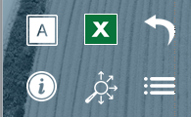
Navigation
Feed Barley
Malt Barley
General Fertilizer Practices
Fertilizer Timing
Fertilizer Timing
Sources of Fertilizer Advice
Fertilizer Source
Fertilizer Source
Frequency of Soil Testing Nitrogen
Fertilizer Placement
Fertilizer Placement
Reasons for Not Soil Testing for N Every Year
Nitrogen Rates
Nitrogen Rates
Frequency of Soil Testing P, K and S
Phosphorus Rates
Phosphorus Rates
Frequency of Soil Testing - Micronutrients
Potassium Rates
Potassium Rates
Frequency of Soil Testing - Electrical Conductivity
Sulphur Rates
Sulphur Rates
Frequency of Soil Testing - Organic Matter
Fertilizer Program
Fertilizer Program
Frequency of Soil Testing - pH
Use of Variable Rates by Fertilizer Type
Use of Variable Rates by Fertilizer Type
Familiarity with 4R Concept
Consistency with 4R Practices
Consistency with 4R Practices
Growers Who Believe They Comply With 4R
Reasons for Not Meeting Consistency Criteria
Reasons for Not Meeting Consistency Criteria
Growers Who Work With A 4R Designated Agronomist
Nitrogen Fixing Crop in Previous Year
Nitrogen Fixing Crop in Previous Year
Growers Who Have A 4R Plan In Place
Rates Set By Field
Rates Set By Field
Benefits Of Having A 4R Plan In Place
Approaches Used To Decide Rate
Approaches Used To Decide Fertilizer Rate
Reasons For Not Putting A 4R Plan In Place
Main Person Who Determined Rate
Main Person Who Determined Rate
Fee to Prepare 4R Plan
Rate Decisions on 4R Consistency Compliance
Rate Decisions on 4R Consistency Compliance
Sources of Fertilizer Information
Professional Designation
Professional Designation
Programs Used to Measure Environmental Footprint
Importance of Professional Designation
Importance of Professional Designation
Deviation from Recommended Rate
Deviation from Recommended Rate
Demographics
Reasons for Increasing Rate
Use of Nitrogen Stabilizers
Farm Size and Crop Acre Categories
Reasons for Decreasing Rate
Use of EEFs by Timing
Demographics
Use of Nitrogen Stabilizers
Target Yield vs. Actual Yield
Study Methodology & Sample
Use of EEFs by Timing
Nitrogen Use Efficiency
Key Findings
Target Yield vs. Actual Yield
Factors Considered When Setting Target Yield
Feed Barley Summary
Nitrogen Use Efficiency
Custom Application by Timing
Malt Barley Summary
Factors Considered When Setting Target Yield
Tillage Practices
4R Nutrient Stewardship
Use of Micro/Secondary Nutrients
Seeding Details
Custom Application by Timing
Use of Biostimulants
Tillage Practices
Seeding Details
Use of Biostimulants
In SLIDESHOW VIEW, click on any title or button on the above slide to navigate to the section.
Use the icons in the side-bar of each slide for convenient navigation and quick access to more information:
DETAILED DATA
Escape from Slideshow View to NORMAL VIEW; then click to open a worksheet with detailed data.
ATTRIBUTES
Click to see the full attribute statement behind abbreviations used in charts.
BACK TO LIST
Click to return to the list of several similar charts.
INFORMATION
Click for a pop-up that explains the slide. Click again to hide.
SECTION NAVIGATION
Click to return to the navigation slide for the section you are in.
NAVIGATION
Click to return to this study navigation slide.

Slide 3
Feed Barley in Manitoba - Summary
NITROGEN
Primary Nitrogen fertilizers were applied on 114% of feed barley acres (multiple applications on some acres). 
Urea represents 52% of total Nitrogen volume, anhydrous ammonia represents another 26% of the volume. 
44% of Nitrogen volumes were applied at planting; 37% of Nitrogen volumes were applied in the fall of the previous year. 
At planting, 28% of Nitrogen volume was mid row banded and 8% side banded. 
Average rate = 95 lbs./ac.  Average rates of Nitrogen at planting were 65 lbs./ac. 
Primary Phosphorus fertilizers were applied on 96% of feed barley acres. 
MAP represents 72% of total Phosphorus volume; MicroEssentials accounts for another 5%. 
68% of Phosphorus volumes were applied at planting. 
48% of P₂O₅ volumes were seed placed, 9% side-banded and 10% mid-row banded. 
Average rate = 30 lbs./ac.  About 16% of feed barley acres were not treated with P₂O₅. 
Potassium fertilizers were applied on 37% of feed barley acres. 
Dry potash represents 59% of total volume; caustic Potash represents another 20%. 
46% of K₂O volumes were applied at planting, while 48% were applied in the previous fall (an increase over 2022). 
25% of K₂O volumes were mid-row banded, 15% seed placed, and 5% side banded. 
Average rate = 8 lbs./ac.  64% of feed barley acres were not treated with any K₂O. 
Primary Sulphur fertilizers were applied on 20% of feed barley acres. 
Elemental sulphur accounts for 39% of the total Sulphur volume, Super S accounts for another 11% of the total S volume. 
82% of Sulphur volumes were applied at planting; an increase compared to 2022, 12% in the previous fall. 
At planting, 22% of Sulphur volumes were mid-row banded, 40% were seed placed, and 14% were broadcast with no incorporation. 
Average rate = 4 lbs./ac.  74% of feed barley acres were not treated with any source of Sulphur. 
Source:
Timing:
Placement:
Rate:
PHOSPHORUS
Feed Barley Summary 
Source:
Timing:
Placement:
Rate:
POTASSIUM
Source:
Timing:
Placement:
Rate:
SULPHUR
Source:
Timing:
Placement:
Rate:

Slide 4
Malt Barley in Manitoba - Summary
NITROGEN
Primary Nitrogen fertilizers were applied on 114% of malt barley acres (multiple applications on some acres). 
Anhydrous ammonia represents 29% of total Nitrogen volume, urea represents another 42% of the volume (an increase in 2023). 
46% of Nitrogen volumes were applied at planting; 44% in the fall of the previous year (an increase compared to 2022). 
At planting, 28% of Nitrogen volume was mid-row banded and 15% side banded. 
Average rate = 99 lbs./ac.  In the fall the average Nitrogen rate was 89 lbs./ac. 
Primary Phosphorus fertilizers were applied on 72% of malt barley acres. 
MAP represents 66% of total Phosphorus volume, an increase compared to 2022. 
86% of Phosphorus volumes were applied at planting (an increase in 2023); another 7% were applied before planting (a decrease). 
37% of P₂O₅ volumes were seed placed, 32% side-banded and 17% mid-row banded. 
Average rate = 26 lbs./ac.  About 30% of malt barley acres were not treated with P₂O₅. 
Potassium fertilizers were applied on 43% of malt barley acres. 
Dry potash represents 77% of total volume; edging slightly lower in 2023. 
59% of K₂O volumes were applied at planting; 39% of the K₂O volumes were applied in the fall of the previous year (an increase). 
At planting, 34% of K₂O volumes were side-banded, 15% mid-row banded, and 11% seed placed. 
Average rate = 12 lbs./ac.  63% of malt barley acres were not treated with any K₂O. 
Primary Sulphur fertilizers were applied on 28% of malt barley acres. 
K Mag represents 24% of total Sulphur volume; Tiger90 represents 27% of total Sulphur volume. 
94% of Sulphur volumes were applied at planting; only 7% of the Sulphur volume was applied before planting. 
20% of Sulphur volumes were seed placed, 41% side-banded and 32% mid-row banded. 
Average rate = 6.2 lbs./ac.  60% of malt barley acres were not treated with any Sulphur. 
Source:
Timing:
Placement:
Rate:
PHOSPHORUS
Malt Barley Summary 
Source:
Timing:
Placement:
Rate:
POTASSIUM
Source:
Timing:
Placement:
Rate:
SULPHUR
Source:
Timing:
Placement:
Rate:

Slide 5
4R Nutrient Stewardship - Summary
NITROGEN
The majority of barley growers believe their fertilizer practices comply with 4R, but few have a 4R plan in place.
28% of growers said they were very familiar with 4R; about half said they were somewhat familiar with the 4R concept. 
4R concept familiarity is lower among small sized farms. 
Growers who are very familiar with 4R were more likely to say that their fertilizer practices comply with 4R nutrient stewardship. 
72% of growers said they believe that their practices meet 4R requirements in 2023. 
36% of barley growers work with a 4R Designated Agronomist. 
Those very familiar with 4R were more likely to work with a 4R Designated Agronomist. 
Only about 18% of farmers have a formal 4R Plan in place. 
Those very familiar with 4R were more likely to have a 4R Plan in place. 
Those with a 4R Plan say there are multiple benefits led by knowing you are using leading environmental stewardship practices. 
Those without a 4R Plan say there are many reasons; Lack of incentive and not supported by retail are the top 2 factors. 
Ag retailers and Certified Crop Advisors are the main sources of information about 4R. 
4R NUTRIENT STEWARDSHIP
PHOSPHORUS
4R Summary 
POTASSIUM
SULPHUR

Slide 6
Feed Barley
Fertilizer Timing
Fertilizer Source
Fertilizer Placement
Nitrogen Rates
Phosphorus Rates
Potassium Rates
Sulphur Rates
Fertilizer Program
Answering Key Questions:
What are the most common application timings for each nutrient and fertilizer type?
What nutrients and fertilizer types are being used?
What are the most common placements for each nutrient and fertilizer type?
What rates are being applied?
To what extent do farmers vary their fertilizer program from field to field?
To what extent are farmers incorporating nitrogen fixing crops into their rotation?
How do farmers decide what fertilizer rate to apply?
How extensively are nitrogen stabilized products being used?
How do actual yields compare to target yields?
How many growers are applying micro or secondary nutrients?
What tillage practices were used?
To what extent were biostimulants used?
Use of Variable Rates by Fertilizer Type
Consistency with 4R Practices
Reasons for Not Meeting Consistency Criteria
Nitrogen Fixing Crop in Previous Year
Rates Set By Field
Approaches Used To Decide Rate
Main Person Who Determined Rate
Rate Decisions on 4R Consistency Compliance
Professional Designation
Importance of Professional Designation
Deviation from Recommended Rate
Reasons for Increasing Rate
Reasons for Decreasing Rate
Use of Nitrogen Stabilizers
Use of EEFs by Timing
Target Yield vs. Actual Yield
Nitrogen Use Efficiency
Factors Considered When Setting Target Yield
Use of Micro/Secondary Nutrients
Custom Application by Timing
Tillage Practices
Seeding Details
Use of Biostimulants
In SLIDESHOW VIEW, click on any title or button on the above slide to navigate to the section.
Use the icons in the side-bar of each slide for convenient navigation and quick access to more information:
DETAILED DATA
Escape from Slideshow View to NORMAL VIEW; then click to open a worksheet with detailed data.
ATTRIBUTES
Click to see the full attribute statement behind abbreviations used in charts.
BACK TO LIST
Click to return to the list of several similar charts.
INFORMATION
Click for a pop-up that explains the slide. Click again to hide.
SECTION NAVIGATION
Click to return to the navigation slide for the section you are in.
NAVIGATION
Click to return to this study navigation slide.

Slide 7

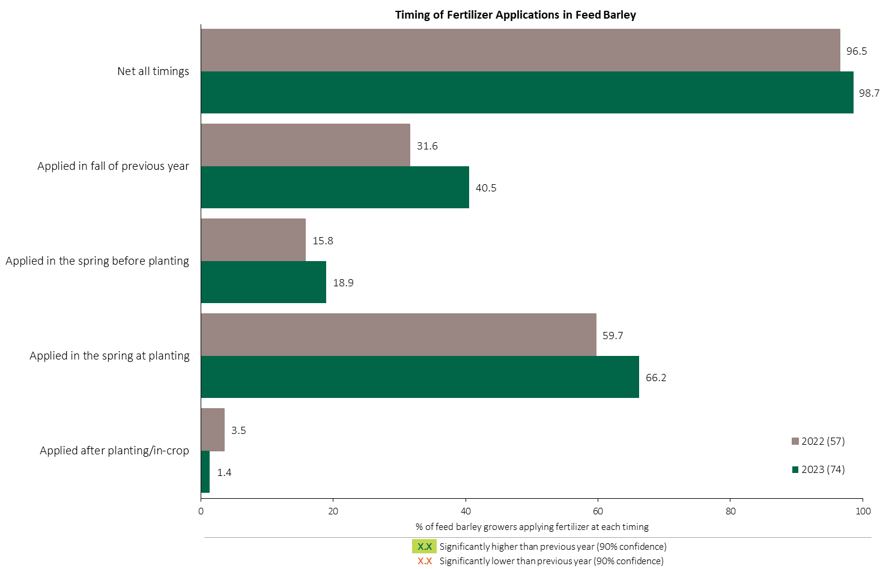

Fertilizer Applications in Feed Barley - % Growers
Feed Barley
About two thirds of feed barley growers apply fertilizer at planting.
Respondents were asked: “For your 2023 feed barley crop, did you apply fertilizer at each timing? – and given the options of a) Applied in fall of previous year, b) in the spring before planting, c) in the spring at planting and d) after planting/in-crop.
The chart illustrates the % of respondents who applied fertilizer at each timing.

Slide 8
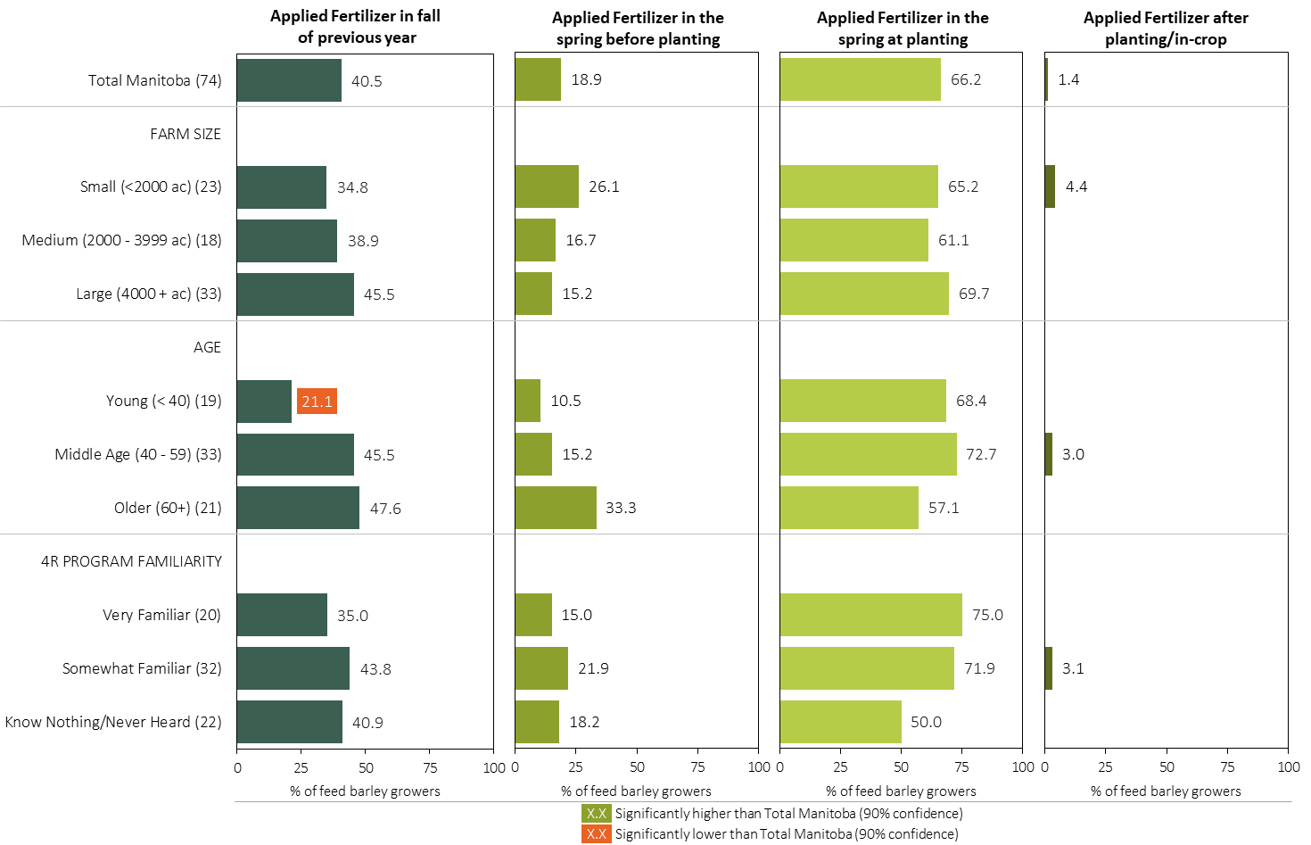
Fertilizer Applications in Feed Barley - % Growers by Timing in 2023
Feed Barley
Respondents were asked: “For your 2023 feed barley crop, did you apply fertilizer at each timing? – and given the options of a) Applied in fall of previous year, b) in the spring before planting, c) in the spring at planting and d) after planting/in-crop.
Separately by farm size, age and 4R program familiarity, the charts illustrate the % of feed barley growers who applied fertilizer at each timing.

Slide 9
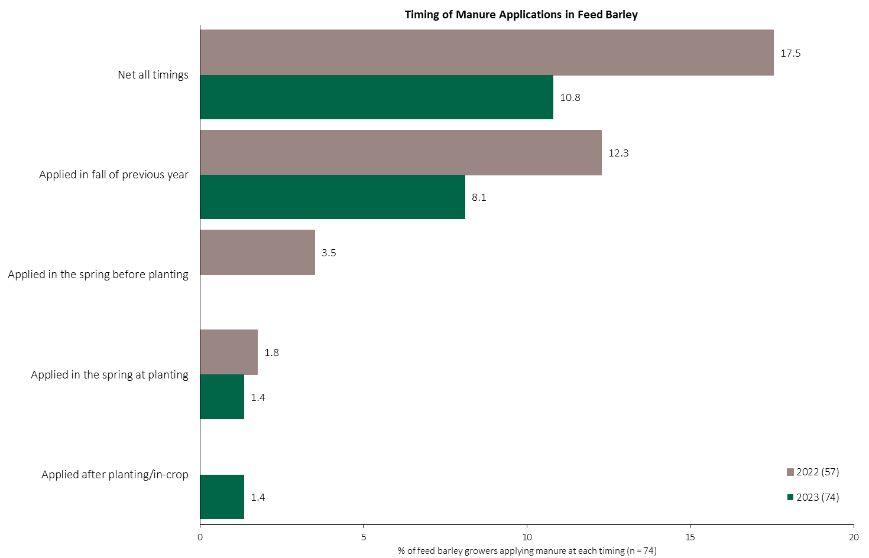
Manure Applications in Feed Barley - % Growers
Feed Barley
Respondents were asked: “For your 2023 feed barley crop, did you apply manure at each timing? – and given the options of a) Applied in fall of previous year, b) in the spring before planting, c) in the spring at planting and d) after planting/in-crop.
The chart illustrates the % of respondents who applied manure at each timing.

Slide 10
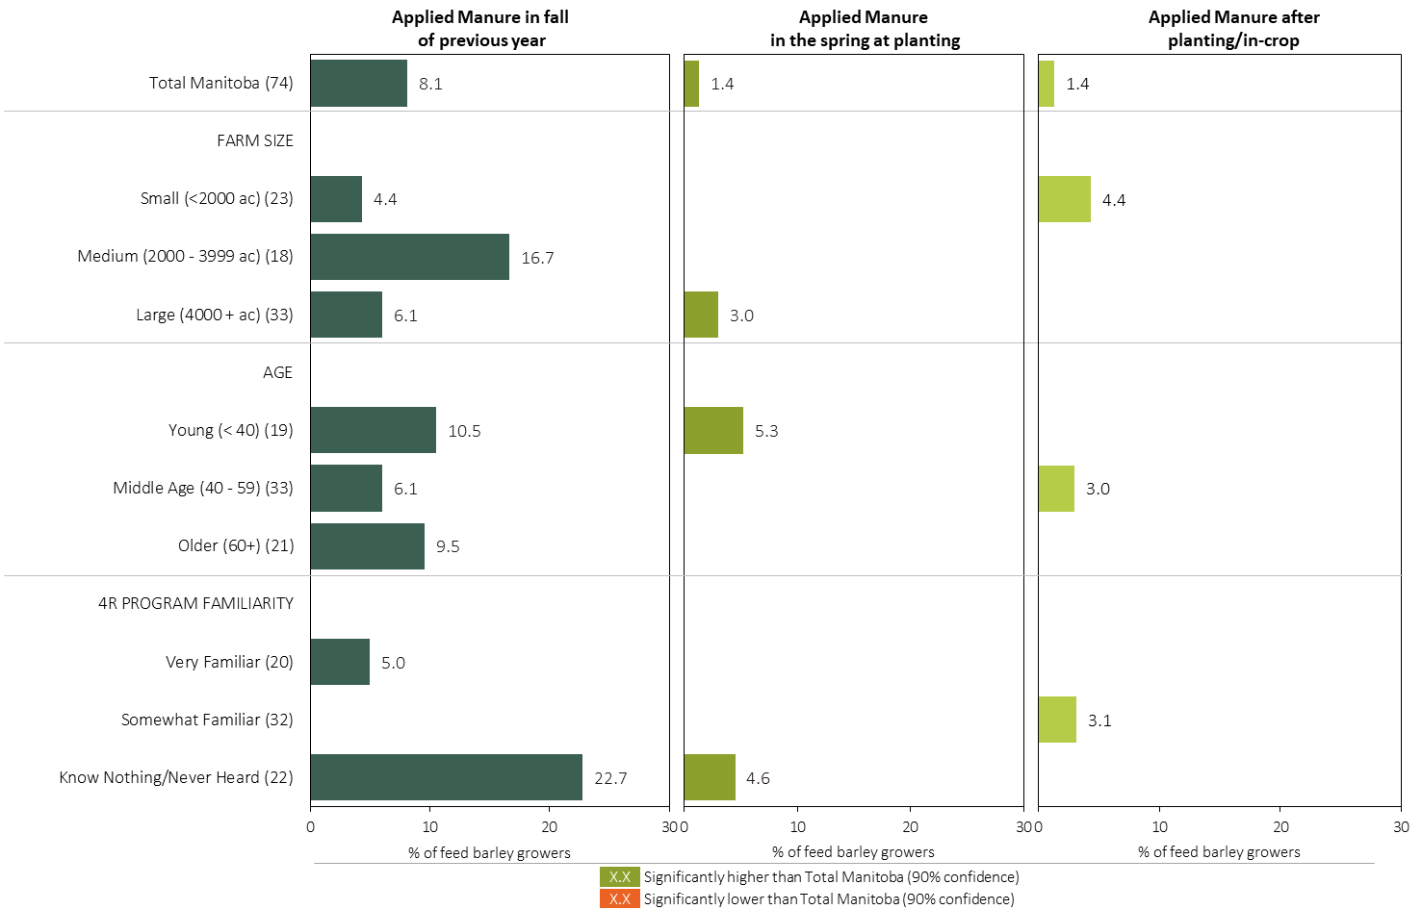
Manure Applications in Feed Barley - % Growers by Timing in 2023
Feed Barley
Respondents were asked: “For your 2023 feed barley crop, did you apply manure at each timing? – and given the options of a) Applied in fall of previous year, b) in the spring before planting, c) in the spring at planting and d) after planting/in-crop.
Separately by farm size, age and 4R program familiarity, the charts illustrate the % of feed barley growers who applied manure at each timing.

Slide 11
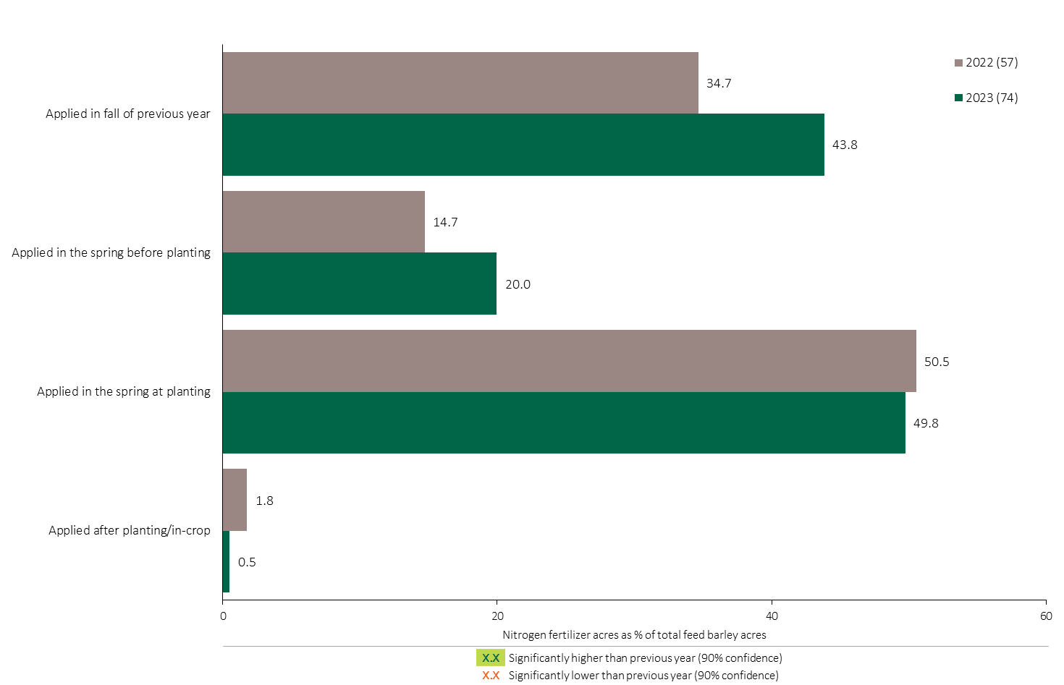

Nitrogen Timing in Feed Barley - % Crop Acres
Feed Barley
20% of feed barley acres were treated with a Nitrogen fertilizer in the spring before planting.
Half of feed barley acres were treated with a Nitrogen fertilizer at planting.
Note: Nitrogen only includes those fertilizer types where nitrogen is the primary component.
For each application timing, respondents were asked: “Of your [xxx] acres of feed barley, how many acres of each fertilizer type did you apply?”
The chart illustrates the % of total feed barley acres that were treated with a primary Nitrogen fertilizer at each timing in 2023. A list of Primary Nitrogen fertilizers can be accessed by clicking on the “A” button.

Slide 12
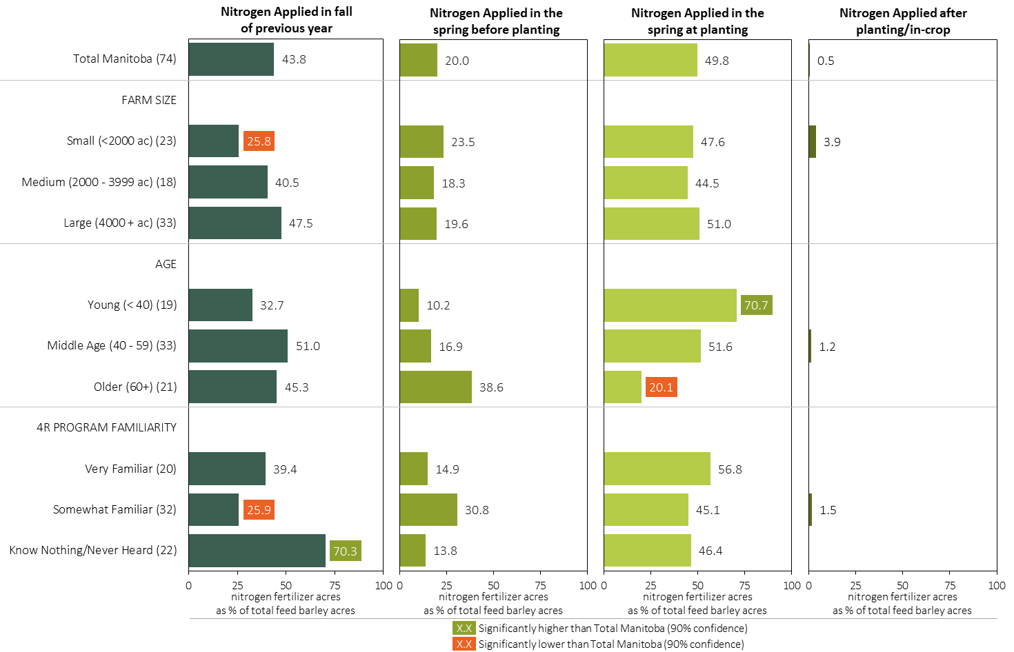
Nitrogen Timing in Feed Barley in 2023 (% of Crop Acres)
Feed Barley
Young farmers were more likely to apply N in the spring at planting.
Note: Nitrogen only includes those fertilizer types where nitrogen is the primary component.
For each application timing, respondents were asked: “Of your [xxx] acres of feed barley, how many acres of each fertilizer type did you apply?”
Separately for each timing, the charts illustrate the % of total feed barley acres that was treated with a primary nitrogen fertilizer by farm size, age and 4R program familiarity.
Nitrogen only includes those fertilizer types where nitrogen is the primary component. A list can be accessed by clicking on the “A” button.

Slide 13
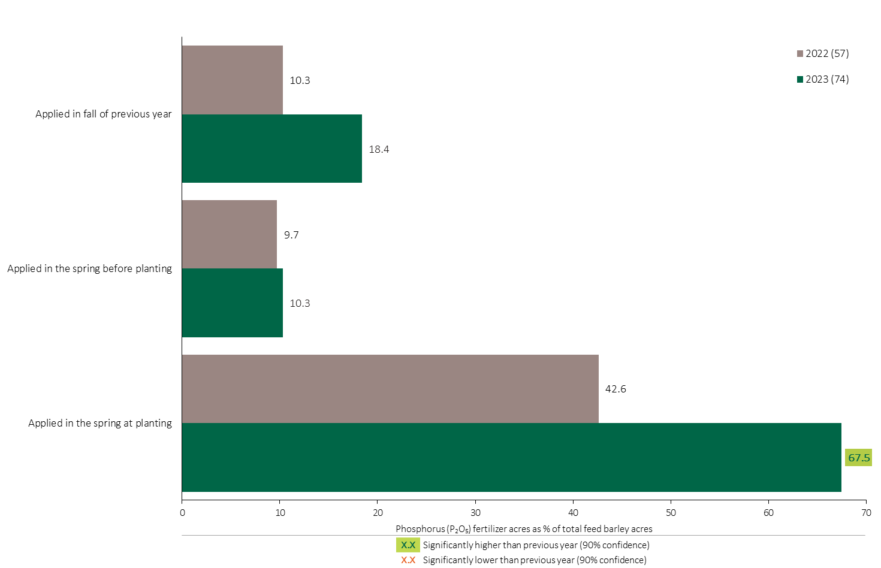
Phosphorus (P₂O₅) Timing in Feed Barley - % Crop Acres
Feed Barley
68% of total feed barley acres were treated with Phosphorous at planting, an increase in 2023.
Note: Phosphorus only includes those fertilizer types where phosphorus is the primary component.
For each application timing, respondents were asked: “Of your [xxx] acres of feed barley, how many acres of each fertilizer type did you apply?”
The chart illustrates the % of total feed barley acres that were treated with a primary Phosphorus fertilizer at each timing in 2023. A list of Primary Phosphorus fertilizers can be accessed by clicking on the “A” button.

Slide 14
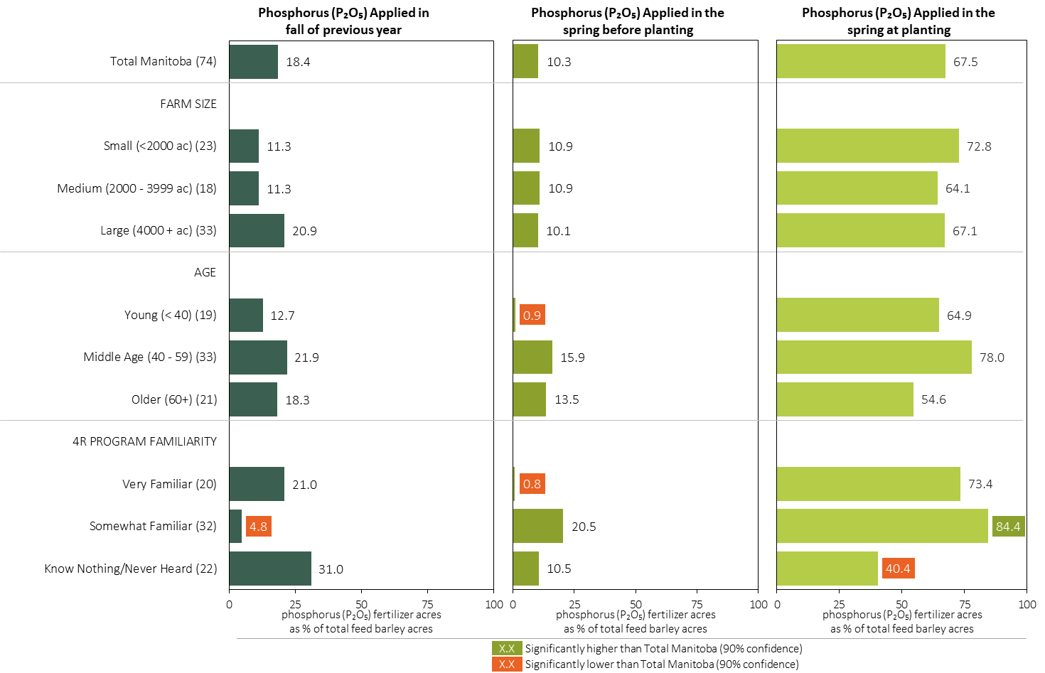
Phosphorus (P₂O₅) Timing in Feed Barley in 2023 (% of Crop Acres)
Feed Barley
Note: Phosphorus only includes those fertilizer types where phosphorus is the primary component.
For each application timing, respondents were asked: “Of your [xxx] acres of feed barley, how many acres of each fertilizer type did you apply?”
Separately for each timing, the charts illustrate the % of total feed barley acres that was treated with a primary phosphorus fertilizer by farm size, age and 4R program familiarity.
Phosphorus only includes those fertilizer types where phosphorus is the primary component. A list can be accessed by clicking on the “A” button.

Slide 15
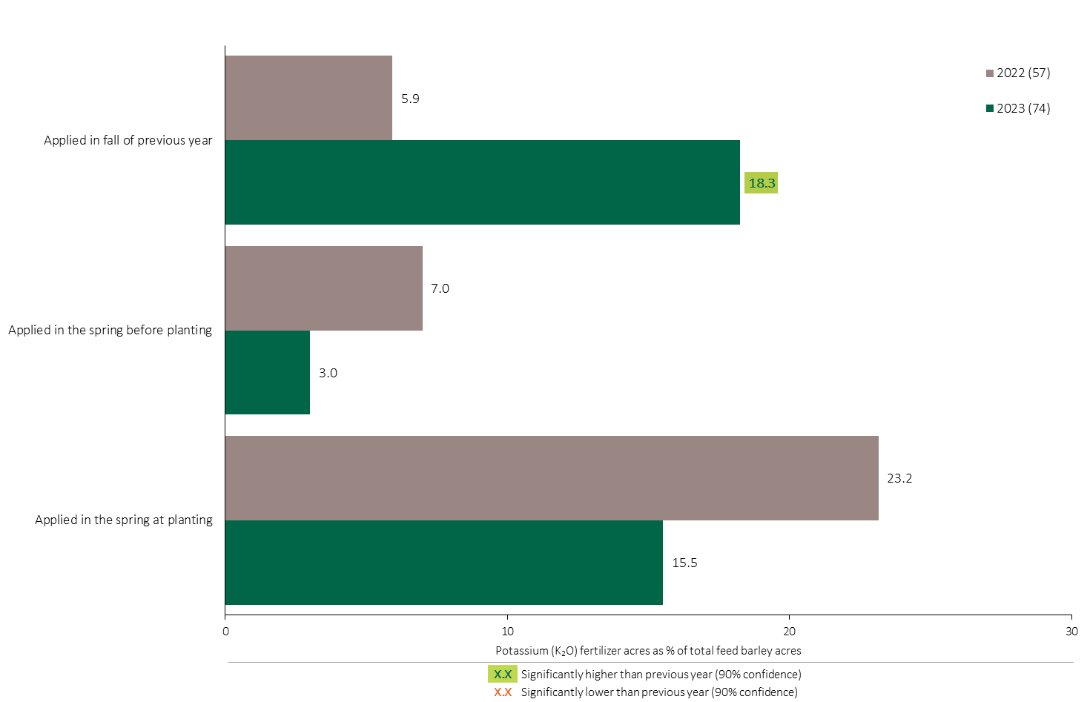
Potassium (K₂O) Timing in Feed Barley - % Crop Acres
Feed Barley
18% of total feed barley acres were treated with Potassium in the fall, an increase in 2023.
Note: Potassium only includes those fertilizer types where potassium is the primary component.
For each application timing, respondents were asked: “Of your [xxx] acres of feed barley, how many acres of each fertilizer type did you apply?”
The chart illustrates the % of total feed barley acres that were treated with a primary Potassium fertilizer at each timing in 2023. A list of Primary Potassium fertilizers can be accessed by clicking on the “A” button.

Slide 16
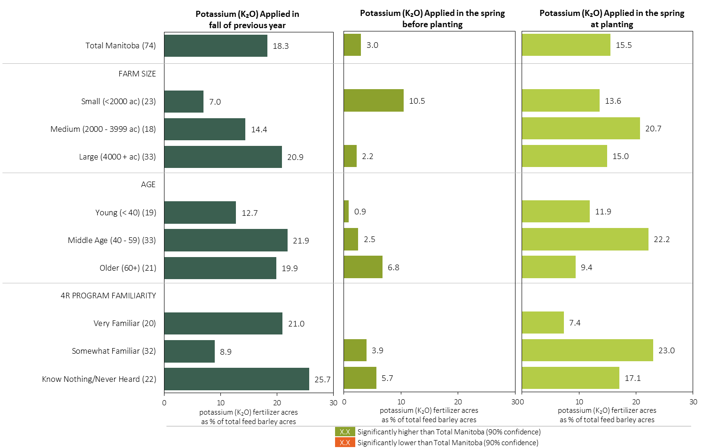
Potassium (K₂O) Timing in Feed Barley in 2023 (% of Crop Acres)
Feed Barley
Note: Potassium only includes those fertilizer types where potassium is the primary component.
For each application timing, respondents were asked: “Of your [xxx] acres of feed barley, how many acres of each fertilizer type did you apply?”
Separately for each timing, the charts illustrate the % of total feed barley acres that was treated with a primary potassium fertilizer by farm size, age and 4R program familiarity.
Potassium only includes those fertilizer types where potassium is the primary component. A list can be accessed by clicking on the “A” button.

Slide 17
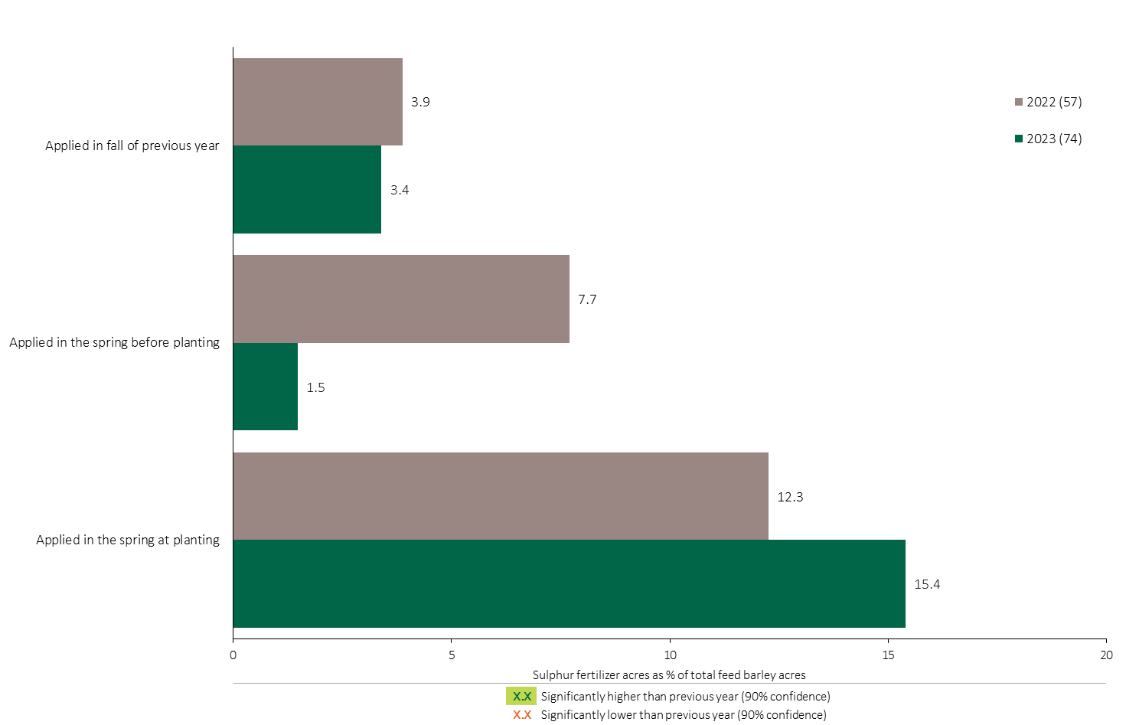
Sulphur Timing in Feed Barley - % Crop Acres
Feed Barley
15% of feed barley acres were treated with a Sulphur fertilizer at planting.
Note: Sulphur only includes those fertilizer types where sulphur is the primary component.
For each application timing, respondents were asked: “Of your [xxx] acres of feed barley, how many acres of each fertilizer type did you apply?”
The chart illustrates the % of total feed barley acres that were treated with a primary Sulphur fertilizer at each timing in 2023. A list of Primary Sulphur fertilizers can be accessed by clicking on the “A” button

Slide 18
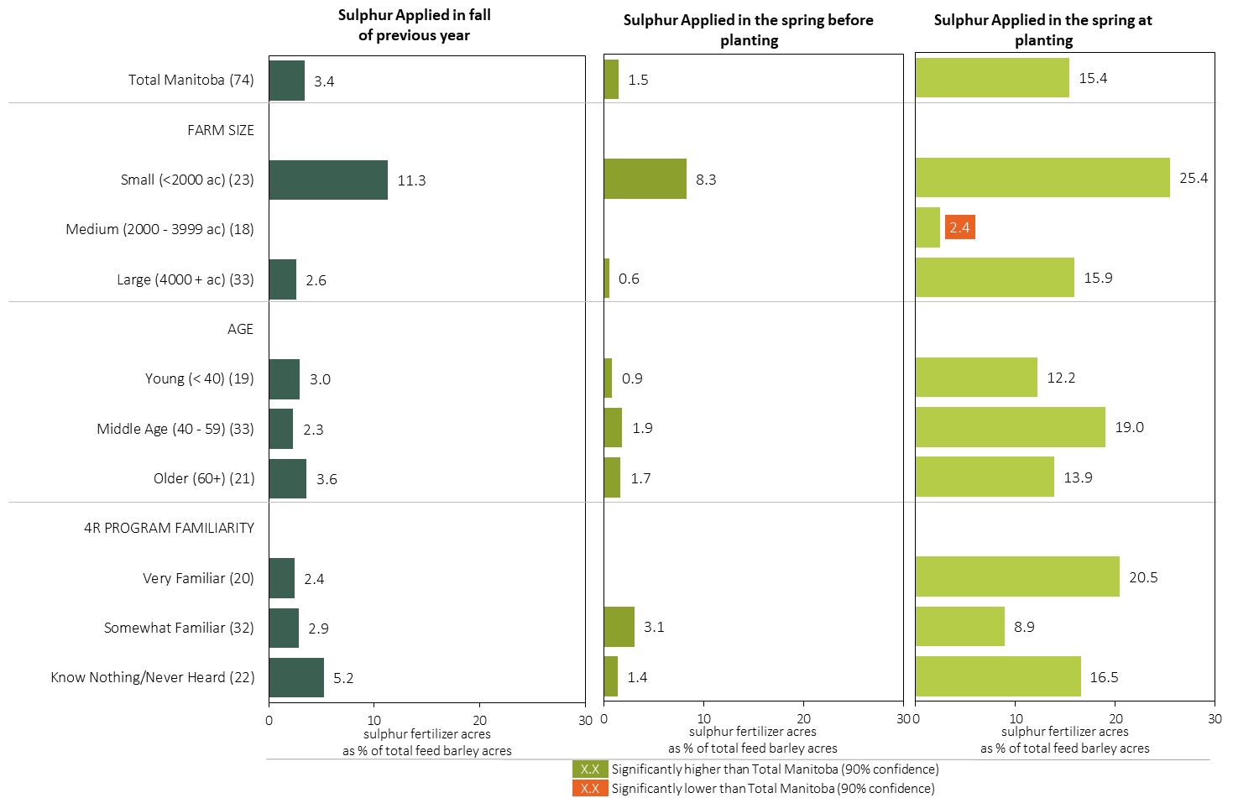
Sulphur Timing in Feed Barley in 2023 (% of Crop Acres)
Feed Barley
Note: Sulphur only includes those fertilizer types where sulphur is the primary component.
For each application timing, respondents were asked: “Of your [xxx] acres of feed barley, how many acres of each fertilizer type did you apply?”
Separately for each timing, the charts illustrate the % of total feed barley acres that was treated with a primary sulphur fertilizer by farm size, age and 4R program familiarity.
Sulphur only includes those fertilizer types where sulphur is the primary component. A list can be accessed by clicking on the “A” button.

Slide 19
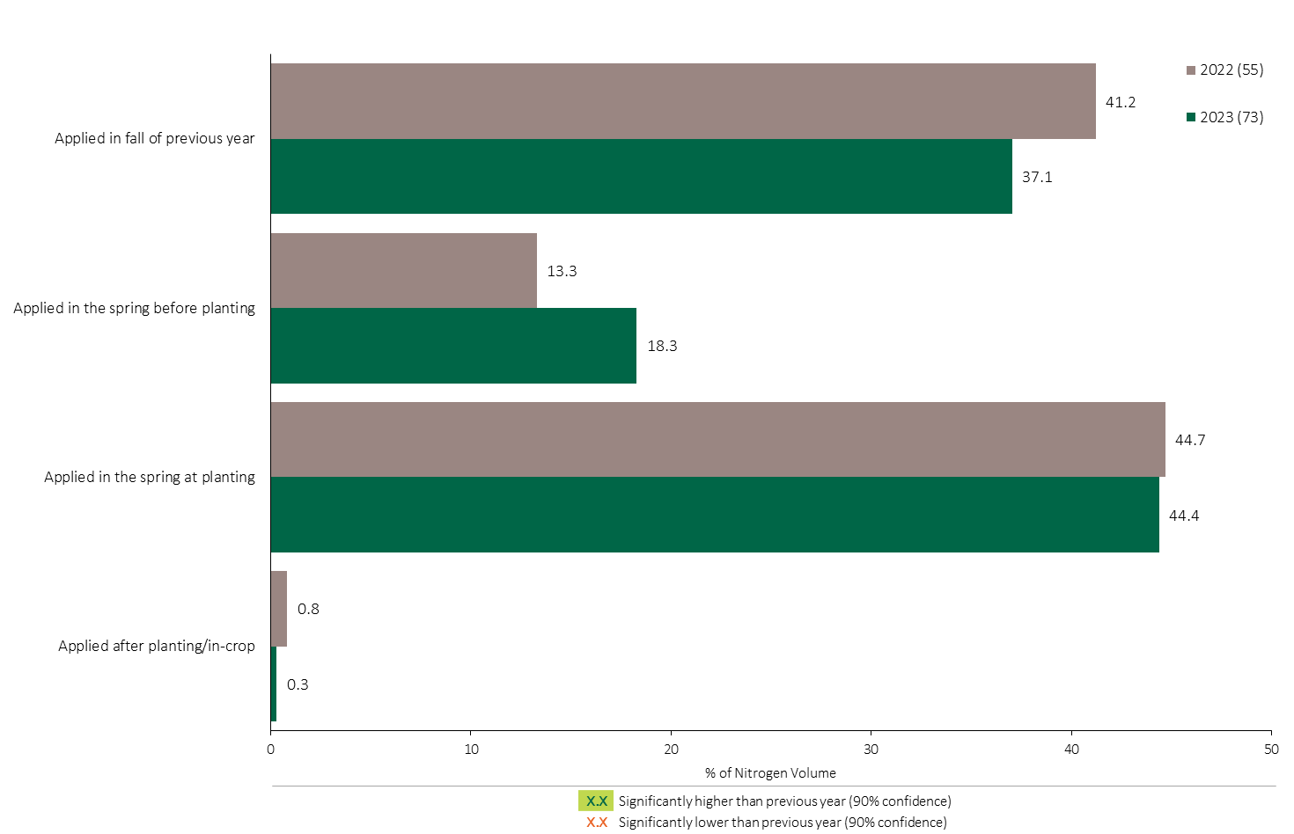
Nitrogen Timing in Feed Barley - % of Volume
Feed Barley
Feed Barley Summary 
About 45% of the total Nitrogen volume applied in feed barley was applied at planting, consistent with 2022.
Note: Nitrogen volume was calculated from all sources of nitrogen contained in all fertilizer types
For each fertilizer type used in either a custom blend or applied as an unblended product, respondents were asked: a) how many acres they applied, and b) the application rate in pounds of actual nutrient/ac. Volumes of each nutrient were calculated by multiplying acres treated times the application rate.
The graph illustrates the % of total Nitrogen volume applied in feed barley that was applied at each timing in 2023.
Total pounds of actual Nitrogen applied was calculated based on all sources of Nitrogen from all fertilizer types.

Slide 20
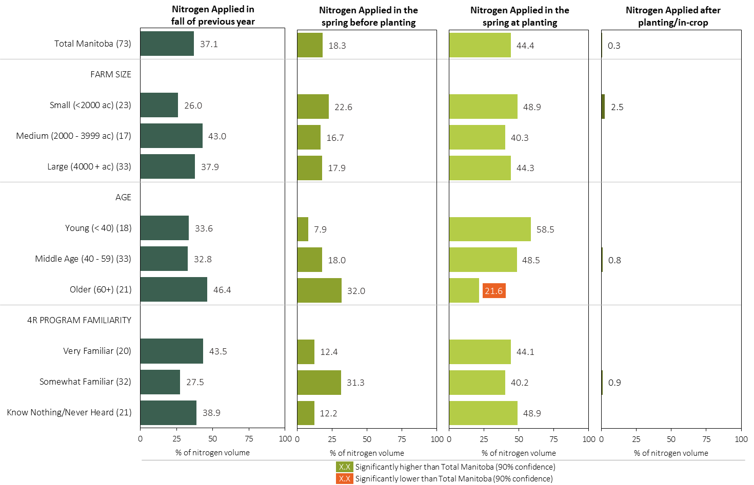
Nitrogen Timing in Feed Barley in 2023 (% of Volume)
Feed Barley
Note: Nitrogen volume was calculated from all sources of nitrogen contained in all fertilizer types
For each fertilizer type used in either a custom blend or applied as an unblended product, respondents were asked: a) how many acres they applied, and b) the application rate in pounds of actual nutrient/ac. Volumes of each nutrient were calculated by multiplying acres treated times the application rate.
Separately for each timing, the charts illustrate the % of total nitrogen volume that was applied by farm size, age and 4R program familiarity.
Total pounds of actual nitrogen applied was calculated based on all sources of nitrogen from all fertilizer types.

Slide 21
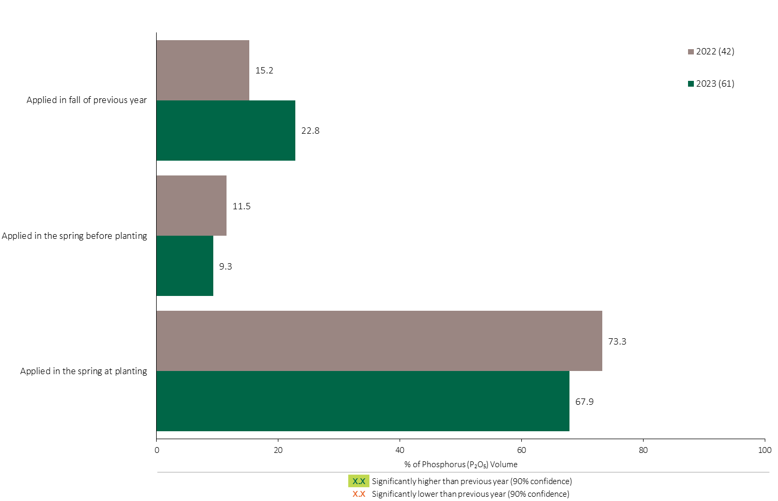
Phosphorus (P₂O₅) Timing in Feed Barley - % of Volume
Feed Barley
Feed Barley Summary 
68% of total Phosphorus (P₂O₅) volume applied in feed barley was applied at planting.
Note: Phosphorus (P₂O₅) volume was calculated from all sources of phosphorus contained in all fertilizer types
For each fertilizer type used in either a custom blend or applied as an unblended product, respondents were asked: a) how many acres they applied, and b) the application rate in pounds of actual nutrient/ac. Volumes of each nutrient were calculated by multiplying acres treated times the application rate.
The graph illustrates the % of total Phosphorus (P₂O₅) volume applied in feed barley that was applied at each timing in 2023.
Total pounds of actual Phosphorus (P₂O₅) applied was calculated based on all sources of Phosphorus (P₂O₅) from all fertilizer types.

Slide 22
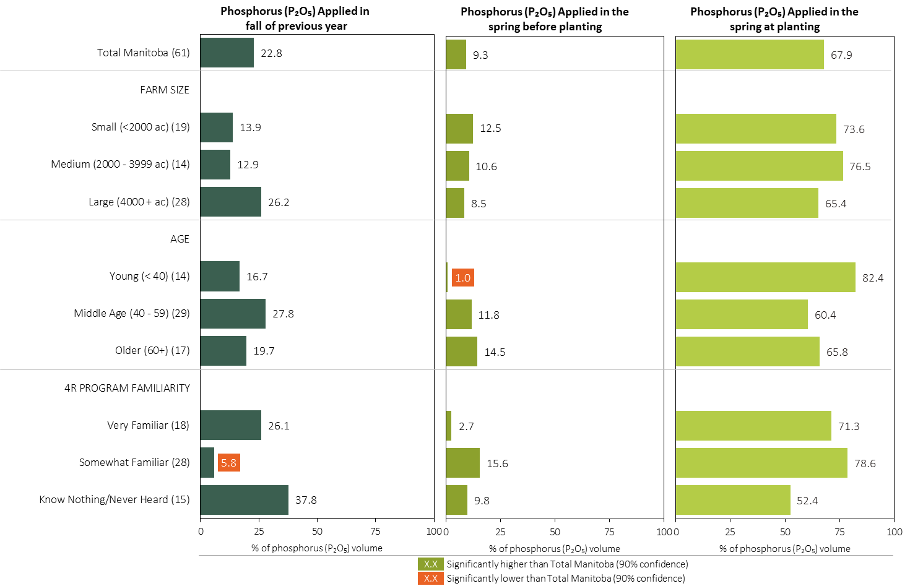
Phosphorus (P₂O₅) Timing in Feed Barley in 2023 (% of Volume)
Feed Barley
Note: Phosphorus (P₂O₅) volume was calculated from all sources of phosphorus contained in all fertilizer types
For each fertilizer type used in either a custom blend or applied as an unblended product, respondents were asked: a) how many acres they applied, and b) the application rate in pounds of actual nutrient/ac. Volumes of each nutrient were calculated by multiplying acres treated times the application rate.
Separately for each timing, the charts illustrate the % of total Phosphorus (P₂O₅) volume that was applied by farm size, age and 4R program familiarity.
Total pounds of actual Phosphorus (P₂O₅) applied was calculated based on all sources of Phosphorus (P₂O₅) from all fertilizer types.

Slide 23
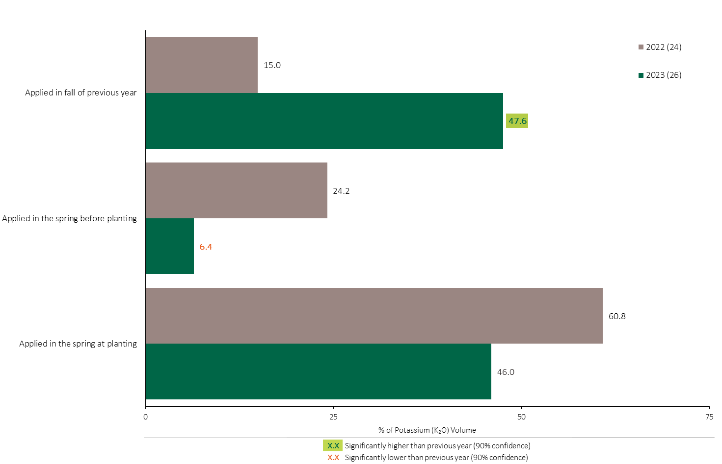
Potassium (K₂O) Timing in Feed Barley - % of Volume
Feed Barley
48% of total Potassium applied in feed barley was applied in the fall, an increase in 2023.
Feed Barley Summary 
A lower volume of Potassium was applied before planting in 2023.
Note: Potassium (K₂O) volume was calculated from all sources of potassium contained in all fertilizer types
For each fertilizer type used in either a custom blend or applied as an unblended product, respondents were asked: a) how many acres they applied, and b) the application rate in pounds of actual nutrient/ac. Volumes of each nutrient were calculated by multiplying acres treated times the application rate.
The graph illustrates the % of total Potassium (K₂O) volume applied in feed barley that was applied at each timing in 2023.
Total pounds of actual Potassium (K₂O) applied was calculated based on all sources of Potassium (K₂O) from all fertilizer types.

Slide 24
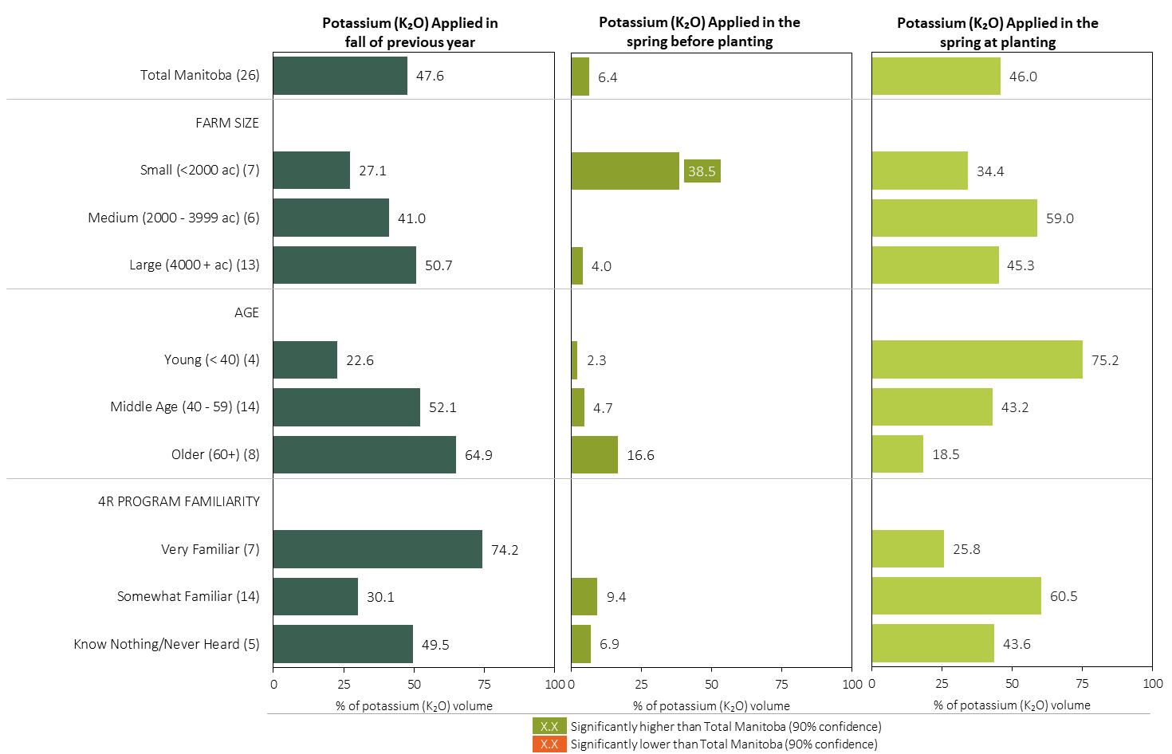
Potassium (K₂O) Timing in Feed Barley in 2023 (% of Volume)
Feed Barley
Note: Potassium (K₂O) volume was calculated from all sources of potassium contained in all fertilizer types
For each fertilizer type used in either a custom blend or applied as an unblended product, respondents were asked: a) how many acres they applied, and b) the application rate in pounds of actual nutrient/ac. Volumes of each nutrient were calculated by multiplying acres treated times the application rate.
Separately for each timing, the charts illustrate the % of total Potassium (K₂O) volume that was applied by farm size, age and 4R program familiarity.
Total pounds of actual potassium (K₂O) applied was calculated based on all sources of potassium (K₂O) from all fertilizer types.

Slide 25
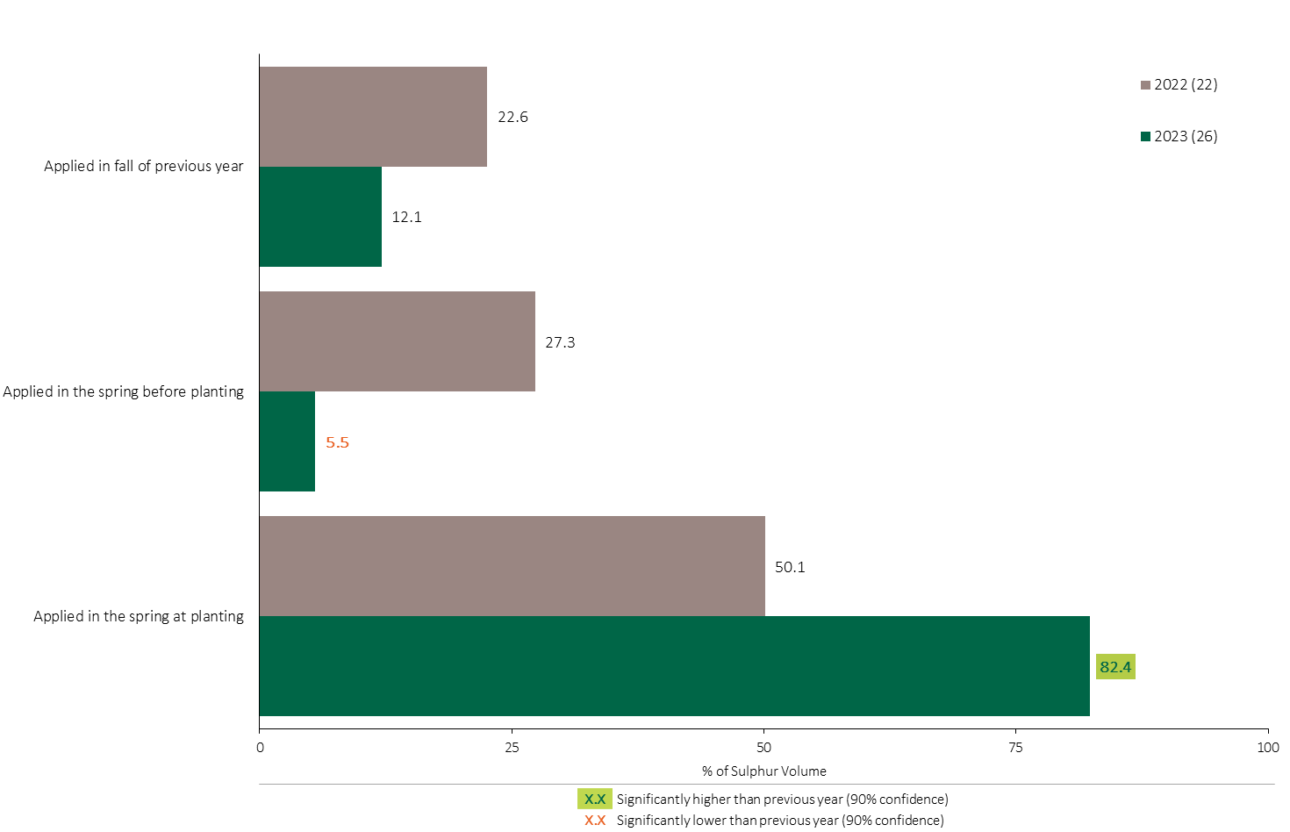
Sulphur Timing in Feed Barley - % of Volume
Feed Barley
Feed Barley Summary 
82% of the Sulphur volume in feed barley was applied at planting in 2023, an increase over 2022.
Note: Sulphur volume was calculated from all sources of sulphur contained in all fertilizer types
For each fertilizer type used in either a custom blend or applied as an unblended product, respondents were asked: a) how many acres they applied, and b) the application rate in pounds of actual nutrient/ac. Volumes of each nutrient were calculated by multiplying acres treated times the application rate.
The graph illustrates the % of total Sulphur volume applied in feed barley that was applied at each timing in 2023.
Total pounds of actual Sulphur applied was calculated based on all sources of Sulphur from all fertilizer types.

Slide 26
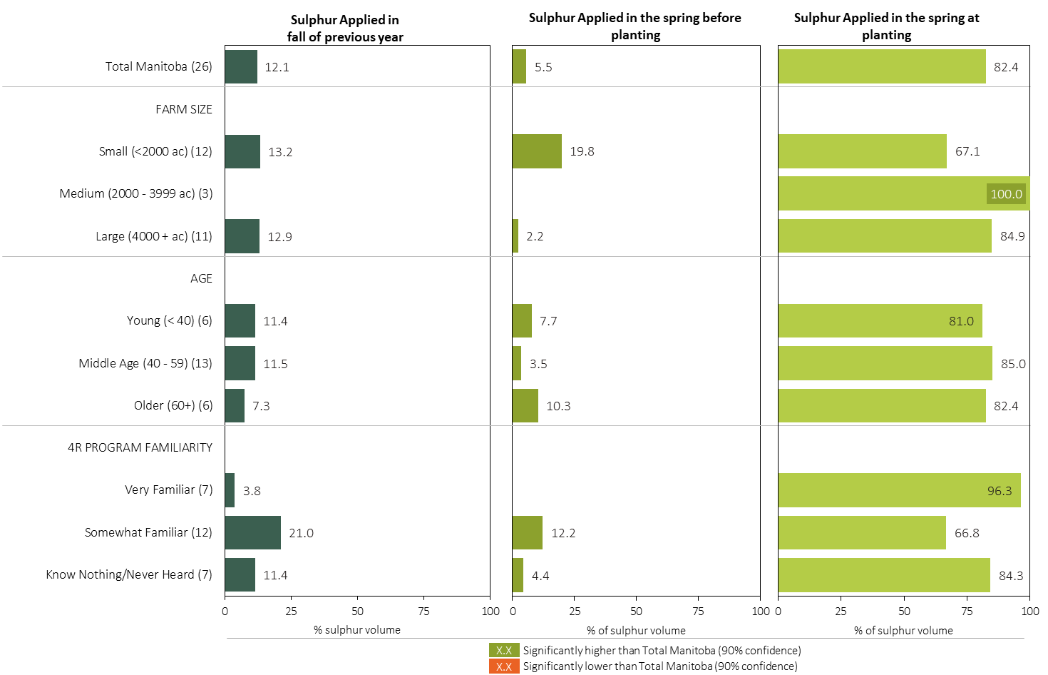
Sulphur Timing in Feed Barley in 2023 (% of Volume)
Feed Barley
Note: Sulphur volume was calculated from all sources of sulphur contained in all fertilizer types
For each fertilizer type used in either a custom blend or applied as an unblended product, respondents were asked: a) how many acres they applied, and b) the application rate in pounds of actual nutrient/ac. Volumes of each nutrient were calculated by multiplying acres treated times the application rate.
Separately for each timing, the charts illustrate the % of total sulphur volume that was applied by, farm size, age and 4R program familiarity.
Total pounds of actual sulphur applied was calculated based on all sources of sulphur from all fertilizer types.

Slide 27
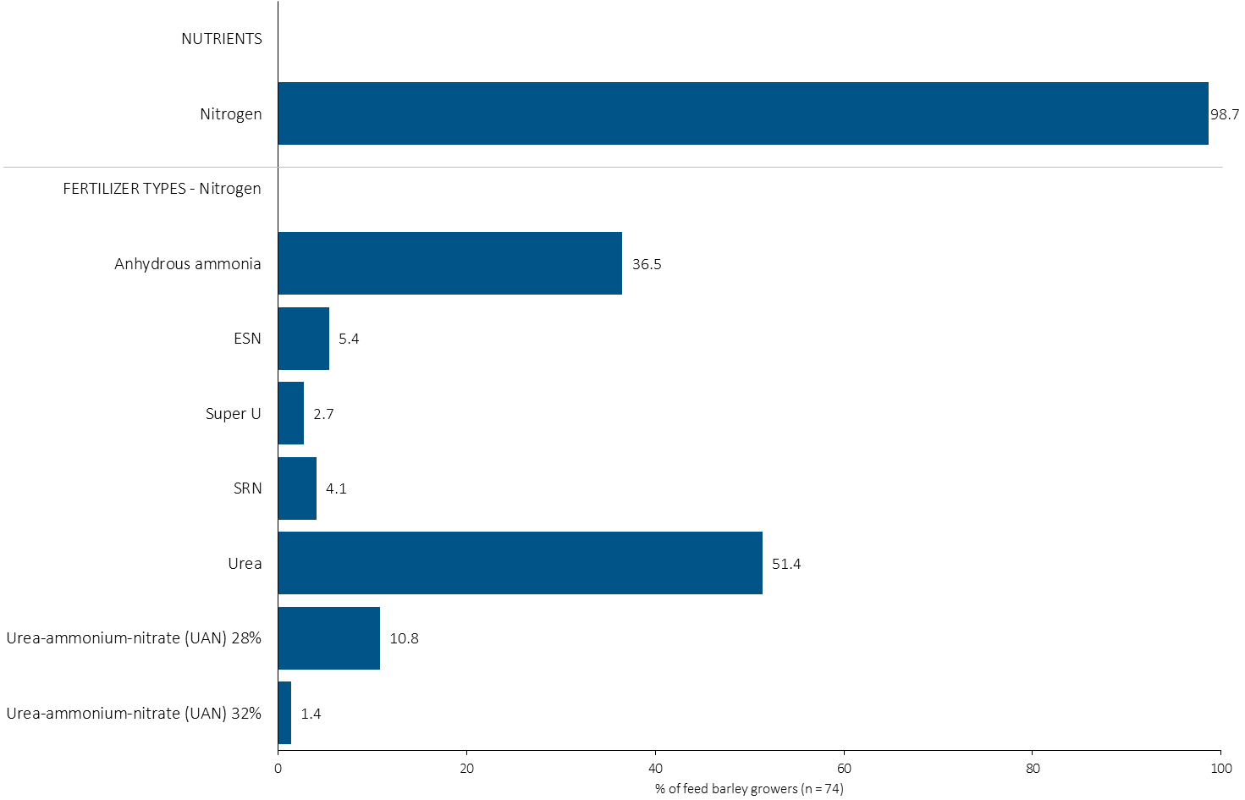
% of Feed Barley Growers Using Each Nitrogen Source in 2023
Feed Barley
37% of feed barley growers used anhydrous ammonia in 2023.
Note: Nutrients were defined based on any fertilizer type that contains the nutrient.
Respondents were asked: “For your 2023 feed barley crop, did you apply fertilizer or manure at each timing? – and given the options of a) Applied in fall of previous year, b) in the spring before planting, c) in the spring at planting and d) after planting/in-crop. For your 2023 feed barley crop, which fertilizer types did you apply at each timing?
The chart illustrates the % of feed barley growers who indicated that they used this nutrient and each fertilizer type in feed barley in 2023.
Nutrients were defined based on any fertilizer type that contains the nutrient.

Slide 28
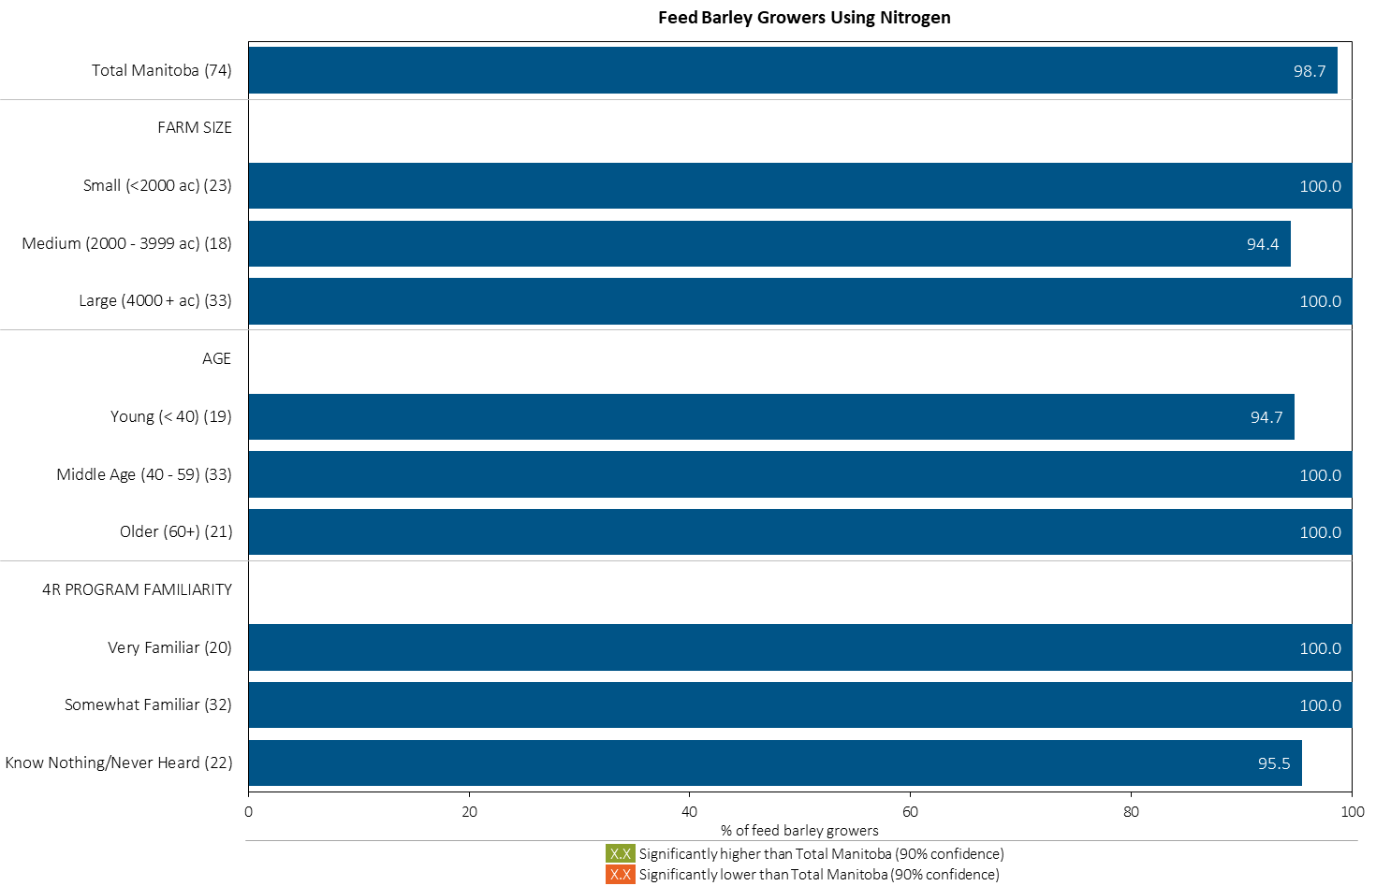
% of Feed Barley Growers Using Nitrogen in 2023
Feed Barley
Note: Nutrients were defined based on any fertilizer type that contains the nutrient.
Respondents were asked: “For your 2023 feed barley crop, did you apply fertilizer or manure at each timing? – and given the options of a) Applied in fall of previous year, b) in the spring before planting, c) in the spring at planting and d) after planting/in-crop. For your 2023 feed barley crop, which fertilizer types did you apply at each timing?
The chart illustrates the % of feed barley growers who indicated that they used this nutrient in feed barley in 2023 by farm size, age and 4R familiarity.
Nutrients were defined based on any fertilizer type that contains the nutrient.

Slide 29
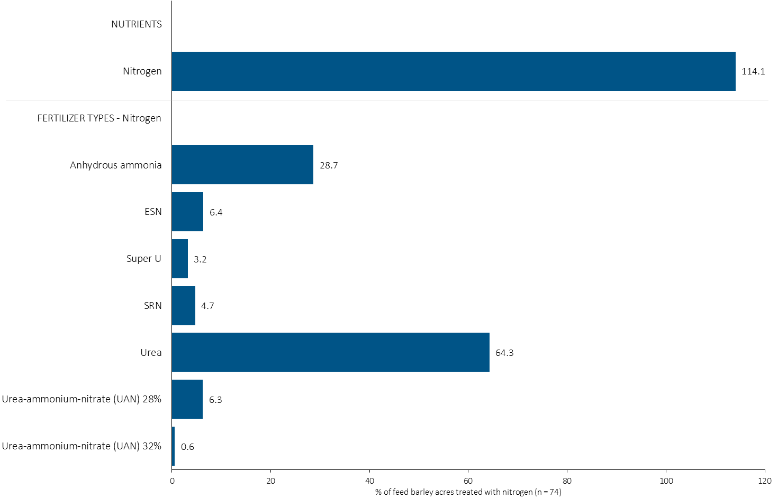
Acres Treated With Each Nitrogen Source in Feed Barley in 2023
Feed Barley
Multiple Nitrogen fertilizers were applied on some feed barley acres.
Feed Barley Summary 
64% of feed barley acres received an application of urea in 2023.
Note: Nutrients were defined based on the primary component of each fertilizer type
For each application timing, respondents were asked: “Of your [xxx] acres of feed barley, how many acres of each fertilizer type did you apply?”
The chart illustrates the % of total feed barley acres that were treated with this nutrient and each fertilizer type in 2023.
Nutrients were defined based on the primary component (see adjacent fertilizer types by clicking on the “A” button).

Slide 30
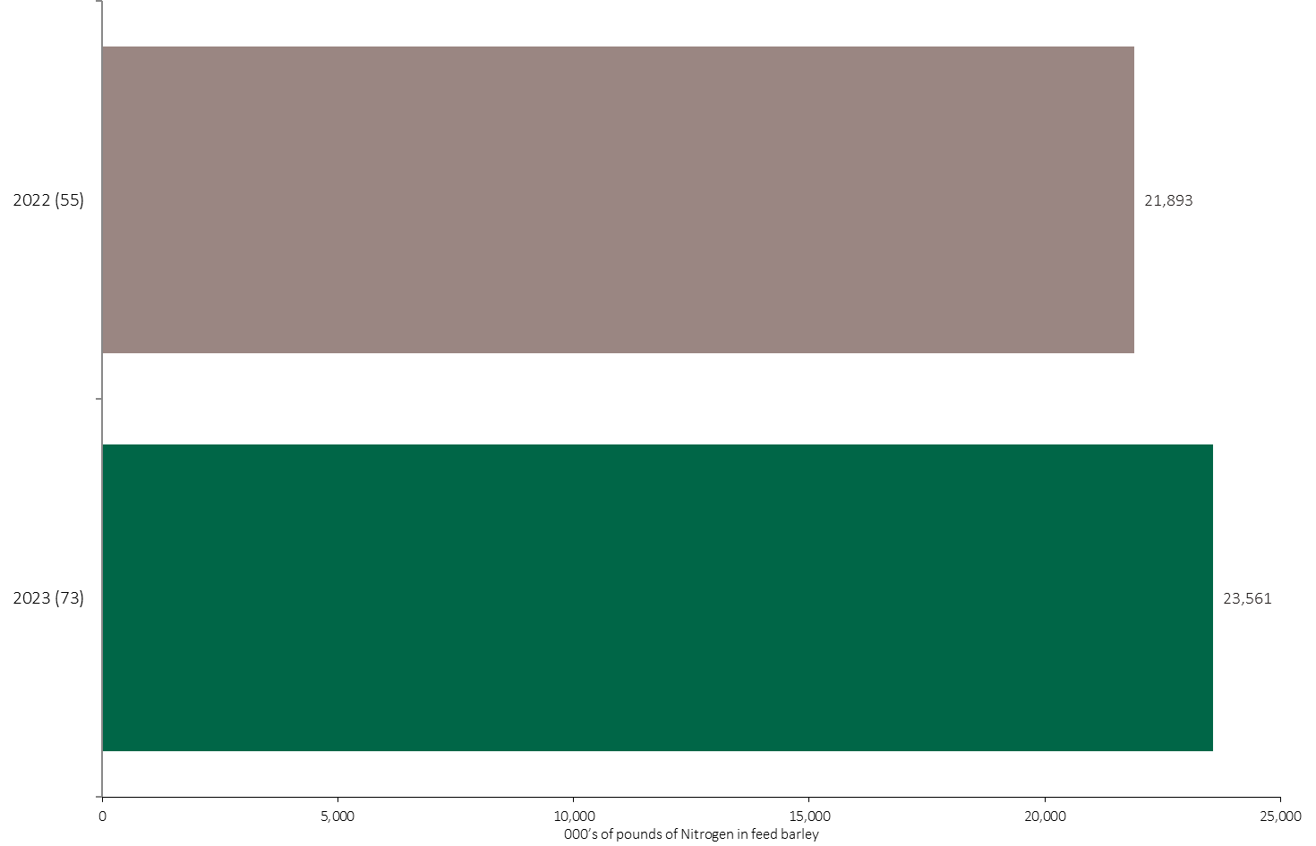
Nitrogen Volume in Feed Barley
Feed Barley
An estimated 24 million pounds of N was used in feed barley in 2023.
Note: Nitrogen volume was calculated from all sources of nitrogen contained in all fertilizer types
For each fertilizer type used in either a custom blend or applied as an unblended product, respondents were asked: a) how many acres they applied, and b) the application rate in pounds of actual nutrient/ac. Volumes of each nutrient were calculated by multiplying acres treated times the application rate.
The chart illustrates the total nitrogen volume (000’s of pounds) that was used in each year. The nitrogen volume was calculated from all sources of nitrogen contained in all fertilizer types.

Slide 31
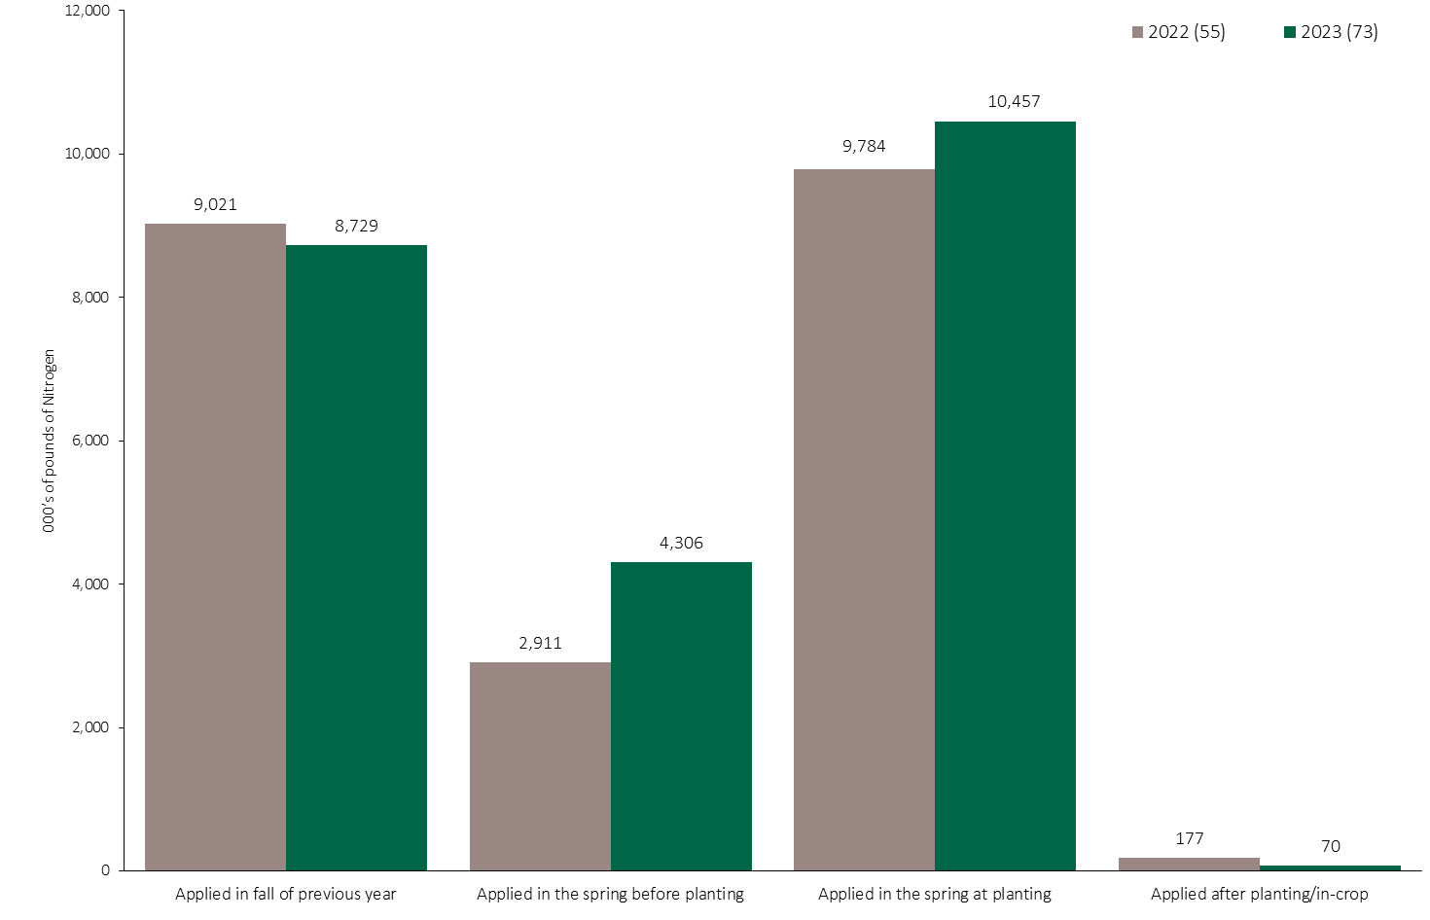
Nitrogen Volume in Feed Barley by Timing
Feed Barley
Note: Nitrogen volume was calculated from all sources of nitrogen contained in all fertilizer types
For each fertilizer type used in either a custom blend or applied as an unblended product, respondents were asked: a) how many acres they applied, and b) the application rate in pounds of actual nutrient/ac. Volumes of each nutrient were calculated by multiplying acres treated times the application rate.
The chart illustrates the total nitrogen volume (000’s of pounds) that was used in each year by application timing. The nitrogen volume was calculated from all sources of nitrogen contained in all fertilizer types.

Slide 32
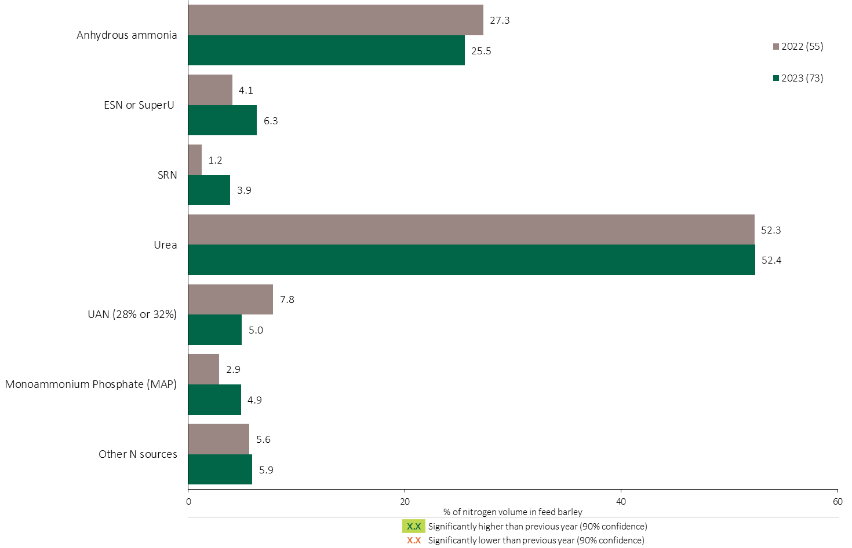
Nitrogen Fertilizer Source in Feed Barley - All Timings
A quarter of the total nitrogen volume was applied as anhydrous ammonia in feed barley.
Feed Barley
Feed Barley Summary 
Over half of the total nitrogen volume was applied as urea in feed barley, consistent with 2022.
Note: Nitrogen volume was calculated from all sources of nitrogen contained in all fertilizer types
For each fertilizer type used in either a custom blend or applied as an unblended product, respondents were asked: a) how many acres they applied, and b) the application rate in pounds of actual nutrient/ac. Volumes of each nutrient were calculated by multiplying acres treated times the application rate.
The chart illustrates the % of total nitrogen volume applied at all timings that was provided by each fertilizer type. The nitrogen volume was calculated from all sources of nitrogen contained in all fertilizer types.

Slide 33
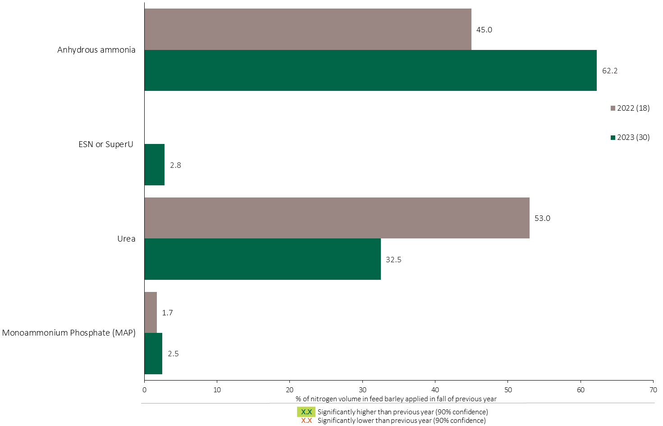
Nitrogen Fertilizer Source in Feed Barley - Fall Timing
Feed Barley
Note: Nitrogen volume was calculated from all sources of nitrogen contained in all fertilizer types
For each fertilizer type used in either a custom blend or applied as an unblended product, respondents were asked: a) how many acres they applied, and b) the application rate in pounds of actual nutrient/ac. Volumes of each nutrient were calculated by multiplying acres treated times the application rate.
The chart illustrates the % of total nitrogen volume applied in the fall of the previous year that was provided by each fertilizer type. The nitrogen volume was calculated from all sources of nitrogen contained in all fertilizer types.

Slide 34
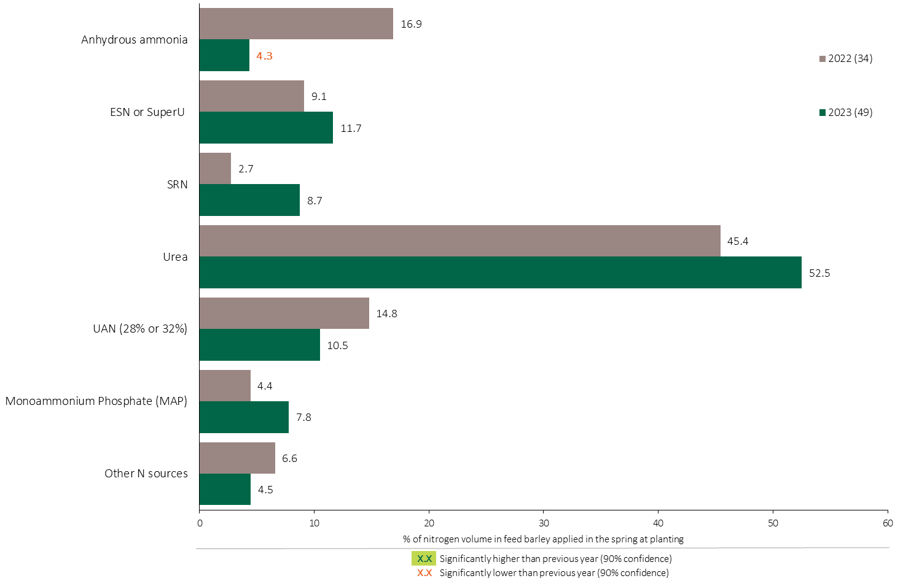
Nitrogen Fertilizer Source in Feed Barley - At Planting
Feed Barley
Note: Nitrogen volume was calculated from all sources of nitrogen contained in all fertilizer types
For each fertilizer type used in either a custom blend or applied as an unblended product, respondents were asked: a) how many acres they applied, and b) the application rate in pounds of actual nutrient/ac. Volumes of each nutrient were calculated by multiplying acres treated times the application rate.
The chart illustrates the % of total nitrogen volume applied in the spring at planting that was provided by each fertilizer type. The nitrogen volume was calculated from all sources of nitrogen contained in all fertilizer types.

Slide 35
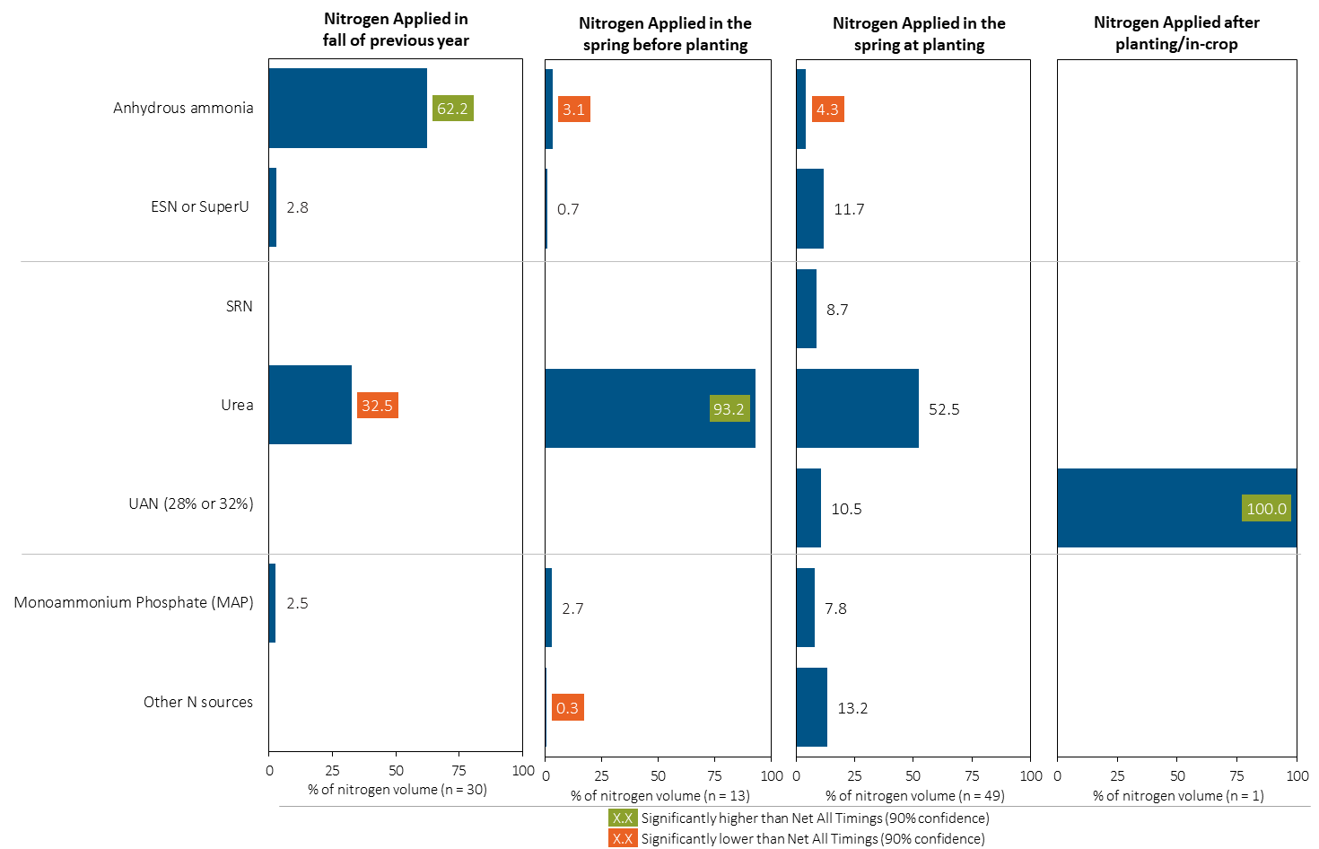
Nitrogen Fertilizer Source in Feed Barley by Timing
Feed Barley
Note: Nitrogen volume was calculated from all sources of nitrogen contained in all fertilizer types
For each fertilizer type used in either a custom blend or applied as an unblended product, respondents were asked: a) how many acres they applied, and b) the application rate in pounds of actual nutrient/ac. Volumes of each nutrient were calculated by multiplying acres treated times the application rate.
Separately for each application timing, the graphs illustrate the % of total nitrogen volume applied in feed barley that came from each fertilizer source.
Total pounds of actual nitrogen applied was calculated based on all sources of nitrogen from all fertilizer types.

Slide 36
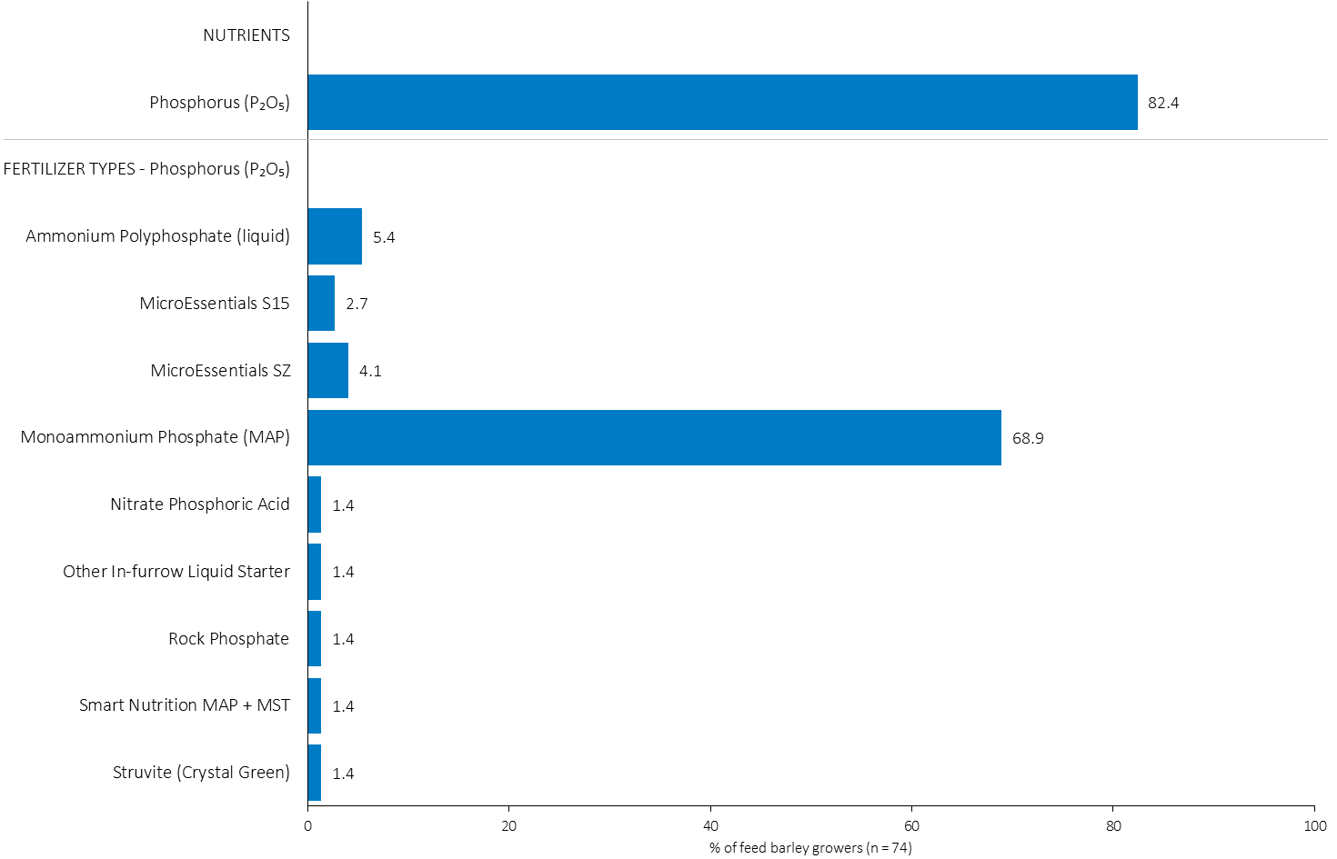
% of Feed Barley Growers Using Each Phosphorus (P₂O₅) Source in 2023
Feed Barley
69% of feed barley growers used MAP in 2023.
Note: Nutrients were defined based on any fertilizer type that contains the nutrient.
Respondents were asked: “For your 2023 feed barley crop, did you apply fertilizer or manure at each timing? – and given the options of a) Applied in fall of previous year, b) in the spring before planting, c) in the spring at planting and d) after planting/in-crop. For your 2023 feed barley crop, which fertilizer types did you apply at each timing?
The chart illustrates the % of feed barley growers who indicated that they used this nutrient and each fertilizer type in feed barley in 2023.
Nutrients were defined based on any fertilizer type that contains the nutrient.

Slide 37
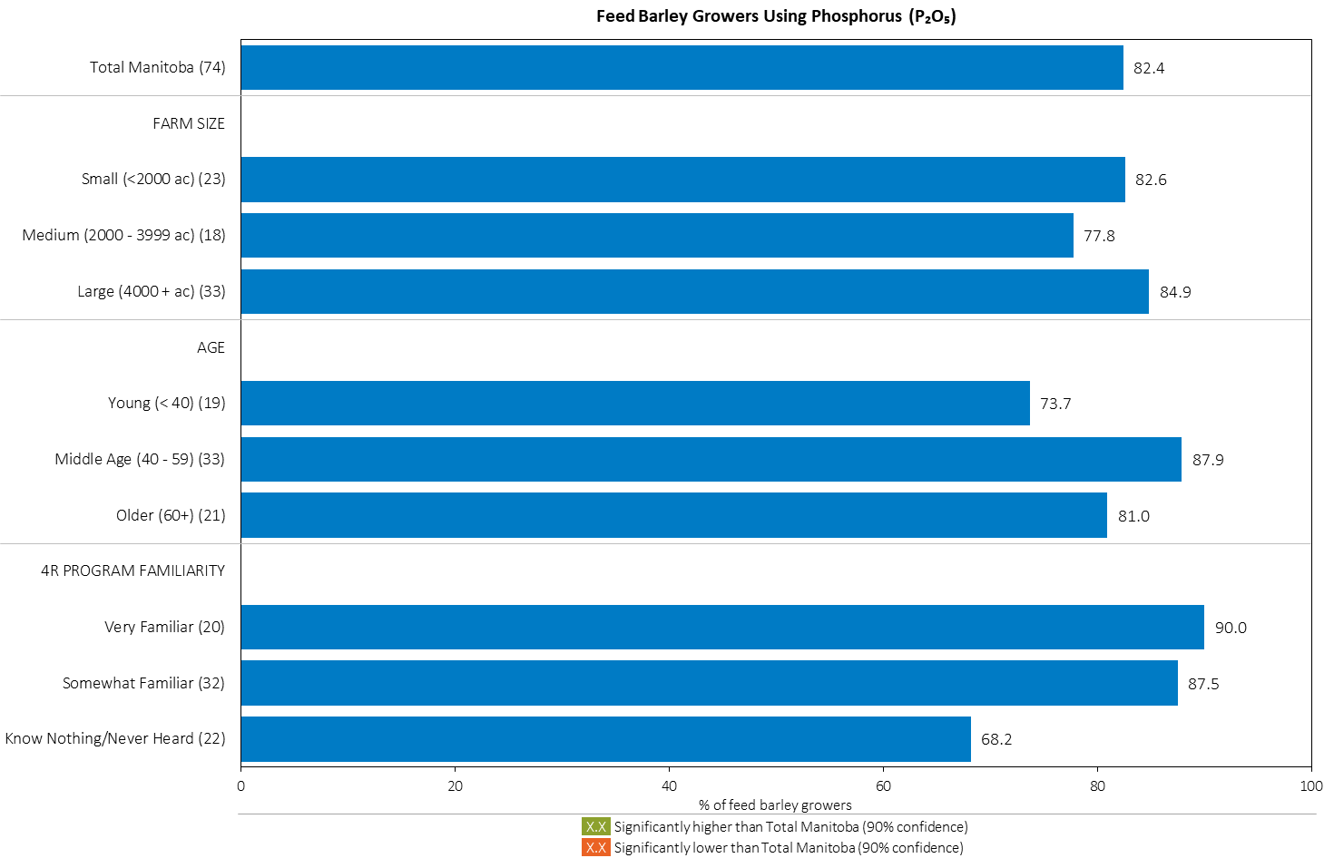
% of Feed Barley Growers Using Phosphorus (P₂O₅) in 2023
Feed Barley
Note: Nutrients were defined based on any fertilizer type that contains the nutrient.
Respondents were asked: “For your 2023 feed barley crop, did you apply fertilizer or manure at each timing? – and given the options of a) Applied in fall of previous year, b) in the spring before planting, c) in the spring at planting and d) after planting/in-crop. For your 2023 feed barley crop, which fertilizer types did you apply at each timing?
The chart illustrates the % of feed barley growers who indicated that they used this nutrient in feed barley in 2023 by farm size, age and 4R familiarity.
Nutrients were defined based on any fertilizer type that contains the nutrient.

Slide 38
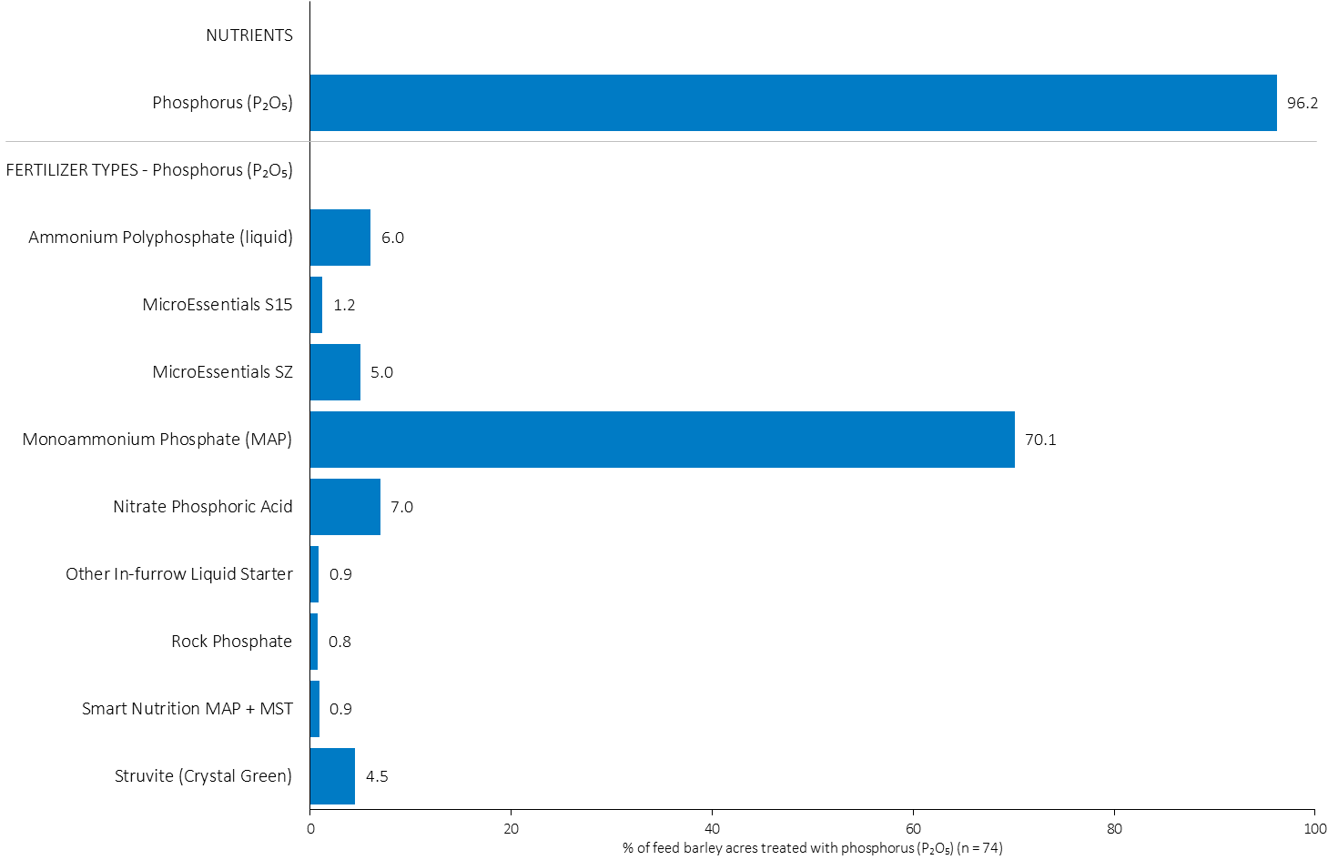
Acres Treated With Each Phosphorus (P₂O₅) Source in Feed Barley in 2023
Feed Barley
Feed Barley Summary 
70% of feed barley acres received an application of MAP in 2023.
Note: Nutrients were defined based on the primary component of each fertilizer type
For each application timing, respondents were asked: “Of your [xxx] acres of feed barley, how many acres of each fertilizer type did you apply?”
The chart illustrates the % of total feed barley acres that were treated with this nutrient and each fertilizer type in 2023.
Nutrients were defined based on the primary component (see adjacent fertilizer types by clicking on the “A” button).

Slide 39
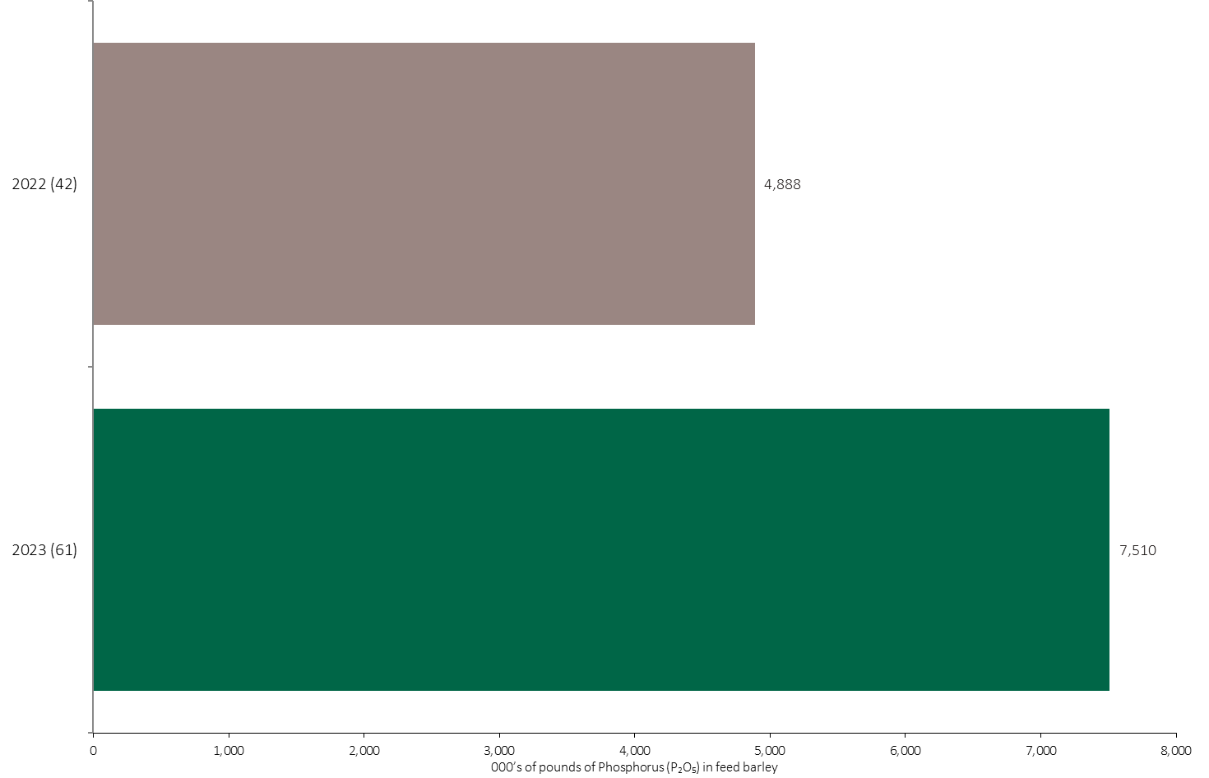
Phosphorus (P₂O₅) Volume in Feed Barley
Feed Barley
An estimated 7.5 million pounds of P₂O₅ was used in feed barley in 2023.
Note: Phosphorus (P₂O₅) volume was calculated from all sources of phosphorus contained in all fertilizer types
For each fertilizer type used in either a custom blend or applied as an unblended product, respondents were asked: a) how many acres they applied, and b) the application rate in pounds of actual nutrient/ac. Volumes of each nutrient were calculated by multiplying acres treated times the application rate.
The chart illustrates the total phosphorus (P₂O₅) volume (000’s of pounds) that was used in each year. The phosphorus (P₂O₅) volume was calculated from all sources of phosphorus (P₂O₅) contained in all fertilizer types.

Slide 40
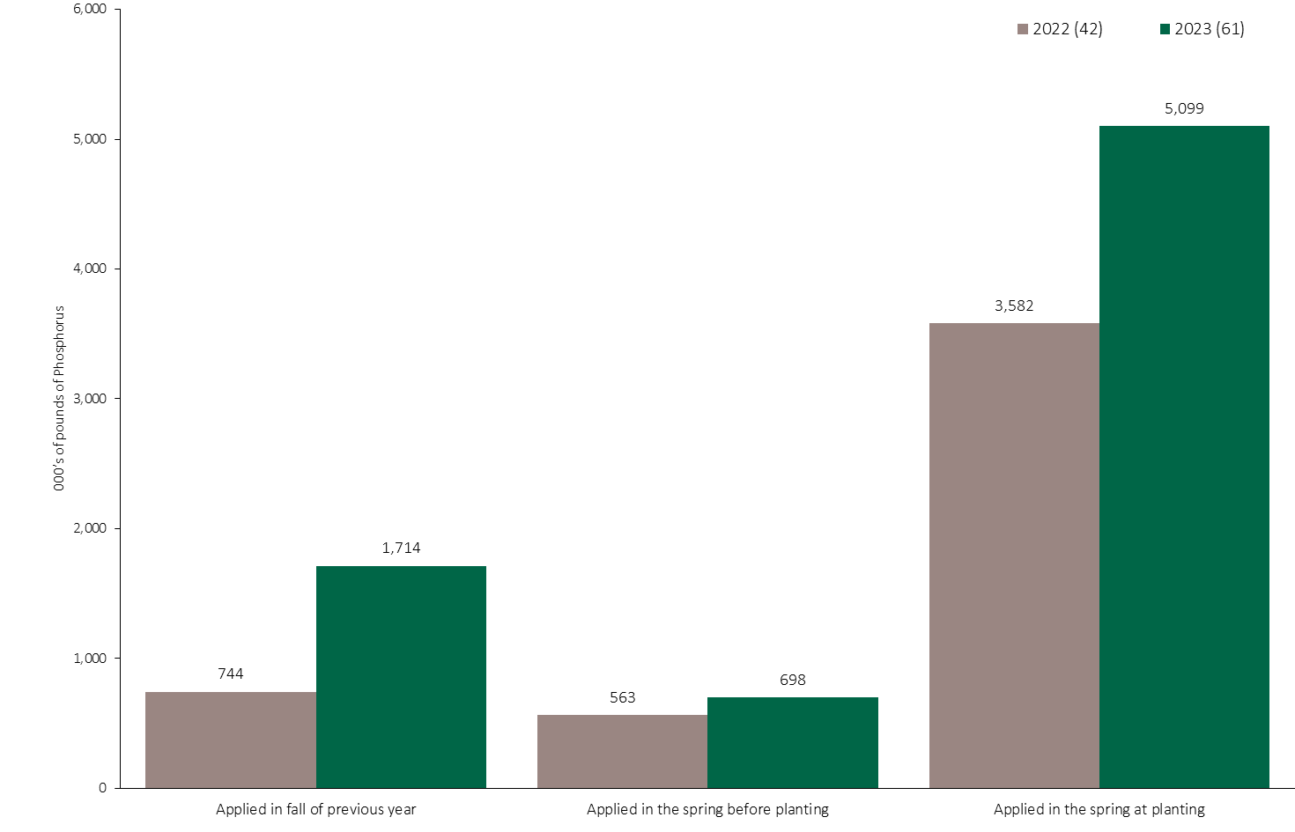
Phosphorus (P₂O₅) Volume in Feed Barley by Timing
Feed Barley
Note: Phosphorus (P₂O₅) volume was calculated from all sources of phosphorus contained in all fertilizer types
For each fertilizer type used in either a custom blend or applied as an unblended product, respondents were asked: a) how many acres they applied, and b) the application rate in pounds of actual nutrient/ac. Volumes of each nutrient were calculated by multiplying acres treated times the application rate.
The chart illustrates the total phosphorus (P₂O₅) volume (000’s of pounds) that was used in each year by application timing. The phosphorus (P₂O₅) volume was calculated from all sources of phosphorus (P₂O₅) contained in all fertilizer types.

Slide 41
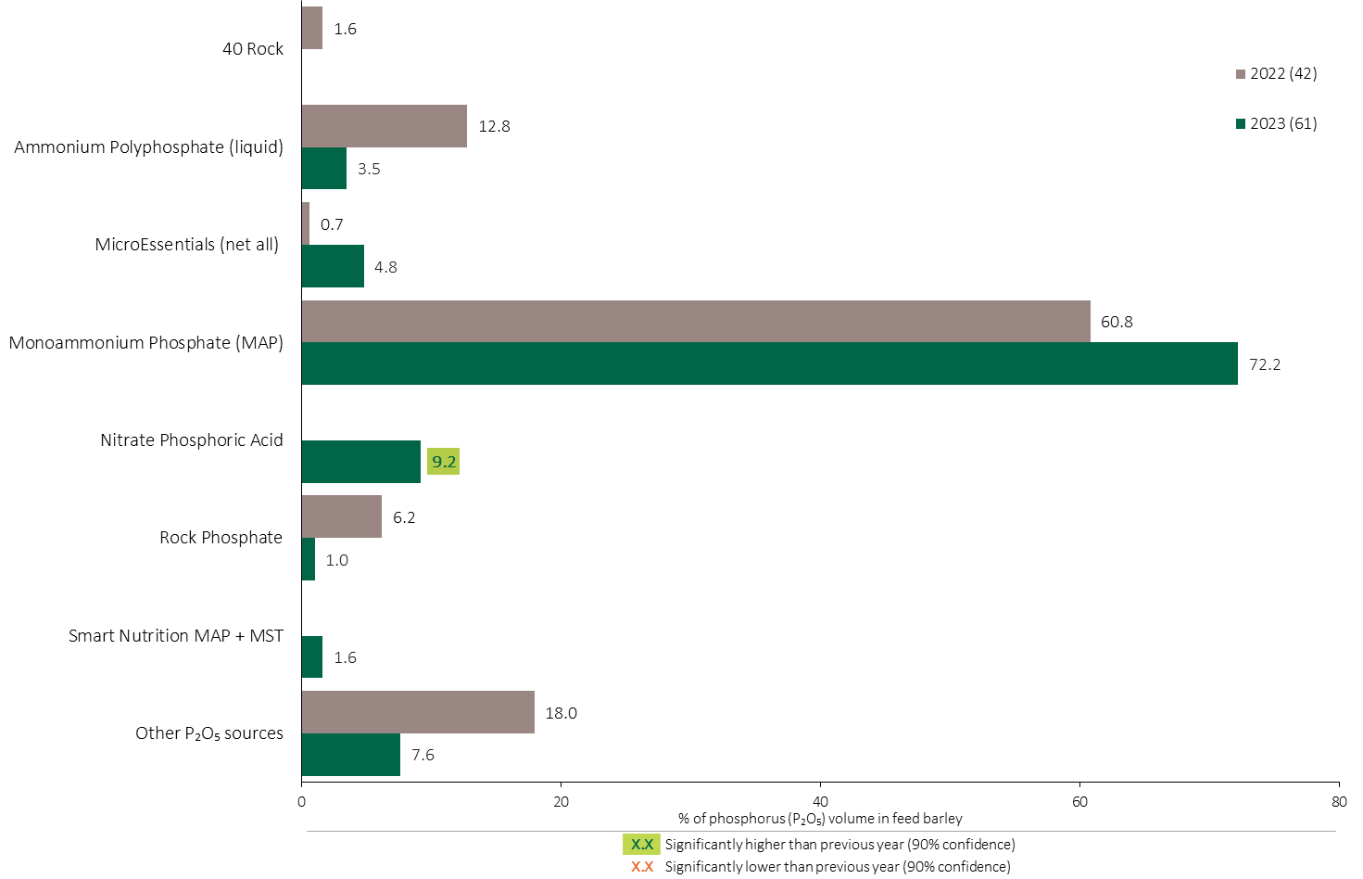
Phosphorus (P₂O₅) Fertilizer Source in Feed Barley - All Timings
Feed Barley
Feed Barley Summary 
72% of the total Phosphorus (P₂O₅) volume was applied as MAP in feed barley.
Note: Phosphorus (P₂O₅) volume was calculated from all sources of phosphorus contained in all fertilizer types
For each fertilizer type used in either a custom blend or applied as an unblended product, respondents were asked: a) how many acres they applied, and b) the application rate in pounds of actual nutrient/ac. Volumes of each nutrient were calculated by multiplying acres treated times the application rate.
The chart illustrates the % of total phosphorus (P₂O₅) volume applied at all timings that was provided by each fertilizer type. The phosphorus (P₂O₅) volume was calculated from all sources of phosphorus (P₂O₅) contained in all fertilizer types.

Slide 42
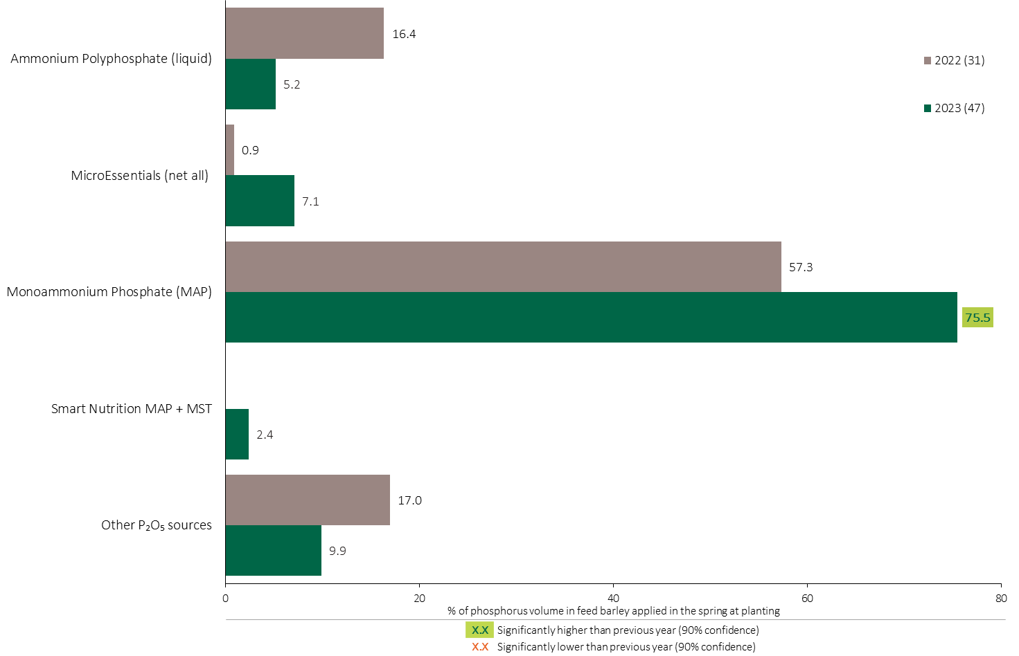
Phosphorus (P₂O₅) Fertilizer Source in Feed Barley - At Planting
Feed Barley
Use of MAP at planting increased in 2023 compared to 2022.
Note: Phosphorus (P₂O₅) volume was calculated from all sources of phosphorus contained in all fertilizer types
For each fertilizer type used in either a custom blend or applied as an unblended product, respondents were asked: a) how many acres they applied, and b) the application rate in pounds of actual nutrient/ac. Volumes of each nutrient were calculated by multiplying acres treated times the application rate.
The chart illustrates the % of total phosphorus (P₂O₅) volume applied in the spring at planting that was provided by each fertilizer type. The phosphorus (P₂O₅) volume was calculated from all sources of phosphorus (P₂O₅) contained in all fertilizer types.

Slide 43
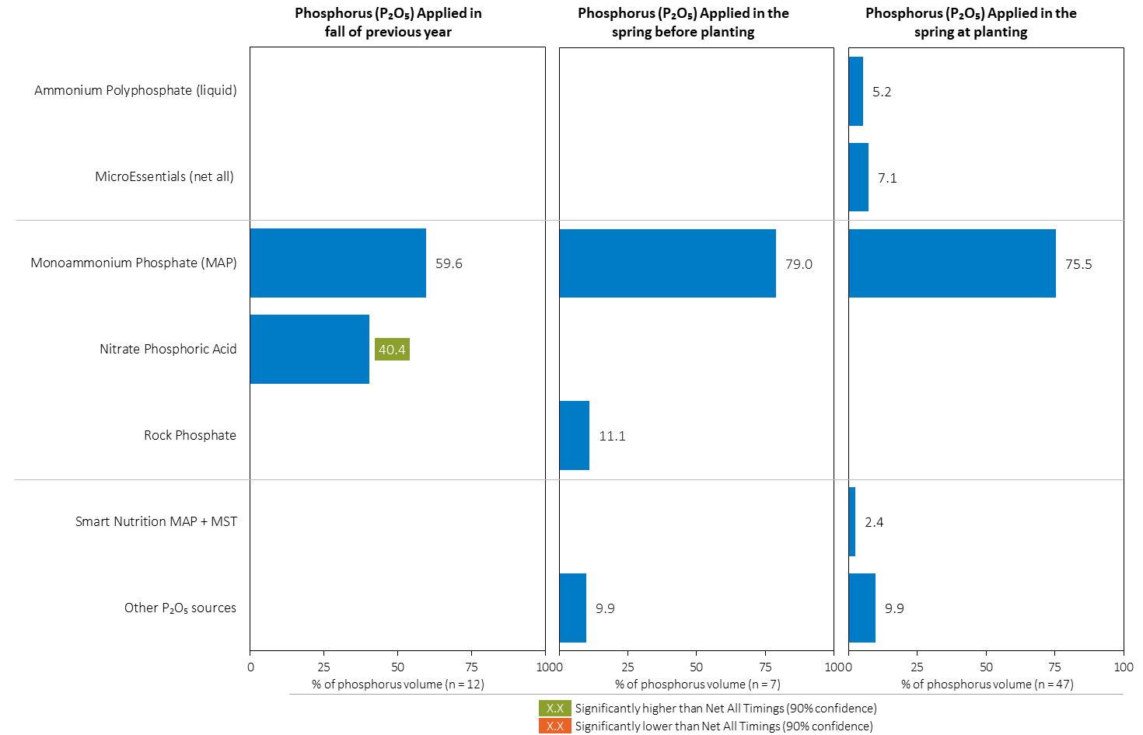
Phosphorus (P₂O₅) Fertilizer Source in Feed Barley by Timing
Feed Barley
Note: Phosphorus (P₂O₅) volume was calculated from all sources of phosphorus contained in all fertilizer types
For each fertilizer type used in either a custom blend or applied as an unblended product, respondents were asked: a) how many acres they applied, and b) the application rate in pounds of actual nutrient/ac. Volumes of each nutrient were calculated by multiplying acres treated times the application rate.
Separately for each application timing, the graphs illustrate the % of total phosphorus (P₂O₅) volume applied in feed barley that came from each fertilizer source.
Total pounds of actual phosphorus (P₂O₅) applied was calculated based on all sources of phosphorus (P₂O₅) from all fertilizer types.

Slide 44
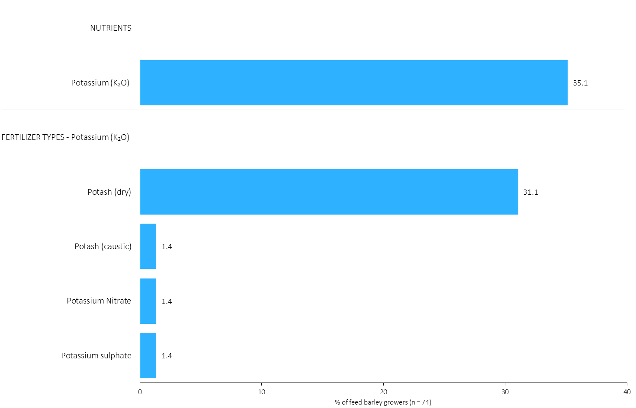
% of Feed Barley Growers Using Each Potassium (K₂O) Source in 2023
Feed Barley
31% of feed barley growers used dry potash in 2023.
Note: Nutrients were defined based on any fertilizer type that contains the nutrient.
Respondents were asked: “For your 2023 feed barley crop, did you apply fertilizer or manure at each timing? – and given the options of a) Applied in fall of previous year, b) in the spring before planting, c) in the spring at planting and d) after planting/in-crop. For your 2023 feed barley crop, which fertilizer types did you apply at each timing?
The chart illustrates the % of feed barley growers who indicated that they used this nutrient and each fertilizer type in feed barley in 2023.
Nutrients were defined based on any fertilizer type that contains the nutrient.

Slide 45
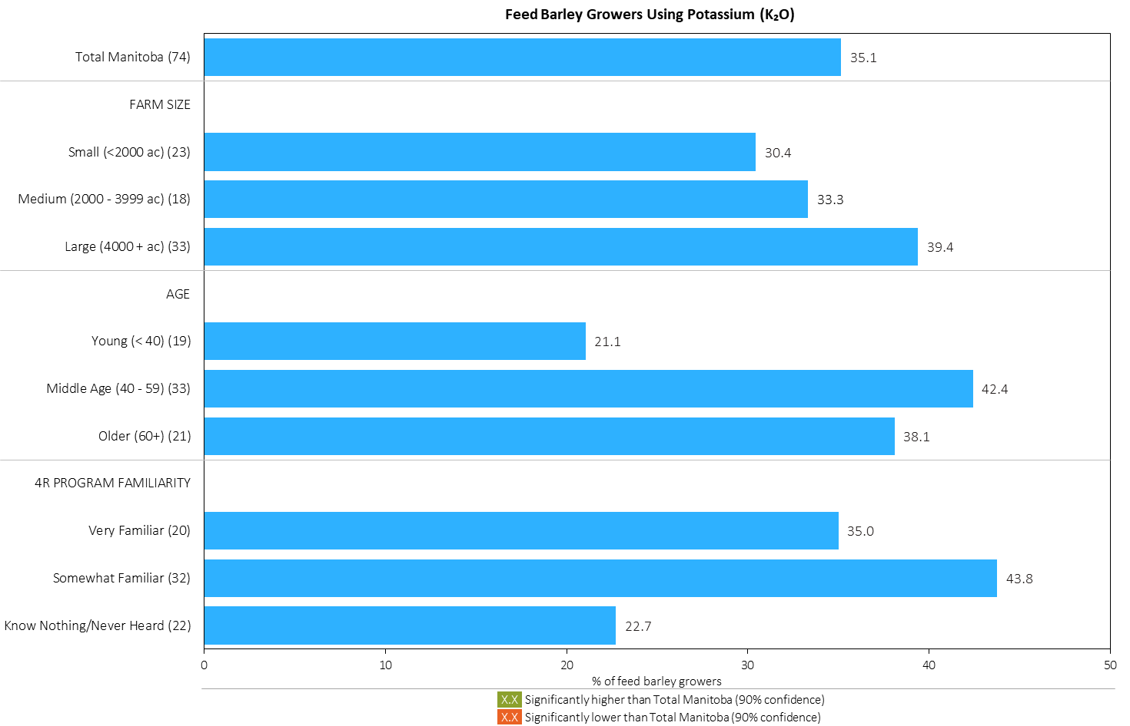
% of Feed Barley Growers Using Potassium (K₂O) in 2023
Feed Barley
Note: Nutrients were defined based on any fertilizer type that contains the nutrient.
Respondents were asked: “For your 2023 feed barley crop, did you apply fertilizer or manure at each timing? – and given the options of a) Applied in fall of previous year, b) in the spring before planting, c) in the spring at planting and d) after planting/in-crop. For your 2023 feed barley crop, which fertilizer types did you apply at each timing?
The chart illustrates the % of feed barley growers who indicated that they used this nutrient in feed barley in 2023 by farm size, age and 4R familiarity.
Nutrients were defined based on any fertilizer type that contains the nutrient.

Slide 46
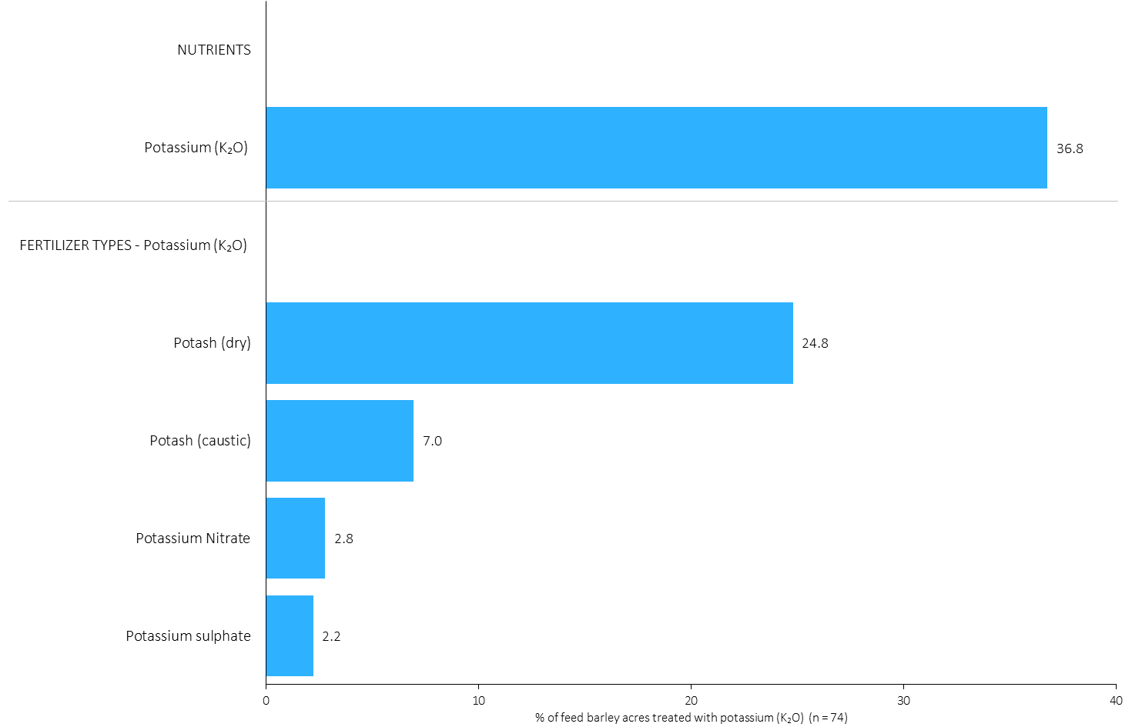
Acres Treated With Each Potassium (K₂O) Source in Feed Barley in 2023
Feed Barley
Feed Barley Summary 
25% of feed barley acres were treated with dry potash in 2023.
Note: Nutrients were defined based on the primary component of each fertilizer type
For each application timing, respondents were asked: “Of your [xxx] acres of feed barley, how many acres of each fertilizer type did you apply?”
The chart illustrates the % of total feed barley acres that were treated with this nutrient and each fertilizer type in 2023.
Nutrients were defined based on the primary component (see adjacent fertilizer types by clicking on the “A” button).

Slide 47
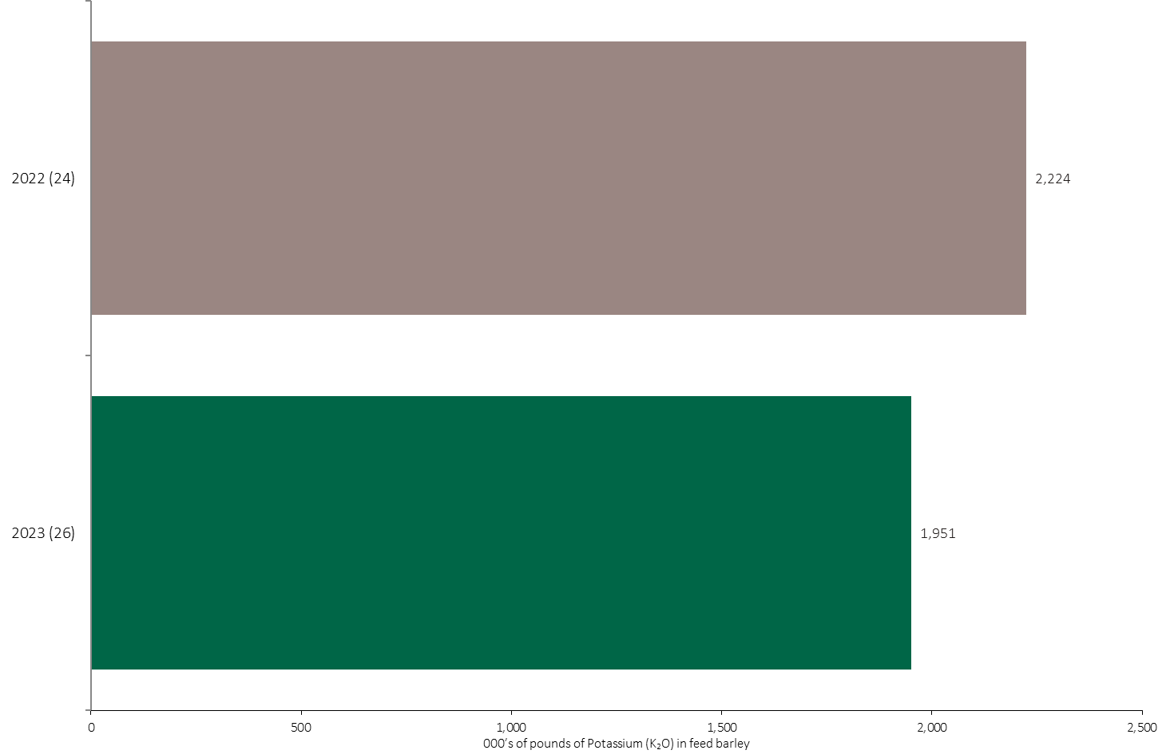
Potassium (K₂O) Volume in Feed Barley
Feed Barley
An estimated 2.0 million pounds of K₂O was used in feed barley in 2023.
Note: Potassium (K₂O) volume was calculated from all sources of potassium contained in all fertilizer types
For each fertilizer type used in either a custom blend or applied as an unblended product, respondents were asked: a) how many acres they applied, and b) the application rate in pounds of actual nutrient/ac. Volumes of each nutrient were calculated by multiplying acres treated times the application rate.
The chart illustrates the total potassium (K₂O) volume (000’s of pounds) that was used in each year. The potassium (K₂O) volume was calculated from all sources of potassium (K₂O) contained in all fertilizer types.

Slide 48
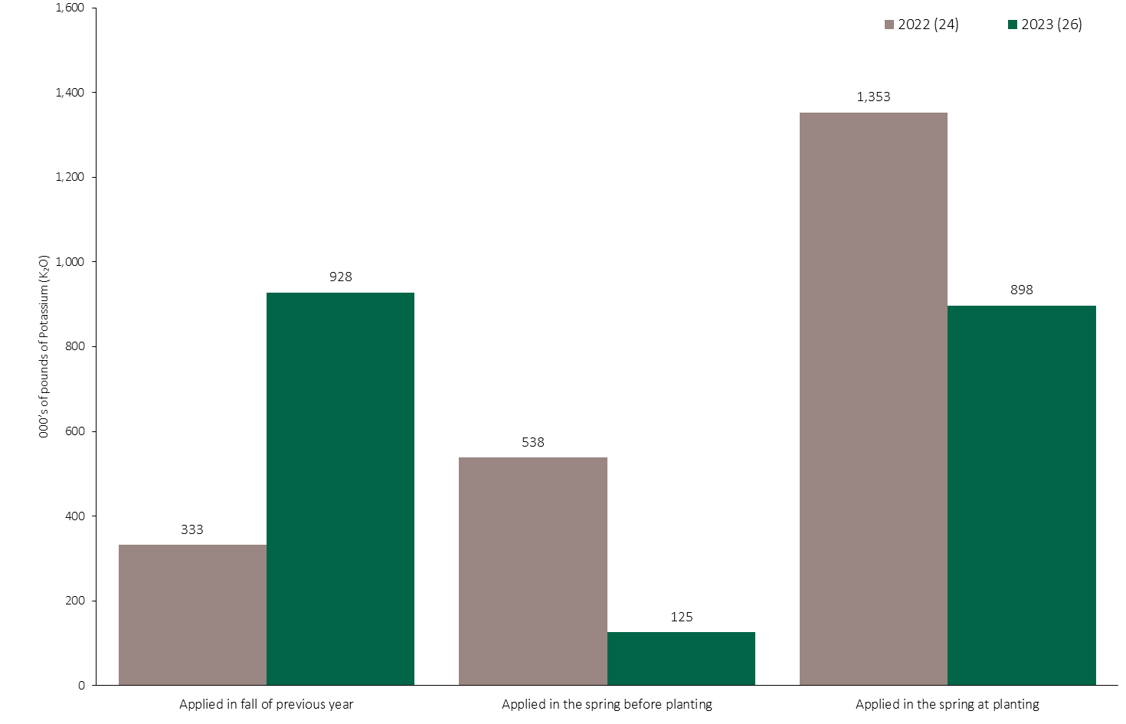
Potassium (K₂O) Volume in Feed Barley by Timing
Feed Barley
Note: Potassium (K₂O) volume was calculated from all sources of potassium contained in all fertilizer types
For each fertilizer type used in either a custom blend or applied as an unblended product, respondents were asked: a) how many acres they applied, and b) the application rate in pounds of actual nutrient/ac. Volumes of each nutrient were calculated by multiplying acres treated times the application rate.
The chart illustrates the total potassium (K₂O) volume (000’s of pounds) that was used in each year by application timing. The potassium (K₂O) volume was calculated from all sources of potassium (K₂O) contained in all fertilizer types.

Slide 49
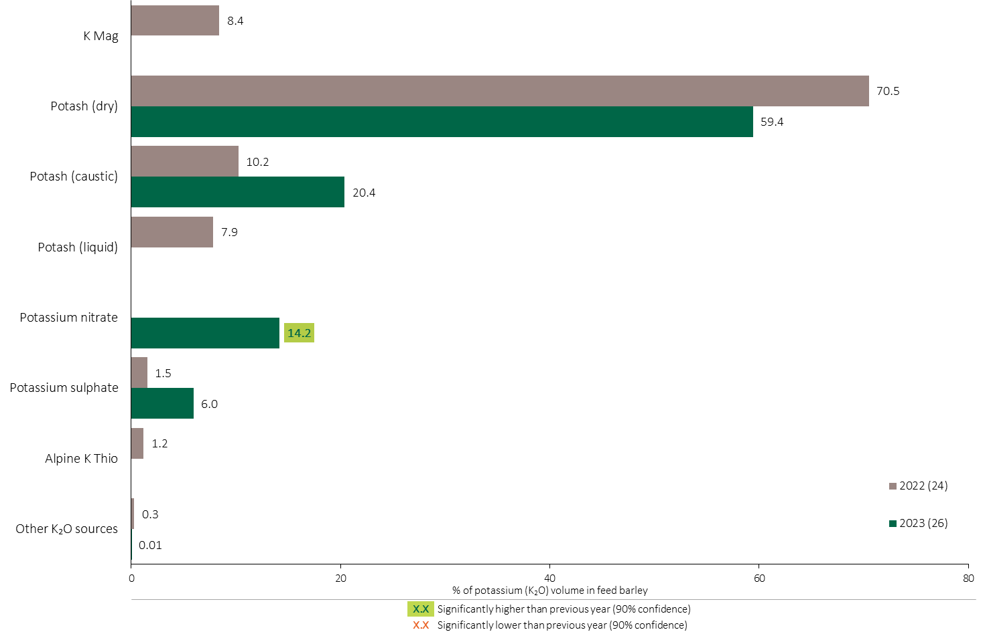
Potassium (K₂O) Fertilizer Source in Feed Barley - All Timings
Feed Barley
Feed Barley Summary 
59% of the total Potassium volume was applied as dry potash in feed barley.
Note: Potassium (K₂O) volume was calculated from all sources of potassium contained in all fertilizer types
For each fertilizer type used in either a custom blend or applied as an unblended product, respondents were asked: a) how many acres they applied, and b) the application rate in pounds of actual nutrient/ac. Volumes of each nutrient were calculated by multiplying acres treated times the application rate.
The chart illustrates the % of total potassium (K₂O) volume applied at all timings that was provided by each fertilizer type. The potassium (K₂O) volume was calculated from all sources of potassium (K₂O) contained in all fertilizer types.

Slide 50
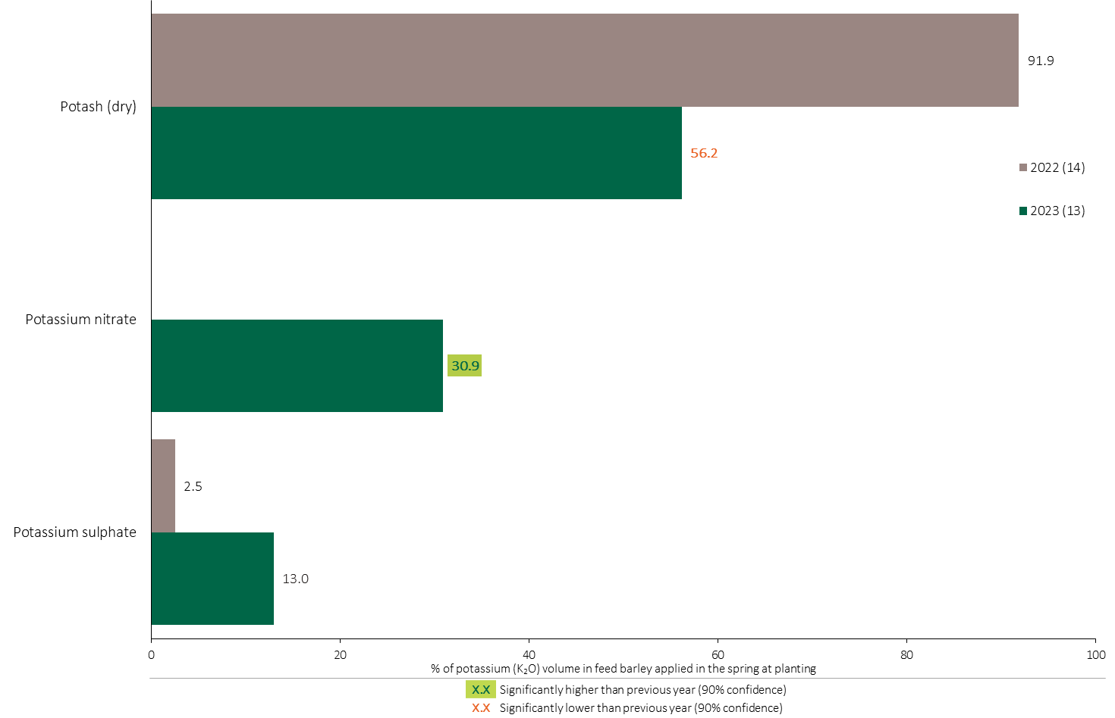
Potassium (K₂O) Fertilizer Source in Feed Barley - At Planting
Feed Barley
Feed Barley Summary 
Note: Potassium (K₂O) volume was calculated from all sources of potassium contained in all fertilizer types
For each fertilizer type used in either a custom blend or applied as an unblended product, respondents were asked: a) how many acres they applied, and b) the application rate in pounds of actual nutrient/ac. Volumes of each nutrient were calculated by multiplying acres treated times the application rate.
The chart illustrates the % of total potassium (K₂O) volume applied in the spring at planting that was provided by each fertilizer type. The potassium (K₂O) volume was calculated from all sources of potassium (K₂O) contained in all fertilizer types.

Slide 51
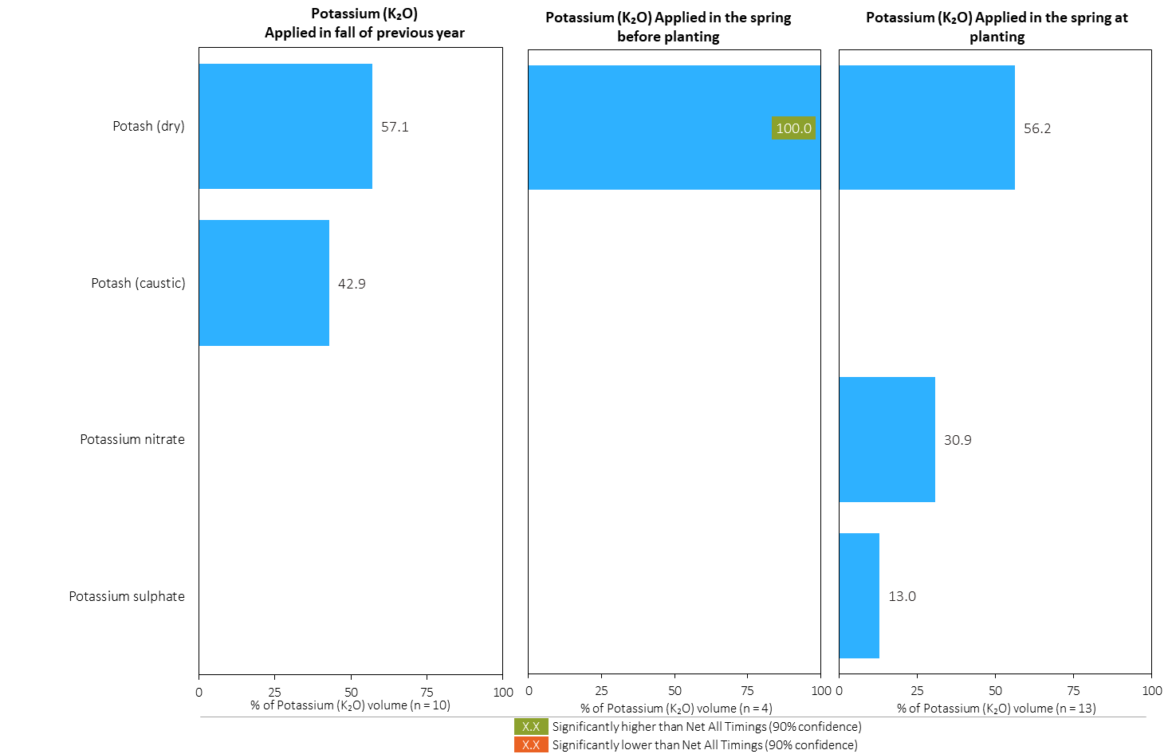
Potassium (K₂O) Fertilizer Source in Feed Barley by Timing
Feed Barley
Note: Potassium (K₂O) volume was calculated from all sources of potassium contained in all fertilizer types
For each fertilizer type used in either a custom blend or applied as an unblended product, respondents were asked: a) how many acres they applied, and b) the application rate in pounds of actual nutrient/ac. Volumes of each nutrient were calculated by multiplying acres treated times the application rate.
Separately for each application timing, the graphs illustrate the % of total potassium (K₂O) volume applied in feed barley that came from each fertilizer source.
Total pounds of actual potassium (K₂O) applied was calculated based on all sources of potassium (K₂O) from all fertilizer types.

Slide 52
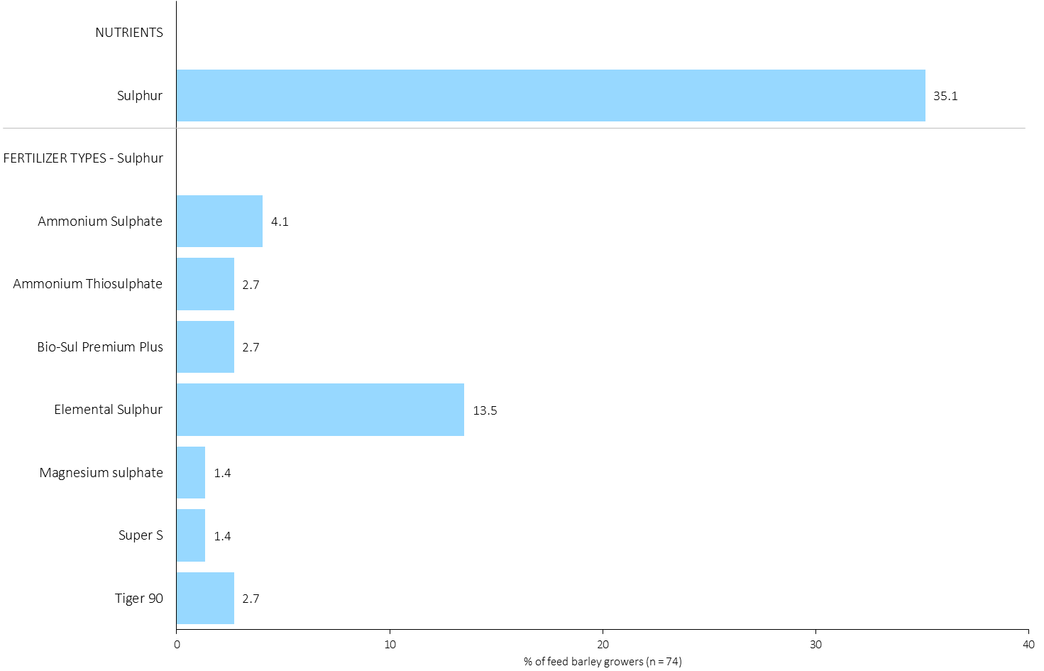
% of Feed Barley Growers Using Each Sulphur Source in 2023
Feed Barley
14% of feed barley growers used Elemental sulphur in 2023.
Note: Nutrients were defined based on any fertilizer type that contains the nutrient.
Respondents were asked: “For your 2023 feed barley crop, did you apply fertilizer or manure at each timing? – and given the options of a) Applied in fall of previous year, b) in the spring before planting, c) in the spring at planting and d) after planting/in-crop. For your 2023 feed barley crop, which fertilizer types did you apply at each timing?
The chart illustrates the % of feed barley growers who indicated that they used this nutrient and each fertilizer type in feed barley in 2023.
Nutrients were defined based on any fertilizer type that contains the nutrient.

Slide 53
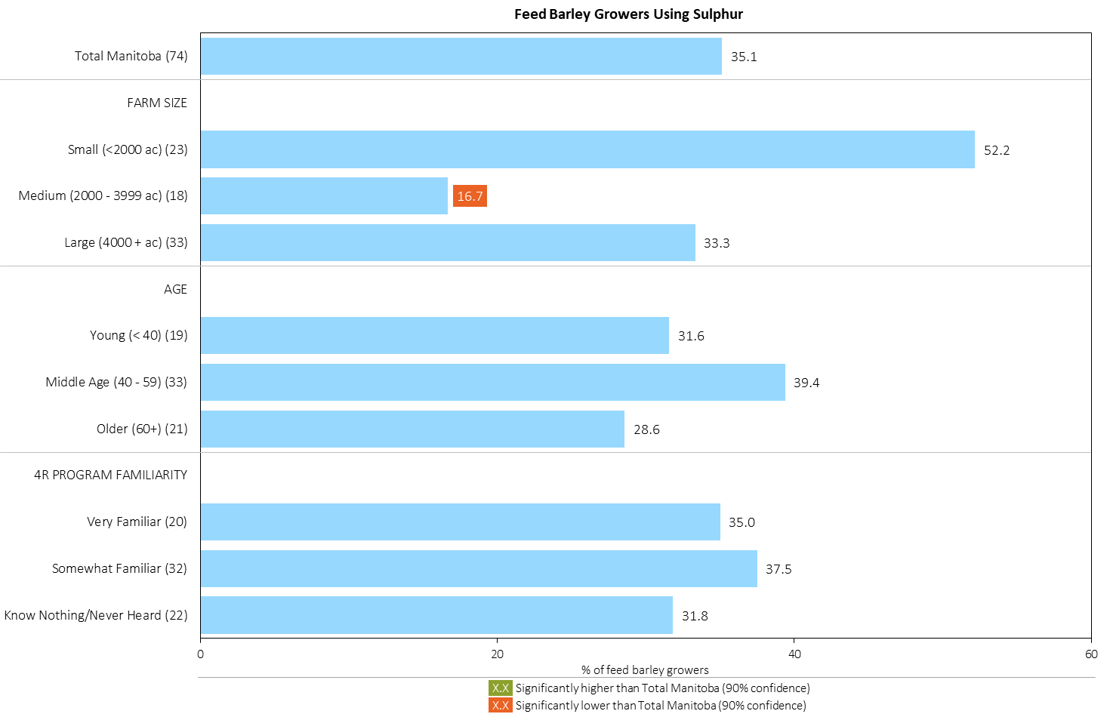
% of Feed Barley Growers Using Sulphur in 2023
Feed Barley
Note: Nutrients were defined based on any fertilizer type that contains the nutrient.
Respondents were asked: “For your 2023 feed barley crop, did you apply fertilizer or manure at each timing? – and given the options of a) Applied in fall of previous year, b) in the spring before planting, c) in the spring at planting and d) after planting/in-crop. For your 2023 feed barley crop, which fertilizer types did you apply at each timing?
The chart illustrates the % of feed barley growers who indicated that they used this nutrient in feed barley in 2023 by farm size, age and 4R familiarity.
Nutrients were defined based on any fertilizer type that contains the nutrient.

Slide 54
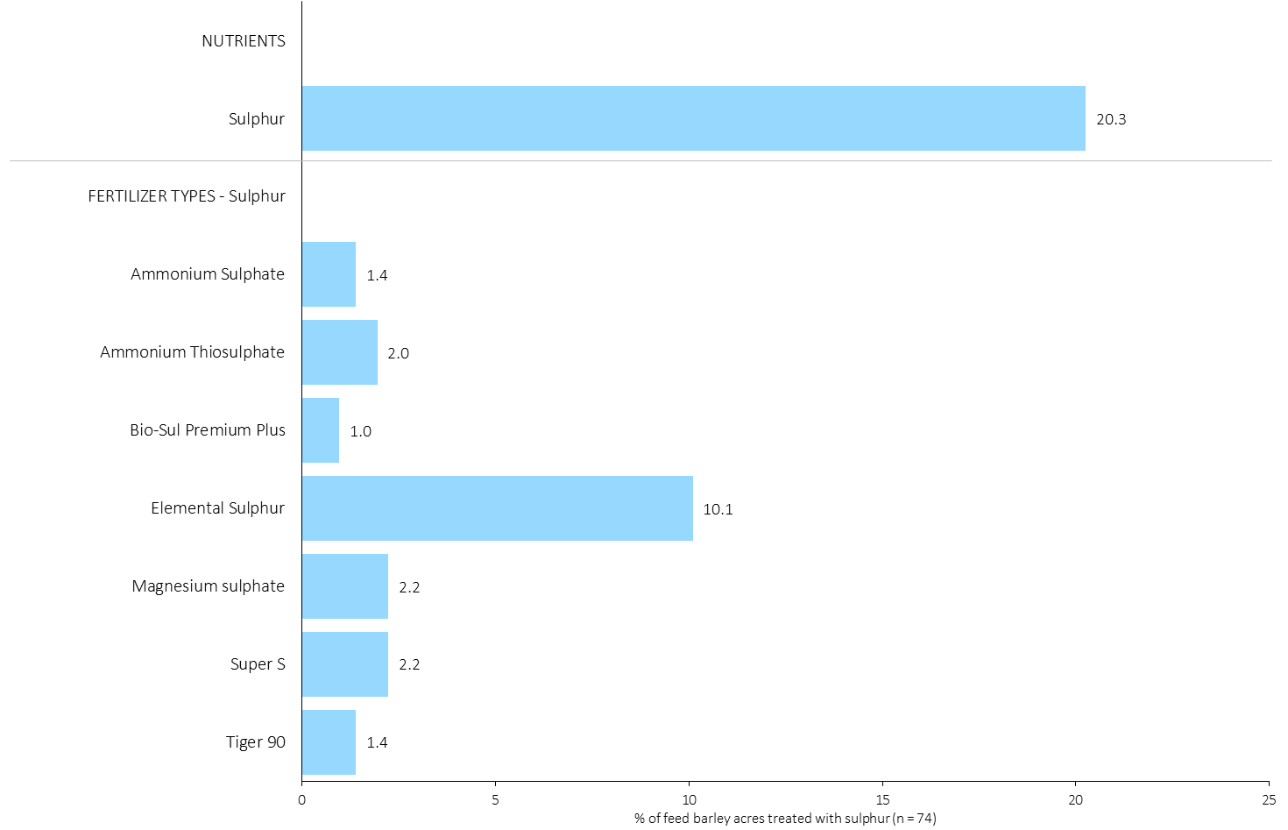
Acres Treated With Each Sulphur Source in Feed Barley in 2023
Feed Barley
Feed Barley Summary 
10% of feed barley acres received an application of Elemental Sulphur in 2023.
Note: Nutrients were defined based on the primary component of each fertilizer type
For each application timing, respondents were asked: “Of your [xxx] acres of feed barley, how many acres of each fertilizer type did you apply?”
The chart illustrates the % of total feed barley acres that were treated with this nutrient and each fertilizer type in 2023.
Nutrients were defined based on the primary component (see adjacent fertilizer types by clicking on the “A” button).

Slide 55
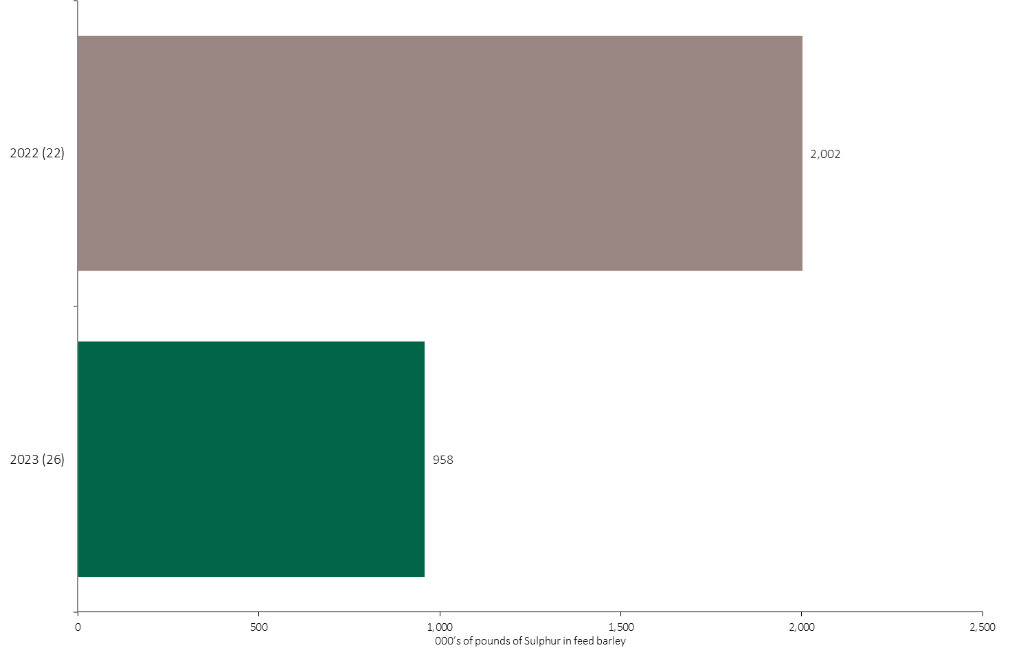
Sulphur Volume in Feed Barley
Feed Barley
An estimated 958,000 pounds of Sulphur was used in feed barley in 2023.
Note: Sulphur volume was calculated from all sources of sulphur contained in all fertilizer types
For each fertilizer type used in either a custom blend or applied as an unblended product, respondents were asked: a) how many acres they applied, and b) the application rate in pounds of actual nutrient/ac. Volumes of each nutrient were calculated by multiplying acres treated times the application rate.
The chart illustrates the total sulphur volume (000’s of pounds) that was used in each year. The sulphur volume was calculated from all sources of sulphur contained in all fertilizer types.

Slide 56

Sulphur Volume in Feed Barley by Timing
Feed Barley
Note: Sulphur volume was calculated from all sources of sulphur contained in all fertilizer types
For each fertilizer type used in either a custom blend or applied as an unblended product, respondents were asked: a) how many acres they applied, and b) the application rate in pounds of actual nutrient/ac. Volumes of each nutrient were calculated by multiplying acres treated times the application rate.
The chart illustrates the total sulphur volume (000’s of pounds) that was used in each year by application timing. The sulphur volume was calculated from all sources of sulphur contained in all fertilizer types.

Slide 57

Sulphur Fertilizer Source in Feed Barley - All Timings
Feed Barley
Feed Barley Summary 
Note: Sulphur volume was calculated from all sources of sulphur contained in all fertilizer types
For each fertilizer type used in either a custom blend or applied as an unblended product, respondents were asked: a) how many acres they applied, and b) the application rate in pounds of actual nutrient/ac. Volumes of each nutrient were calculated by multiplying acres treated times the application rate.
The chart illustrates the % of total sulphur volume applied at all timings that was provided by each fertilizer type. The sulphur volume was calculated from all sources of sulphur contained in all fertilizer types.

Slide 58

Sulphur Fertilizer Source in Feed Barley - At Planting
Feed Barley
Feed Barley Summary 
Note: Sulphur volume was calculated from all sources of sulphur contained in all fertilizer types
For each fertilizer type used in either a custom blend or applied as an unblended product, respondents were asked: a) how many acres they applied, and b) the application rate in pounds of actual nutrient/ac. Volumes of each nutrient were calculated by multiplying acres treated times the application rate.
The chart illustrates the % of total sulphur volume applied in the spring at planting that was provided by each fertilizer type. The sulphur volume was calculated from all sources of sulphur contained in all fertilizer types.

Slide 59

Sulphur Fertilizer Source in Feed Barley by Timing
Feed Barley
Note: Sulphur volume was calculated from all sources of sulphur contained in all fertilizer types
For each fertilizer type used in either a custom blend or applied as an unblended product, respondents were asked: a) how many acres they applied, and b) the application rate in pounds of actual nutrient/ac. Volumes of each nutrient were calculated by multiplying acres treated times the application rate.
Separately for each application timing, the graphs illustrate the % of total sulphur volume applied in feed barley that came from each fertilizer source.
Total pounds of actual sulphur applied was calculated based on all sources of sulphur from all fertilizer types.

Slide 60

Nitrogen Placement in Feed Barley - % Crop Acres
Feed Barley
Note: Nutrients were defined based on the primary component of each fertilizer type
For each application timing, respondents were asked: “Of your [xxx] acres of feed barley, how many acres of each fertilizer type did you apply?”
For Nitrogen, the chart illustrates the % of total feed barley acres that was applied using each placement at each timing.
Nitrogen was defined based on it being the primary component (see adjacent fertilizer types by clicking on the “A” button).

Slide 61

Nitrogen Placement in Feed Barley - % Nutrient Volume Applied at All Timings
Feed Barley
Feed Barley Summary 
Note: Nutrient volume was calculated from all sources of the nutrient contained in all fertilizer types
For each fertilizer type used in either a custom blend or applied as an unblended product, respondents were asked: a) how many acres they applied, and b) the application rate in pounds of actual nutrient/ac. Volumes of each nutrient were calculated by multiplying acres treated times the application rate.
For Nitrogen, the graph illustrates the % of total nutrient volume applied in feed barley that was applied at each timing/placement (i.e. across all timings, the sum of percentages = 100%).
Total pounds of actual nutrient applied was calculated based on all sources of the nutrient from all fertilizer types.

Slide 62

Phosphorus (P₂O₅) Placement in Feed Barley - % Crop Acres
Feed Barley
Note: Nutrients were defined based on the primary component of each fertilizer type
For each application timing, respondents were asked: “Of your [xxx] acres of feed barley, how many acres of each fertilizer type did you apply?”
For Phosphorus, the chart illustrates the % of total feed barley acres that was applied using each placement at each timing.
Phosphorus was defined based on it being the primary component (see adjacent fertilizer types by clicking on the “A” button).

Slide 63

Phosphorus (P₂O₅) Placement in Feed Barley - % Nutrient Volume Applied at All Timings
Feed Barley
Feed Barley Summary 
Note: Nutrient volume was calculated from all sources of the nutrient contained in all fertilizer types
For each fertilizer type used in either a custom blend or applied as an unblended product, respondents were asked: a) how many acres they applied, and b) the application rate in pounds of actual nutrient/ac. Volumes of each nutrient were calculated by multiplying acres treated times the application rate.
For Phosphorus, the graph illustrates the % of total nutrient volume applied in feed barley that was applied at each timing/placement (i.e. across all timings, the sum of percentages = 100%).
Total pounds of actual nutrient applied was calculated based on all sources of the nutrient from all fertilizer types.

Slide 64

Potassium (K₂O) Placement in Feed Barley - % Crop Acres
Feed Barley
Note: Nutrients were defined based on the primary component of each fertilizer type
For each application timing, respondents were asked: “Of your [xxx] acres of feed barley, how many acres of each fertilizer type did you apply?”
For Potassium, the chart illustrates the % of total feed barley acres that was applied using each placement at each timing.
Potassium was defined based on it being the primary component (see adjacent fertilizer types by clicking on the “A” button).

Slide 65

Potassium (K₂O) Placement in Feed Barley - % Nutrient Volume Applied at All Timings
Feed Barley
Feed Barley Summary 
Note: Nutrient volume was calculated from all sources of the nutrient contained in all fertilizer types
For each fertilizer type used in either a custom blend or applied as an unblended product, respondents were asked: a) how many acres they applied, and b) the application rate in pounds of actual nutrient/ac. Volumes of each nutrient were calculated by multiplying acres treated times the application rate.
For Potassium, the graph illustrates the % of total nutrient volume applied in feed barley that was applied at each timing/placement (i.e. across all timings, the sum of percentages = 100%).
Total pounds of actual nutrient applied was calculated based on all sources of the nutrient from all fertilizer types.

Slide 66

Sulphur Placement in Feed Barley - % Crop Acres
Feed Barley
Note: Nutrients were defined based on the primary component of each fertilizer type
For each application timing, respondents were asked: “Of your [xxx] acres of feed barley, how many acres of each fertilizer type did you apply?”
For Sulphur, the chart illustrates the % of total feed barley acres that was applied using each placement at each timing.
Sulphur was defined based on it being the primary component (see adjacent fertilizer types by clicking on the “A” button).

Slide 67

Sulphur Placement in Feed Barley - % Nutrient Volume Applied at All Timings
Feed Barley
Feed Barley Summary 
Note: Nutrient volume was calculated from all sources of the nutrient contained in all fertilizer types
For each fertilizer type used in either a custom blend or applied as an unblended product, respondents were asked: a) how many acres they applied, and b) the application rate in pounds of actual nutrient/ac. Volumes of each nutrient were calculated by multiplying acres treated times the application rate.
For Sulphur, the graph illustrates the % of total nutrient volume applied in feed barley that was applied at each timing/placement (i.e. across all timings, the sum of percentages = 100%).
Total pounds of actual nutrient applied was calculated based on all sources of the nutrient from all fertilizer types.

Slide 68

Average Nitrogen Rates in Feed Barley
Average Nitrogen rates were higher in 2023.
Feed Barley
Feed Barley Summary 
Note: Nitrogen volume was calculated from all sources of nitrogen contained in all fertilizer types
Note: Rates include growers who did not apply any nitrogen
For each fertilizer type used in either a custom blend or applied as an unblended product, respondents were asked: a) how many acres they applied, and b) the application rate in pounds of actual nutrient/ac. Volumes of each nutrient were calculated by multiplying acres treated times the application rate.
The chart illustrates the average rate of nitrogen applied in each year expressed in pounds of actual nitrogen per acre.

Slide 69

Nitrogen Rates in Feed Barley - Average Rate in 2023
Feed Barley
Feed Barley Summary 
Note: Nitrogen volume was calculated from all sources of nitrogen contained in all fertilizer types
Note: Rates include growers who did not apply any nitrogen
For each fertilizer type used in either a custom blend or applied as an unblended product, respondents were asked: a) how many acres they applied, and b) the application rate in pounds of actual nutrient/ac. Volumes of each nutrient were calculated by multiplying acres treated times the application rate.
Separately by farm size, age and 4R familiarity, the graph illustrates the average nitrogen application rate in pounds of nitrogen per acre (including untreated feed barley acres).

Slide 70

Nitrogen Rates in Feed Barley - Rate Ranges in 2023
Feed Barley
Note: Nitrogen volume was calculated from all sources of nitrogen contained in all fertilizer types
For each fertilizer type used in either a custom blend or applied as an unblended product, respondents were asked: a) how many acres they applied, and b) the application rate in pounds of actual nutrient/ac. Volumes of each nutrient were calculated by multiplying acres treated times the application rate.
The graph on the left illustrates the % of feed barley acres that were treated with nitrogen at an application rate that fell within each rate range. The graph on the right illustrates the cumulative % of feed barley acres that were treated with nitrogen at an application rate that fell within each rate range.

Slide 71

Nitrogen Rate Ranges in Feed Barley - % of Volume in 2023
Feed Barley
20% of the N volume was applied between 80 – 89.9 lbs./ac.
Note: Nitrogen volume was calculated from all sources of nitrogen contained in all fertilizer types
For each fertilizer type used in either a custom blend or applied as an unblended product, respondents were asked: a) how many acres they applied, and b) the application rate in pounds of actual nutrient/ac. Volumes of each nutrient were calculated by multiplying acres treated times the application rate.
The chart illustrates the % of nitrogen volume that was applied in feed barley within each rate range.
Total pounds of actual nitrogen applied was calculated based on all sources of nitrogen from all fertilizer types.

Slide 72

Average Nitrogen Rates in Feed Barley - By Timing
Feed Barley
Feed Barley Summary 
Note: Nitrogen volume was calculated from all sources of nitrogen contained in all fertilizer types
Note: Rates exclude growers who did not apply any nitrogen
For each fertilizer type used in either a custom blend or applied as an unblended product, respondents were asked: a) how many acres they applied, and b) the application rate in pounds of actual nutrient/ac. Volumes of each nutrient were calculated by multiplying acres treated times the application rate.
The chart illustrates the average rate of Nitrogen applied at each application timing in each year expressed in pounds of actual Nitrogen per acre.
Note: Rates exclude non-users of Nitrogen.

Slide 73

Average Phosphorus (P₂O₅) Rates in Feed Barley
Average Phosphorus rates were higher in 2023.
Feed Barley
Feed Barley Summary 
Note: Phosphorus (P₂O₅) volume was calculated from all sources of phosphorus contained in all fertilizer types
Note: Rates include growers who did not apply any phosphorus
For each fertilizer type used in either a custom blend or applied as an unblended product, respondents were asked: a) how many acres they applied, and b) the application rate in pounds of actual nutrient/ac. Volumes of each nutrient were calculated by multiplying acres treated times the application rate.
The chart illustrates the average rate of Phosphorus (P₂O₅) applied in each year expressed in pounds of actual Phosphorus (P₂O₅) per acre.
Note: Rates include non-users of Phosphorus (P₂O₅).

Slide 74

Phosphorus (P₂O₅) Rates in Feed Barley - Average Rate in 2023
Feed Barley
Feed Barley Summary 
Note: Phosphorus (P₂O₅) volume was calculated from all sources of phosphorus contained in all fertilizer types
Note: Rates include growers who did not apply any phosphorus
For each fertilizer type used in either a custom blend or applied as an unblended product, respondents were asked: a) how many acres they applied, and b) the application rate in pounds of actual nutrient/ac. Volumes of each nutrient were calculated by multiplying acres treated times the application rate.
Separately by farm size, age and 4R familiarity, the graph illustrates the average Phosphorus (P₂O₅) application rate in pounds of Phosphorus (P₂O₅) per acre (including untreated feed barley acres).

Slide 75

Phosphorus (P₂O₅) Rates in Feed Barley - Rate Ranges in 2023
Feed Barley
16% of feed barley acres did not receive an application of Phosphorous.
Feed Barley Summary 
Note: Phosphorus (P₂O₅) volume was calculated from all sources of phosphorus contained in all fertilizer types
For each fertilizer type used in either a custom blend or applied as an unblended product, respondents were asked: a) how many acres they applied, and b) the application rate in pounds of actual nutrient/ac. Volumes of each nutrient were calculated by multiplying acres treated times the application rate.
The graph on the left illustrates the % of feed barley acres that were treated with phosphorus (P₂O₅) at an application rate that fell within each rate range. The graph on the right illustrates the cumulative % of feed barley acres that were treated with phosphorus (P₂O₅) at an application rate that fell within each rate range.

Slide 76

Phosphorus (P₂O₅) Rate Ranges in Feed Barley - % of Volume in 2023
Feed Barley
68% of the P₂O₅ volume was applied between 30 – 44.9 lbs./ac.
Note: Phosphorus (P₂O₅) volume was calculated from all sources of phosphorus contained in all fertilizer types
For each fertilizer type used in either a custom blend or applied as an unblended product, respondents were asked: a) how many acres they applied, and b) the application rate in pounds of actual nutrient/ac. Volumes of each nutrient were calculated by multiplying acres treated times the application rate.
The chart illustrates the % of phosphorus (P₂O₅) volume that was applied in feed barley within each rate range.
Total pounds of actual phosphorus (P₂O₅) applied was calculated based on all sources of phosphorus (P₂O₅) from all fertilizer types.

Slide 77

Average Phosphorus (P₂O₅) Rates in Feed Barley - By Timing
Feed Barley
Note: Phosphorus (P₂O₅) volume was calculated from all sources of phosphorus contained in all fertilizer types
Note: Rates exclude growers who did not apply any phosphorus
For each fertilizer type used in either a custom blend or applied as an unblended product, respondents were asked: a) how many acres they applied, and b) the application rate in pounds of actual nutrient/ac. Volumes of each nutrient were calculated by multiplying acres treated times the application rate.
The chart illustrates the average rate of Phosphorus (P₂O₅) applied at each application timing in each year expressed in pounds of actual Phosphorus (P₂O₅) per acre.
Note: Rates exclude non-users of Phosphorus (P₂O₅).

Slide 78

Average Potassium (K₂O) Rates in Feed Barley
Average Potassium rates were slightly lower in 2023.
Feed Barley
Feed Barley Summary 
Note: Potassium (K₂O) volume was calculated from all sources of potassium contained in all fertilizer types
Note: Rates include growers who did not apply any potassium
For each fertilizer type used in either a custom blend or applied as an unblended product, respondents were asked: a) how many acres they applied, and b) the application rate in pounds of actual nutrient/ac. Volumes of each nutrient were calculated by multiplying acres treated times the application rate.
The chart illustrates the average rate of Potassium (K₂O) applied in each year expressed in pounds of actual Potassium (K₂O) per acre.
Note: Rates include non-users of Potassium (K₂O).

Slide 79

Potassium (K₂O) Rates in Feed Barley - Average Rate in 2023
Feed Barley
Small farms tend to use slightly lower K₂O rates.
Feed Barley Summary 
Note: Potassium (K₂O) volume was calculated from all sources of potassium contained in all fertilizer types
Note: Rates include growers who did not apply any potassium
For each fertilizer type used in either a custom blend or applied as an unblended product, respondents were asked: a) how many acres they applied, and b) the application rate in pounds of actual nutrient/ac. Volumes of each nutrient were calculated by multiplying acres treated times the application rate.
Separately by farm size, age and 4R familiarity, the graph illustrates the average potassium (K₂O) application rate in pounds of potassium (K₂O) per acre (including untreated feed barley acres).

Slide 80

Potassium (K₂O) Rates in Feed Barley - Rate Ranges in 2023
Feed Barley
64% of feed barley acres did not receive any Potassium in 2023.
Feed Barley Summary 
Note: Potassium (K₂O) volume was calculated from all sources of potassium contained in all fertilizer types
For each fertilizer type used in either a custom blend or applied as an unblended product, respondents were asked: a) how many acres they applied, and b) the application rate in pounds of actual nutrient/ac. Volumes of each nutrient were calculated by multiplying acres treated times the application rate.
The graph on the left illustrates the % of feed barley acres that were treated with potassium (K₂O) at an application rate that fell within each rate range. The graph on the right illustrates the cumulative % of feed barley acres that were treated with potassium (K₂O) at an application rate that fell within each rate range.

Slide 81

Potassium (K₂O) Rate Ranges in Feed Barley - % of Volume in 2023
Feed Barley
Half of the potassium volume applied in feed barley was applied at a rate of 20 to 24.9 lbs/ac
Note: Potassium (K₂O) volume was calculated from all sources of potassium contained in all fertilizer types
For each fertilizer type used in either a custom blend or applied as an unblended product, respondents were asked: a) how many acres they applied, and b) the application rate in pounds of actual nutrient/ac. Volumes of each nutrient were calculated by multiplying acres treated times the application rate.
The chart illustrates the % of potassium (K₂O) volume that was applied in feed barley within each rate range.
Total pounds of actual potassium (K₂O) applied was calculated based on all sources of potassium (K₂O) from all fertilizer types.

Slide 82

Average Potassium (K₂O) Rates in Feed Barley - By Timing
Feed Barley
Note: Potassium (K₂O) volume was calculated from all sources of potassium contained in all fertilizer types
Note: Rates exclude growers who did not apply any potassium
For each fertilizer type used in either a custom blend or applied as an unblended product, respondents were asked: a) how many acres they applied, and b) the application rate in pounds of actual nutrient/ac. Volumes of each nutrient were calculated by multiplying acres treated times the application rate.
The chart illustrates the average rate of Potassium (K₂O) applied at each application timing in each year expressed in pounds of actual Potassium (K₂O) per acre.
Note: Rates exclude non-users of Potassium (K₂O).

Slide 83

Average Sulphur Rates in Feed Barley
Feed Barley
Feed Barley Summary 
Average Sulphur rates were lower in 2023.
Note: Sulphur volume was calculated from all sources of sulphur contained in all fertilizer types
For each fertilizer type used in either a custom blend or applied as an unblended product, respondents were asked: a) how many acres they applied, and b) the application rate in pounds of actual nutrient/ac. Volumes of each nutrient were calculated by multiplying acres treated times the application rate.
The chart illustrates the average rate of Sulphur applied in each year expressed in pounds of actual Sulphur per acre.
Note: Rates include non-users of Sulphur.

Slide 84

Sulphur Rates in Feed Barley - Average Rate in 2023
Feed Barley
Feed Barley Summary 
Note: Sulphur volume was calculated from all sources of sulphur contained in all fertilizer types
For each fertilizer type used in either a custom blend or applied as an unblended product, respondents were asked: a) how many acres they applied, and b) the application rate in pounds of actual nutrient/ac. Volumes of each nutrient were calculated by multiplying acres treated times the application rate.
Separately by farm size, age and 4R familiarity, the graph illustrates the average sulphur application rate in pounds of sulphur per acre (including untreated feed barley acres).

Slide 85

Sulphur Rates in Feed Barley - Rate Ranges in 2023
Feed Barley
74% of feed barley acres did not receive any Sulphur in 2023.
Feed Barley Summary 
Note: Sulphur volume was calculated from all sources of sulphur contained in all fertilizer types
For each fertilizer type used in either a custom blend or applied as an unblended product, respondents were asked: a) how many acres they applied, and b) the application rate in pounds of actual nutrient/ac. Volumes of each nutrient were calculated by multiplying acres treated times the application rate.
The graph on the left illustrates the % of feed barley acres that were treated with sulphur at an application rate that fell within each rate range. The graph on the right illustrates the cumulative % of feed barley acres that were treated with sulphur at an application rate that fell within each rate range.

Slide 86

Sulphur Rate Ranges in Feed Barley - % of Volume in 2023
Feed Barley
69% of the S volume was applied between 10 – 24.9 lbs./ac.
Note: Sulphur volume was calculated from all sources of sulphur contained in all fertilizer types
For each fertilizer type used in either a custom blend or applied as an unblended product, respondents were asked: a) how many acres they applied, and b) the application rate in pounds of actual nutrient/ac. Volumes of each nutrient were calculated by multiplying acres treated times the application rate.
The chart illustrates the % of sulphur volume that was applied in feed barley within each rate range.
Total pounds of actual sulphur applied was calculated based on all sources of sulphur nutrient from all fertilizer types.

Slide 87

Average Sulphur Rates in Feed Barley - By Timing
Feed Barley
Note: Sulphur volume was calculated from all sources of sulphur contained in all fertilizer types
Note: Rates exclude growers who did not apply any sulphur
For each fertilizer type used in either a custom blend or applied as an unblended product, respondents were asked: a) how many acres they applied, and b) the application rate in pounds of actual nutrient/ac. Volumes of each nutrient were calculated by multiplying acres treated times the application rate.
The chart illustrates the average rate of Sulphur applied at each application timing in each year expressed in pounds of actual Sulphur per acre.
Note: Rates exclude non-users of Sulphur.

Slide 88

Fertilizer Program in Feed Barley
Feed Barley
Most feed barley growers use the same program for all fields.
Respondents were asked: “For your fertilizer application on your 2023 feed barley crop, did you: a) use variable rate technology based on prescription maps on all of your feed barley acres, b) use variable rate technology based on prescription maps on some of your feed barley acres, c) tailor your fertilizer program on a field-by-field basis or d) use exactly the same fertilizer program for all feed barley fields on the farm?
The graph illustrates the % of feed barley growers who followed each fertilizer program in their 2023 feed barley crop.

Slide 89

Trend in Fertilizer Program in Feed Barley
Feed Barley
In 2023, fewer growers were tailoring programs by field, and more were using the same program for all fields.
Respondents were asked: “For your fertilizer application on your 2023 feed barley crop, did you: a) use variable rate technology based on prescription maps on all of your feed barley acres, b) use variable rate technology based on prescription maps on some of your feed barley acres, c) tailor your fertilizer program on a field-by-field basis or d) use exactly the same fertilizer program for all feed barley fields on the farm?
The graph illustrates the % of feed barley growers who followed each fertilizer program in their feed barley crop in each year.

Slide 90

Fertilizer Program in Feed Barley - by Sub-Group
Feed Barley
Large growers were more likely to tailor their program field by field.
Those who are very familiar with 4R were less likely to use the same program for all their fields.
Respondents were asked: “For your fertilizer application on your 2023 feed barley crop, did you: a) use variable rate technology based on prescription maps on all of your feed barley acres, b) use variable rate technology based on prescription maps on some of your feed barley acres, c) tailor your fertilizer program on a field-by-field basis or d) use exactly the same fertilizer program for all feed barley fields on the farm?
Separately by farm size, age and 4R familiarity, the graph on the left illustrates the % of feed barley growers who used variable rates on some or all of their feed barley fields. The graph in the middle illustrates the % of feed barley growers who tailored their fertilizer program on a field-by-field basis. The graph on the right illustrates the % of feed barley growers who used the same fertilizer program on all of their feed barley fields.

Slide 91

Use of Variable Rates by Fertilizer Type
Feed Barley
Users of each fertilizer type who used variable rates on some or all of their fields were asked: "For which of the following fertilizer types/blends did you use variable rates?"
The chart illustrates the % of users of each fertilizer type who used variable rates when they applied that fertilizer type.

Slide 92

Consistency Criteria for Feed Barley
LEVEL 1 – NITROGEN
RATE Must meet the following criteria for N rate determination:
- Do one or more of the following:
- Soil test for N every year
- Nutrient balance calculation
- CCA/Qualified agronomist recommendation
- Follow provincial recommendations
- Use variable rate prescription maps
- Use on farm research
TIMING Must not do any of the following:
- Apply UAN or Ammonium nitrate in the fall
- Apply NH3 or Urea in the fall before October 15
- Apply any N fertilizer in winter on snow covered or frozen ground
PLACEMENT Must not do any of the following:
- Apply Urea in the fall on the surface with no incorporation
- Apply NH3, Urea, UAN or AN preplant on the surface with no incorporation
- Apply NH3, Urea, UAN or AN at planting on the surface with no incorporation
LEVEL 1 – PHOSPHORUS
RATE Must meet the following criteria for P rate determination:
- Soil test at least every 4 years AND
- Do one or more of the following:
    - Soil test
- Nutrient balance calculation
- CCA/Qualified agronomist recommendation
- Follow provincial recommendations
- Use variable rate prescription maps
- Use on farm research
TIMING Must not do any of the following:
- Apply any P fertilizer in winter on snow covered or frozen ground
PLACEMENT Must not do any of the following:
- Apply any P fertilizer in the fall on the surface with no incorporation
- Apply any P fertilizer preplant on the surface with no incorporation
- Apply any P fertilizer at planting on the surface with no incorporation
Feed Barley
Fewer feed barley acres were Level 1 and Level 2 compliant in 2023.
CONSISTENCY CRITERIA
Level 1 consistency means that the grower’s on-farm practices meet the requirements for 4R best management practices as defined by Fertilizer Canada.
Level 2 compliance means that, in addition to meeting the Level 1 criteria, the grower also works with a 4R designated agronomist.
The upper charts illustrate Level 1 Consistency with 4R best management practices expressed as the % of feed barley acres and feed barley acres (000s). The lower charts illustrate Level 2 Consistency expressed as the % of feed barley acres and feed barley acres (000s).
LEVEL 2 Must work with a 4R Designated Agronomist

Slide 93

Reasons for Not Meeting 4R Consistency Criteria
Feed Barley
More feed barley acres did not meet 4R criteria due to nitrogen timing in 2023.
Respondents were asked a series of questions about their fertilizer use practices. Those practices were matched against the 4R consistency criteria that were developed by Fertilizer Canada.
The chart illustrates the reasons for not meeting the Level 1 4R Consistency Criteria, expressed as a % of total planted acres of feed barley.

Slide 94

Do Not Meet 4R Consistency Criteria in 2023
Feed Barley
Respondents were asked a series of questions about their fertilizer use practices. Those practices were matched against the 4R consistency criteria that were developed by Fertilizer Canada.
The chart illustrates the % of total planted acres of feed barley that did not meet the Level 1 4R consistency criteria across various demographic segments.

Slide 95

Use of Nitrogen Fixing Crop in Previous Year - Feed Barley
Feed Barley
Large farms were slightly more likely to have grown an N-fixing crop in some of their fields.
The majority of feed barley growers did not grow an N-fixing crop in the previous year.
Respondents were asked: “Thinking of your 2023 feed barley crop, in the year prior (2022) did you grow a nitrogen fixing crop on: a) all of your 2023 feed barley fields, b) some of your 2023 feed barley fields, or c) none of your 2023 feed barley fields? (Nitrogen fixing crops include peas, beans, corn for grains, chickpeas, oats, and forage legumes)."
The graph on the left illustrates the % of feed barley growers who planted a nitrogen fixing crop in 2022 on all of their 2023 feed barley fields, some of their 2023 feed barley fields or none of their 2023 feed barley fields. Separately by farm size, age and 4R familiarity, the graph on the right illustrates the % of feed barley growers who planted a nitrogen fixing crop in 2022 on some or all of their 2023 feed barley fields.

Slide 96

Trend in Use of Nitrogen Fixing Crop in Previous Year - Feed Barley
Feed Barley
Respondents were asked: “Thinking of your 2023 feed barley crop, in the year prior (2022) did you grow a nitrogen fixing crop on: a) all of your 2023 feed barley fields, b) some of your 2023 feed barley fields, or c) none of your 2023 feed barley fields? (Nitrogen fixing crops include peas, beans, corn for grains, chickpeas, oats, and forage legumes).“
The chart illustrates the % of feed barley growers who planted a nitrogen fixing crop in the prior year on all of their feed barley fields, some of their feed barley fields or none of their feed barley fields.

Slide 97

Rates Set By Field Based On Expected Crop Yield
Feed Barley
51% of feed barley growers set rates by field.
Medium-sized farms less often set rates by field.
Those who are very or somewhat familiar with 4R were slightly more likely to set rates by field.
Respondents were asked: "Do you set specific rates for each feed barley field based on expected crop yield?"
The chart on the left illustrates the % of feed barley growers who set rates for each field based on expected crop yield in each year. Separately for various demographic segments, the chart on the right illustrates the % of feed barley growers who set rates based on expected yields.

Slide 98

Approaches Used to Decide Fertilizer Rate in Feed Barley
Feed Barley
Respondents who used a fertilizer type containing each nutrient were asked: “For each nutrient, which approaches did you use to decide the amount of fertilizer to apply to your feed barley in 2023? (Please check all that apply.)”
Separately by nutrient type, the graphs illustrate the % of nutrient users who used each approach to decide their application rate in feed barley in 2023.

Slide 99

Trend in Approaches Used to Decide Nitrogen Rate in Feed Barley
Feed Barley
In 2023, fewer N users determined rates using calculations based on credits.
More growers determined N rates using provincial government recommendations.
Respondents who used a fertilizer type containing each nutrient were asked: “For each nutrient, which approaches did you use to decide the amount of fertilizer to apply to your feed barley in 2023? (Please check all that apply.)”
Separately by nutrient type, the graphs illustrate the % of Nitrogen users who used each approach to decide their application rate in feed barley in 2022 and 2023.

Slide 100

Trend in Approaches Used to Decide Phosphorus Rate in Feed Barley
Feed Barley
In 2023, fewer growers determined P₂O₅ rates using calculations based on credits.
Fewer growers determined P₂O₅ rates using on-farm research.
More growers did not use any of the above methods to determine their P₂O₅ rate.
Respondents who used a fertilizer type containing each nutrient were asked: “For each nutrient, which approaches did you use to decide the amount of fertilizer to apply to your feed barley in 2023? (Please check all that apply.)”
Separately by nutrient type, the graphs illustrate the % of Phosphorus users who used each approach to decide their application rate in feed barley in 2022 and 2023.

Slide 101

Main Person Who Determined Fertilizer Rate
Feed Barley
Middle-aged growers were less likely to rely on their ag retailer to set rates.
Respondents were asked: "Who was the main person who determined what fertilizer application rate you should use for your feed barley in 2023?"
The chart on the left illustrates the % of feed barley growers who indicated each person who determined their fertilizer application rate in 2023. Separately by farm size, age and 4R familiarity, the chart on the right illustrates the % of feed barley growers for whom their fertilizer rate was determined by their ag retailer.

Slide 102

Linkage of Who Makes Rate Decisions on 4R Consistency Compliance – Feed Barley
Feed Barley
When fertilizer rate decisions are made on by an ICA, compliance is slightly higher.
Respondents were asked: "Who is the main person who determined what fertilizer application rate you should use for your Feed Barley?”
The chart illustrates the % of crop acres that meet Level 1 and Level 2 4R consistency criteria based on who made the fertilizer rate decision in each year.

Slide 103

Professional Designation of Person Who Determined Fertilizer Rate
Feed Barley
Respondents were asked: "Did the person who determined your fertilizer application rate hold any of the following professional designations?"
Separately for each type of person who determined the fertilizer application rate, the charts illustrate the professional designation of those people.

Slide 104

Importance of Professional Designation
Feed Barley
42% of those growers who rely on an ag retailer to provide fertilizer rate recommendations indicated a professional designation is extremely important.
Respondents were asked: "How important is it to you that the person providing your fertilizer application rate recommendation has a professional designation (i.e. CCA, P.Ag.)"
Separately for each type of person who determined the fertilizer application rate, the chart illustrates the level of importance for having a professional designation.

Slide 105

Deviation from Recommended Application Rate
Feed Barley
Respondents were asked: "Did you decide to increase or decrease your fertilizer application rate in feed barley above or below the recommended rate?"
The chart illustrates the % of respondents who went above the recommended rate, below the recommended rate or applied the recommended rate. Separately for various demographic segments, the chart on the right illustrates the % of respondents who decreased their application rate below the recommended rate.

Slide 106

Use of Nitrogen Stabilizers by Geographic/Demographic Segment
Feed Barley
Note: This analysis excludes ESN and SuperU
Separately for each timing, users of primary nitrogen fertilizers were asked: "Which of the following nitrogen stabilizers did you use?”
Separately for each demographic segment, the chart illustrates the use of any nitrogen stabilizer on any nitrogen fertilizer type, expressed as the % of acres treated with any primary nitrogen fertilizer type that was treated with any nitrogen stabilizer.

Slide 107

Use of EEFs by Timing - % of Nitrogen Volume
Feed Barley
10% of total N volume was applied in a protected form.
All respondents were asked: "Which of the following fertilizer types did you apply (the list included ESN and SuperU)?"
Respondents who used any other primary Nitrogen fertilizer (excluding ESN and Super U) were asked: "Which of the following nitrogen stabilizers did you use?"
Separately for each application timing, the chart illustrates the % of Nitrogen volume that was protected with each type of EEF.

Slide 108

Use of EEFS by Placement - % of Nitrogen Volume - Net All Timings
Feed Barley
Respondents were asked: "Which of the following fertilizer types did you apply (the list included ESN and SuperU)"
Respondents who used any primary Nitrogen fertilizer (excluding ESN and SuperU) were asked: "Which of the following nitrogen stabilizers did you use?"
Separately for each EEF type, the chart illustrates the % of primary Nitrogen fertilizer volume that was applied with an EEF using each placement.

Slide 109

Target vs. Actual Yield in Feed Barley
Feed Barley
Actual yields were about 4 bu/ac below target yields in 2023.
Respondents were asked: “What was your target yield for your feed barley in 2023 (respondents had the option to report that they did not have a target yield)? What was the average yield for your feed barley in 2023?
The graph illustrates the average target yield and the average actual yield reported in each year.

Slide 110

Target vs. Actual Yield in Feed Barley in 2023
Feed Barley
Small growers fell short of their target yield by a wide margin.
Respondents were asked: “What was your target yield for your feed barley in 2023 (respondents had the option to report that they did not have a target yield)? What was the average yield for your feed barley in 2023?
Separately by farm size, age and 4R familiarity, the graph on the left illustrates the average target yield in 2023. The middle graph illustrates the average actual yield in 2023. The graph on the right illustrates the gap between the target yield and the actual yield.

Slide 111

Nitrogen Use Efficiency
Feed Barley
The chart illustrates Feed Barley nitrogen use efficiency based on average actual yields and target yields. The NUE was calculated by dividing the total volume of nitrogen applied across all timings in Feed Barley by the average actual yield and target yield.

Slide 112

Factors Considered When Setting Target Yield
Feed Barley
Respondents who set a target yield were asked: "Which of the following factors did you consider when you set your target yield for feed barley in 2023?"
The chart illustrates the main factor and other factors considered when setting the target yield in feed barley.

Slide 113

Use of Micro/Secondary Nutrients - % of Growers Using
Feed Barley
Boron was the most commonly applied micronutrient in feed barley in 2023.
Fewer feed barley growers applied zinc in 2023.
Separately for each timing, respondents were asked: “Did you use any of the following micro/secondary nutrients for your 2023 feed barley crop – boron, calcium, copper, magnesium, manganese, molybdenum, zinc?”
The chart illustrates the % of feed barley growers who used each micronutrient in each year.

Slide 114

Custom Application by Fertilizer Source
Feed Barley
Respondents were asked: "For each fertilizer type that was applied [TIMING], was it custom applied?"
Separately for each fertilizer type, the chart illustrates the % of fertilizer type users who self-applied versus custom-applied the fertilizer type.

Slide 115

Tillage Practices - % of planted acres
Feed Barley
Large farms were more likely to do zero till.
Respondents were asked: "For your tillage practices, what percent of your feed barley acres in 2023 was zero till, min-till and conventional tillage?
Zero till means there were no dedicated tillage operations and a reasonably low disturbance one-pass seeding opener.
Min-till means there was one tillage operation in addition to the seeding operation or a higher disturbance opener on the seeding equipment.
Conventional tillage means there were multiple tillage operations to prepare the seedbed.
Separately for various demographic segments, the chart illustrates the % of feed barley acres with each tillage practice.

Slide 116

Field Passes Used
Feed Barley
Respondents were asked: "In those fields where you planted feed barley in 2023, which of the following field passes did you do?"
The chart illustrates the % of feed barley growers who completed each field pass.

Slide 117

Type of Seeding Equipment
Feed Barley
Respondents were asked: "For those fields where you planted feed barley in 2023, what type of seeding equipment did you use?"
The chart illustrates the % of feed barley growers who used each type of seeding equipment.

Slide 118

Opener Width
Feed Barley
35% of feed barley growers used a 1-inch opener width.
Respondents were asked: "For the seeding equipment that you used to plant feed barley in 2023, what was the opener width?
The chart illustrates the % of feed barley growers who used seeding equipment with each opener width.

Slide 119

Row Spacing
Feed Barley
Respondents were asked: "For your feed barley in 2023, what was the row spacing?"
The chart illustrates the % of feed barley growers who used each row spacing.

Slide 120

Seed Bed Utilization
Feed Barley
Respondents were asked: "For the seeding equipment that you used to plant feed barley in 2023, what was the opener width? For your feed barley in 2023, what was the row spacing?"
Seed bed utilization was calculated using the following formula: opener width divided by row spacing times 100.

Slide 121

Use of Biostimulants
Feed Barley
Young growers and those familiar with 4R were slightly more likely to have used a biostimulant.
Respondents were asked: "Biostimulants contain substances or microorganisms whose marketed function when applied to plants or in the root zone is to stimulate natural processes to enhance nutrient uptake, nutrient use efficiency, tolerance to environmental stress, and/or crop quality. Examples include seaweed extracts, humic/fulvic acid, plant hormones, beneficial bacteria, or fungi, but not Bio-Pesticide products. Did you use a biostimulant product on your feed barley in the 2023 season?
The chart illustrates the % of growers who used a biostimulant in 2023.

Slide 122
Malt Barley
Fertilizer Timing
Fertilizer Source
Fertilizer Placement
Nitrogen Rates
Phosphorus Rates
Potassium Rates
Sulphur Rates
Answering Key Questions:
What are the most common application timings for each nutrient and fertilizer type?
What nutrients and fertilizer types are being used?
What are the most common placements for each nutrient and fertilizer type?
What rates are being applied?
To what extent do farmers vary their fertilizer program from field to field?
To what extent are farmers incorporating nitrogen fixing crops into their rotation?
How do farmers decide what fertilizer rate to apply?
How extensively are nitrogen stabilized products being used?
How do actual yields compare to target yields?
How many growers are applying micro or secondary nutrients?
What tillage practices were used?
To what extent were biostimulants used?
Fertilizer Program
Use of Variable Rates by Fertilizer Type
Consistency with 4R Practices
Reasons for Not Meeting Consistency Criteria
Nitrogen Fixing Crop in Previous Year
Rates Set By Field
Approaches Used To Decide Fertilizer Rate
Main Person Who Determined Rate
Rate Decisions on 4R Consistency Compliance
Professional Designation
Importance of Professional Designation
Deviation from Recommended Rate
Use of Nitrogen Stabilizers
Use of EEFs by Timing
Target Yield vs. Actual Yield
Nitrogen Use Efficiency
Factors Considered When Setting Target Yield
Custom Application by Timing
Tillage Practices
Seeding Details
Use of Biostimulants
In SLIDESHOW VIEW, click on any title or button on the above slide to navigate to the section.
Use the icons in the side-bar of each slide for convenient navigation and quick access to more information:
DETAILED DATA
Escape from Slideshow View to NORMAL VIEW; then click to open a worksheet with detailed data.
ATTRIBUTES
Click to see the full attribute statement behind abbreviations used in charts.
BACK TO LIST
Click to return to the list of several similar charts.
INFORMATION
Click for a pop-up that explains the slide. Click again to hide.
SECTION NAVIGATION
Click to return to the navigation slide for the section you are in.
NAVIGATION
Click to return to this study navigation slide.

Slide 123

Fertilizer Applications in Malt Barley - % Growers
Malt Barley
A higher % of malt barley growers applied fertilizer in the fall in 2023.
Respondents were asked: “For your 2023 malt barley crop, did you apply fertilizer at each timing? – and given the options of a) Applied in fall of previous year, b) in the spring before planting, c) in the spring at planting and d) after planting/in-crop.
The chart illustrates the % of respondents who applied fertilizer at each timing.

Slide 124

Fertilizer Applications in Malt Barley - % Growers by Timing in 2023
Malt Barley
Respondents were asked: “For your 2023 malt barley crop, did you apply fertilizer at each timing? – and given the options of a) Applied in fall of previous year, b) in the spring before planting, c) in the spring at planting and d) after planting/in-crop.
Separately by farm size, age and 4R program familiarity, the charts illustrate the % of malt barley growers who applied fertilizer at each timing.

Slide 125

Manure Applications in Malt Barley - % Growers
Malt Barley
Respondents were asked: “For your 2023 feed barley crop, did you apply manure at each timing? – and given the options of a) Applied in fall of previous year, b) in the spring before planting, c) in the spring at planting and d) after planting/in-crop.
The chart illustrates the % of respondents who applied manure at each timing.

Slide 126

Nitrogen Timing in Malt Barley - % Crop Acres
Malt Barley
More malt barley acres were treated with a Nitrogen fertilizer in the fall and fewer in the spring before planting compared to 2022.
Note: Nitrogen only includes those fertilizer types where nitrogen is the primary component.
For each application timing, respondents were asked: “Of your [xxx] acres of malt barley, how many acres of each fertilizer type did you apply?”
The chart illustrates the % of total malt barley acres that were treated with a primary Nitrogen fertilizer at each timing in 2023. A list of Primary Nitrogen fertilizers can be accessed by clicking on the “A” button.

Slide 127

Nitrogen Timing in Malt Barley in 2023 (% of Crop Acres)
Malt Barley
Note: Nitrogen only includes those fertilizer types where nitrogen is the primary component.
For each application timing, respondents were asked: “Of your [xxx] acres of malt barley, how many acres of each fertilizer type did you apply?”
Separately for each timing, the charts illustrate the % of total malt barley acres that was treated with a primary nitrogen fertilizer by farm size, age and 4R program familiarity.
Nitrogen only includes those fertilizer types where nitrogen is the primary component. A list can be accessed by clicking on the “A” button.

Slide 128

Phosphorus (P₂O₅) Timing in Malt Barley - % Crop Acres
Malt Barley
Fewer malt barley acres were treated with a Phosphorus fertilizer before planting in 2023.
Note: Phosphorus only includes those fertilizer types where phosphorus is the primary component.
For each application timing, respondents were asked: “Of your [xxx] acres of malt barley, how many acres of each fertilizer type did you apply?”
The chart illustrates the % of total malt barley acres that were treated with a primary Phosphorus fertilizer at each timing in 2023. A list of Primary Phosphorus fertilizers can be accessed by clicking on the “A” button.

Slide 129

Phosphorus (P₂O₅) Timing in Malt Barley in 2023 (% of Crop Acres)
Malt Barley
Note: Phosphorus only includes those fertilizer types where phosphorus is the primary component.
For each application timing, respondents were asked: “Of your [xxx] acres of malt barley, how many acres of each fertilizer type did you apply?”
Separately for each timing, the charts illustrate the % of total malt barley acres that was treated with a primary phosphorus fertilizer by farm size, age and 4R program familiarity.
Phosphorus only includes those fertilizer types where phosphorus is the primary component. A list can be accessed by clicking on the “A” button.

Slide 130

Potassium (K₂O) Timing in Malt Barley - % Crop Acres
Malt Barley
29% of malt barley acres were treated with a Potassium fertilizer in the spring at planting.
Note: Potassium only includes those fertilizer types where potassium is the primary component.
For each application timing, respondents were asked: “Of your [xxx] acres of malt barley, how many acres of each fertilizer type did you apply?”
The chart illustrates the % of total malt barley acres that were treated with a primary Potassium fertilizer at each timing in 2023. A list of Primary Potassium fertilizers can be accessed by clicking on the “A” button.

Slide 131

Potassium (K₂O) Timing in Malt Barley in 2023 (% of Crop Acres)
Malt Barley
Note: Potassium only includes those fertilizer types where potassium is the primary component.
For each application timing, respondents were asked: “Of your [xxx] acres of malt barley, how many acres of each fertilizer type did you apply?”
Separately for each timing, the charts illustrate the % of total malt barley acres that was treated with a primary potassium fertilizer by farm size, age and 4R program familiarity.
Potassium only includes those fertilizer types where potassium is the primary component. A list can be accessed by clicking on the “A” button.

Slide 132

Sulphur Timing in Malt Barley - % Crop Acres
Malt Barley
24% of malt barley acres were treated with a Sulphur fertilizer at planting in 2023.
Note: Sulphur only includes those fertilizer types where sulphur is the primary component.
For each application timing, respondents were asked: “Of your [xxx] acres of malt barley, how many acres of each fertilizer type did you apply?”
The chart illustrates the % of total malt barley acres that were treated with a primary Sulphur fertilizer at each timing in 2023. A list of Primary Sulphur fertilizers can be accessed by clicking on the “A” button.

Slide 133

Sulphur Timing in Malt Barley in 2023 (% of Crop Acres)
Malt Barley
Note: Sulphur only includes those fertilizer types where sulphur is the primary component.
For each application timing, respondents were asked: “Of your [xxx] acres of malt barley, how many acres of each fertilizer type did you apply?”
Separately for each timing, the charts illustrate the % of total malt barley acres that was treated with a primary sulphur fertilizer by farm size, age and 4R program familiarity.
Sulphur only includes those fertilizer types where sulphur is the primary component. A list can be accessed by clicking on the “A” button.

Slide 134

Nitrogen Timing in Malt Barley - % of Volume
Malt Barley
Malt Barley Summary 
A higher % of the total N volume was applied in the fall and a lower % was applied before planting in 2023.
Note: Nitrogen volume was calculated from all sources of nitrogen contained in all fertilizer types
For each fertilizer type used in either a custom blend or applied as an unblended product, respondents were asked: a) how many acres they applied, and b) the application rate in pounds of actual nutrient/ac. Volumes of each nutrient were calculated by multiplying acres treated times the application rate.
The graph illustrates the % of total Nitrogen volume applied in malt barley that was applied at each timing in 2023.
Total pounds of actual Nitrogen applied was calculated based on all sources of Nitrogen from all fertilizer types.

Slide 135

Nitrogen Timing in Malt Barley in 2023 (% of Volume)
Malt Barley
Note: Nitrogen volume was calculated from all sources of nitrogen contained in all fertilizer types
For each fertilizer type used in either a custom blend or applied as an unblended product, respondents were asked: a) how many acres they applied, and b) the application rate in pounds of actual nutrient/ac. Volumes of each nutrient were calculated by multiplying acres treated times the application rate.
Separately for each timing, the charts illustrate the % of total nitrogen volume that was applied by farm size, age and 4R program familiarity.
Total pounds of actual nitrogen applied was calculated based on all sources of nitrogen from all fertilizer types.

Slide 136

Phosphorus (P₂O₅) Timing in Malt Barley - % of Volume
Malt Barley
Malt Barley Summary 
About 86% of total Phosphorus applied in malt barley was applied at planting, an increase compared to 2022.
Note: Phosphorus (P₂O₅) volume was calculated from all sources of phosphorus contained in all fertilizer types
For each fertilizer type used in either a custom blend or applied as an unblended product, respondents were asked: a) how many acres they applied, and b) the application rate in pounds of actual nutrient/ac. Volumes of each nutrient were calculated by multiplying acres treated times the application rate.
The graph illustrates the % of total Phosphorus (P₂O₅) volume applied in malt barley that was applied at each timing in 2023.
Total pounds of actual Phosphorus (P₂O₅) applied was calculated based on all sources of Phosphorus (P₂O₅) from all fertilizer types.

Slide 137

Phosphorus (P₂O₅) Timing in Malt Barley in 2023 (% of Volume)
Malt Barley
Note: Phosphorus (P₂O₅) volume was calculated from all sources of phosphorus contained in all fertilizer types
For each fertilizer type used in either a custom blend or applied as an unblended product, respondents were asked: a) how many acres they applied, and b) the application rate in pounds of actual nutrient/ac. Volumes of each nutrient were calculated by multiplying acres treated times the application rate.
Separately for each timing, the charts illustrate the % of total Phosphorus (P₂O₅) volume that was applied by farm size, age and 4R program familiarity.
Total pounds of actual Phosphorus (P₂O₅) applied was calculated based on all sources of Phosphorus (P₂O₅) from all fertilizer types.

Slide 138

Potassium (K₂O) Timing in Malt Barley - % of Volume
Malt Barley
A higher % of the Potassium (K₂O) volume was applied in the fall in 2023.
Malt Barley Summary 
Note: Potassium (K₂O) volume was calculated from all sources of potassium contained in all fertilizer types
For each fertilizer type used in either a custom blend or applied as an unblended product, respondents were asked: a) how many acres they applied, and b) the application rate in pounds of actual nutrient/ac. Volumes of each nutrient were calculated by multiplying acres treated times the application rate.
The graph illustrates the % of total Potassium (K₂O) volume applied in malt barley that was applied at each timing in 2023.
Total pounds of actual Potassium (K₂O) applied was calculated based on all sources of Potassium (K₂O) from all fertilizer types.

Slide 139

Potassium (K₂O) Timing in Malt Barley in 2023 (% of Volume)
Malt Barley
Note: Potassium (K₂O) volume was calculated from all sources of potassium contained in all fertilizer types
For each fertilizer type used in either a custom blend or applied as an unblended product, respondents were asked: a) how many acres they applied, and b) the application rate in pounds of actual nutrient/ac. Volumes of each nutrient were calculated by multiplying acres treated times the application rate.
Separately for each timing, the charts illustrate the % of total Potassium (K₂O) volume that was applied by farm size, age and 4R program familiarity.
Total pounds of actual potassium (K₂O) applied was calculated based on all sources of potassium (K₂O) from all fertilizer types.

Slide 140

Sulphur Timing in Malt Barley - % of Volume
Malt Barley
Malt Barley Summary 
The majority of the Sulphur volume in malt barley was applied at planting.
Note: Sulphur volume was calculated from all sources of sulphur contained in all fertilizer types
For each fertilizer type used in either a custom blend or applied as an unblended product, respondents were asked: a) how many acres they applied, and b) the application rate in pounds of actual nutrient/ac. Volumes of each nutrient were calculated by multiplying acres treated times the application rate.
The graph illustrates the % of total Sulphur volume applied in malt barley that was applied at each timing in 2023.
Total pounds of actual Sulphur applied was calculated based on all sources of Sulphur from all fertilizer types.

Slide 141

Sulphur Timing in Malt Barley in 2023 (% of Volume)
Malt Barley
Note: Sulphur volume was calculated from all sources of sulphur contained in all fertilizer types
For each fertilizer type used in either a custom blend or applied as an unblended product, respondents were asked: a) how many acres they applied, and b) the application rate in pounds of actual nutrient/ac. Volumes of each nutrient were calculated by multiplying acres treated times the application rate.
Separately for each timing, the charts illustrate the % of total sulphur volume that was applied by farm size, age and 4R program familiarity.
Total pounds of actual sulphur applied was calculated based on all sources of sulphur from all fertilizer types.

Slide 142

% of Malt Barley Growers Using Each Nitrogen Source in 2023
Malt Barley
38% of malt barley growers used anhydrous ammonia in 2023.
Note: Nutrients were defined based on any fertilizer type that contains the nutrient.
Respondents were asked: “For your 2023 malt barley crop, did you apply fertilizer or manure at each timing? – and given the options of a) Applied in fall of previous year, b) in the spring before planting, c) in the spring at planting and d) after planting/in-crop. For your 2023 malt barley crop, which fertilizer types did you apply at each timing?
The chart illustrates the % of malt barley growers who indicated that they used this nutrient and each fertilizer type in malt barley in 2023.
Nutrients were defined based on any fertilizer type that contains the nutrient.

Slide 143

% of Malt Barley Growers Using Nitrogen in 2023
Malt Barley
Note: Nutrients were defined based on any fertilizer type that contains the nutrient.
Respondents were asked: “For your 2023 malt barley crop, did you apply fertilizer or manure at each timing? – and given the options of a) Applied in fall of previous year, b) in the spring before planting, c) in the spring at planting and d) after planting/in-crop. For your 2023 malt barley crop, which fertilizer types did you apply at each timing?
The chart illustrates the % of malt barley growers who indicated that they used this nutrient in malt barley in 2023 by farm size, age and 4R familiarity.
Nutrients were defined based on any fertilizer type that contains the nutrient.

Slide 144

Acres Treated With Each Nitrogen Source in Malt Barley in 2023
Malt Barley
Multiple Nitrogen fertilizers were applied on some malt barley acres.
Malt Barley Summary 
46% of malt barley acres received an application of Urea in 2023.
Note: Nutrients were defined based on the primary component of each fertilizer type
For each application timing, respondents were asked: “Of your [xxx] acres of malt barley, how many acres of each fertilizer type did you apply?”
The chart illustrates the % of total malt barley acres that were treated with this nutrient and each fertilizer type in 2023.
Nutrients were defined based on the primary component (see adjacent fertilizer types by clicking on the “A” button).

Slide 145

Nitrogen Volume in Malt Barley
Malt Barley
An estimated 16 million pounds of N was used in malt barley in 2023.
Note: Nitrogen volume was calculated from all sources of nitrogen contained in all fertilizer types
For each fertilizer type used in either a custom blend or applied as an unblended product, respondents were asked: a) how many acres they applied, and b) the application rate in pounds of actual nutrient/ac. Volumes of each nutrient were calculated by multiplying acres treated times the application rate.
The chart illustrates the total nitrogen volume (000’s of pounds) that was used in each year. The nitrogen volume was calculated from all sources of nitrogen contained in all fertilizer types.

Slide 146

Nitrogen Volume in Malt Barley by Timing
Malt Barley
Note: Nitrogen volume was calculated from all sources of nitrogen contained in all fertilizer types
For each fertilizer type used in either a custom blend or applied as an unblended product, respondents were asked: a) how many acres they applied, and b) the application rate in pounds of actual nutrient/ac. Volumes of each nutrient were calculated by multiplying acres treated times the application rate.
The chart illustrates the total nitrogen volume (000’s of pounds) that was used in each year by application timing. The nitrogen volume was calculated from all sources of nitrogen contained in all fertilizer types.

Slide 147

Nitrogen Fertilizer Source in Malt Barley - All Timings
Malt Barley
A lower % of the nitrogen volume in malt barley was applied as ESN/Super U in 2023.
Malt Barley Summary 
42% of the total nitrogen volume in malt barley was applied as urea, an increase in 2023.
Note: Nitrogen volume was calculated from all sources of nitrogen contained in all fertilizer types
For each fertilizer type used in either a custom blend or applied as an unblended product, respondents were asked: a) how many acres they applied, and b) the application rate in pounds of actual nutrient/ac. Volumes of each nutrient were calculated by multiplying acres treated times the application rate.
The chart illustrates the % of total nitrogen volume applied at all timings that was provided by each fertilizer type. The nitrogen volume was calculated from all sources of nitrogen contained in all fertilizer types.

Slide 148

Nitrogen Fertilizer Source in Malt Barley - Fall Timing
Malt Barley
Note: Nitrogen volume was calculated from all sources of nitrogen contained in all fertilizer types
For each fertilizer type used in either a custom blend or applied as an unblended product, respondents were asked: a) how many acres they applied, and b) the application rate in pounds of actual nutrient/ac. Volumes of each nutrient were calculated by multiplying acres treated times the application rate.
The chart illustrates the % of total nitrogen volume applied in the fall of the previous year that was provided by each fertilizer type. The nitrogen volume was calculated from all sources of nitrogen contained in all fertilizer types.

Slide 149

Nitrogen Fertilizer Source in Malt Barley – At Planting
Malt Barley
Note: Nitrogen volume was calculated from all sources of nitrogen contained in all fertilizer types
For each fertilizer type used in either a custom blend or applied as an unblended product, respondents were asked: a) how many acres they applied, and b) the application rate in pounds of actual nutrient/ac. Volumes of each nutrient were calculated by multiplying acres treated times the application rate.
The chart illustrates the % of total nitrogen volume applied in the spring at planting that was provided by each fertilizer type. The nitrogen volume was calculated from all sources of nitrogen contained in all fertilizer types.

Slide 150

Nitrogen Fertilizer Source in Malt Barley by Timing
Malt Barley
Note: Nitrogen volume was calculated from all sources of nitrogen contained in all fertilizer types
For each fertilizer type used in either a custom blend or applied as an unblended product, respondents were asked: a) how many acres they applied, and b) the application rate in pounds of actual nutrient/ac. Volumes of each nutrient were calculated by multiplying acres treated times the application rate.
Separately for each application timing, the graphs illustrate the % of total nitrogen volume applied in malt barley that came from each fertilizer source.
Total pounds of actual nitrogen applied was calculated based on all sources of nitrogen from all fertilizer types.

Slide 151

% of Malt Barley Growers Using Each Phosphorus (P₂O₅) Source in 2023
Malt Barley
54% of malt barley growers used MAP in 2023.
Note: Nutrients were defined based on any fertilizer type that contains the nutrient.
Respondents were asked: “For your 2023 malt barley crop, did you apply fertilizer or manure at each timing? – and given the options of a) Applied in fall of previous year, b) in the spring before planting, c) in the spring at planting and d) after planting/in-crop. For your 2023 malt barley crop, which fertilizer types did you apply at each timing?
The chart illustrates the % of malt barley growers who indicated that they used this nutrient and each fertilizer type in malt barley in 2023.
Nutrients were defined based on any fertilizer type that contains the nutrient.

Slide 152

% of Malt Barley Growers Using Phosphorus (P₂O₅) in 2023
Malt Barley
Note: Nutrients were defined based on any fertilizer type that contains the nutrient.
Respondents were asked: “For your 2023 malt barley crop, did you apply fertilizer or manure at each timing? – and given the options of a) Applied in fall of previous year, b) in the spring before planting, c) in the spring at planting and d) after planting/in-crop. For your 2023 malt barley crop, which fertilizer types did you apply at each timing?
The chart illustrates the % of malt barley growers who indicated that they used this nutrient in malt barley in 2023 by farm size, age and 4R familiarity.
Nutrients were defined based on any fertilizer type that contains the nutrient.

Slide 153

Acres Treated With Each Phosphorus (P₂O₅) Source in Malt Barley in 2023
Malt Barley
Malt Barley Summary 
47% of malt barley acres received an application of MAP in 2023.
Note: Nutrients were defined based on the primary component of each fertilizer type
For each application timing, respondents were asked: “Of your [xxx] acres of malt barley, how many acres of each fertilizer type did you apply?”
The chart illustrates the % of total malt barley acres that were treated with this nutrient and each fertilizer type in 2023.
Nutrients were defined based on the primary component (see adjacent fertilizer types by clicking on the “A” button).

Slide 154

Phosphorus (P₂O₅) Volume in Malt Barley
Malt Barley
An estimated 4.3 million pounds of P₂O₅ was used in malt barley in 2023.
Note: Phosphorus (P₂O₅) volume was calculated from all sources of phosphorus contained in all fertilizer types
For each fertilizer type used in either a custom blend or applied as an unblended product, respondents were asked: a) how many acres they applied, and b) the application rate in pounds of actual nutrient/ac. Volumes of each nutrient were calculated by multiplying acres treated times the application rate.
The chart illustrates the total phosphorus (P₂O₅) volume (000’s of pounds) that was used in each year. The phosphorus (P₂O₅) volume was calculated from all sources of phosphorus (P₂O₅) contained in all fertilizer types.

Slide 155

Phosphorus (P₂O₅) Volume in Malt Barley by Timing
Malt Barley
Note: Phosphorus (P₂O₅) volume was calculated from all sources of phosphorus contained in all fertilizer types
For each fertilizer type used in either a custom blend or applied as an unblended product, respondents were asked: a) how many acres they applied, and b) the application rate in pounds of actual nutrient/ac. Volumes of each nutrient were calculated by multiplying acres treated times the application rate.
The chart illustrates the total phosphorus (P₂O₅) volume (000’s of pounds) that was used in each year by application timing. The phosphorus (P₂O₅) volume was calculated from all sources of phosphorus (P₂O₅) contained in all fertilizer types.

Slide 156

Phosphorus (P₂O₅) Fertilizer Source in Malt Barley – All Timing
Malt Barley
Malt Barley Summary 
A higher % of the total Phosphorus (P₂O₅) volume was applied as MAP in 2023.
Note: Phosphorus (P₂O₅) volume was calculated from all sources of phosphorus contained in all fertilizer types
For each fertilizer type used in either a custom blend or applied as an unblended product, respondents were asked: a) how many acres they applied, and b) the application rate in pounds of actual nutrient/ac. Volumes of each nutrient were calculated by multiplying acres treated times the application rate.
The chart illustrates the % of total phosphorus (P₂O₅) volume applied at all timings that was provided by each fertilizer type. The phosphorus (P₂O₅) volume was calculated from all sources of phosphorus (P₂O₅) contained in all fertilizer types.

Slide 157

Phosphorus (P₂O₅) Fertilizer Source in Malt Barley – At Planting
Malt Barley
Note: Phosphorus (P₂O₅) volume was calculated from all sources of phosphorus contained in all fertilizer types
For each fertilizer type used in either a custom blend or applied as an unblended product, respondents were asked: a) how many acres they applied, and b) the application rate in pounds of actual nutrient/ac. Volumes of each nutrient were calculated by multiplying acres treated times the application rate.
The chart illustrates the % of total phosphorus (P₂O₅) volume applied at all timings that was provided by each fertilizer type. The phosphorus (P₂O₅) volume was calculated from all sources of phosphorus (P₂O₅) contained in all fertilizer types.

Slide 158

Phosphorus (P₂O₅) Fertilizer Source in Malt Barley by Timing
Malt Barley
Note: Phosphorus (P₂O₅) volume was calculated from all sources of phosphorus contained in all fertilizer types
For each fertilizer type used in either a custom blend or applied as an unblended product, respondents were asked: a) how many acres they applied, and b) the application rate in pounds of actual nutrient/ac. Volumes of each nutrient were calculated by multiplying acres treated times the application rate.
Separately for each application timing, the graphs illustrate the % of total phosphorus (P₂O₅) volume applied in malt barley that came from each fertilizer source.
Total pounds of actual phosphorus (P₂O₅) applied was calculated based on all sources of phosphorus (P₂O₅) from all fertilizer types.

Slide 159

% of Malt Barley Growers Using Each Potassium (K₂O) Source in 2023
Malt Barley
30% of malt barley growers used dry potash in 2023.
Note: Nutrients were defined based on any fertilizer type that contains the nutrient.
Respondents were asked: “For your 2023 malt barley crop, did you apply fertilizer or manure at each timing? – and given the options of a) Applied in fall of previous year, b) in the spring before planting, c) in the spring at planting and d) after planting/in-crop. For your 2023 malt barley crop, which fertilizer types did you apply at each timing?
The chart illustrates the % of malt barley growers who indicated that they used this nutrient and each fertilizer type in malt barley in 2023.
Nutrients were defined based on any fertilizer type that contains the nutrient.

Slide 160

% of Malt Barley Growers Using Potassium (K₂O) in 2023
Malt Barley
Note: Nutrients were defined based on any fertilizer type that contains the nutrient.
Respondents were asked: “For your 2023 malt barley crop, did you apply fertilizer or manure at each timing? – and given the options of a) Applied in fall of previous year, b) in the spring before planting, c) in the spring at planting and d) after planting/in-crop. For your 2023 malt barley crop, which fertilizer types did you apply at each timing?
The chart illustrates the % of malt barley growers who indicated that they used this nutrient in malt barley in 2023 by farm size, age and 4R familiarity.
Nutrients were defined based on any fertilizer type that contains the nutrient.

Slide 161

Acres Treated With Each Potassium (K₂O) Source in Malt Barley in 2023
Malt Barley
Malt Barley Summary 
31% of malt barley acres received an application of dry potash in 2023.
Note: Nutrients were defined based on the primary component of each fertilizer type
For each application timing, respondents were asked: “Of your [xxx] acres of malt barley, how many acres of each fertilizer type did you apply?”
The chart illustrates the % of total malt barley acres that were treated with this nutrient and each fertilizer type in 2023.
Nutrients were defined based on the primary component (see adjacent fertilizer types by clicking on the “A” button).

Slide 162

Potassium (K₂O) Volume in Malt Barley
Malt Barley
An estimated 2.0 million pounds of K₂O was used in malt barley in 2023.
Note: Potassium (K₂O) volume was calculated from all sources of potassium contained in all fertilizer types
For each fertilizer type used in either a custom blend or applied as an unblended product, respondents were asked: a) how many acres they applied, and b) the application rate in pounds of actual nutrient/ac. Volumes of each nutrient were calculated by multiplying acres treated times the application rate.
The chart illustrates the total potassium (K₂O) volume (000’s of pounds) that was used in each year. The potassium (K₂O) volume was calculated from all sources of potassium (K₂O) contained in all fertilizer types.

Slide 163

Potassium (K₂O) Volume in Malt Barley by Timing
Malt Barley
Note: Potassium (K₂O) volume was calculated from all sources of potassium contained in all fertilizer types
For each fertilizer type used in either a custom blend or applied as an unblended product, respondents were asked: a) how many acres they applied, and b) the application rate in pounds of actual nutrient/ac. Volumes of each nutrient were calculated by multiplying acres treated times the application rate.
The chart illustrates the total potassium (K₂O) volume (000’s of pounds) that was used in each year by application timing. The potassium (K₂O) volume was calculated from all sources of potassium (K₂O) contained in all fertilizer types.

Slide 164

Potassium (K₂O) Fertilizer Source in Malt Barley - All Timings
Malt Barley
Malt Barley Summary 
77% of the potassium volume in malt barley was applied as potash.
Note: Potassium (K₂O) volume was calculated from all sources of potassium contained in all fertilizer types
For each fertilizer type used in either a custom blend or applied as an unblended product, respondents were asked: a) how many acres they applied, and b) the application rate in pounds of actual nutrient/ac. Volumes of each nutrient were calculated by multiplying acres treated times the application rate.
The chart illustrates the % of total potassium (K₂O) volume applied at all timings that was provided by each fertilizer type. The potassium (K₂O) volume was calculated from all sources of potassium (K₂O) contained in all fertilizer types.

Slide 165

Potassium (K₂O) Fertilizer Source in Malt Barley by Timing
Malt Barley
Note: Potassium (K₂O) volume was calculated from all sources of potassium contained in all fertilizer types
For each fertilizer type used in either a custom blend or applied as an unblended product, respondents were asked: a) how many acres they applied, and b) the application rate in pounds of actual nutrient/ac. Volumes of each nutrient were calculated by multiplying acres treated times the application rate.
Separately for each application timing, the graphs illustrate the % of total potassium (K₂O) volume applied in malt barley that came from each fertilizer source.
Total pounds of actual potassium (K₂O) applied was calculated based on all sources of potassium (K₂O) from all fertilizer types.

Slide 166

% of Malt Barley Growers Using Each Sulphur Source in 2023
Malt Barley
8% of malt barley growers used ammonium thiosulphate in 2023.
Note: Nutrients were defined based on any fertilizer type that contains the nutrient.
Respondents were asked: “For your 2023 malt barley crop, did you apply fertilizer or manure at each timing? – and given the options of a) Applied in fall of previous year, b) in the spring before planting, c) in the spring at planting and d) after planting/in-crop. For your 2023 malt barley crop, which fertilizer types did you apply at each timing?
The chart illustrates the % of malt barley growers who indicated that they used this nutrient and each fertilizer type in malt barley in 2023.
Nutrients were defined based on any fertilizer type that contains the nutrient.

Slide 167

% of Malt Barley Growers Using Sulphur in 2023
Malt Barley
Note: Nutrients were defined based on any fertilizer type that contains the nutrient.
Respondents were asked: “For your 2023 malt barley crop, did you apply fertilizer or manure at each timing? – and given the options of a) Applied in fall of previous year, b) in the spring before planting, c) in the spring at planting and d) after planting/in-crop. For your 2023 malt barley crop, which fertilizer types did you apply at each timing?
The chart illustrates the % of malt barley growers who indicated that they used this nutrient in malt barley in 2023 by farm size, age and 4R familiarity.
Nutrients were defined based on any fertilizer type that contains the nutrient.

Slide 168

Acres Treated With Each Sulphur Source in Malt Barley in 2023
Malt Barley
Malt Barley Summary 
10% of malt barley acres received an application of elemental Sulphur in 2023.
Note: Nutrients were defined based on the primary component of each fertilizer type
For each application timing, respondents were asked: “Of your [xxx] acres of malt barley, how many acres of each fertilizer type did you apply?”
The chart illustrates the % of total malt barley acres that were treated with this nutrient and each fertilizer type in 2023.
Nutrients were defined based on the primary component (see adjacent fertilizer types by clicking on the “A” button).

Slide 169

Sulphur Volume in Malt Barley
Malt Barley
An estimated 1 million pounds of Sulphur was used in malt barley in 2023.
Note: Sulphur volume was calculated from all sources of sulphur contained in all fertilizer types
For each fertilizer type used in either a custom blend or applied as an unblended product, respondents were asked: a) how many acres they applied, and b) the application rate in pounds of actual nutrient/ac. Volumes of each nutrient were calculated by multiplying acres treated times the application rate.
The chart illustrates the total sulphur volume (000’s of pounds) that was used in each year. The sulphur volume was calculated from all sources of sulphur contained in all fertilizer types.

Slide 170

Sulphur Volume in Malt Barley by Timing
Malt Barley
Note: Sulphur volume was calculated from all sources of sulphur contained in all fertilizer types
For each fertilizer type used in either a custom blend or applied as an unblended product, respondents were asked: a) how many acres they applied, and b) the application rate in pounds of actual nutrient/ac. Volumes of each nutrient were calculated by multiplying acres treated times the application rate.
The chart illustrates the total sulphur volume (000’s of pounds) that was used in each year by application timing. The sulphur volume was calculated from all sources of sulphur contained in all fertilizer types.

Slide 171

Sulphur Fertilizer Source in Malt Barley - All Timings
Malt Barley
Malt Barley Summary 
26% of the total Sulphur volume was applied as Tiger 90 in 2023.
Note: Sulphur volume was calculated from all sources of sulphur contained in all fertilizer types
For each fertilizer type used in either a custom blend or applied as an unblended product, respondents were asked: a) how many acres they applied, and b) the application rate in pounds of actual nutrient/ac. Volumes of each nutrient were calculated by multiplying acres treated times the application rate.
The chart illustrates the % of total sulphur volume applied at all timings that was provided by each fertilizer type. The sulphur volume was calculated from all sources of sulphur contained in all fertilizer types.

Slide 172

Sulphur Fertilizer Source in Malt Barley by Timing
Malt Barley
Note: Sulphur volume was calculated from all sources of sulphur contained in all fertilizer types
For each fertilizer type used in either a custom blend or applied as an unblended product, respondents were asked: a) how many acres they applied, and b) the application rate in pounds of actual nutrient/ac. Volumes of each nutrient were calculated by multiplying acres treated times the application rate.
Separately for each application timing, the graphs illustrate the % of total sulphur volume applied in malt barley that came from each fertilizer source.
Total pounds of actual sulphur applied was calculated based on all sources of sulphur from all fertilizer types.

Slide 173

Nitrogen Placement in Malt Barley - % Crop Acres
Malt Barley
Note: Nutrients were defined based on the primary component of each fertilizer type
For each application timing, respondents were asked: “Of your [xxx] acres of malt barley, how many acres of each fertilizer type did you apply?”
For Nitrogen, the chart illustrates the % of total malt barley acres that was applied using each placement at each timing.
Nitrogen was defined based on it being the primary component (see adjacent fertilizer types by clicking on the “A” button).

Slide 174

Nitrogen Placement in Malt Barley - % Nutrient Volume Applied at All Timings
Malt Barley
Malt Barley Summary 
Note: Nutrient volume was calculated from all sources of the nutrient contained in all fertilizer types
For each fertilizer type used in either a custom blend or applied as an unblended product, respondents were asked: a) how many acres they applied, and b) the application rate in pounds of actual nutrient/ac. Volumes of each nutrient were calculated by multiplying acres treated times the application rate.
For Nitrogen, the graph illustrates the % of total nutrient volume applied in malt barley that was applied at each timing/placement (i.e. across all timings, the sum of percentages = 100%).
Total pounds of actual nutrient applied was calculated based on all sources of the nutrient from all fertilizer types.

Slide 175

Phosphorus (P₂O₅) Placement in Malt Barley - % Crop Acres
Malt Barley
Note: Nutrients were defined based on the primary component of each fertilizer type
For each application timing, respondents were asked: “Of your [xxx] acres of malt barley, how many acres of each fertilizer type did you apply?”
For Phosphorus, the chart illustrates the % of total malt barley acres that was applied using each placement at each timing.
Phosphorus was defined based on it being the primary component (see adjacent fertilizer types by clicking on the “A” button).

Slide 176

Phosphorus (P₂O₅) Placement in Malt Barley - % Nutrient Volume Applied at All Timings
Malt Barley
Malt Barley Summary 
Note: Nutrient volume was calculated from all sources of the nutrient contained in all fertilizer types
For each fertilizer type used in either a custom blend or applied as an unblended product, respondents were asked: a) how many acres they applied, and b) the application rate in pounds of actual nutrient/ac. Volumes of each nutrient were calculated by multiplying acres treated times the application rate.
For Phosphorus, the graph illustrates the % of total nutrient volume applied in malt barley that was applied at each timing/placement (i.e. across all timings, the sum of percentages = 100%).
Total pounds of actual nutrient applied was calculated based on all sources of the nutrient from all fertilizer types.

Slide 177

Potassium (K₂O) Placement in Malt Barley - % Crop Acres
Malt Barley
Note: Nutrients were defined based on the primary component of each fertilizer type
For each application timing, respondents were asked: “Of your [xxx] acres of malt barley, how many acres of each fertilizer type did you apply?”
For Potassium, the chart illustrates the % of total malt barley acres that was applied using each placement at each timing.
Potassium was defined based on it being the primary component (see adjacent fertilizer types by clicking on the “A” button).

Slide 178

Potassium (K₂O) Placement in Malt Barley - % Nutrient Volume Applied at All Timings
Malt Barley
Malt Barley Summary 
Note: Nutrient volume was calculated from all sources of the nutrient contained in all fertilizer types
For each fertilizer type used in either a custom blend or applied as an unblended product, respondents were asked: a) how many acres they applied, and b) the application rate in pounds of actual nutrient/ac. Volumes of each nutrient were calculated by multiplying acres treated times the application rate.
For Potassium, the graph illustrates the % of total nutrient volume applied in malt barley that was applied at each timing/placement (i.e. across all timings, the sum of percentages = 100%).
Total pounds of actual nutrient applied was calculated based on all sources of the nutrient from all fertilizer types.

Slide 179

Sulphur Placement in Malt Barley - % Crop Acres
Malt Barley
Note: Nutrients were defined based on the primary component of each fertilizer type
For each application timing, respondents were asked: “Of your [xxx] acres of malt barley, how many acres of each fertilizer type did you apply?”
For Sulphur, the chart illustrates the % of total malt barley acres that was applied using each placement at each timing.
Sulphur was defined based on it being the primary component (see adjacent fertilizer types by clicking on the “A” button).

Slide 180

Sulphur Placement in Malt Barley - % Nutrient Volume Applied at All Timings
Malt Barley
Malt Barley Summary 
Note: Nutrient volume was calculated from all sources of the nutrient contained in all fertilizer types
For each fertilizer type used in either a custom blend or applied as an unblended product, respondents were asked: a) how many acres they applied, and b) the application rate in pounds of actual nutrient/ac. Volumes of each nutrient were calculated by multiplying acres treated times the application rate.
For Sulphur, the graphs illustrate the % of total nutrient volume applied in malt barley that was applied at each timing/placement (i.e. across all timings, the sum of percentages = 100%).
Total pounds of actual nutrient applied was calculated based on all sources of the nutrient from all fertilizer types.

Slide 181

Average Nitrogen Rates in Malt Barley
Nitrogen rates in malt barley were higher in 2023 compared to 2022.
Malt Barley
Malt Barley Summary 
Note: Nitrogen volume was calculated from all sources of nitrogen contained in all fertilizer types
Note: Rates include growers who did not apply any nitrogen
For each fertilizer type used in either a custom blend or applied as an unblended product, respondents were asked: a) how many acres they applied, and b) the application rate in pounds of actual nutrient/ac. Volumes of each nutrient were calculated by multiplying acres treated times the application rate.
The chart illustrates the average rate of nitrogen applied in each year expressed in pounds of actual nitrogen per acre.

Slide 182

Nitrogen Rates in Malt Barley - Average Rate in 2023
Malt Barley
Malt Barley Summary 
Note: Nitrogen volume was calculated from all sources of nitrogen contained in all fertilizer types
Note: Rates include growers who did not apply any nitrogen
For each fertilizer type used in either a custom blend or applied as an unblended product, respondents were asked: a) how many acres they applied, and b) the application rate in pounds of actual nutrient/ac. Volumes of each nutrient were calculated by multiplying acres treated times the application rate.
Separately by farm size, age and 4R familiarity, the graph illustrates the average nitrogen application rate in pounds of nitrogen per acre (including untreated malt barley acres).

Slide 183

Nitrogen Rates in Malt Barley - Rate Ranges in 2023
Malt Barley
The most common Nitrogen rate was between 90 – 99.9 pounds/acre.
Note: Nitrogen volume was calculated from all sources of nitrogen contained in all fertilizer types
For each fertilizer type used in either a custom blend or applied as an unblended product, respondents were asked: a) how many acres they applied, and b) the application rate in pounds of actual nutrient/ac. Volumes of each nutrient were calculated by multiplying acres treated times the application rate.
The graph on the left illustrates the % of malt barley acres that were treated with nitrogen at an application rate that fell within each rate range. The graph on the right illustrates the cumulative % of malt barley acres that were treated with nitrogen at an application rate that fell within each rate range.

Slide 184

Nitrogen Rate Ranges in Malt Barley - % of Volume in 2023
Malt Barley
55% of the N volume was applied between 90 – 109.9 lbs./ac.
Note: Nitrogen volume was calculated from all sources of nitrogen contained in all fertilizer types
For each fertilizer type used in either a custom blend or applied as an unblended product, respondents were asked: a) how many acres they applied, and b) the application rate in pounds of actual nutrient/ac. Volumes of each nutrient were calculated by multiplying acres treated times the application rate.
The chart illustrates the % of nitrogen volume that was applied in malt barley within each rate range.
Total pounds of actual nitrogen applied was calculated based on all sources of nitrogen from all fertilizer types.

Slide 185

Average Nitrogen Rates in Malt Barley - By Timing
Malt Barley
Malt Barley Summary 
Note: Nitrogen volume was calculated from all sources of nitrogen contained in all fertilizer types
Note: Rates exclude growers who did not apply any nitrogen
For each fertilizer type used in either a custom blend or applied as an unblended product, respondents were asked: a) how many acres they applied, and b) the application rate in pounds of actual nutrient/ac. Volumes of each nutrient were calculated by multiplying acres treated times the application rate.
The chart illustrates the average rate of Nitrogen applied at each application timing in each year expressed in pounds of actual Nitrogen per acre.
Note: Rates exclude non-users of Nitrogen.

Slide 186

Average Phosphorus (P₂O₅) Rates in Malt Barley
Malt Barley
Phosphorus rates in malt barley were lower in 2023 compared to 2022.
Malt Barley Summary 
Note: Phosphorus (P₂O₅) volume was calculated from all sources of phosphorus contained in all fertilizer types
Note: Rates include growers who did not apply any phosphorus
For each fertilizer type used in either a custom blend or applied as an unblended product, respondents were asked: a) how many acres they applied, and b) the application rate in pounds of actual nutrient/ac. Volumes of each nutrient were calculated by multiplying acres treated times the application rate.
The chart illustrates the average rate of Phosphorus (P₂O₅) applied in each year expressed in pounds of actual Phosphorus (P₂O₅) per acre.
Note: Rates include non-users of Phosphorus (P₂O₅).

Slide 187

Phosphorus (P₂O₅) Rates in Malt Barley - Average Rate in 2023
Malt Barley
Malt Barley Summary 
Young malt barley growers tend to use lower P₂O₅ rates.
Note: Phosphorus (P₂O₅) volume was calculated from all sources of phosphorus contained in all fertilizer types
Note: Rates include growers who did not apply any phosphorus
For each fertilizer type used in either a custom blend or applied as an unblended product, respondents were asked: a) how many acres they applied, and b) the application rate in pounds of actual nutrient/ac. Volumes of each nutrient were calculated by multiplying acres treated times the application rate.
Separately by farm size, age and 4R familiarity, the graph illustrates the average Phosphorus (P₂O₅) application rate in pounds of Phosphorus (P₂O₅) per acre (including untreated malt barley acres).

Slide 188

Phosphorus (P₂O₅) Rates in Malt Barley - Rate Ranges in 2023
Malt Barley
30% of malt barley acres did not receive an application of Phosphorus in 2023.
Malt Barley Summary 
Note: Phosphorus (P₂O₅) volume was calculated from all sources of phosphorus contained in all fertilizer types
For each fertilizer type used in either a custom blend or applied as an unblended product, respondents were asked: a) how many acres they applied, and b) the application rate in pounds of actual nutrient/ac. Volumes of each nutrient were calculated by multiplying acres treated times the application rate.
The graph on the left illustrates the % of malt barley acres that were treated with phosphorus (P₂O₅) at an application rate that fell within each rate range. The graph on the right illustrates the cumulative % of malt barley acres that were treated with phosphorus (P₂O₅) at an application rate that fell within each rate range.

Slide 189

Phosphorus (P₂O₅) Rate Ranges in Malt Barley - % of Volume in 2023
Malt Barley
65% of the P₂O₅ volume was applied between 35 – 44.9 lbs/ac.
Note: Phosphorus (P₂O₅) volume was calculated from all sources of phosphorus contained in all fertilizer types
For each fertilizer type used in either a custom blend or applied as an unblended product, respondents were asked: a) how many acres they applied, and b) the application rate in pounds of actual nutrient/ac. Volumes of each nutrient were calculated by multiplying acres treated times the application rate.
The chart illustrates the % of phosphorus (P₂O₅) volume that was applied in malt barley within each rate range.
Total pounds of actual phosphorus (P₂O₅) applied was calculated based on all sources of phosphorus (P₂O₅) from all fertilizer types.

Slide 190

Average Phosphorus (P₂O₅) Rates in Malt Barley - By Timing
Malt Barley
Note: Phosphorus (P₂O₅) volume was calculated from all sources of phosphorus contained in all fertilizer types
Note: Rates exclude growers who did not apply any phosphorus
For each fertilizer type used in either a custom blend or applied as an unblended product, respondents were asked: a) how many acres they applied, and b) the application rate in pounds of actual nutrient/ac. Volumes of each nutrient were calculated by multiplying acres treated times the application rate.
The chart illustrates the average rate of Phosphorus (P₂O₅) applied at each application timing in each year expressed in pounds of actual Phosphorus (P₂O₅) per acre.
Note: Rates exclude non-users of Phosphorus (P₂O₅).

Slide 191

Potassium (K₂O) Rates in Malt Barley - Average Rate in 2023
Potassium rates in malt barley were slightly higher in 2023 compared to 2022.
Malt Barley
Malt Barley Summary 
Note: Potassium (K₂O) volume was calculated from all sources of potassium contained in all fertilizer types
Note: Rates include growers who did not apply any potassium
For each fertilizer type used in either a custom blend or applied as an unblended product, respondents were asked: a) how many acres they applied, and b) the application rate in pounds of actual nutrient/ac. Volumes of each nutrient were calculated by multiplying acres treated times the application rate.
The chart illustrates the average rate of Potassium (K₂O) applied in each year expressed in pounds of actual Potassium (K₂O) per acre.
Note: Rates include non-users of Potassium (K₂O).

Slide 192

Potassium (K₂O) Rates in Malt Barley - Average Rate in 2023
Malt Barley
Malt Barley Summary 
Note: Potassium (K₂O) volume was calculated from all sources of potassium contained in all fertilizer types
Note: Rates include growers who did not apply any potassium
For each fertilizer type used in either a custom blend or applied as an unblended product, respondents were asked: a) how many acres they applied, and b) the application rate in pounds of actual nutrient/ac. Volumes of each nutrient were calculated by multiplying acres treated times the application rate.
Separately by farm size, age and 4R familiarity, the graph illustrates the average potassium (K₂O) application rate in pounds of potassium (K₂O) per acre (including untreated malt barley acres).

Slide 193

Potassium (K₂O) Rates in Malt Barley - Rate Ranges in 2023
Malt Barley
63% of malt barley acres did not receive any Potassium in 2023.
Malt Barley Summary 
Note: Potassium (K₂O) volume was calculated from all sources of potassium contained in all fertilizer types
For each fertilizer type used in either a custom blend or applied as an unblended product, respondents were asked: a) how many acres they applied, and b) the application rate in pounds of actual nutrient/ac. Volumes of each nutrient were calculated by multiplying acres treated times the application rate.
The graph on the left illustrates the % of malt barley acres that were treated with potassium (K₂O) at an application rate that fell within each rate range. The graph on the right illustrates the cumulative % of malt barley acres that were treated with potassium (K₂O) at an application rate that fell within each rate range.

Slide 194

Potassium (K₂O) Rate Ranges in Malt Barley - % of Volume in 2023
Malt Barley
43% of the K₂O volume was applied at rate of 40 lbs/ac or higher.
Note: Potassium (K₂O) volume was calculated from all sources of potassium contained in all fertilizer types
For each fertilizer type used in either a custom blend or applied as an unblended product, respondents were asked: a) how many acres they applied, and b) the application rate in pounds of actual nutrient/ac. Volumes of each nutrient were calculated by multiplying acres treated times the application rate.
The chart illustrates the % of potassium (K₂O) volume that was applied in malt barley within each rate range.
Total pounds of actual potassium (K₂O) applied was calculated based on all sources of potassium (K₂O) from all fertilizer types.

Slide 195

Average Potassium (K₂O) Rates in Malt Barley - By Timing
Malt Barley
Note: Potassium (K₂O) volume was calculated from all sources of potassium contained in all fertilizer types
Note: Rates exclude growers who did not apply any potassium
For each fertilizer type used in either a custom blend or applied as an unblended product, respondents were asked: a) how many acres they applied, and b) the application rate in pounds of actual nutrient/ac. Volumes of each nutrient were calculated by multiplying acres treated times the application rate.
The chart illustrates the average rate of Potassium (K₂O) applied at each application timing in each year expressed in pounds of actual Potassium (K₂O) per acre.
Note: Rates exclude non-users of Potassium (K₂O).

Slide 196

Average Sulphur Rates in Malt Barley
Sulphur rates in malt barley were slightly higher in 2023 compared to 2022.
Malt Barley
Malt Barley Summary 
Note: Sulphur volume was calculated from all sources of sulphur contained in all fertilizer types
For each fertilizer type used in either a custom blend or applied as an unblended product, respondents were asked: a) how many acres they applied, and b) the application rate in pounds of actual nutrient/ac. Volumes of each nutrient were calculated by multiplying acres treated times the application rate.
The chart illustrates the average rate of Sulphur applied in each year expressed in pounds of actual Sulphur per acre.
Note: Rates include non-users of Sulphur.

Slide 197

Sulphur Rates in Malt Barley - Average Rate in 2023
Malt Barley
Malt Barley Summary 
Large farms tend to use slightly higher S rates.
Note: Sulphur volume was calculated from all sources of sulphur contained in all fertilizer types
For each fertilizer type used in either a custom blend or applied as an unblended product, respondents were asked: a) how many acres they applied, and b) the application rate in pounds of actual nutrient/ac. Volumes of each nutrient were calculated by multiplying acres treated times the application rate.
Separately by farm size, age and 4R familiarity, the graph illustrates the average sulphur application rate in pounds of sulphur per acre (including untreated malt barley acres).

Slide 198

Sulphur Rates in Malt Barley - Rate Ranges in 2023
Malt Barley
60% of malt barley acres did not receive any Sulphur in 2023.
Malt Barley Summary 
Note: Sulphur volume was calculated from all sources of sulphur contained in all fertilizer types
For each fertilizer type used in either a custom blend or applied as an unblended product, respondents were asked: a) how many acres they applied, and b) the application rate in pounds of actual nutrient/ac. Volumes of each nutrient were calculated by multiplying acres treated times the application rate.
The graph on the left illustrates the % of malt barley acres that were treated with sulphur at an application rate that fell within each rate range. The graph on the right illustrates the cumulative % of malt barley acres that were treated with sulphur at an application rate that fell within each rate range.

Slide 199

Sulphur Rate Ranges in Malt Barley - % of Volume in 2023
Malt Barley
A third of the S volume was applied between 20 – 24.9 lbs./ac.
Note: Sulphur volume was calculated from all sources of sulphur contained in all fertilizer types
For each fertilizer type used in either a custom blend or applied as an unblended product, respondents were asked: a) how many acres they applied, and b) the application rate in pounds of actual nutrient/ac. Volumes of each nutrient were calculated by multiplying acres treated times the application rate.
The chart illustrates the % of sulphur volume that was applied in malt barley within each rate range.
Total pounds of actual sulphur applied was calculated based on all sources of sulphur nutrient from all fertilizer types.

Slide 200

Average Sulphur Rates in Malt Barley - By Timing
Malt Barley
Note: Sulphur volume was calculated from all sources of sulphur contained in all fertilizer types
Note: Rates exclude growers who did not apply any sulphur
For each fertilizer type used in either a custom blend or applied as an unblended product, respondents were asked: a) how many acres they applied, and b) the application rate in pounds of actual nutrient/ac. Volumes of each nutrient were calculated by multiplying acres treated times the application rate.
The chart illustrates the average rate of Sulphur applied at each application timing in each year expressed in pounds of actual Sulphur per acre.
Note: Rates exclude non-users of Sulphur.

Slide 201

Fertilizer Program in Malt Barley
Malt Barley
57% of malt barley growers say they use the same fertilizer program on all of their fields.
Respondents were asked: “For your fertilizer application on your 2023 malt barley crop, did you: a) use variable rate technology based on prescription maps on all of your malt barley acres, b) use variable rate technology based on prescription maps on some of your malt barley acres, c) tailor your fertilizer program on a field-by-field basis or d) use exactly the same fertilizer program for all malt barley fields on the farm?
The graph illustrates the % of malt barley growers who followed each fertilizer program in their 2023 malt barley crop.

Slide 202

Trend in Fertilizer Program in Malt Barley
Malt Barley
Respondents were asked: “For your fertilizer application on your 2023 malt barley crop, did you: a) use variable rate technology based on prescription maps on all of your malt barley acres, b) use variable rate technology based on prescription maps on some of your malt barley acres, c) tailor your fertilizer program on a field-by-field basis or d) use exactly the same fertilizer program for all malt barley fields on the farm?
The graph illustrates the % of malt barley growers who followed each fertilizer program in their malt barley crop in each year.

Slide 203

Fertilizer Program in Malt Barley - by Sub-Group
Malt Barley
Respondents were asked: “For your fertilizer application on your 2023 malt barley crop, did you: a) use variable rate technology based on prescription maps on all of your malt barley acres, b) use variable rate technology based on prescription maps on some of your malt barley acres, c) tailor your fertilizer program on a field-by-field basis or d) use exactly the same fertilizer program for all malt barley fields on the farm?
Separately by farm size, age and 4R familiarity, the graph on the left illustrates the % of malt barley growers who used variable rates on some or all of their malt barley fields. The graph in the middle illustrates the % of malt barley growers who tailored their fertilizer program on a field-by-field basis. The graph on the right illustrates the % of malt barley growers who used the same fertilizer program on all of their malt barley fields.

Slide 204

Use of Variable Rates by Fertilizer Type
Malt Barley
Users of each fertilizer type who used variable rates on some or all of their fields were asked: "For which of the following fertilizer types/blends did you use variable rates?"
The chart illustrates the % of users of each fertilizer type who used variable rates when they applied that fertilizer type.

Slide 205

Consistency Criteria for Malt Barley
LEVEL 1 – NITROGEN
RATE Must meet the following criteria for N rate determination:
- Do one or more of the following:
- Soil test for N every year
- Nutrient balance calculation
- CCA/Qualified agronomist recommendation
- Follow provincial recommendations
- Use variable rate prescription maps
- Use on farm research
TIMING Must not do any of the following:
- Apply UAN or Ammonium nitrate in the fall
- Apply NH3 or Urea in the fall before October 15
- Apply any N fertilizer in winter on snow covered or frozen ground
PLACEMENT Must not do any of the following:
- Apply Urea in the fall on the surface with no incorporation
- Apply NH3, Urea, UAN or AN preplant on the surface with no incorporation
- Apply NH3, Urea, UAN or AN at planting on the surface with no incorporation
LEVEL 1 – PHOSPHORUS
RATE Must meet the following criteria for P rate determination:
- Soil test at least every 4 years AND
- Do one or more of the following:
- Soil test
- Nutrient balance calculation
- CCA/Qualified agronomist recommendation
- Follow provincial recommendations
- Use variable rate prescription maps
- Use on farm research
TIMING Must not do any of the following:
- Apply any P fertilizer in winter on snow covered or frozen ground
PLACEMENT Must not do any of the following:
- Apply any P fertilizer in the fall on the surface with no incorporation
- Apply any P fertilizer preplant on the surface with no incorporation
- Apply any P fertilizer at planting on the surface with no incorporation
Malt Barley
72% of malt barley acres meet the Level 1 Compliance criteria in 2023.
CONSISTENCY CRITERIA
32% of malt barley acres meet the Level 2 Compliance criteria in 2023.
Level 1 consistency means that the grower’s on-farm practices meet the requirements for 4R best management practices as defined by Fertilizer Canada.
Level 2 compliance means that, in addition to meeting the Level 1 criteria, the grower also works with a 4R designated agronomist.
The upper charts illustrate Level 1 Consistency with 4R best management practices expressed as the % of malt barley acres and malt barley acres (000s). The lower charts illustrate Level 2 Consistency expressed as the % of malt barley acres and malt barley acres (000s).
LEVEL 2 Must work with a 4R Designated Agronomist

Slide 206

Reasons for Not Meeting 4R Consistency Criteria
Malt Barley
Growers’ practices did not comply with N rate criteria on 17% of malt barley acres.
Respondents were asked a series of questions about their fertilizer use practices. Those practices were matched against the 4R consistency criteria that were developed by Fertilizer Canada.
The chart illustrates the reasons for not meeting the Level 1 4R Consistency Criteria, expressed as a % of total planted acres of malt barley.

Slide 207

Do Not Meet 4R Consistency Criteria in 2023
Malt Barley
Small farms and older farmers were more likely to not meet 4R criteria.
Respondents were asked a series of questions about their fertilizer use practices. Those practices were matched against the 4R consistency criteria that were developed by Fertilizer Canada.
The chart illustrates the % of total planted acres of malt barley that did not meet the Level 1 4R consistency criteria across various demographic segments.

Slide 208

Use of Nitrogen Fixing Crop in Previous Year - Malt Barley
Malt Barley
The majority of malt barley growers did not grow a N-fixing crop in the previous year.
Respondents were asked: “Thinking of your 2023 malt barley crop, in the year prior (2022) did you grow a nitrogen fixing crop on: a) all of your 2023 malt barley fields, b) some of your 2023 malt barley fields, or c) none of your 2023 malt barley fields? (Nitrogen fixing crops include peas, beans, corn for grains, chickpeas, oats, and forage legumes)."
The graph on the left illustrates the % of malt barley growers who planted a nitrogen fixing crop in 2022 on all of their 2023 malt barley fields, some of their 2023 malt barley fields or none of their 2023 malt barley fields. Separately by farm size, age and 4R familiarity, the graph on the right illustrates the % of malt barley growers who planted a nitrogen fixing crop in 2022 on some or all of their 2023 malt barley fields.

Slide 209

Trend in Use of Nitrogen Fixing Crop in Previous Year - Malt Barley
Malt Barley
Respondents were asked: “Thinking of your 2023 malt barley crop, in the year prior (2022) did you grow a nitrogen fixing crop on: a) all of your 2023 malt barley fields, b) some of your 2023 malt barley fields, or c) none of your 2023 malt barley fields? (Nitrogen fixing crops include peas, beans, corn for grains, chickpeas, oats, and forage legumes).“
The chart illustrates the % of malt barley growers who planted a nitrogen fixing crop in the prior year on all of their malt barley fields, some of their malt barley fields or none of their malt barley fields.

Slide 210

Rates Set By Field Based On Expected Crop Yield
Malt Barley
57% of malt barley growers set rates by field.
Respondents were asked: "Do you set specific rates for each malt barley field based on expected crop yield?"
The pie chart illustrates the % of malt barley growers who provided each response. Separately for various demographic segments, the chart on the right illustrates the % of malt barley growers who set rates based on expected yields.

Slide 211

Approaches Used to Decide Fertilizer Rate in Malt Barley
Malt Barley
Respondents who used a fertilizer type containing each nutrient were asked: “For each nutrient, which approaches did you use to decide the amount of fertilizer to apply to your malt barley in 2023? (Please check all that apply.)”
Separately by nutrient type, the graphs illustrate the % of nutrient users who used each approach to decide their application rate in malt barley in 2023.

Slide 212

Trend in Approaches Used to Decide Nitrogen Rate in Malt Barley
Malt Barley
Respondents who used a fertilizer type containing each nutrient were asked: “For each nutrient, which approaches did you use to decide the amount of fertilizer to apply to your malt barley in 2023? (Please check all that apply.)”
Separately by nutrient type, the graphs illustrate the % of Nitrogen users who used each approach to decide their application rate in malt barley in 2023 and 2023.

Slide 213

Trend in Approaches Used to Decide Phosphorus Rate in Malt Barley
Malt Barley
Respondents who used a fertilizer type containing each nutrient were asked: “For each nutrient, which approaches did you use to decide the amount of fertilizer to apply to your malt barley in 2023? (Please check all that apply.)”
Separately by nutrient type, the graphs illustrate the % of Phosphorus users who used each approach to decide their application rate in malt barley in 2022 and 2023.

Slide 214

Main Person Who Determined Fertilizer Rate
Malt Barley
57% of malt barley growers determine their own fertilizer rates.
Respondents were asked: "Who was the main person who determined what fertilizer application rate you should use for your malt barley in 2023?"
The chart on the left illustrates the % of malt barley growers who indicated each person who determined their fertilizer application rate in 2023. Separately by farm size, age and 4R familiarity, the chart on the right illustrates the % of malt barley growers for whom their fertilizer rate was determined by their ag retailer.

Slide 215

Linkage of Who Makes Rate Decisions on 4R Consistency Compliance - Malt Barley
Malt Barley
Respondents were asked: "Who is the main person who determined what fertilizer application rate you should use for your Malt Barley?" The chart illustrates the % of crop acres that meet Level 1 and Level 2 4R consistency criteria based on who made the fertilizer rate decision.

Slide 216

Professional Designation of Person Who Determined Fertilizer Rate
Malt Barley
Respondents were asked: "Did the person who determined your fertilizer application rate hold any of the following professional designations?"
Separately for each type of person who determined the fertilizer application rate, the charts illustrate the professional designation of those people.

Slide 217

Importance of Professional Designation
Malt Barley
44% of those growers who use an ICA to provide fertilizer rate recommendations indicated the professional designation is extremely important.
Respondents were asked: "How important is it to you that the person providing your fertilizer application rate recommendation has a professional designation (i.e. CCA, P.Ag.)"
Separately for each type of person who determined the fertilizer application rate, the chart illustrates the level of importance for having a professional designation.

Slide 218

Deviation from Recommended Application Rate
Malt Barley
Respondents were asked: "Did you decide to increase or decrease your fertilizer application rate in malt barley above or below the recommended rate?"
The chart illustrates the % of respondents who went above the recommended rate, below the recommended rate or applied the recommended rate. Separately for various demographic segments, the chart on the right illustrates the % of respondents who decreased their application rate below the recommended rate.

Slide 219

Use of Nitrogen Stabilizers by Geographic/Demographic Segment
Malt Barley
Note: This analysis excludes ESN and SuperU
Separately for each timing, users of primary nitrogen fertilizers were asked: "Which of the following nitrogen stabilizers did you use?"
Separately for each demographic segment, the chart illustrates the use of any nitrogen stabilizer on any nitrogen fertilizer type, expressed as the % of acres treated with any primary nitrogen fertilizer type that was treated with any nitrogen stabilizer.

Slide 220

Use of EEFs by Timing - % of Nitrogen Volume
Malt Barley
21% of the N volume in malt barley was applied in a protected form.
All respondents were asked: "Which of the following fertilizer types did you apply (the list included ESN and SuperU)?"
Respondents who used any other primary Nitrogen fertilizer (excluding ESN and Super U) were asked: "Which of the following nitrogen stabilizers did you use?"
Separately for each application timing, the chart illustrates the % of Nitrogen volume that was protected with each type of EEF.

Slide 221

Use of EEFS by Placement - % of Nitrogen Volume - Net All Timings
Malt Barley
Respondents were asked: "Which of the following fertilizer types did you apply (the list included ESN and SuperU)"
Respondents who used any primary Nitrogen fertilizer (excluding ESN and SuperU) were asked: "Which of the following nitrogen stabilizers did you use?"
Separately for each EEF type, the chart illustrates the % of primary Nitrogen fertilizer volume that was applied with an EEF using each placement.

Slide 222

Target vs. Actual Yield in Malt Barley
Malt Barley
Actual yields were about 1.5 bu/ac above targeted yields in 2023.
Respondents were asked: “What was your target yield for your malt barley in 2023 (respondents had the option to report that they did not have a target yield)? What was the average yield for your malt barley in 2023?
The graph illustrates the average target yield and the average actual yield reported in each year.

Slide 223

Target vs. Actual Yield in Malt Barley in 2023
Malt Barley
Respondents were asked: “What was your target yield for your malt barley in 2023 (respondents had the option to report that they did not have a target yield)? What was the average yield for your malt barley in 2023?
Separately by farm size, age and 4R familiarity, the graph on the left illustrates the average target yield in 2023. The middle graph illustrates the average actual yield in 2023. The graph on the right illustrates the gap between the target yield and the actual yield.

Slide 224

Nitrogen Use Efficiency
Malt Barley
The chart illustrates Malt Barley nitrogen use efficiency based on average actual yields and target yields. The NUE was calculated by dividing the total volume of nitrogen applied across all timings in Malt Barley by the average actual yield and target yield.

Slide 225

Factors Considered When Setting Target Yield
Malt Barley
Respondents who set a target yield were asked: "Which of the following factors did you consider when you set your target yield for malt barley in 2023?"
The chart illustrates the main factor and other factors considered when setting the target yield in malt barley.

Slide 226

Custom Application by Fertilizer Source
Malt Barley
Respondents were asked: "For each fertilizer type that was applied [TIMING], was it custom applied?”
Separately for each fertilizer type, the chart illustrates the % of fertilizer type users who self-applied versus custom-applied the fertilizer type.

Slide 227

Tillage Practices - % of planted acres
Just under half of malt barley acres were zero till.
Malt Barley
Respondents were asked: "For your tillage practices, what percent of your malt barley acres in 2023 was zero till, min-till and conventional tillage?
Zero till means there were no dedicated tillage operations and a reasonably low disturbance one-pass seeding opener.
Min-till means there was one tillage operation in addition to the seeding operation or a higher disturbance opener on the seeding equipment.
Conventional tillage means there were multiple tillage operations to prepare the seedbed.
Separately for various demographic segments, the chart illustrates the % of malt barley acres with each tillage practice.

Slide 228

Field Passes Used
Malt Barley
Respondents were asked: "In those fields where you planted malt barley in 2023, which of the following field passes did you do?"
The chart illustrates the % of malt barley growers who completed each field pass.

Slide 229

Type of Seeding Equipment
Malt Barley
Respondents were asked: "For those fields where you planted malt barley in 2023, what type of seeding equipment did you use?"
The chart illustrates the % of malt barley growers who used each type of seeding equipment.

Slide 230

Opener Width
Malt Barley
32% of malt barley growers used an opener width of .75-.99 inches.
Respondents were asked: "For the seeding equipment that you used to plant malt barley in 2023, what was the opener width?
The chart illustrates the % of malt barley growers who used seeding equipment with each opener width.

Slide 231

Row Spacing
Malt Barley
Respondents were asked: "For your malt barley in 2023, what was the row spacing?"
The chart illustrates the % of malt barley growers who used each row spacing.

Slide 232

Seed Bed Utilization
Malt Barley
Respondents were asked: "For the seeding equipment that you used to plant malt barley in 2023, what was the opener width? For your malt barley in 2023, what was the row spacing?"
Seed bed utilization was calculated using the following formula: opener width divided by row spacing times 100.

Slide 233

Use of Biostimulants
Malt Barley
Respondents were asked: "Biostimulants contain substances or microorganisms whose marketed function when applied to plants or in the root zone is to stimulate natural processes to enhance nutrient uptake, nutrient use efficiency, tolerance to environmental stress, and/or crop quality. Examples include seaweed extracts, humic/fulvic acid, plant hormones, beneficial bacteria, or fungi, but not Bio-Pesticide products. Did you use a biostimulant product on your malt barley in the 2023 season?
The chart illustrates the % of growers who used a biostimulant in 2023.

Slide 234
General Fertilizer Practices
Sources of Fertilizer Advice
Frequency of Soil Testing Nitrogen
Reasons for Not Soil Testing for N Every Year
Frequency of Soil Testing P, K and S
Answering Key Questions:
Where do farmers get advice about fertilizer management?
How often do they do soil testing?
Why do some farmers not do soil testing for nitrogen every year?
How familiar are farmers with the 4R nutrient stewardship program?
How many growers believe that they comply with 4R nutrient stewardship guidelines?
How many growers are working with a 4R Designated Agronomist or a 4R Nutrient Management Specialty CCA?
How many growers have a 4R Plan in place? What are the benefits?
Why do some farmers not have a 4R Plan for their farm?
Why do some farmers not adopt 4R practices?
What are the sources that farmers would use to get information about the 4R program?
Frequency of Soil Testing - Micronutrients
Frequency of Soil Testing - Electrical Conductivity
Frequency of Soil Testing - Organic Matter
Frequency of Soil Testing - pH
Familiarity with 4R Concept
Growers Who Believe They Comply With 4R
Growers Who Work With A 4R Designated Agronomist
Growers Who Have A 4R Plan In Place
Benefits Of Having A 4R Plan In Place
Reasons For Not Putting A 4R Plan In Place
Fee to Prepare 4R Plan
Sources of Fertilizer Information
Programs Used to Measure Environmental Footprint
In SLIDESHOW VIEW, click on any title or button on the above slide to navigate to the section.
Use the icons in the side-bar of each slide for convenient navigation and quick access to more information:
DETAILED DATA
Escape from Slideshow View to NORMAL VIEW; then click to open a worksheet with detailed data.
ATTRIBUTES
Click to see the full attribute statement behind abbreviations used in charts.
BACK TO LIST
Click to return to the list of several similar charts.
INFORMATION
Click for a pop-up that explains the slide. Click again to hide.
SECTION NAVIGATION
Click to return to the navigation slide for the section you are in.
NAVIGATION
Click to return to this study navigation slide.

Slide 235

Sources of Fertilizer Advice
Just over a third of barley growers say they used an independent crop advisor.
General Fertilizer Practices
32% of barley growers indicated that they rely on advice from their retailer.
Respondents were asked: “Did you use any of the following for your decisions about fertilizer and nutrient management? (Please check all that apply)”
The chart illustrates the % of total respondents who indicated that they use each source when making decisions about their fertilizer program.

Slide 236

Sources of Fertilizer Advice
General Fertilizer Practices
Respondents were asked: “Did you use any of the following for your decisions about fertilizer and nutrient management? (Please check all that apply.)”
Separately by farm size, age category and 4R program familiarity, the graphs illustrate the % of total respondents who get advice about fertilizer management from each source.

Slide 237

Frequency of Soil Testing - Nitrogen
General Fertilizer Practices
59% of growers said they test for nitrogen every year.
Respondents were asked: “How often does each of your fields typically get soil tested for Nitrogen - a) every year, b) every 2nd year, c) every 3rd year, d) every 4 or 5 years, e) less often than every 4 or 5 years, or f) never?”
The chart illustrates the % of total respondents who reported each frequency of soil testing for nitrogen in each year.

Slide 238

Frequency of Soil Testing - Nitrogen
General Fertilizer Practices
59% of growers said they test for nitrogen every year.
Large farms and those very familiar with 4R were more likely to test for N every year.
Respondents were asked: “How often does each of your fields typically get soil tested for Nitrogen - a) every year, b) every 2nd year, c) every 3rd year, d) every 4 or 5 years, e) less often than every 4 or 5 years, or f) never?”
The graph on the left illustrates the % of total respondents who do soil testing for nitrogen at each frequency level. Separately by farm size, age category and 4R familiarity, the graph on the right illustrates the % of total respondents who soil test for nitrogen every year.

Slide 239

Reasons for Not Soil Testing for Nitrogen Every Year
Cost is the main reason for not testing for nitrogen every year.
General Fertilizer Practices
Respondents who do not soil test for nitrogen every year were asked: “Please tell us what keeps you from soil testing for nitrogen every year. (Check all that apply.) “
The graph illustrates the % of those respondents who do not soil test for nitrogen every year who reported each reason for not soil testing every year.

Slide 240

Frequency of Soil Testing - Phosphorus
General Fertilizer Practices
59% of growers said they test for phosphorus every year.
Respondents were asked: “How often does each of your fields typically get soil tested for Phosphorus - a) every year, b) every 2nd year, c) every 3rd year, d) every 4 or 5 years, e) less often than every 4 or 5 years, or f) never?”
The chart illustrates the % of total respondents who reported each frequency of soil testing for Phosphorus in each year.

Slide 241

Frequency of Soil Testing - Phosphorus
General Fertilizer Practices
83% of growers say they test for Phosphorous at least every 3 years.
Respondents were asked: “How often does each of your fields typically get soil tested for Phosphorus - a) every year, b) every 2nd year, c) every 3rd year, d) every 4 or 5 years, e) less often than every 4 or 5 years, or f) never?”
The graph on the left illustrates the % of total respondents who do soil testing for phosphorus at each frequency level. Separately by farm size, age category and 4R familiarity, the graph on the right illustrates the % of total respondents who soil test for phosphorus at least every 3 years.

Slide 242

Frequency of Soil Testing - Potassium
General Fertilizer Practices
Respondents were asked: “How often does each of your fields typically get soil tested for Potassium - a) every year, b) every 2nd year, c) every 3rd year, d) every 4 or 5 years, e) less often than every 4 or 5 years, or f) never?”
The chart illustrates the % of total respondents who reported each frequency of soil testing for Potassium in each year.

Slide 243

Frequency of Soil Testing - Potassium
General Fertilizer Practices
83% of growers soil test for K at least every 3 years.
Respondents were asked: “How often does each of your fields typically get soil tested for Potassium - a) every year, b) every 2nd year, c) every 3rd year, d) every 4 or 5 years, e) less often than every 4 or 5 years, or f) never?”
The graph on the left illustrates the % of total respondents who do soil testing for potassium at each frequency level. Separately by farm size, age category and 4R familiarity, the graph on the right illustrates the % of total respondents who soil test for potassium at least every 3 years.

Slide 244

Frequency of Soil Testing - Sulphur
General Fertilizer Practices
Respondents were asked: “How often does each of your fields typically get soil tested for Sulphur - a) every year, b) every 2nd year, c) every 3rd year, d) every 4 or 5 years, e) less often than every 4 or 5 years, or f) never?”
The chart illustrates the % of total respondents who reported each frequency of soil testing for Sulphur in each year.

Slide 245

Frequency of Soil Testing - Sulphur
General Fertilizer Practices
83% of growers test for S at least every 3 years.
Respondents were asked: “How often does each of your fields typically get soil tested for Sulphur - a) every year, b) every 2nd year, c) every 3rd year, d) every 4 or 5 years, e) less often than every 4 or 5 years, or f) never?”
The graph on the left illustrates the % of total respondents who do soil testing for sulphur at each frequency level. Separately by farm size, age category and 4R familiarity, the graph on the right illustrates the % of total respondents who soil test for sulphur at least every 3 years.

Slide 246

Frequency of Soil Testing - Micronutrients
General Fertilizer Practices
Respondents were asked: “How often does each of your fields typically get soil tested for micronutrients - a) every year, b) every 2nd year, c) every 3rd year, d) every 4 or 5 years, e) less often than every 4 or 5 years, or f) never?”
The chart illustrates the % of total respondents who reported each frequency of soil testing for micronutrients in each year.

Slide 247

Frequency of Soil Testing - Micronutrients
General Fertilizer Practices
73% of growers test for micronutrients at least every 3 years.
Young growers were more likely to test micronutrients.
Respondents were asked: "How often does each of your fields typically get soil tested for micronutrients?
The chart on the left illustrates the % of total respondents who reported each frequency of soil testing for micronutrients. Separately by farm size, age category and 4R familiarity, the chart on the right illustrates the % of total respondents who soil test for micronutrients at least every 3 years.

Slide 248

Frequency of Soil Testing - Electrical Conductivity
General Fertilizer Practices
Respondents were asked: “How often does each of your fields typically get soil tested for electrical conductivity - a) every year, b) every 2nd year, c) every 3rd year, d) every 4 or 5 years, e) less often than every 4 or 5 years, or f) never?”
The chart illustrates the % of total respondents who reported each frequency of soil testing for electrical conductivity in each year.

Slide 249

Frequency of Soil Testing - Electrical Conductivity
General Fertilizer Practices
Just under half of growers test for EC at least every 3 years.
Older growers were less likely to test for EC.
Respondents were asked: "How often does each of your fields typically get soil tested for electrical conductivity?“
The chart on the left illustrates the % of total respondents who reported each frequency of soil testing for electrical conductivity. Separately by farm size, age category and 4R familiarity, the chart on the right illustrates the % of total respondents who soil test for electrical conductivity at least every 3 years.

Slide 250

Frequency of Soil Testing - Organic Matter
General Fertilizer Practices
Respondents were asked: “How often does each of your fields typically get soil tested for organic matter - a) every year, b) every 2nd year, c) every 3rd year, d) every 4 or 5 years, e) less often than every 4 or 5 years, or f) never?”
The chart illustrates the % of total respondents who reported each frequency of soil testing for organic matter in each year.

Slide 251

Frequency of Soil Testing - Organic Matter
General Fertilizer Practices
79% of growers test for soil organic matter at least every 3 years.
Respondents were asked: "How often does each of your fields typically get soil tested for organic matter?
The chart on the left illustrates the % of total respondents who reported each frequency of soil testing for organic matter. Separately by farm size, age category and 4R familiarity, the chart on the right illustrates the % of total respondents who soil test for organic matter at least every 3 years.

Slide 252

Frequency of Soil Testing - pH
General Fertilizer Practices
Respondents were asked: “How often does each of your fields typically get soil tested for pH - a) every year, b) every 2nd year, c) every 3rd year, d) every 4 or 5 years, e) less often than every 4 or 5 years, or f) never?”
The chart illustrates the % of total respondents who reported each frequency of soil testing for pH in each year.

Slide 253

Frequency of Soil Testing - pH
General Fertilizer Practices
79% of growers test soil pH at least every 3 years.
Respondents were asked: "How often does each of your fields typically get soil tested for pH?
The chart on the left illustrates the % of total respondents who reported each frequency of soil testing for pH. Separately by farm size, age category and 4R familiarity, the chart on the right illustrates the % of total respondents who soil test for pH at least every 3 years.

Slide 254

Familiarity With 4R Concept
General Fertilizer Practices
28% of barley growers say they are very familiar with 4R.
4R Summary 
Respondents were asked: “Which of the following best describes how familiar you are with the concept of 4R nutrient stewardship, meaning right source, right rate, right time, right place?”
The chart illustrates the % of total respondents who expressed each level of familiarity with the concept of 4R nutrient stewardship.

Slide 255

Familiarity With 4R Concept
General Fertilizer Practices
4R Summary 
Small farms were less familiar with the 4R concept.
Respondents were asked: “Which of the following best describes how familiar you are with the concept of 4R nutrient stewardship, meaning right source, right rate, right time, right place?”
The graph on the left illustrates the % of total respondents who are a) very familiar with the 4R nutrient stewardship program, b) somewhat familiar, c) heard about it but don’t know anything about it or d) never heard of it.
Separately by farm size and age category, the graph on the right illustrates the % of total respondents who are very familiar with the 4R nutrient stewardship program.

Slide 256

Growers Who Believe Their Fertilizer Practices Comply With 4R Nutrient Stewardship
General Fertilizer Practices
72% of barley growers said their practices meet 4R requirements.
4R Summary 
Respondents who do not have a formal 4R Plan in place were asked: "Do you think that your fertilizer practices comply with the guidelines of 4R nutrient stewardship?“ Those respondents with a 4R Plan were assigned a “yes” response.
The chart illustrates the % of respondents who believe that their fertilizer program complies with the 4R nutrient stewardship guidelines.

Slide 257

Growers Who Believe Their Fertilizer Practices Comply With 4R Nutrient Stewardship
General Fertilizer Practices
4R Summary 
Those familiar with 4R were more likely to say their practices were compliant.
Respondents who do not have a formal 4R Plan in place were asked: "Do you think that your fertilizer practices comply with the guidelines of 4R nutrient stewardship?"
The chart illustrates the % of respondents in each demographic segment who believe that their fertilizer program complies with the 4R nutrient stewardship guidelines.

Slide 258

Growers Who Work With A 4R Designated Agronomist
General Fertilizer Practices
36% of growers said they work with a 4R Designated Agronomist.
4R Summary 
Respondents in Manitoba were asked: "Do you work with a 4R Designated Agronomist (that is, the agronomist and fertilizer retailer you work with has undergone training to be designated as competent to advise farmers about 4R Nutrient Stewardship)?"
The chart illustrates the % of respondents who work with a 4R Designated Agronomist.

Slide 259

Growers Who Work With A 4R Designated Agronomist
General Fertilizer Practices
4R Summary 
Those very familiar with 4R were more likely to work with a 4R agronomist.
Respondents in Manitoba were asked: "Do you work with a 4R Designated Agronomist (that is, the agronomist and fertilizer retailer you work with has undergone training to be designated as competent to advise farmers about 4R Nutrient Stewardship)?"
The chart illustrates the % of respondents in each demographic segment who work with a 4R Designated Agronomist.

Slide 260

Growers Who Work With A 4R Nutrient Management Specialty CCA
General Fertilizer Practices
About a third of barley growers worked with a 4R Nutrient Management Specialty CCA in 2023.
Respondents in Manitoba were asked: "Do you work with a 4R Nutrient Management Specialty CCA (Certified Crop Advisor) – that is a CCA who focuses their work in the area of nutrient management planning?"
The chart illustrates the % of respondents who work with a 4R Nutrient Management Specialty CCA.

Slide 261

Growers Who Work With A 4R Nutrient Management Specialty CCA
General Fertilizer Practices
Large farms and those very familiar with 4R were more likely to work with a specialty CCA.
Respondents were asked: "Do you work with a 4R Nutrient Management Specialty CCA (Certified Crop Advisor) – that is a CCA who focuses their work in the area of nutrient management planning?"
Separately for various demographic segments, the chart illustrates the % of respondents who work with a 4R Nutrient Management Specialty CCA.

Slide 262

Growers Who Have A 4R Plan In Place
General Fertilizer Practices
Just under 20% of barley growers had a formal 4R plan in place in 2023.
4R Summary 
Respondents in Manitoba were asked: "Do you have a 4R Plan in place for your farm (that is, a formal plan that has been approved by your 4R Designated Agronomist?)"
The chart illustrates the % of respondents who have/do not have a formal 4R Plan in place.

Slide 263

Growers Who Have A 4R Plan In Place
General Fertilizer Practices
4R Summary 
Respondents in Manitoba were asked: "Do you have a 4R Plan in place for your farm (that is, a formal plan that has been approved by your 4R Designated Agronomist?)"
The chart illustrates the % of respondents in each demographic segment who have a formal 4R Plan in place.

Slide 264

Benefits Of Having A 4R Plan In Place
Knowing you are using the best environmental stewardship practices was the leading benefit of a 4R Plan.
General Fertilizer Practices
4R Summary 
Respondents with a formal 4R Plan in place were asked: "In your experience, what are the benefits of having a 4R Plan in place? Check all that apply."
The chart illustrates the % of those respondents with a 4R Plan in place who indicated each benefit.

Slide 265

Reasons For Not Putting A 4R Plan In Place
Lack of incentive was the main reason for not putting a 4R plan in place.
General Fertilizer Practices
4R Summary 
Respondents in Manitoba who have heard of 4R but do not have a 4R Plan in place were asked: "What is the main reason that has prevented you from working with a 4R Designated Agronomist to put a 4R Plan in place for your farm? And what are the other reasons that have prevented you from putting a 4R Plan in place?"
The chart illustrates the % of respondents who have heard of 4R but do not have a 4R Plan in place who indicated each reason for not having a 4R Plan.

Slide 266

Fee to Prepare 4R Plan
General Fertilizer Practices
Respondents who have a 4R Plan in place were asked: "Did you pay someone a fee to prepare the 4R Plan?"
The chart illustrates the % of those with a 4R Plan who paid a fee to get the 4R Plan prepared in each year.

Slide 267

Fee to Prepare 4R Plan
General Fertilizer Practices
Respondents who have a 4R Plan in place were asked: "Did you pay someone a fee to prepare the 4R Plan?"
Separately for various demographic segments, the chart illustrates the % of those with a 4R Plan who paid a fee to get the 4R Plan prepared.

Slide 268

Sources of Information About 4R Nutrient Stewardship Program
General Fertilizer Practices
4R Summary 
Respondents were asked: “From what sources would you be most likely to obtain information about 4R nutrient stewardship? (Please check your main sources - you can select up to three.)”
The graph illustrates the % of total respondents who mentioned each information source.

Slide 269

Programs Used to Measure Environmental Footprint
General Fertilizer Practices
4R Summary 
Respondents were asked: "Agricultural practices can have adverse impacts on the environment. Fertilizer loss from the field can result in reduced air and water quality and contribute to greenhouse gas emissions. There are programs growers can use to determine the impact of their on-farm practices on the environment or their “environmental footprint.”
Have you ever used any of the following programs below to determine your environmental footprint? Select all that apply."
The chart illustrates the percent of respondents who indicated they use each of the programs to determine their environmental footprint.

Slide 270
Demographics
Farm Size and Crop Acre Categories
Demographics
Study Methodology & Sample
In SLIDESHOW VIEW, click on any title or button on the above slide to navigate to the section.
Use the icons in the side-bar of each slide for convenient navigation and quick access to more information:
DETAILED DATA
Escape from Slideshow View to NORMAL VIEW; then click to open a worksheet with detailed data.
ATTRIBUTES
Click to see the full attribute statement behind abbreviations used in charts.
BACK TO LIST
Click to return to the list of several similar charts.
INFORMATION
Click for a pop-up that explains the slide. Click again to hide.
SECTION NAVIGATION
Click to return to the navigation slide for the section you are in.
NAVIGATION
Click to return to this study navigation slide.

Slide 271

Farm Size and Crop Acre Categories
Demographics
Respondents were asked:
“In total, how many acres of crops did you grow in 2023? “

Slide 272

Demographics
Demographics
Respondents were asked:
In what year were you born?
When it comes to implementing new ideas about crop production on your farm, do you find that you are often one of the first in your area to try the new ideas or you like to wait and see the results proven by others?
Which of the following statements best describes your farm operation in five years: increase the size of your farm, stay about the same size as it is today, decrease the size of your farm or exit farming?
Do you pay an independent crop advisor to provide crop consulting services? By independent crop advisor, we mean an advisor who is not employed by an Ag Retailer.
Which types of livestock do you produce?

Slide 273
Study Methodology & Sample
Data Collection
Online survey:
  Data collected during period of October 30th, 2023 to December 26, 2023.
  Average length was 27 minutes.
  Farmers paid $24 to $40 as an incentive for participation.
Questionnaire design:
  Input provided by project technical committee.
  2023 questionnaire modified by Stratus with input from Fertilizer Canada.
  Programmed and tested by Stratus.
Sampling:
  Stratus has large, unbiased database of Canadian farmers (14,000 with valid email address; 4,500 active survey participants).
  Additional malt barley and feed barley grower contacts were provided by Manitoba Crop Alliance.
  Survey invitations distributed by email to random sample. Repeated weekly.
  Screened for:
    Main decision maker for fertilizer use decisions.
    Minimum of 100 acres of feed barley and/or 100 acres of malt barley
    Quotas set by Census Ag Region in proportion to crop acres.
Demographics

Slide 274
Study Methodology & Sample
Data Cleaning
Each individual record was reviewed for accuracy:
  Eliminate any obvious duplication in fertilizer types reported as both blended and unblended products.
  Verify that fertilizer blends contained either all dry or all liquid components.
  Calculate rates for minor nutrient components (e.g. N rate in MAP).
  Calculate total pounds of each nutrient for each respondent; clean outliers.
  Check for missing rates for each nutrient; if missing fill with average rate.
Demographics

Slide 275
^{FERTILIZER USE}
^{Manitoba}
^{CDN 2023}

